Slide 1

Golang

Slide 2
Goroutines
Goroutines are lightweight executions running multiple per thread.
Thread will run one goroutine until it is blocked, it will then swap for another goroutine.
Goroutines use less memory, taking kilobytes instead of a full threads megabytes.

Slide 3
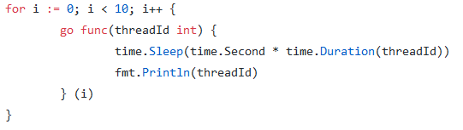
Goroutine Example
To use goroutines for a function it must be prefixed by ‘go’.
This loops 10 times creating goroutines that sleep seconds equal to the thread id and then prints the thread id.

Slide 4
Channels
Channels are a method to send and receive data between goroutines.
A channel is a queue that contain a list of references to data.
Channels are typed, all data pushed into the channel must be of its type. Ex. int, string
By default channels are blocking so that goroutines will wait until is can send or receive from the channel.

Slide 5

Channels Example
The declaration of a channel is: <name> chan <type>
Pushing data into the channel is: <channel> <- <data>
Taking data out of the channel is: <optional var> <- <channel>

Slide 6
Sync & Sync/Atomic Packages
The sync package includes many resources used for concurrency, two major types are Mutex Locks and Wait Groups.
Mutex Locks are similar to those used in pthreads where there is a call to start a critical section and another to end it.
Wait Groups are the closest thing Go has to a barrier, it can be used to count goroutines and block them until they have all reached a specific point.
The sync/atomic package adds many useful atomic statements and types for atomic operations.

Slide 7
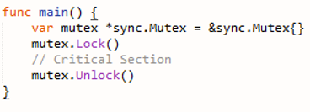
Mutex Lock Example
Packages must be imported:
To create a critical section initialize the mutex so that Lock() and Unlock() can be used.

Slide 8
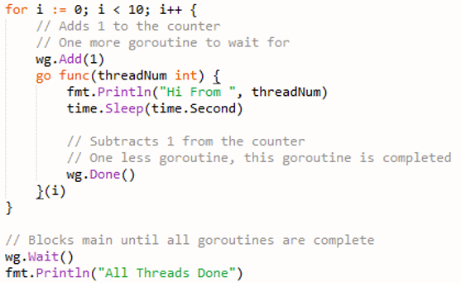
Wait Groups
The wait group must be initialized:
Add(x) is used to increment the goroutine count and Done() is used to decrement.
Wait() is then used to block main until all goroutines have finished.

Slide 9
Parallelism
If you wish to have multiple threads running goroutines then you are able to add more logical processors with the GOMAXPROCS(x) function.
The scheduler will distribute goroutines between these logical processers which will result in them being run on separate threads.

