Slide 1



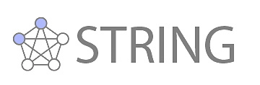
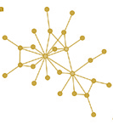

Inputs to the inference of a Boolean Network
Experiments
Disease
Set of genes
Pathway
LINCS or in-house
Dis_{Ge}NET
Omni
Path
Experiments
Binarized
loss or gain of
function genetic perturbations
Prior
Knowledge
Network
Network Inference
NORDic NI
Disease-specific Boolean Network
Simulated dynamics
with Boolean function for each gene
State transitions
Downstream analysis
Applications
Priorization of master regulators
NORDic PMR
Simulation of drug treatment
NORDic DS
Drug repurposing
NORDic DR
9
8
4
3
1
5
6
2
7
10

Slide 2

LINCS
Dis_{Ge}NET
Omni
Path

Slide 3
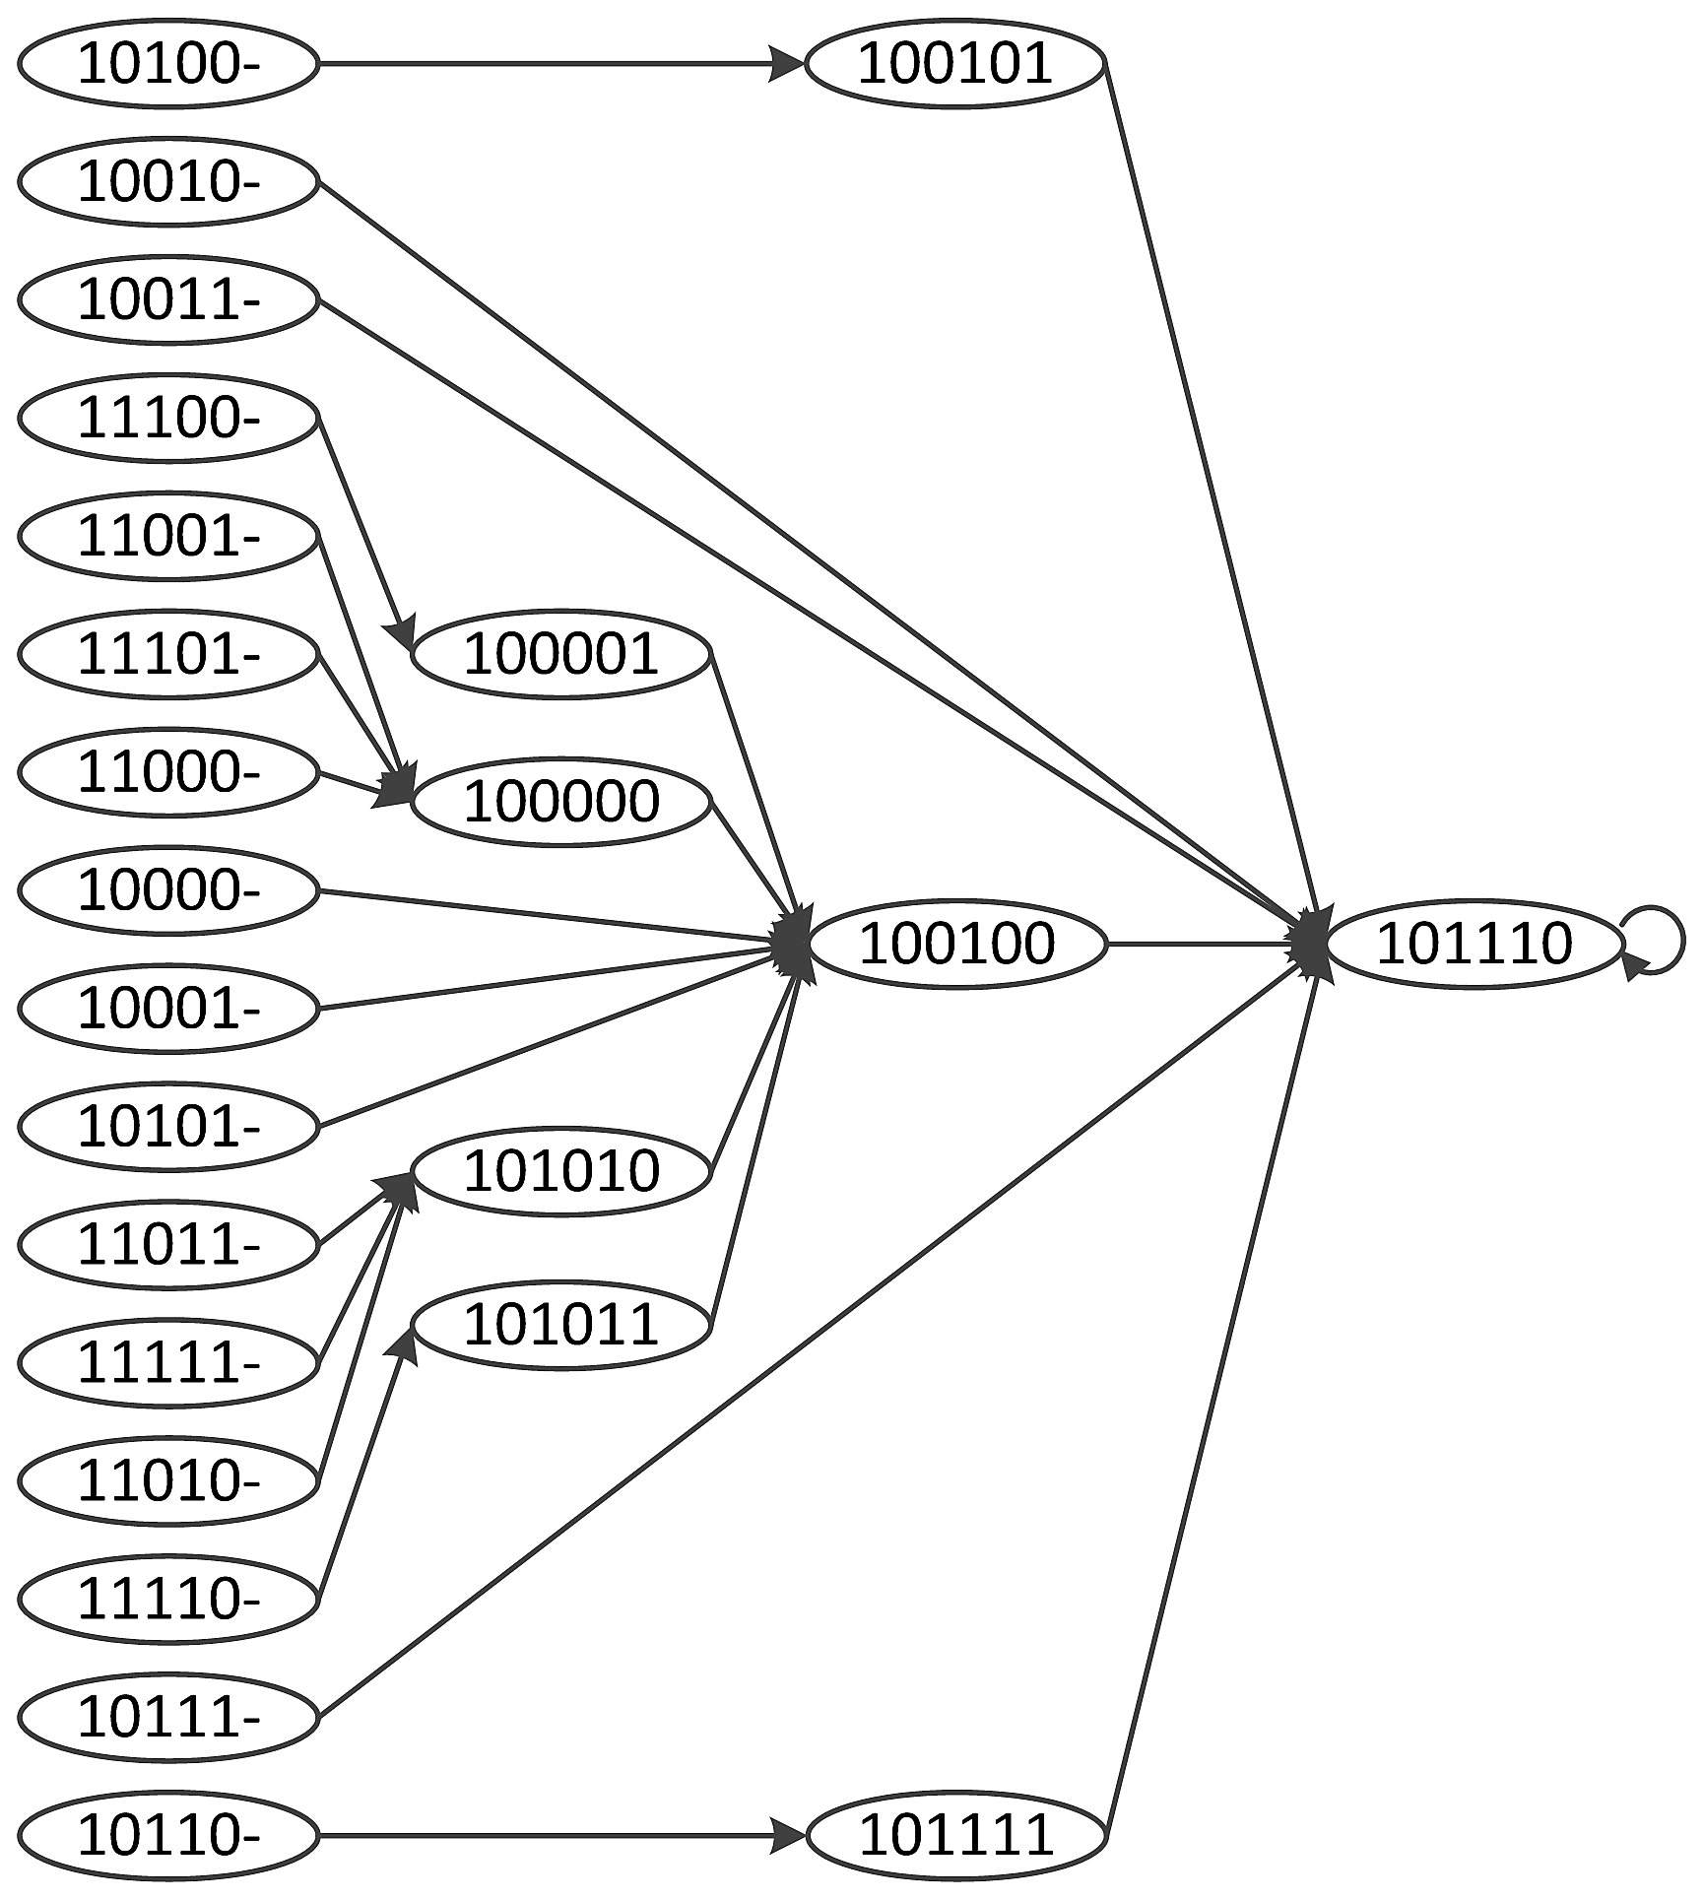
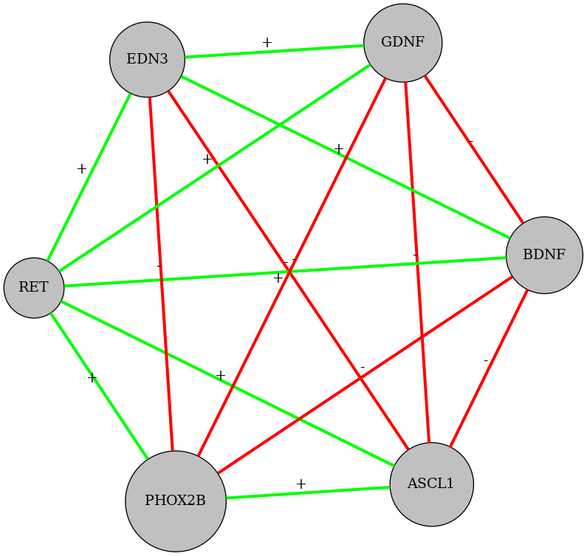
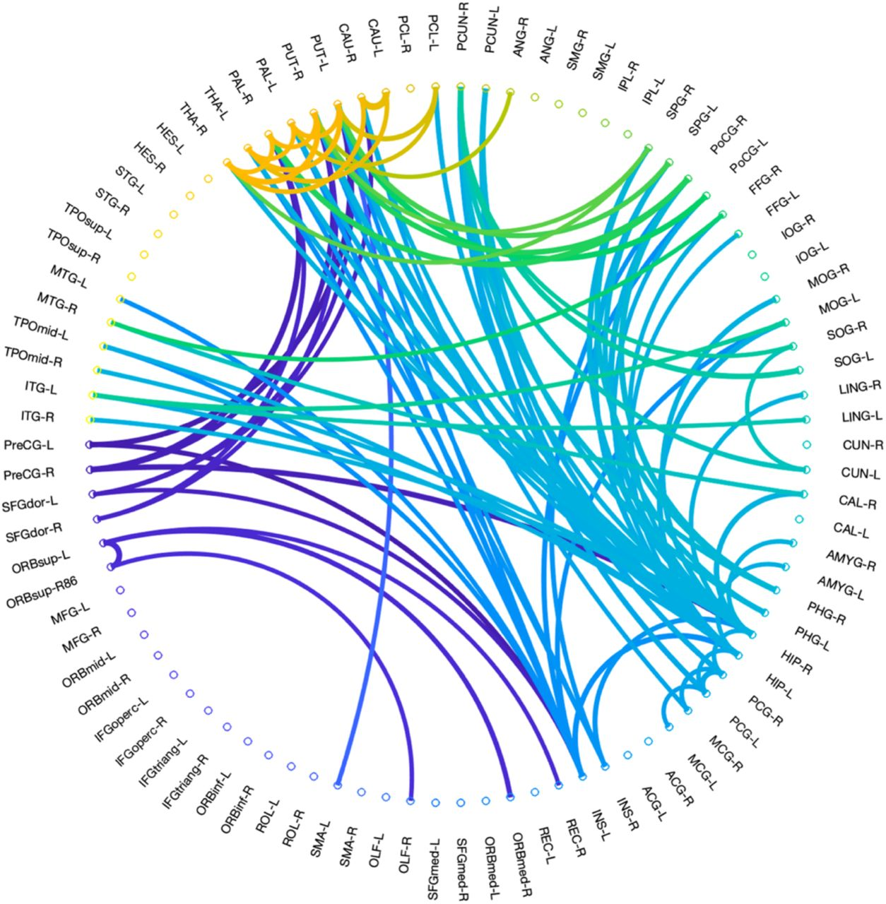
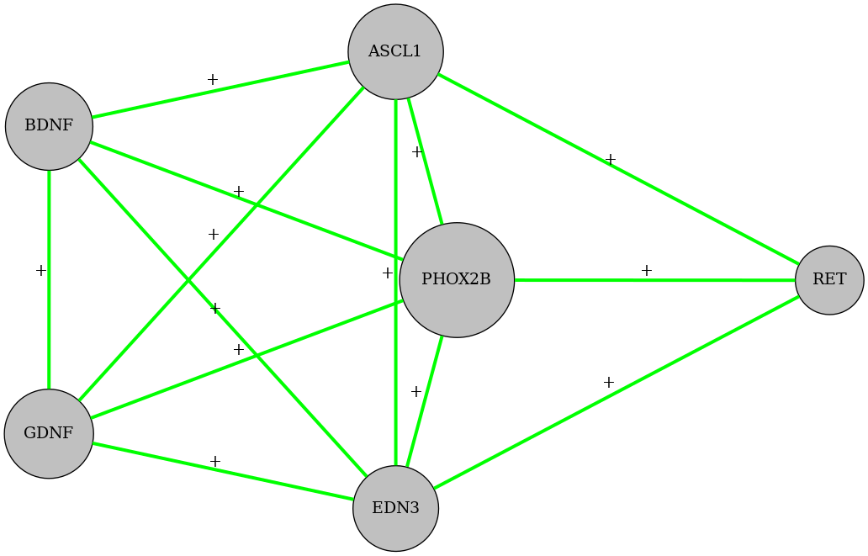
9
8
1
3
4
6
5
10
2
7

Slide 4
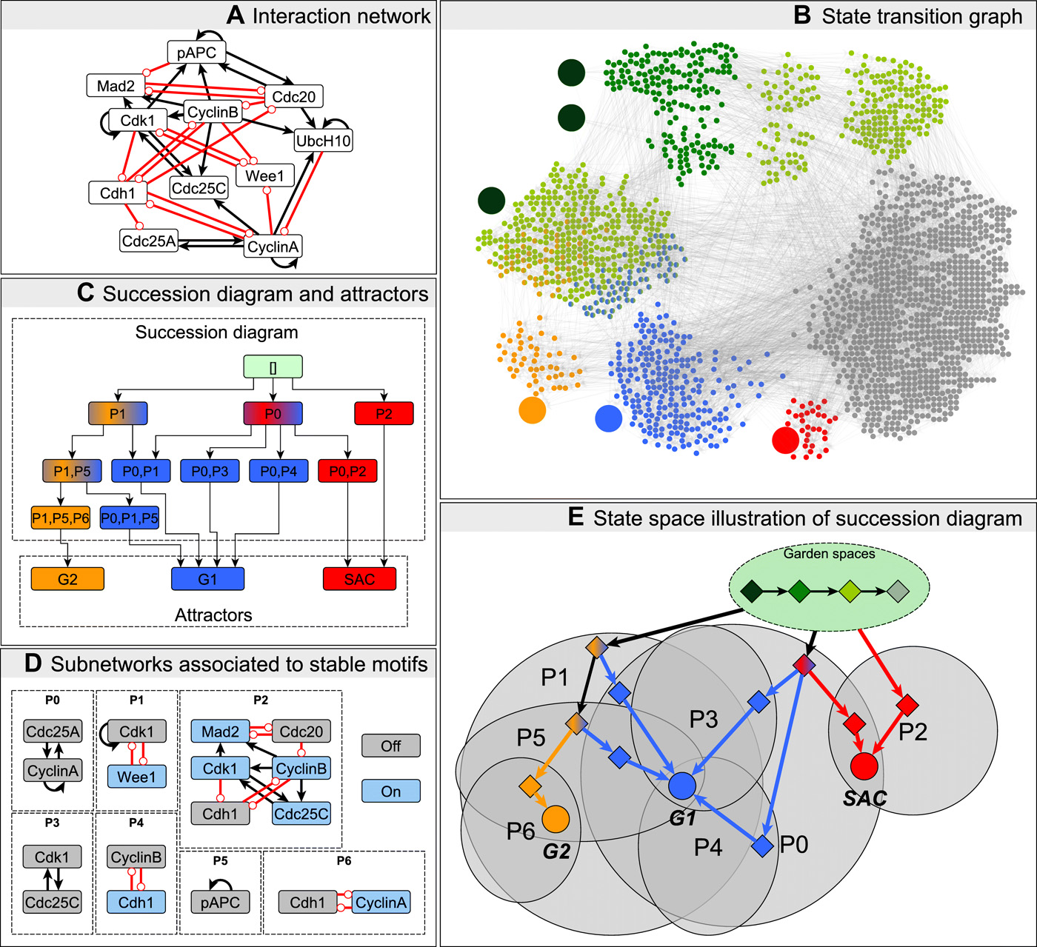
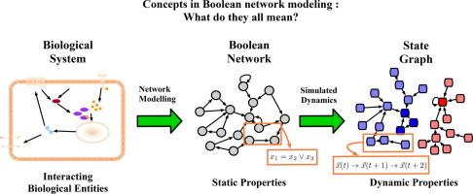
9
8
4
1
3
6
5
10
2
7

Slide 5
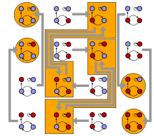
https://en.wikipedia.org/wiki/Boolean_network

Slide 6
