Slide 1
CLAUDIO STAUB
Predicting hospital readmissions
in diabetes patients

Slide 2
MOTIVATION AND DESCRIPTION
Motivation: - Estimated costs: ~$10 billion per annum - As many as 70% of readmissions estimated preventable - Financial, ethical and professional incentive
Description: - Can we find predictors to help reduce preventable readmission? - Data set made available by UCI Machine Learning Repo - 130 US Hospitals were tracked for years 1999-2008 - 100k+ instances, 50 features

Slide 3
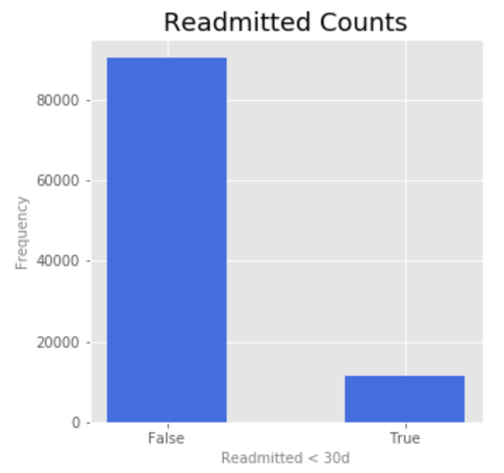
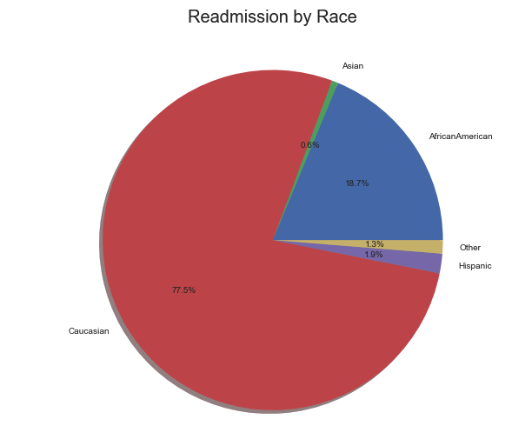
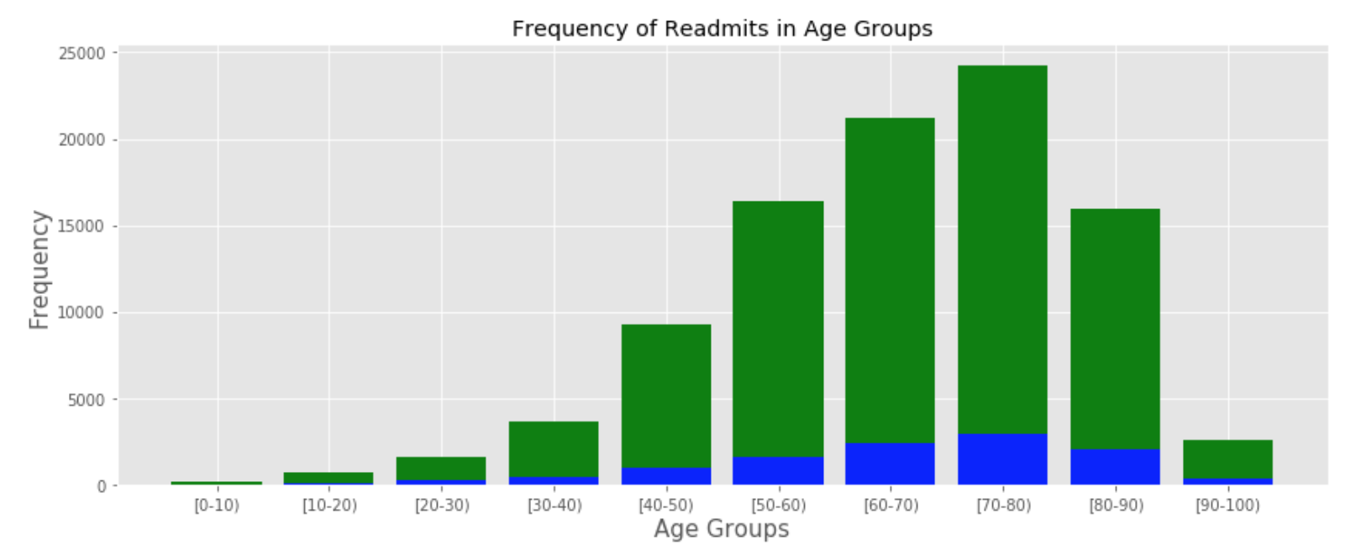
Exploratory Data Analysis

Slide 4
EXPLoratory data analysis
More missing values than initially thought
Need to redefine scope..
Further analysis is needed..
Manipulation of existing

Slide 5
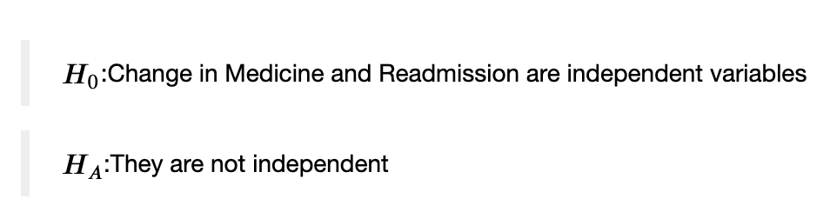
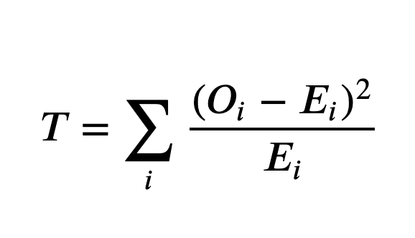
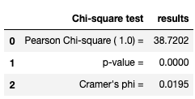
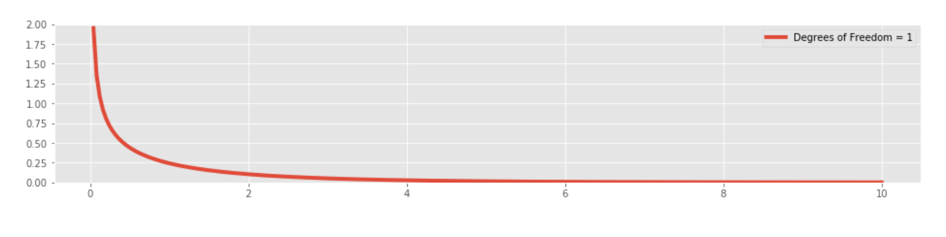
Hypothesis TEST and OUTCOME
Since each column only had two levels, the degrees of freedom are (#cols - 1)(#rows - 1) = 1
Chi Square Test result = 39.03; p-value = 4.177 * 10 e^(-10)

Slide 6
Conclusion and Next steps
More Analysis needed.. - Changes in medication dosage - Analysis of ICD-9 classifications in diagnosis column and test for independence.
Logistic Regression,

