Slide 1
CLAUDIO STAUB
Predicting hospital readmissions
in diabetes patients

Slide 2
MOTIVATION AND DESCRIPTION
Motivation: - Estimated costs: ~$10 billion per annum - As many as 70% of readmissions estimated preventable - Financial, ethical and professional incentive
Description: - Can we find predictors to help reduce preventable readmission? - Data set made available by UCI Machine Learning Repo - 130 US Hospitals were tracked for years 1999-2008 - 100k+ instances, 50 features

Slide 3
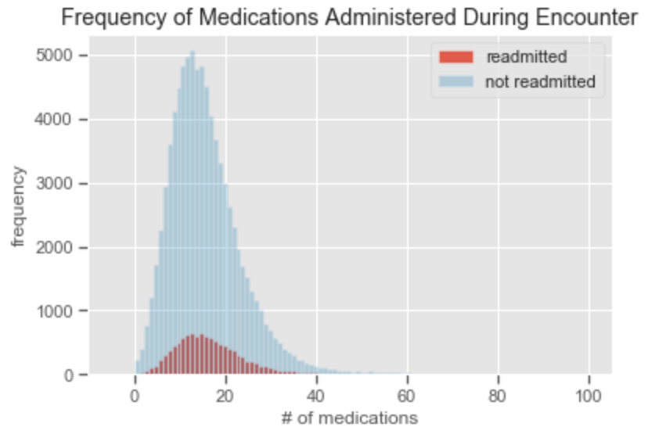
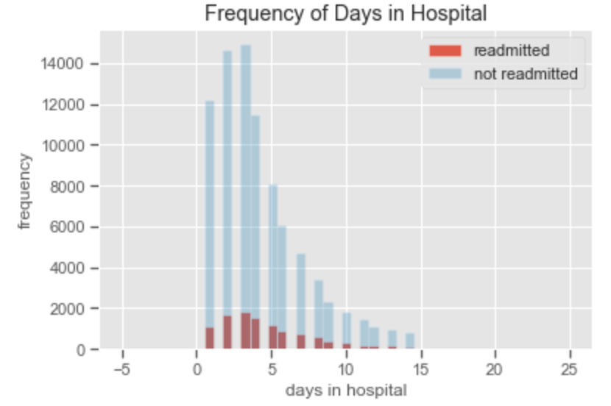
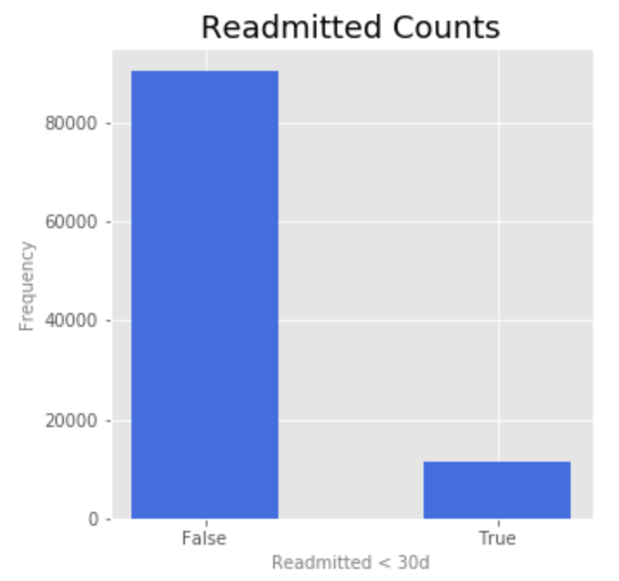
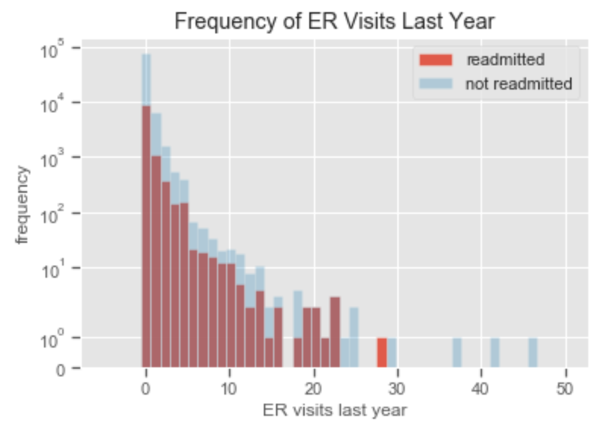
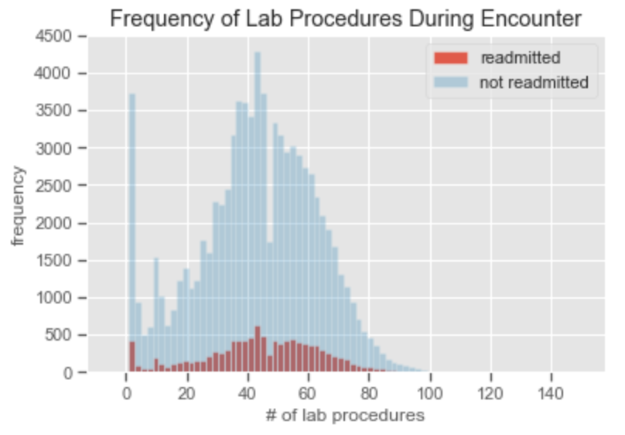
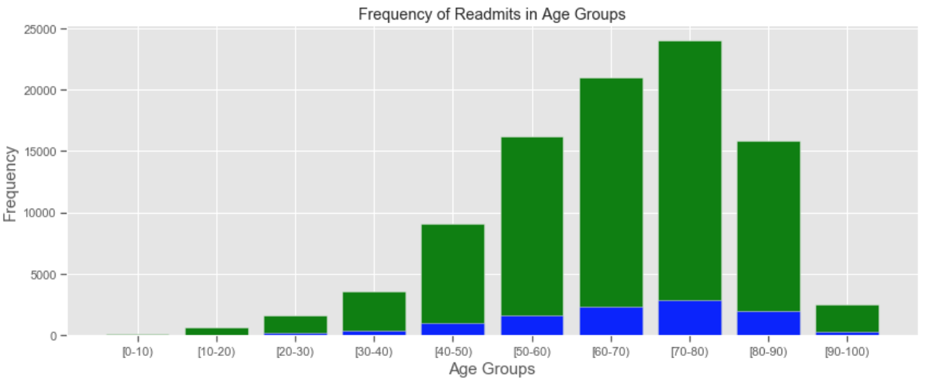
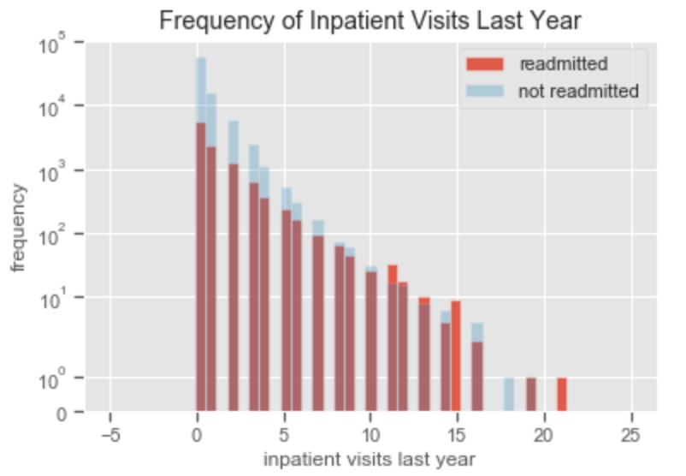
Exploratory Data Analysis

Slide 4
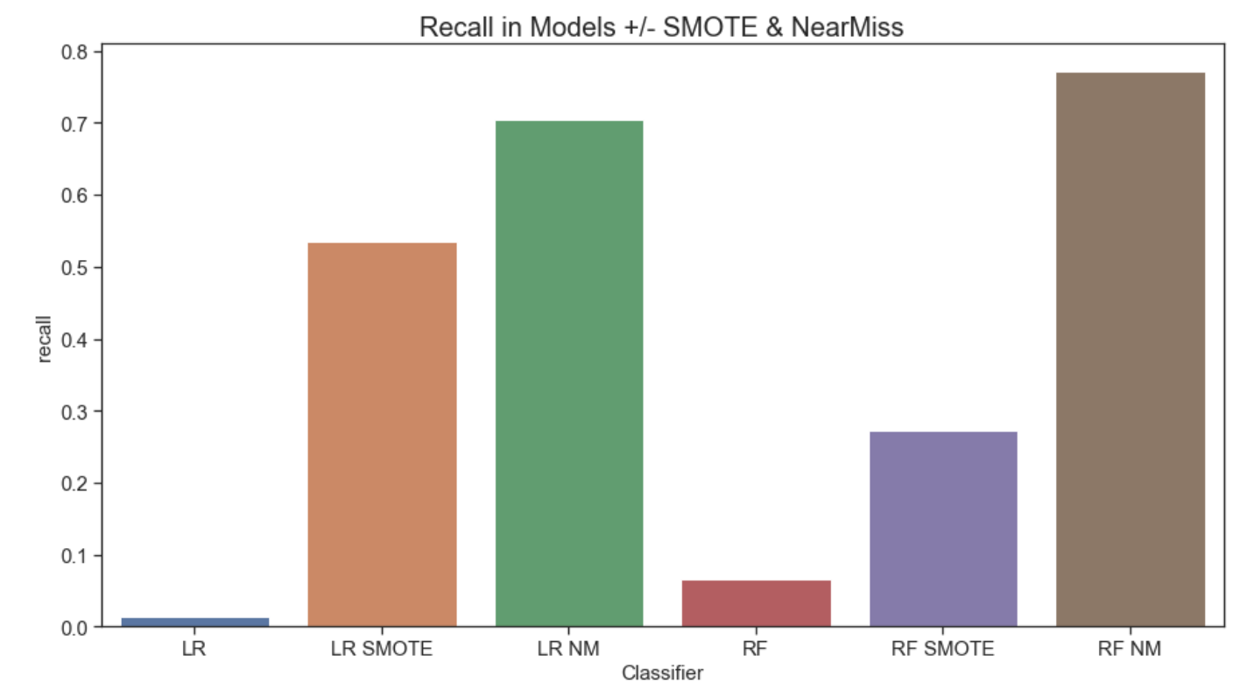
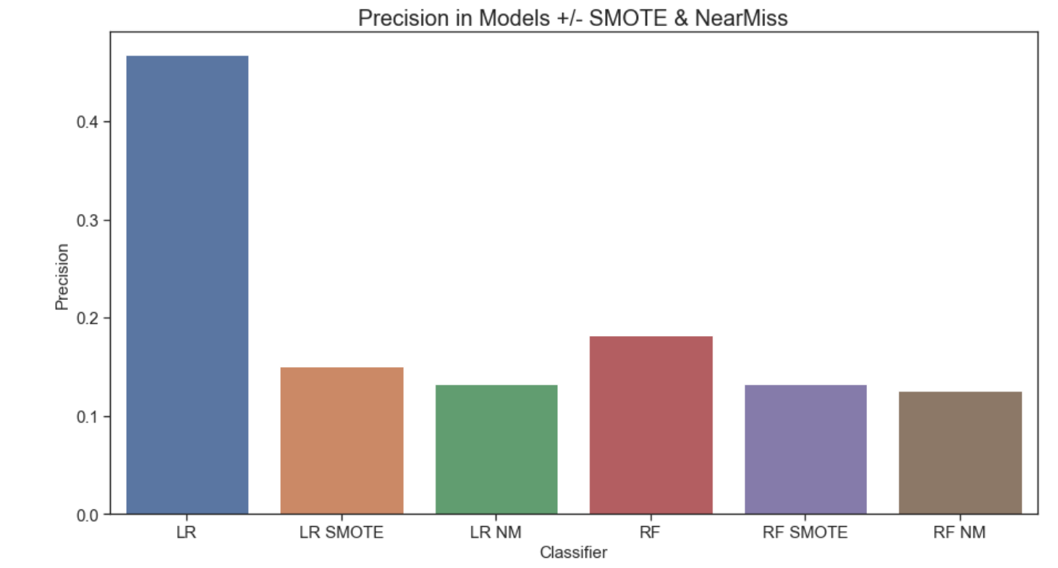
Feature Engineering & MOdeling
OneHotEncode Categorical Variables
SMOTE (Oversampling) and NearMiss (Undersampling) to resolve imbalance of data set.
Inherent Tradeoffs (Overfitting vs. Loss of Data)
StandardScaler to Normalize Continuous Variables
Tested various feature sets

Slide 5
Conclusion and Next steps
Recall improved with Oversampling and Undersampling but not without dip in Precision
Poor Precision-Recall Curves
EDA !!!
Will not continue with this data set
Good data is hard to find

Slide 6
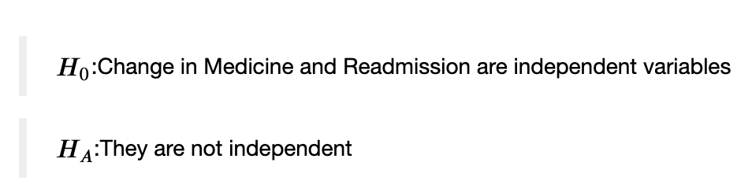
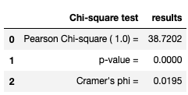
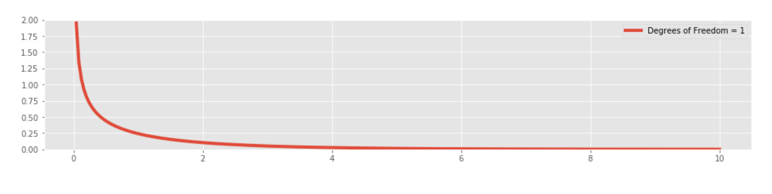
Hypothesis TEST and OUTCOME
Since each column only had two levels, the degrees of freedom are (#cols - 1)(#rows - 1) = 1
Chi Square Test result = 39.03; p-value = 4.177 * e^(-10)

