Slide 1
COLLEGE SCORECARD QUANDARIES
THE SNOWBOARDING PYSCHOLOGIST’S QUEST FOR THE PERFECT UNIVERSITY
Notes:
Hi everyone,
My name is Claudio. I'm currently a Senior in High School getting ready to apply for college.

Slide 2
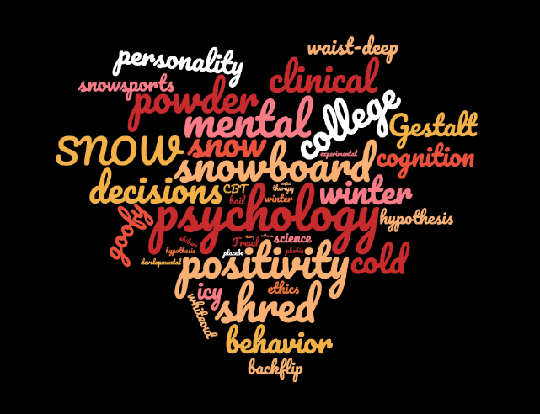
Problem Statement
Overwhelming amount of Universities to choose from
Must cater to my passions of Snowboarding, Psychology and getting paid!

Slide 3
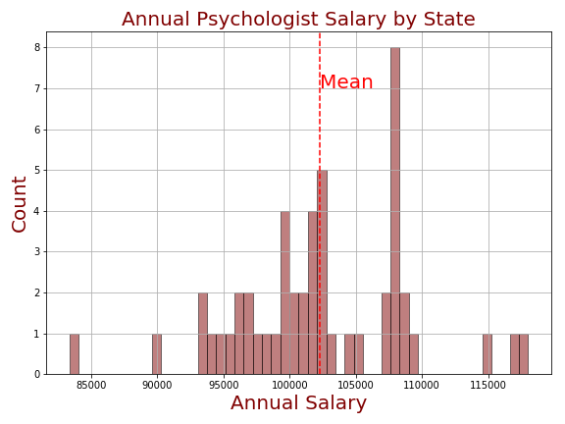
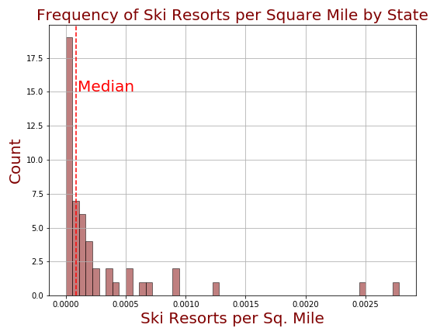
Exploration of Data

Slide 4
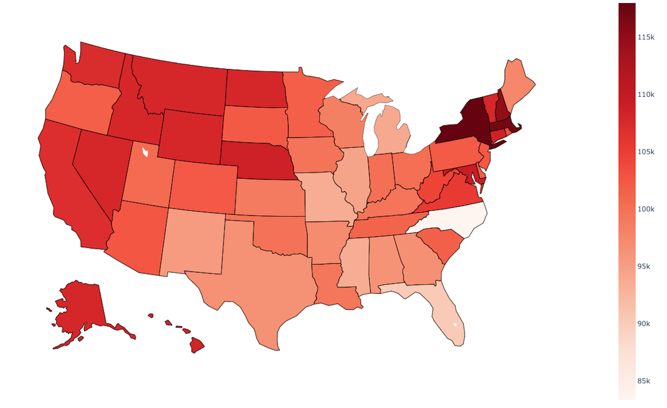
ANNUAL PSYCHOLOGIST SALARY BY STATE

Slide 5
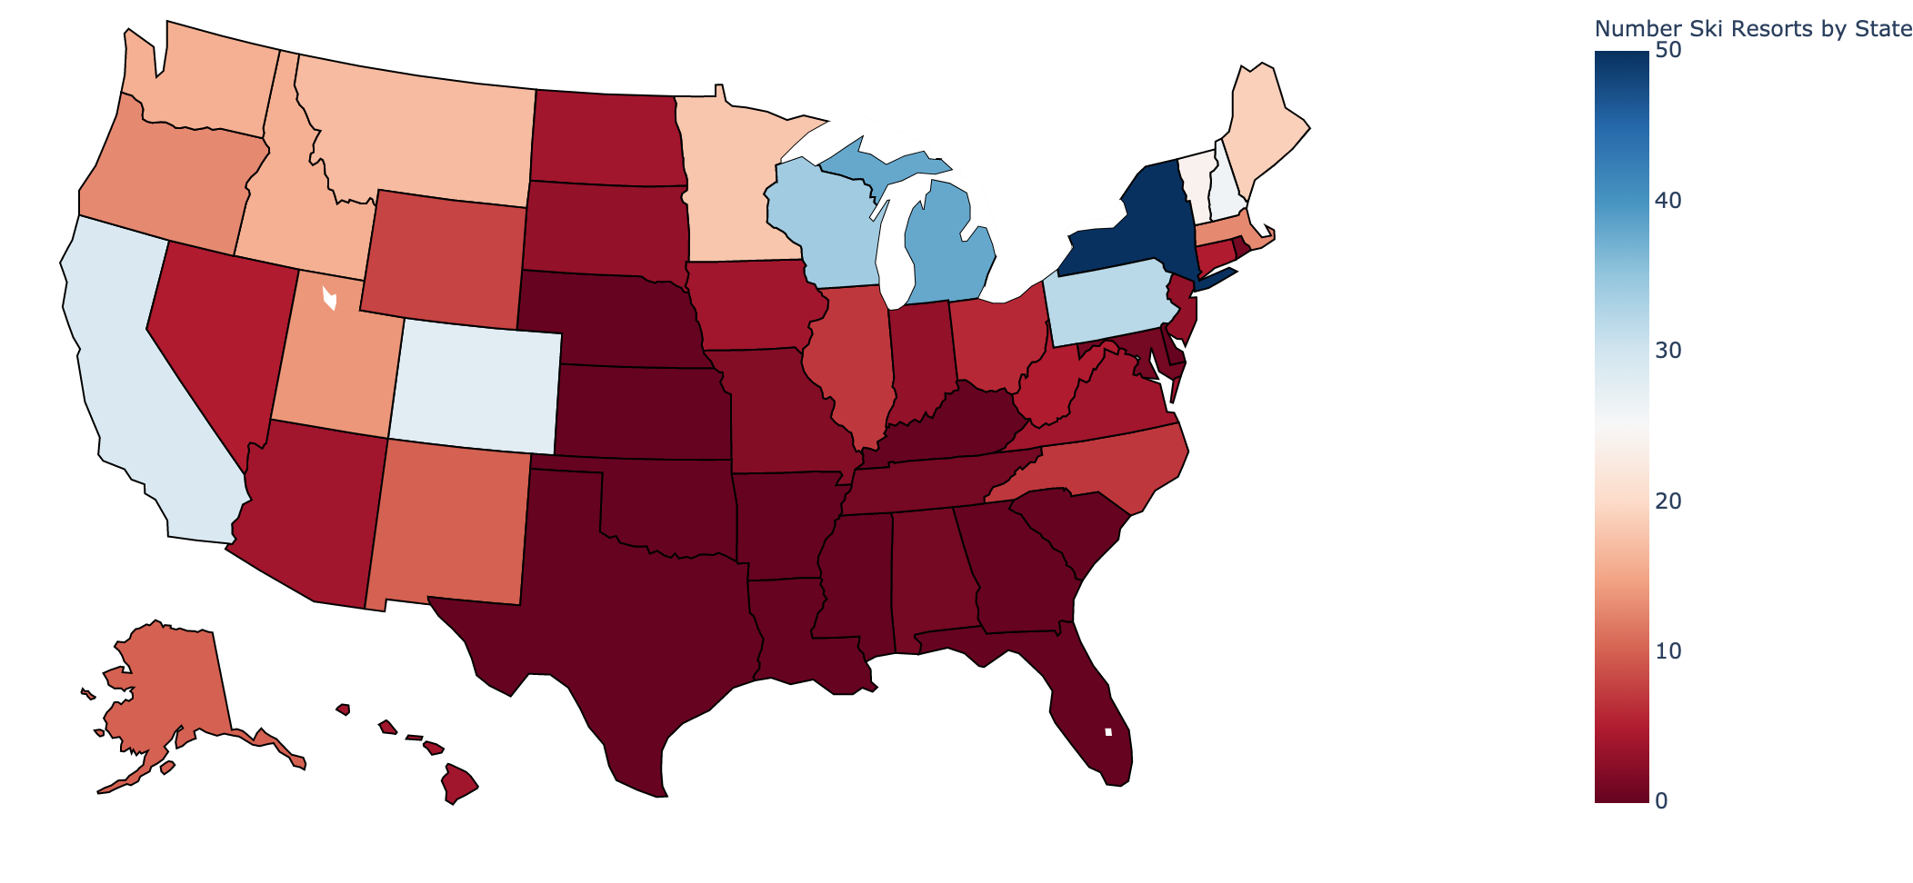
Number of Ski Resorts By State

Slide 6





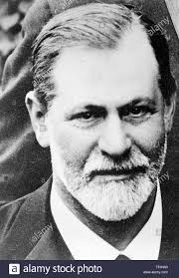


Pipeline
college scorecard csv
Select features, filter out schools by degree type, active status, locale, and clean data in Pandas
Merge State and College Scorecard Dataframes,
EDA
Filter by State data,
Sort by Median Earnings
Prepare aggregated State csv:
Avg. Psychologist Salary By State,
# Ski Resorts per State,
Square Miles per State

Slide 7
Top 3 Universities
Institution | City | State | Median Earnings 10 years post Enrollment | Avg Hourly Wage in State | Average Annual Salary in State | Number of Ski Resorts in State
Dartmouth College | Hanover | NH | $75,500 | $55.24 / hr | $114,893 / yr | 26
Clarkson University | Potsdam | NY | $72,200 | $56.74 / hr | &118,011 / yr | 50
Colgate University | Hamilton | NY | $63,600 | $56.74 / hr | &118,011 / yr | 50

Slide 8
QUESTIONS?
Thank you
Questions and Feedback appreciated

Slide 9
Sources
https://catalog.data.gov/dataset/college-scorecard
https://www.onthesnow.com/news/a/9422/what-state-has-the-most-ski-resorts
https://en.wikipedia.org/wiki/List_of_U.S._states_and_territories_by_area
https://www.ziprecruiter.com/Salaries/What-Is-the-Average-Psychologist-Salary-by-State
https://www.bestcolleges.com/features/best-colleges-for-skiing-snowboarding/
https://www.collegeconsensus.com/rankings/top-ski-colleges/

