Slide 1
DutchSemCor
an exclusive inside look
Marlisa Hommel
Chantal van Son

Slide 2
Why this project?
To conduct research
To train word-sense disambiguation system
To help second language learners
To avoid lexical ambiguity:
I like dates...
because I’m single / they’re tasty

Slide 3
The corpus
The corpus includes homonyms, but mainly aims at polysemy
E.g.: bank¹
A financial institution
The building where a financial institution offers services
bank²
A piled-up mass
The slope of land adjoining a body of water

Slide 4
Stage 1: Manual Annotation
250,000 tokens
-> 274,344 tokens
3,000 most frequent & polysemous words
3.4 senses per word (on average)
≥ 25 examples per sense
65% nouns, 23% verbs, 12% adjectives
≥ 80% Inter-annotator agreement
-> 90%
8 annotators, 2 years.

Slide 5
Stage 1: Manual Annotation
Nouns
Verbs
Nemen: innemen, overnemen, afnemen, etc.
Adjectives
Goed-beter-best

Slide 6
Stage 2: Active Learning
Word-sense disambiguation system (WSD)
750,000 tokens
≥ 75 examples per sense
WSD-system agreement was 44%
4 annotators (later 12), 6 months
System tagged all examples, pro and con

Slide 7
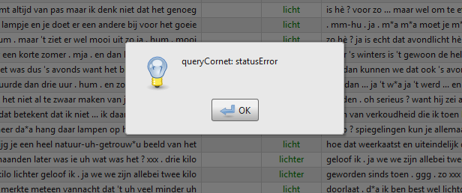
Teething troubles...

Slide 8
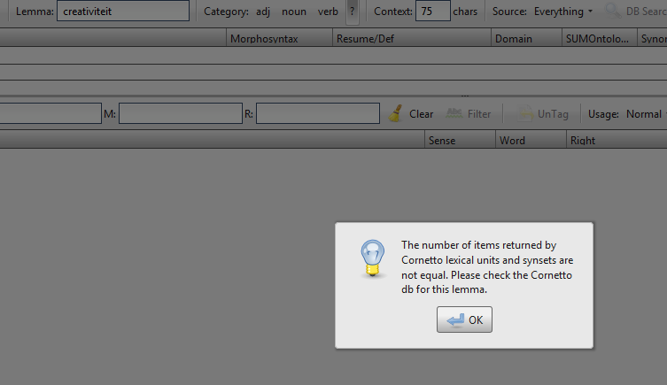
Teething troubles...

Slide 9
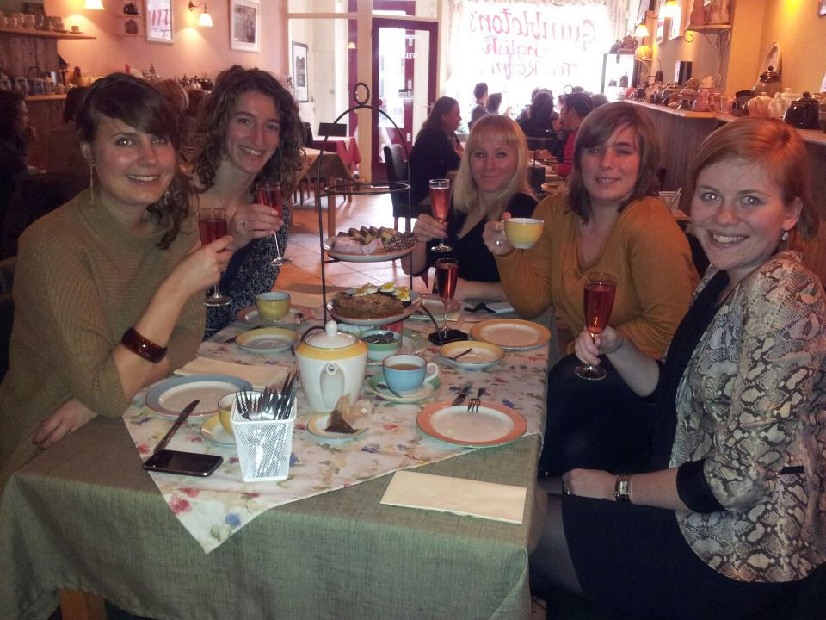
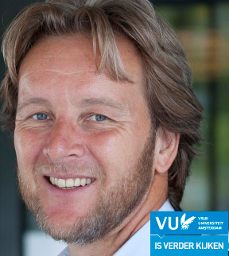
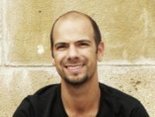

Slide 10
Teething troubles...
SAT tool
Corpus Gesproken Nederlands
Snippet tool

Slide 11

Clear meanings?
Process and result

Slide 12

Clear meanings?
General and specific

Slide 13

Enough examples?
Domain-specific

Slide 14


Enough examples?
Uncommon

Slide 15

Enough examples?
Or both...

Slide 16
Two different experiences with DutchSemCor
Involvement in the project:
Active Learning
Practical use of the database:
Bachelor thesis: Using domain information for Word Sense Disambiguation in Dutch

Slide 17
The Active Learning phase
No search for good examples: annotating all the tokens of the given selection
And to make it worse: only senses that perform badly…

Slide 18
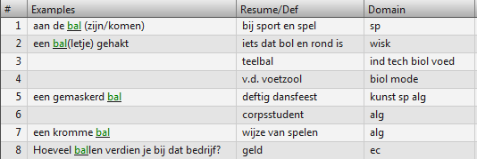
Annotating‘real language’ in practice
This shouldn’t be too hard…

Slide 19
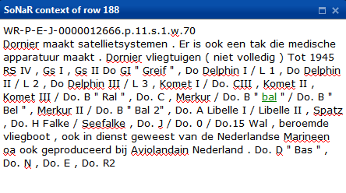
Annotating‘real language’ in practice
Luckily we have the ‘rubbish’ button

Slide 20
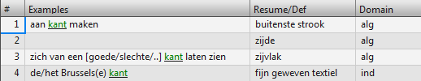
Annotating‘real language’ in practice
But there were also the more difficult ones…

Slide 21
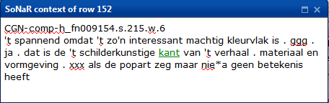
Annotating‘real language’ in practice
Which meaning does ‘kant’ have here?

Slide 22
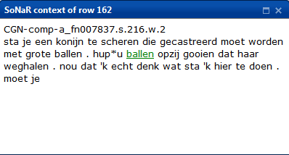
Annotating‘real language’ in practice
Of course there were also the easy ones

Slide 23
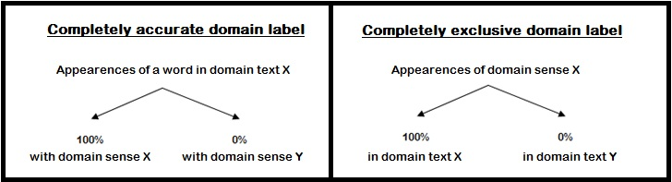
Bachelor thesis
An explorative study for the value of the domain labels in Cornetto for WSD in Dutch
Accuracy and exclusivity

Slide 24
DSC as a research tool
What was needed:
Three domains: SPORTS, ECONOMICS and BIOLOGY
10 polysemous words within each domain
Text examples
Using the SAT for collecting text examples in which the words were annotated
Data was very useful in this research
User friendly tool

Slide 25
Handy websites
http://dutchsemcor.uvt.nl/sat/
http://dutchsemcor.uvt.nl/snippet/
https://sites.google.com/site/dutchsemcor/

