Slide 1
NewsReader Building structured event indexes of large volumes of financial and economic data for decision making
Luciano Serafini
FBK-IRST
Trento, Italia

Slide 2
Motivations
Professionals need to have access to accurate and complete knowledge
Increasing size of data they need to consider
knowledge and information is evolving and is quickly getting out of date
They more and more rely on technology that filter and select knowledge and information because they cannot physically and mentally cope with it

Slide 3
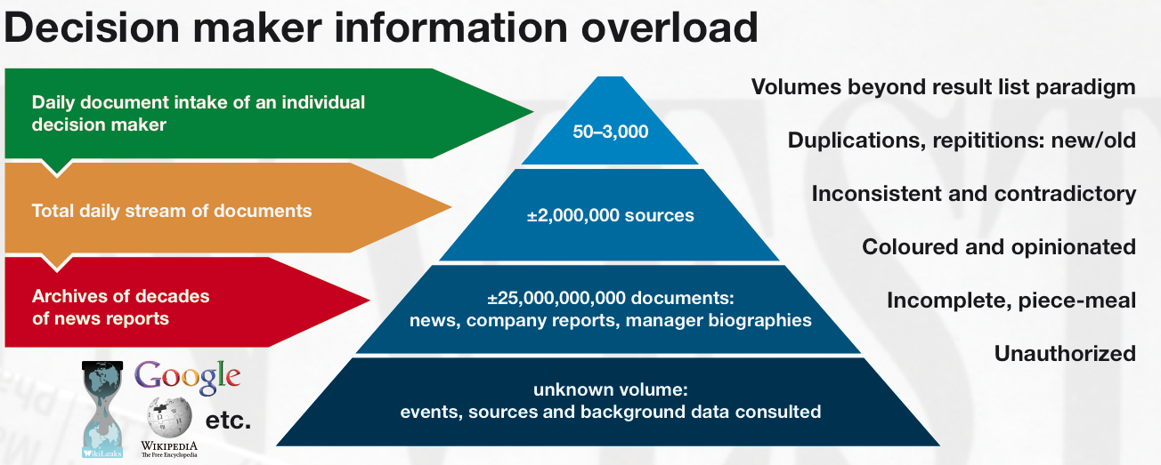
Motivations

Slide 4
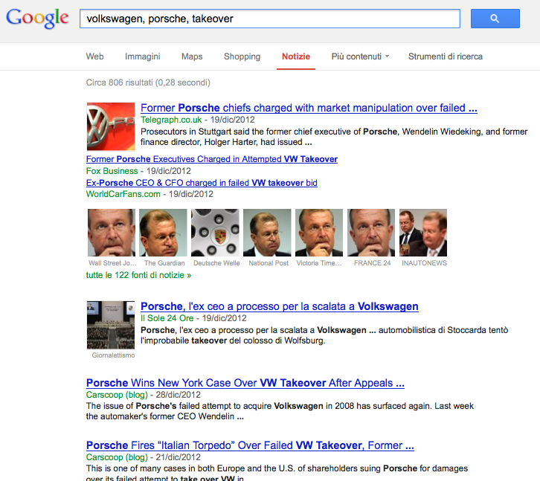
Existing Tools
General purpose tools like Google News based on syntactic/keywords search…

Slide 5
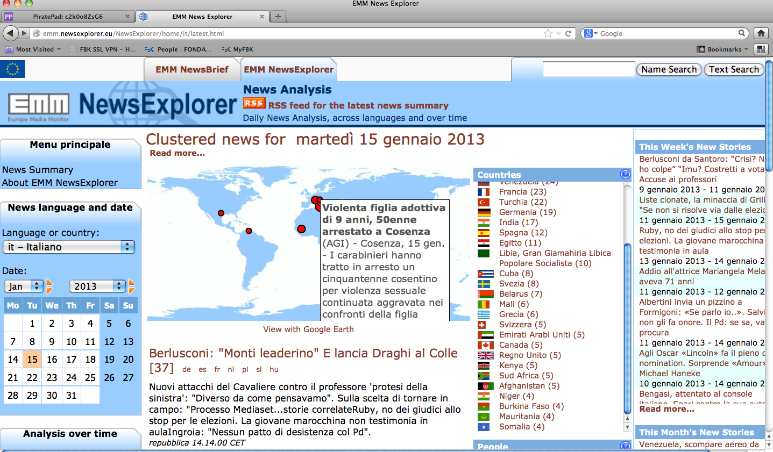
Tools with more semantics…
Analyze the news and recognize entities, like people, locations and organizations that appear in the news.

Slide 6
… actually, we are interested in EVENTS and STORIES
Single events and class of events:
How many takeovers happened during 2011 in Italy and among which companies?
Causal chains
What are the effects of the takeover of Porsche by VolksWagen on the two companies?
Scripts and narratives involving a set of entities
How happened that VW took over Porsche?

Slide 7
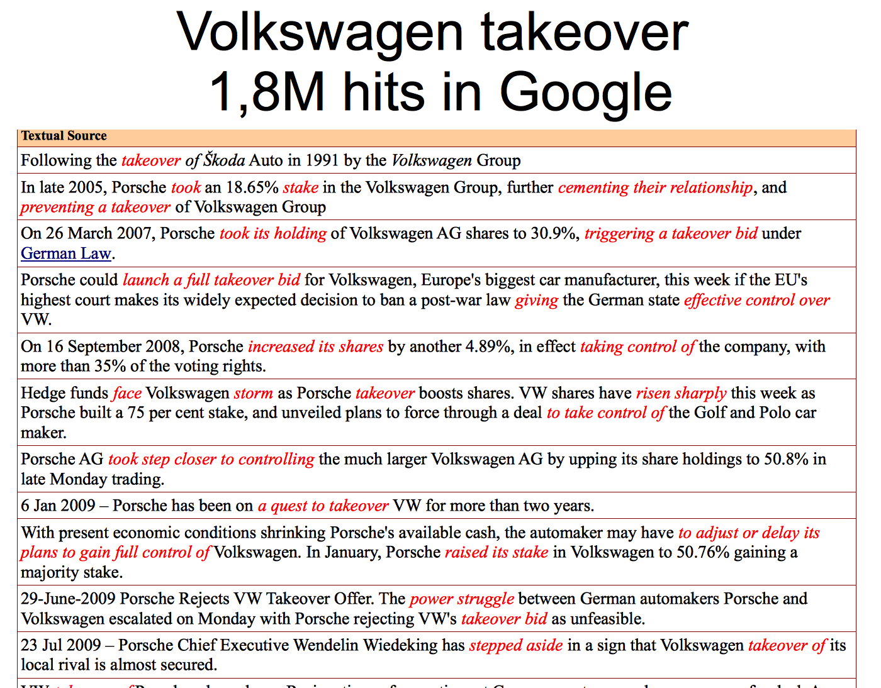

Slide 8
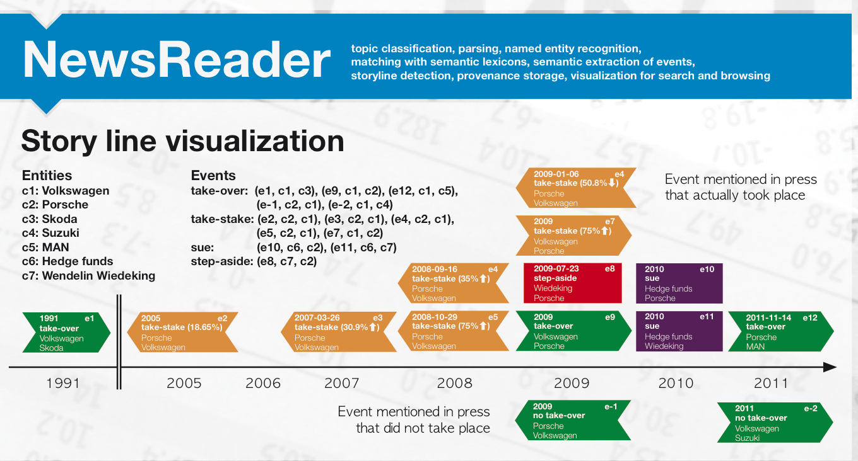
This is what we would like to have…

Slide 9
NewsReader will …
process streams of news in 4 different languages.
extract what happened to whom, when and where,
removing duplication (event co-reference),
complementing information (event integration),
registering inconsistencies (reasoning about events)
keeping track of the original sources
Distinguishing real events from events that never happen (factual/hypothetical events)
Discovering relations between events (containment, temporal sequence, causation …)
archive everything in a knowledge store, which allows to retrieve and reason about all the acquired knowledge.

Slide 10
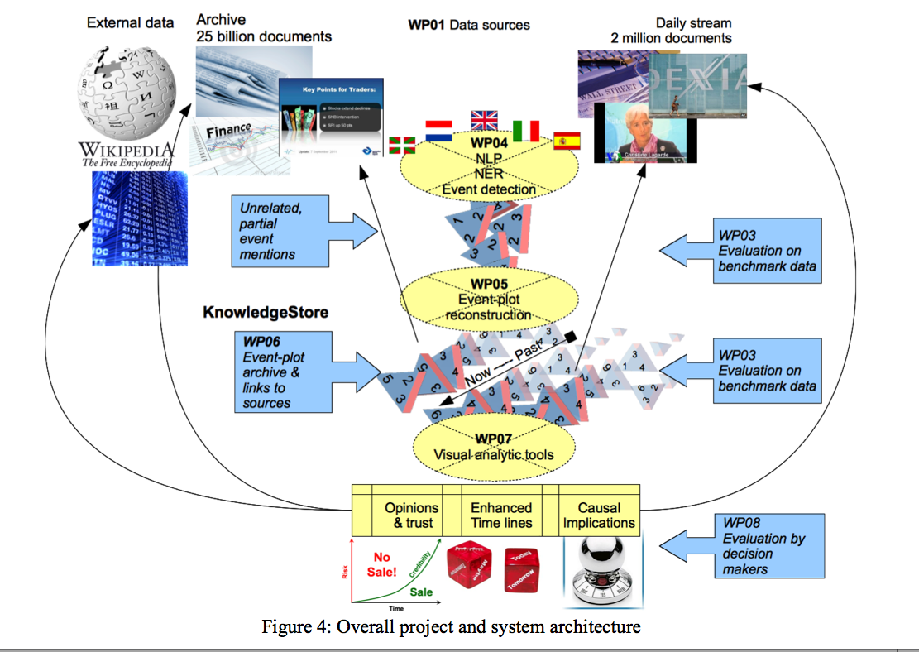
System Architecture

Slide 11






The Consortium

