Slide 1
Birth Ratio in the US
Dongguk Jeon

Slide 2
Contents
Introduction
Data
Machine Learning Models
Model Performance (measured in RMSE)
Conclusion

Slide 3
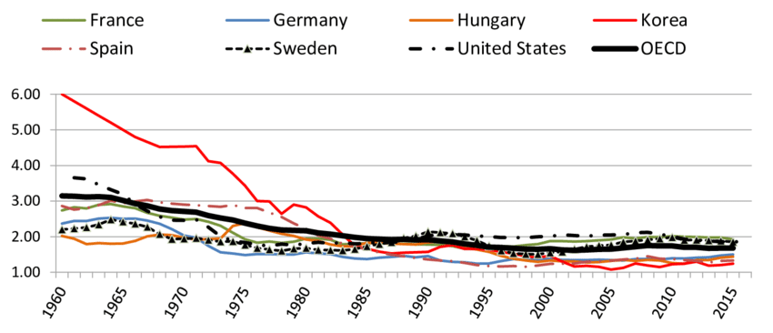
Birth rate
Tackling child poverty in Korea - Scientific Figure on ResearchGate. Available from: https://www.researchgate.net/figure/Fertility-is-lowest-in-Korea-compared-to-other-OECD-countries-Total-period-fertility-rate_fig4_328828016 [accessed 16 Dec, 2019]
Notes:
Recently, I read news that South Korea has the birth rate under 1 kid per a couple.
This statistic caught me attention on what affects birth rate. To understand /investigate the factors, I first carefully pondered on possible reasons.
Birth rate has a massive impact on the economy. As the birth rate drops, the proportion of elderly people increase, which follows serious economic consequences. Health care costs for the elderly will strain resources, while the smaller working population will struggle to produce enough income tax revenue to support these rising costs.
- num of top-ranked universities in the nation by state
- ratio of the church members by state
- ratio of race by state
- ratio of people with college or higher degree by state
- average age people getting married by state
- abortion --> can be done secretly and not reported. I crossed out.
- female participation in the labor force
However, I had difficulty gathering all those information. Especially, I was restrained to use web scraping or api to gather the information, and I could not find reliable sources for them.
Thus, I looked for a similar dataset: How many babies were born each date? Luckily, I was able to web scrape the data for the U.S. citizens for 20 years from 1994 to 2014. I thought this was also interesting because I wondered which month has the most births.

Slide 4
Research Questions
^{From EDA:}
- Is there any particular date of each year that has more births than other dates?
- Is there any particular date of each year that has fewer births than other dates?
- Which month has the most/least births?
- Is the birth ratio smaller on holidays?
From Machine Learning Model:
- How well does my model predict the birth ratio?
- Which features are most important to increase/decrease the birth ratio?

Slide 5
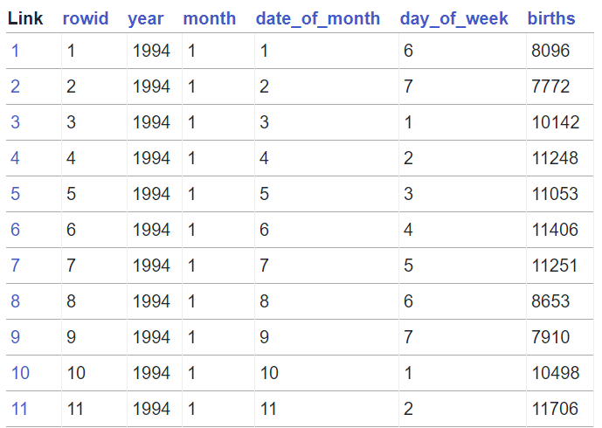
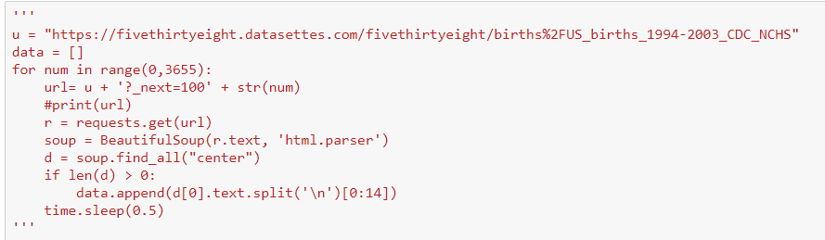
Data Collection
https://fivethirtyeight.datasettes.com/fivethirtyeight/births%2FUS_births_

Slide 6
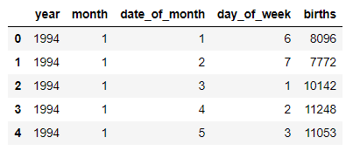
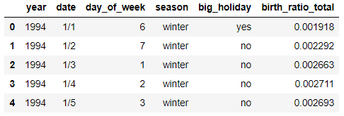
Feature Engineering

Slide 7
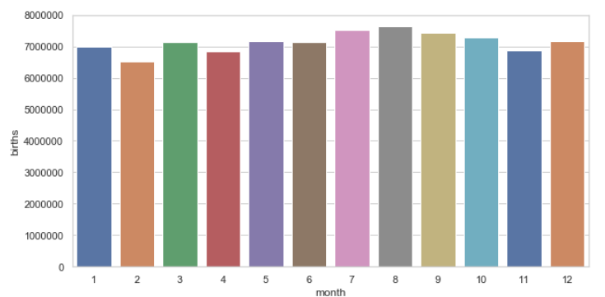
Which month has the most births?

Slide 8
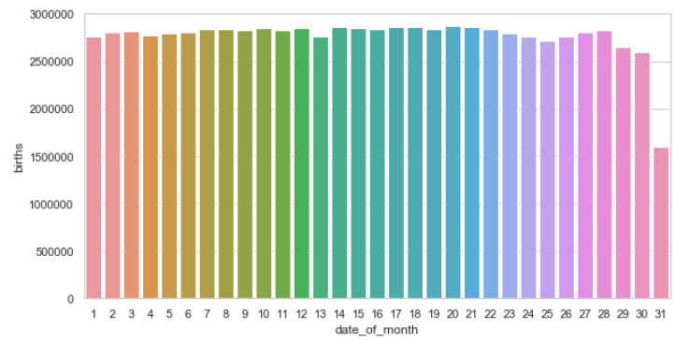
Is there any particular date of each year that has more births than other dates?

Slide 9
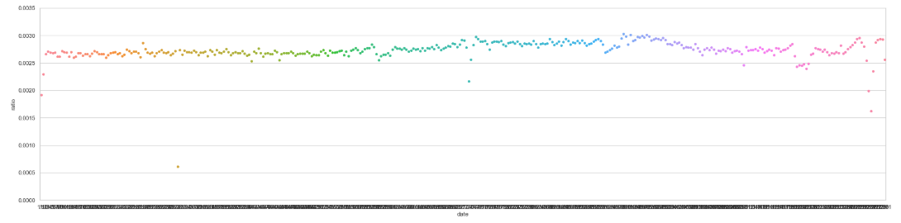
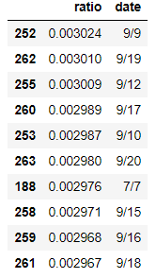
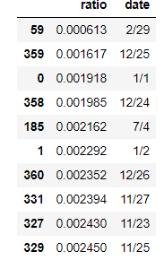

Slide 10
Machine Learning Models
Linear Regression
Random Forest
KNN
SVM
Notes:
Why? – supervised (making predictions based on labeled training data)
not ridge or lasso because I thought each variable had almost equal importance
Strengths: I did not have any na values. luckily num births between months were similar throughout the years.
Limitations: independence assumption was probably broken

Slide 11
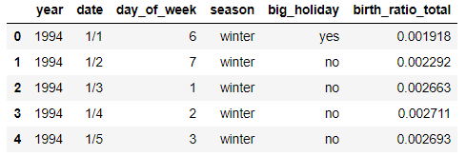
How data looks like

Slide 12
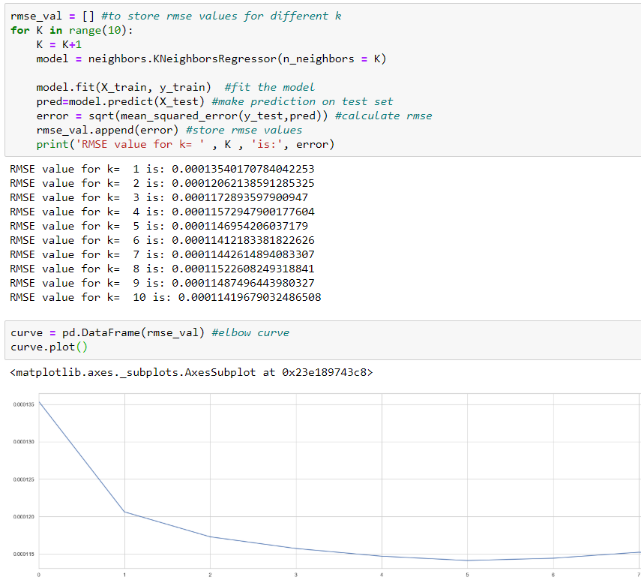
My trying to improve the model

Slide 13

Reporting RMSE
Notes:
Why?: was going to use the minimum mse to determine the best model, but my response was already too small, so used sqrt to increase the mse for visualization purpose

Slide 14

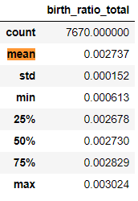
How well does my model predict the birth ratio?

Slide 15
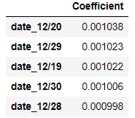
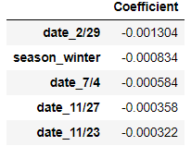
Which Features Matter?

Slide 16
New Quesitons
Why are there drops on certain dates?
What other models could I have included?

Slide 17
Conclusions

