Slide 1
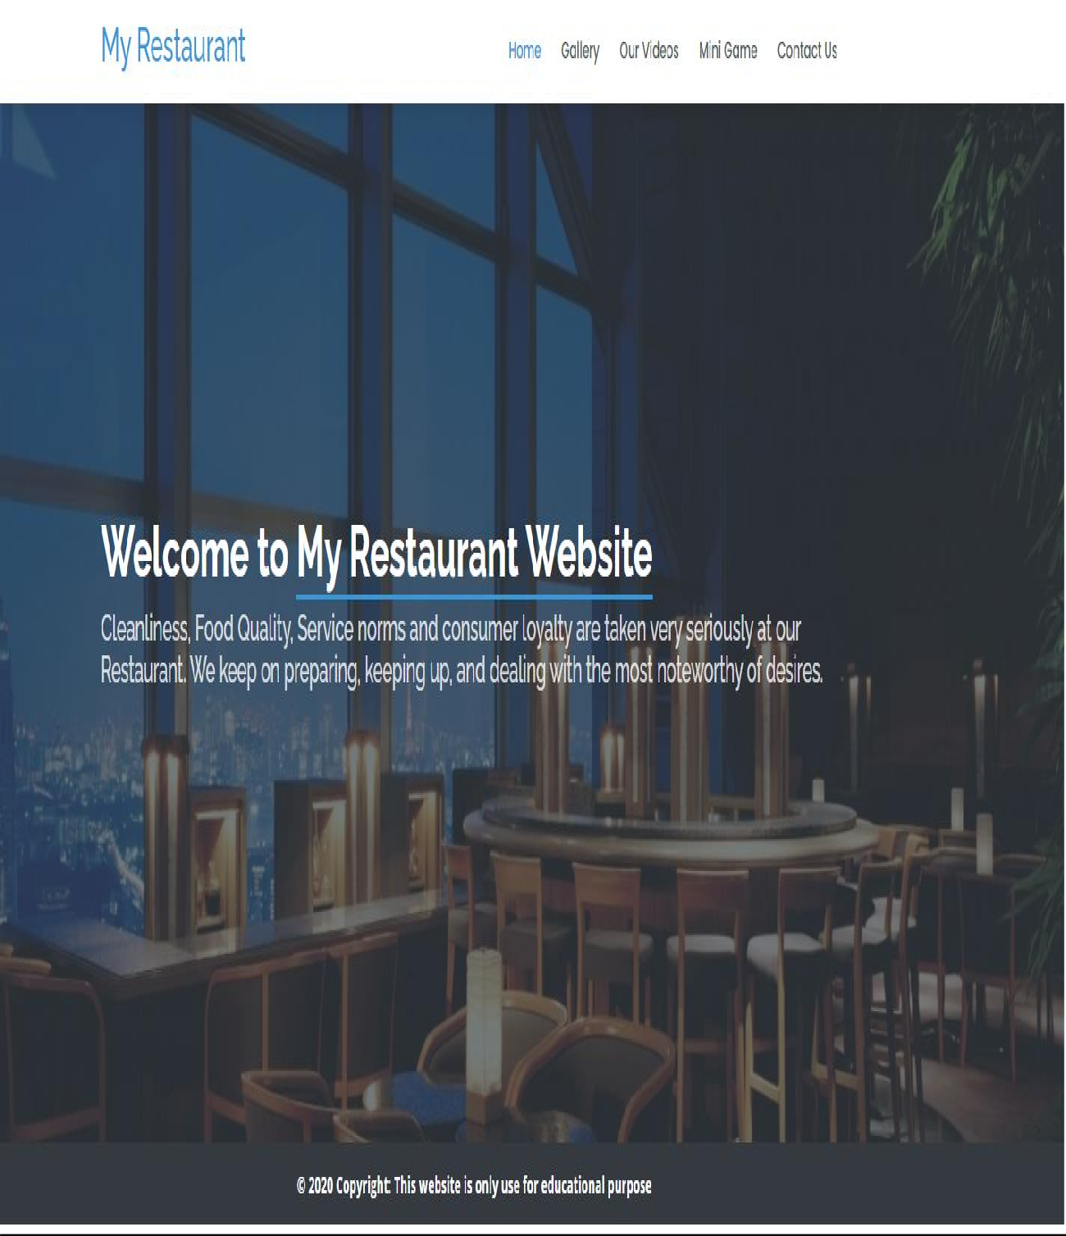
Restaurant Portfolio Website: Landing Page Design:

Slide 2
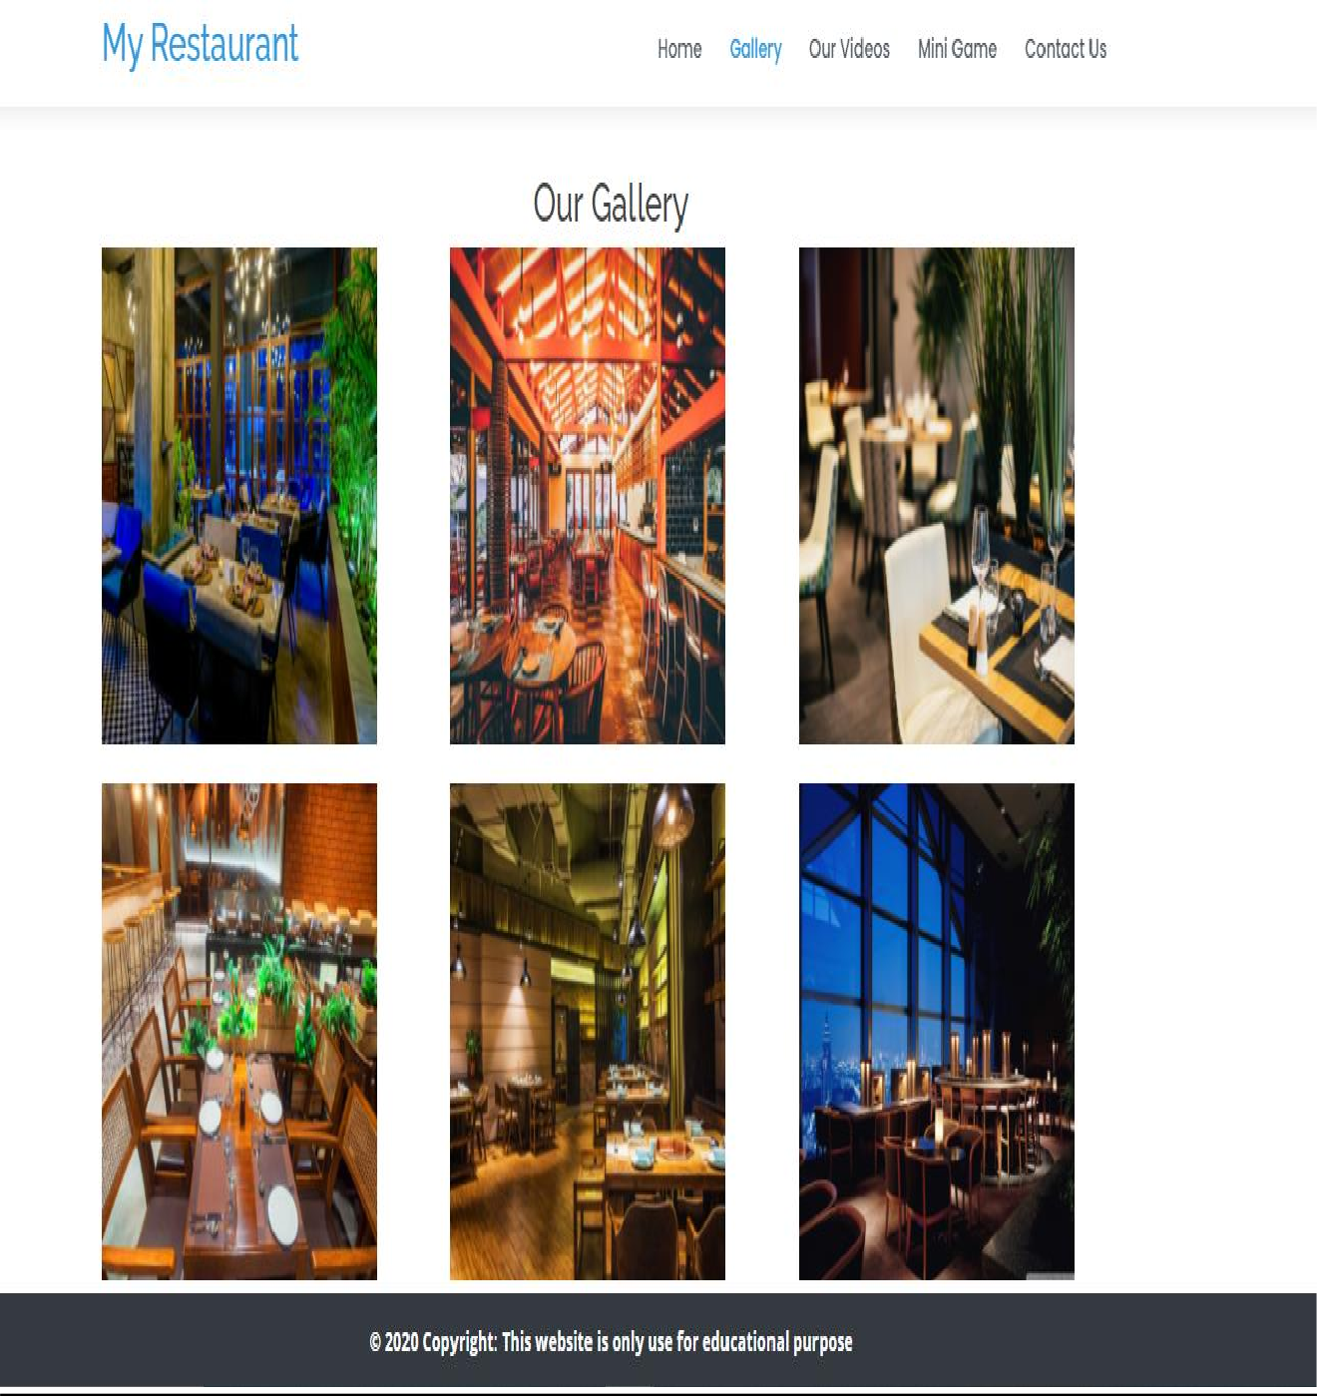
Website Specification/Overview Overview:
This is the restaurant portfolio website where we can see the restaurant details like its videos, it’s all images and can contact to that restaurant by sending them message through this site. The Gallery and the video page sketches are:
Gallery Page

Slide 3

Video Page :

Slide 4
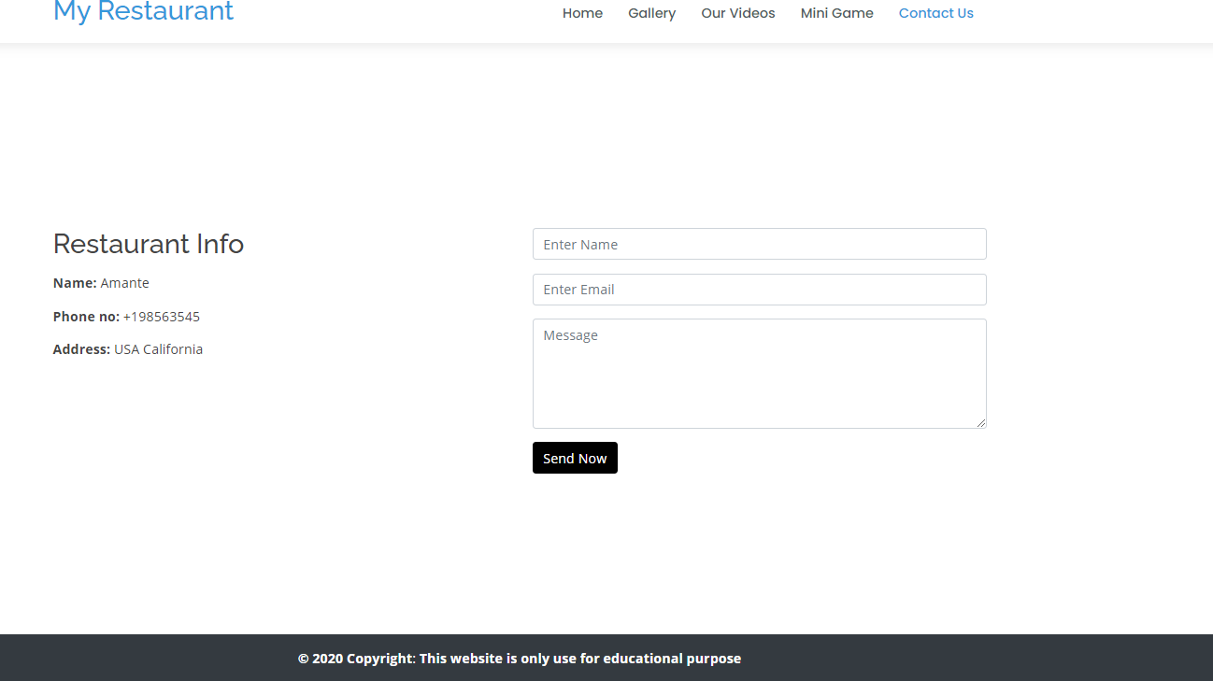
Contact us Page:
Mini Game Page:
I also added the one mini game which I made using html, css and javascript in order to make the site little attractive.

Slide 5
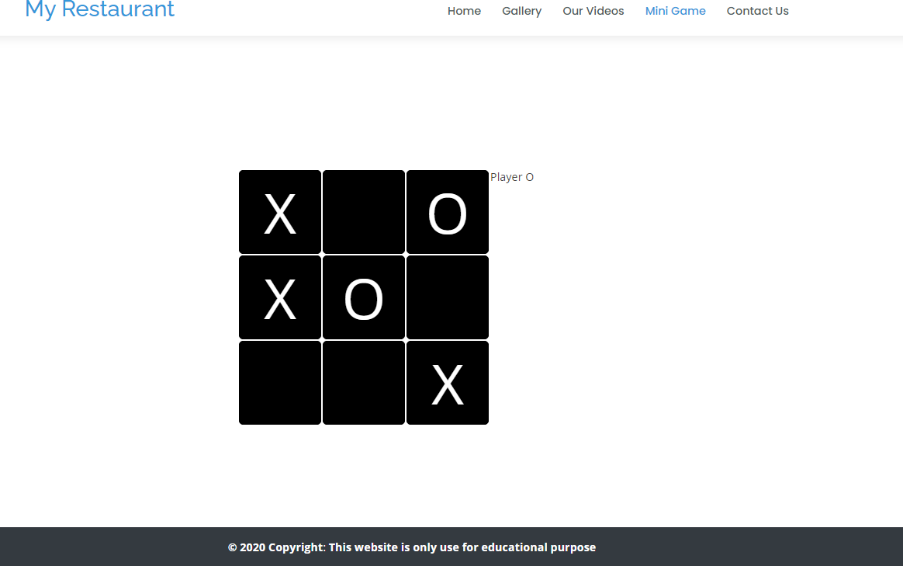
And here is the design of that game
HTML And Site Structure
How I chosen this site to organize:
In these days everything is going on the digital platform so I decided to make the site for Restaurant portfolio which can be used for any restaurant to show their portfolio like there dishes, there new foods etc. And the site also contain one mini game on the top of the page which I made only to make the site little attractive.

Slide 6
How I Structured the data:
The structure of the site is like the main page is the index page along with the different menus like gallery, videos, mini game, contact us
First page is the home page and beside that menu there are other pages are linked like gallery, videos, mini game, contact us. When you click on gallery it will take you to the gallery page, when you click on the videos page it will take you to the video page because all the links are placed properly.
Design of the menus:
Files location:
All the files are in the main folder which is my-project. And this is the main folder inside this folder all the files are present like:
Index.html
Gallery.html
Videos.html
Mini-game.html
Contact-us.html
The above are the html files of the site after that the css files and the css files are located inside the main directory which is name assets. Inside that asset directory there is a css folder where all the css files are listed. After Css there is the img folder in that asset folder which contains all the website images. And on the last there is a JS folder which contains the JavaScript scripts use in the site.
So, this is how I organized my all images, css style files and javascript scripts because in that way I can use the directories dynamically anywhere in the site because when I organize that way my all the images, styles and js scripts are easy to obtain from any page of the site.
Semantic Mark-up:
1. About semantic mark up the entire website is in html language. On the main page which is the index.html page the entire content of the site is in html body tag and inside that body tag there is the header tag which is responsible for the top nav of the site and inside that header tag I separated all the menus with the separate div tag. After the header tag there is a section tag which include the entire content of the site apart from header and the footer. And in that section tag there is div tag where the. After that section page there is the footer tag which contains the website footer.

Slide 7
2nd page is the gallery page which includes all the images of the website. Inside that gallery page first tag is the body tag which is the html body tag which is responsible for the entire content of the page. Inside that body tag there is the header tag which is responsible for the top nav of the site and inside that header tag I separated all the menus with the separate div tag. After that header tag there is h2 heading tag which is used in order to write Our Gallery heading. After that heading tag there is a main div which includes all the images of the page. Last tag in the page is the footer tag which includes the website footer.
3rd Page is the website videos page which includes all the videos of the website. Inside that video page first tag is the body tag which is the html body tag which is responsible for the entire content of the page. Inside that body tag there is the header tag which is responsible for the top nav of the site and inside that header tag I separated all the menus with the separate div tag. After that header tag there is a video tag which
contains the page video and this video is running in the page background. After that video tag there is a pause button which I kept in the div tag and inside that div tag there is a button tag which is that pause button.
4th page is the mini game page which I made only for attractive the site. In this page the markup tags are body, header, div section etc. Body tag is the main tag which I used to enter the entire code in that tag. After that body tag there is the header tag which is responsible for the top nav of the site and inside that header tag I separated all the menus with the separate div tag. After header tag there is a section tag which is responsible for the game content. And after that section tag there is a footer
5th page is the Contact us page where the tags used are header tag, body, section tag and the footer tag. Header tag in order to show the top menu navigation bar and after that body tag which is used to enter the contact us form tag and inside that body tag there is a section tag which is used to enter the form content. In the section tag there is a form tag which is used to make the contact us form. In this form tag the fields are listed using the input tag and the label tag and in the last there is a button tag which is used to send the user message. And on the last there is a footer tag which shows the website footer
In the site the media tag im using the video tag which I’m in the video page. And in that video page the video is running using that video tag. That video tag works like that
<video autoplay muted loop>
<source src="assets/img/26160562_healthy-foodintro_by_w_a_k_a_preview.mp4"
type="video/mp4">
</video>
Main tag is the video tag and which is the parent tag and inside that tag is the loop word which is used to run the video repeatedly and inside that tag there is a source tag where you put your video source means where that video is kept.
About validating the site every tag is properly checked and every single tag is working fine in all the versions. Every page is mobile responsive it means every page is opening well on mobile screens and on tablet screens. There is a contact us page on the site and

Slide 8
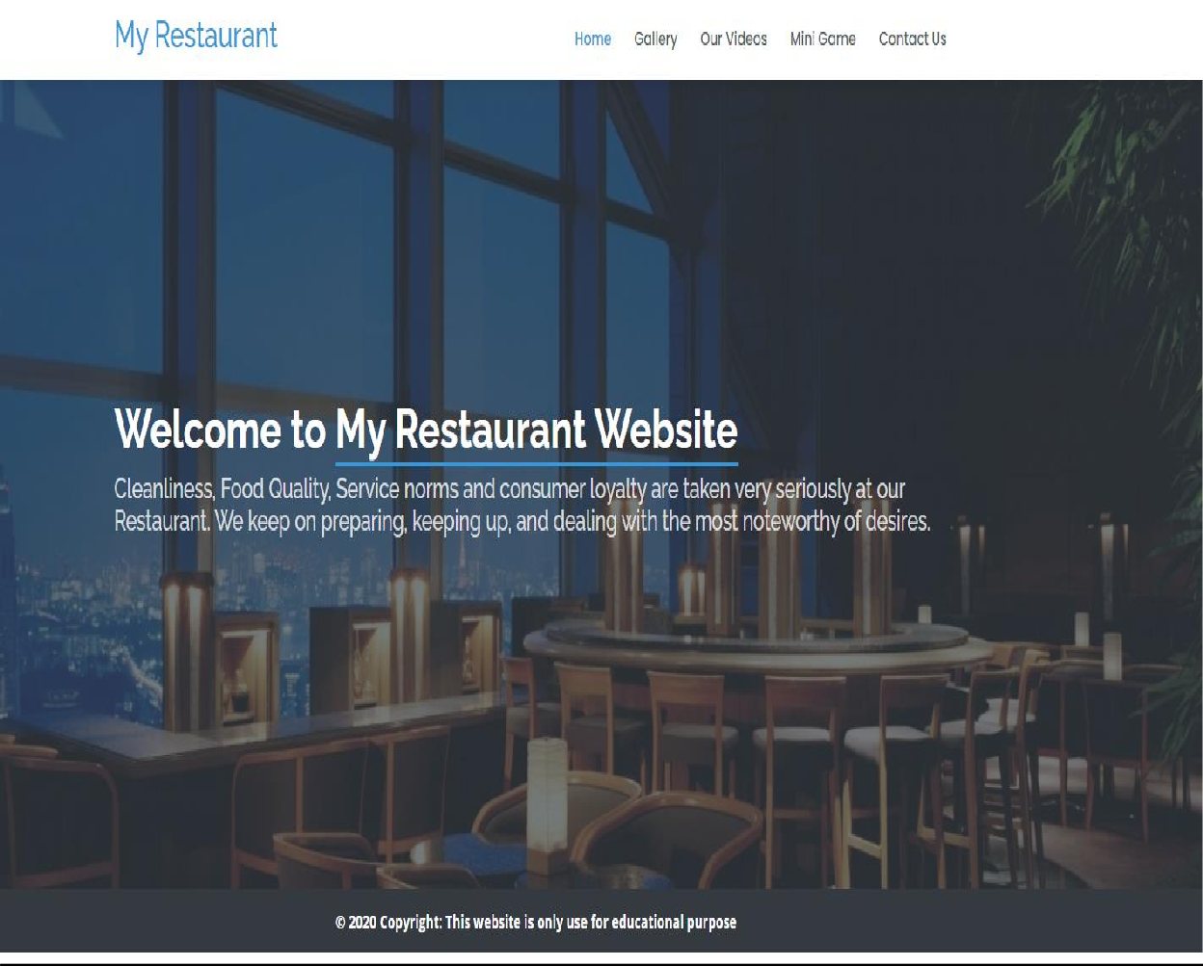
in that page there is a contact us page which is properly validate before proceeding further.
About Browser compatibility notes there are some tags in the website which are not supported in the safari browser.
CSS Documentation:
The Main look of the site is like:
In that first page first the header is listed using the header tag and in that header tag I have used the class fixed top which is used to fix the top menu of the page and beside that class the other class used is d-flex class which is the bootstrap css class in order to keep all the menus beside each other and there is a class used in that header tag is align-center which keep the menus in the center. The classes used in the header I have define the color in those classes in order to change the background color of the header and to change the font. In the Header tag I’m using

Slide 9

the id which is responsible for giving the background color to the header and for the fonts of that header.
Design of the header
After that header there is a body tag and inside that body tag there is a div tag where I am using the section tag and inside that section tag there is a div where I’m using the class container in order to align the image and inside that div there is a by default tag which is data-aos=”fade-up” and this tag is using for fading the image. Here is the image of the section part.
After the section part there is a footer part where the class is used is page-footer and beside that there is a class bg-dark which is used to making the background color dark and inside that footer tag there is div for writing the license content and inside that div two classes are using first one is the footer-copyright and the other class is text-center which is used to center the text of the footer and there is another pre-defined class is used which is py-3 which is used to give padding to the text and make it fit on the screen.
2nd Page is the gallery page and in that page the header is showing using the header tag and in that header tag I have used the class fixed top which is used to fix the top menu of the page and beside that class the other class used is d-flex class which is the bootstrap css class in order to

Slide 10
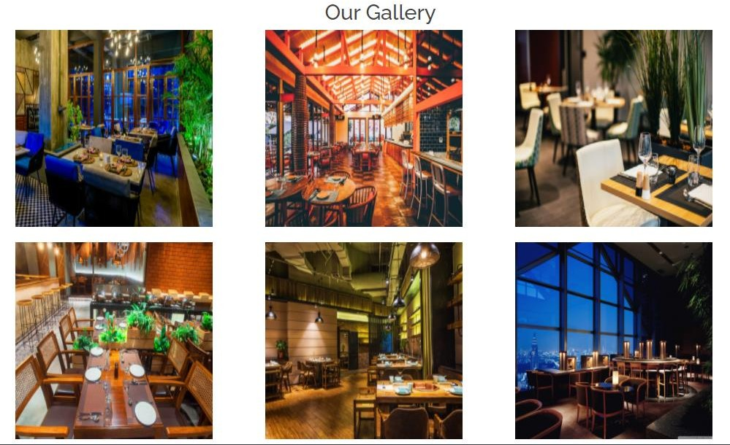
keep all the menus beside each other and there is a class used in that header tag is align-center which keep the menus in the center. The classes used in the header I have define the color in those classes in order to change the background color of the header and to change the font. In the Header tag I’m using the id which is responsible for giving the background color to the header and for the fonts of that header. After that header the h2 heading is used to give heading to the text and inside that h2 tag the class text-center is used in order to keep the heading in the center. After that heading part there is a div which is used to put all the images and inside that div I have given the class container which is used to fit the gallery section fit on the screen. Inside that container class there is a row class which is used to put the images beside each other and inside that there is a col-md-4 class which is used to put 3 images besides each other
3rd page is the videos page and in that page the header is showing using the header tag and in that header tag I have used the class fixed top which is used to fix the top menu of the page and beside that class the other class used is d-flex class which is the bootstrap css class in order to keep all the menus beside each other and there is a class used in that header tag is align-center which keep the menus in the center. The classes used in the header I have define the color in those classes in order to change the background color of the header and to change the font. In the Header tag I’m using the id which is responsible for giving the background color to the header and for the fonts of that header.
Design of the video page

Slide 11
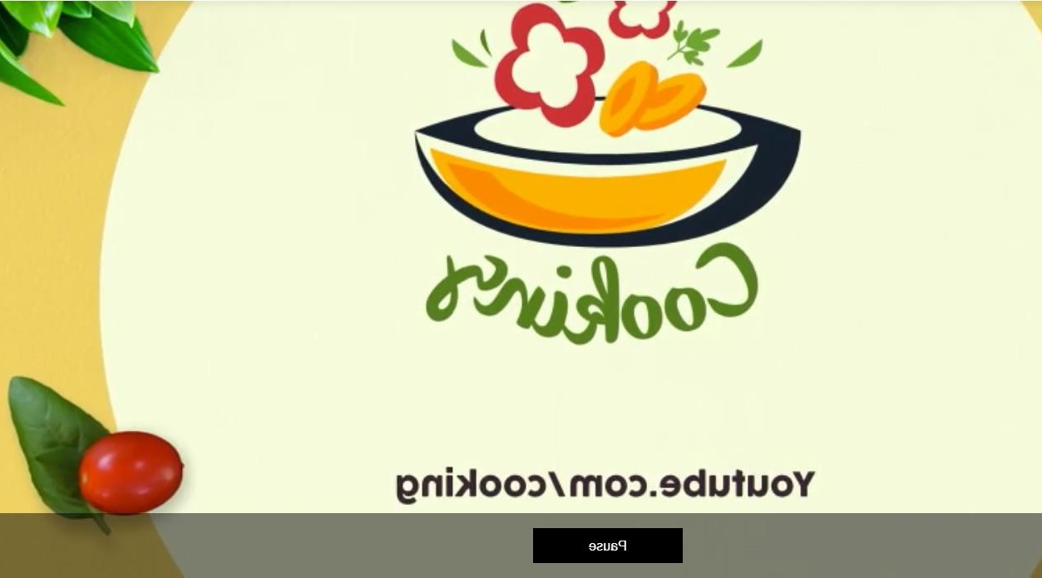
4th page is the Mini Game page and in that page the header is showing using the header tag and in that header tag I have used the class fixed top which is used to fix the top menu of the page and beside that class the other class used is d-flex class which is the bootstrap css class in order to keep all the menus beside each other and there is a class used in that header tag is align-center which keep the menus in the center. The classes used in the header I have define the color in those classes in order to change the background color of the header and to change the font. In the Header tag I’m using the id which is responsible for giving the background color to the header and for the fonts of that header.
Design of the mini game page

Slide 12
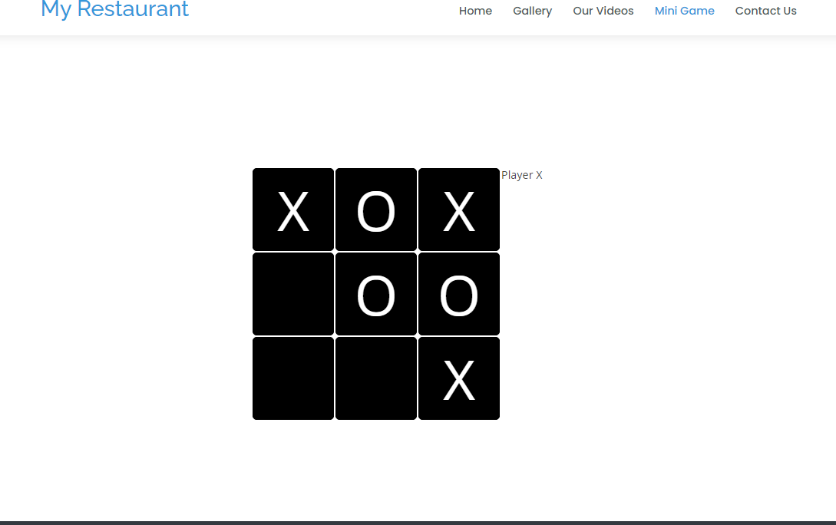
About making the site responsive there are different classes are used. First section is the header section on the entire website and the classes used in that header tag are used are fixed-top, d-flex and align-items-center. Fixed-top class is for fixing the header on the top side, the d-flex class is for putting the menus beside each other on the desktop screen and on the mobile screen and the last class used in the header tag is the align- items-center class which is used to keep the menus in the center in the desktop screen and on the mobile screen.
On the index page after the top navigation bar there is a section menu where the main image of the site with the text written on it. Inside that section tag there is a div which is opening well on the mobile screen also using the class Container this class container fit the thing according to the device width. And inside that class there is a heading and the paragraph section which is on the center using the center class which makes the page fit on the desktop as well as on mobile screen.
And on the last there is a footer class and in that footer tag three classes are used in order to make it responsive on all the small devices and these classes are: footer- copyright, text-center and py-3. Footer-copyright is used to fit the text fit on all the devices and the text-center class is used to center that text on all small devices also and the last class is py-3 which is giving the equal padding to all the section on mobile devices also.

Slide 13
About Browser compatibility. There is not a single class used which is not supported on the different browser every class that is used properly and the website can be access on all the browsers.
JavaScript Documentation
On the video page the video is running repeatedly using the video tag but there is a pause button on the bottom of that page there is a pause button which if you press gonna pause the video. In that button im pausing the video using the JavaScript. I have did that by giving the id to the main button and fetch that button inner text in the script tag. Inside that script tag we write JavaScript code and I fetch the inner html of the video by giving the function on that pause button like :
function myFunction() {
if (video.paused) {
video.play();
btn.innerHTML = "Pause";
} else {
video.pause(); btn.innerHTML = "Play";
}
}
On the Mini game page I’m using the JavaScript in order to run the game. And I did that by giving the id to the only span I’m using in the div section and that game design achieved in that page by using this JavaScript code.
<script>
/*
Tic Tac Toe
*
A Tic Tac Toe game in HTML/JavaScript/CSS.
*
@author: Vasanth Krishnamoorthy
*/
var N_SIZE = 3,
EMPTY = "&nbsp;",
boxes = [],
turn = "X", score, moves;
/*
* Initializes the Tic Tac Toe board and starts the game.
*/
function init() {
var board = document.createElement('table'); board.setAttribute("border", 1);
board.setAttribute("cellspacing", 0);
var identifier = 1;
for (var i = 0; i < N_SIZE; i++) {
var row = document.createElement('tr'); board.appendChild(row);
for (var j = 0; j < N_SIZE; j++) {
var cell = document.createElement('td');

Slide 14
cell.setAttribute('height', 120);
cell.setAttribute('width', 120); cell.setAttribute('align', 'center'); cell.setAttribute('valign', 'center'); cell.classList.add('col' + j,'row' + i); if (i == j) {
cell.classList.add('diagonal0');
}
if (j == N_SIZE - i - 1) {
cell.classList.add('diagonal1');
}
cell.identifier = identifier; cell.addEventListener("click", set); row.appendChild(cell); boxes.push(cell);
identifier += identifier;
}
}
document.getElementById("tictactoe").appendChild(board);
startNewGame();
}
/*
* New game
*/
function startNewGame() {
score = {
"X": 0,
"O": 0
};
moves = 0;
turn = "X";
boxes.forEach(function (square) { square.innerHTML = EMPTY;
});
}
/*
* Check if a win or not
*/
function win(clicked) {
// Get all cell classes
var memberOf = clicked.className.split(/\s+/);
for (var i = 0; i < memberOf.length; i++) {
var testClass = '.' + memberOf[i];
var items = contains('#tictactoe ' + testClass, turn);
// winning condition: turn == N_SIZE
if (items.length == N_SIZE) {
return true;
}
}
return false;
}
function contains(selector, text) {
var elements = document.querySelectorAll(selector);
return [].filter.call(elements, function(element){ return RegExp(text).test(element.textContent);
});
}
/*

Slide 15
* Sets clicked square and also updates the turn.
*/
function set() {
if (this.innerHTML !== EMPTY) {
return;
}
this.innerHTML = turn; moves += 1;
score[turn] += this.identifier; if (win(this)) {
alert('Winner: Player ' + turn);
startNewGame();
} else if (moves === N_SIZE * N_SIZE) {
alert("Draw"); startNewGame();
} else {
turn = turn === "X" ? "O" : "X";
document.getElementById('turn').textContent = 'Player ' + turn;
}
}
init();
</script>
On Contact us page I’m using the JavaScript in order to validate the fields before the fields further proceed. On that form page I have given the return function on the form section which returning the form validation by giving the id to all the input fields and fetch the inner text of the inputs in the script tag in order to validate them.
The code for validation is:
function checkContactValidations() { document.getElementById('nameError').style.display = 'none'; document.getElementById('phoneNoError').style.display = 'none'; document.getElementById('emailError').style.display = 'none'; document.getElementById('messageError').style.display = 'none'; if (document.getElementById('name').value === '') {
document.getElementById('nameError').style.display = 'block'; return false;
}
if (document.getElementById('email').value === '') { document.getElementById('emailError').style.display = 'block'; return false;
}
if (document.getElementById('message').value === '') { document.getElementById('messageError').style.display = 'block'; return false;
}
}
PHP Documentation
Php is only using on the contact us page where the user come to the site and wanna contact to the website owner by submitting the form and this submission can be done by using some server side so I used php in that way. In order to get the form values In the php file we have to give the name to all the fields and then we can submit the form to the action url given in the form tag. I’ve give action=”save.php” and made a new php file save.php where I’m receiving the form values but before that we have to make a connection of the server side with

Slide 16
the database and this can be achieved using the msqli connect function and this function requires 4 parameters in order to run . Those 4 parameters are ‘host- name’, ‘username’,’ db-password‘,’db-name’. I have kept that function in a separate file which so I can use that function anywhere in the site. Now in order to fetch the form values I’ve first include the connection file in that save file so I can use that function in order to save the form values and after that I fetched all the value of the form and kept them in the variables and then use the database query in order to save the form data. The code for saving the form data is:
<?php
include("connection.php");
$nam= $_POST['name'];
$mail=$_POST['email'];
$message=$_POST['message'];
$q="insert into `contact_us`(name,email,message)
value('$nam','$mail','$message')";
mysqli_query($conn,$q);
header('location:contact-us.html');
?>

