Slide 1
Business to Business Identity Management
(SAML Primer)
Jargon, Acronyms and a high level description of how SAML works
Presentation Version: 5 – Last updated Feb 22, 2004 9:30 AM

Slide 2
Current-Typical State of Play Without SAML
Each webserver handles authentication issues on its own, typically involves passing “cookies” back to the end users browser so that the next time the user hits the site, they don’t get challenged to sign on again
Network
End User
has to sign on to each of the sites they visit typically with different credentials.
Software Co.
Credential
Store
Strength
Each enterprise (webserver) can handle authentication in any way it see’s fit (flexible for the enterprise)
Weakness
Does not support seamless navigation to extranet partner sites, because access to the extranet partner site will require its own challenge/response authentication
Health Care Insurance Provider
Credential
Store
401K Management Provider
Credential
Store
CA Internal Use Only

Slide 3
What SAML makes possible
Each webserver can serve as an authentication authority, OR can defer to one of its “trusted partners”
Network
End User
only has to signon once
Can traverse between the extranet partners without having to
re-authenticate
Software Co.
Credential
Store
Strength:
Each enterprise (webserver) can handle authentication in any way it see’s fit (flexible for the enterprise) and any visit to a “trusted partner” that is initiated through the server that handled the credential authentication will not require an end user (re)-signon to that site.
Health Care Insurance Provider
Credential
Store
401K Management Provider
Credential
Store
CA Internal Use Only

Slide 4
With SAML Without SAML
Network
Network
Software Co.
Credential
Store
Software Co.
Credential
Store
Health Care Insurance Provider
Credential
Store
Health Care Insurance Provider
Credential
Store
401K Management Provider
401K Management Provider
Credential
Store
Credential
Store
Wait a minute !!
The diagrams are the same… aren’t they ?
CA Internal Use Only

Slide 5
That’s Correct ! The Diagrams ARE the same.
Network
Network
Software Co.
Credential
Store
Software Co.
Credential
Store
Health Care Insurance Provider
Credential
Store
Health Care Insurance Provider
Credential
Store
401K Management Provider
401K Management Provider
Credential
Store
Credential
Store
Why ?
Because each Enterprise still maintains its own credential stores and its own applications. SAML is NOT about single credential – its about single signon !
CA Internal Use Only

Slide 6
Truth or False about SAML – Question # 1
SAML makes it possible to maintain a single set of credentials across multiple disparate enterprises.
      FALSE !
      SAML makes it possible for otherwise disparate enterprises to recognize one another as trusted parties and defer authentication of a requestor (typically a user) to one another.
      This facilitates transparent single signon, WITHOUT requiring a single set of credentials across multiple disparate enterprises
CA Internal Use Only

Slide 7
How it works – without SAML
The user signs on to a website that is participating in an extranet trust relationship with one or more other parties.
That site, which validates the credentials, is referred to as the Authentication Authority (AA) that will vouch for this user being who they claim to be.
The Authentication Authority (AA) is also referred to as the “Source Site” (SS) - because it will be the “source” of assertions passed between the extranet partners AND may also commonly referred to as the Asserting Party (AP) or Identity Provider (idP).
The user could sign on to ANY of these sites… at which point in time, that site is designated as the AA/AP/SS/idP for this user
Network
Software Co.
Credential
Store
401K Management Provider
Credential
Store
CA Internal Use Only

Slide 8
How it Works – without SAML
Alice signed on to this site, so it will serve as her AA/AP/SS/idP
For example, user “Alice” happens to be an employee of a Software Co. and signs on to the Software Co.’s employee use only, internal HR website.
To signon, she uses her company internal, userid and password.
The site that validates and accepts those credentials (in this case the Software Co. internal website) is acting as the Authentication Authority (AA)
(AKA Source Site (SS)
AKA Asserting Party (AP)
AKA Identity Provider (idP))
Network
Software Co.
401K Management Provider
Credential
Store
CA Internal Use Only

Slide 9
How it Works – without SAML
Network
If alternatively, “Alice” had chosen to signon to the 401K management site, THAT site doesn’t have any knowledge of what here company userid is, as that site uses a Social Security Number as a userid, and a password that the 401k site maintains locally.
If she had directed her browser to the 401K Management provider and logged in using her social security number and her password for that site, then THAT website is acting as the Authentication Authority (AA)
(AKA Source Site (SS)
AKA Asserting Party (AP)
AKA Identity Provider (idP))
Software Co.
401K Management Provider
Credential
Store
Alice signed on to this site, so it will serve as her AA/AP/SS/idP
CA Internal Use Only

Slide 10
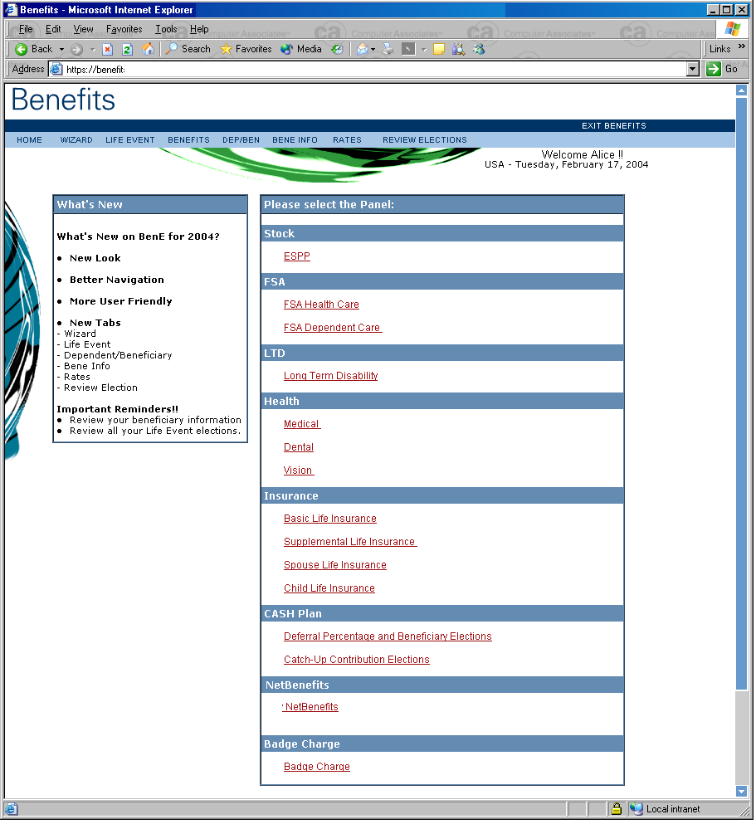
Okay… let’s assume that Alice has signed on to her companies internal website and gone to the Benefits page… and because she has been authenticated by her companies internal website already she gets access to the page.
“Alice” signs on to her companies internal employee only benefits site. She successfully authenticated to that site and it has recognized her, and it has served up her home page
More importantly, (at least for the purposes of explaining SAML) the Software Co.’s internal site is now serving as
Authentication Authority (AA)
(AKA Source Site (SP)
AKA Asserting Party (AP)
AKA Identity Provider (idP))
Network
Alice signed on to this site, so it will serve as her AA/AP/SS/idP
Software Co.
401K Management Provider
CA Internal Use Only
Credential
Store

Slide 11
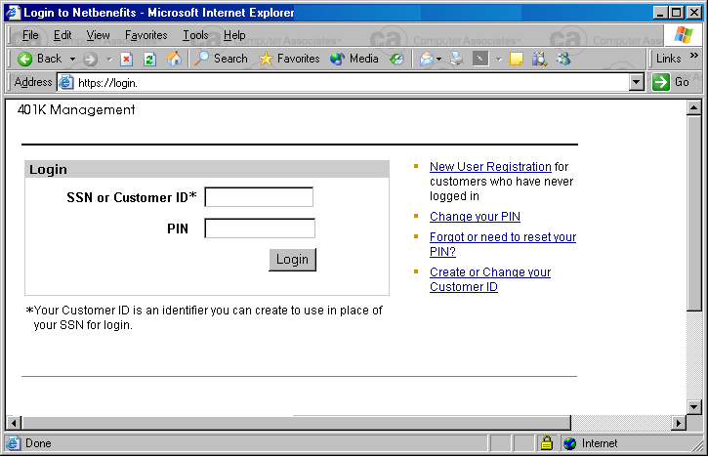
From her home page, she selects the 401K link ?
Consider what happens WithOUT SAML
After having signed on to her internal employee only website, Alice selects 401K Management
The link takes her to the 401K Management site, which is an extranet partner that has a relationship with her employer to provide 401K services for the companies employee’s. That site then challenges her requiring her to login.
Note that it is not only an additional signon – the credential types and values are also different
CA Internal Use Only

Slide 12
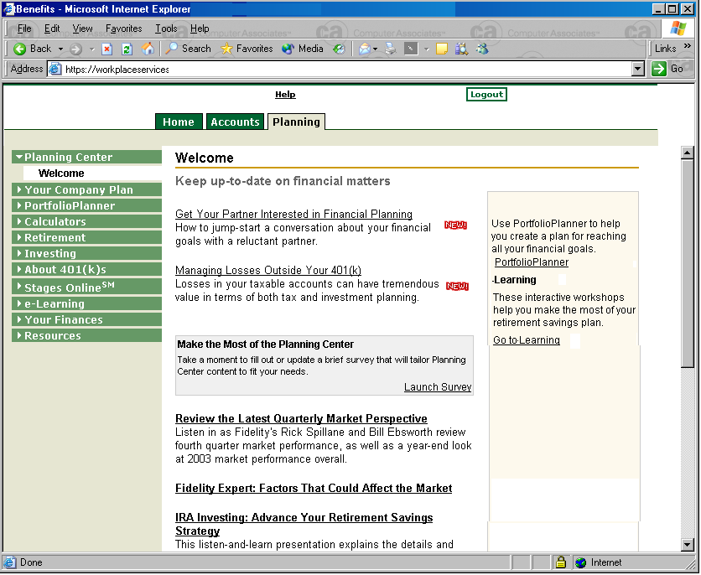
With SAML
From the internal, employee only website, Alice selects 401K Management
The link takes her to the 401K Management site, which is an extranet partner that has a relationship with her employer to provide 401K services for the companies employee’s
With SAML, she is NOT challenged and required to enter “site specific” credentials, rather the site recognizes her, and opens up her customized home page for that site.
In this case, the 401K management site, has recognized that Alice has already authenticated to a trusted Authentication Authority (AA) and accepts that site’s assertion that Alice is who she claims to be.
CA Internal Use Only

Slide 13
What happened behind the scenes to enable the 401K site to recognize Alice ?
It’s actually a pretty straight forward sequence and there are two primary methods to accomplishing the automation with SAML.
1) Using a technique referred to as
BAP – Browser Artifact Profile
2) Using a technique referred to as
BPP - Browser Post Profile.
The first example we’ll take you through will describe what happens behind the scenes when using the SAML BAP techniques.
CA Internal Use Only

Slide 14
SAML – Behind the Scenes
Part 1 - BAP
What happens behind the scenes when using the Browser Artifact Profile (BAP) approach to achieving Web SSO with SAML

Slide 15
What exactly is a Browser Artifact Profile ?
This is actually a two part question.
Part 1 – What is a Profile (in SAML terms) ?
In SAML terms, a profile is a set of rules that describe how assertions (a set of attributes that describe something, for example, a user) should be included into, and extracted from, a message exchange.
Part 2 - What is a Browser Artifact Profile ?
A Browser Artifact Profile is a set of rules that describe how to provide access to the requisite assertions, through use of a SAML Artifact.
Okay… but what in the world is a SAML Artifact ?!
(you think to yourself, but are too polite to blurt out !)
Not to worry, we’ll explain what a SAML Artifact is as we go along.
CA Internal Use Only

Slide 16
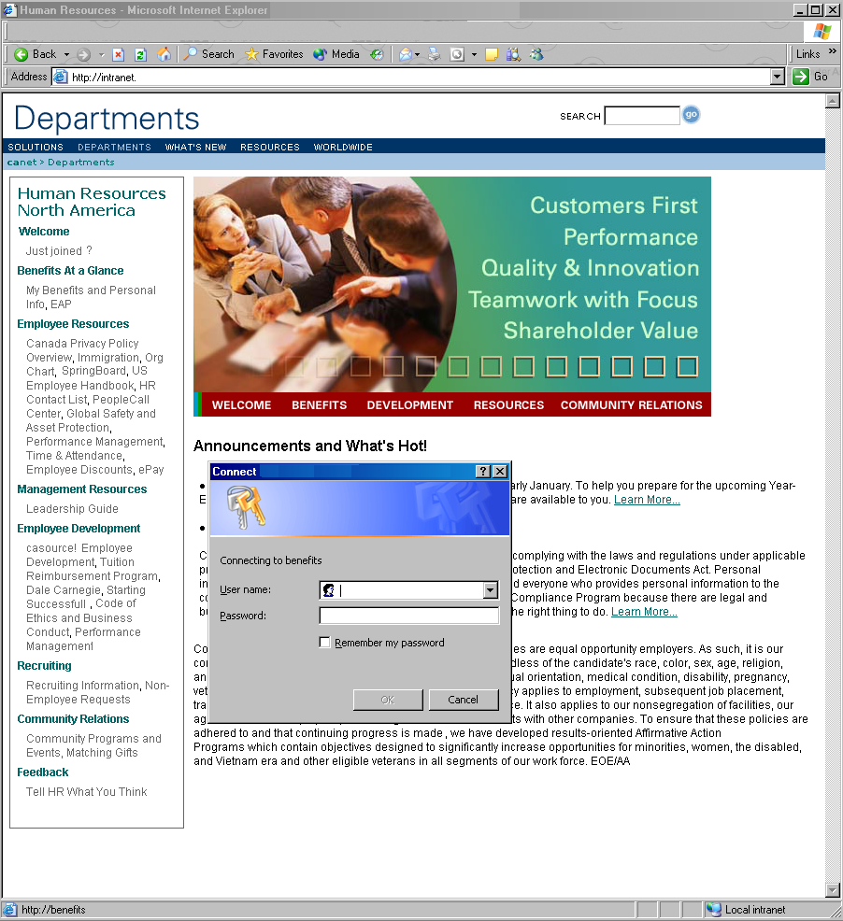
What happened behind the scenes to enable the 401K site to recognize Alice ? Using BAP
It’s actually a pretty straight forward sequence…
Alice logs into her Local HR site, which processes her credentials and is serving as an Authentication Authority that has a pre-defined trust relationship with the 401K Management site
Alice signed on to this site, so it will serve as her AA/AP/SS/idP
Network
Software Co.
401K Management Provider
CA Internal Use Only

Slide 17
What’s happening behind the scenes - BAP (continued)
Her “start page” for that site, is automatically served up.
On that page, she clicks on the link to the 401K Management site.
That link does NOT send Alice to the 401K management site. Rather, the link on the web page was updated by the webmaster to directs Alice’s browser to the Inter Site Transfer (ISX) service that is running on the Software Co.’s employee use only website, which is serving as the the Source Site (SS) (aka Authentication Authority (AA) aka Asserting Party (AP) aka Identity Provider (idP))
The actual URL for the website that Alice wants to visit, IS passed along to the ISX as an argument that identifies the “target” that Alice wants to reach, in the case of our example, this would be the 401K management site that belongs to the extranet partner
Network
ISX
Software Co Internal Website – serving as AA/AP/SS/idP.
CA Internal Use Only

Slide 18
What’s happening behind the scenes - BAP (continued)
Software Co Internal Website serving as AA/AP/SS/idP.
The Inter Site Transfer (ISX) service, running on the Source Site then examines that <TARGET> argument that was passed along to it on the URL, to determine where Alice wants to go
    The ISX consults its local configuration store to get information about the Target Site
    (aka Destination Site (DS)
    aka Relying Party (RP)
    aka Service Provider (SP))
    that is hosting the web page that Alice wants access to.
    Part of that config information, is a special URL that identifies the Artifact Receiver (AR) on the Destination Site (DS)
Network
ISX
Local SAML config info.
AR
401K Management Provider serving as DS/RP/SP
CA Internal Use Only

Slide 19
What’s happening behind the scenes - BAP (continued)
Software Co Internal Website serving as AA/AP/SS/idP
The Inter Site Transfer Service (ISX), next prepares an assertion.
An assertion, is a set of attributes that describe Alice, and any information that the target site has said it needs in order to decide whether to allow Alice access.
The assertion provided by the Source Site (SS) serving as the Asserting Party (AP), is basically a predefined set of xml tags and value pairs.
The format and content of the assertion, (in other words, the particular tags to provide and the format of the values provided for each), are agreed upon in advance between the Source Site (SS), and the Destination Site (DS)
Network
ISX
Local SAML config info.
AR
401K Management Provider serving as DS/RP/SP
CA Internal Use Only

Slide 20
What’s happening behind the scenes - BAP (continued)
Software Co Internal Website serving as AA/AP/SS/idP
The ISX then creates an Artifact which is basically a handle, or nickname, that uniquely corresponds to the Assertion that was just generated.
See, we told you we’d explain what an Artifact is !
Network
ISX
Local SAML config info.
AR
401K Management Provider serving as DS/RP/SP
CA Internal Use Only

Slide 21
What’s happening behind the scenes - BAP (continued)
Software Co Internal Website serving as AA/AP/SS/idP
The Inter Site Transfer Service (ISX), running on the Source Site (SS), now sends a redirect (302) back to Alice’s browser.
The redirect that the Source Site sends back to Alice’s browser, still doesn’t send her browser to the URL she is actually interested in. Rather, it will direct the browser to the Artifact Receiver (AR) Service running on the destination site (in this case, the 401K mgmt site).
Of importance to note, is that the redirection URL contains some special arguments:
<TARGET>
Identities the actual URL that Alice
wants to access on the
Destination Site (DS)
<SAMLart>
The SAML Artifact, which is a
“unique one time use nickname” for the Assertions that the Source Site (SS) generated, for use on the
Destination Site (DS)
Redirect
Network
ISX
AR
401K Management Provider serving as DS/RP/SP
CA Internal Use Only

Slide 22
What’s happening behind the scenes - BAP (continued)
Software Co Internal Website serving as AA/AP/SS/idP.
The redirect causes the browser to contact the Artifact Receiver (AR) Service on the 401K mgmt site.
In SAML terms, this 401K mgmt site is now serving as a Destination Site (DS) aka Relying Party (RP)
aka Service Provider (SP)
Network
ISX
AR
401K Management Provider serving as DS/RP/SP
CA Internal Use Only

Slide 23
What’s happening behind the scenes - BAP (continued)
Software Co Internal Website serving as AA/AP/SS/idP
The Artifact Receiver (AR) Service, looks at the URL that it was sent, and finds the artifact that was passed along on the URL, (passed as a <SAMLart> argument).
This artifact includes information that identifies the Source Site (SS) that generated the Artifact.
    The AR, running on the Destination Site (DS) then consults its local configuration to get information about the Source Site that created this artifact.
    Included in that config info will be the URL that should be used by the Artifact Receiver on the Destination Site, to contact the Responder Service (RS) - also referred to as a SAML Responder - running on the Source Site
Network
ISX
RS
AR
401K Management Provider serving as DS/RP/SP
Local SAML config info.
Credential
Store
CA Internal Use Only

Slide 24
What’s happening behind the scenes - BAP (continued)
Software Co Internal Website serving as AA/AP/SS/idP.
The Artifact Receiver (AR) Service, sends an Assertion Artifact request to the Responder Service (RS) - aka SAML Responder - running on the
Source Site (SS).
This request basically asks the SAML Responder to return the assertion that it earlier created, which corresponds to this artifact
Note that this request is sent DIRECTLY from the DS to the SS, it does not use a redirect through Alice’s browser
Network
ISX
RS
AR
401K Management Provider serving as DS/RP/SP
Local SAML config info.
Credential
Store
CA Internal Use Only

Slide 25
What’s happening behind the scenes - BAP (continued)
Software Co Internal Website serving as AA/AP/SS/idP
The Responder Service (RS) aka SAML Responder, see’s this request to return the assertion associated with this artifact.
It confirms that the Artifact Assertion being requested by the Artifact Receiver (AR) running on the Destination Site (DS), is referencing an Artifact that was in fact intended for that Destination Site, and if so, it prepares the assertion - the set of attributes that describe the user that is associated with this one-time use artifact.
The Responder Service (RS) aka SAML Responder, running on the Source Site (SS), then responds to the Request providing the Assertion that corresponds to the Artifact
Note that this response is sent DIRECTLY from the SS to the DS, it does not use a redirect through Alice’s browser
Network
ISX
RS
AR
401K Management Provider serving as DS/RP/SP
Local SAML config info.
Credential
Store
CA Internal Use Only

Slide 26
What’s happening behind the scenes - BAP (continued)
Software Co Internal Website serving as AA/AP/SS/idP.
    The Artifact Receiver (AR) on the destination site, receives the assertion, and the pre-defined set of attributes that describe Alice. In this case, the two parties (the software co. and the 401K provider) agreed in advance that one of those attributes provided would be the users Social Security Number.
    The AR on the destination site now knows the userid to be associated with Alice on it’s site (its her Social Security Number – one of the attributes provided in the assertion) so it automatically logs her into the site without requiring her to provide any kind of password, and creates a cookie.
    The AR now sends a redirect (302) back to the users browser, including the cookie. The redirect will cause the users browser to request the TARGET URL from the Destination Site
Network
ISX
RS
Redirect
AR
WS
401K Management Provider serving as DS/RP/SP
Local SAML config info.
Credential
Store
CA Internal Use Only

Slide 27
What’s happening behind the scenes - BAP (continued)
Software Co Internal Website serving as AA/AP/SS/idP.
This redirect causes Alice’s browser to request the TARGET URL from the Service Provider (SP), (this TARGET URL, is the URL of the actual application she was interested in).
The Web Server on the destination site see’s the request for the 401K application.
It validates that the requesting party (Alice) is appropriately logged in.
It finds that Alice IS logged in (the Artifact Receiver (AR) service took care of that before it sent a redirect to her browser (see prior slide))
Network
ISX
AR
WS
401K Management Provider serving as DS/RP/SP
Credential
Store
CA Internal Use Only

Slide 28
What’s happening behind the scenes - BAP (continued)
Software Co Internal Website serving as AA/AP/SS/idP.
    The Web Server on the destination site, satisfied that Alice is logged in, serves up the requested page and Alice is provided access to the extranet site.
    She was provided the access, and auto-logged in without ever having to enter any credentials, or even see a challenge.
Network
ISX
RS
AR
WS
401K Management Provider serving as DS/RP/SP
Local SAML config info.
Credential
Store
CA Internal Use Only

Slide 29
Truth or False about SAML – Question #2
If a site is SAML compliant, it will be able to automatically interoperate with any other SAML compliant site ?
FALSE
There are several steps required to get two [already] SAML compliant parties to be able to recognize and understand one another
CA Internal Use Only

Slide 30
Truth or False about SAML – Question #2
These steps include:
1) Exchange Configuration Information to Identify one another's:
Inter Site Transfer (ISX) URL‘s
Artifact Receiver (AR) URL’s
Responder Server (RS) aka SAML Responder URL’s
2) Exchange Certificates to enable the ISX, AR and RS to
communicate with one another via https
3) Define Assertion content that the communicating parties agree to
In SAML-ese: what are the detailed characteristics of the agreed upon namespace.
In English: what attributes should be returned as part of
the assertion, and what is the format of each
attribute
4) Configure network security to allow the requisite access between the enterprises
5) And a bunch more…
CA Internal Use Only

Slide 31
SAML – Behind the Scenes
Part 2 - BPP
What happens behind the scenes when using the Browser Post Profile (BPP) approach to achieving Web SSO with SAML

Slide 32
What exactly is a Browser Post Profile ?
A Browser Post Profile is a set of rules that describe an approach that makes it possible to provide access to the requisite assertions, without requiring the use of a SAML Artifact.
This approach has the following benefits over BAP
      1) No need to create an Artifact
    2) Less redirection (no need for the initial Artifact redirect
    from the Source Site (SS), back to the browser,
    to the Artifact Receiver (AR) URL on the
    Destination Site (DS).
    3) No need for the Source Site(SS) and
    Destination Site (DS) to have to
    communicate with one another in order
    to translate the Artifact into an Assertion
    (no need to dereference)
CA Internal Use Only

Slide 33
BPP seems a lot simpler than BAP ?
Yes, in some ways, its simpler than BAP, but the BPP approach introduces some specific requirements of its own that BAP does not, specifically in the area of Digital Signatures.
CA Internal Use Only

Slide 34
Which is better – BAP or BPP ?
Neither is better or worse – they are simply different ways of accomplishing the same thing.
Which is more appropriate, depends on the context of the implementation
CA Internal Use Only

Slide 35
Let’s Not Debate…
The objective of this presentation isn’t to debate the merits of BAP over BPP… it’s to provide you an introduction to the terms, jargon and operational concepts of SAML
Accordingly, lets cover the same scenario as we did before, this time using BPP…
CA Internal Use Only

Slide 36
What happened behind the scenes to enable the 401K site to recognize Alice ? Using BPP
As before, it’s actually a pretty straight forward sequence…
Alice logs into her Local HR site, which processes her credentials and is serving as an Authentication Authority that has a pre-defined trust relationship with the 401K Management site
Alice signed on to this site, so it will serve as her AA/AP/SS/idP
Network
Software Co.
401K Management Provider
CA Internal Use Only

Slide 37
What’s happening behind the scenes - BPP (continued)
Her “start page” for that site, is automatically served up.
On that page, she clicks on the link to the 401K Management site.
That link doesn’t send Alice to the 401K management site. Rather, it directs Alice’s browser to the Inter Site Transfer (ISX) service that is running on the Software Co.’s employee use only website, which is serving as the the Source Site (SS) (aka Authentication Authority (AA) aka Asserting Party (AP) aka Identity Provider (idP))
The actual URL for the website that Alice wants to visit, IS passed along to the ISX as an argument that identifies the “target” that Alice wants to reach, in the case of our example, this would be the 401K management site that belongs to the extranet partner
Network
ISX
Software Co Internal Website – serving as AA/AP/SS/idP.
CA Internal Use Only

Slide 38
What’s happening behind the scenes - BPP (continued)
Software Co Internal Website serving as AA/AP/SS/idP.
The Inter Site Transfer (ISX) service, running on the Source Site then examines that <TARGET> argument that was passed along to it on the URL, to determine where Alice wants to go
    The ISX consults its local configuration store to get information about the Target Site
    (aka Destination Site (DS)
    aka Relying Party (RP)
    aka Service Provider (SP))
    that is hosting the web page that Alice wants access to.
    Part of that config information, is a special URL that identifies the Assertion Consumer (AC) service on the Destination Site (DS)
Network
ISX
Local SAML config info.
AC
401K Management Provider serving as DS/RP/SP
CA Internal Use Only

Slide 39
What’s happening behind the scenes - BPP (continued)
Software Co Internal Website serving as AA/AP/SS/idP.
The Inter Site Transfer Service (ISX), next prepares an assertion
As before, the assertion, is a set of attributes that describe Alice, and any information that the target site has said it needs in order to decide whether to allow Alice access.
To review, the assertion provided by the Source Site (SS) serving as the Asserting Party (AP), is basically a predefined set of xml tags and value pairs.
The format and content of the assertion, (in other words, the particular tags to provide and the format of the values provided for each), are agreed upon in advance between the Source Site (SS), and the Destination Site (DS)
Network
ISX
Local SAML config info.
AC
401K Management Provider serving as DS/RP/SP
CA Internal Use Only

Slide 40
What’s happening behind the scenes - BPP (continued)
Software Co Internal Website serving as AA/AP/SS/idP.
The ISX then takes that assertion and constructs a SAML response that includes that assertion
The ISX then digitally signs that SAML Response (a very interesting process in its own right, that is beyond the scope of this discussion)
Network
ISX
Local SAML config info.
AC
401K Management Provider serving as DS/RP/SP
CA Internal Use Only

Slide 41
What’s happening behind the scenes - BPP (continued)
Software Co Internal Website serving as AA/AP/SS/idP
Next, the ISX constructs a URL that references the Assertion Consumer (AC) service running on the Destination Site (DS).
Including on that URL:
o the SAML response
o the digital signature for that
SAML response
o the TARGET URL that Alice
is interested in accessing.
Finally, the ISX takes this generated URL and returns it back to Alice’s browser as part of an HTML form
Form is Returned
Network
ISX
Local SAML config info.
AC
401K Management Provider serving as DS/RP/SP
CA Internal Use Only

Slide 42
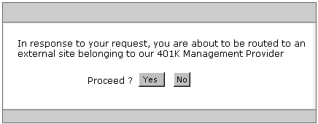
What’s happening behind the scenes - BPP (continued)
For example, the type of form returned by the ISX to Alice’s browser, might look something like what you see here.
CA Internal Use Only

Slide 43
What’s happening behind the scenes - BPP (continued)
Software Co Internal Website serving as AA/AP/SS/idP.
Alice elects to proceed, and clicks on the Yes button.
The logic built into the form causes her browser to send an HTTPS post to the Assertion Consumer (AC) service, running on the Destination Site.
Included on the URL are arguments that provide:
o the SAML Response (part of
which is the SAML Assertion)
o the digital signature for that SAML response
o the TARGET URL that Alice
is interested in accessing.
Network
ISX
AC
401K Management Provider serving as DS/RP/SP
CA Internal Use Only

Slide 44
What’s happening behind the scenes - BPP (continued)
Software Co Internal Website serving as AA/AP/SS/idP
The Assertion Consumer (AC) service, looks at the URL that it was sent, and finds the SAML Response (and the SAML Assertions that are included in that response) and the Digital Signature of that Response
It then validates that Digital Signature (a very interesting process in its own right that is beyond the scope of this discussion)
With the Digital Signature verified, the Assertion Consumer (AC) service can be confident that the message did originate from the Source Site that it claims to be from, and that the message has not been altered.
Network
ISX
RS
AC
401K Management Provider serving as DS/RP/SP
Local SAML config info.
Credential
Store
CA Internal Use Only

Slide 45
What’s happening behind the scenes - BPP (continued)
Software Co Internal Website serving as AA/AP/SS/idP.
    The Assertion Consumer (AC) service on the destination site, finds the assertion (the
    pre-defined set of attributes that describe Alice) in the SAML response.
    As in our earlier example, we’re going to assume that the two parties (the software co. and the 401K provider) agreed in advance that one of those attributes provided would be the users Social Security Number.
    The AC on the destination site now knows the userid to be associated with Alice on it’s site (its her Social Security Number – one of the attributes provided in the assertion) so it automatically logs her into the site without requiring her to provide any kind of password, and creates a cookie.
    The AC now sends a redirect (302) back to the users browser, including the cookie. The redirect will cause the users browser to request the TARGET URL from the Destination Site
Network
ISX
RS
Redirect
AC
WS
401K Management Provider serving as DS/RP/SP
Local SAML config info.
Credential
Store
CA Internal Use Only

Slide 46
What’s happening behind the scenes - BPP (continued)
Software Co Internal Website serving as AA/AP/SS/idP.
The redirect causes Alice’s browser to request the TARGET URL from the Service Provider (SP). (This TARGET URL is the actual URL of the application she was interested in)
The Web Server on the destination site see’s the request for the 401K application. It validates that the requesting party (Alice) is appropriately logged.
It finds that Alice IS logged in (the Assertion Consumer (AC) service took care of that before it sent a redirect to her browser (see prior slide))
Network
ISX
AC
WS
401K Management Provider serving as DS/RP/SP
Credential
Store
CA Internal Use Only

Slide 47
What’s happening behind the scenes - BPP (continued)
Software Co Internal Website serving as AA/AP/SS/idP.
    The Web Server on the destination site, satisfied that Alice is logged in, serves up the requested page and Alice is provided access to the extranet site.
    She was provided the access, and auto-logged in without ever having to enter any credentials, or even see a challenge.
Network
ISX
RS
AC
WS
401K Management Provider serving as DS/RP/SP
Local SAML config info.
Credential
Store
CA Internal Use Only

Slide 48
Truth or False about SAML – Question #3
Careful consideration has to be given as to whether to use a Browser Artifact Profile (BAP) or Browser Post Profile (BPP) approach, because a given web server can only use one of these.
FALSE
These can be used on the same site, at the same time, to access the same resources.
CA Internal Use Only

Slide 49

The End

