Slide 1

Machine Translation: English to German
By Claire Lueking
CSPB 4380 Special Topics: Natural Language Processing

Slide 2


Problem Overview
NLP Task: Machine Translation
Usefulness:
German is the 12th most spoken language in the world (4th most common for business)
Translation mechanisms are not always fast and accurate from English to German
Can be cost-effective compared to human translation in certain scenarios
Notes:
- Machine Trnsltn defn: Automated process of translating text or speech from one language to another via a computer
- German is the 12th most spoken language in the world: (4th most common for business): most common native language spoken in the EU, clues to why: lots in common with English, Germany is very large compared to many other EU countries
Translation mechanisms are not always accurate: due to German grammar and sentence structures.
Can be cost-effective: Customer support tickets (emails need translated to be answered) and social media monitoring (analyze trends in thousands of reviews across many langauges)

Slide 3

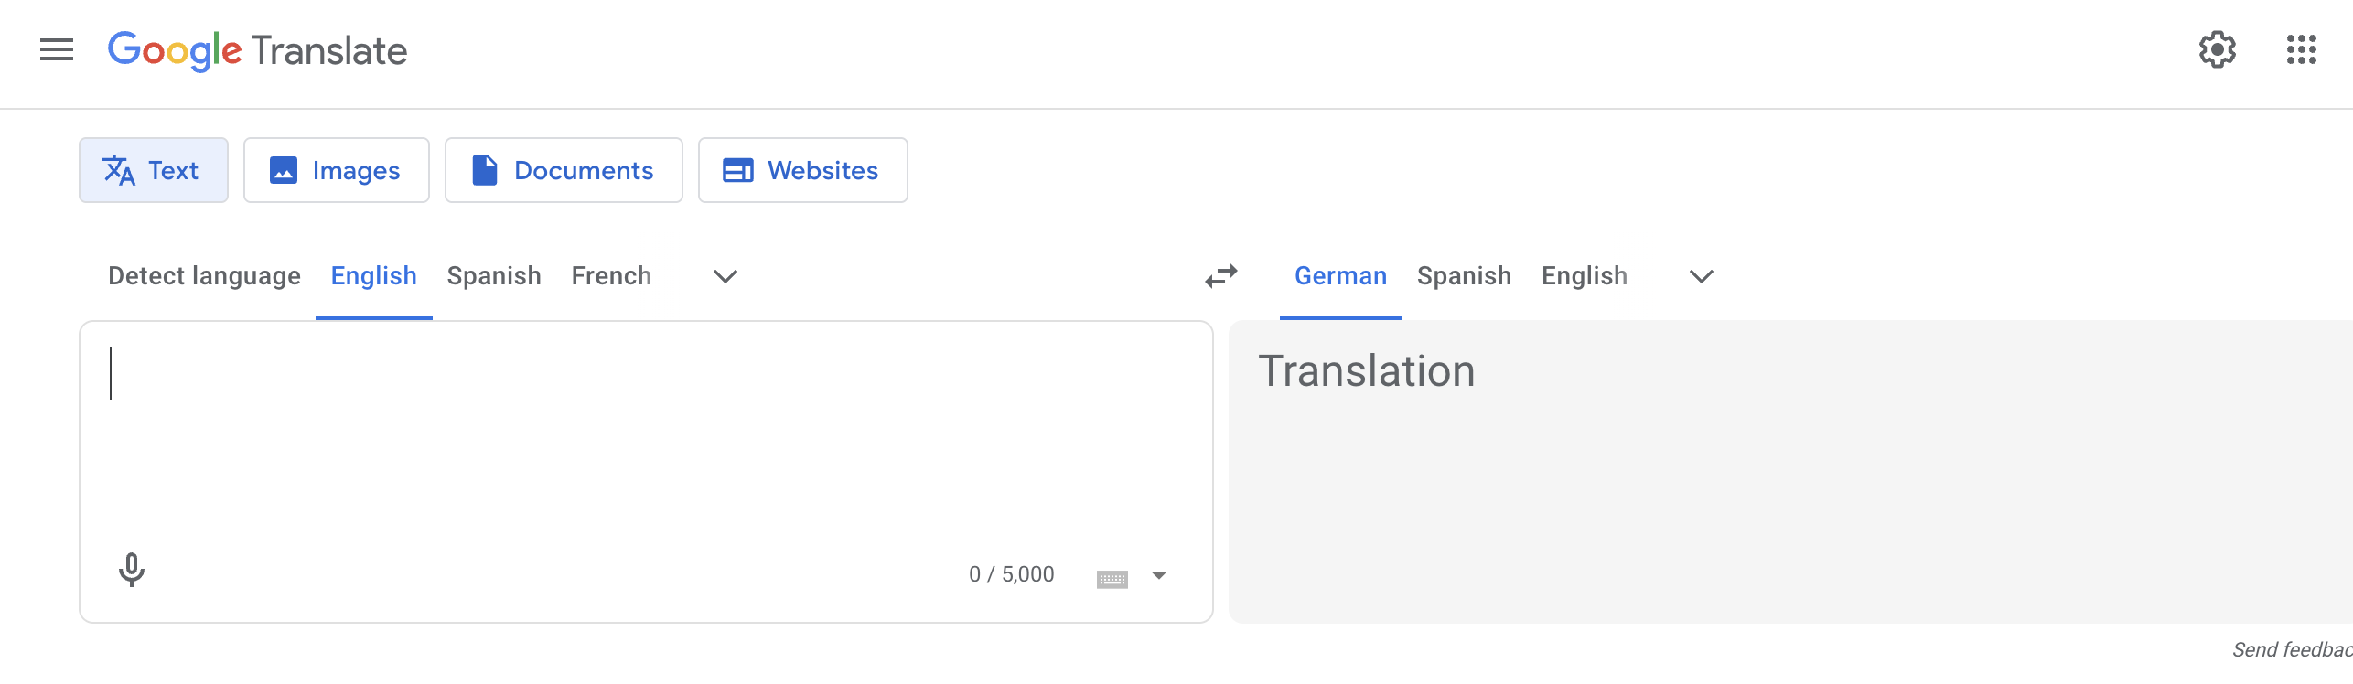

Motivation & Goals
Main Objective: Get close to or surpass Google Translate’s ability to translate English to German
Trying to Achieve:
Get a BLEU score that is close to or better than Google Translate’s BLEU Score
Use Accuracy (of word for word translation) and F1 Score to verify the numerical analysis of the translation
Google Translate BLEU: 4.71 out of 10 (causeweb.org 2023)
N-gram Models BLEUs: ?

Slide 4
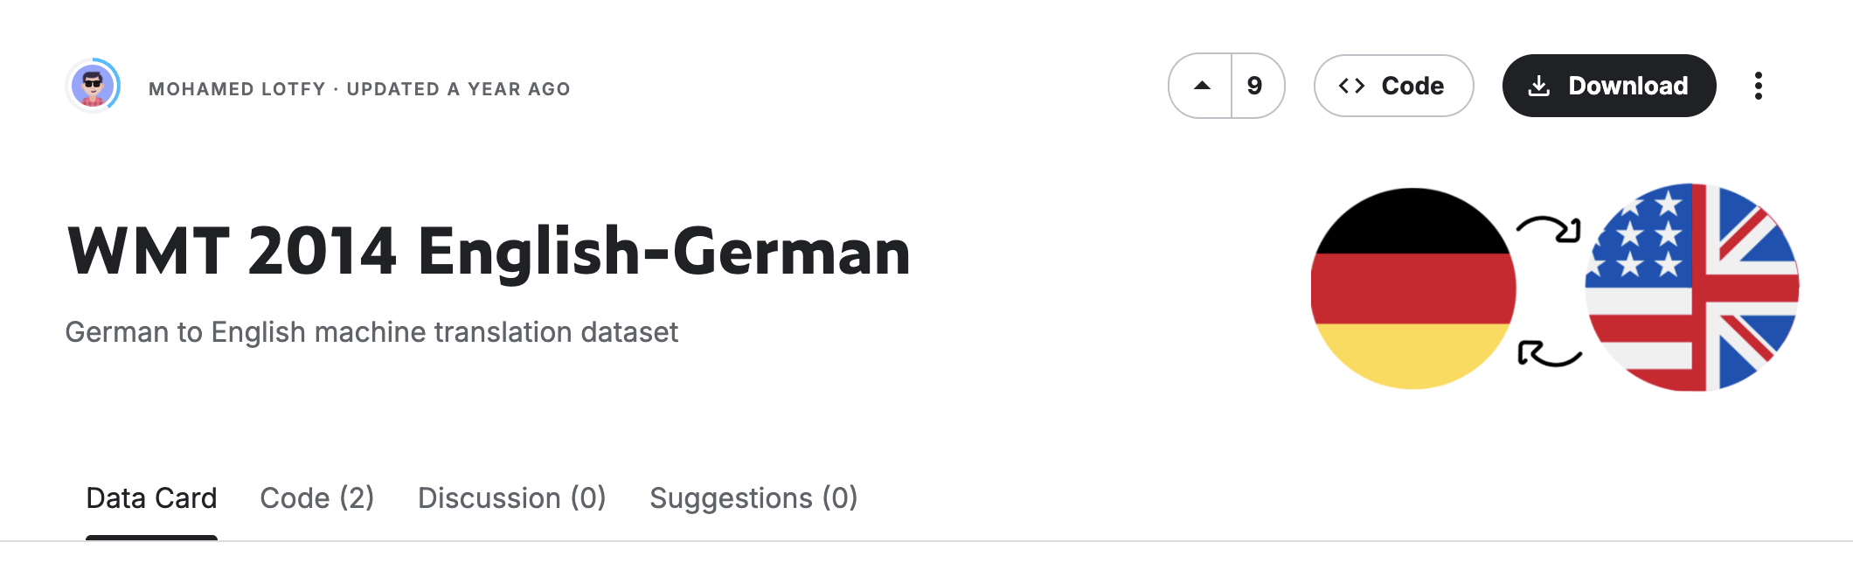
Dataset Description
Source: WMT 2014 English-to-German (Lofty 2024)
Size: 4.5 million parallel sentences
Structure: English & German parallel sentence pairs
Data Cleaning & Preprocessing:
Return empty string for NULL values
Make everything lowercase
Get rid of extra spaces
Keep common German characters (i.e. äöüß)
Tokenize (and detokenize when needed) sentences into separate English and German categories
Notes:
Return empty string for NULL vals: ensures valid data makes it through but if there is not a matching pair, then it doesn’t process for training (and eventually testing)
Everything lowercase and get rid of extra spaces: keep things simple for translation task so it doesn’t get confused by inconsistent formatting
Keep common German char: helps to keep translation accuracy across the languages
Tokenize and detokenize: put things into separate categories to help with the BLEU translation comparison tokens

Slide 5

Approach Overview
The Plan: 1. Baseline:
- Clean and preprocess data
- Tokenize sentences
2. Main Models:
- Create N-gram Models
- Translate examples using tokenized sentences
- Calculate Accuracy, Precision, F1 Score, and BLEU score
3. Methods:
- Self-created tokenizer
- Create basic test sentences to measure common translation accuracy via human
translation verification
- Run 150,000 rows to test
Notes:
Main Models: create 2 n-gram models (unigram and bigram), accuracy and precision are used in the F1 score, BLEU score gives a percentage of how good the models are compared to human translation
Methods: self-created tokenizer because spaCy wasn’t doing exactly what was wanted (wanted simpler tokenizer and more lightweight) , created basic test sentences for easily-understood human (self and a friend) comparison, run 150k rows to test data in the set

Slide 6

Tools & Techniques
Key Libraries:
Python: pandas, numpy, re, sacrebleu (corpus_bleu), collections (defaultdict), sklearn (train_test_split)
Frameworks: Python, NLTK (nltk.util ngrams)
Models: None
Notes:
Libraries: pandas for data manipulation and analysis (i.e. load datasets), numpy for fast numerical operations and arrays (i.e. converting sentence lengths or BLEU stats to arrays for quick processing, re for pattern matching and text cleaning (i.e. removing punctation),
sacrebleu (corpus bleu) for standardized BLEU score calculation, collections.defaultdict for dictionary automatically creates default values for missing keys (i.e. helps with building frequency dictionaries)
sklearn.model_selection.train_test_split for splitting data into training and test sets (i.e. 80 train 20 test)
Frameworks: nltk.util.ngrams for generating ngrams from text, python as programming language

Slide 7

Experiments & Analysis
What I Tried: N-grams, BPE
What Worked: N-grams
Comparisons:
N-grams: Easy to understand and implement, performance is limited
Basic Unigram
Basic Bigram
Custom Unigram
Custom Bigram
Byte Pair Encoding (BPE): Couldn’t get working at good enough performance
Basic BPE
Notes:
Ngrams: Basic Unigram (Maps single word to every target unigram it appears with), Basic Bigram (Maps pairs of words to every target bigram it appears with), Custom Unigram (Adds weights based on positional similarity and normalizes probabilities per source unigram), Custom Bigram (Adds Gaussian weighting based on distance between bigrams and normalizes with smoothing)
Basic BPE: outputs subword tokens that can be merged to full words -- However: I tried many iterations that did not give me much improvement compared to the n-gram models

Slide 8
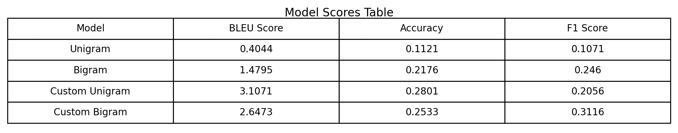
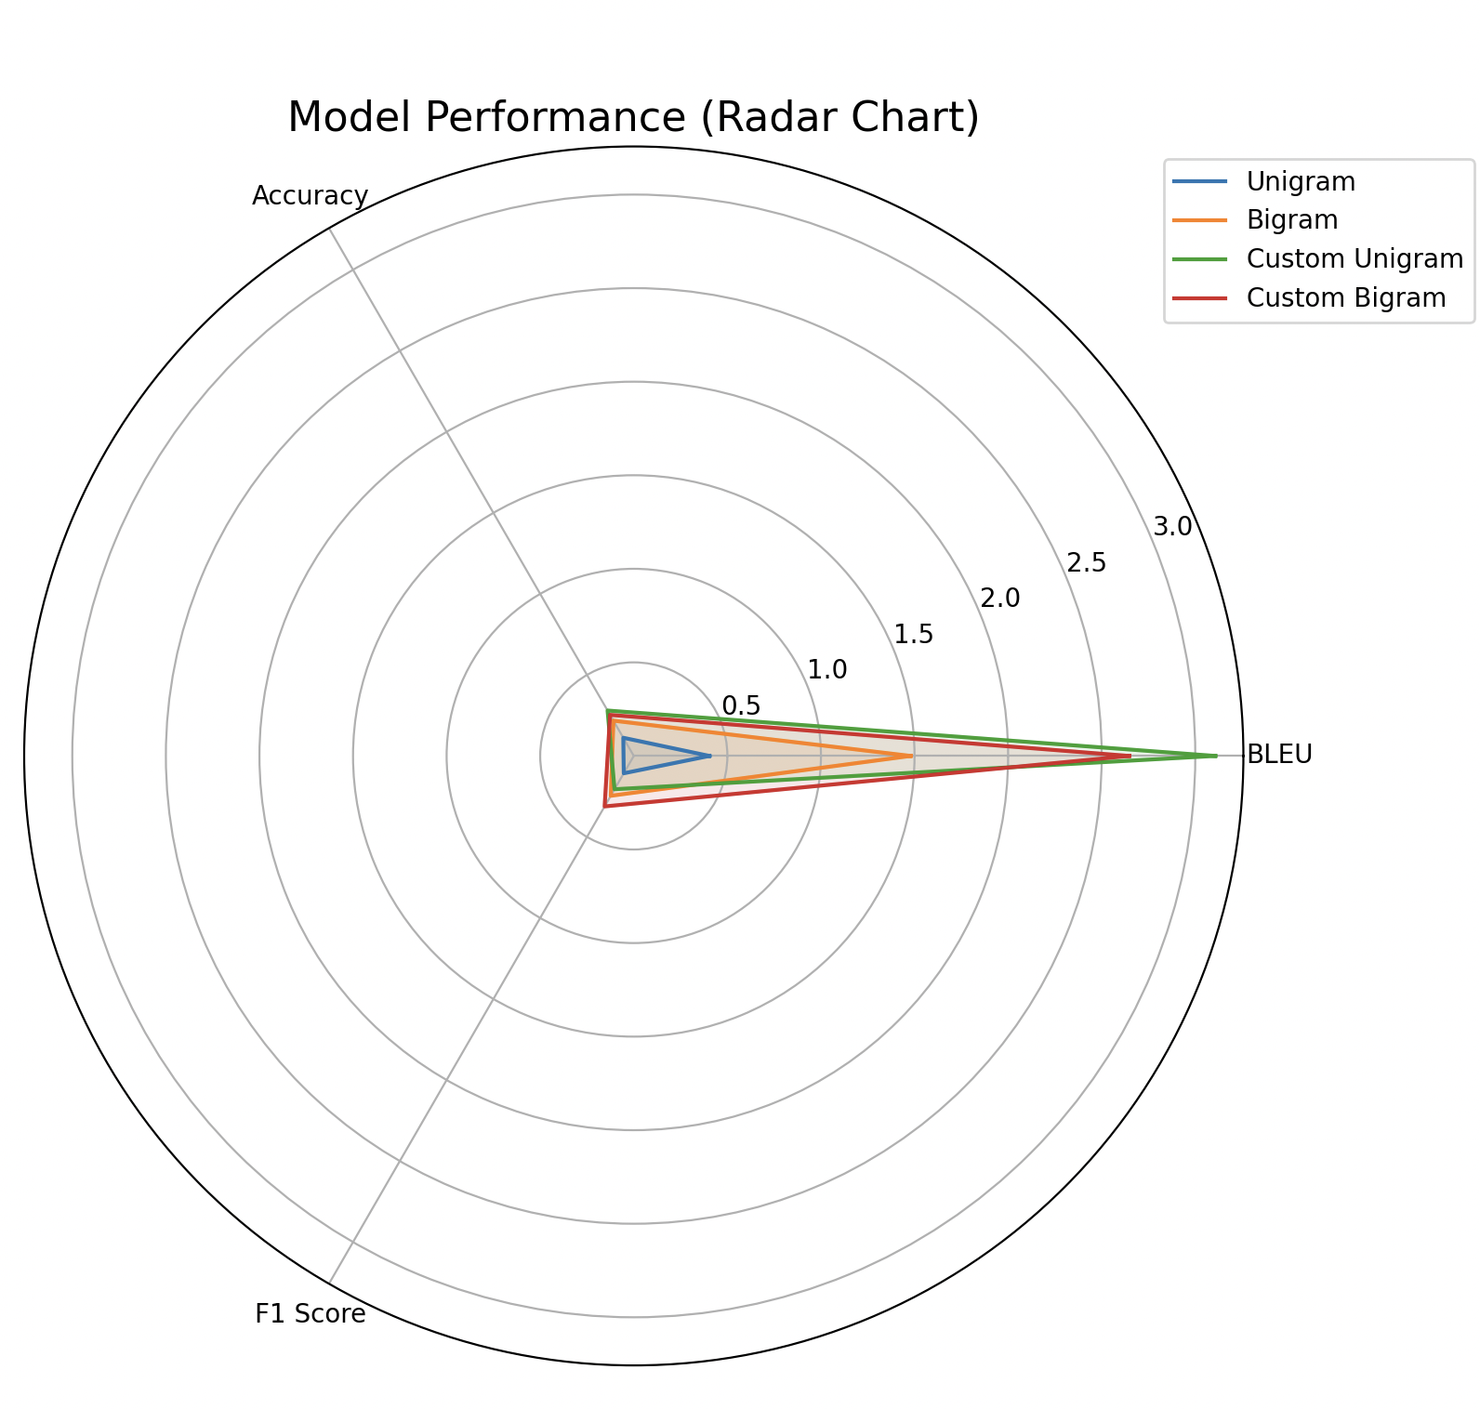
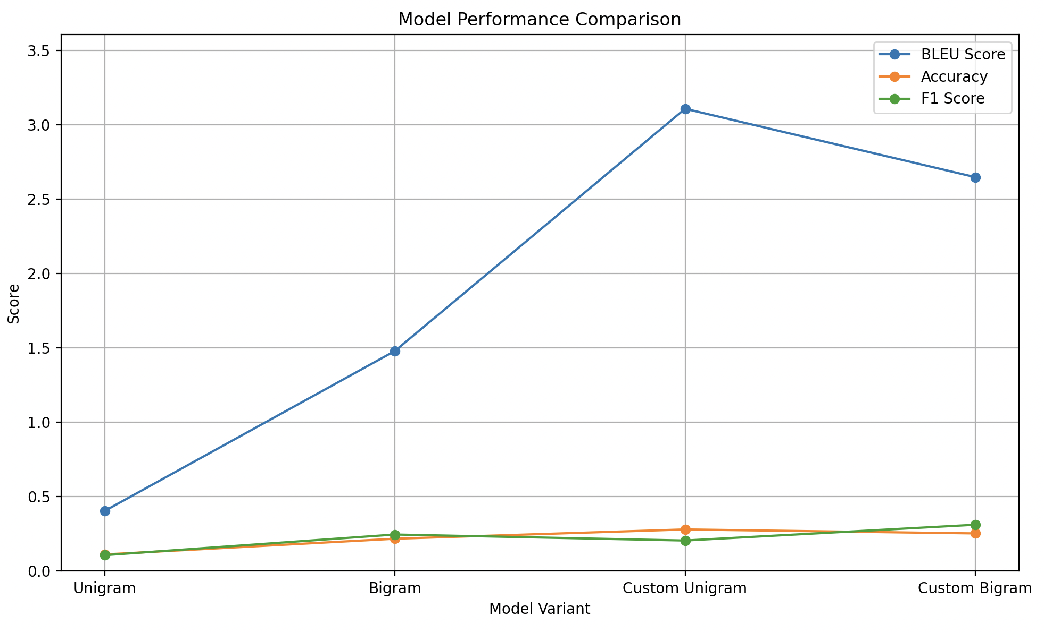
Results 1
Key Metrics: BLEU score, Accuracy (word for word translation), F1 Score (word for word translation)
Visualizations:
These all show the same thing, just in different ways!
Notes:
Table: Breaks down basic models and custom models by their scores
Radar chart: shows mostly BLEU info where the basic unigram did the worst and the custom unigram did the best
Line chart: shows BLEU score mostly, but easier to see the accuracy and F1 Scores are not great showing room for improvement within the models, but the BLEU score is the main translation focus

Slide 9
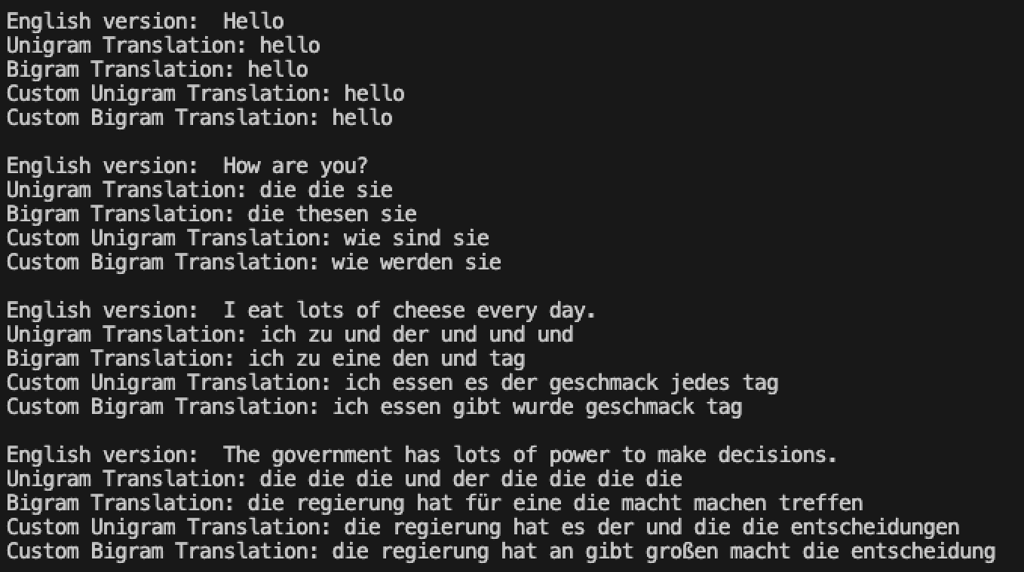
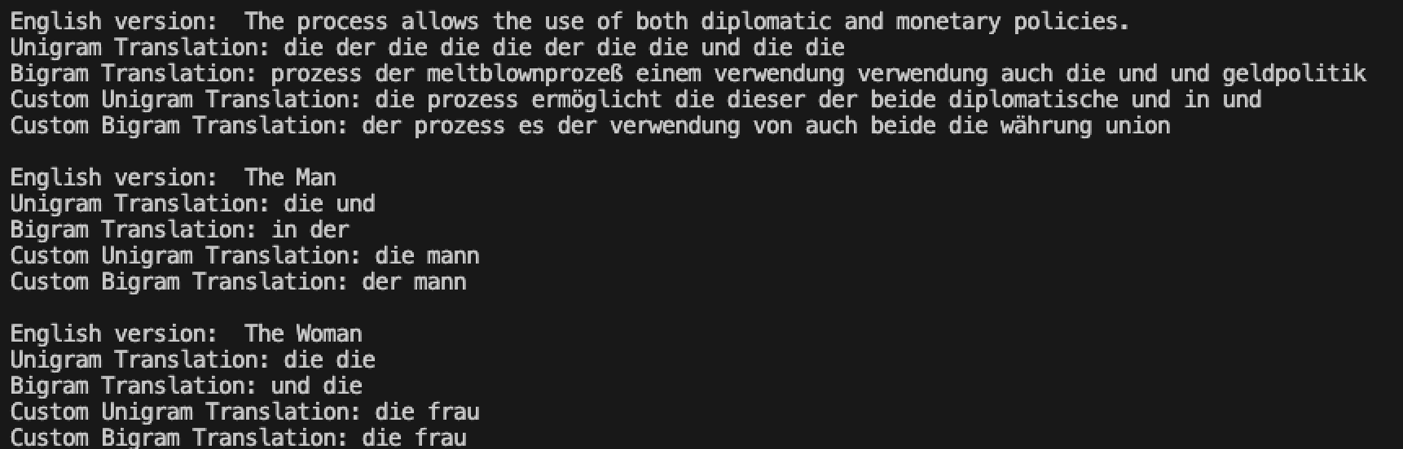
Results 2
- Output Examples:
Notes:
Shows different versions starting with English input and then all the model translations… some translations are exact or close enough (custom models) and the basic models are mostly relying on common words they see such as die = the
6 forms of the, hence the diffenece between the man and the woman with der for masculine and die for feminine

Slide 10

Challenges & Lessons Learned
Obstacles Faced:
1. Local machine restrictions
2. German language structure-- hard to get a direct translation to
English
3. Familiarity with Python libraries
What I Learned:
1. There is a reason there is no 100% for multiple matches for
machine translation tasks with spoken language
2. Building a “good” translation model takes a lot of time
Notes:
Obstacles:
Local machine restrictions: difficult to run REALLY large amounts of data quickly (google drive broke and can’t upload files to run on Google Colab
German language structure-- hard to get a direct translation to English: (example: have 6 ways to say “the” (der, die, das, des, dem, den))
Familiarity with Python libraries: I have some experience with numpy and pandas, but not a ton and no familiarity previously with BLEU scores and the python library associated with it
What I Learned:
There is a reason there is no 100% for multiple matches for machine translation tasks with spoken language: need extra contact and knowledge of colloquial things to fully understand and translate things
Building a “good” translation model takes a lot of time: It takes almost constant tweaking and a significant amount of time to be able to run it over and over

Slide 11

Conclusion & Future Work
Final Takeaways:
1. Use as much training and test data as possible
2. Fine tuning data improves correct translation (to a point)
3. N-grams may not be the best way to create a translation model
Future Work:
Improvement of current models to account for more grammar rules and sentence structure issues based on situational data
Develop a neural machine translation (NMT) model
Specialize models for industries being used (i.e. Medical, Legal, etc.)
Notes:
Future Work:
- improvement: be able to handle the 6 “the’s” correctly, certain sentences or slang can be included eventually
- specialize: small way to improve for industry specific information and translations

Slide 12
Sources
-Causeweb.org. “A comparative Analysis of Translation Performance: ChatGPT vs. Google Translate.” Causeweb.org, 2023, https://www.causeweb.org/usproc/sites/default/files/usclap/2023-1/usclap%203010%20-%20a%20comparative%20analysis%20of%20translation%20performance%20chatgpt%20vs%20google%20translate.pdf.
- Lotfy, Mohamed. “WMT 2014 English-German.” Kaggle.com, 2024, www.kaggle.com/datasets/mohamedlotfy50/wmt-2014-english-german.

