Slide 1


Deep Learning for Natural Language Processing DLNLP 6: Best Practices in Deep Learning
Mihai Surdeanu and Marco A. Valenzuela-Escárcega

Slide 2
Overview
Mini-batching
Other optimization algorithms
Other activation functions
Cost functions
Regularization
Dropout
Parameter initialization and normalization

Slide 3
Why?
All these topics essentially reduce overfitting (“hallucinating” a classifier) and/or improve the stability of the learning process

Slide 4
Mini-batching

Slide 5
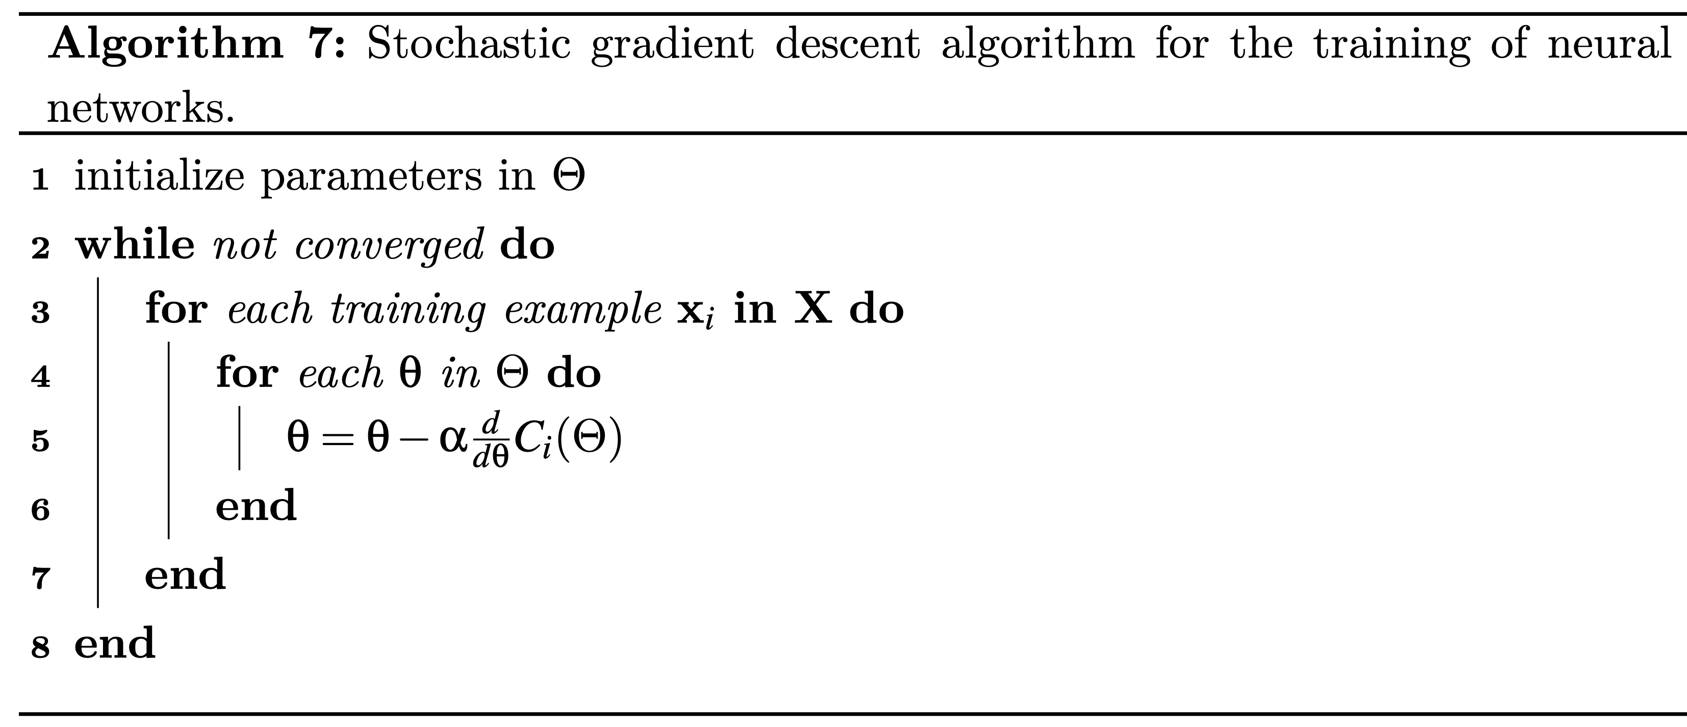
One example at a time!

Slide 6

Advantages of stochastic GD
May converge quickly due to the many updates
May “jump out” of local minima due to the high variance in the gradients
Easy to implement

Slide 7
Disadvantages of stochastic GD
May “jump around” good solutions as well… Slower convergence on realistic data
Computational expensive (many updates)

Slide 8
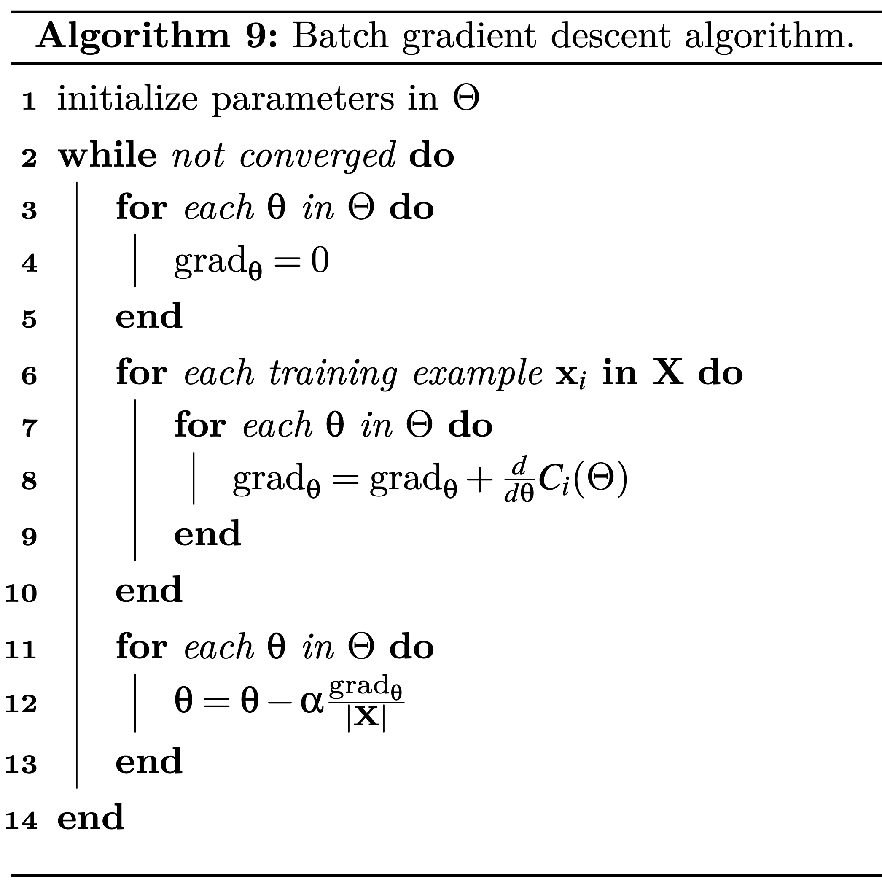
Compute 1 gradient for all examples in the training data

Slide 9

Advantages of batch GD
More stable gradients, which often leads to better convergence
More computationally efficient (can be parallelized)

Slide 10
Disadvantages of batch GD
Less likely to “jump out” of bad solutions
Needs more epochs to train
More complicated implementation

Slide 11
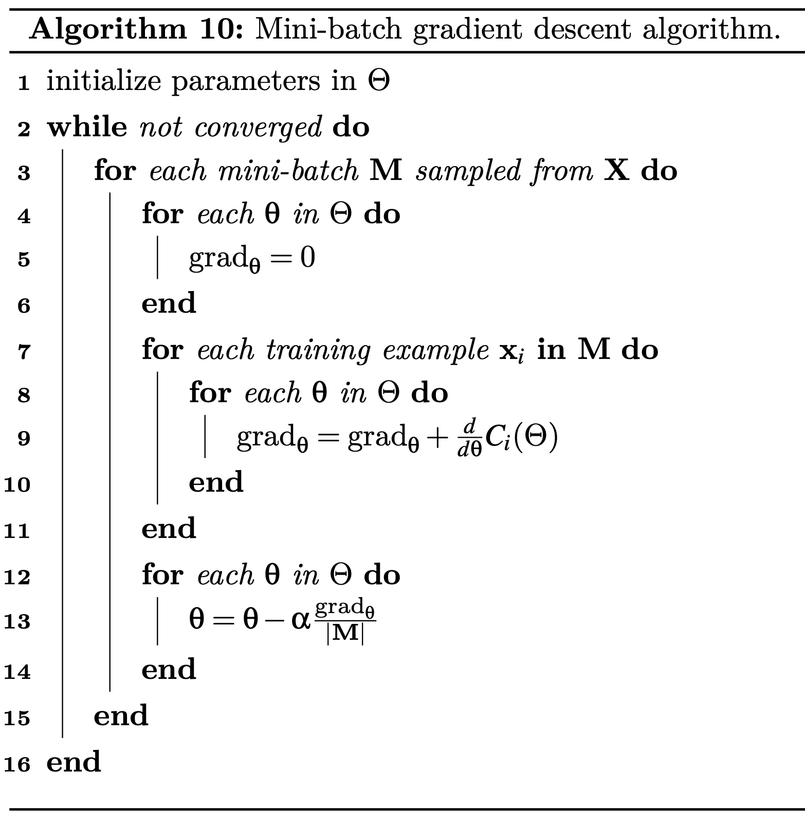
Break the training data into small groups of examples

Slide 12

Advantages of mini-batch GD
Often leads to better solutions (less “jumping around”, but can still “jump out” of bad solutions)
Still computationally efficient (can be parallelized)

Slide 13
Disadvantages of mini-batch GD
More complicated implementation
Introduces a new hyper parameter: the size of the mini batch

Slide 14
Other optimization algorithms

Slide 15
Two key improvements
Momentum
Strategies for setting the learning rate

Slide 16
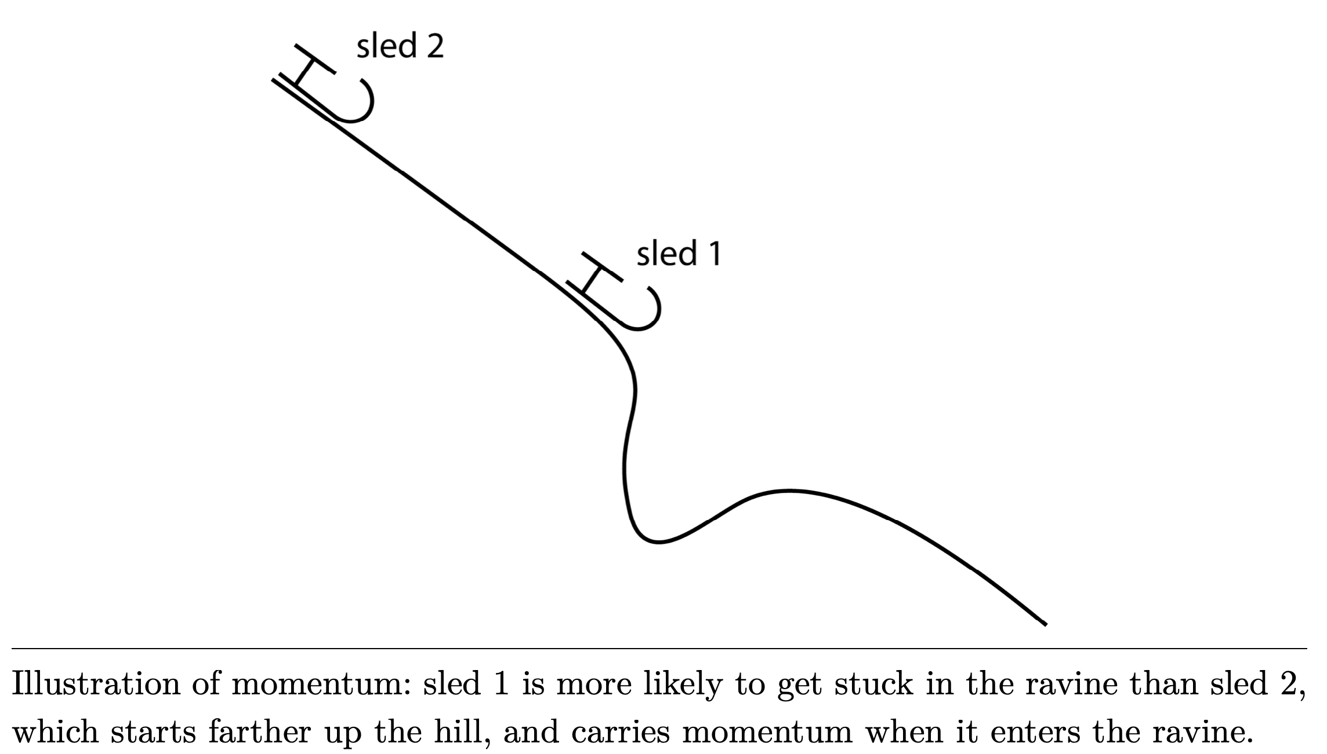
Momentum intuition

Slide 17
Momentum intuition

Slide 19
At each step, the updates start at 0 (no momentum!)

Slide 20
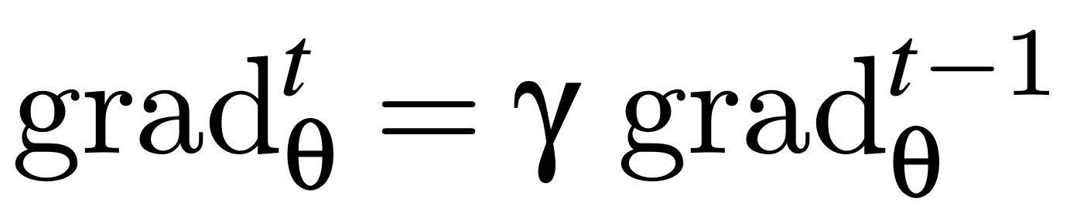
Keep some of the momentum from the previous gradient

Slide 21
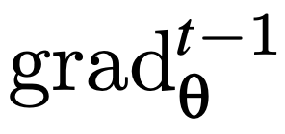
Nesterov momentum: subtract a fraction of from each parameter in θ when computing C_{i}. This allows the algorithm to peak one step into the future.

Slide 22
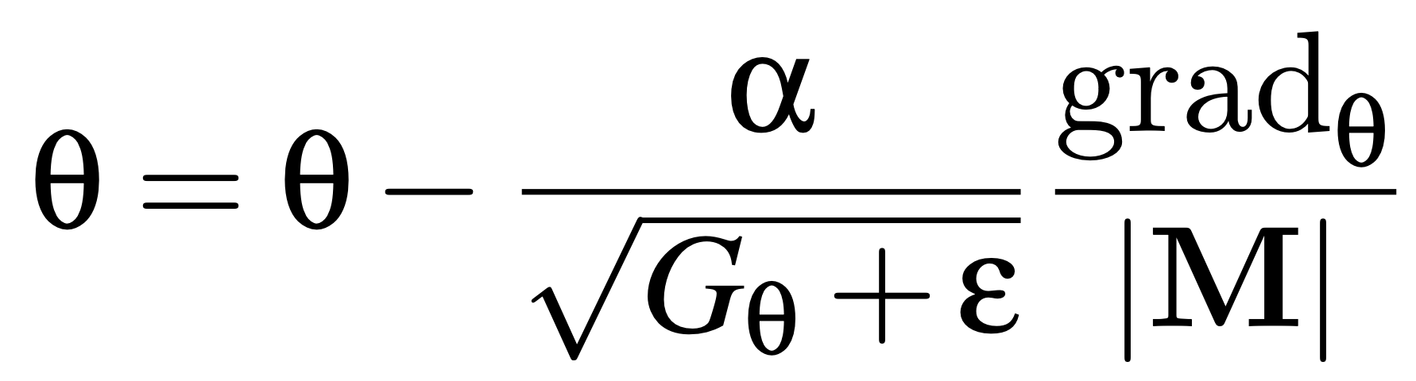
Adaptive learning rate

Slide 23
Adaptive learning rate
Sum of the squares of the gradients observed for this parameter until the current mini-batch

Slide 24
Adaptive learning rate
Different learning rates for different features
Learning rate larger in the beginning, smaller later
Frequent features will get smaller updates (avoids the “rich get richer” problem)

Slide 25
Other optimizers (1/2)
Adagrad
Nesterov momentum + adaptive learning rate
AdaDelta and RMSProp
Address the problem that AdaGrad’s learning rates are continuously diminishing
Solutions:
G iterates only over the most recent gradients
Decaying average: smaller weights for older gradients

Slide 26
Other optimizers (2/2)
Adaptive Momentum Estimation (Adam)
Builds on top of AdaDelta
Applies the same decaying average idea (from the computation of G) to the gradient values in the parameter updates

Slide 27
Adam: decaying average in gradient updates
NOTE: fudgy math here!
Instead of using the average gradient computed for this mini-batch, Adam uses a decaying average of the current and previous gradient.

Slide 28
Other activation functions

Slide 29
Vanishing gradient problem
The sigmoid is prone to the vanishing gradient problem because its derivative may be very small.
Other activation functions are more robust
Hyperbolic tangent (tanh)
Rectified Linear Unit (ReLU)
Exponential Linear Unit (ELU)
Gaussian Error Linear Unit (GELU)

Slide 30
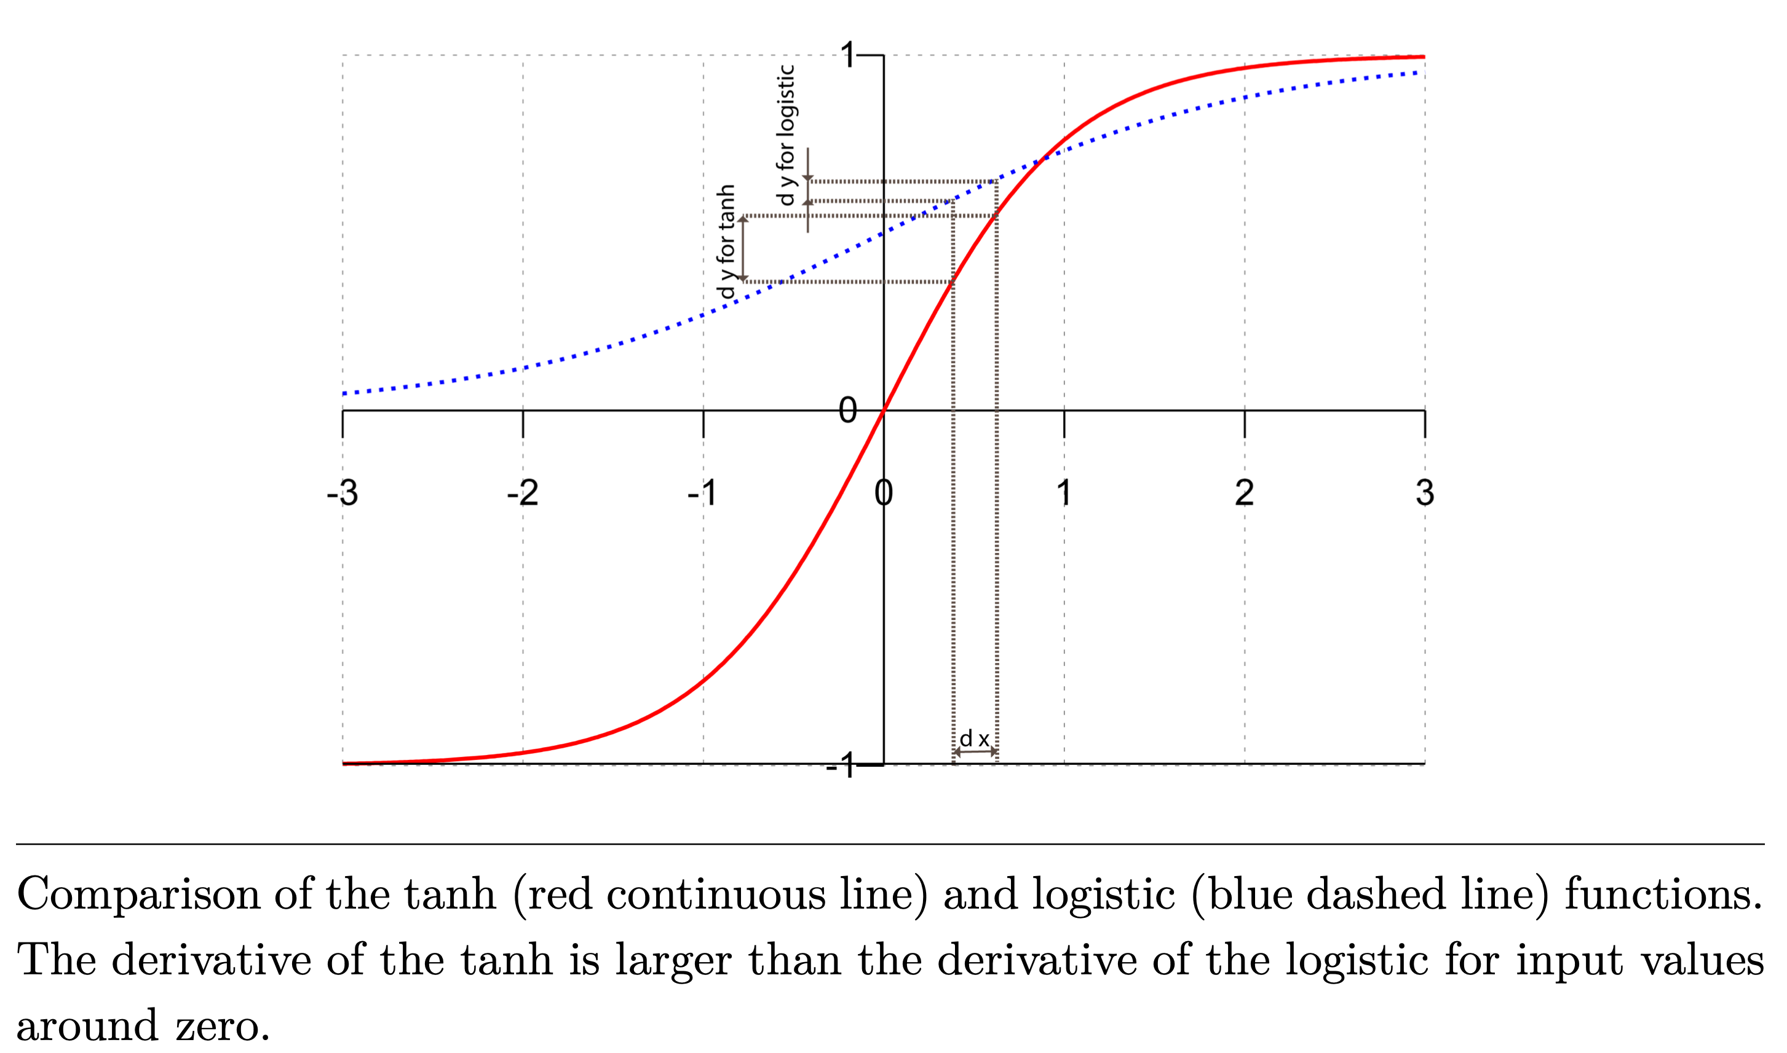
Sigmoid vs. tanh

Slide 31
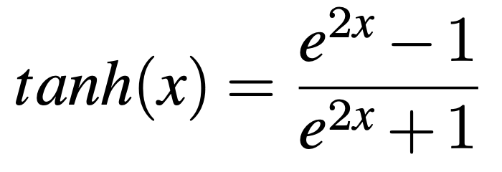
Tanh

Slide 32
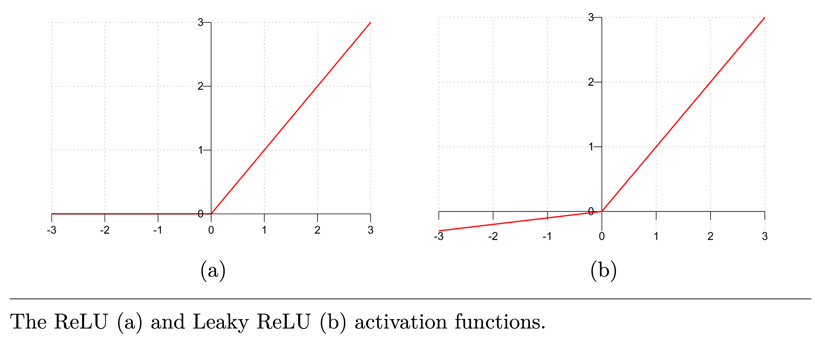
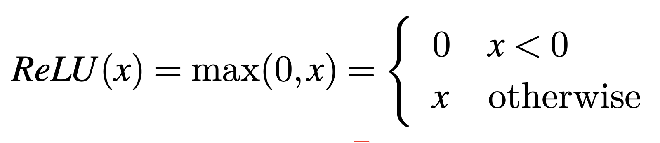
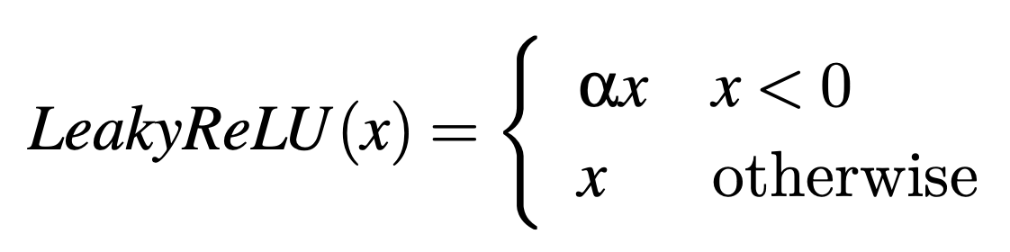
ReLU

Slide 33
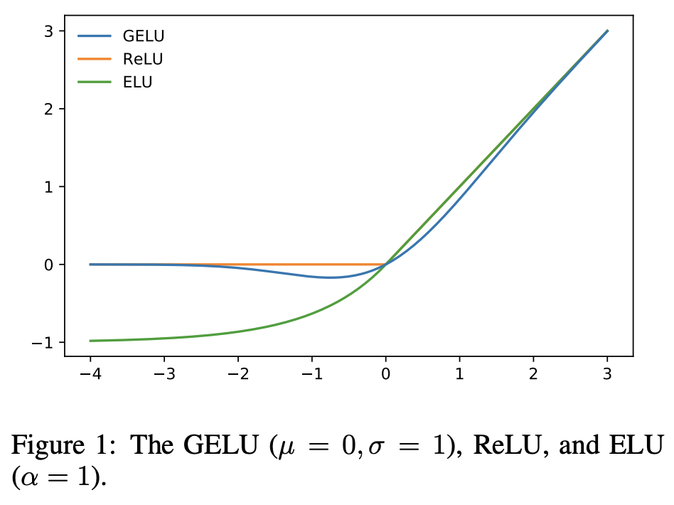
GELU
GELU and ELU allow negative values and are differentiable:
https://paperswithcode.com/method/gelu

Slide 34
Cost functions

Slide 35
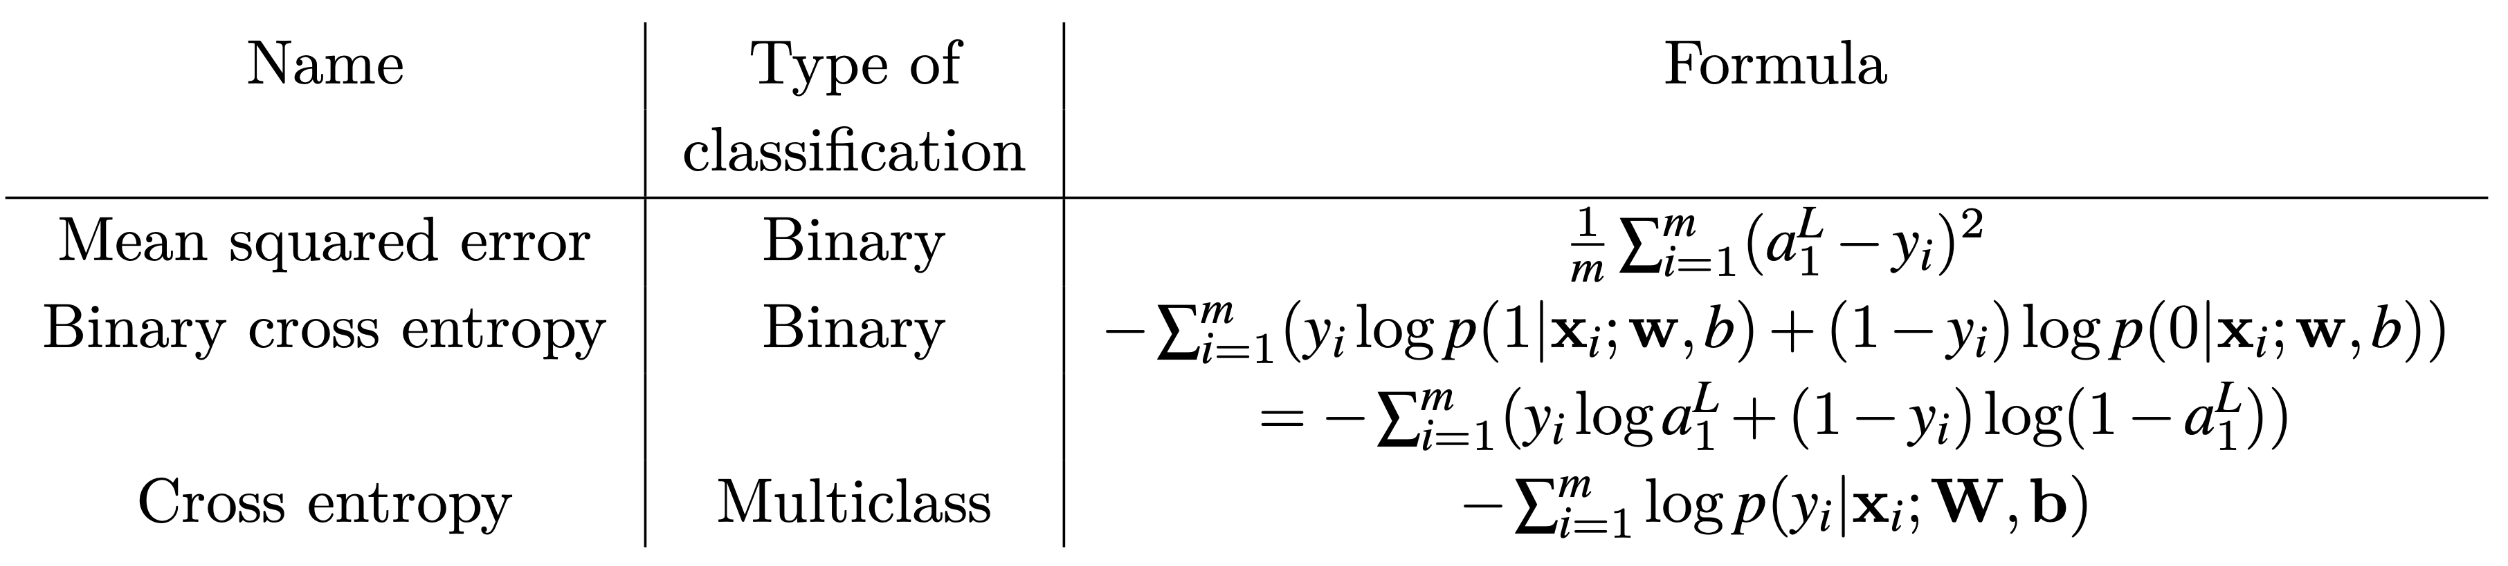
Three common cost functions
MSE is the simplest to implement, but it may lead to learning slowdown because its derivative is proportional to the derivative of the activation function.

Slide 36
regularization

Slide 37
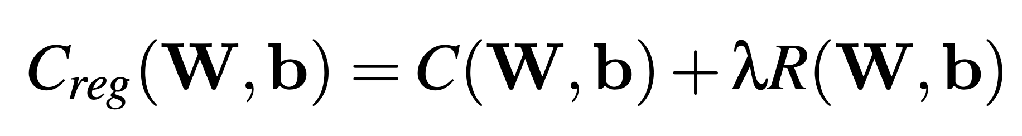
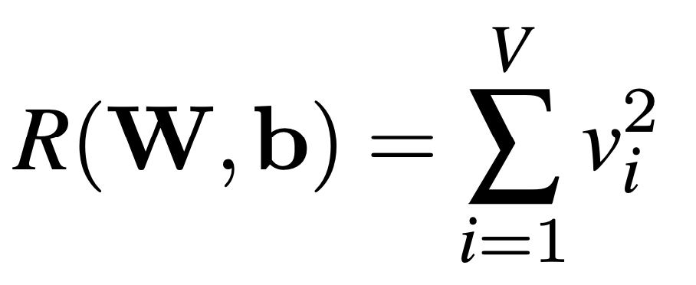

Regularization = “Tug of war”
Minimizing C_{reg} has the effect of:
Maximizing some weights due to C
Minimizing all weights due to R
Insignificant weights are pushed to 0

Slide 38
dropout

Slide 39
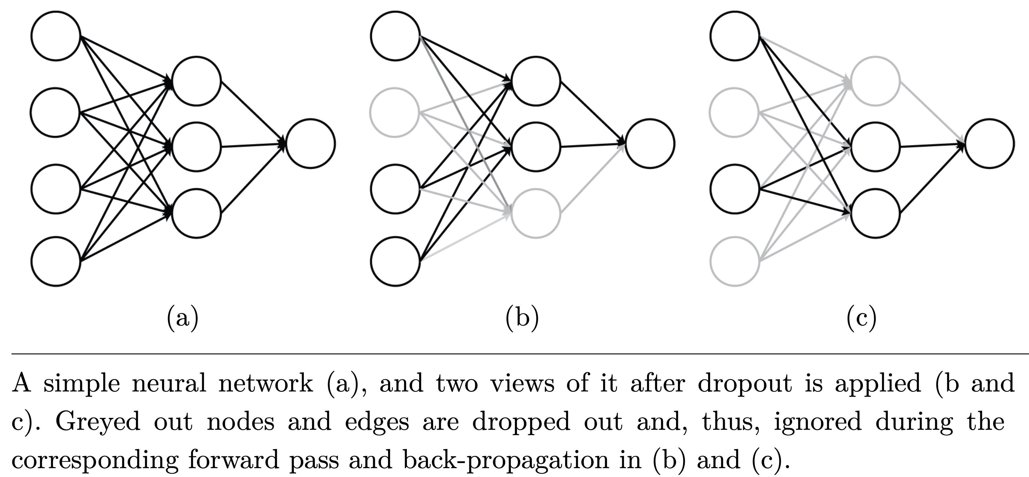
Dropout

Slide 40
Dropout is applied only during training
Because dropout is applied only during training, we need to scale the network’s output values so training/testing behaviors are comparable
Two options:
Testing: scale down the outputs during testing, or
Training: scale up the outputs during training

Slide 41
Parameter initialization and normalization

Slide 42
Where we start matters
Gradient descent is a greedy algorithm that finds a local minimum
Thus, where we start matters!

Slide 43
Rules of thumb for initialization
The parameters should be initialized randomly.
The initial parameter values should not be too small.
On the other hand, parameter values should not be too large either.
The distribution of parameter values should be centered around zero.

Slide 44
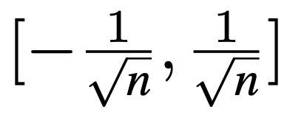
Glorot (or Xavier) initialization
Neuron edge weights initialized to from the uniform distribution , where n is the number of input edges.

Slide 45
Rules of thumb for activations
The output values should not be too small.
On the other hand, output values should not be too large either.
The distribution of output values should be centered around zero.

Slide 46
Normalization of output values
Batch normalization
Compute mean and standard deviation for each weight
Center activations around 0 by subtracting the mean
Scale them to a standard deviation of 1 by dividing the above values by the standard deviation

Slide 47
Layer normalization
Sometimes there is no batch.
Normalizes all activations in the same network layer.

Slide 48
Take away
Mini-batching
Other optimization algorithms
Other activation functions
Cost functions
Regularization
Dropout
Parameter initialization and normalization

