Slide 1
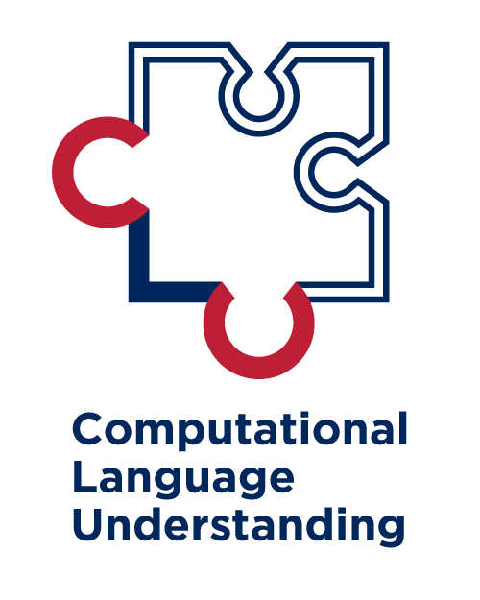

Deep Learning for Natural Language Processing DLNLP 4: PyTorch Notes
Mihai Surdeanu and Marco A. Valenzuela-Escárcega

Slide 2
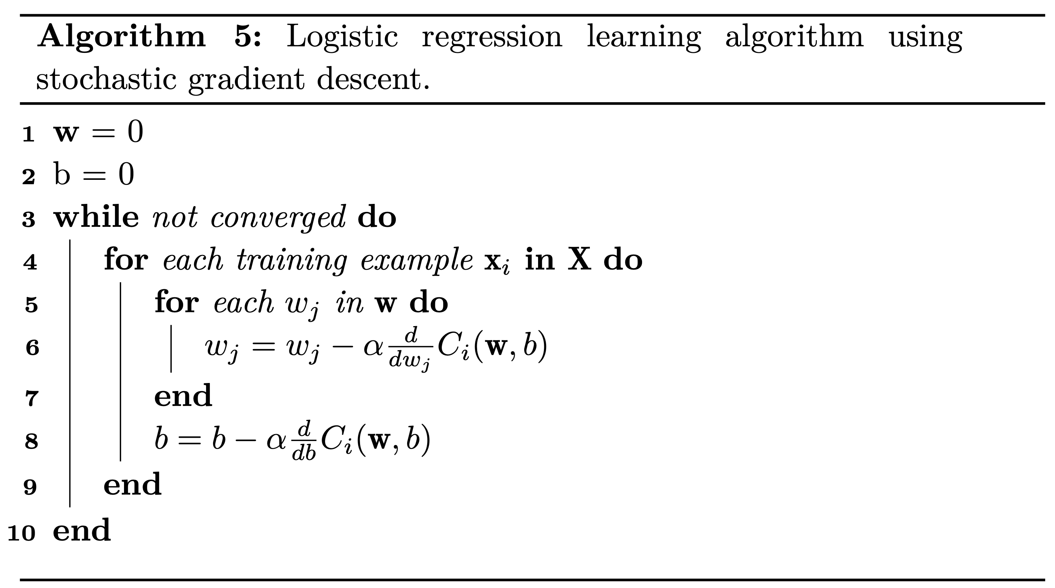
What does PyTorch do?

Slide 3
What does PyTorch do?
Loss functions such as NLLLoss or CrossEntropyLoss compute the loss for one or a small number of examples (a “mini batch”)
model(x) runs the forward pass through the model for the current example (or mini batch). This is necessary for the loss.

Slide 4
What does PyTorch do?
loss.backward() computes the partial derivatives for all parameters in your model.
Where are these parameters stored?
What is a computational graph?
What is a dynamic computational graph?

Slide 5
What does PyTorch do?
optimizer.step() updates all model parameters

Slide 6
What does PyTorch do?
model.zero_grad() resets the gradients for all model parameters

Slide 7
Other notes
All the tensors that PyTorch sees must be PyTorch tensors NOT NumPy ones!
This allows for the computation and the storage of the partial derivates
This allows for the construction of computational graphs
They play well with GPUs
More on this soon

