Slide 1


Deep Learning for Natural Language Processing DLNLP 10: Recurrent Neural Networks
Mihai Surdeanu and Marco A. Valenzuela-Escárcega

Slide 2
Overview
Vanilla recurrent neural networks (RNN)
Deep RNNs
Long short-term memory networks (LSTM)
Conditional random fields
Drawbacks

Slide 3
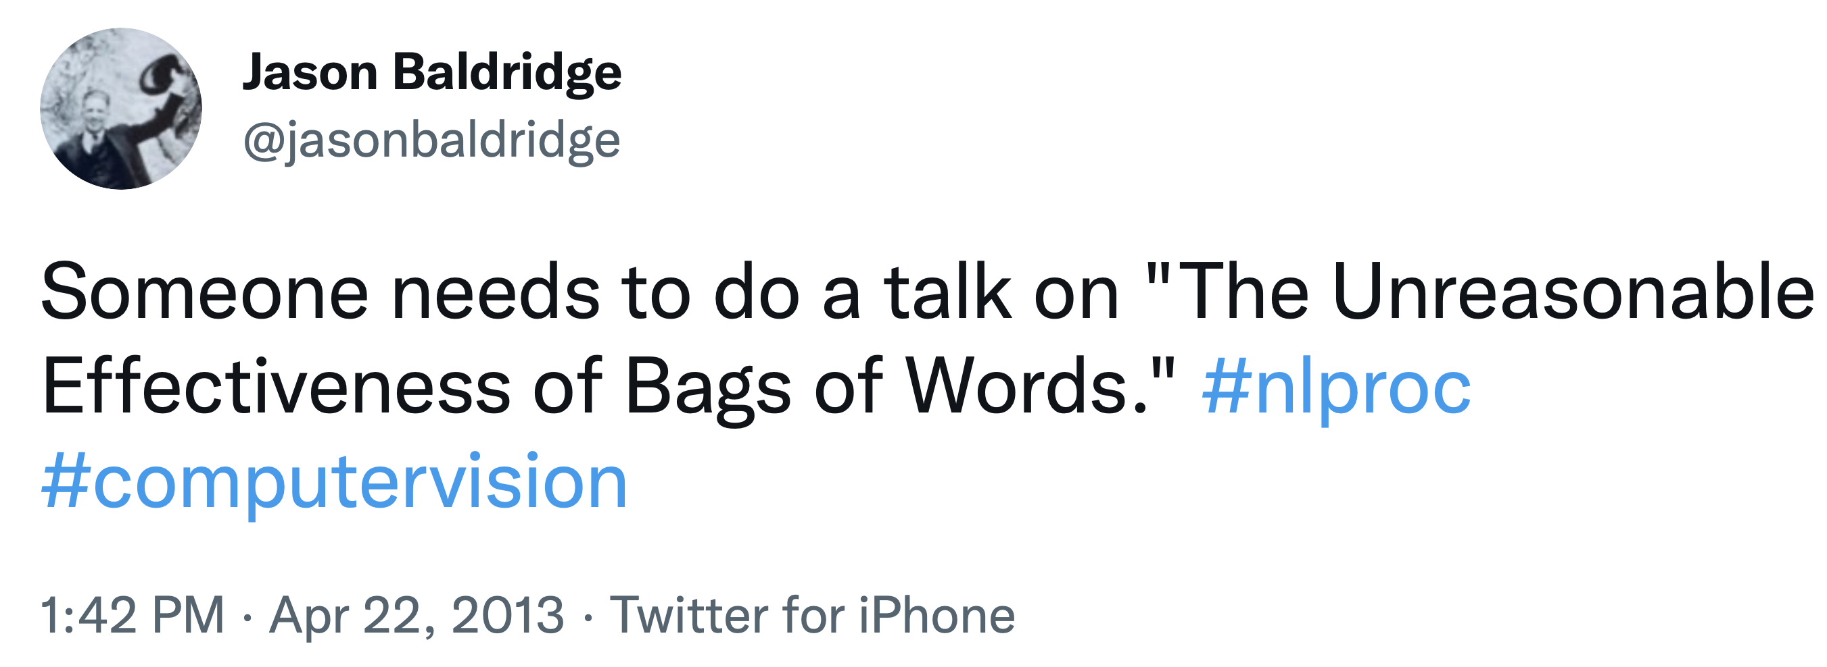
Bag-of-words methods
Up to this point, we have only discussed neural approaches for text classification (e.g., review and news classification) that handle the text as a bag of words.
These methods are very effective!

Slide 4
Word order is important
For many NLP tasks, we need to capture the word-order information more explicitly.
What are examples of such applications?
In this chapter, we will discuss one direction for explicitly modeling word order: recurrent neural networks (RNN).
Starting with chapter 14, we will discuss transformer networks.

Slide 5
Vanilla rnns

Slide 6
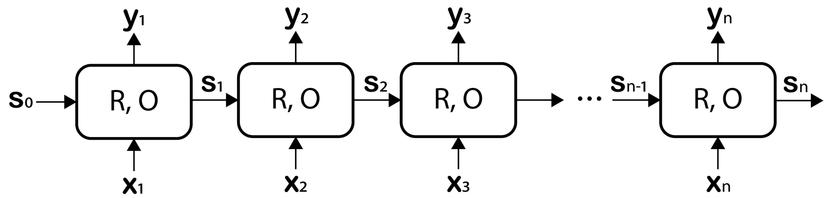
“Vanilla” RNN
R – computes s
O – computes y
Contextualized output embeddings that are based on the sequence up to this point
Static embeddings (e.g., word2vec)
State vectors that capture the information that has “flown” through the sequence until this cell.

Slide 7
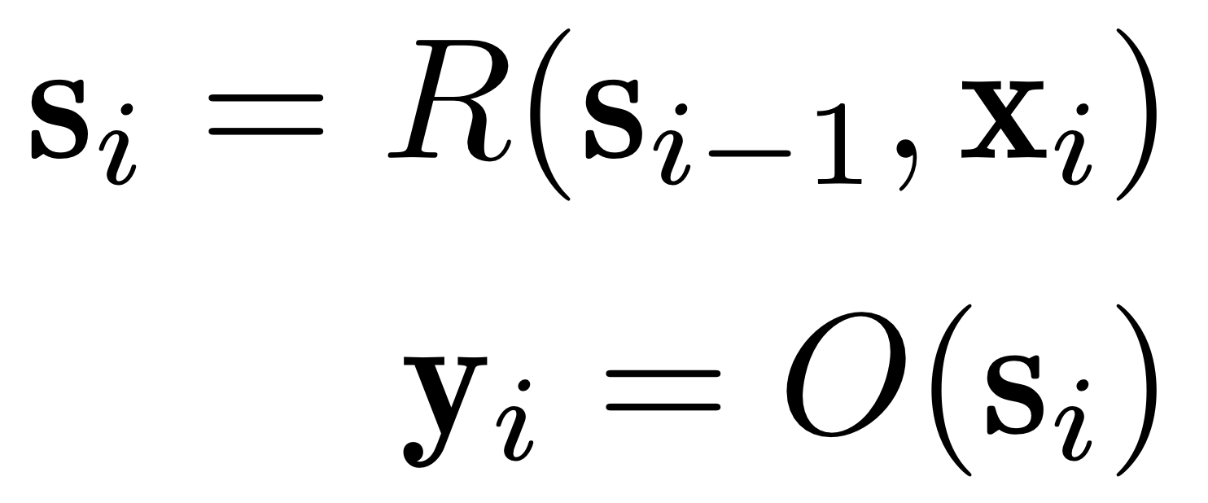
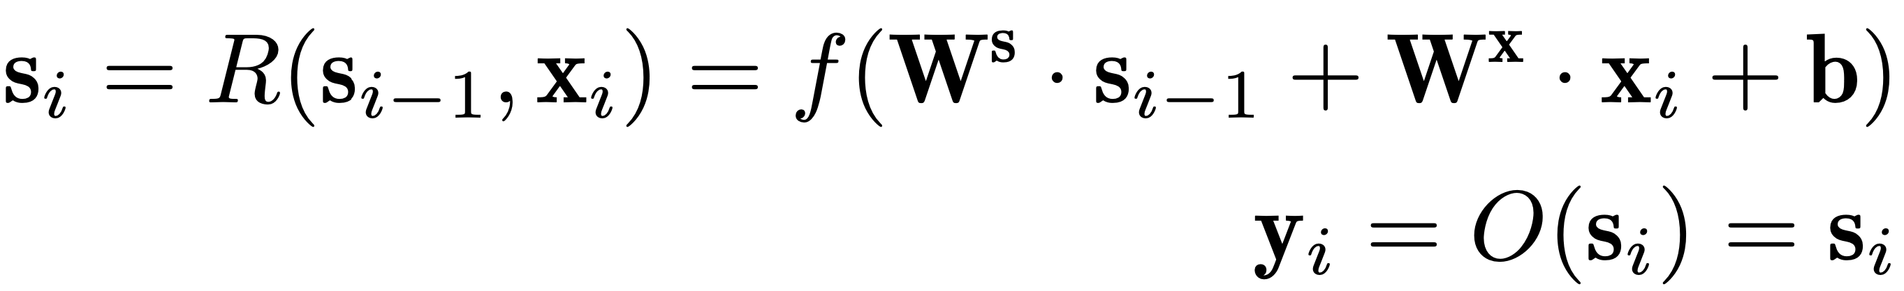
Computing s_{i} and y_{i}
The RNN parameters, shared between all cells!

Slide 8
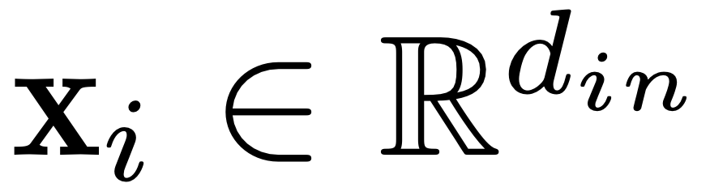
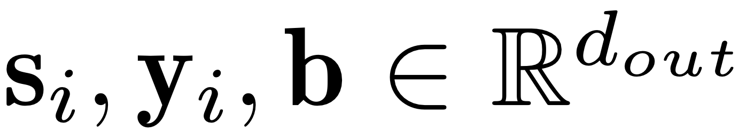
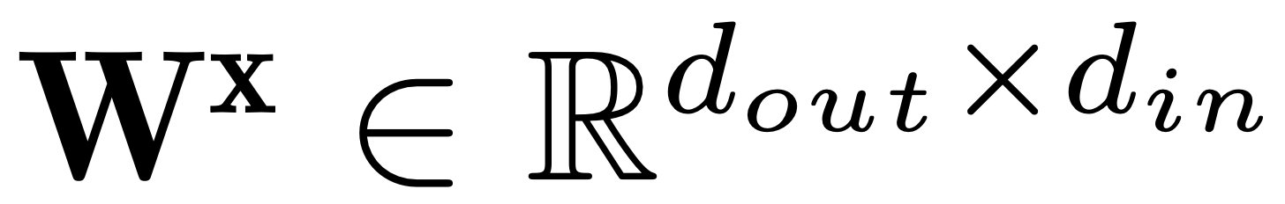

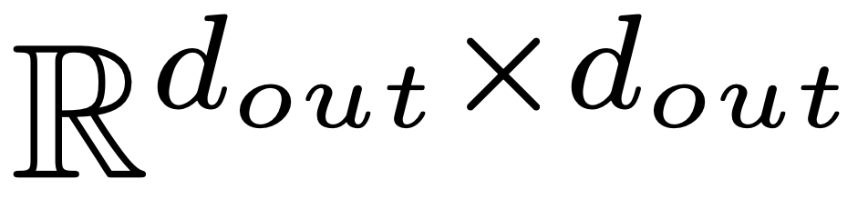
Dimensions of inputs, outputs, and parameters

Slide 9
Training
“Backpropagation through time”
(it is just backpropagation)

Slide 10
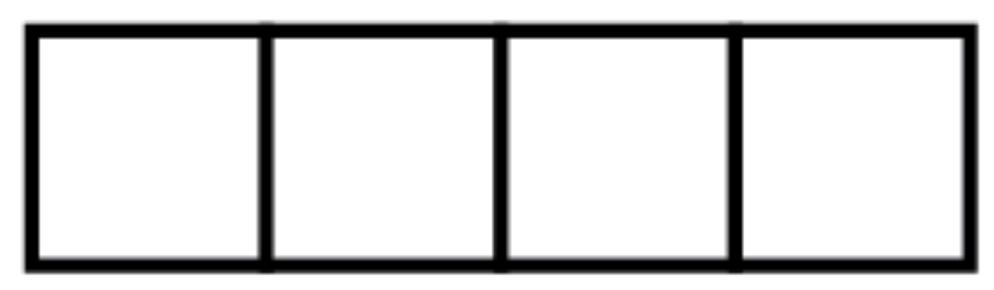
Training: Acceptor RNN
One output neuron per class to learn for the whole text, e.g., AG News topic classification

Slide 11
Training: Transducer RNN
One output neuron per class to learn for each word, e.g., part-of-speech tag classification

Slide 12
Training: Encoder-decoder RNN
Input text
Output text

Slide 13
deep rnns

Slide 14
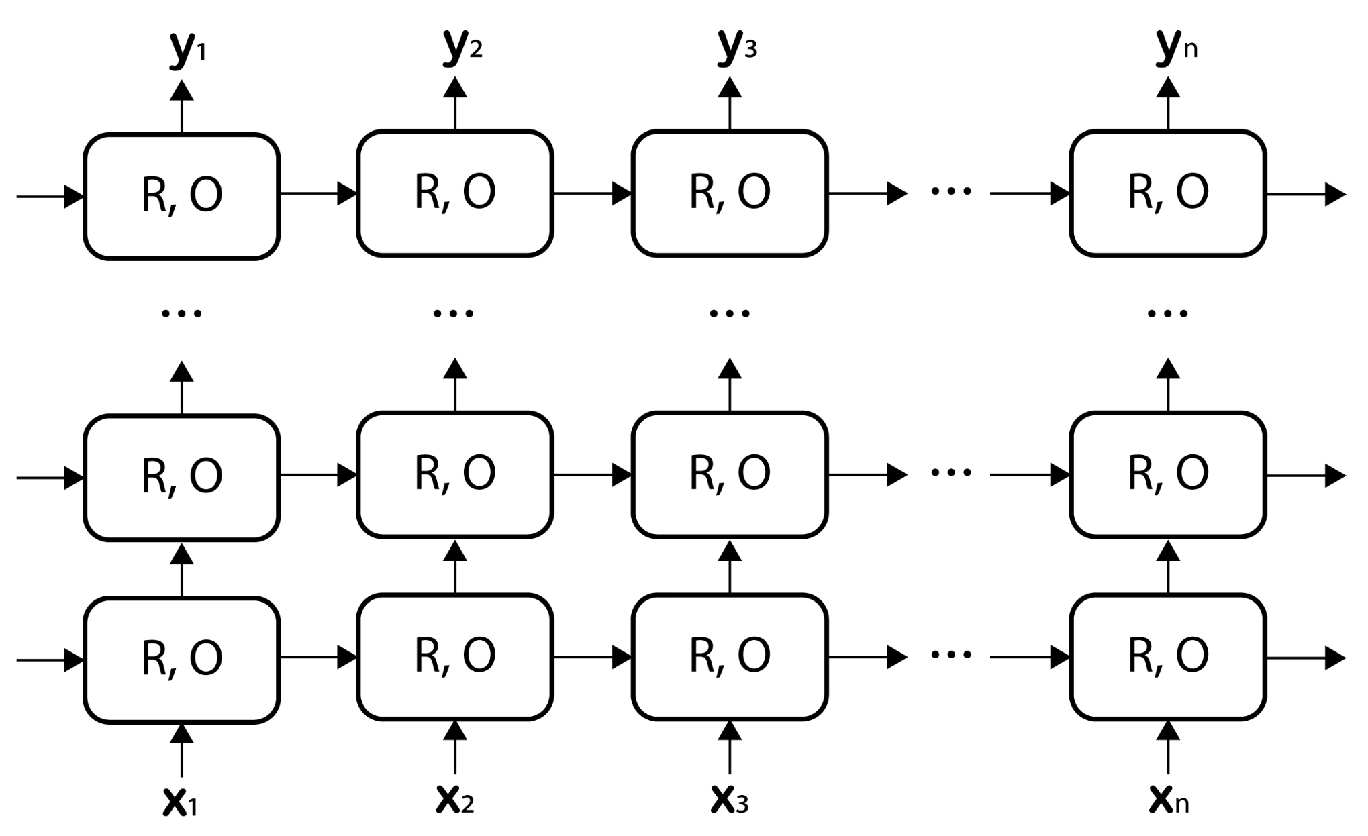
Deep/Stacked RNN
The output of each layer becomes the input to the next layer!

Slide 15
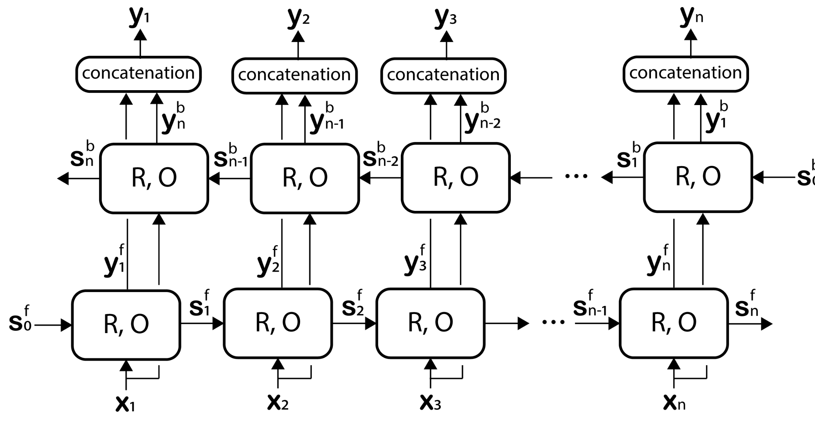
Bidirectional RNN

Slide 16
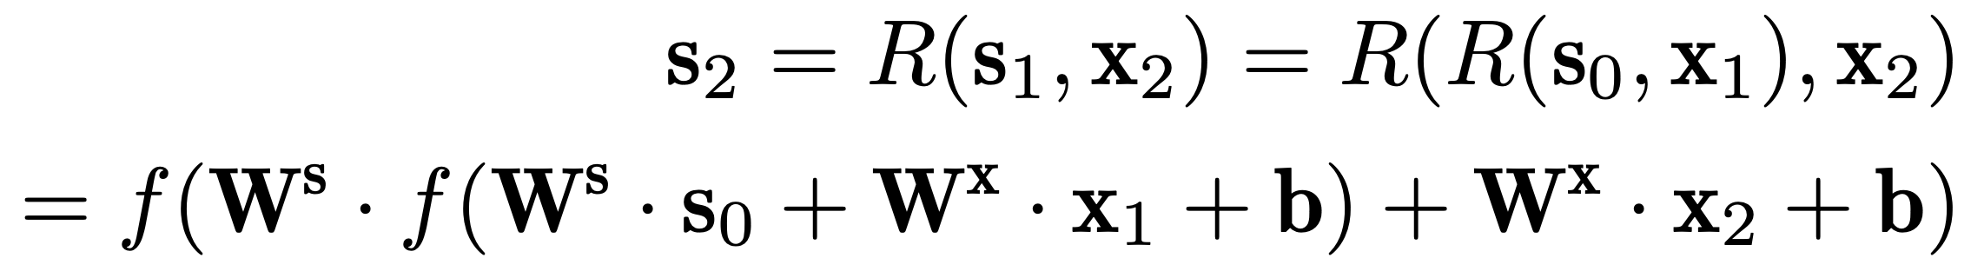
The Problem with Simple RNNs: Vanishing Gradient
Vanilla RNNs suffer from a bad case of vanishing gradient due to the sequential cells
Consider an RNN with two cells:
Multiplying multiple activation functions (f) will degenerate to 0!
Even unbounded activations tend to be normalized to [-1, 1]…

Slide 17
Long short-memory networks

Slide 18
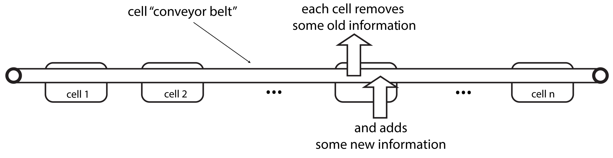
Key intuition
Replace the multiplicative architecture of the vanilla RNN with an additive one that is less prone to the vanishing gradient problem:

Slide 19
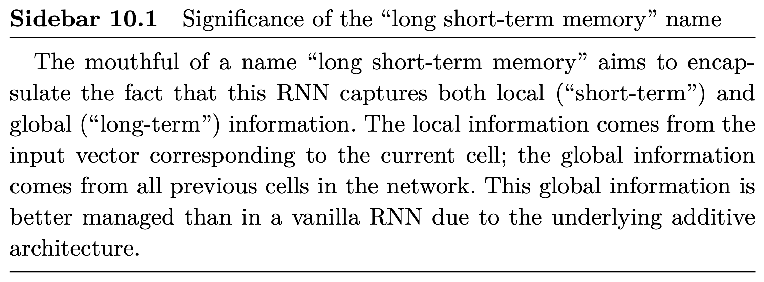
Why the LSTM name

Slide 20
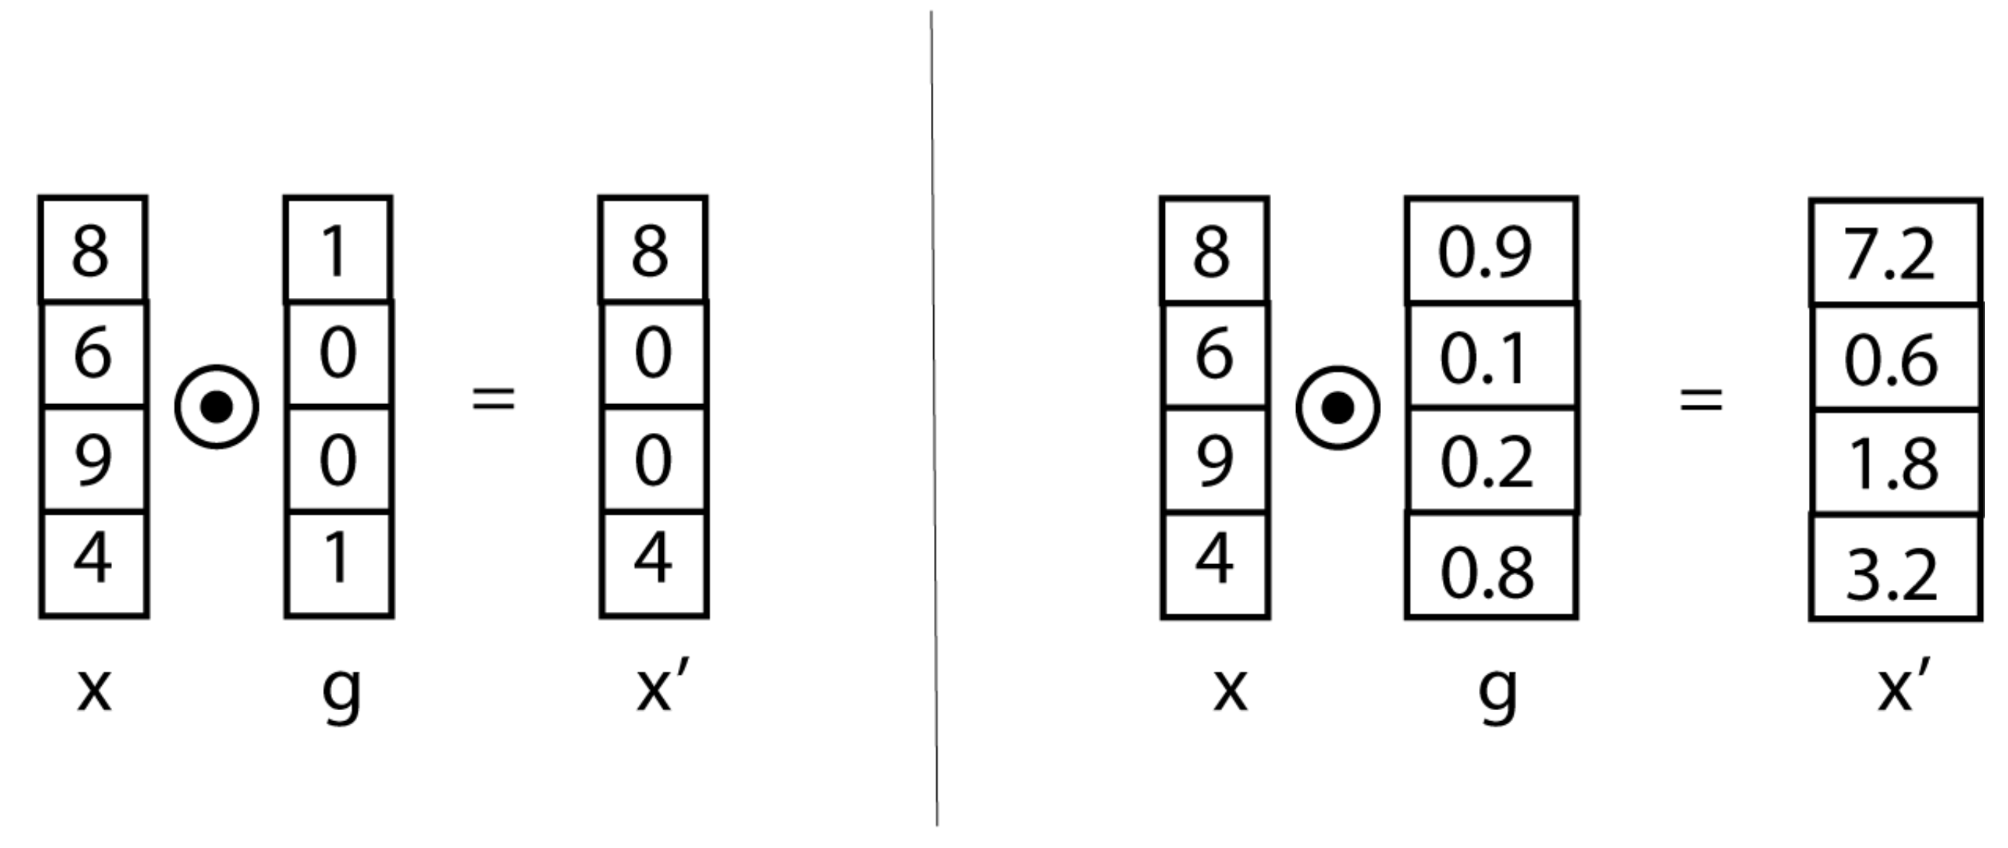
LSTM building block: the neural gate
Binary gate
Gate with real-valued elements

Slide 21
LSTM uses 3 gates
Forget gate (f) – controls how much of the content on the conveyor belt to preserve in the current cell,
Input gate (i) – decides how much of the input local to the current cell to add to the conveyor belt, and
Output gate (o) – controls how much of the conveyor belt vector to include in the hidden state vector for each cell.

Slide 22
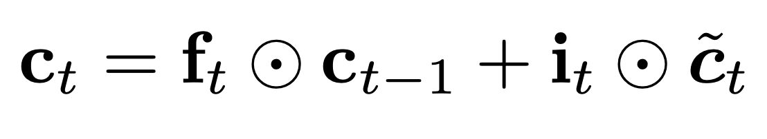
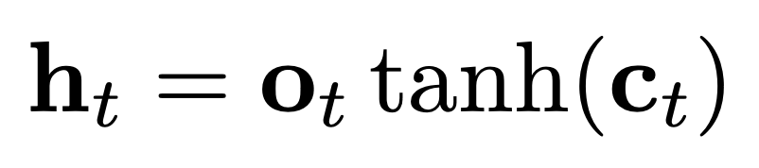
LSTM equations (1/3)
Computing the information on the “conveyor belt” (similar to s_{i} in the vanilla RNN):
Computing the output embedding for a word (similar to y_{i} in the vanilla RNN):

Slide 23
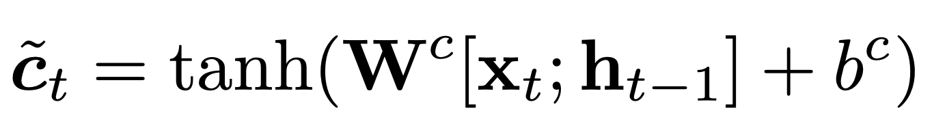
LSTM equations (2/3)
Computing the local contribution of each cell to the conveyor belt:

Slide 24
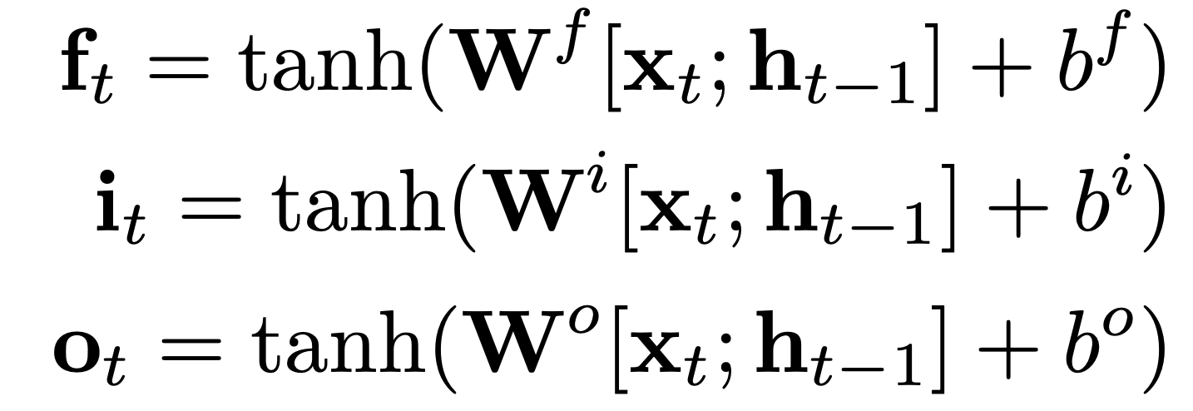
LSTM equations (3/3)
Computing the 3 gates:

Slide 25
LSTM learnable parameters
W^{c}, W^{f}, W^{i}, and Wº (and their corresponding bias terms)
These are shared between all cells!
Optionally: the input embedding vectors (x^{t})
Similar to what we saw in chapter 9

Slide 26
Vanishing vs. exploding gradients
Additive architectures such as the LSTM mitigate the vanishing gradient problem
But they suffer from the exploding gradient problem, i.e., when gradient values become very large in magnitude. Why?
Exploding gradients is a serious problem because it leads to unstable training.
Solutions:
Everything we discussed in chapter 6, i.e., small learning rates, Xavier initialization, output normalization
In addition: gradient clipping.

Slide 27
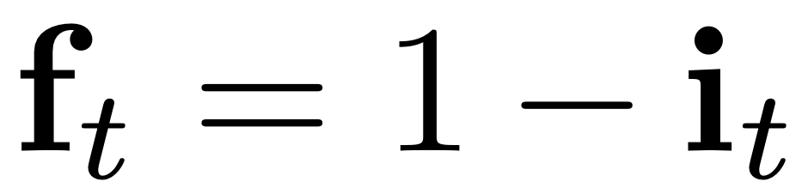
LSTM variant: Gated Recurrent Unit (GRU)
Intuition: we introduce as much new information on the conveyor belt as what we forget from the previous cell:
Advantages:
Intuitive
Fewer parameters to learn (we got rid of W^{f})

Slide 28
LSTM advantages/disadvantages
Advantages
Additive recurrent architectures are (more) resistant to vanishing gradient
Fundamental for many applications that depend on sequences
Disadvantages
“Fuzzy far away” (Khandelwal et al., 2018)
Hard to parallelize
Exploding gradient
More explanations and visualizations: https://colah.github.io/posts/2015-08-Understanding-LSTMs/

Slide 29
Take away
Vanilla recurrent neural networks (RNN)
Deep RNNs
Long short-term memory networks (LSTM)
Conditional random fields
Drawbacks

