Slide 1


Deep Learning for Natural Language Processing DLNLP 3: Logistic Regression
Mihai Surdeanu and Marco A. Valenzuela-Escárcega

Slide 2
Overview
Logistic regression (LR) decision function
Learning algorithm for LR
LR cost function
Gradient descent
Deriving the LR update rule
From binary to multiclass classification
Drawbacks

Slide 3
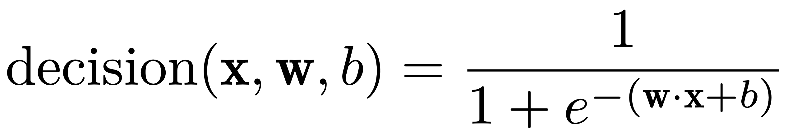
First change from perceptron: decision function
Logistic function, part of the sigmoid function family

Slide 4
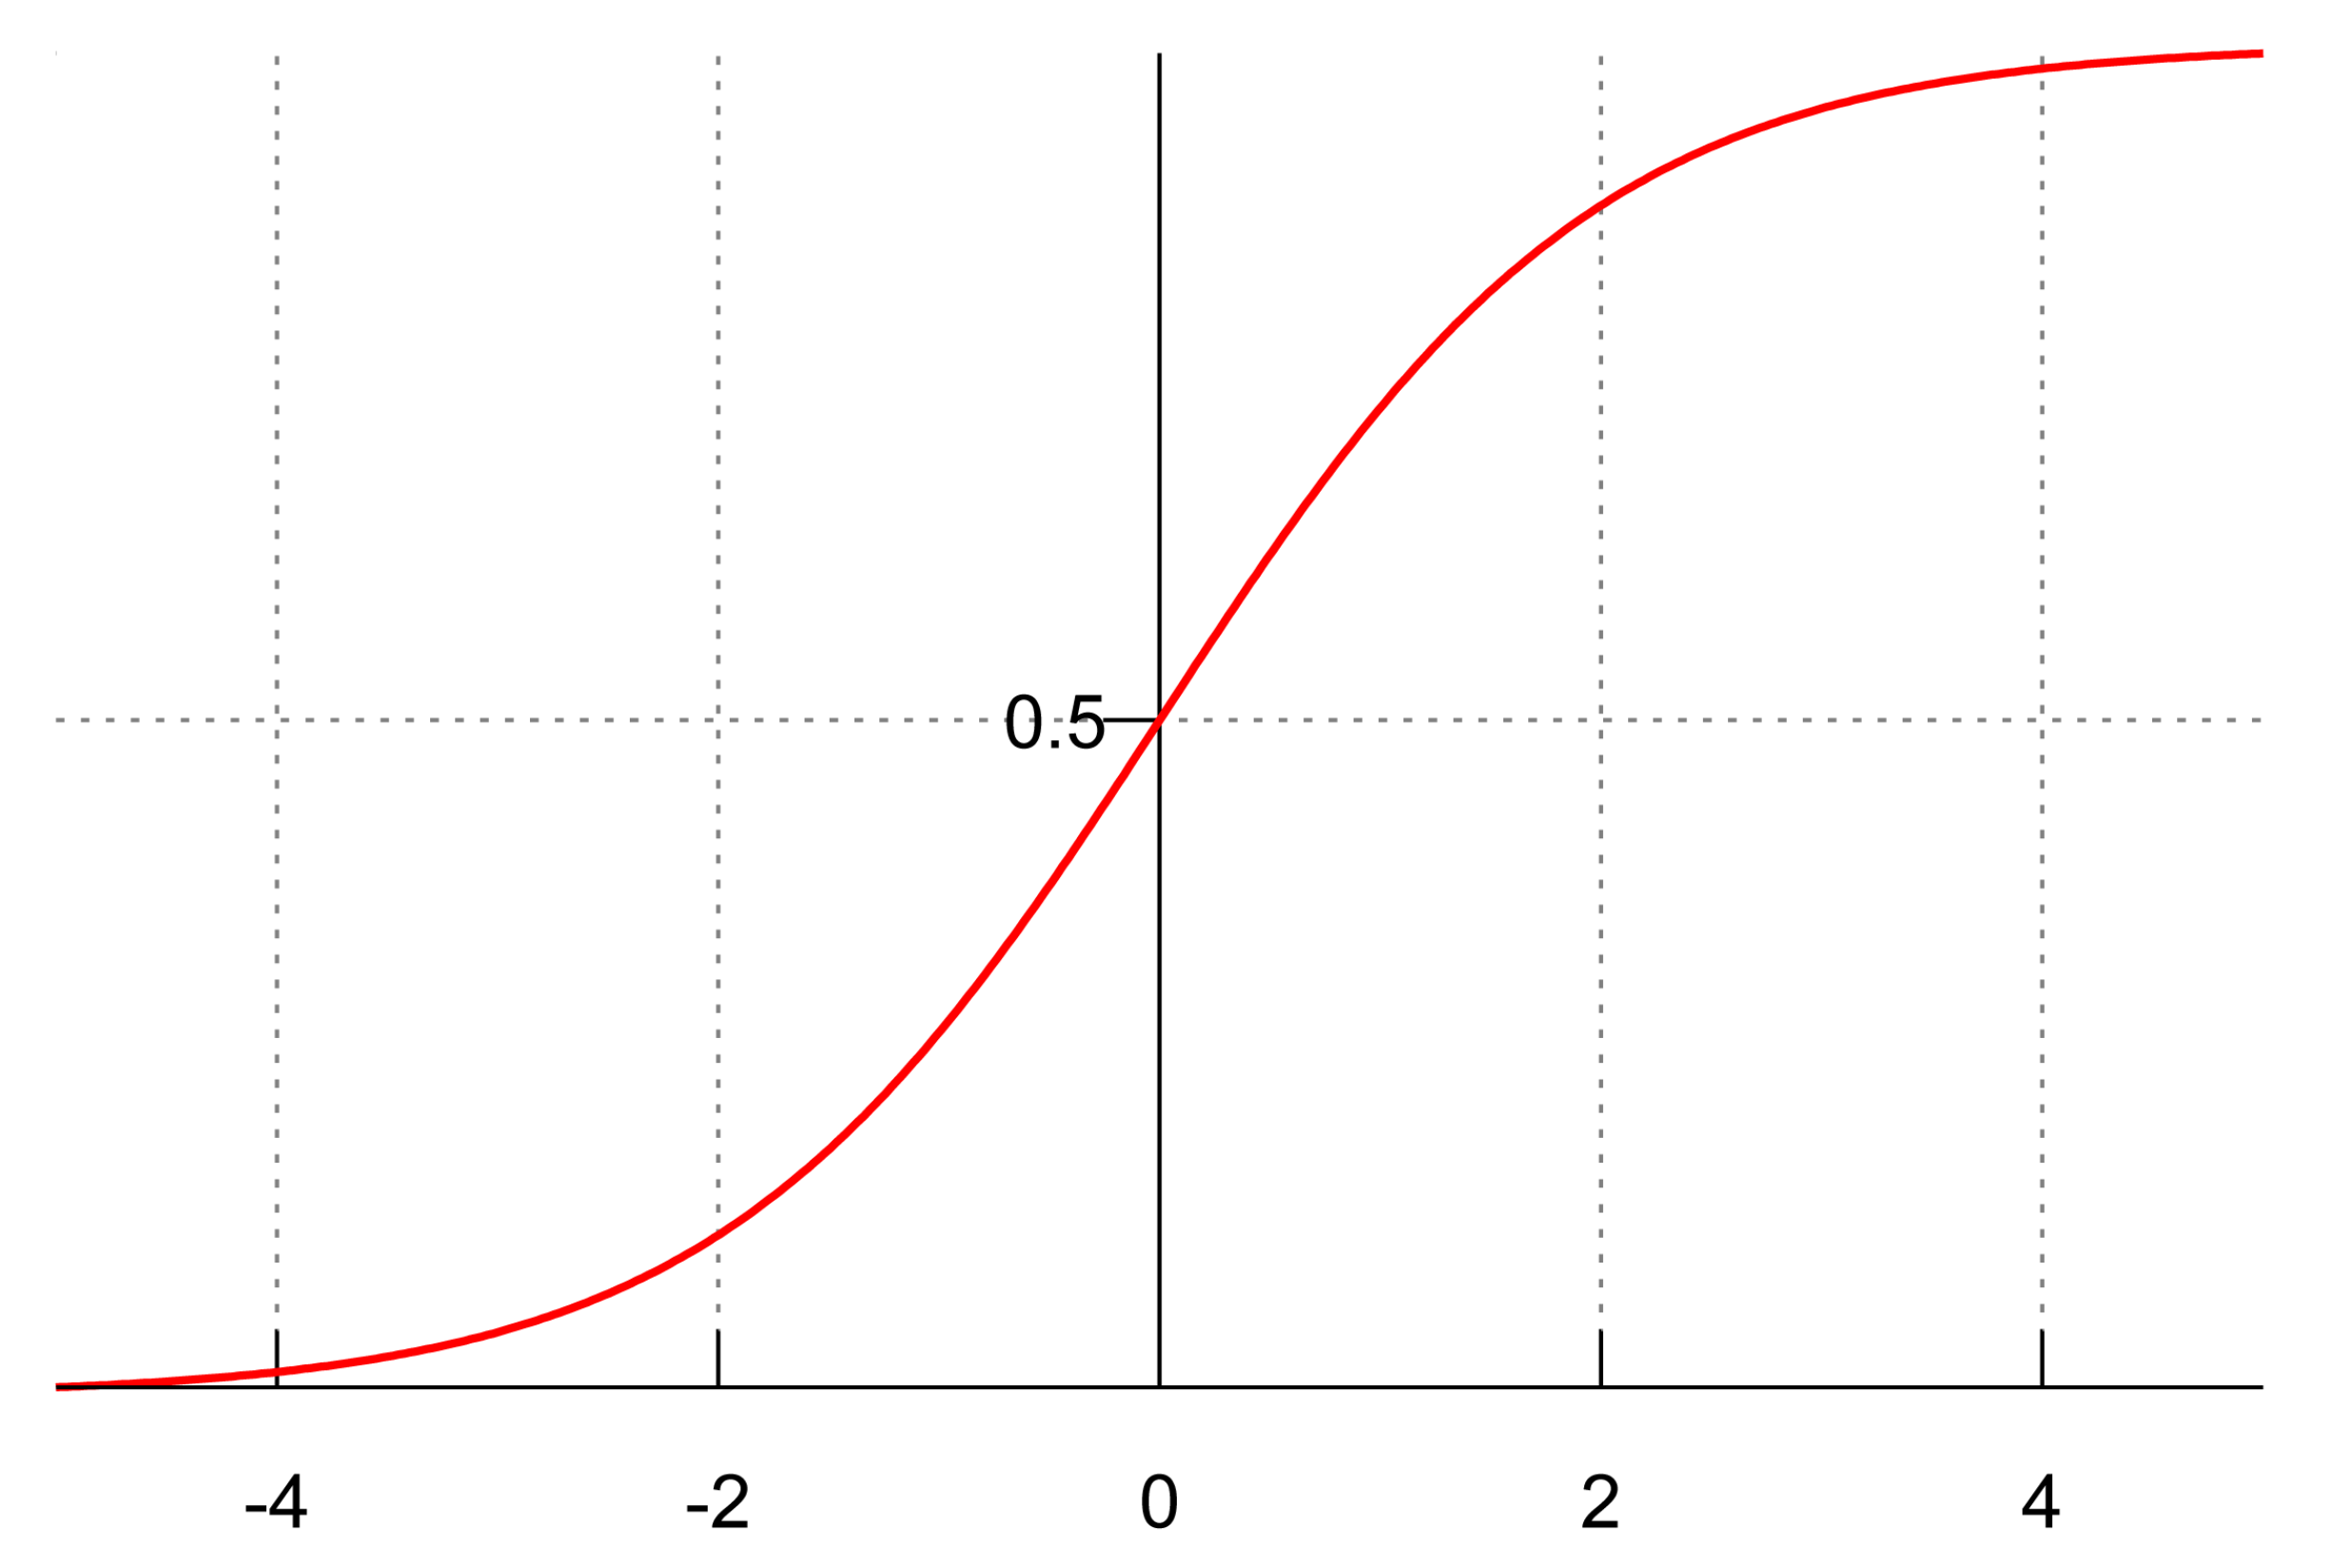
Logistic function

Slide 5
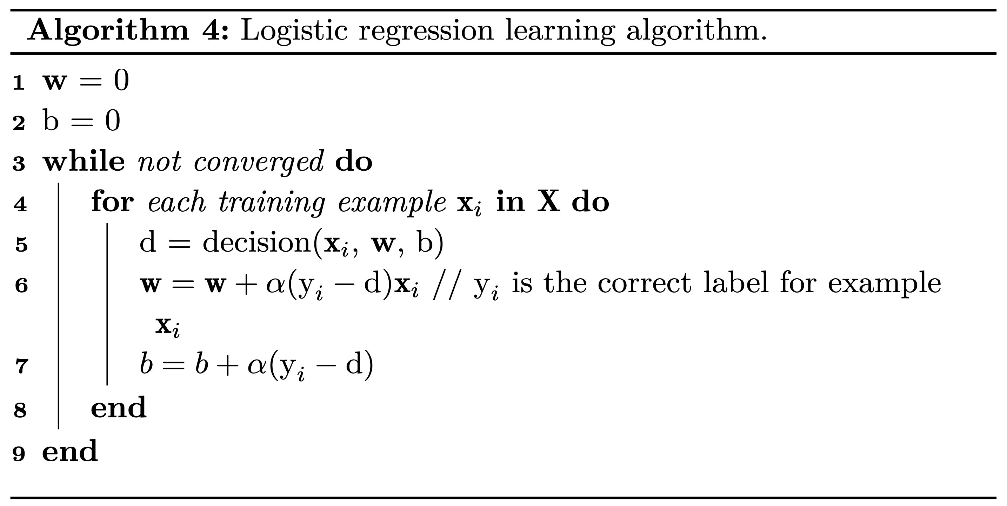
Peeking ahead: the LR training algorithm

Slide 6
Peeking ahead: the LR training algorithm
“Soft” updates: bigger for big mistakes, smaller for small ones

Slide 7
Peeking ahead: the LR learning algorithm
Learning rate: positive value that indicates the magnitude of the update

Slide 8
Deriving the lr learning algorithm (only required for grad students)

Slide 9
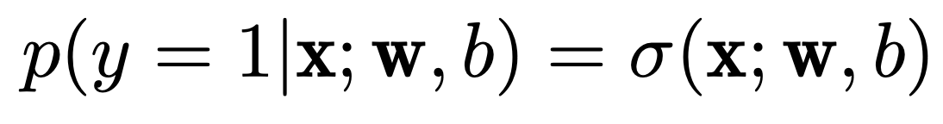
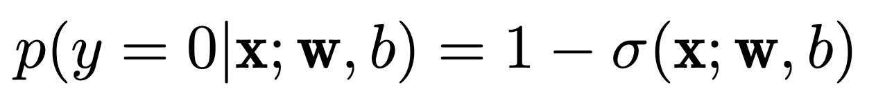
LR decision function = conditional probability
Probability of label 1
Probability of label 0
Probability of any label (syntactic sugar)

Slide 10
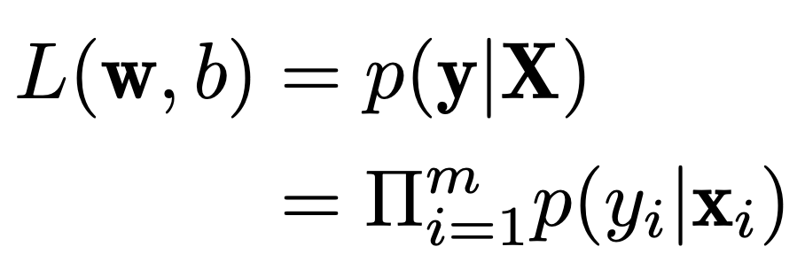
Likelihood of data and cost function
Likelihood of data
(A good learning algorithm will maximize it)

Slide 11
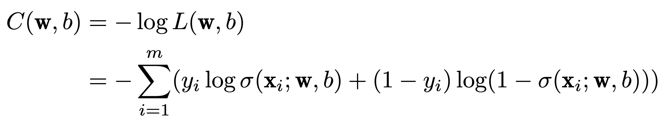
Likelihood of data and cost function
Cost function:
Positive function
Has large values when the model makes big mistakes
Thus, we want to minimize it
Why log?

Slide 12
How to minimize the cost function? Gradient descent to the rescue!
Gradient descent: finds the parameters (e.g., w and b for LR) that minimize a (convex) function by taking small steps towards the minimum
Function slope = derivative of f(x) with respect to x
If negative, the function decreases
If positive, the function increases
If 0, we found a minimum or maximum
Gradient descent takes small steps in the opposite direction indicated by the slope

Slide 13
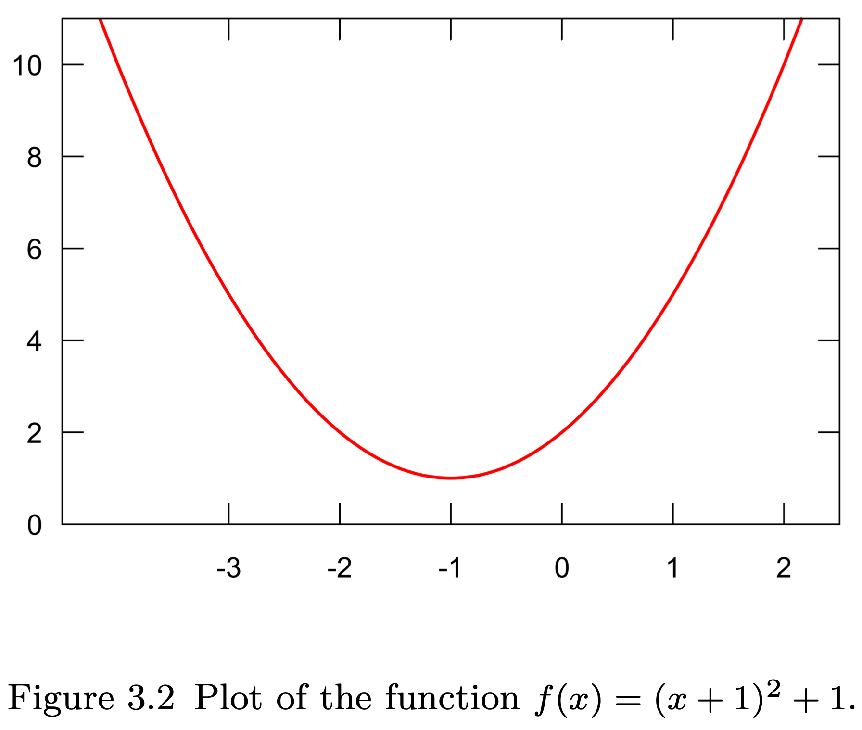
Gradient descent example
What is the derivative of this function?

Slide 14
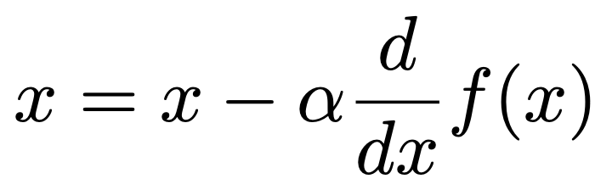
Gradient descent example
We initialize x randomly, and then repeatedly compute until we find the minimum
Steps:
x = -3
x = -3 – 0.1 x 2(-3+1) = -2.6
x = -2.6 – 0.1 x 2(-2.6 + 1) = -2.28
…
x = -1.001
Why do we need the learning rate?

Slide 15
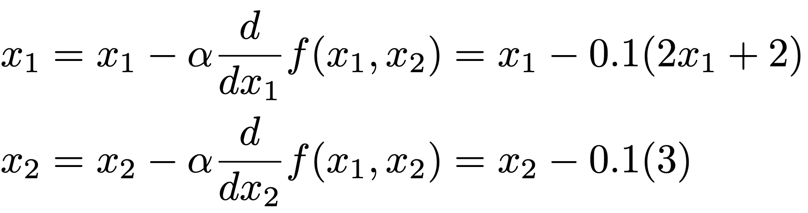
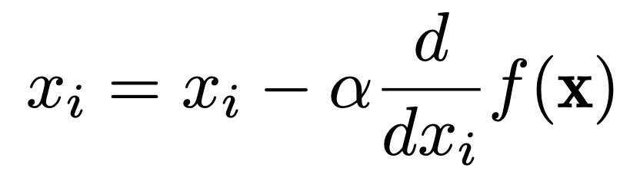
What about functions with multiple parameters?
Example: f(x₁, x₂) = (x₁ + 1)² + 3x₂ + 1
In each iteration:
In general:
Wait… Why not solve the equation where the derivative equals 0, as we were taught in calculus?

Slide 16
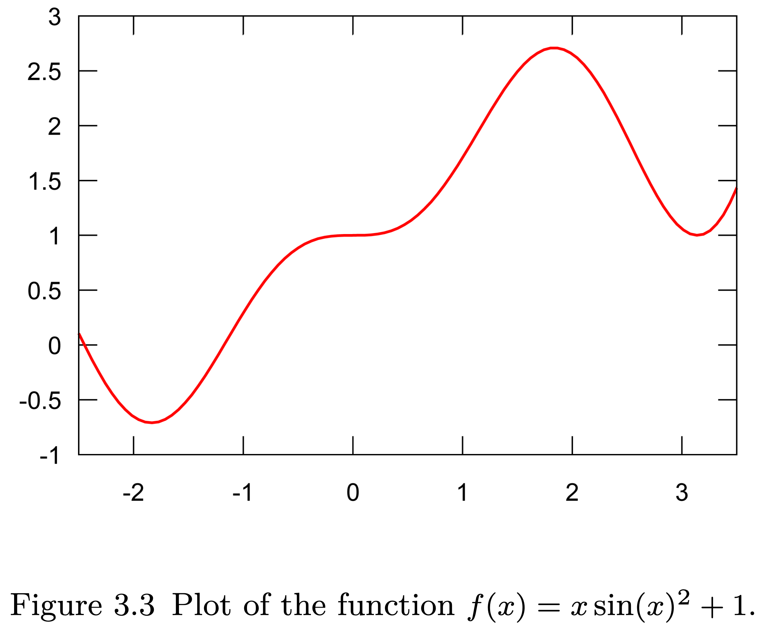
What about non-convex functions?

Slide 17
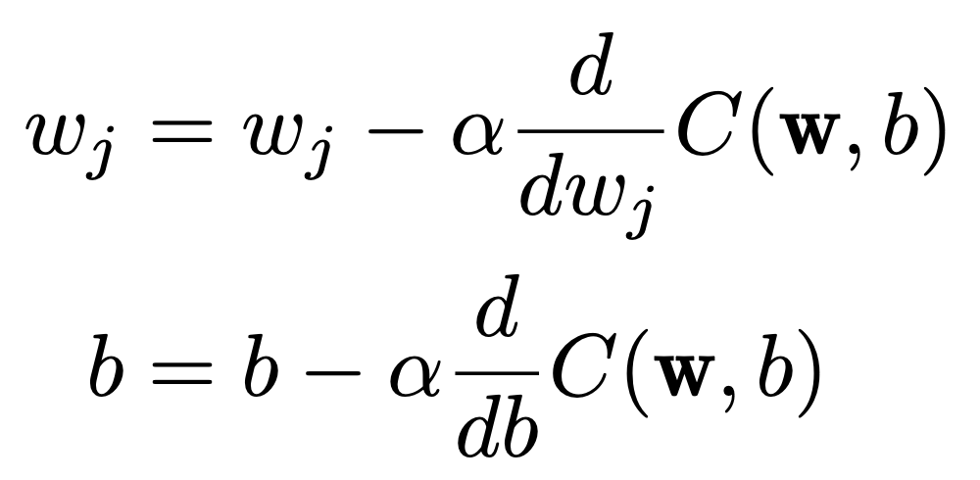
Minimizing the cost function
For all training examples:
For one training example:
Expensive because we need to compute C over all training examples
Stochastic gradient descent → online learning

Slide 18
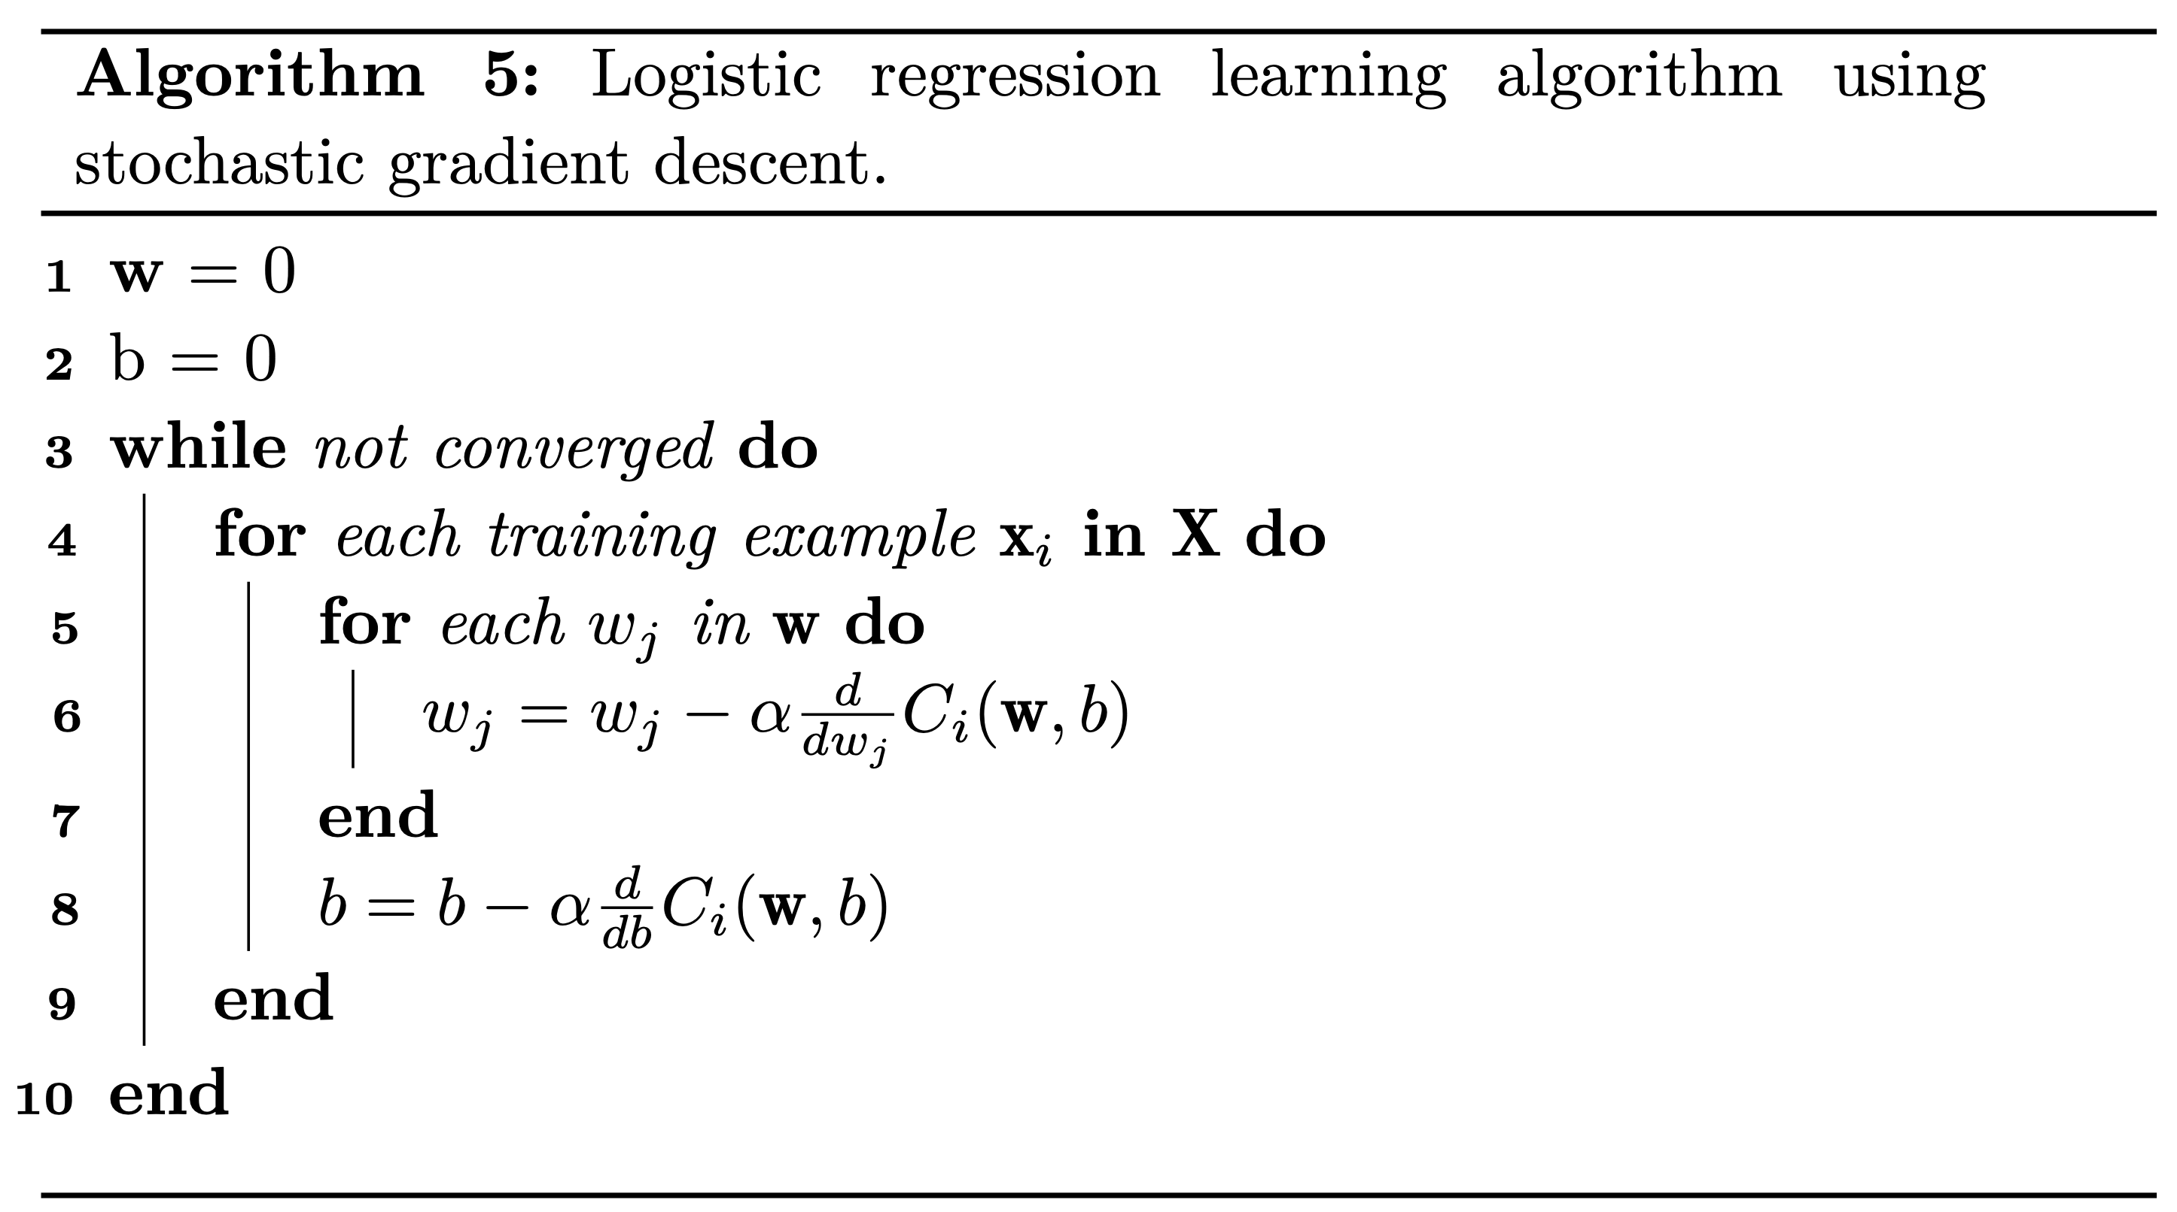
More formal algorithm

Slide 19
Computing the partial derivatives
See Section 3.4 in the book

Slide 20
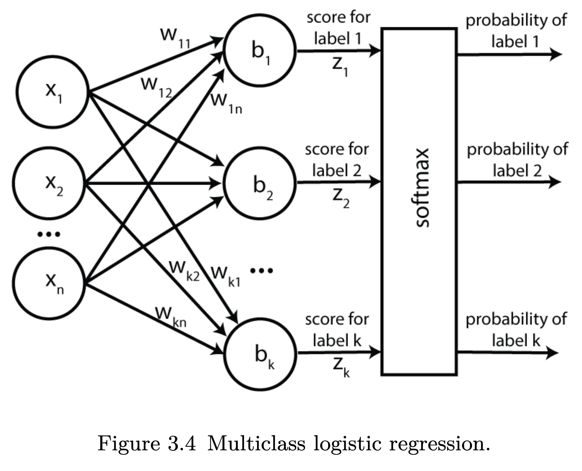
From binary to multiclass classification

Slide 21
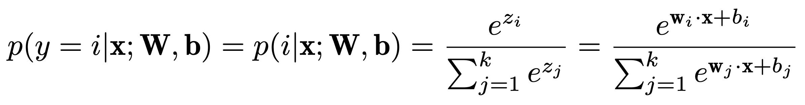
Multiclass probabilities
Softmax function. Reduces to the logistic function for two classes (see book).

Slide 22
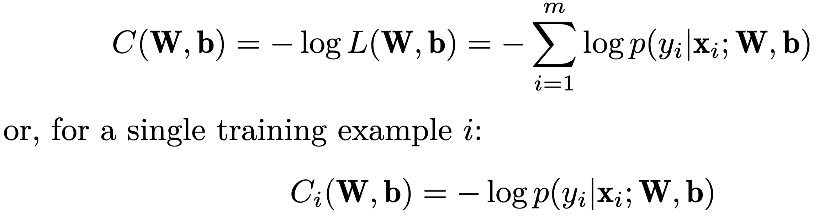
Cost function for multiclass LR
Cross entropy loss
Wait... ”cost” or “loss” function?

Slide 23
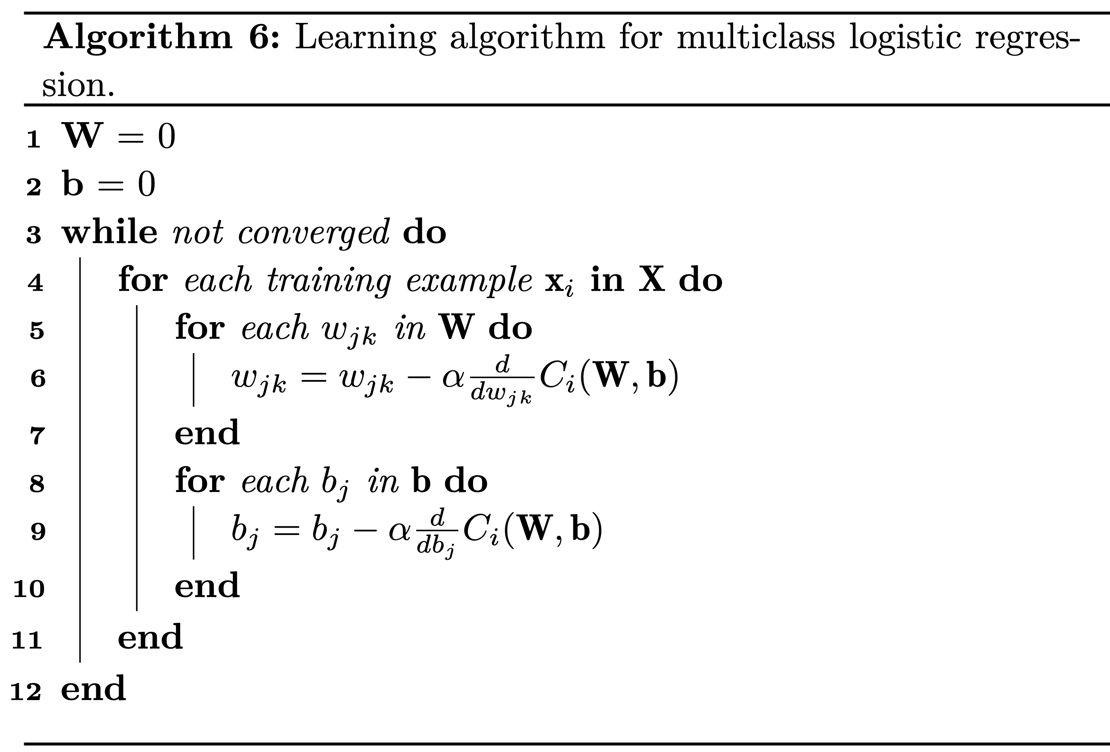
Learning algorithm for multiclass LR

Slide 24
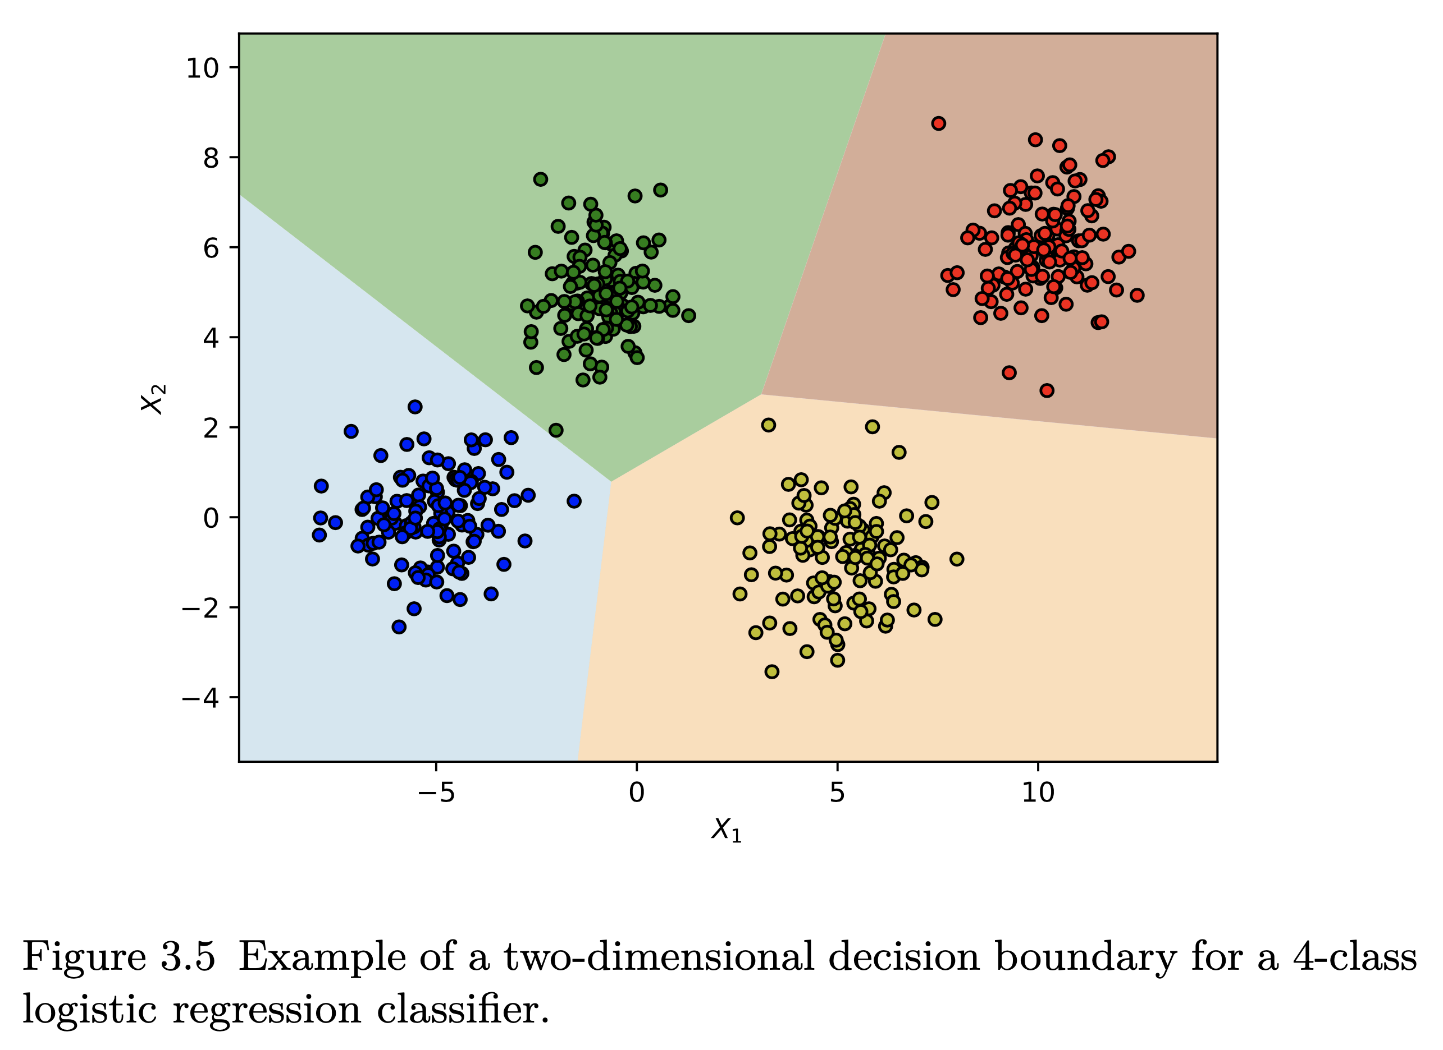
Decision boundaries for multiclass LR

Slide 25
Drawbacks of logistic regression
Similar to the perceptron, LR is a linear classifier
Relies on explicit features (or properties)

Slide 26
Take away
Logistic regression (LR) decision function
Learning algorithm for LR
LR cost function
Gradient descent
Deriving the LR update rule
From binary to multiclass classification
Drawbacks

