Slide 1


Deep Learning for Natural Language Processing DLNLP 8: Distributional Hypothesis and Representation Learning
Mihai Surdeanu and Marco A. Valenzuela-Escárcega

Slide 2
Motivation
Language is sparse (see Zipf’s law)
This impacts search and classification
For example, if the word great is seen in training, but fantastic is not, a classifier would not know how to classify a review containing the word fantastic

Slide 3
Overview
Distributional hypothesis
Traditional distributional representation
The word2vec algorithm
Drawbacks of word2vec

Slide 4
Distributional hypothesis

Slide 5
What comes next?
Bread and ___________

Slide 6
What comes next?
Bagel and ___________

Slide 7
Distributional hypothesis
“A word is characterized by the company it keeps.” (Firth, 1957)
Words that occur in similar contexts tend to have similar meanings. (Harris, 1954)
We will define a numerical representation of words that captures the context in which they occur!

Slide 8
word2vec

Slide 9
Intuition
word2vec’s training objective predicts the context in which a given word is likely to occur
Flips Firth’s observation: the context is defined by the word

Slide 10
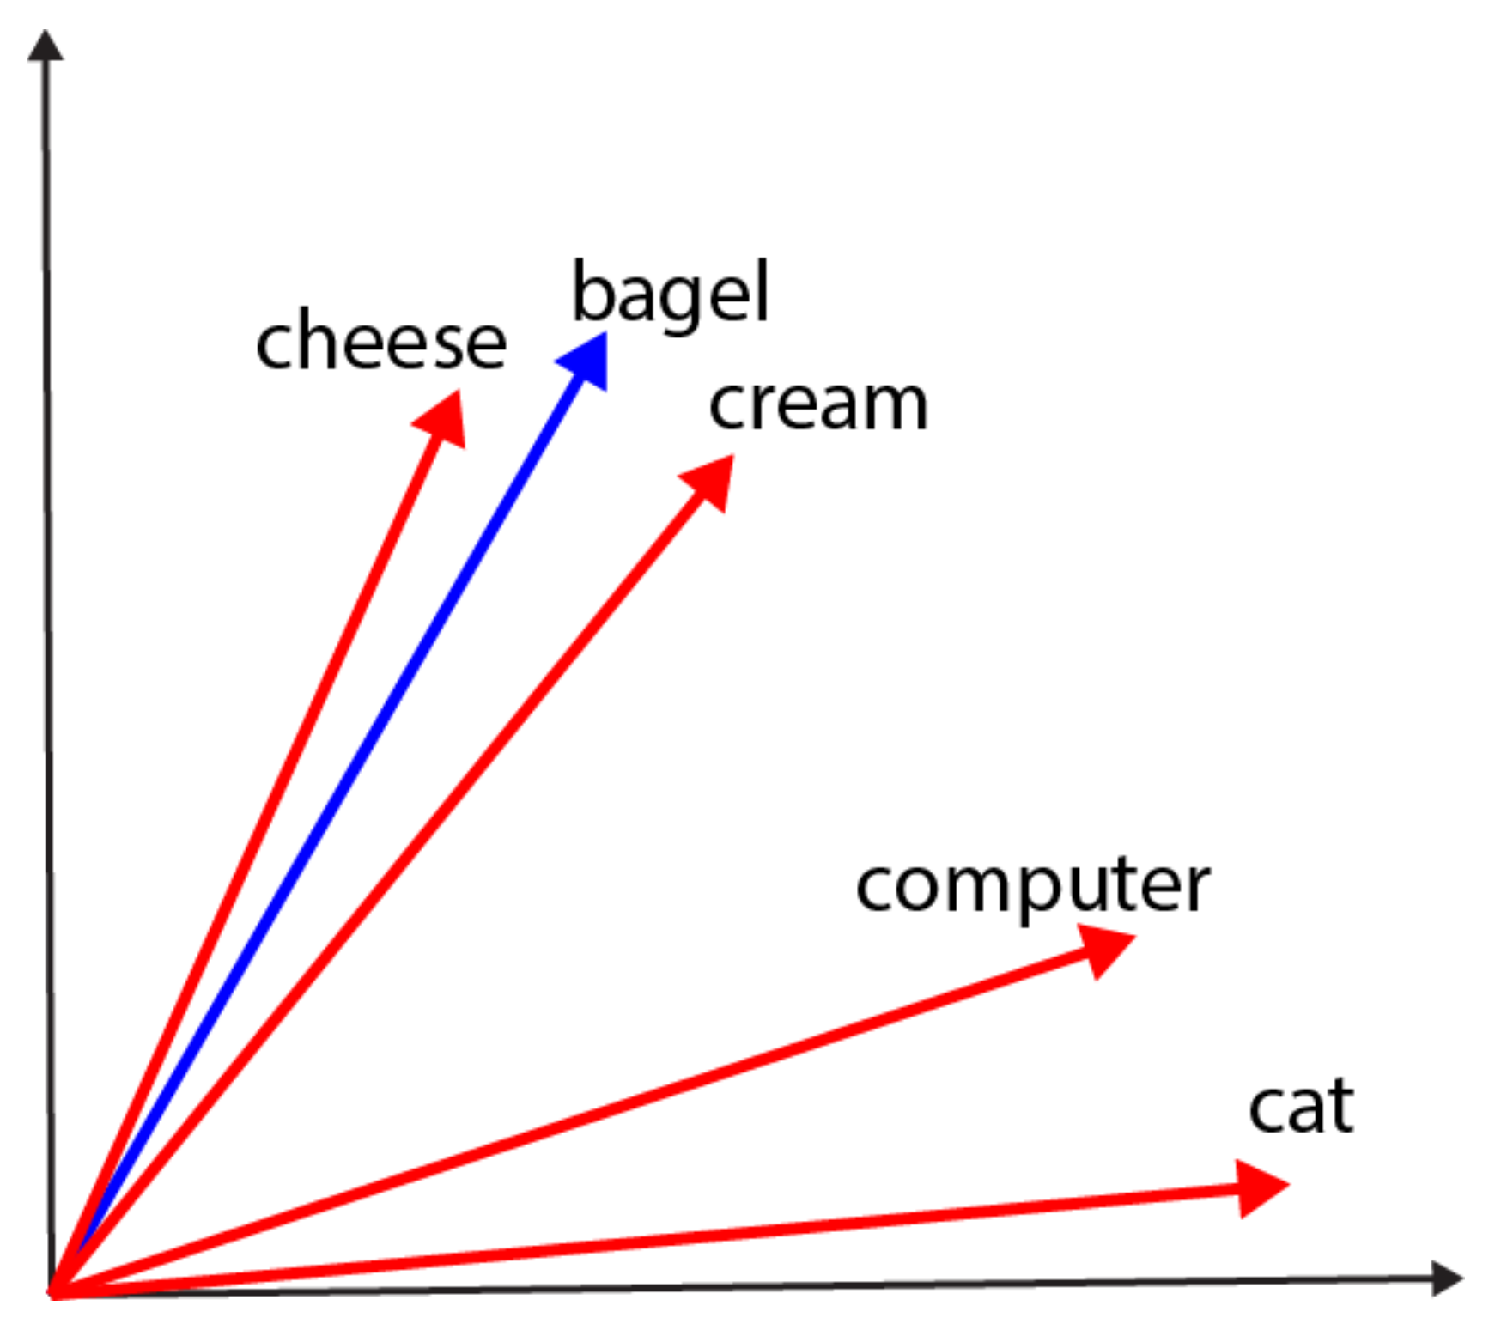
Blue: input (or center) vector
Red: output (or context) vector
“A bagel and cream cheese (also known as bagel with cream cheese) is a
common food pairing in American cuisine.”

Slide 11
Intuition: push/pull
Pull the red vectors for words in context closer to the blue vector for the center word
Push the red vectors for words not in context away

Slide 12
Formalization
Train as a language model:
Consider a window of [-c, +c] words around each window in a text
Learn to predict the context words, i.e., words in this window, given the center word

Slide 13
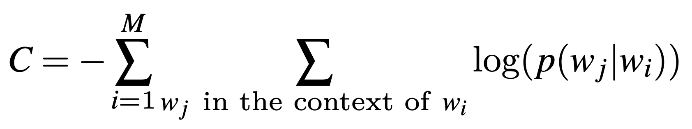
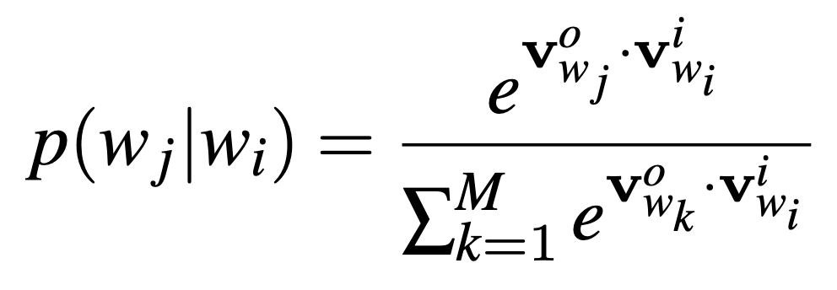
Formalization
Blue: v^{i}
Red: vº
Similar to multiclass LR, but…

Slide 14
Difference from LR
The v^{i} and vº are learned during training, whereas for traditional LR, the feature vectors are static (they do not change)
Word2vec has been described as “dynamic LR”
The v^{i} and vº are simply coordinates in a multi-dimensional space
Hard to interpret!
The number of classes to learn for word2vec is very large (approximately the size of the vocabulary because any word may appear in some context)
Need an approximated cost function

Slide 15
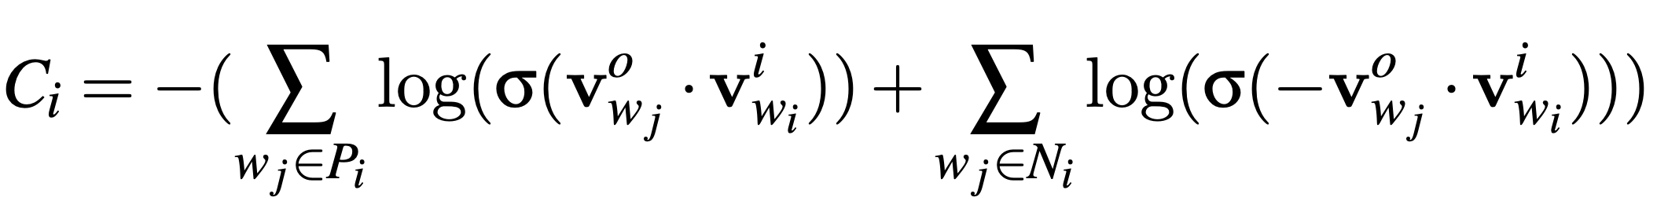
Actual cost function for word2vec
Skipping the denominator, which is expensive to compute
A small sample of words not in context

Slide 16
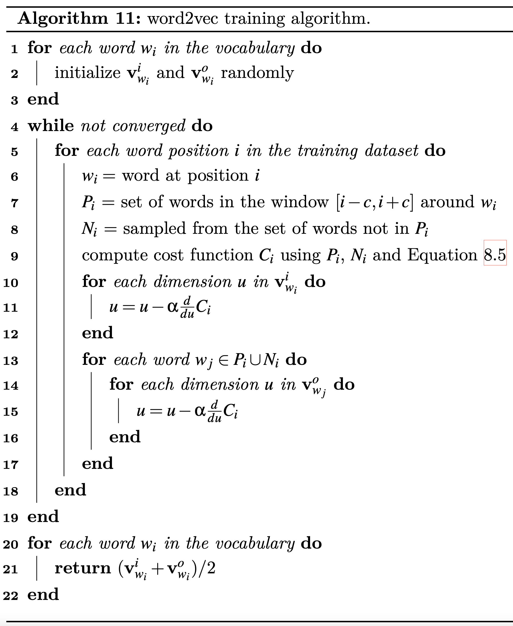

Slide 17
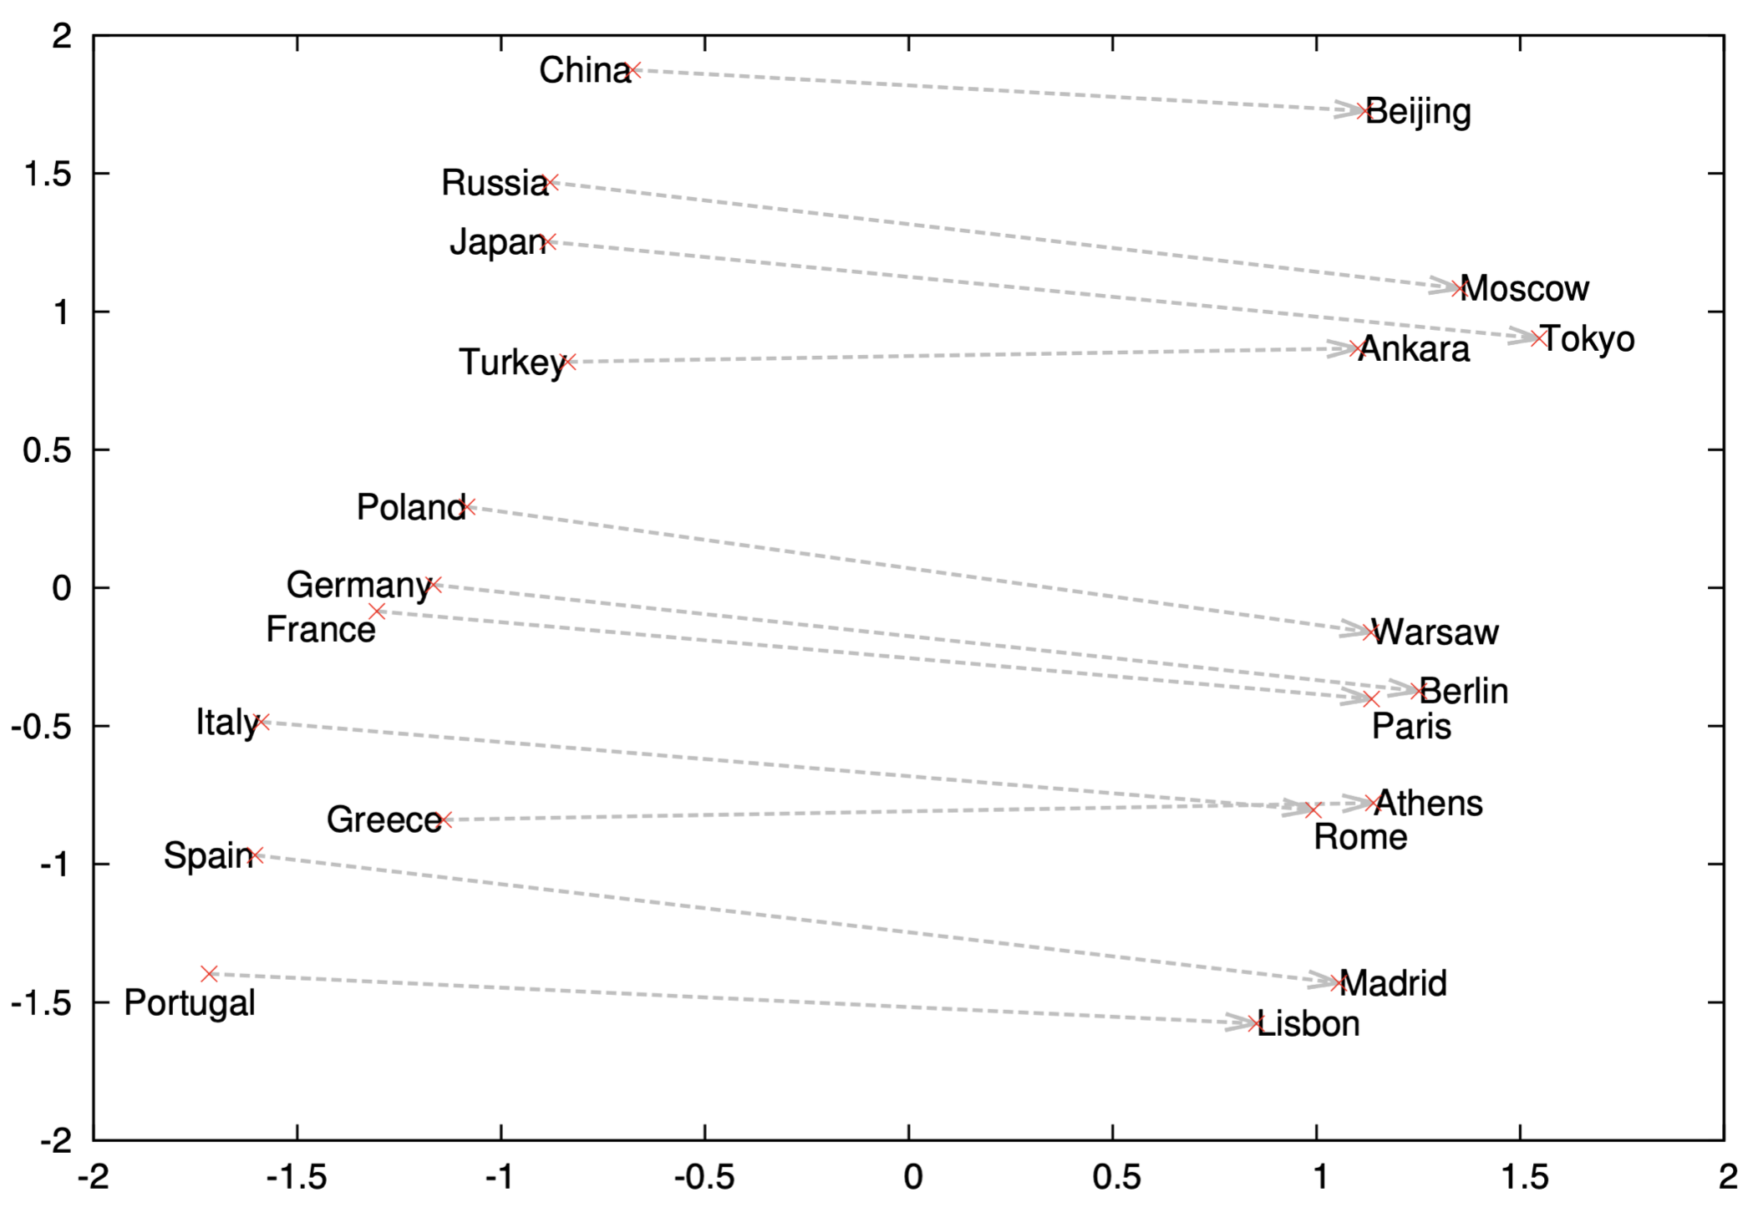
What does word2vec learn?

Slide 18
What does word2vec learn?
The vectors capture meaningful semantics:
v(China) – v(Beijing) = v(France) – v(Paris)
v(king) – v(man) = v(queen) – v(woman)

Slide 19
drawbacks

Slide 20
Drawbacks of word2vec
The numerical representations are static, i.e., they are the same for all senses of a word:
Bank of the river
Bank of America
The numerical representations capture potential biases in the textual data:
v(doctor) – v(man) = v(nurse) – v(woman)

Slide 21
Take away
Distributional hypothesis
Traditional distributional representation
The word2vec algorithm
Drawbacks of word2vec

