Slide 1


Deep Learning for Natural Language Processing DLNLP 5: Feed Forward Neural Networks
Mihai Surdeanu and Marco A. Valenzuela-Escárcega

Slide 2
Overview
Architecture of feed-forward neural networks (FFNNs)
Learning algorithm for FFNNs
Equations of back-propagation

Slide 3
Architecture

Slide 4
Drawbacks of logistic regression
Linear classifier
Feed-forward neural networks (FFNNs) can approximate any function!

Slide 5
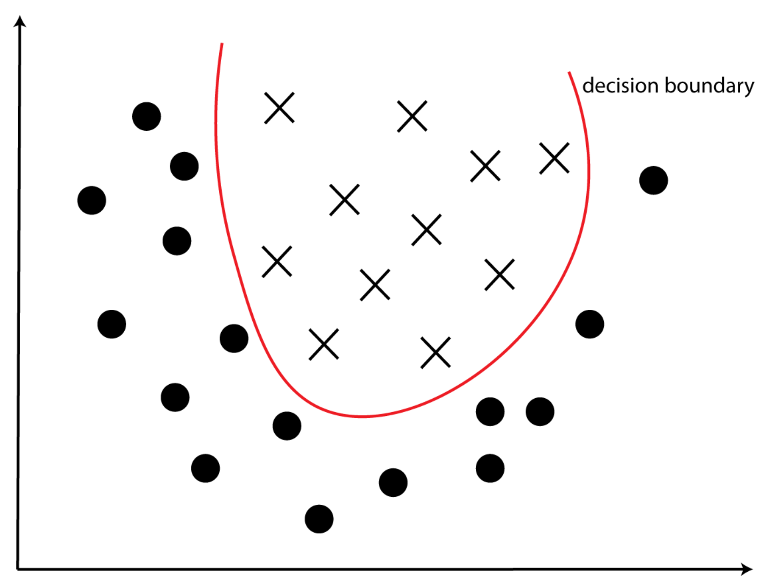
Example of non-linear classifier

Slide 6
Drawbacks of logistic regression
Linear classifier
Feed-forward neural networks (FFNNs) can approximate any function!
Hand-crafted features
We will address this limitation when we discuss word embeddings (chapter 8)

Slide 7
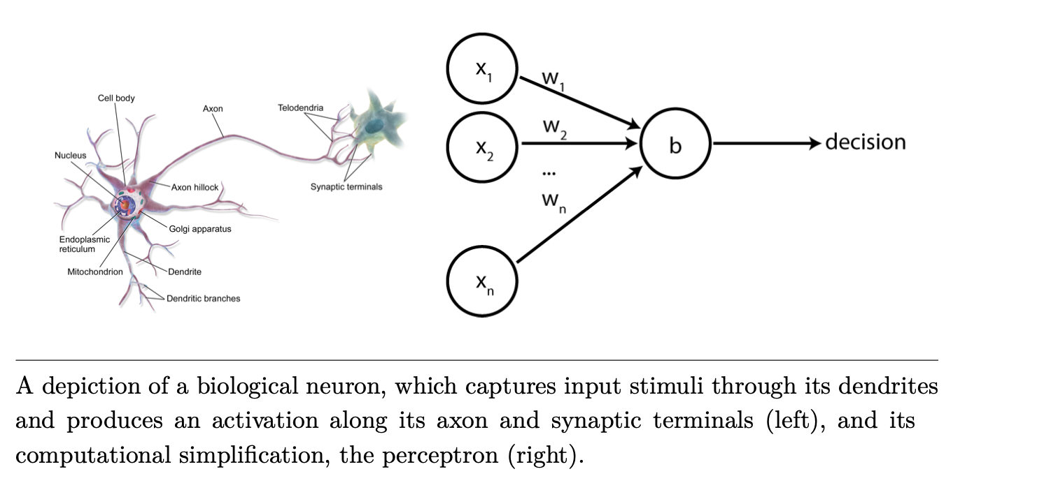
Reminder: perceptron/logistic regression

Slide 8
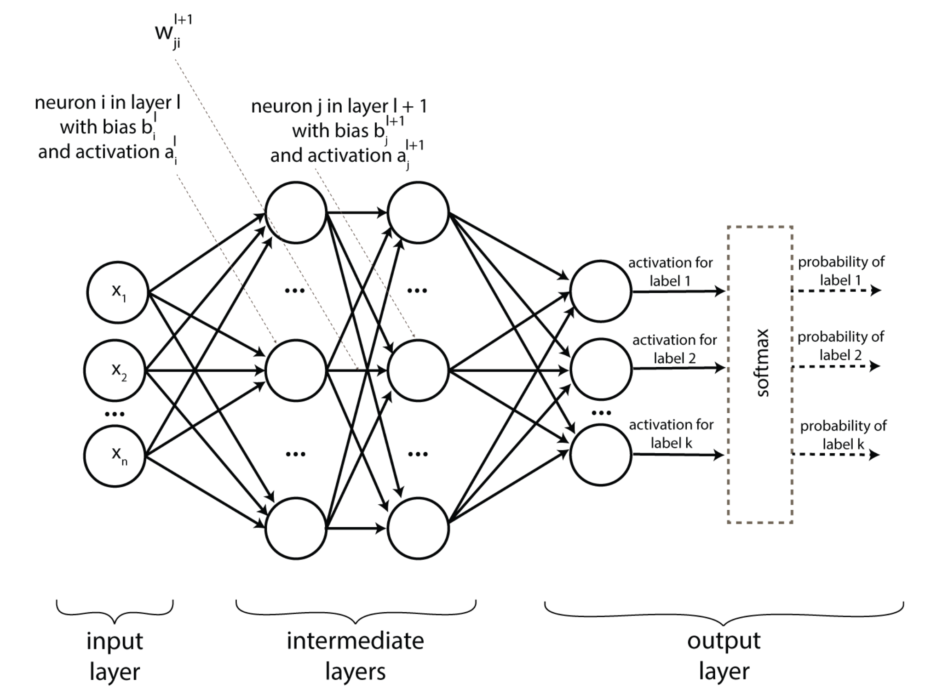
FFNN architecture

Slide 9
Input layer

Slide 10
Input layer
Each input vector x describes one data point
Collection of explicit features (what we have seen so far), or
A numerical representation of the input (based on word embeddings, chapter 8)

Slide 11
Intermediate layers

Slide 12
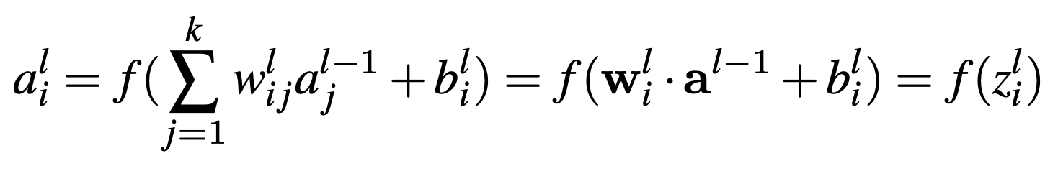
Intermediate layers

Slide 13
Intermediate layers
Output (or activation) of this neuron

Slide 14
Intermediate layers
Inputs to this neuron, i.e., activations of neurons in the previous layer

Slide 15
Intermediate layers
Weights of the edges connecting layer l - 1 with layer l

Slide 16
Intermediate layers
Nonlinear function such as sigmoid (or tanh, ReLU)

Slide 17
Output layer

Slide 18
Output layer
One neuron per class to be learned
For example, we need 3 neurons to learn a review classifier that outputs: positive, neutral, negative.
Output scores may be converted to a probability distribution using the softmax function
Softmax: takes a bunch of values and converts them to values in the [0, 1] interval such that they sum up to 1.

Slide 19
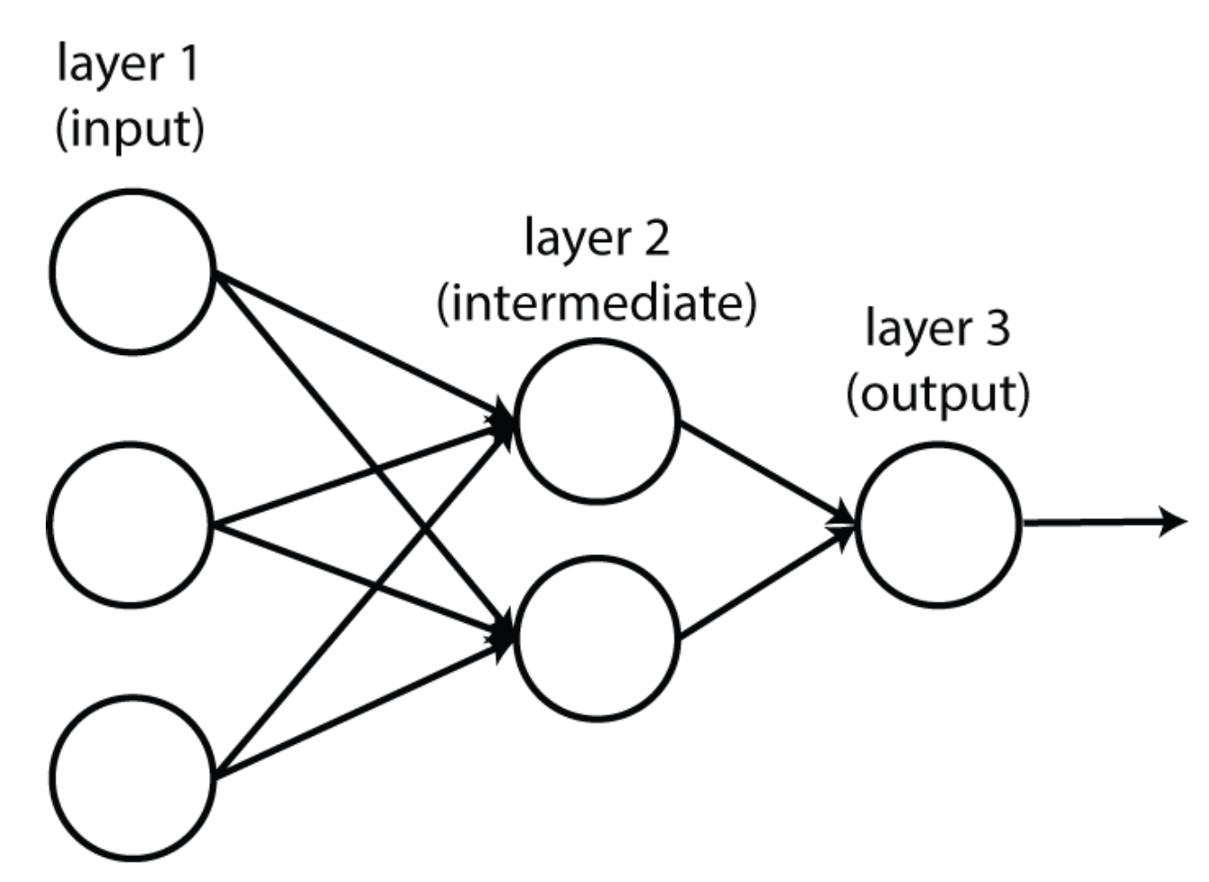
FFNNs can be linear functions (when f is a pass-through function: f(x) = x)

Slide 20
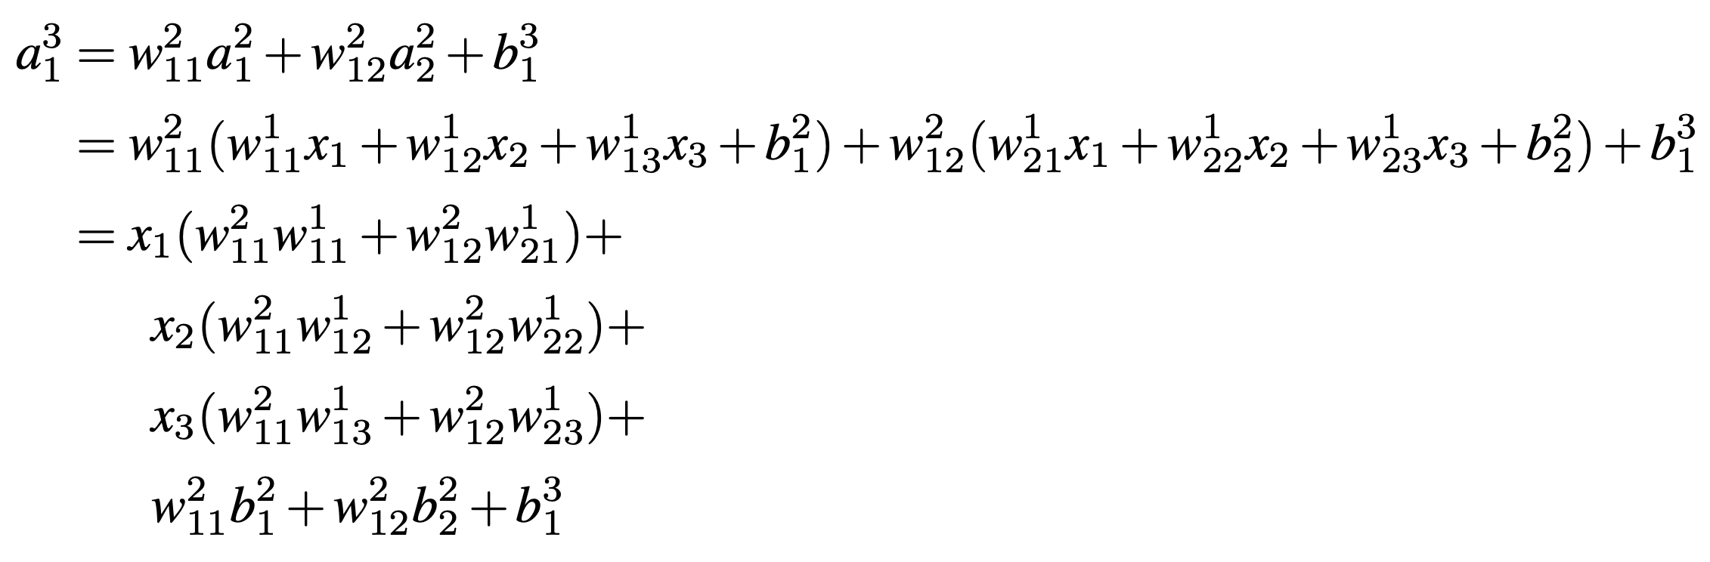
FFNNs can be linear functions (when f is a pass-through function: f(x) = x)

Slide 21
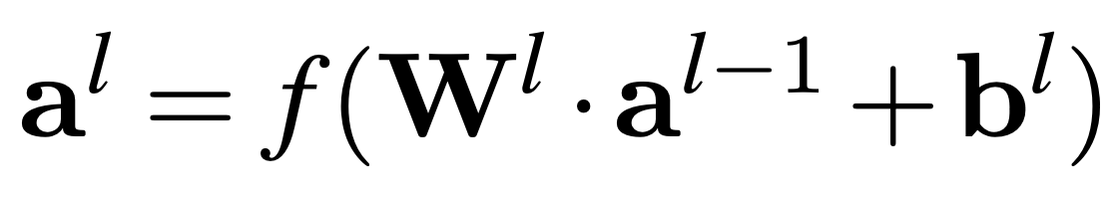
Tensor notation
Each layer can be described by this simpler equation that relies on matrices and vectors:
Remember:
Lower case, bold font = vector
Upper case, bold font = matrix

Slide 22
Tensor notation
Each layer can be described by this simpler equation that relies on matrices and vectors:
All activations in layer l
All activations in layer l - 1

Slide 23
Tensor notation
Each layer can be described by this simpler equation that relies on matrices and vectors:
All weights connecting layer l – 1 with layer l

Slide 24
FFNNs are generalizations of the perceptron and LR
Perceptron
No intermediate layers
f(x) = x
Single output neuron; no softmax
Binary logistic regression
No intermediate layers
f(x) = sigmoid(x)
Single output neuron; no softmax
Multiclass logistic regression
No intermediate layers
f(x) = x
Multiple output neurons with softmax

Slide 25
Learning algorithm

Slide 26
Learning algorithm intuition
Gradient descent, exactly the same as the one used for logistic regression!
“Knob turning”
”knob” = weight of an edge
If a neuron increases the probability of an incorrect prediction, its knobs will be turned down.
If a neuron increases the probability of a correct prediction, its knobs will be turned up.

Slide 27
Intuition
See this video until minute 9:30: https://www.youtube.com/watch?v=Ilg3gGewQ5U

Slide 28
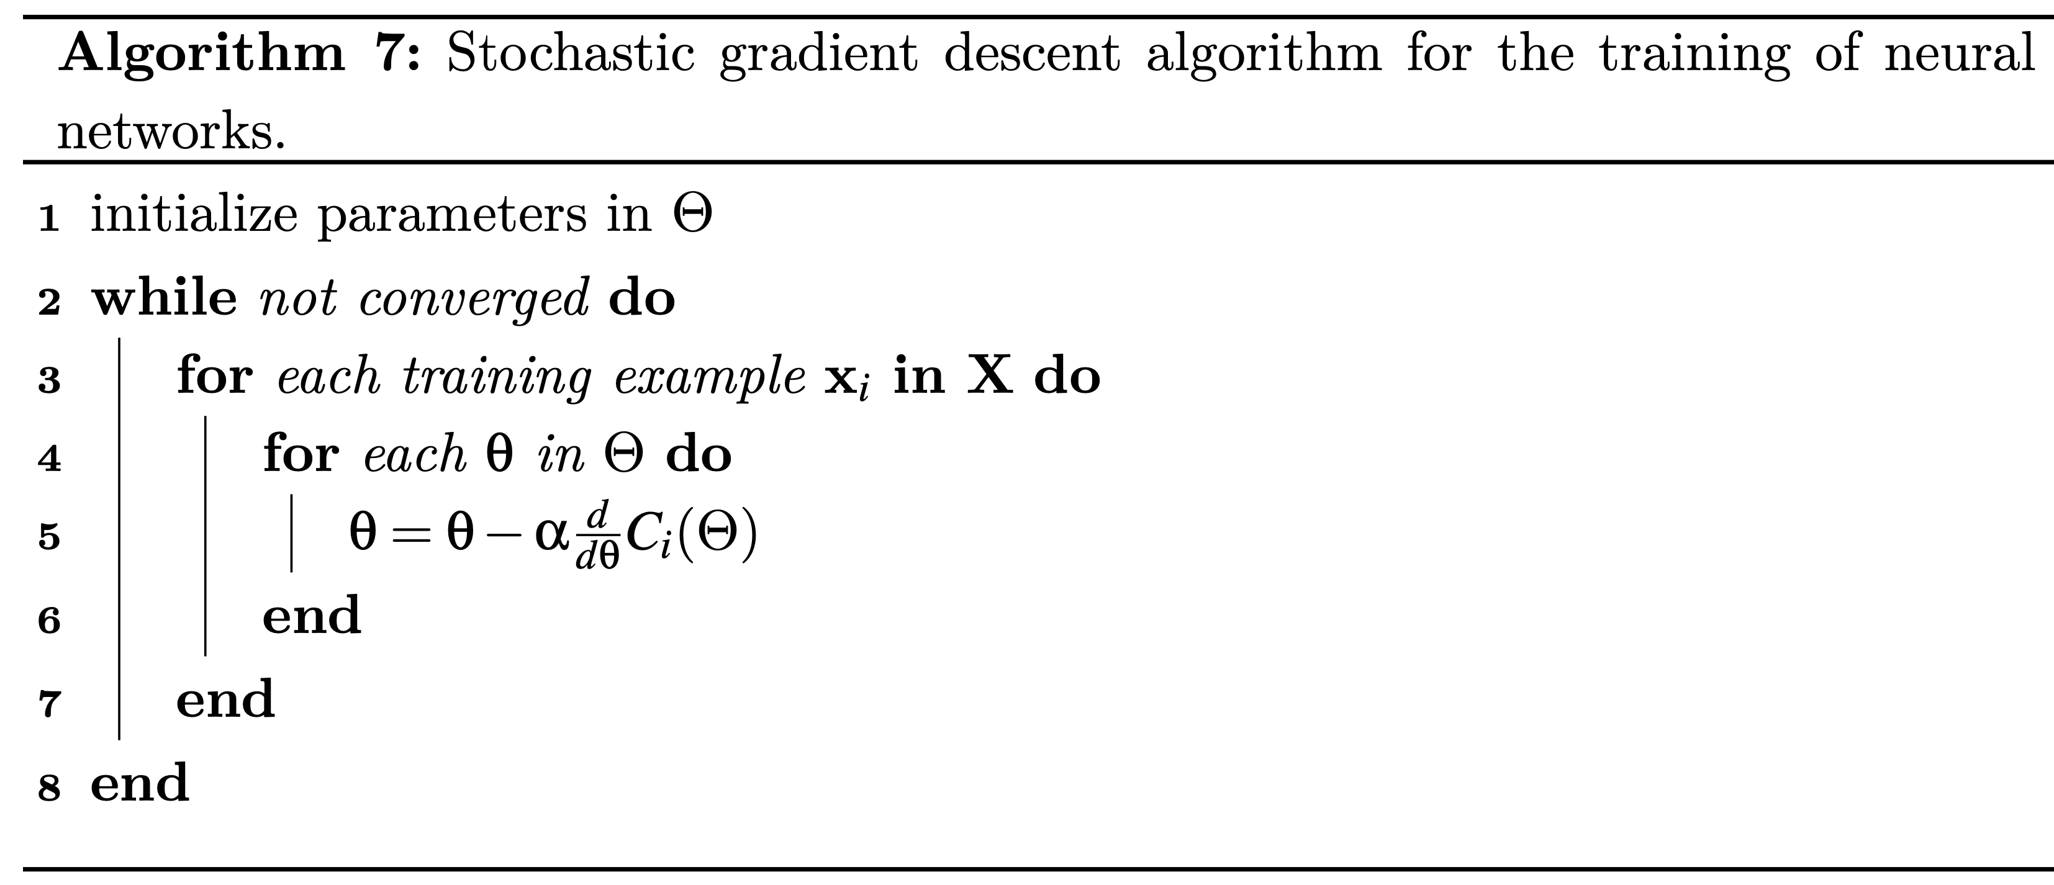

Slide 29
Collection of all weights and biases in the network

Slide 30
One training example

Slide 31
Partial derivative of the cost function C for each parameter (weight or bias) in the network

Slide 32
Learning rate, which is a hyper parameter

Slide 33
But how do we efficiently compute these partial derivatives, especially for edges that are not directly connected to the output neurons?
Back-propagation to the rescue!

Slide 34
Intuition
Compute all neuron activations using current weights and biases
(left to right)
(right to left)
Adjust weights and biases based on the magnitude of the contribution to the mistake

Slide 35
Equations of back-propagation

Slide 36
Back-propagation intuition
Recursively propagate neuron contributions to the output errors from the last layer back to the first

Slide 37
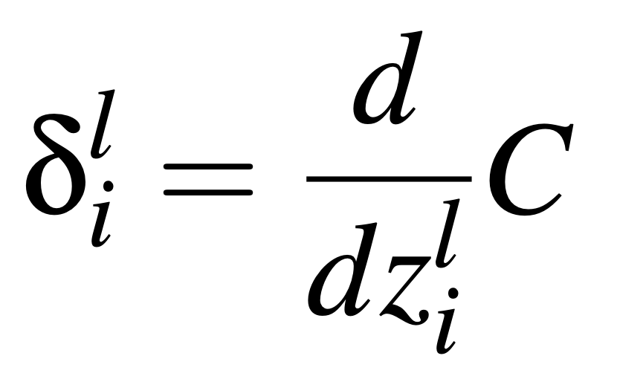
Notations
Notation simplification: denote C_{i}(Θ) as C
Error of neuron i in layer l:
The error of a neuron measures what impact a small change in its output z has on the cost C
Why use z instead of a?

Slide 38
Notations
Notation simplification: denote C_{i}(Θ) as C
Error of neuron i in layer l:
This is the key “knob”
The higher the error, the larger the parameter adjustments for this neuron

Slide 39
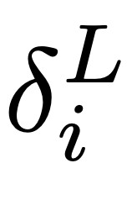
Notations
Notation simplification: denote C_{i}(Θ) as C
Error of neuron i in layer l:
This is the key “knob”
The higher the error, the larger the parameter adjustments for this neuron
L: index of the final network layer. Thus, is the error of neuron i in the last layer.

Slide 40
The equations of back-propagation
Compute the error of the neurons in the last layer (L)
From right-to-left, compute the errors of the neurons in all layers l, using the errors of the neurons in layer l + 1
Adjust the edge weights and biases in the entire network using these errors

Slide 41
Warning: heaviest math in this book coming up!

Slide 42
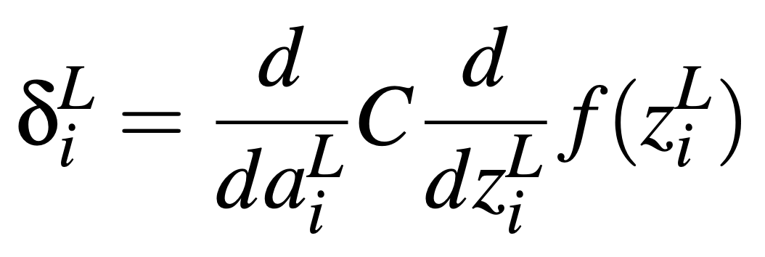
Backprop equation 1: Error of a neuron in the final layer
In general:
This yields the following formula for the last layer:

Slide 43
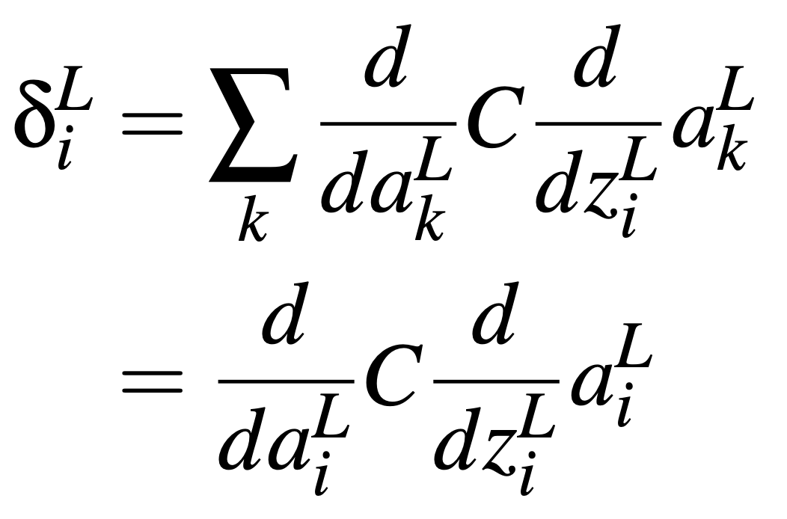
Proof of backprop equation 1

Slide 44
Proof of backprop equation 1
Must loop over all k neurons in the last layer because C depends on all activations in the last layer. However, neuron i impacts only its own activation, so we can ignore the others.

Slide 45
Proof of backprop equation 1
Chain rule!

Slide 46
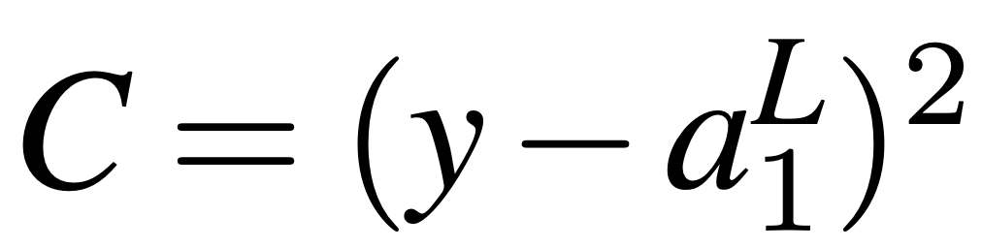
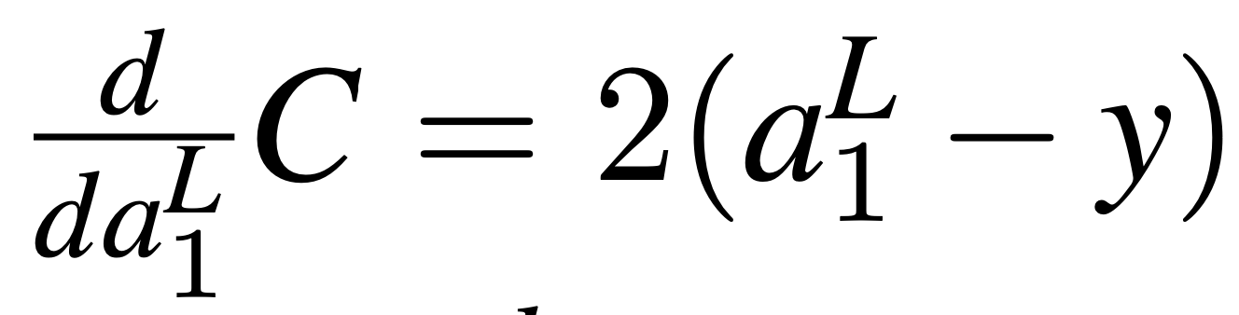
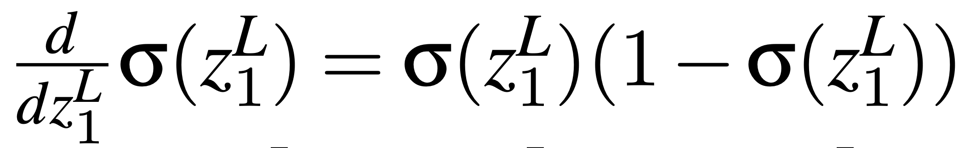
Example of equation 1: Binary logistic regression with MSE cost
Mean squared error (MSE) cost:
Derivatives we need:
Then:

Slide 47
Example of equation 1: Binary logistic regression with MSE cost
This is a good “knob.” For example, when the gold label y is 1 and the neuron output (σ) is large, the error will be small. When the neuron is “confused,” e.g., its output (σ) is 0.5, the error will be large.

Slide 48
Example of equation 1: Binary logistic regression with MSE cost
Peeking ahead:
What’s the problem here?

Slide 49
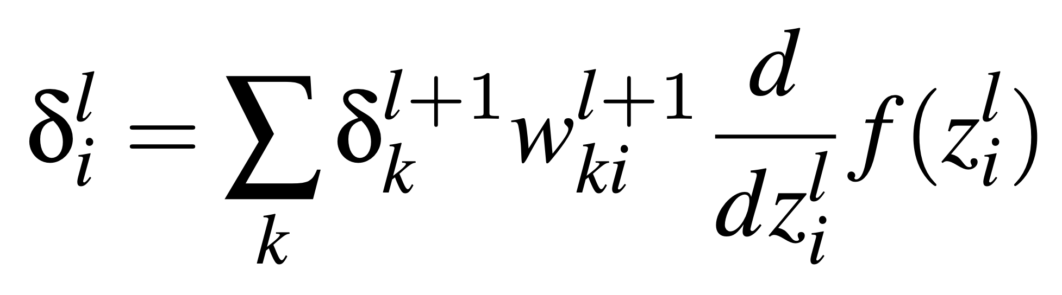
Backprop equation 2: Error of a neuron in an intermediate layer
Recursive back-propagation and quick to compute!
What type of programming is this?

Slide 50
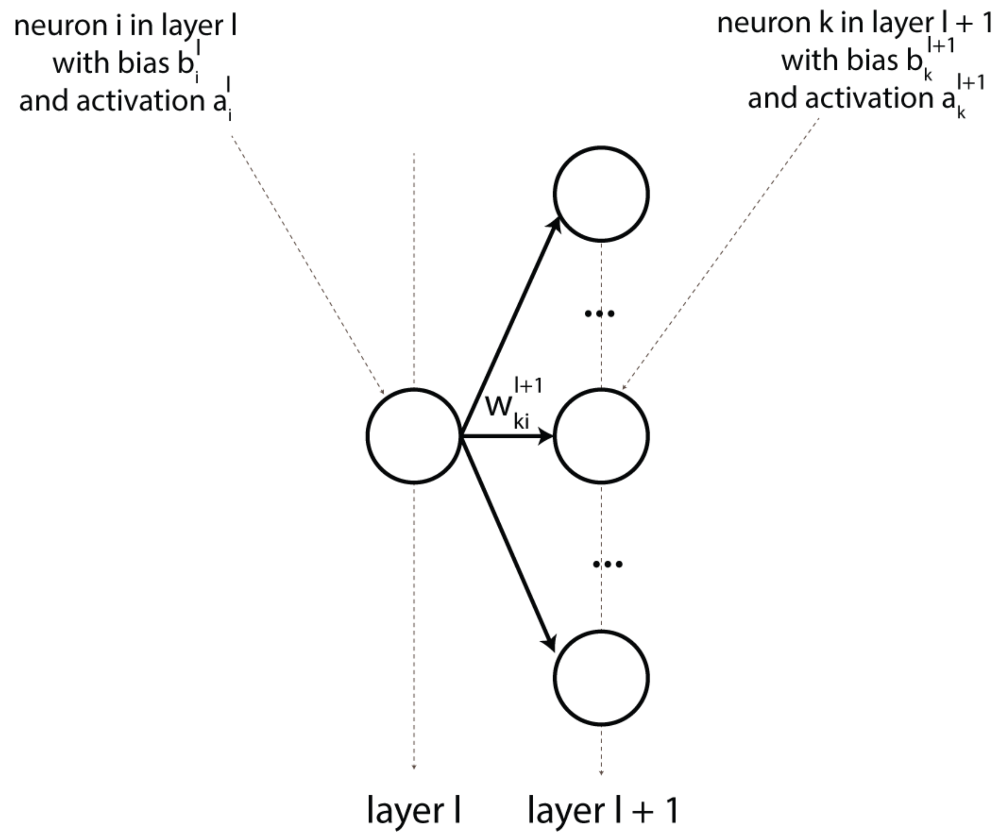
Visual helper for backprop equation 2

Slide 51
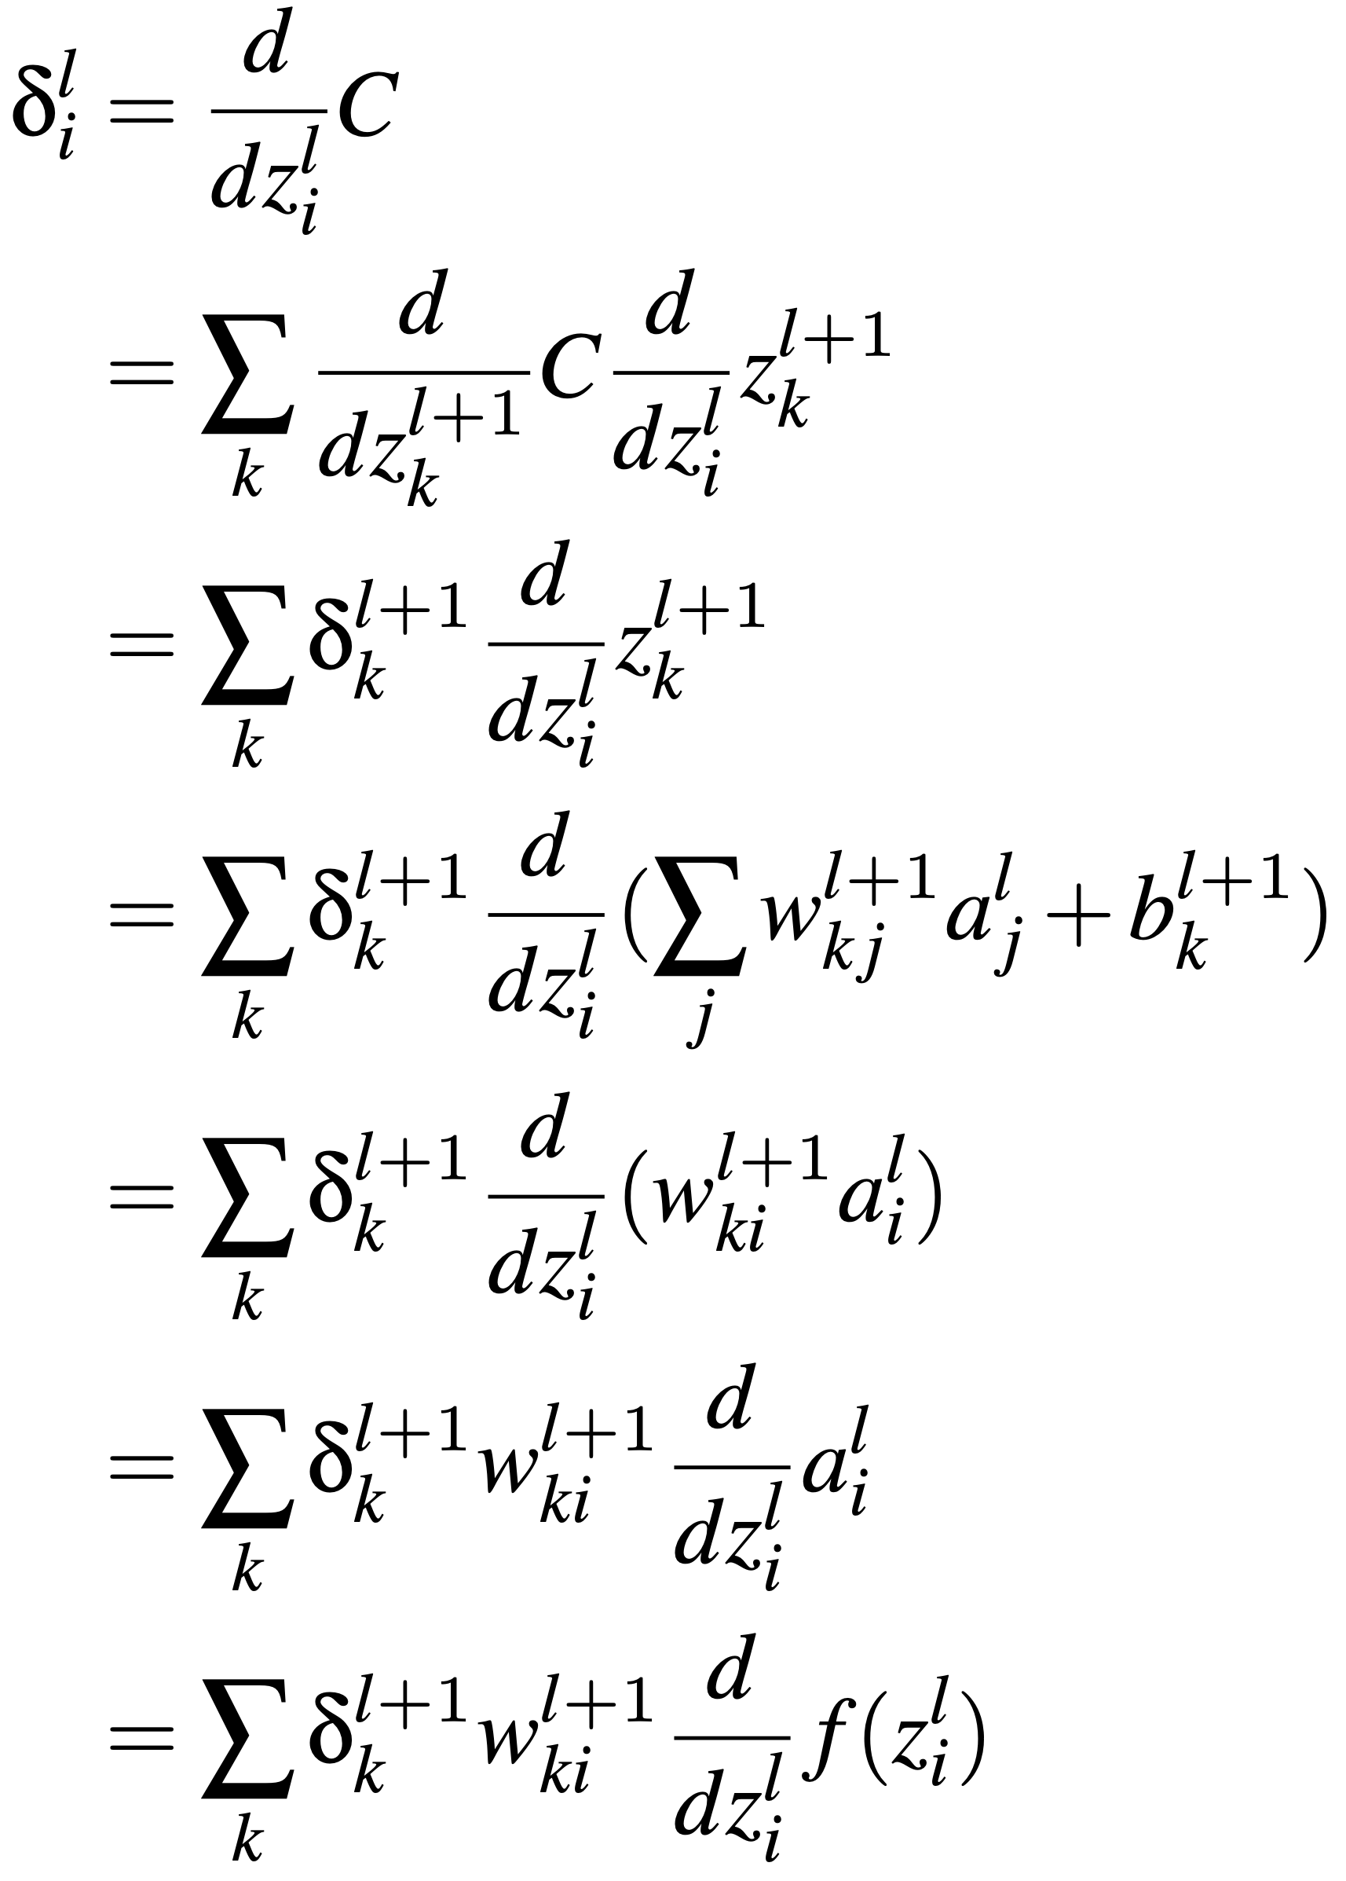
Proof of backprop equation 2

Slide 52
Proof of backprop equation 2
Chain rule again. We need to use all neurons in the next layer because they are all impacted by the current neuron

Slide 53
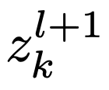
Proof of backprop equation 2
Just the definition of

Slide 54
Proof of backprop equation 2
Connections from neuron j to k can be ignored for i != j

Slide 55
Proof of backprop equation 2
Chain rule again

Slide 56
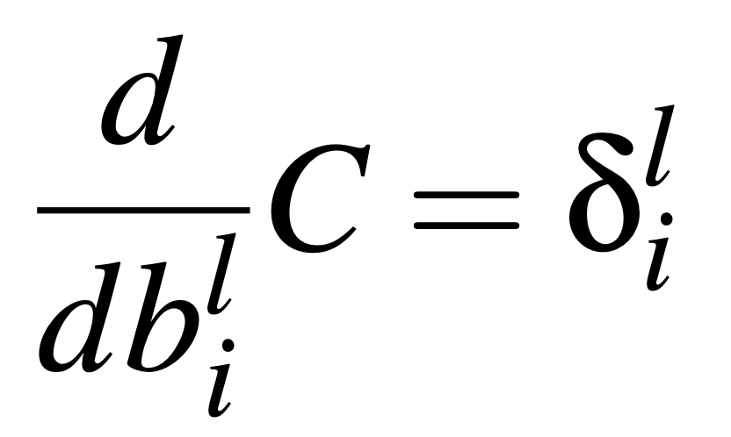
Backprop equation 3: Update for any bias term

Slide 57
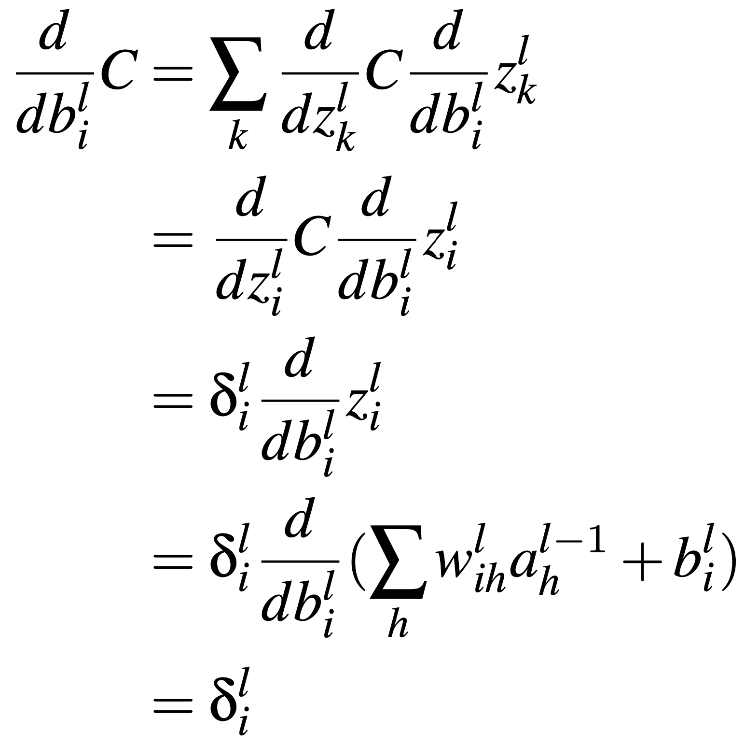
Proof for backprop equation 3
What rules have we applied here?

Slide 58
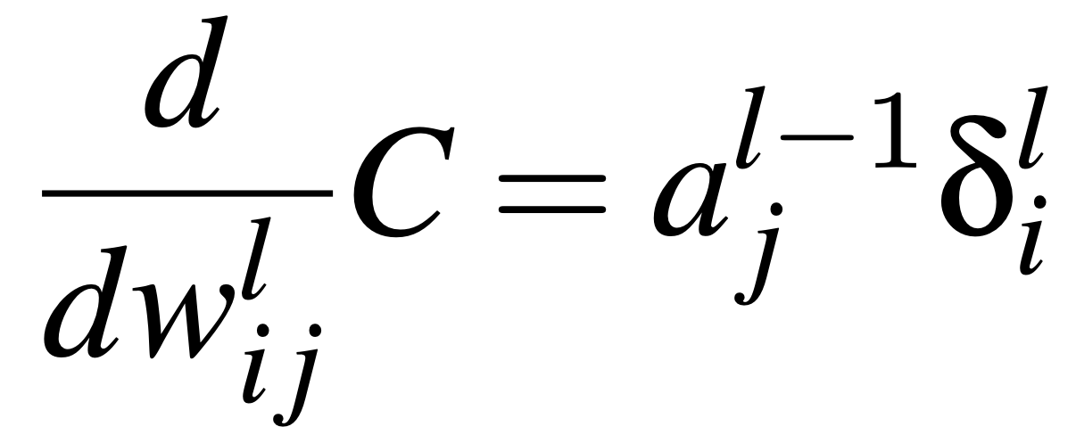
Backprop equation 4

Slide 59
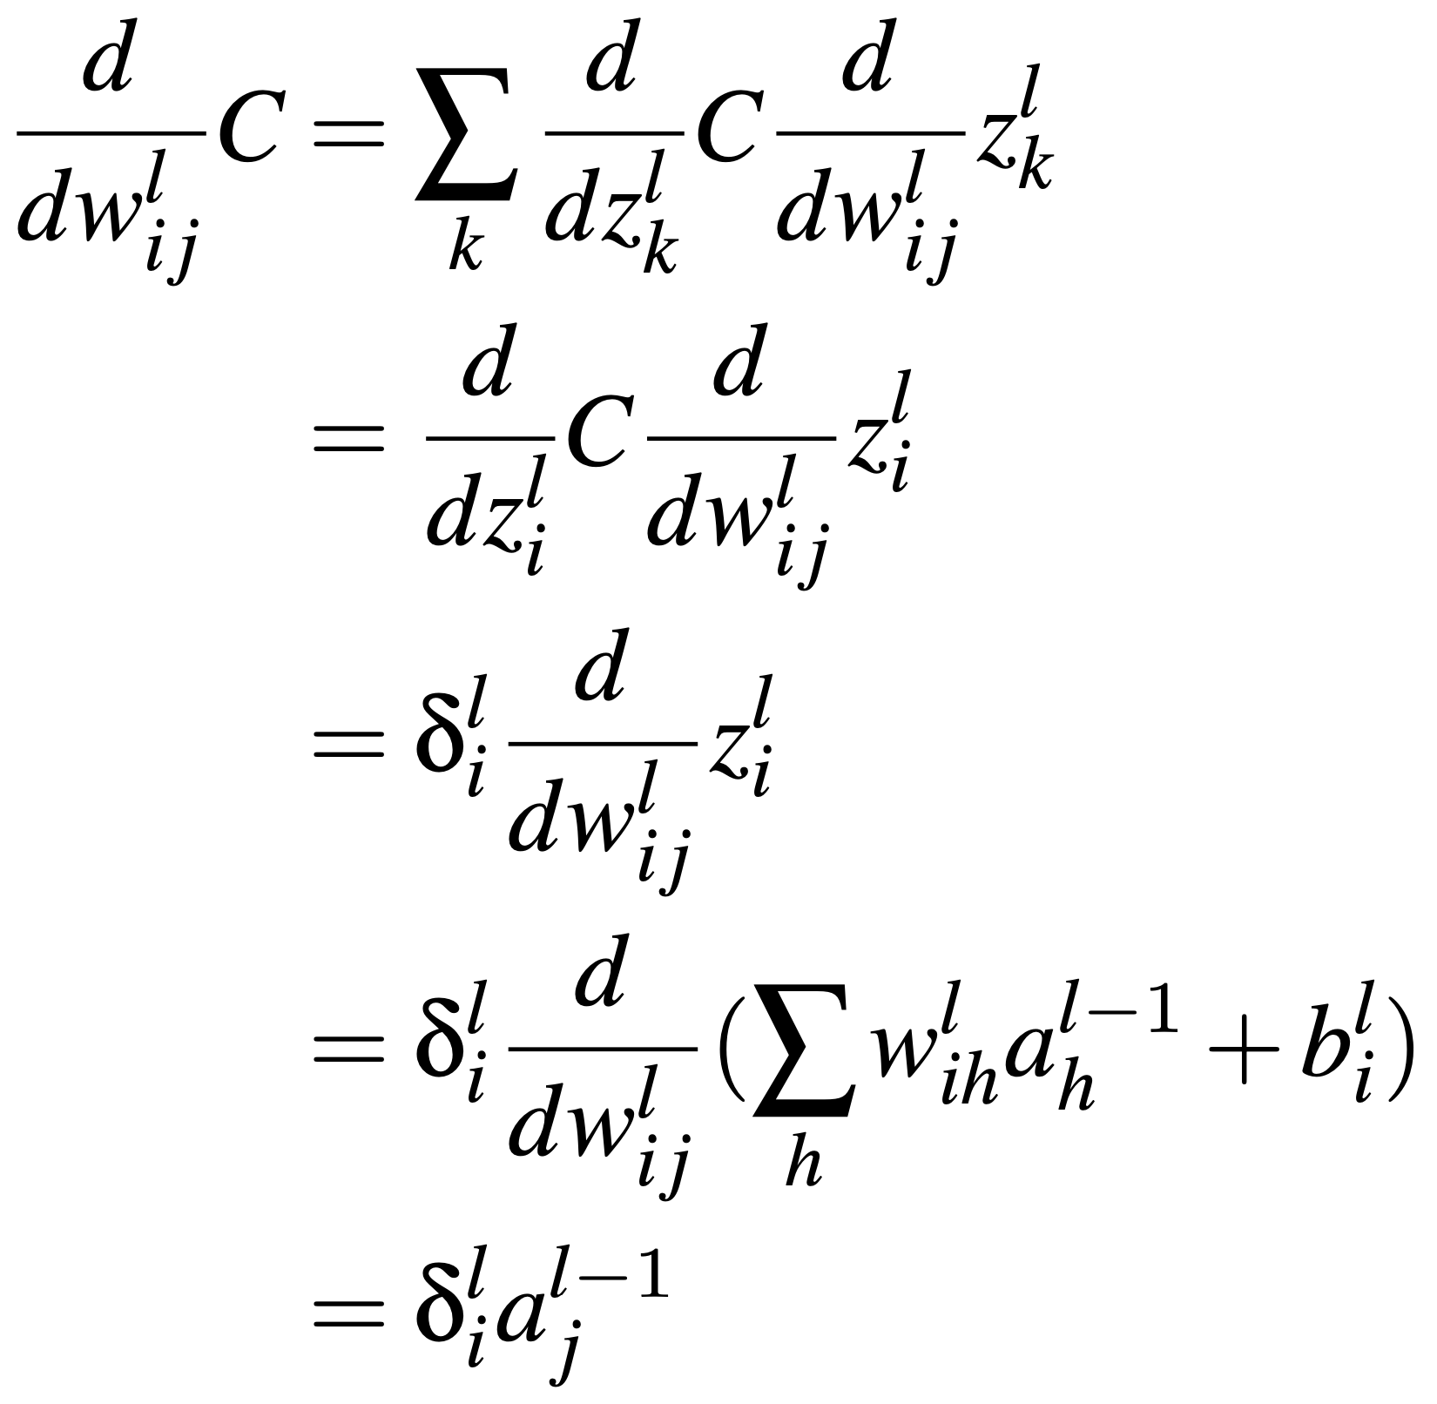
Proof of backprop equation 4
What rules have we applied here?

Slide 60
The 4 equations of back-propagation
Step 1:
Step 2:
Step 3:

Slide 61
Math over!

Slide 62
Wait a minute…
There are auto-differentiation libraries nowadays that can compute the partial derivative wrt to any parameter directly... Why do we need to go through all this trouble?
What type of algorithm is back-propagation?

Slide 63
Drawbacks of feed-forward neural networks
Back-propagation is slow, especially for networks with >> parameters.
The brain probably does not learn using back-propagation (e.g., if it did, our vision would regularly black out during updates)
FFNNs are very powerful classifiers (i.e., can learn any function), but this can lead to overfitting (i.e., “hallucinating” a classifier)
So far, we discussed FFNNs that rely on hand-crafted features

Slide 64
Take away
Architecture of feed-forward neural networks (FFNNs)
Learning algorithm for FFNNs
Equations of back-propagation

