Slide 1


Deep Learning for Natural Language Processing DLNLP 8: Distributional Hypothesis and Representation Learning
Mihai Surdeanu and Marco A. Valenzuela-Escárcega

Slide 2
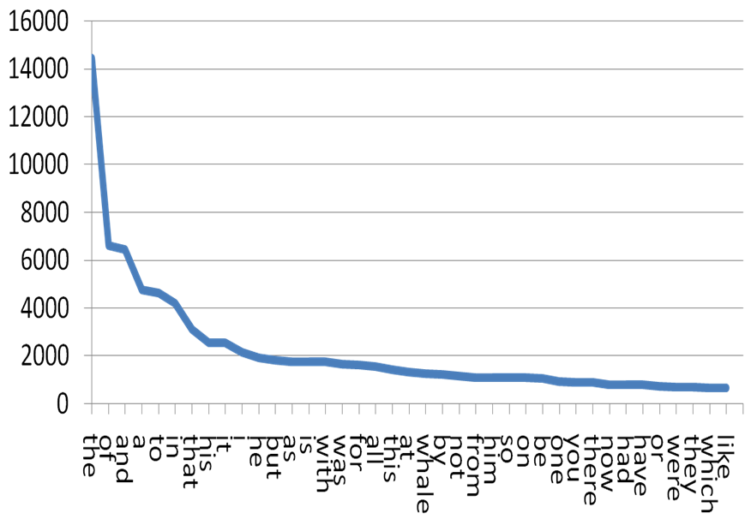
Motivation
Language is sparse, see Zipf’s law:
https://slackersite.wordpress.com/2015/08/28/zipf-it-word-frequency-and-line-drawing/

Slide 3
Motivation
Sparsity impacts search and classification
For example, if the word great is seen in training, but fantastic is not, a classifier would not know how to classify a review containing the word fantastic
How does this impact search?

Slide 4
Overview
Distributional hypothesis
Traditional distributional representation
The word2vec algorithm
Drawbacks of word2vec

Slide 5
Distributional hypothesis

Slide 6
What comes next?
Bread and ___________

Slide 7
What comes next?
Bagel and ___________

Slide 8
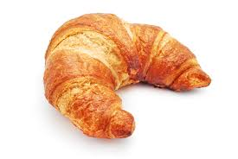
What is X?
tasty X
X with butter
X and coffee
greasy X

Slide 9
Distributional hypothesis
“A word is characterized by the company it keeps.” (Firth, 1957)
Words that occur in similar contexts tend to have similar meanings. (Harris, 1954)
We will define a numerical representation of words that captures the context in which they occur!

Slide 10
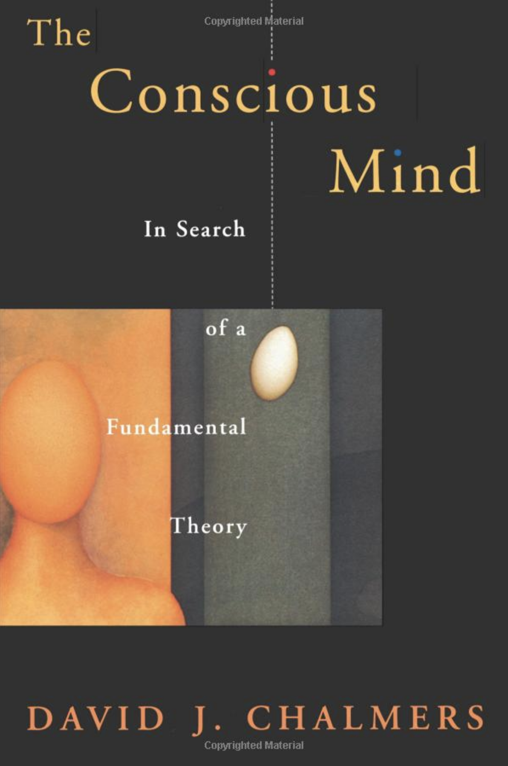
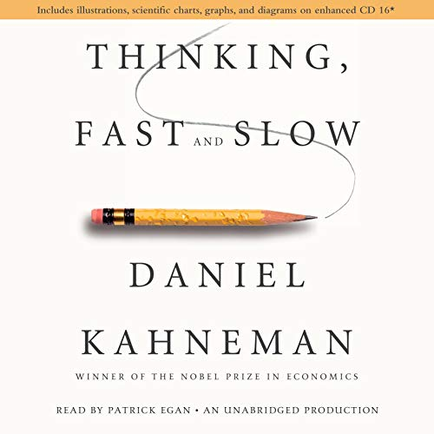
Mihai’s shallow taxonomy of consciousness
The “hard problem” of consciousness
consciousness
phenomenal
(how you feel)
first person
hard
psychological
(how you act)
third person
easy
system 1
(automated action)
easier
system 2
(mental activity)
harder
The distributional hypothesis is in here

Slide 11
Traditional distributional representation

Slide 12
Key idea: co-occurrence matrix
If words are defined by the company they keep, let’s keep track of this company
One vector per word, which stores the frequency of the words seen around it

Slide 13
Co-occurrence matrix
Counts computed over a context window (say +/- 10 words) around each occurrence of a word

Slide 14
Co-occurrence matrix
One vector for each word seen
Constructed from all windows of size [−c, +c] (e.g., c = 10) words around all instances of the word in text
Vocabulary size

Slide 15
Co-occurrence matrix
“The dog barks at strangers”
Vector for “dog”
…
“at”
“bark”
“stranger”
“the”
…
1
1
1
1
Vocabulary size

Slide 16
Co-occurrence matrix
“The dog barked at the cat”
Vector for “dog”
…
“at”
“bark”
“cat”
“stranger”
“the”
…
2
2
1
1
3
Vocabulary size

Slide 17
Co-occurrence matrix
Then repeat for all words seen in a large corpus of texts, e.g., Wikipedia or the whole web…

Slide 18
Quick questions
What is the length of this vector?
What do you observe about this vector?
How would you use these vectors for text classification?
What problems do you see with the previous approach?
Notes:
Observations: (1) does capture semantics; (2) it is sparse

Slide 19
The problem
These context vectors are too sparse
We can “densify” them using linear algebra tricks such as singular value decomposition (SVD)!

Slide 20
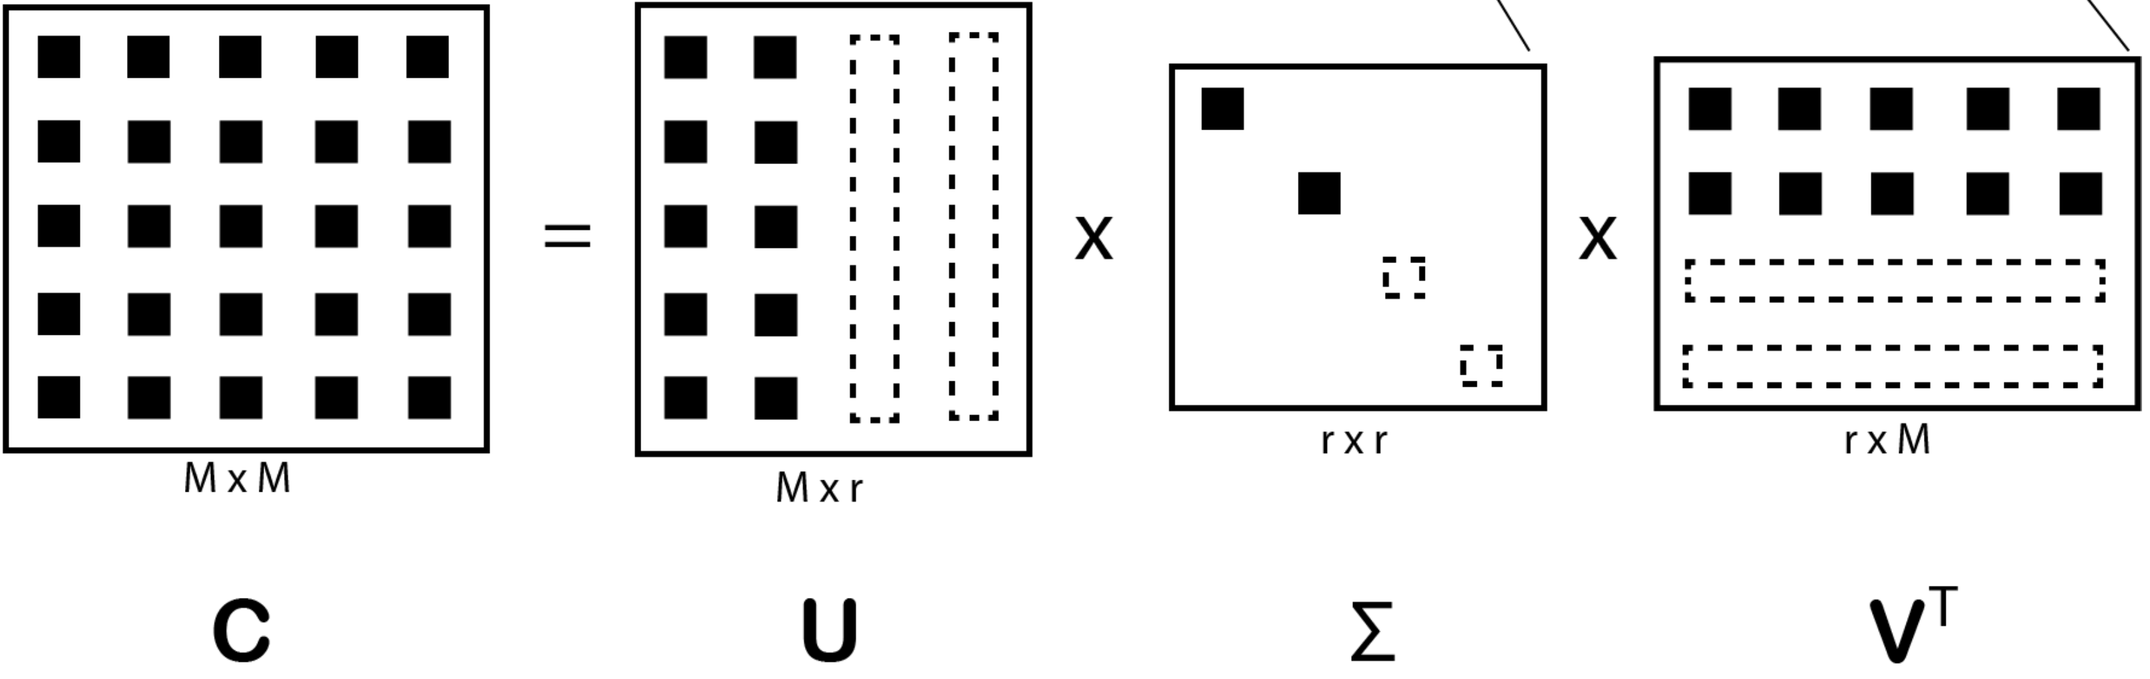
Singular value decomposition
C is our previous context matrix
The empty rectangles with dashed lines indicate which elements are zeroed out under the low-rank approximation.

Slide 21
Singular value decomposition
Each row in the matrix U contains the numerical representation of a single word in the vocabulary, and each column in U is one semantic dimension, or topic, used to describe the underlying documents that were used to construct C. For example, if row i contains the co-occurrence vector for the word bagel and column j contains a topic describing foods, we would expect c_{ij} to have a high value because the food topic is an important part of the semantic description of the word bagel.
However, topics are not easily interpretable!

Slide 22
Singular value decomposition
Diagonal matrix with values sorted in descending order. The values in Σ indicate the importance of topics captured in U.

Slide 23
Singular value decomposition
Each row i in V^{T} contains a bag-of-words description of topic i, where the value at position j in row i indicates the importance of word j to topic i. For example, if the three highest values in a given row point to the words bagel, bread, and croissant, one can (subjectively) interpret this topic to be about bakery products.
Interpreting topics is hard!

Slide 24
Low-rank approximation
Zeroing out the bottom of the diagonal eliminates the least important topics in U → low-rank approximation. Typically, we keep the left-most 100 or 200 columns in U.

Slide 25
Drawbacks
The new features (columns in U) are hard to interpret…
The vectors in U collapse all the word senses of the given word
The runtime of SVD is cubic in the size of C.

Slide 26
word2vec

Slide 27
Intuition
word2vec’s training objective predicts the context in which a given word is likely to occur
Flips Firth’s observation: the context is defined by the word

Slide 28

Historical context
The previous objective in word2vec is called “skip-gram”. Why?
There is another ☺
This objective matches the distribution hypothesis directly, i.e., predict the word given the context.
This objective was called “continuous bag of words.” Why?
In the original work, this objective was shown to perform worse than skip-gram. However, future work shown this to be caused by a bug in the original word2vec implementation…

Slide 29
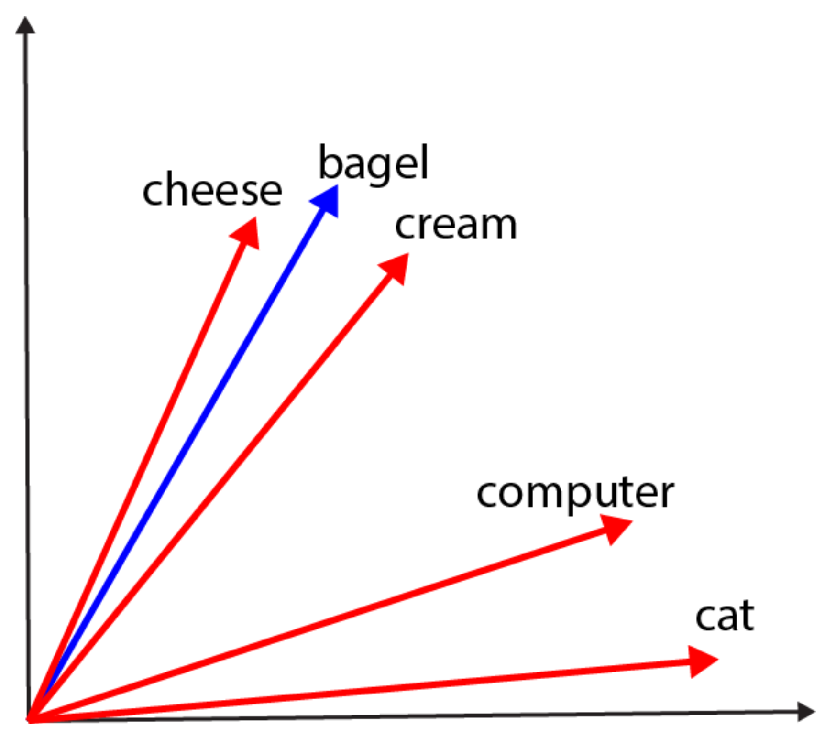
Blue: input (or center) vector
Red: output (or context) vector
“A bagel and cream cheese (also known as bagel with cream cheese) is a
common food pairing in American cuisine.”

Slide 30
Intuition: push/pull
Pull the red vectors for words in context closer to the blue vector for the center word
Push the red vectors for words not in context away

Slide 31
Formalization
Train as a language model:
Consider a window of [-c, +c] words around each word in a text
Learn to predict the context words, i.e., words in this window, given the center word

Slide 32
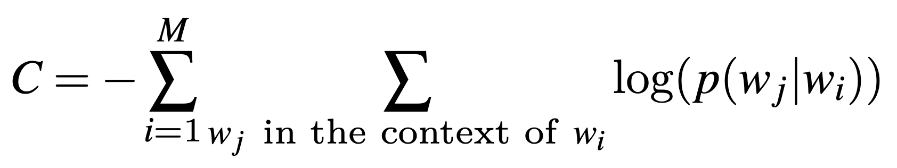
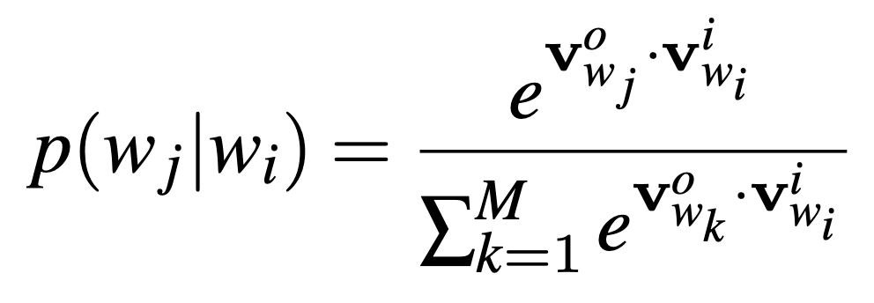
Formalization
Blue: v^{i}
Red: vº
Similar to multiclass LR, but…

Slide 33
Difference from LR
The v^{i} and vº are learned during training, whereas for traditional LR, the feature vectors are static (they do not change)
Word2vec has been described as “dynamic LR”
The v^{i} and vº are simply coordinates in a multi-dimensional space
Hard to interpret!
The number of classes to learn for word2vec is very large (approximately the size of the vocabulary because any word may appear in some context)
Need an approximated cost function

Slide 34
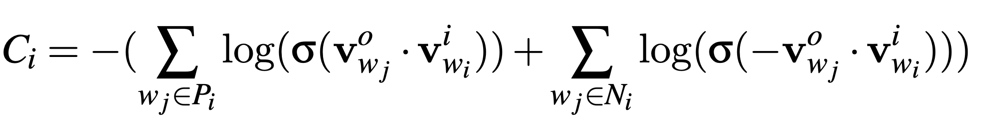
Actual cost function for word2vec
Skipping the denominator, which is expensive to compute
A small sample of words not in context

Slide 35
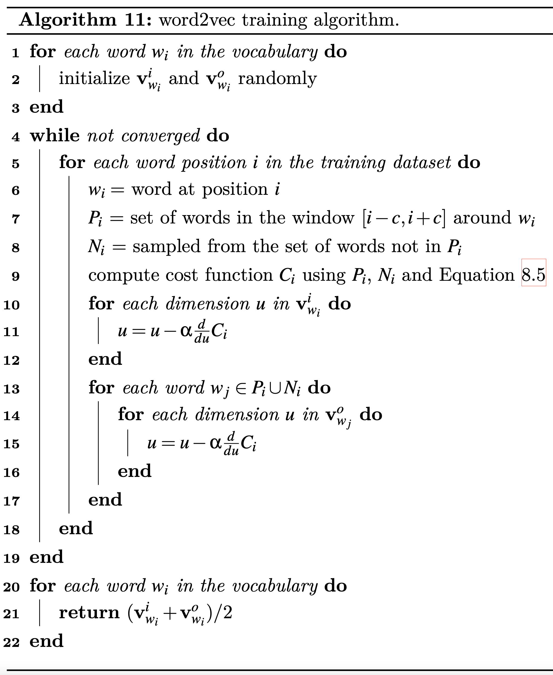

Slide 36
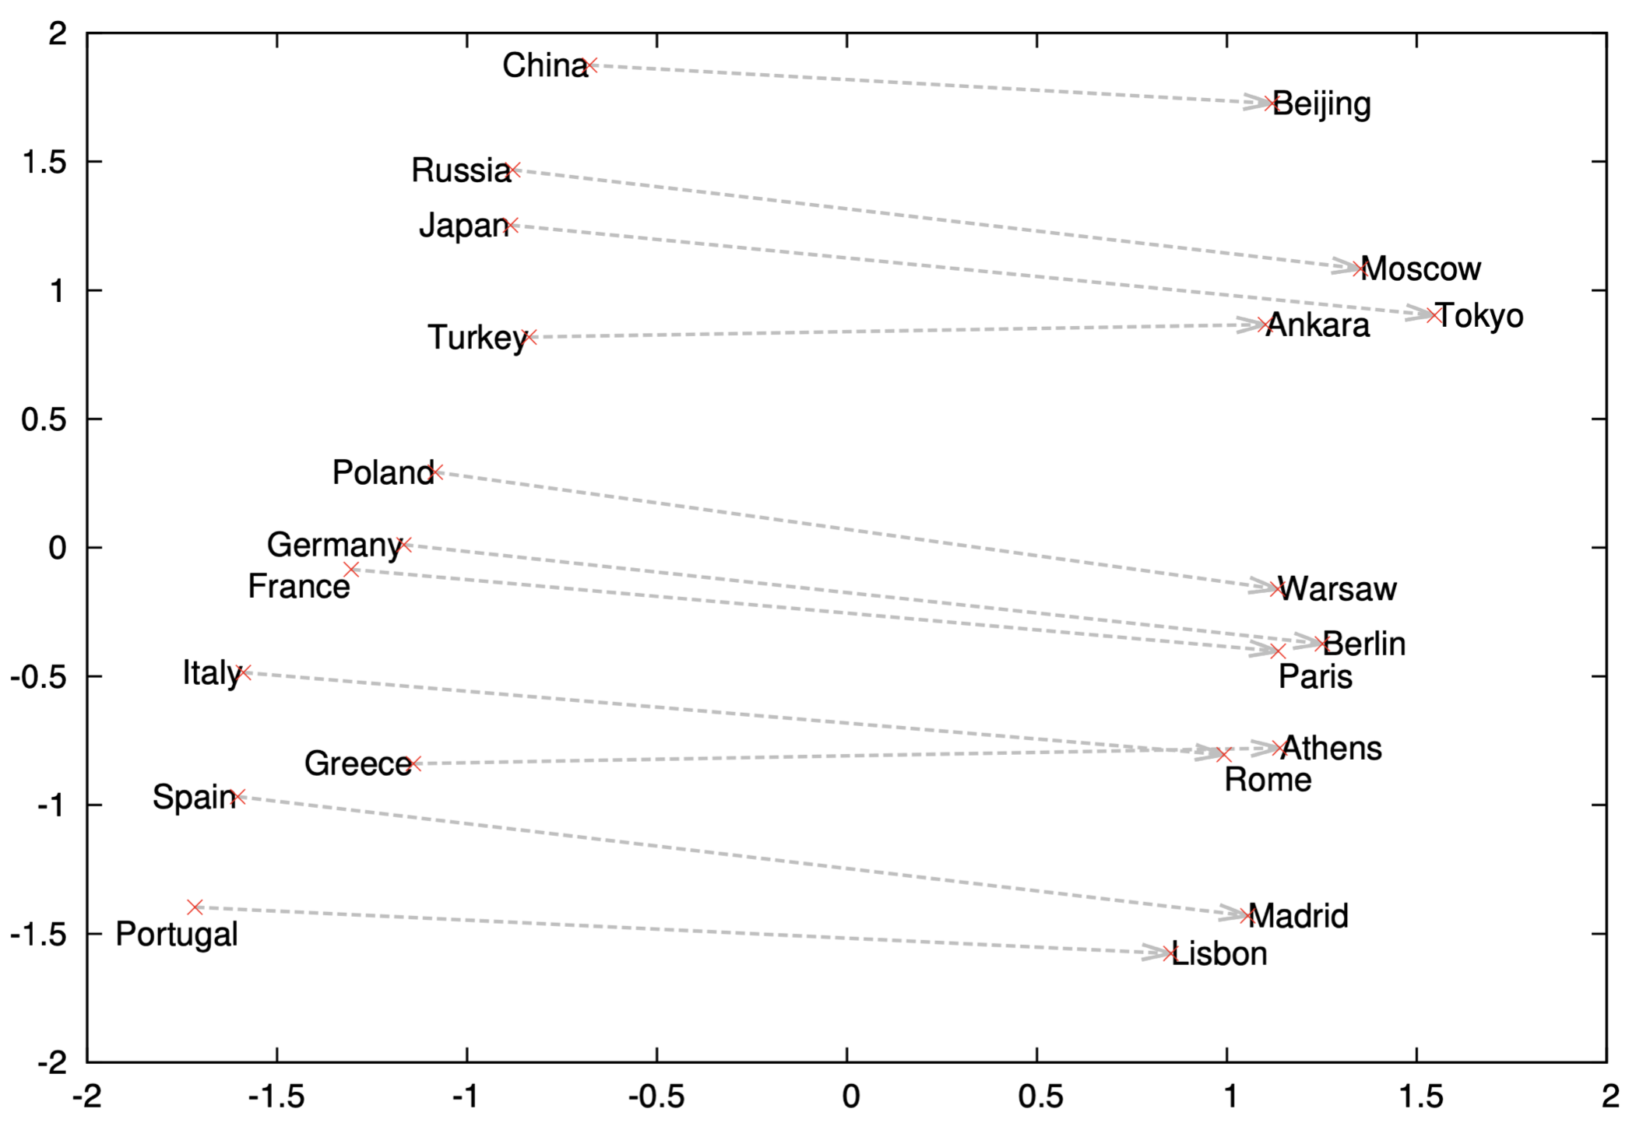
What does word2vec learn?

Slide 37
What does word2vec learn?
The vectors capture meaningful semantics:
v(China) – v(Beijing) = v(France) – v(Paris)
v(king) – v(man) = v(queen) – v(woman)

Slide 38
Drawbacks of word2vec
The numerical representations are static, i.e., they are the same for all senses of a word:
Bank of the river
Bank of America
The numerical representations capture potential biases in the textual data:
v(doctor) – v(man) = v(nurse) – v(woman)

Slide 39
Take away
Distributional hypothesis
Traditional distributional representation
The word2vec algorithm
Drawbacks of word2vec

