Slide 1
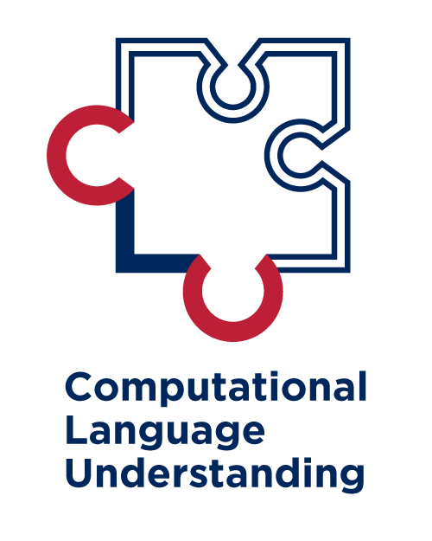

On Machine Reasoning
Mihai Surdeanu
February 2023

Slide 2
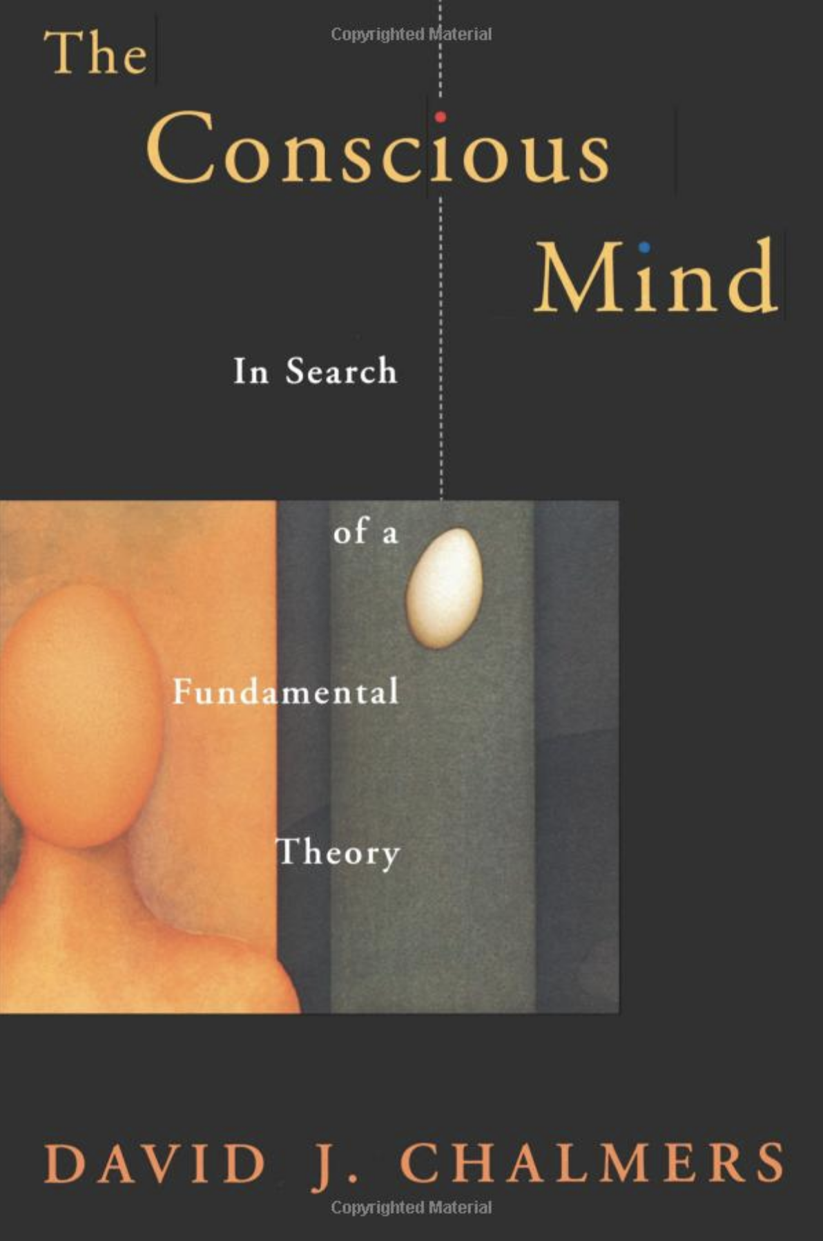
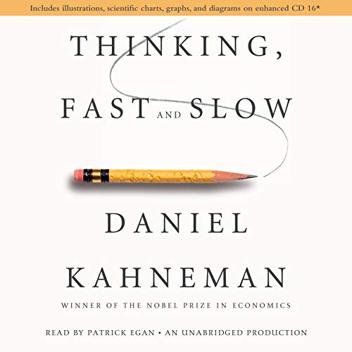
Mihai’s poor consciousness taxonomy
consciousness
phenomenal
(how you feel)
first person
hard
psychological
(how you act)
third person
easy
system 1
(automated action)
easier
system 2
(mental activity)
harder

Slide 3
Organization of my talk:
Reasoning as two systems (Kahneman 2011)

Slide 4
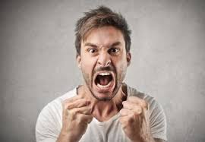
System 1
The man is angry

Slide 5
System 1
Bread and …

Slide 6
System 1
Bread and butter

Slide 7
System 1
Kahneman: “System 1 operates automatically and quickly, with little or no effort and no sense of voluntary control.”
Neural networks perform well at System 1 tasks

Slide 8
System 2
173
x 327
_____

Slide 9
System 2
173
x 327
_____
56,571

Slide 10
System 2 == reasoning
Kahneman: “System 2 allocates attention to the effortful mental activities that demand it, including complex computations.”
Manning: “Understanding bigger things from knowing smaller parts.”
(Vanilla) neural networks do not perform well at System 2 tasks

Slide 11
Types of reasoning
Logic (be it first-order logic or natural logic)
Graph-based algorithms
Reinforcement learning
Sequence-to-sequence

