Slide 1

Markov Logic
Sixth generation computing?
Using FOL to wire-together structured max ent dist.

Slide 2
Markov Logic:
A Unifying Language for Information and Knowledge Management
Pedro Domingos
Dept. of Computer Science & Eng.
University of Washington
Joint work with Stanley Kok, Daniel Lowd,
Hoifung Poon, Matt Richardson, Parag Singla,
Marc Sumner, and Jue Wang
Markov Logic: A Unifying Language for Information and Knowledge Management
Pedro Domingos, 2008 (1616 views)
@ ACM 17th Conference on Information and Knowledge Management (CIKM), Napa Valley 2008
http://videolectures.net/cikm08_domingos_mlmaul/?q=markov%20logic%20networks

Slide 3
Overview
Motivation
Background
Markov logic
Inference
Learning
Software
Applications
Discussion

Slide 4
Information & Knowledge Management Circa 1988
Databases
SQL
Datalog
Knowledge bases
First-order logic
Free text
Information retrieval
NLP
Structured Information Unstructured

Slide 5
Information & Knowledge Management Today (=2008)
Web Services
SOAP
WSDL
Hypertext
HTML
Databases
SQL
Datalog
Knowledge bases
First-order logic
Free text
Information retrieval
NLP
Semi-Structured Info.
XML
Deep Web
Semantic Web
RDF
OWL
Information Extraction
Sensor Data
Structured Information Unstructured

Slide 6
What We Need
We need languages that can handle
  Structured information
  Unstructured information
  Any variation or combination of them
We need efficient algorithms for them
  Inference
  Machine learning

Slide 7
This Talk: Markov Logic
Unifies first-order logic and probabilistic graphical models
  First-order logic handles structured information
  Probability handles unstructured information
  No separation between the two
Builds on previous work
  KBMC, PRMs, etc.
First practical language with complete
open-source implementation

Slide 8
Markov Logic
Syntax: Weighted first-order formulas
Semantics: Templates for Markov nets
Inference: WalkSAT, MCMC, KBMC
Learning: Voted perceptron, pseudo-likelihood, inductive logic programming
Software: Alchemy
Applications: Information extraction,
Web mining, social networks, ontology refinement, personal assistants, etc.

Slide 9
Overview
Motivation
Background
Markov logic
Inference
Learning
Software
Applications
Discussion

Slide 10
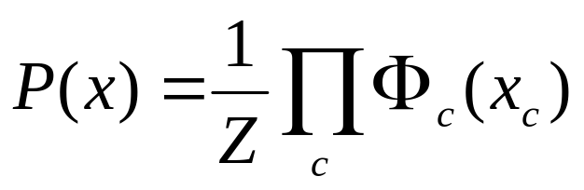
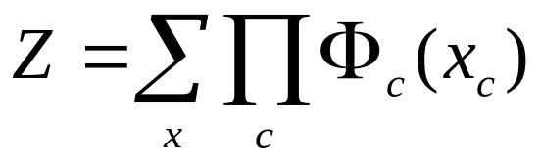
Markov Networks
Undirected graphical models
Smoking
Cancer
Asthma
Cough
Potential functions defined over cliques
Smoking | Cancer | Ф(S,C)
False | False | 4.5
False | True | 4.5
True | False | 2.7
True | True | 4.5
Notes:
Potential function

Slide 11
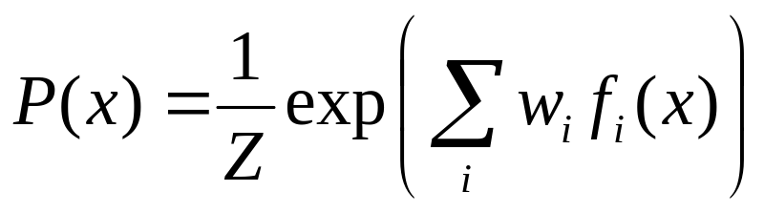
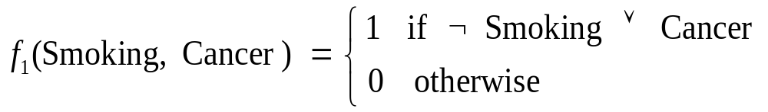

Markov Networks
Undirected graphical models
Smoking
Cancer
Asthma
Cough
Log-linear model:
Weight of Feature i
Feature i

Slide 12
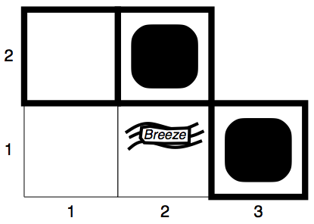
Models – Prop. Logic Example
Logicians often characterize semantics (meaning) in terms of models.
¬P12
P22
α₁ : P21 ⋁ P31
α₂ : P21 ⋀ P31
P31
¬P11
¬B11
B21
¬P21

Slide 13
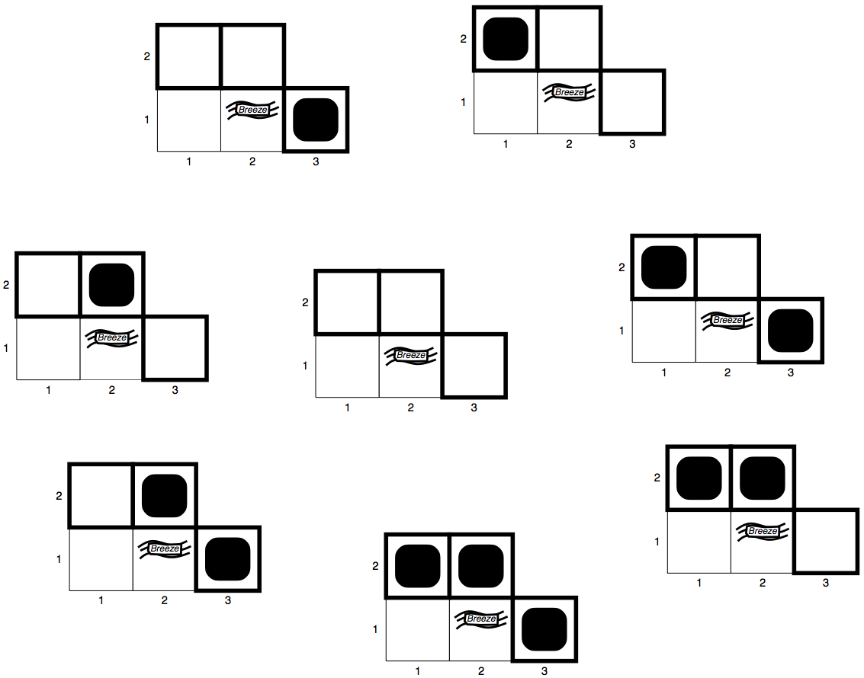
Models – Prop. Logic Example
Logicians often characterize semantics (meaning) in terms of models.
¬P12
P22
α₁ : P21 ⋁ P31
α₂ : P21 ⋀ P31
P31
¬P11
¬B11
B21
¬P21

Slide 14

Models
We say m is a model of a sentence α if m makes α true
M(α) is the set of all models of α
Then KB ⊨ α iff M(KB) ⊂ M(α)
  KB = UA won and ASU won
  α = UA won
  Then KB ⊨ α
M(α)
A particular model
α₁ : P21 ⋁ P31

Slide 15

Entailment in the Wumpus World
Situation after detecting nothing in [1,1], moving right, breeze in [2,1]
Consider possible models for KB assuming only pits and restricting cells to {(1,3)(2,1)(2,2)}
3 Boolean choices, so 2³=8 possible models

Slide 16
Wumpus Models

Slide 17
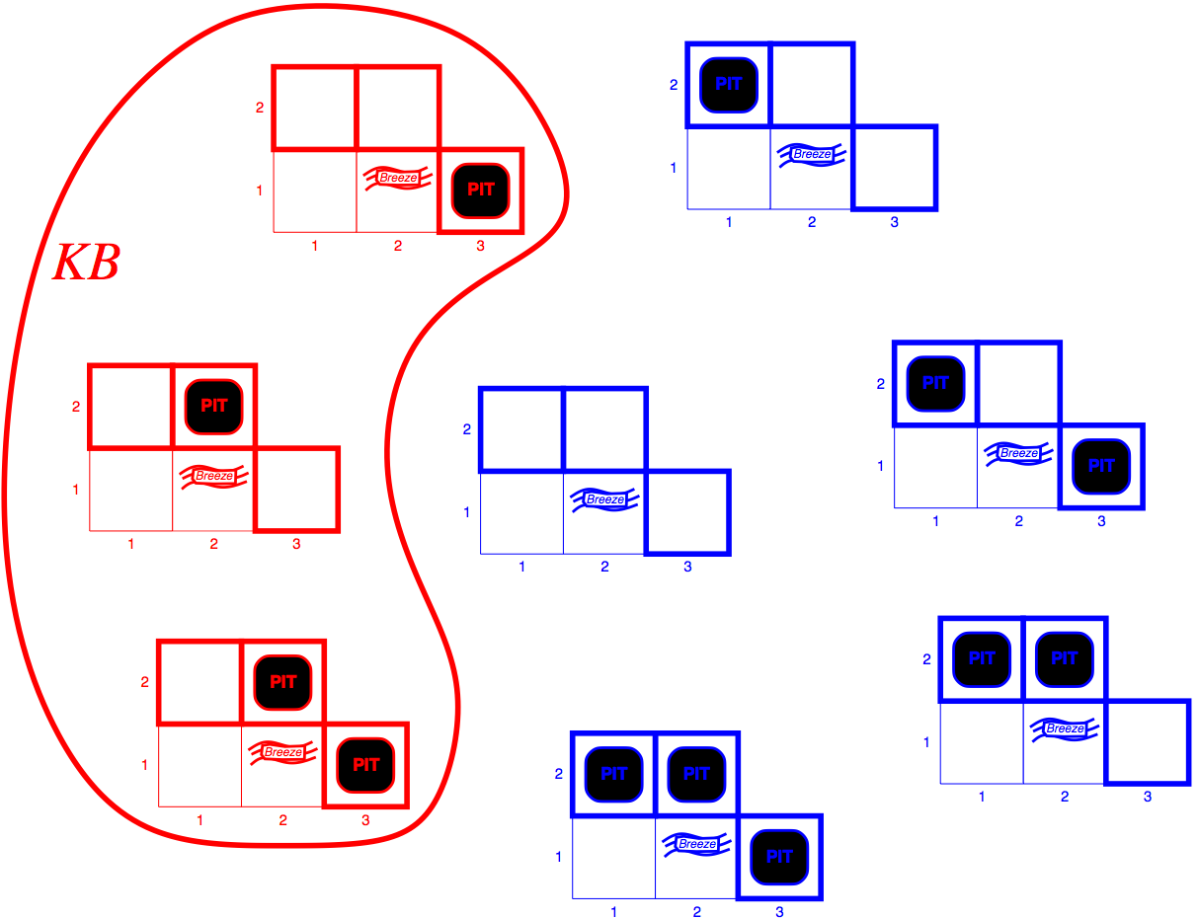
Wumpus Models
KB = wumpus-world rules + observations

Slide 18
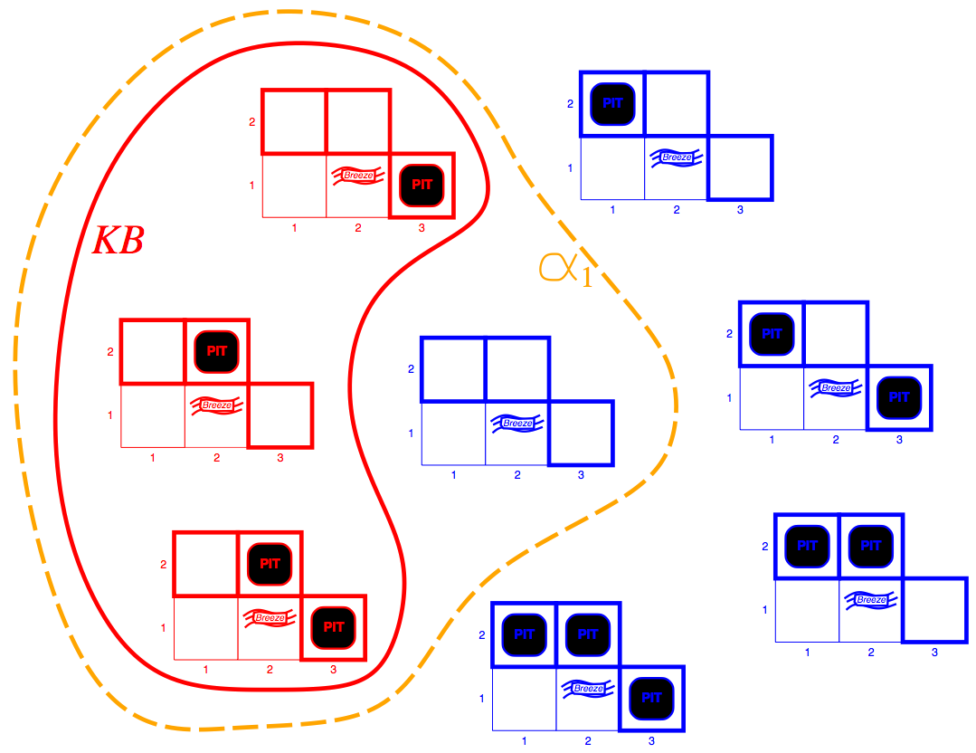
Wumpus Models
KB = wumpus-world rules + observations
α₁ = “[1,2] is safe”

Slide 19
Wumpus Models
KB = wumpus-world rules + observations
α₁ = “[1,2] is safe” – Since all KB models include α₁
KB ⊨ α₁ , proved by Model Checking.

Slide 20
Wumpus Models
KB = wumpus-world rules + observations

Slide 21
Wumpus Models
KB = wumpus-world rules + observations
α₂ = “[2,2] is safe”

Slide 22
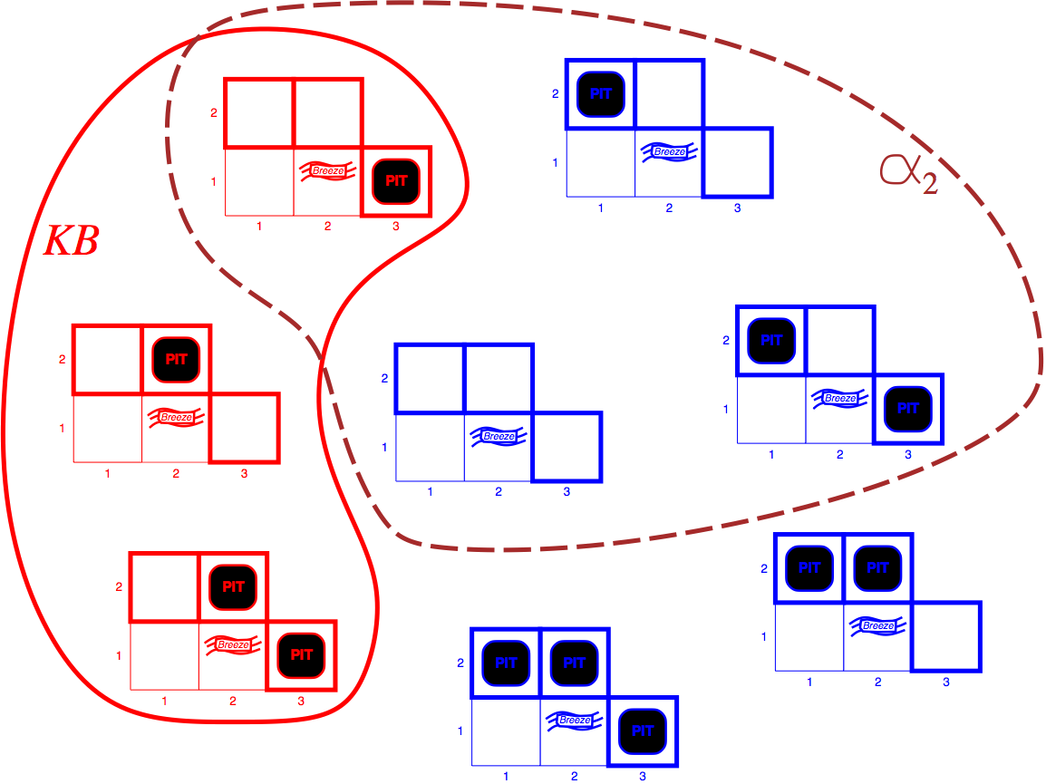
Wumpus Models
KB = wumpus-world rules + observations
α₂ = “[2,2] is safe”
KB ⊭ α₂

Slide 23
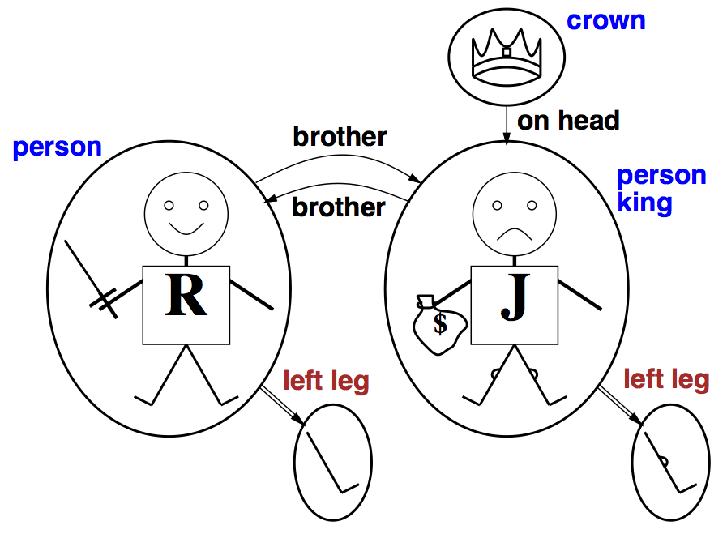
Models for FOL: Example
Notes:
Richard the Lionheart
King John

Slide 24
First-Order Logic
Constants, variables, functions, predicates
E.g.: Anna, x, MotherOf(x), Friends(x,y)
Grounding: Replace all variables by constants
E.g.: Friends (Anna, Bob)
World (model, interpretation):
Assignment of truth values to all ground predicates

Slide 25
FOL Inference
What to do with these variables?
  Universal Instantiation – assign ground terms
  Existential Instantiation – Skolem constants
Reduction to Propositional Inference
  Practical problems with propositionalization
Handle variables better: Unification
Efficient Inference with F.O. definite clauses
  Generalized Modus Ponens
  Forward Chaining (Datalog)
  Backward Chaining (Logic Programming)
First-Order Resolution
  F.O. Conversion to CNF (including Skolemnization)
  Then Resolution: proof by contradiction using unification & resolution

Slide 26
Overview
Motivation
Background
Markov logic
Inference
Learning
Software
Applications
Discussion

Slide 27
Markov Logic
A logical KB is a set of hard constraints
on the set of possible worlds
Let’s make them soft constraints:
When a world violates a formula,
It becomes less probable, not impossible
Give each formula a weight
(Higher weight ⇒ Stronger constraint)

Slide 28
Definition
A Markov Logic Network (MLN) is a set of pairs (F, w) where
  F is a formula in first-order logic
  w is a real number
Together with a set of constants,
it defines a Markov network with
  One node for each grounding of each predicate in the MLN
  One feature for each grounding of each formula F in the MLN, with the corresponding weight w

Slide 29
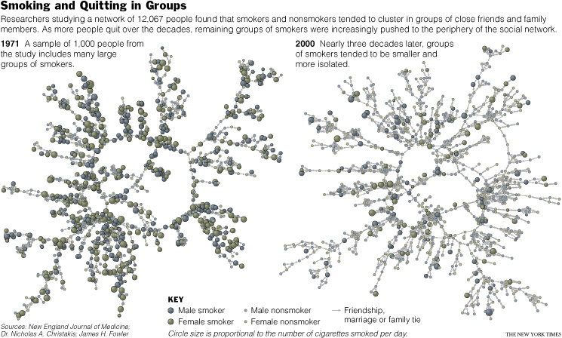
Example: Friends & Smokers

Slide 30
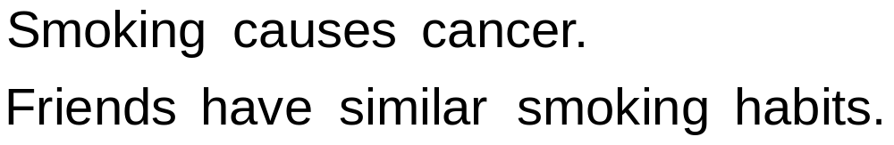
Example: Friends & Smokers

Slide 31
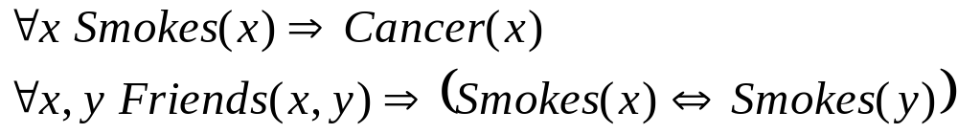
Example: Friends & Smokers

Slide 32

Example: Friends & Smokers

Slide 33
Example: Friends & Smokers
Two constants: Anna (A) and Bob (B)

Slide 34
Example: Friends & Smokers
Two constants: Anna (A) and Bob (B)
Smokes(A)
Smokes(B)
Cancer(A)
Cancer(B)

Slide 35
Example: Friends & Smokers
Two constants: Anna (A) and Bob (B)
Friends(A,B)
Friends(A,A)
Smokes(A)
Smokes(B)
Friends(B,B)
Cancer(A)
Cancer(B)
Friends(B,A)

Slide 36
Example: Friends & Smokers
Two constants: Anna (A) and Bob (B)
Friends(A,B)
Friends(A,A)
Smokes(A)
Smokes(B)
Friends(B,B)
Cancer(A)
Cancer(B)
Friends(B,A)

Slide 37
Example: Friends & Smokers
Two constants: Anna (A) and Bob (B)
Friends(A,B)
Friends(A,A)
Smokes(A)
Smokes(B)
Friends(B,B)
Cancer(A)
Cancer(B)
Friends(B,A)

Slide 38
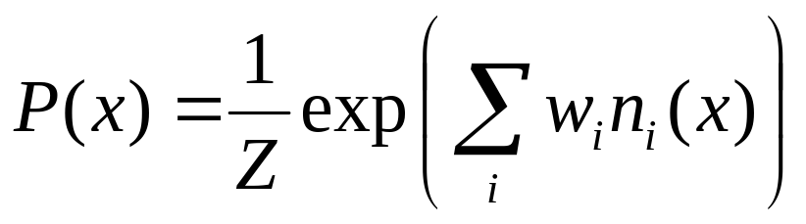
Markov Logic Networks
MLN is template for ground Markov nets
Probability of a world x:
Typed variables and constants greatly reduce size of ground Markov net
Functions, existential quantifiers, etc.
Infinite and continuous domains
Weight of formula i
No. of true groundings of formula i in x

Slide 39
Relation to First-Order Logic
Infinite weights ⇒ First-order logic
Satisfiable KB, finite positive weights ⇒
Satisfying assignments = Modes of distribution
Markov logic allows contradictions between formulas

Slide 40
Relation to Statistical Models
Special cases:
  Markov networks
  Markov random fields
  Bayesian networks
  Log-linear models
  Exponential models
  Max. entropy models
  Gibbs distributions
  Boltzmann machines
  Logistic regression
  Hidden Markov models
  Conditional random fields
Obtained by making all predicates zero-arity
Markov logic allows objects to be interdependent
(non-i.i.d.)

Slide 42
Overview
Motivation
Background
Markov logic
Inference
Learning
Software
Applications
Discussion

Slide 43
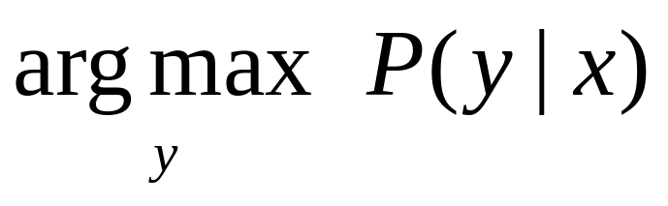
MAP/MPE Inference
Problem: Find most likely state of world given evidence
Query
Evidence
Notes:
MPE = Most probable explanation
Symptoms, what’s most probable disease that explains them.
This is what the viterbi algorithm does

Slide 44
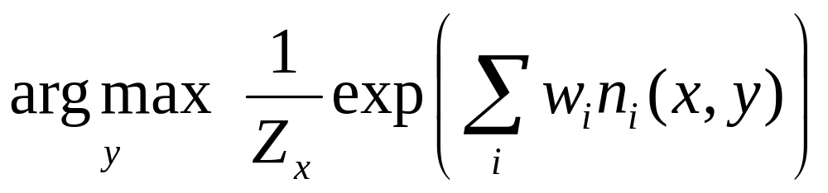
MAP/MPE Inference
Problem: Find most likely state of world given evidence
Notes:
Monotonically increasing fun, so really only need to maximize what’s inside

Slide 45
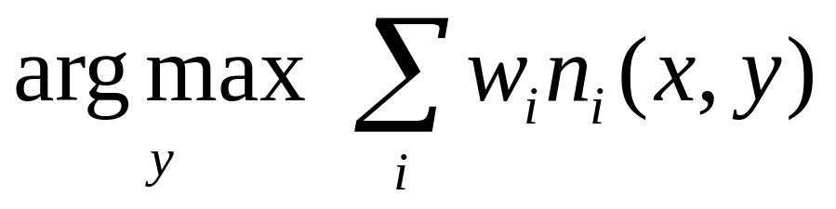
MAP/MPE Inference
Problem: Find most likely state of world given evidence
Notes:
What we’re doing: find assignment of values to boolean variables that maximizes the sum of the weights of the ground formulas you have

Slide 46
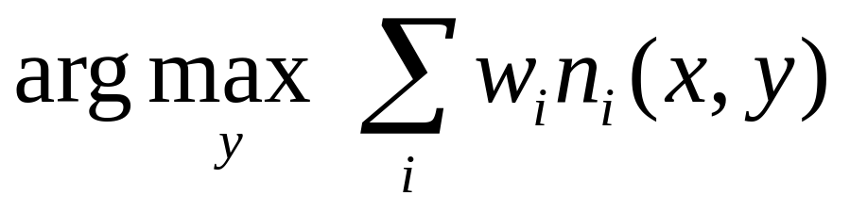
MAP/MPE Inference
Problem: Find most likely state of world given evidence
This is just the weighted MaxSAT problem
Use weighted SAT solver
(e.g., MaxWalkSAT [Kautz et al., 1997] )
Potentially faster than logical inference (!)
Notes:
This is just the weighted maxSat problem: satisfiability problem (looking for assignments that satisfy all formulae) – max sat: satisfy as many as possible
Faster than logical inference
surprising: FOL is not fast, neither prob. Inference
Turns out that using this scheme, can do inference in MLN faster than FOL
b/c if take previously hard constraints and make them soft, then easier problem to solve

Slide 47
The WalkSAT Algorithm
for i ← 1 to max-tries do
solution = random truth assignment
for j ← 1 to max-flips do
if all clauses satisfied then
return solution
c ← random unsatisfied clause
with probability p
flip a random variable in c
else
flip variable in c that maximizes
number of satisfied clauses
return failure
Notes:
Goal: find an assignment of truth values to boolean varaibles that makes all clauses in KB true at same time
Greedy search step
or
(b) Random step: to avoid local minima
(same idea as metropolis hastings!

Slide 48
The MaxWalkSAT Algorithm
for i ← 1 to max-tries do
solution = random truth assignment
for j ← 1 to max-flips do
if ∑ weights(sat. clauses) > threshold then
return solution
c ← random unsatisfied clause
with probability p
flip a random variable in c
else
flip variable in c that maximizes
∑ weights(sat. clauses)
return failure, best solution found
Notes:
Same algo,
but instead of flipping var that maximizes the number of satisfied formulas, instead maximes the sum of the weights of the satisfied formulas
Can use for MAP inference

Slide 49
But … Memory Explosion
Problem:
If there are n constants
and the highest clause arity is c,
the ground network requires O(n ) memory
Solution:
Exploit sparseness of relational domains; ground clauses lazily
→ LazySAT algorithm [Singla & Domingos, 2006]
c
Notes:
Problem: memory explosion when grounding network
Claim handling every work in English language is a constant
6 billion people in world
36 billion billion groundings of potential friendship
Most ground clauses are trivially satisfied b/c their preconditions don’t fire

Slide 50
Computing Probabilities
P(Formula|MLN,C) = ?
MCMC: Sample worlds, check formula holds
P(Formula1|Formula2,MLN,C) = ?
If Formula2 = Conjunction of ground atoms
  First construct min subset of network necessary to answer query (generalization of KBMC)
  Then apply MCMC (or other)
Can also do lifted (resolution) inference
[Singla & Domingos, 2008]
Notes:
Other main inference problem: computing probabilities
P(Formula is true) is simply sum of prob of worlds for which the formula is true
Can’t do exhaustively.
Instead, sample to estimate (Monte Carlo)
in each world, check wether world satisfies formula, count relative to total
conditioning: check if conditioning formula holds, if so, then count
----
Conditioning formula is conjunction of ground facts
Construct minimum subset of network needed to answer the query, and do inference on that…
----
Lifted resolution

Slide 51
Ground Network Construction
network ← Ø
queue ← query nodes
repeat
node ← front(queue)
remove node from queue
add node to network
if node not in evidence then
add neighbors(node) to queue
until queue = Ø
Notes:
Knowledge-based model construction
Construct minimum network out from query nodes until hit evidence
Search outward for boundary made up of evidence
If find the evidence boundary, then could stop
“Observed” Markov blanket!

Slide 52
MCMC: Gibbs Sampling
state ← random truth assignment
for i ← 1 to num-samples do
for each variable x
sample x according to P(x|neighbors(x))
state ← state with new value of x
P(F) ← fraction of states in which F is true

Slide 53
But … Insufficient for Logic
Problem:
Deterministic dependencies break MCMC
Near-deterministic ones make it very slow
Solution:
Combine MCMC and WalkSAT
→ MC-SAT algorithm [Poon & Domingos, 2006]
Notes:
Next sample is proposed by a sat solver --- SAT solver become the proposal distribution, rather than deterministic (and therefore not reversible) constraints

Slide 54
Overview
Motivation
Background
Markov logic
Inference
Learning
Software
Applications
Discussion

Slide 55
Learning
Data is a relational database
Closed world assumption (if not: EM)
Learning parameters (weights)
  Generatively
  Discriminatively
Learning structure (formulas)
Notes:
Closed world assumption:
Every ground predicate not in db is assumed false

Slide 56
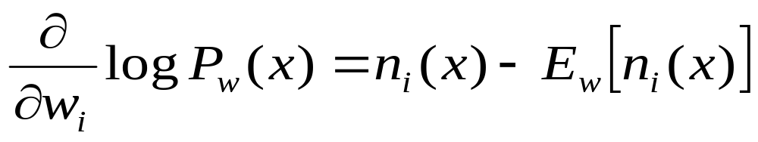
Generative Weight Learning
Maximize likelihood
  Not closed form (so need to do iterative update)
  But, is convex - No local maxima
Use gradient ascent or L-BFGS
Requires inference at each step (to get the expectation) (slow!)
No. of true groundings of clause i in data
Expected no. true groundings according to model
Notes:
L-BFGS – quasi-Newton second order gradient methods
Expectation is expensive: requires inference! Still costly

Slide 57
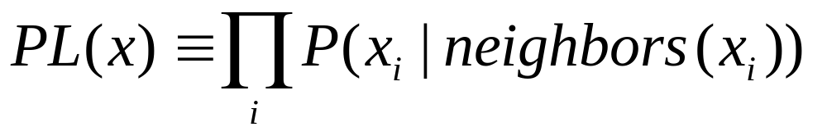
Pseudo-Likelihood
Likelihood of each variable given its neighbors in the data [Besag, 1975]
Does not require inference at each step
Consistent estimator
Widely used in vision, spatial statistics, etc.
But PL parameters may not work well for
long inference chains (misses long-range effects)
Notes:
Optimize something easier that has some relation to original problem
Just markov blanket (Gibbs sampling)
Combine with L-BFGS is fast
But sometimes gives bad results – doesn’t take into account long-range effects

Slide 58
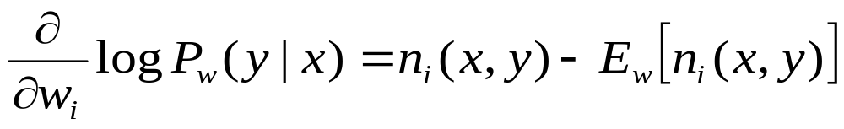
Discriminative Weight Learning
Maximize conditional likelihood of query (y) given evidence (x)
Approximate expected counts by counts in MAP state of y given x
No. of true groundings of clause i in data
Expected no. true groundings according to model
Notes:
When you know in advance which variables will be query and which will be evidence
Tends to give better results
Maximize conditional likelihood of the query
Don’t need dependecies between query variables.
Inference is usually hard b/c have many modes and need to find an average over them.
But when you condition on evidence, modes go away – more you condition on, more go away.
Instead, just find most likely state and take as average over all states.

Slide 59
Voted Perceptron
Originally proposed for training HMMs discriminatively [Collins, 2002]
Assumes network is linear chain
w_{i} ← 0
for t ← 1 to T do
y_{MAP} ← Viterbi(x)
w_{i} ← w_{i} + η [count_{i}(y_{Data}) – count_{i}(y_{MAP})]
return ∑_{t} w_{i} / T
Notes:
Take counts in most likely state as
Assume network is a linear chain – sequential perceptron.

Slide 60
Voted Perceptron for MLNs
HMMs are special case of MLNs
Replace Viterbi by MaxWalkSAT
Network can now be arbitrary graph
w_{i} ← 0
for t ← 1 to T do
y_{MAP} ← MaxWalkSAT(x)
w_{i} ← w_{i} + η [count_{i}(y_{Data}) – count_{i}(y_{MAP})]
return ∑_{t} w_{i} / T
Notes:
Use MaxWalkSAT to do MAP inference.

Slide 61
Structure Learning
Generalizes feature induction in Markov nets
Any inductive logic programming approach can be used, but . . .
Goal is to induce any clauses, not just Horn
Evaluation function should be likelihood
Requires learning weights for each candidate
Turns out not to be bottleneck
Bottleneck is counting clause groundings
Solution: Subsampling

Slide 62
Structure Learning
Initial state: Unit clauses or hand-coded KB
Operators: Add/remove literal, flip sign
Evaluation function:
Pseudo-likelihood + Structure prior
Search:
  Beam [Kok & Domingos, 2005]
  Shortest-first [Kok & Domingos, 2005]
  Bottom-up [Mihalkova & Mooney, 2007]

Slide 63
Overview
Motivation
Background
Markov logic
Inference
Learning
Software
Applications
Discussion

Slide 64
Alchemy
Open-source software including:
Full first-order logic syntax
Generative & discriminative weight learning
Structure learning
Weighted satisfiability and MCMC
Programming language features
alchemy.cs.washington.edu

Slide 65
 | Alchemy | Prolog | BUGS
Represent-ation | F.O. Logic + Markov nets | Horn clauses | Bayes nets
Inference | Model check- ing, MC-SAT | Theorem proving | Gibbs sampling
Learning | Parameters & structure | No | Params.
Uncertainty | Yes | No | Yes
Relational | Yes | Yes | No

Slide 66
Overview
Motivation
Background
Markov logic
Inference
Learning
Software
Applications
Discussion

Slide 67
Applications
Information extraction*
Entity resolution
Link prediction
Collective classification
Web mining
Natural language processing
Ontology refinement **
Computational biology
Social network analysis
Activity recognition
Probabilistic Cyc
CALO
Etc.
* Winner of LLL-2005 information extraction competition
[Riedel & Klein, 2005]
** Best paper award at CIKM-2007 [Wu & Weld, 2007]

Slide 68
Information Extraction
Parag Singla and Pedro Domingos, “Memory-Efficient
Inference in Relational Domains” (AAAI-06).
Singla, P., & Domingos, P. (2006). Memory-efficent
inference in relatonal domains. In Proceedings of the
Twenty-First National Conference on Artificial Intelligence
(pp. 500-505). Boston, MA: AAAI Press.
H. Poon & P. Domingos, Sound and Efficient Inference
with Probabilistic and Deterministic Dependencies”, in
Proc. AAAI-06, Boston, MA, 2006.
P. Hoifung (2006). Efficent inference. In Proceedings of the
Twenty-First National Conference on Artificial Intelligence.

Slide 69
Segmentation
Author
Title
Venue
Parag Singla and Pedro Domingos, “Memory-Efficient
Inference in Relational Domains” (AAAI-06).
Singla, P., & Domingos, P. (2006). Memory-efficent
inference in relatonal domains. In Proceedings of the
Twenty-First National Conference on Artificial Intelligence
(pp. 500-505). Boston, MA: AAAI Press.
H. Poon & P. Domingos, Sound and Efficient Inference
with Probabilistic and Deterministic Dependencies”, in
Proc. AAAI-06, Boston, MA, 2006.
P. Hoifung (2006). Efficent inference. In Proceedings of the
Twenty-First National Conference on Artificial Intelligence.

Slide 70
Entity Resolution
Parag Singla and Pedro Domingos, “Memory-Efficient
Inference in Relational Domains” (AAAI-06).
Singla, P., & Domingos, P. (2006). Memory-efficent
inference in relatonal domains. In Proceedings of the
Twenty-First National Conference on Artificial Intelligence
(pp. 500-505). Boston, MA: AAAI Press.
H. Poon & P. Domingos, Sound and Efficient Inference
with Probabilistic and Deterministic Dependencies”, in
Proc. AAAI-06, Boston, MA, 2006.
P. Hoifung (2006). Efficent inference. In Proceedings of the
Twenty-First National Conference on Artificial Intelligence.

Slide 71
Entity Resolution
Parag Singla and Pedro Domingos, “Memory-Efficient
Inference in Relational Domains” (AAAI-06).
Singla, P., & Domingos, P. (2006). Memory-efficent
inference in relatonal domains. In Proceedings of the
Twenty-First National Conference on Artificial Intelligence
(pp. 500-505). Boston, MA: AAAI Press.
H. Poon & P. Domingos, Sound and Efficient Inference
with Probabilistic and Deterministic Dependencies”, in
Proc. AAAI-06, Boston, MA, 2006.
P. Hoifung (2006). Efficent inference. In Proceedings of the
Twenty-First National Conference on Artificial Intelligence.

Slide 72
State of the Art
Segmentation – latent labeling problem
  HMM (or CRF) to assign each token to a field
Entity resolution
  Logistic regression to predict same field/citation
  Transitive closure
Alchemy implementation: Seven formulas

Slide 73
Types and Predicates
token = {Parag, Singla, and, Pedro, ...}
field = {Author, Title, Venue}
citation = {C1, C2, ...}
position = {0, 1, 2, ...}
Token(token, position, citation)
InField(position, field, citation)
SameField(field, citation, citation)
SameCit(citation, citation)

Slide 74
Types and Predicates
token = {Parag, Singla, and, Pedro, ...}
field = {Author, Title, Venue, ...}
citation = {C1, C2, ...}
position = {0, 1, 2, ...}
Token(token, position, citation)
InField(position, field, citation)
SameField(field, citation, citation)
SameCit(citation, citation)
Optional
Notes:
Could infer types from DB

Slide 75
Types and Predicates
token = {Parag, Singla, and, Pedro, ...}
field = {Author, Title, Venue}
citation = {C1, C2, ...}
position = {0, 1, 2, ...}
Token(token, position, citation)
InField(position, field, citation)
SameField(field, citation, citation)
SameCit(citation, citation)
Evidence
Notes:
Predicate token - evidence: token occurs in position

Slide 76
Types and Predicates
token = {Parag, Singla, and, Pedro, ...}
field = {Author, Title, Venue}
citation = {C1, C2, ...}
position = {0, 1, 2, ...}
Token(token, position, citation)
InField(position, field, citation)
SameField(field, citation, citation)
SameCit(citation, citation)
Query
Notes:
Query: what we’d like to learn
Segmentation
inField: this position in this citation Is part of this field
Once we’ve inferred the truth values of this predicate, will know which tokens belong to which fields
Entity resolution:
SameField
SameCit – same citations
Write MLN that takes Tokens and infers three predicates

Slide 77
Formulas
Token(+t,i,c) => InField(i,+f,c)
InField(i,+f,c) <=> InField(i+1,+f,c)
f != f’ => (!InField(i,+f,c) v !InField(i,+f’,c))
Token(+t,i,c) ^ InField(i,+f,c) ^ Token(+t,i’,c’)
^ InField(i’,+f,c’) => SameField(+f,c,c’)
SameField(+f,c,c’) <=> SameCit(c,c’)
SameField(f,c,c’) ^ SameField(f,c’,c”)
=> SameField(f,c,c”)
SameCit(c,c’) ^ SameCit(c’,c”) => SameCit(c,c”)
Notes:
Top 3 do segmentation
Bottom 4 do entity resolution

Slide 78
Formulas
Token(+t,i,c) => InField(i,+f,c)
InField(i,+f,c) <=> InField(i+1,+f,c)
f != f’ => (!InField(i,+f,c) v !InField(i,+f’,c))
Token(+t,i,c) ^ InField(i,+f,c) ^ Token(+t,i’,c’)
^ InField(i’,+f,c’) => SameField(+f,c,c’)
SameField(+f,c,c’) <=> SameCit(c,c’)
SameField(f,c,c’) ^ SameField(f,c’,c”)
=> SameField(f,c,c”)
SameCit(c,c’) ^ SameCit(c’,c”) => SameCit(c,c”)
Notes:
First three define an HMM
If I have a certain token in certain position, then that position is in a certain field
All free vars a universally quantified, so this grounds out to every field and token combination
Think about the role of the implication!: IF token is true, then InField has to be true. That’s a particular assumption: this allows that token is NOT ALWAYS present when in that field.
+ means learn a different weight for every combination of variables that have these +’s
+ means learn weights for each different combination of token (t) and fields (f) – capture correlations
So the first formula learn an observation/emission
observations are tokens, states are fields.
Weights capture correlations between tokens and fields

Slide 79
Formulas
Token(+t,i,c) => InField(i,+f,c)
InField(i,+f,c) <=> InField(i+1,+f,c)
f != f’ => (!InField(i,+f,c) v !InField(i,+f’,c))
Token(+t,i,c) ^ InField(i,+f,c) ^ Token(+t,i’,c’)
^ InField(i’,+f,c’) => SameField(+f,c,c’)
SameField(+f,c,c’) <=> SameCit(c,c’)
SameField(f,c,c’) ^ SameField(f,c’,c”)
=> SameField(f,c,c”)
SameCit(c,c’) ^ SameCit(c’,c”) => SameCit(c,c”)
Notes:
Transition matrix:
Tend to stay in author field – sufficient for IR to capture staying in same field
(could try to learn transition from any field to any field by include f ⬄ f’, but not necessary here)

Slide 80
Formulas
Token(+t,i,c) => InField(i,+f,c)
InField(i,+f,c) <=> InField(i+1,+f,c)
f != f’ => (!InField(i,+f,c) v !InField(i,+f’,c))
Token(+t,i,c) ^ InField(i,+f,c) ^ Token(+t,i’,c’)
^ InField(i’,+f,c’) => SameField(+f,c,c’)
SameField(+f,c,c’) <=> SameCit(c,c’)
SameField(f,c,c’) ^ SameField(f,c’,c”)
=> SameField(f,c,c”)
SameCit(c,c’) ^ SameCit(c’,c”) => SameCit(c,c”)
Notes:
I can’t be in more than one field at once
We could handle things not in any field without having to create a dummy “other” field, but this adds the constraint that

Slide 81
Formulas
Token(+t,i,c) => InField(i,+f,c)
InField(i,+f,c) <=> InField(i+1,+f,c)
f != f’ => (!InField(i,+f,c) v !InField(i,+f’,c))
Token(+t,i,c) ^ InField(i,+f,c) ^ Token(+t,i’,c’)
^ InField(i’,+f,c’) => SameField(+f,c,c’)
SameField(+f,c,c’) <=> SameCit(c,c’)
SameField(f,c,c’) ^ SameField(f,c’,c”)
=> SameField(f,c,c”)
SameCit(c,c’) ^ SameCit(c’,c”) => SameCit(c,c”)
Notes:
Entity resolution
Predicts whether two fields are the field by whether they share the same tokens
similarity comparison between fields
like a logistic regression: features -> class variable

Slide 82
Formulas
Token(+t,i,c) => InField(i,+f,c)
InField(i,+f,c) <=> InField(i+1,+f,c)
f != f’ => (!InField(i,+f,c) v !InField(i,+f’,c))
Token(+t,i,c) ^ InField(i,+f,c) ^ Token(+t,i’,c’)
^ InField(i’,+f,c’) => SameField(+f,c,c’)
SameField(+f,c,c’) <=> SameCit(c,c’)
SameField(f,c,c’) ^ SameField(f,c’,c”)
=> SameField(f,c,c”)
SameCit(c,c’) ^ SameCit(c’,c”) => SameCit(c,c”)
Notes:
Equivalence
If fields are same, citations are the same (and vice versa)
two papers that we conclude are the same then can infer conference fields are same
If papers are the same
Uses info from other connections to propagate constraints, rather than pipeline

Slide 83
Formulas
Token(+t,i,c) => InField(i,+f,c)
InField(i,+f,c) <=> InField(i+1,+f,c)
f != f’ => (!InField(i,+f,c) v !InField(i,+f’,c))
Token(+t,i,c) ^ InField(i,+f,c) ^ Token(+t,i’,c’)
^ InField(i’,+f,c’) => SameField(+f,c,c’)
SameField(+f,c,c’) <=> SameCit(c,c’)
SameField(f,c,c’) ^ SameField(f,c’,c”)
=> SameField(f,c,c”)
SameCit(c,c’) ^ SameCit(c’,c”) => SameCit(c,c”)
Notes:
Implements transitive closure
Fields
Citations
A lot of work was put into getting CRFs to do transitive closure (mccallum)

Slide 84
Formulas
Token(+t,i,c) => InField(i,+f,c)
InField(i,+f,c) ^ !Token(“.”,i,c) <=> InField(i+1,+f,c)
f != f’ => (!InField(i,+f,c) v !InField(i,+f’,c))
Token(+t,i,c) ^ InField(i,+f,c) ^ Token(+t,i’,c’)
^ InField(i’,+f,c’) => SameField(+f,c,c’)
SameField(+f,c,c’) <=> SameCit(c,c’)
SameField(f,c,c’) ^ SameField(f,c’,c”)
=> SameField(f,c,c”)
SameCit(c,c’) ^ SameCit(c’,c”) => SameCit(c,c”)
Notes:
Segmentation is not so great, because has trouble with boundaires
Doesn’t know where author end and title ends
Systems use rules for finding boudaries
Good predictor in citation matching: end when one of the fields contains period token.

Slide 85
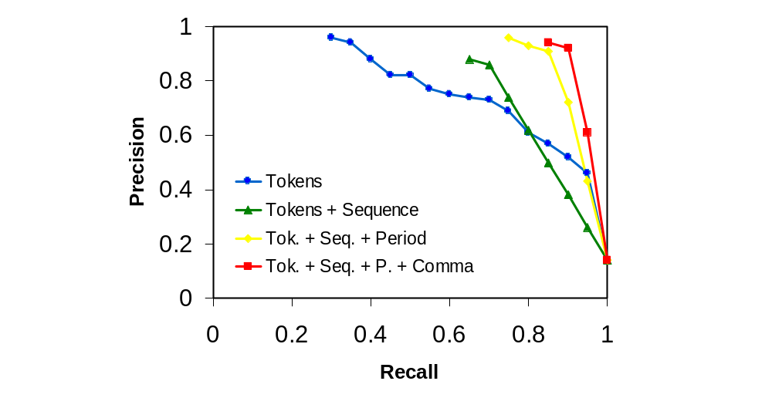
Results: Segmentation on Cora

Slide 86
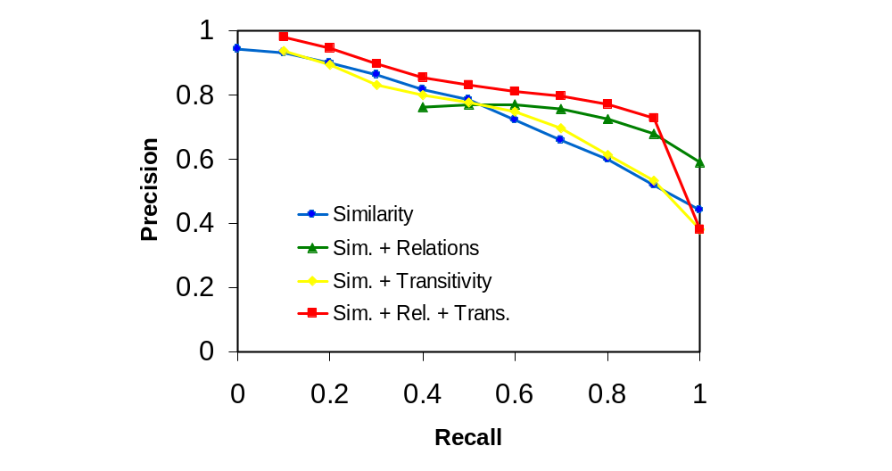
Results:
Matching Venues on Cora

Slide 87
Overview
Motivation
Background
Markov logic
Inference
Learning
Software
Applications
Discussion

Slide 88
Discussion
The structured-unstructured information
spectrum has exploded
We need languages that can handle it
Markov logic provides this
Much research to do
  Scale up inference and learning
  Make algorithms more robust
  Enable use by non-experts
  New applications
A new way of doing computer science
Try it out: alchemy.cs.washington.edu

