Slide 1
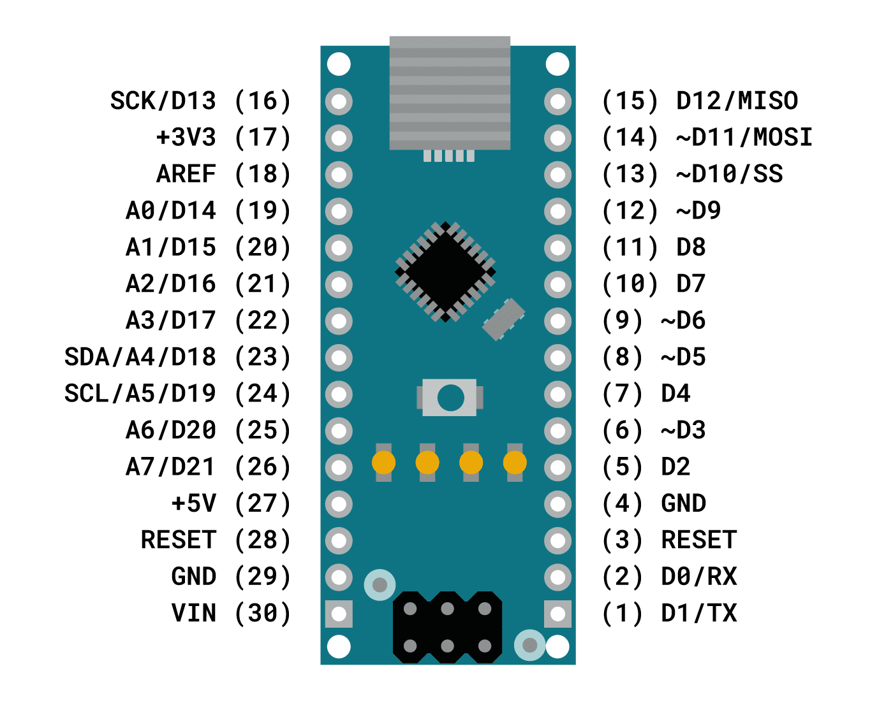

Slide 2
13
12
11
10
14
9
15
8
16
7
17
6
18
5
19
4
Cannot be used as a digital pin
20
3
Cannot be used as a digital pin. If you try to use as digital output, this actually outputs to 8 and 10
21
2
Red # = integer value to refer to pin in code

