Slide 1
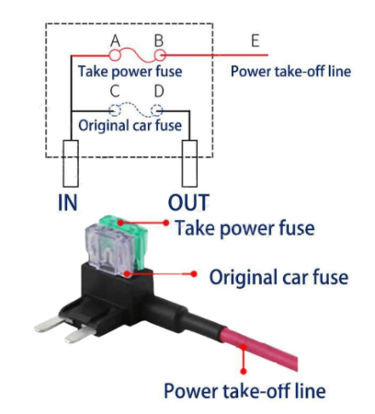
New load fuse
New load line
New load line

