Slide 1
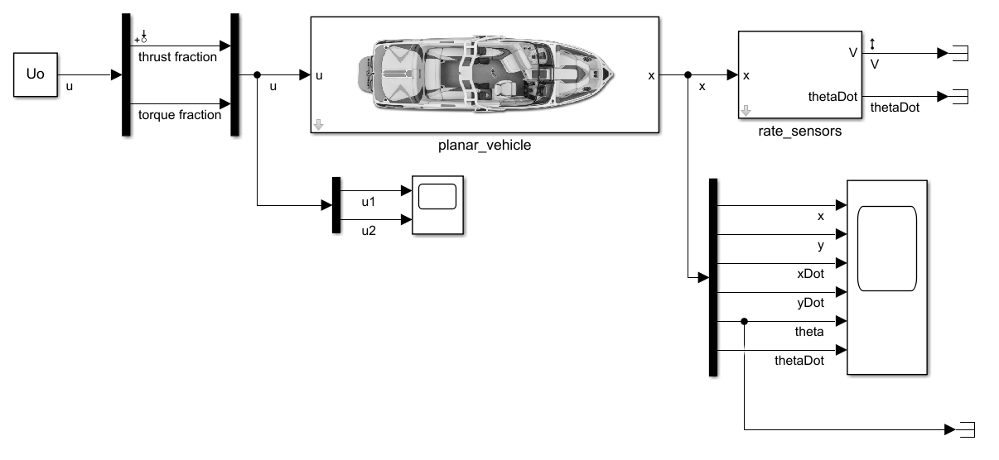
Input Perturbation
Output Measurement

Slide 2
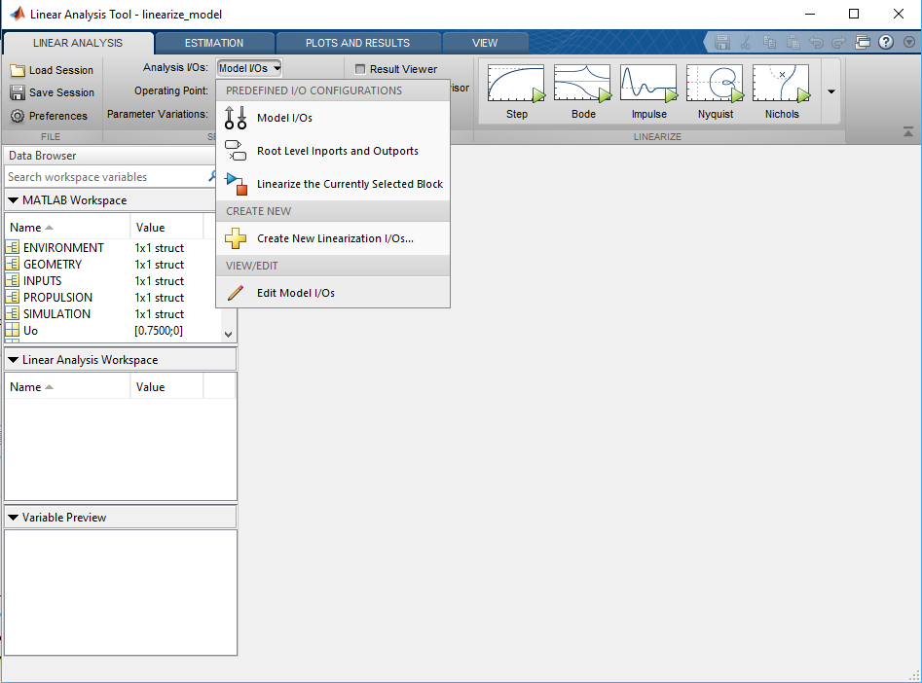
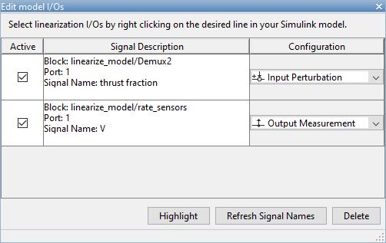

Slide 3
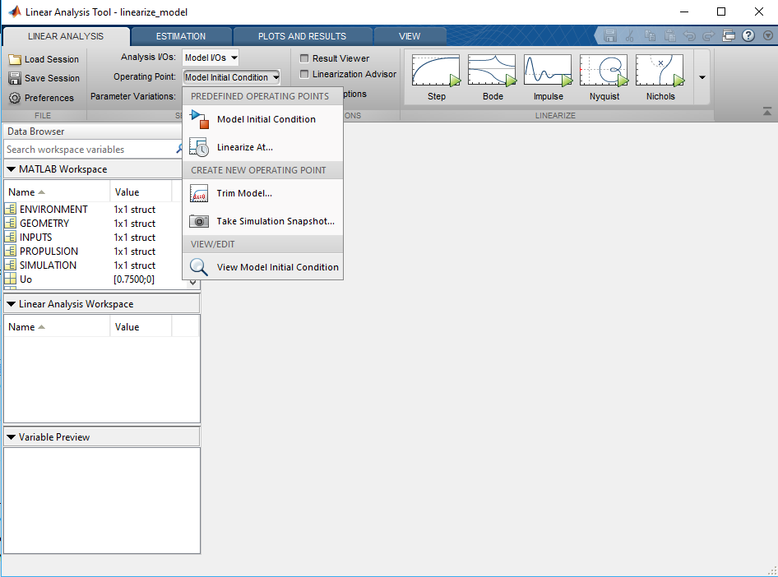
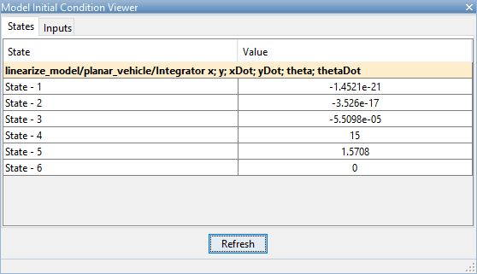
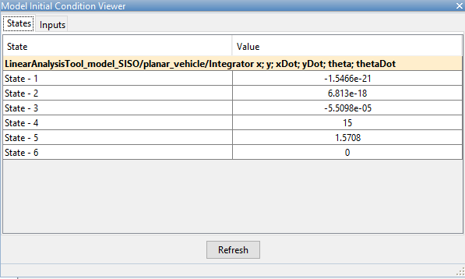

Slide 4
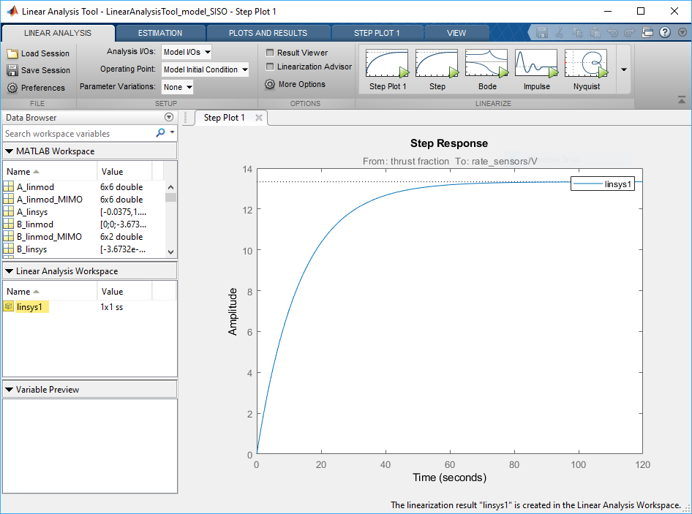

Slide 5
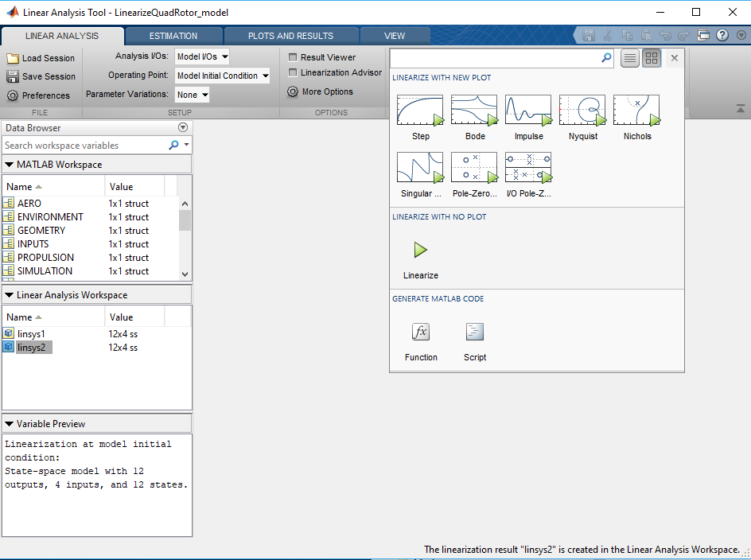

Slide 6
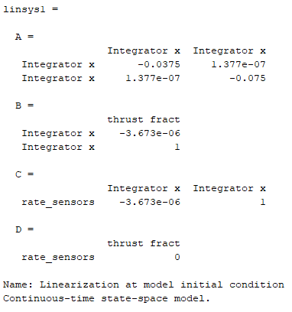

Slide 7

[GV_num, GV_den] = ss2tf(A_linsys, B_linsys, C_linsys, D_linsys);
GV = minreal(tf(GV_num, GV_den))

Slide 8
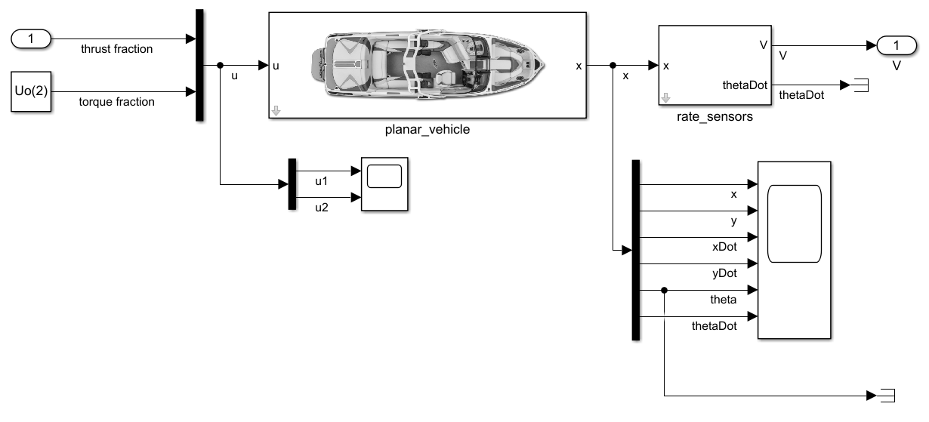
Input Perturbation
Output Measurement

Slide 9
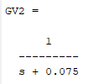
Notice this to make dimensions match
[A_linmod, B_linmod, C_linmod, D_linmod] = linmod('linmod_model', Xo, Uo(1));
[GV_num2, GV_den2] = ss2tf(A_linmod, B_linmod, C_linmod, D_linmod);
GV2 = minreal(tf(GV_num2, GV_den2))

