Slide 1
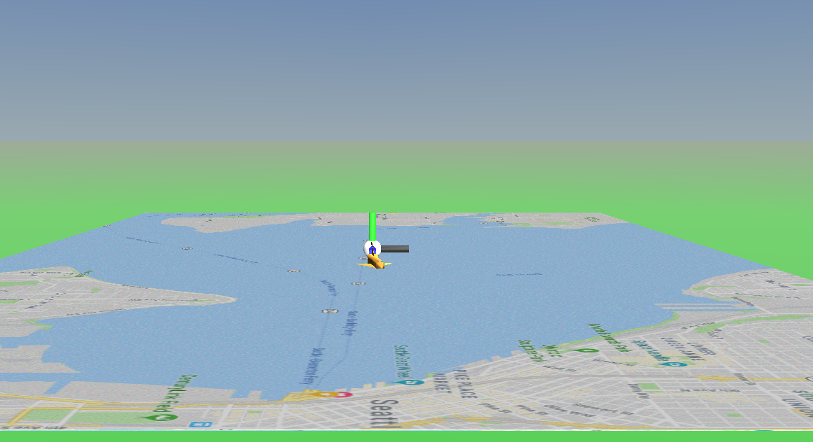



$$+y^{VRML}=Up$$
$$+z^{VRML}=East$$
$$+x^{VRML}=North$$

Slide 2
