Slide 1
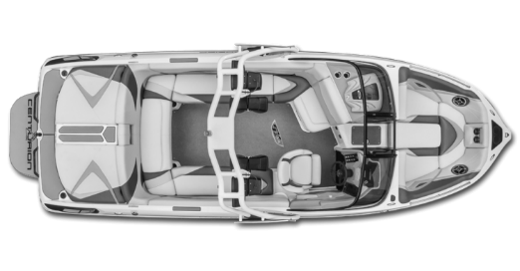








$$V$$
$$θ$$
$$y$$
$$M_{d}$$
$$M_{u}$$
$$F_{u}$$
$$F_{d}$$
$$x$$

