Slide 1
Introduction to Algorithms II
Mikhail Anukhin 2020

Slide 2
Course Structure
Program
Final grade: homework + zachet
Max. 7 points for homework
Max. 3 points for exam
Graphs
2 lectures
Shortest paths
4 lectures
Dynamic Programming
4 lectures
Advanced Topics
Homework in code review format

Slide 3
Infrastructure
Homework code review:
Publishing homework on GitHub: https://github.com/clumpytuna/introduction-to-algorithms-II-2020
You write code locally then show and explain it during online code review
Discord server: https://discord.gg/FByd4v
Questions about the course and homework in a telegram chat
Telegram chat (Q & A):
https://t.me/joinchat/CCyXg0u8HkTW5r37dwZROA

Slide 4
Unit 1: Graphs
Program
Graph Representations
Applications of Graph Search (Explore a graph)
Breadth-First Search
Depth-First Search
Topological Sort

Slide 5
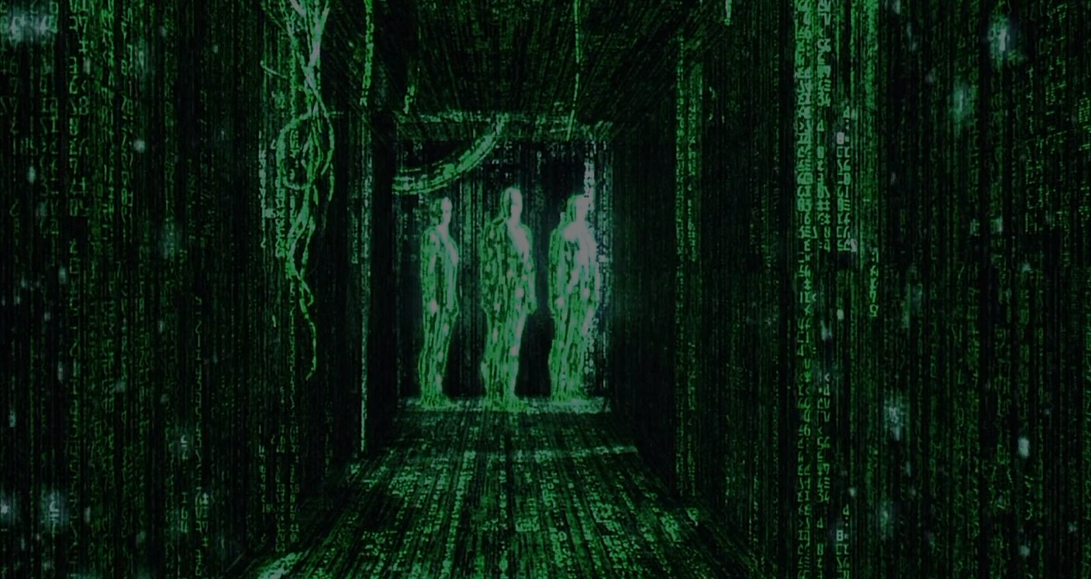
Applications:
web crawling (how Google finds pages)
social networking (Facebook friend finder)
network broadcast routing
garbage collection
model checking (finite state machine)
checking mathematical conjectures
solving puzzles and games

Slide 6
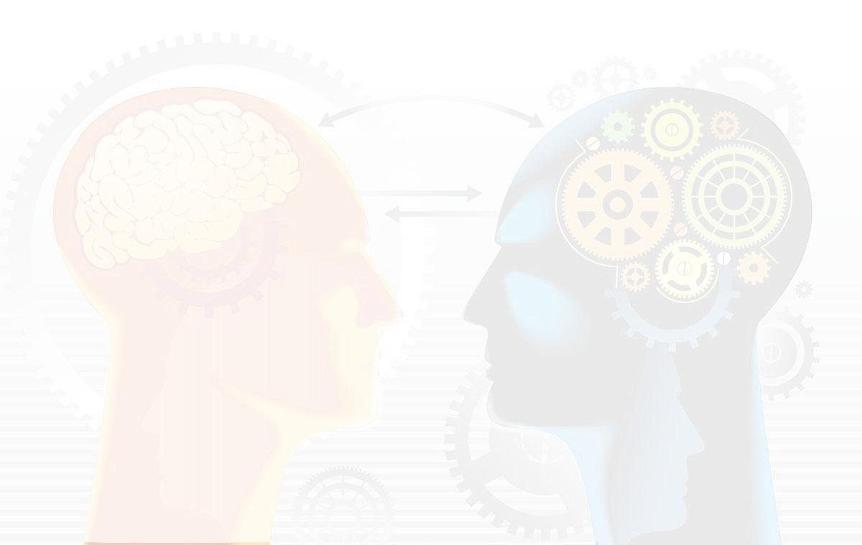
Unit 2: Shortest paths
Program
Weighted Graphs
Single-source shortest path problem
Dijkstra Algorithm
Bellman Ford Algorithm
Optimized Dijkstra

Slide 7

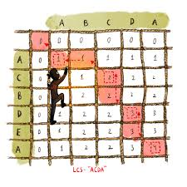
Unit 3: Dynamic programming
Dynamic programming is both a mathematical optimization method and a computer programming method.
In both contexts it refers to simplifying a complicated problem by breaking it down into simpler sub-problems in a recursive manner.

Slide 8
Unit 3: Dynamic programming
Program
Fibonacci, shortest paths
Text justification
Parenthesization, edit distance, knapsack
Powerful algorithm design technique

Slide 9
Important links
Telegram chat (Q&A): https://t.me/joinchat/CCyXg0u8HkTW5r37dwZROA
Discord (online lectures): https://discord.gg/FByd4v
Homework and general course information: https://github.com/clumpytuna/introduction-to-algorithms-II-2020
Materials: Algorithms, 4th Edition by Robert Sedgewick and Kevin Wayne
Introduction to Algorithms, Third Edition | The MIT Press

