Slide 1
Lecture 1
Graphs I: Breadth First Search

Slide 2
Overview
Applications of Graph Search
Graph Representations
Breadth-First Search

Slide 3
Readings
CLRS Chapter 22.2

Slide 4
What is a graph?
Graph G = (V, E)
• V = set of vertices (arbitrary labels) • E = set of edges i.e. vertex pairs (v, w)
– ordered pair ⇒ directed edge of graph
– unordered pair ⇒ undirected

Slide 5
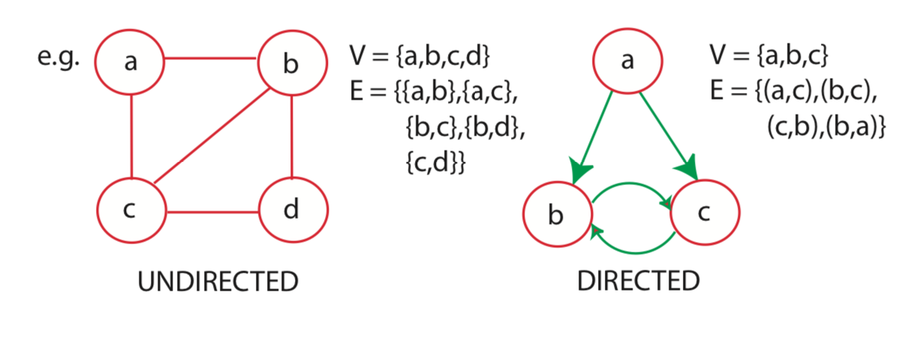
What is a graph?

Slide 6
What is a graph search?
“Explore a graph”, e.g. :
find a path from start vertex s to a desired vertex
visit all vertices or edges of graph, or only those reachable from s

Slide 7
Applications:
There are many!
web crawling (how Google finds pages) social networking (Facebook friend finder)
network broadcast routing
garbage collection
model checking (finite state machine)
checking mathematical conjectures
solving puzzles and games

Slide 8
Pocket Cube: 2x2x2 Rubik’s Cube
Configuration Graph:
vertex for each possible state
edge for each basic move (e.g., 90 degree turn) from one state to another
undirected: moves are reversible

Slide 9
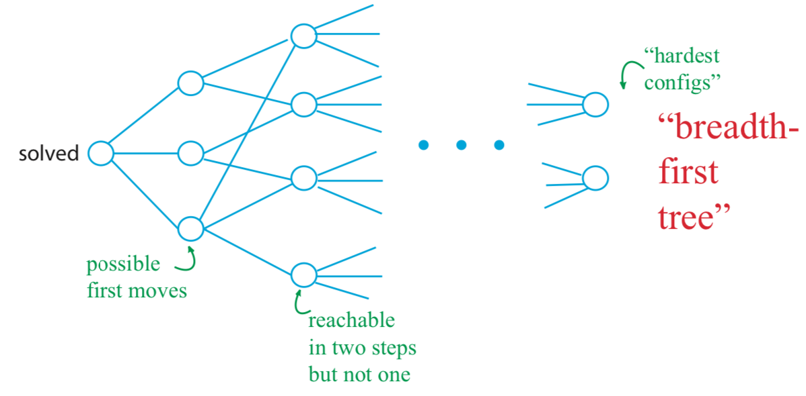
Pocket Cube: Configuration Graph
Diameter (“God’s Number”) = 11

Slide 10
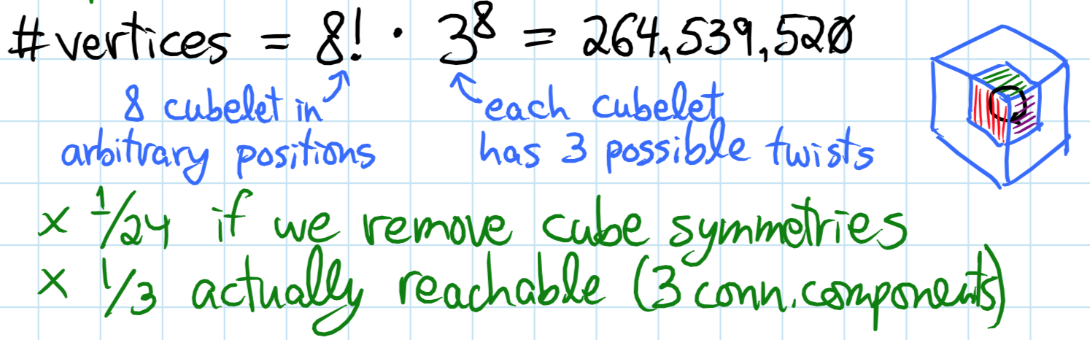
Pocket Cube: 2x2x2 Rubik’s Cube
How many vertices?

Slide 11
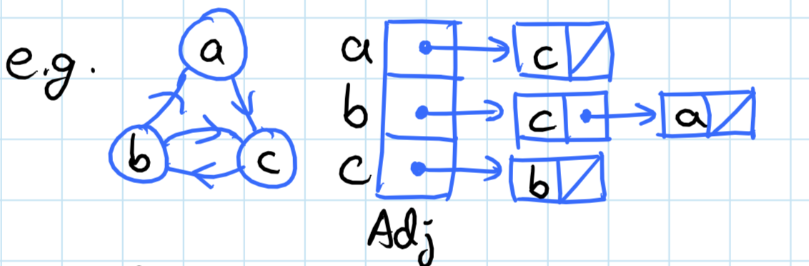
Graph Representations: (data structures)
Adjacency lists:
for each vertex u ∈ V, Adj[u] stores u’s neighbors, i.e., {v ∈ V | (u, v) ∈ E}. (u, v) are just outgoing edges if directed.

Slide 12
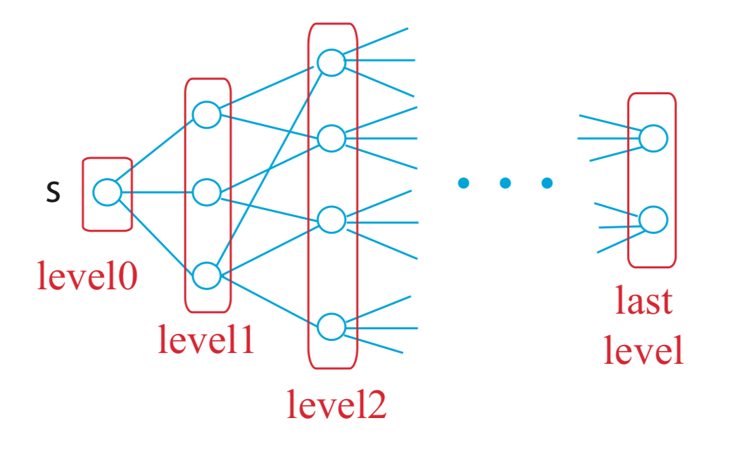
Breadth-First Search
Explore graph level by level from s:
level 0 = {s}
level i = vertices reachable by path of i edges but not fewer
build level i > 0 from level i − 1 by trying all outgoing edges, but ignoring vertices from previous levels

Slide 13
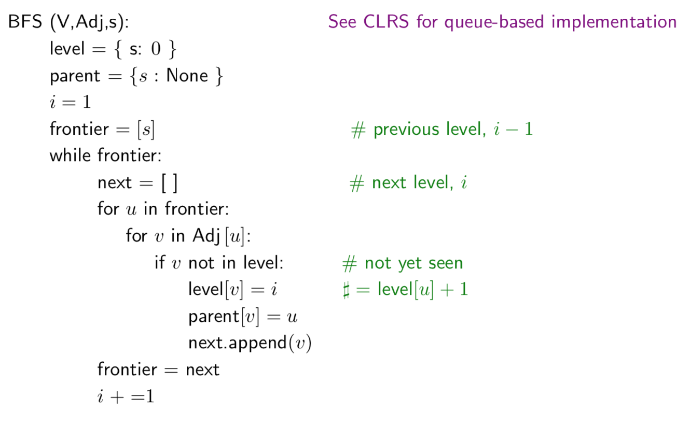
Breadth-First Search Algorithm

Slide 14
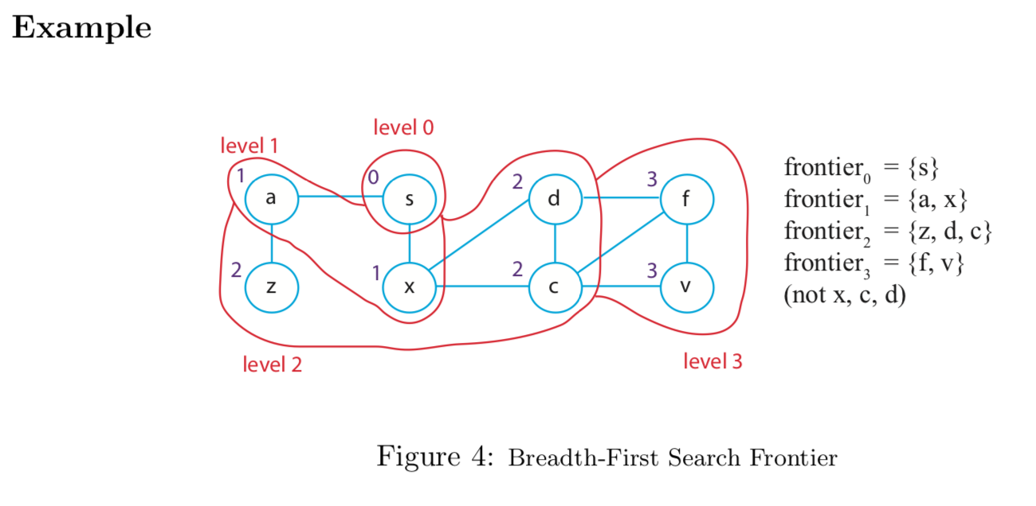
Breadth-First Search Algorithm

Slide 15
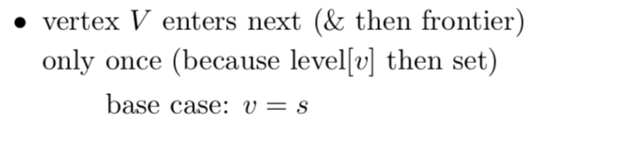
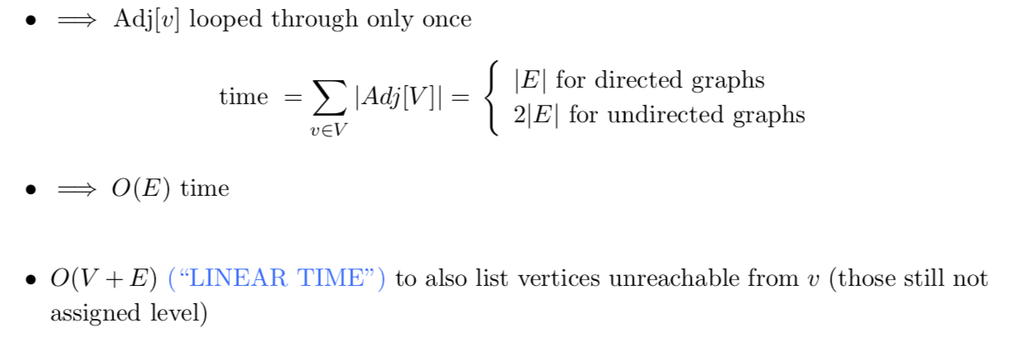
Analysis:

Slide 16
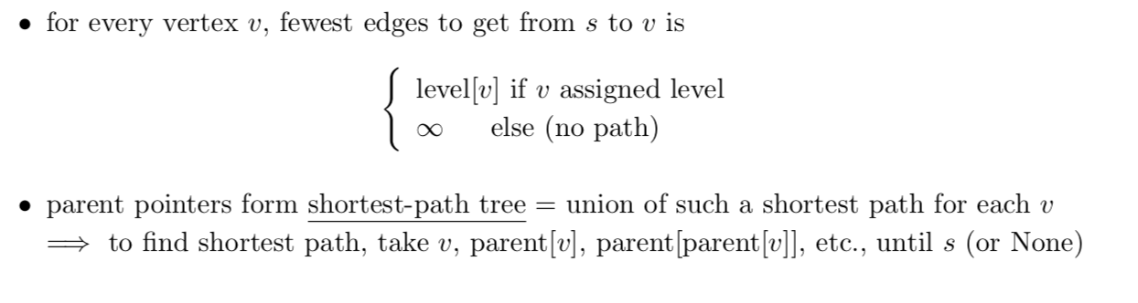
Shortest Paths:

