Slide 1
Enterprise Integration With Clojure

Slide 2
Intro
http://github.com/clumsyjedi/euroclojure2013
Aims to connect and combines people, processes, systems, and technologies to ensure that the right people and the right processes have the right information at the right time – Brosey et al.
The voodoo of making systems communicate reliably and predictably using asynchronous messaging - Me
Why can’t the sales team see the supplier database yet? What am I paying you for – Your boss
It’s just middleware dude – Liz Wize

Slide 3
Areas of Interest
Systems Integration Message Broker Adaptors Database Adaptors etc
Business Rules Capture Topology now hold lots of biz logic formerly in apps Topology descriptions Topology visualisation
Distributed Systems Orchestration Fault tolerance Throughput Collaboration etc

Slide 4
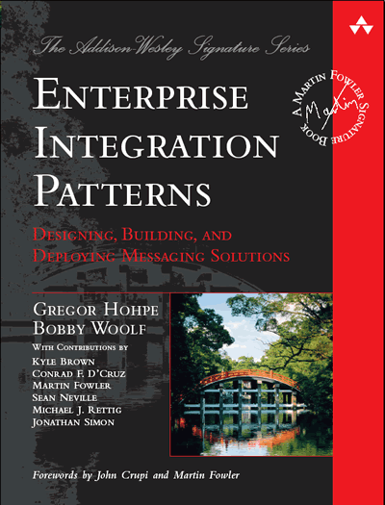
Enterprise Integration Patterns
Tech bookshelf mainstay
A collection of patterns (like Go4)
Captures transitions and interactions at a micro-level
It's incredibly boring
Prescriptive
Powerful languages can render patterns obsolete

Slide 5
Case Study
Low throughput (< 5 messages a second) at peak
Resistant to change
A replacement for an existing system
One-way flow
Delivery is critical

Slide 6
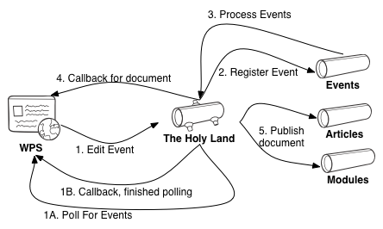
Component View

Slide 7
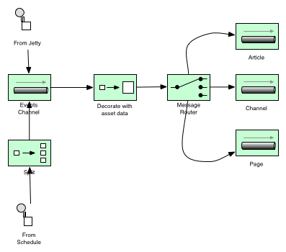
EIP View

Slide 8
Pattern Analysis
Message
Discrete event
Message Channel
Logical address
Message Endpoints
Interface to the channel
When networked, these three provide the core of distributed orchestration
Message Router
Branch workflow
Content Enricher
Decorate message
Pipeline
Sequential processing
Splitter
Emit many messages from one
Aggregator
Produce one message (or side effect) from many
Dead Letter Channel
Error handling
And many many more

Slide 9
The Products
MuleSoft Mule (Bad Jon, bad)
Apache Camel (HolyGrail)
Lamina
Clojure EEP
Twitter Storm
Had to trim this list

Slide 10
Mule
No-one understood it
No-one wanted to understand it
It was breaking
No replacement for a proper ESB in Clojure space that we know of

Slide 11
Apache Camel (HolyGrail)
Designed to satisfy the EIPs
A java project with a Clojure DSL
What we use in production
Constrains thinking
Hard things are hard
Mature framework

Slide 12
Apache Camel: Systems Integration
Lot's of adaptors
It will satisfy most message brokers
Has a number of built-in adaptors for HTTP send/receive, file system etc
Can reify EndPoint iface to make your own

Slide 13
Apache Camel: Business rules capture
Meh
HolyGrail transforms method chaining DSL into clojure like syntax from(“source”).process(MyBean.class).to(“dest”) (from “source”) (process (processor …)) (to “dest”)
Englishy
HolyGrail DSL is EDNish so you could feasibly build visualisations on top of it
No killer visualisation without a spring configuration

Slide 14
Apache Camel: Distributed Systems orchestration
Message
MessageInterface
Message Channel/Endpoint
Simple as URLs, provides stream merging
Message Router
via when construct, recipient list
Content Enricher
via custom processor
Pipeline
Top to bottom in the topology
Splitter
(split <expression>)
Aggregator
Not shown, because it doesn’t help our probelm
Dead Letter Channel
error handler comes for free

Slide 15
Lamina
An elegant approach using idiomatic Clojure
Leverages the power of the Clojure language rather than adhering to patterns
Well documented, seems like a strong community, good vibes
First of many “Event Stream Processing” libraries
Are they useful in this space?

Slide 16
Lamina: System integration
Aleph, built on top of Lamina
Provides adaptors based on Lamina channels
Feasibly offers alternative to broker
Low level adaptors though
It’s a place to start and bind channles to backends
A bit lightweight right now
I've used clamq, compojure and quartzite

Slide 17
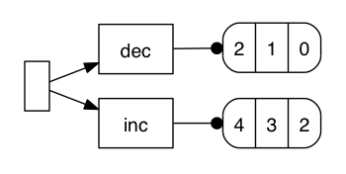
Lamina: business rule capture
Routes are very nicely captured in succinct Clojure blocks
has nice integration with graphviz
Breaks down a bit with the proliferation of anon function

Slide 18
Lamina: Distributed Systems Orchestration
Message Channel
Lamina provides it's own channel construct
Memory only
Message Endpoint
Without this, we’re not distributed
Used Clamq to get us out of a jiffy
Pipeline
See (pipeline) ☺
Not needed
Content Enricher
Splitter
Message Router
DLQ

Slide 19
EEP
A quite young framework
Idiomatic Clojure again, no yucky interop
Not advertised as an integration solution
But there's overlap
See also Riemann etc

Slide 20
EEP: Systems Integration
No, by design
There's no channel or queue construct per se
We can simulate this using emitters and observers
Again, adaptors to brokers etc provided by compojure, clamq, and quartzite
Core.async

Slide 21
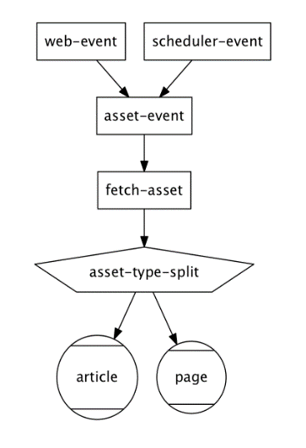
EEP: Business rules capture
It's better than anything we've seen so far
Because the topologies consist of a few constructs with predictable behaviours)
Because the processors reference each other
You can graph the entire topology, not just the path taken by one event

Slide 22
EEP: Distributed Systems orchestration
Message Endpoints
Not distributed without it
Message Router
Via dispatching to different streams via defsplitter
Content Enricher
Via deftransformer
Pipeline
defined as a linked list of sorts in the topology
Aggregator
Good instrumentation around aggregation, but without brokr backed channels we can’t solve the WPS callback problem
Dead Letter Channel
No error handling
Not used
Message Channel
Splitter

Slide 23
Storm
Also a real time event processing tool
A java/Clojure hybrid
Allows components to be written in other languages

Slide 24
Storm: Systems integration
Again we are rolling our own
No dependency on message queuing libs for distributed work
Ships with an ancient Compojure

Slide 25
Storm: : Business Rules Capture
Clojure DSL is not terribly human readable
No topology visualisations

Slide 26
Storm: Distributed systems orchestration
Message
Tuple, must be serializable
Content Enricher
Bolt emits a modified tuple
Pipeline
Reverse of EEP, nodes specify where they read from
Splitter
As simple as (doseq emit! [])
Aggregator
YES! It is possible to do this in storm
We can distribute work amongst workers
But process alike tasks on a single node
Dead Letter Channel
We have the constructs ack! and fail!
these ensure processing of messages by downstream consumer
default behaviour is to process un'acked messages again (forever)
Not Used
Message Channel
Message broker

Slide 27
Beyond Patterns
Most of these projects have eschewed the language of patterns
Patterns can be seen in the samples
Also places where the patterns are not noticeable
Better for code clarity
Worse for topology clarity
Evolution beyond patterns
Storm IPC
Storm error handling (possibly)
Where patterns are not explicitly defined, there’s mileage in winging it

Slide 28
Conclusions
No clear winner
Clear winners for different priorities though
Lamina is the most well-rounded product here
Camel gives the best adaptor support
If you need an ESB you will probably need to stick with java
or write your own ;)
Storm has by far the best distributed systems orchestration
Does this by breaking out of traditional orchestration paradigms
EEP actually gave the best topology visualisation
Not even designed for integration

