Slide 1
Enterprise Integration With Clojure

Slide 2
Intro
The voodoo of making systems communicate reliably and predictably using messages.

Slide 3
Areas of Interest
Systems Integration
Business Rules Capture
Distributed Systems Orchestration

Slide 4
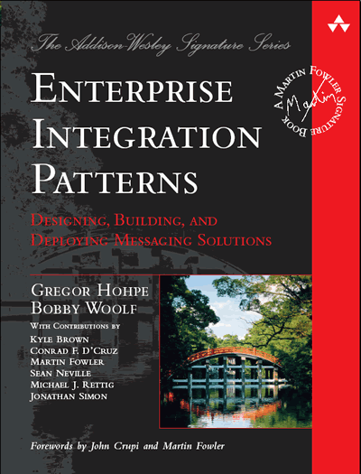
Enterprise Integration Patterns
Tech bookshelf mainstay
A collection of patterns (like Go4)
They capture transitions and interactions at a micro-level
It's incredibly boring
Powerful languages can render patterns obsolete
Hopefully you can follow without having read this

Slide 5
Case Study
Low throughput (< 5 messages a second) at peak
Resistant to change
A replacement for an existing system
One-way flow
Delivery is critica

Slide 6
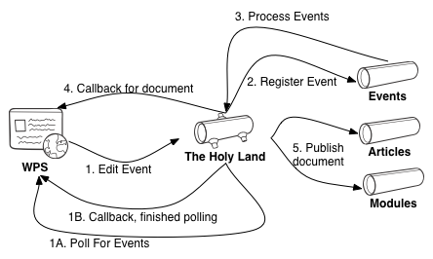
Component View

Slide 7
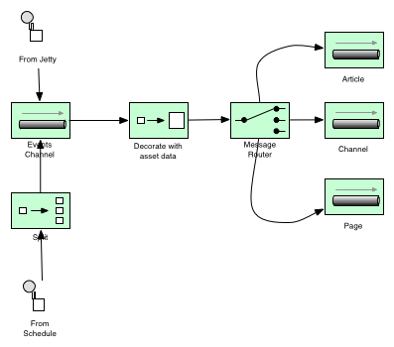
EIP View

Slide 8
Pattern Analysis
Message
Message Channel
Message Broker
Message Router
Content Enricher
Pipeline
Splitter
Aggregator
Dead Letter Channel

Slide 9
The Products
MuleSoft Mule
Apache Camel (HolyGrail)
Lamina
Clojure EEP
Esper
Twitter Storm
Honourable Mentions
core.async
pipeseq
pipejine
ClamQ

Slide 10
Mule
No-one understood it
No-one wanted to understand it
It was breaking
No replacement for a proper ESB in Clojure space that we know of

Slide 11
Apache Camel (HolyGrail)
Designed to satisfy the EIPs

Slide 12
Apache Camel: Systems Integration
Lot's of adaptors
It will satisfy most message brokers
Has a number of built-in adaptors for HTTP send/receive, file system etc

Slide 13
Apache Camel: Business rules capture
Not bad
HolyGrail transforms method chaining DSL into clojure like syntax
HolyGrail DSL is homoiconic so you can build visualisations on top of it
No killer visualisation without a spring configuration

Slide 14
Apache Camel: Distributed Systems orchestration
Message
MessageInterface
Message Channel
nice, initialised from URLs
Message Broker
required for distributed operation
Message Router
via when construct
Content Enricher
via custom processor
Pipeline
default behaviour of the DSL
Splitter
via split construct
Aggregator
Not shown, not suitable for this case
Dead Letter Channel
error handler comes for free
bit hard to modify, customize

Slide 15
Lamina
An elegant approach using idiomatic clojure
Leverages the power of clojure.core rather than adherance to patterns
Well documented, seems like a strong community

Slide 16
Lamina: System integration
Aleph, built on top of lamina
Provides adaptors based on Lamina channels
A bit lightweight right now
I've used clamq, compojure and quartzite

Slide 17
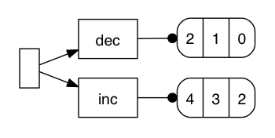
Lamina: business rule capture
Routes are very nicely captured in succinct clojure blocks
has nice integration with graphviz
Breaks down a bit with the proliferation of anon function

Slide 18
Lamina: Distributed Systems Orchestration
Message Channel
Lamina provides it's own channels
Message Broker
transformed to an activemq channel via clam in 3 lines
Message Router
clojure flow control operators inside pipelines
also some constructs for dispatching to different pipelines (IE exec style behaviour)
Content Enricher
map
Pipeline
that's the name of the construct
Splitter
(map named-pipeline collection)
enforces a break in pipelines where there may not logically be one
Aggregator
there's a merge results construct
not explored, because it doesn't solve our distributed problem
Dead Letter Channel
via the :error-handler
but handling resubmission, incremental backoff is all on the developer

Slide 19
EEP
A quite young framework
Idiomatic clojure again, no yucky interop
Not advertised as an integration solution
But there's overlap

Slide 20
EEP: Systems Integration
No, by design
There's no channel or queue construct per se
We can simulate this using emmiters and observers
Again, adaptors to brokers etc provided by compojure, clam, and quartzite

Slide 21
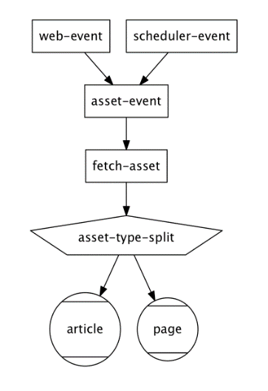
EEP: Business rules capture
No, by design
There's no channel or queue construct per se
We can simulate this using emmiters and observers
Again, adaptors to brokers etc provided by compojure, clam, and quartzite

Slide 22
EEP: Distributed Systems orchestration
Message Channel
Nope, make your own if you need it
Message Broker
Nope, make your own if you have to
Message Router
Yes, via dispatching to different streams
defsplitter
Content Enricher
deftransformer
Pipeline
defined as a linked list of sorts in the topology
Splitter
Seems to go against the grain of EEP, which is to aggregate
Aggregator
treats this as a math problem
stream dispatch mechanism allow us to separate aggregatable events from similar events
it definitely solves the problem in a single node/process
without the patterns around channels and brokers this solution cannot be distributed
Dead Letter Channel
No error handling

Slide 23
Storm
Also a real time event processing tool
A java/clojure hybrid
Allows componnts to be written in other languages

Slide 24
Storm: Systems integration
Again we are rolling our own
No dependency on message queuing libs for distributed work
Ships with an ancient compojure

Slide 25
Storm: : Business Rules Capture
Clojure DSL is not terribly human readable
No topology visualisations

Slide 26
Storm: Distributed systems orchestration
Message Channel
Not as such
Spouts and bolts fill this role as well as being transformers
Message Broker
Nope, distribution according to the stream grouping parameters
Message Router
Ummmmmmmm Direct grouping
Content Enricher
Yep, any bolt
Pipeline
Yes, but parallel operation is the default
Splitter
As simple as (doseq emit! [])
Aggregator
YES! It is possible to do this in storm
We can distribute work amongst workers
But process alike tasks on a single node
Dead Letter Channel
We have the constructs ack! and fail!
these ensure processing of messages by downstream consumer
default behaviour is to process un'acked messages again (forever)

Slide 27
Some Others in brief
Many libraries solving th problem of channels/queues
PipeSeq: Queues for parallel processing of blocking code
Pipejine: In memory pipelining and queues. Similar in scope to lamina.
core.async: Queues for parallel processing of CPU bound code
We're using this in the Storm example to give asynchronous communication of HTTP messages to th storm layer
Clamq: Adaptors for JMS, activemq and othr message brokers. We're using this to for our AMQ operations.

Slide 28
Beyond Patterns
Most of these projects have eschewed the language of patterns
Patterns can be implied in th solutions above
Storm gave us a solution that worked without message channels and brokers\
solved a problem
Also gave us what I believe is a superior mechanism to DLQ
But this is subjective

Slide 29
Conclusions
No clear winner
Clear winners for different priorities though
Lamina is the most well-rounded product here
Camel givs the best adaptor support
If you need an ESB you will probably need to stick with java
or write your own ;)
Storm has by far the best distributed systems orchestration
Does this by breaking out of traditional orchestration paradigms
EEP actually gave the best topology visualisation
Not even designed for integration

