Slide 1
Scaling Up COFFEA at a USCMS Tier2
COFFEA team
Lindsey Gray, Matteo Cremonesi, Bo Jayatilaka, Oliver Gutsche, Nick Smith, Allison Hall,
Kevin Pedro, Maria Acosta (FNAL); Andrew Melo (Vanderbilt); Stefano Belforte (INFN);
Jim Pivarski (Princeton); and others
Jim Pivarski (Princeton); Ben Galewsky (NCSA); Mark Neubauer (UIUC)
IRIS-HEP
Ken Bloom, Carl Lundstedt, Mat Adamec
University of Nebraska, HTCondor/SLRUM Testing
Stefan Piperov, Dmitry Kondratyev
Purdue University, SLURM Testing
Brian Bockelman
Morgridge Institute

Slide 2
COFFEA - Columnar Object Framework For Effective Analysis
Leveraging large data and data analysis tools from python to provide an array-based syntax for manipulating HEP event data.
Stark contrast to common, well established event loop techniques.
Tremendous potential to fundamentally change the time-to-science in HEP.
Scales well horizontal
Cannot easily utilize current
analysis facilities (T2s) as the
analysis is not grid friendly, it's
meant to be quasi-interactive
Columnar image here
(Need my desktop)

Slide 3
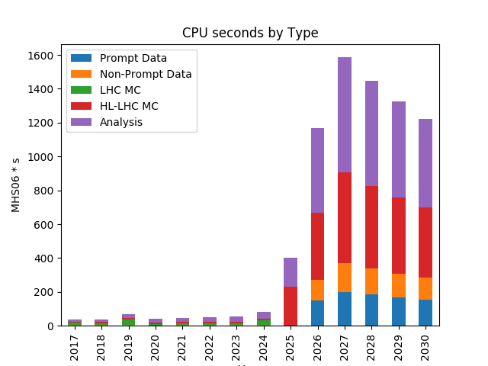
coffea – performance (Motivation)
The Present Challenge
  Analysze all LHC Run 2 data: O(10 billion events)
  Investigate data quality issues with fast time-to-insight
  Optimize complex (e.g. deep learning algorithms)
Multiply by O(1000) data analysts
These challenges magnified
20x in HL-LHC
Nick Smith, CHEP 2019

Slide 4

coffea – performance (Solution Requirements)
Solutions must be:
  Easy to use
  Scalable
  Fast
  Utilize currently deployed hardware/middleware (at least in near-term)
  Minimally intrusive for site administrators
Some work to leverage SPARK
DASK appears to be more inline with “Easy”
Nebraska and Purdue investigated using DASK on their T2s

Slide 5

Usage Patterns Are Changing
Resources Should Change, Too
SITES
USERS

Slide 6
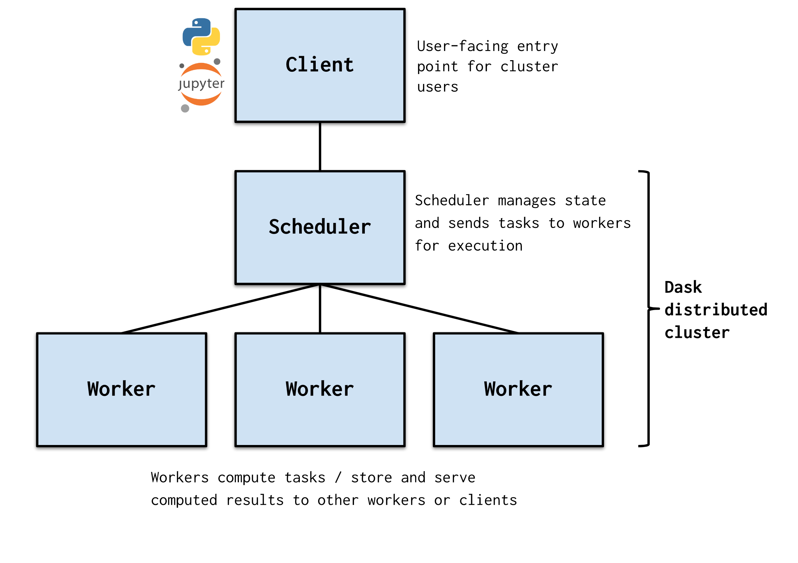

Dask
“Dask is a flexible library for parallel computing in Python.”
Think of Dask as run-time parallel + cluster plugin for python
Easily installed via Conda as the module “distributed”.
NOT really designed with multi-user
environments in mind
out-of-the-box.
Integrates with HPC clusters
running a variety of schedulers
including SLURM & HTCondor
via “dask-jobqueue”.

Slide 7
DASK @ 10,000 feet
*Diagram by DASK collaboration

Slide 8
DASK @ 10,000 feet
Numerous ways to instantiate the
DASK cluster. Scheduler and workers
can be run on dedicated hardware,
submitted into a jobqueue OR
provisioned at runtime via
orchestration.
We investigated several ways to bring
a DASK cluster up in our various
batch systems.
*Diagram by DASK collaboration

Slide 9


Starting DASK @ Purdue
Step 0) Set up environment*
Step 1) Start a scheduler*
Step 2) Scale the cluster*
Step 3) Create a client*
Step 4) Send some tasks to the workers*
Step 5) Brag to anyone who’ll listen how fast it went
*Detailed commands in additional slides

Slide 10
SLURM Testing at Purdue
 |  | one 2017B file |  | SingleMuon 2017B |  | Full SingleMuon 2017
 |  | 144k events |  | 136M events |  | 769M events
 | processes | Time (m:s) | Evts/s | Time (m:s) | Evts/s | Time (m:s) |  | Evts/s
Single node | 1 | 0:21.0 | 7k | 201:40.0 | 11k | too long
 | 48 | 0:13.6 | 11k | 5:28.1 | 415k | 34:57.5 | 367k
SLURM Cluster | 48 | 0:08.4 | 17k | 4:13.4 | 537k | 22:27.1 | 570k
 | 300 | 0:11.0 | 13k | 0:46.8 | 2.9M | 6:46.0 | 1.9M
 | 500 | 0:08.4 | 17k | 0:35.6 | 3.8M | 3:51.8 | 3.3M
 | 500 (setup w/ DNN evaluation) | 0:25.6 | 6k | 1:14.4 | 1.8M | 9:23.5 | 1.4M
*For full analysis detail, see extra
slides.

Slide 11
Start Dask at Nebraska
User setup is no different than Purdue
DASK Scheduler was started on the T3 login node**
Workers started in a variety of ways:
  By admin on dedicated nodes
  By user via Condor jobs submitted at the CLI
  By Jupyter using HTCondorCluster module

Slide 12
Scaling*
Dask Workers started in Docker by root user, connect to static,dedicated scheduler
# Events | Nodes | Cores | Time (m:s) | Events per second
3,495,799 | 1 | 64 (32 proc, 2 thread) | 1:16.6 | 45,637
30,268,764 | 1 | 64 | 7:52.3 | 64,088
90,988,105 | 1 | 64 | 23:11.6 | 65,383
3,495,799 | 4 | 256 | 0:33.1 | 105,613
30,268,764 | 4 | 256 | 2:37.5 | 192,182
90,988,105 | 4 | 256 | 8:50.0 | 171,675
*Take these results as mostly anecdotal

Slide 13
Scaling* (via HTCondor)
Dask Workers started in Docker by HTCondor submitted by user,
workers stillconnect to static,dedicated scheduler
# Events | Nodes | Cores | Time (m:s) | Events per second
3,495,799 | 1 | 64 (32 proc, 2 thread) | 1:00.5 | 57,781
30,268,764 | 1 | 64 | 11:29.7 | 43,886
90,988,105 | 1 | 64 | 23:13.9 | 65,275
3,495,799 | 4 | 256 | 0:22.7 | 153,999
30,268,764 | 4 | 256 | 5:15.2 | 96,030
90,988,105 | 4 | 256 | 12:59.5 | 116,726
Dask started within Docker via Condor
*Take these results as mostly anecdotal

Slide 14
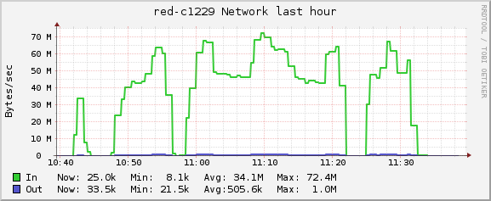
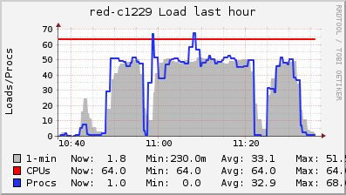

Single Node Run Networking and Load
Network
1 – 3.4 million events, 1:16
2 – 30 million events, 7:52
3 – 90.8 million events, 23:11
2
3
1
Load
1
2
3
Gap between load and cpu
count I/O blocking? It’s not
Networking...a discussion for
A different day.

Slide 15
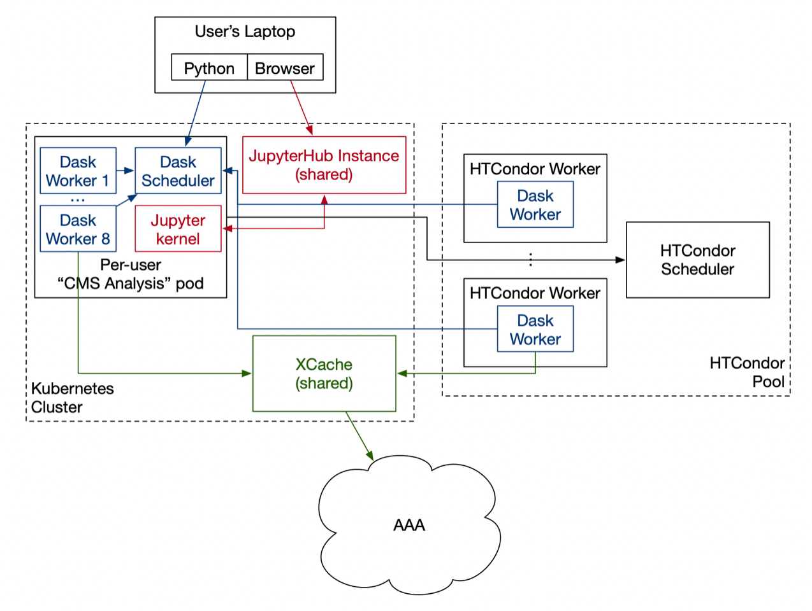
Proposed Scale Up @ T2 Nebraska
*Diagram by Brian Bockelman

Slide 16
Proposed Scale Up @ T2 Nebraska
Can scale up to available Condor
Slots on the T2 resource.
8 Core “CMS Analysis pod” created
on login.
*Diagram by Brian Bockelman

Slide 17

Problem/Uncertain Areas

Slide 18
Problem/Uncertain Areas
User Management at the T2s is (and will
continue to be) a non-starter. User
access management will have to be done at
another administrative level (SSO)
UNL T2 admins have Limited Experience
with Kubernetes. (But solid experience with
Docker.)
Performance can be sensitive to caching,
integration and performance studies need
to be done long term. Current tests did
not leverage XCache @ Nebraska.
No tests at Nebraska using AAA (yet),
performance may seriously suffer if
WAN becomes involved.
Little to no operational experience at
Nebraska T2 for JupyterHub management.
Our colleagues in Holland have experience
using it for our HPC clusters.

Slide 19
Conclusions
Investigate DASK on current T2 deploys
DASK is easy to use, easy to hack and stands
as perhaps an easy way to allow new analysis
techniques to access T2 resources
DASK could be used in an HPC environment
NOW, how do we move to include all users and
manage the workflows in a meaningful manner?
Nebraska is going to investigate creating an
analysis facility as outlined

Slide 21
Dataset Info (extra)
Small Medium Large
all events 3495799
all jets 28404552
all muons 3542845
electrons 4490586
loose muons 1487022
fakeable muons 1264087
tight muons 1045695
loose electrons 1389332
fakeable electrons 837772
tight electrons 330102
Tight Dilepton-Channel e 7260
Tight Dilepton-Channel mu 22966
Tight Trilepton-Channel e 1021
Tight Trilepton-Channel mu 3215
Trilepton Jets 4981
Dilepton Jets 61400
passing 1412
all events 30268764
all jets 173353642
all muons 26816638
electrons 31032707
loose muons 16035325
fakeable muons 12382828
tight muons 10345973
loose electrons 13542971
fakeable electrons 8050688
tight electrons 2993715
Tight Dilepton-Channel e 65959
Tight Dilepton-Channel mu 201125
Tight Trilepton-Channel e 9772
Tight Trilepton-Channel mu 26651
Trilepton Jets 46847
Dilepton Jets 626474
passing 12141
all events 90988105
all jets 662845397
all muons 79309765
electrons 110891123
loose muons 39537817
fakeable muons 32283727
tight muons 26262265
loose electrons 35680939
fakeable electrons 21218904
tight electrons 7758698
Tight Dilepton-Channel e 171429
Tight Dilepton-Channel mu 437223
Tight Trilepton-Channel e 39200
Tight Trilepton-Channel mu 116449
Trilepton Jets 238550
Dilepton Jets 1555519
passing 51883
I’ll put more data provenance in in the morning

Slide 22
Purdue Test Analysis Details
– VBF channel of H->µµ search, targeting the final state with two muons and two jets.
– The analysis is template-based, a variable sensitive to S/B is constructed using DNN and then fit to data
(therefore Data/MC agreement is important)
– Full event selection, muon selection, jet selection, b-jet veto and electron veto implemented
– The most important corrections include FSR recovery, Rochester correction, jet energy corrections (latter two implemented using Coffea tools); also, numerous corrections and weights are implemented with Coffea as lookup tables (pile-up reweighing, Z_pT reweighing, jet PU ID weights).
– Save two types of the output: binned, to quickly make validation plots after processing, and unbinned – to use for MVA training and further statistical analysis
– Some numbers to give an idea about how many events are filtered out
Example for one SingleMuon 2017B file. Selection efficiency will be of course different for MC events:
– Input: ~144500 events
– Passing lumimask, HLT and with at least 2 (any) muons: ~8400 events
– Passing muon selections: ~2600 events
– Have 2 jets passing all jet selections: 444 events
– Falling into VBF category (dijet mass > 400 GeV, rapidity separation between jets deltaEta>2.5): 8 events

Slide 23
Detailed Purdue Setup Steps
Step 0) Set up environment:
---------------------------
$ module load anaconda/5.3.1-py37
$ conda create --name daskproj
$ source activate daskproj
$ conda install dask ipython
$ conda install -c conda-forge dask-jobqueue jupyter-server-proxy
Step 1) Start a scheduler:
--------------------------
$ ssh hammer-c019 # this is a regular SLURM node
$ module load anaconda/5.3.1-py37
$ source activate daskproj
$ ipython
From dask_jobqueue import SLURMClusterIn [1]: from dask_jobqueue import SLURMCluster
In [2]: cluster = SLURMCluster( account='standby', cores=2, memory='10GB', walltime='00:30:00', job_extra=['--qos=normal', '-o dask_job.%j.%N.out','-e dask_job.%j.%N.error'])
In [3]: print(cluster)
SLURMCluster('tcp://128.211.149.152:35144', workers=0, threads=0, memory=0 B) # the <IP:port> is your 'cluster' object to use later
In [4]: cluster.dashboard_link
Out[4]: 'https://128.211.149.152:8787
# Enter this in a web browser to monitor your DASK cluster
At command prompt =
In Jupyter

Slide 24
Detailed Purdue Steps (cont)
Step 2) Scale the cluster:
---------------------------
Two options:
2a) manually control the size:
In [5]: cluster.scale(50)
In [6]: print(cluster)
SLURMCluster('tcp://128.211.149.152:35144', workers=25, threads=50, memory=250.00 GB)
Or
2b) Adaptive scaling:
In [5]: cluster.adapt(minimum=10, maximum=100)
Out[5]: <distributed.deploy.adaptive.Adaptive at 0x2afc27fd5580>
In [6]: print(cluster)
SLURMCluster('tcp://128.211.149.152:35144', workers=10, threads=20, memory=100.00 GB)
Step 3) Create a client:
------------------------
On the same machine, or on a difeerent one:
$ module load anaconda/5.3.1-py37
$ source activate daskproj
$ ipython
In [1]: from distributed import Client
In [2]: client = Client('128.211.149.152:35144')
In [3]: print(client)
<Client: 'tcp://128.211.149.152:35144' processes=10 threads=20, memory=100.00 GB>

Slide 25
Detailed Purdue Steps (cont)
Step 4) Send some tasks to the workers:
--------------------------------------
The 'client' above can be passed as an argument to Coffeaʼs
'dask_executor', which is loaded using Coffeaʼs function
'run_uproot_job'.
So basically Coffea executor can understand a client instance
as a parameter, and start interacting with it.

