Slide 1


SMART INDIA HACKATHON 2026
TITLE PAGE
• Problem Statement ID : 26153
• Problem Statement Title : AI based Network Attack Forecasting from Network Traffic Data
• Theme : Blockchain & Cybersecurity
• PS Category : Software
• Team ID : <Team ID>
• Team Name : Pied Piper
N I D R A
Network Intrusion Dynamics & Risk Anticipation — a network world model that forecasts attack trajectories before compromise completes.
OBSERVE → REPRESENT → LEARN DYNAMICS → IMAGINE → FORECAST

Slide 2
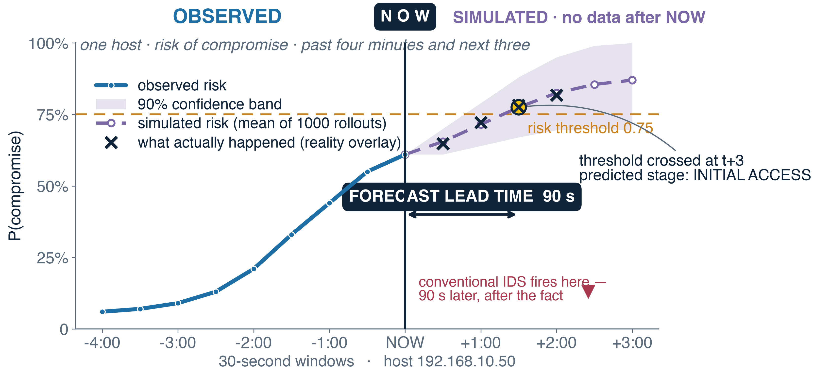
NIDRA — PROPOSED SOLUTION
Network Intrusion Dynamics & Risk Anticipation · a world model that forecasts attack trajectories — not an intrusion detector
★ = innovation
THE PROBLEM WITH DETECTION
▸ Detection is always late. An IDS computes f(traffic) → benign / malicious. It fires once evidence exists — the behaviour already happened.
▸ Attacks are processes, not packets. Recon → scan → access → lateral → exfil unfolds over minutes; per-flow classifiers discard that structure.
▸ Labels are the bottleneck. Supervised IDS needs labelled attacks — expensive, stale, non-transferable.
WHAT NIDRA PREDICTS — THREE LEVELS
1 · STATE what comes next? Ŝ t+1 … Ŝ t+6
2 · THREAT how likely is compromise? P(compromise) + 90% band
3 · PROGRESSION which stage? P(stage | Ŝ), ATT&CK tactic
All three derive from one simulated trajectory — “312 of 1000 futures reach Lateral Movement”, not a point estimate.
Everything right of NOW is simulated — states the model generated, scored by a frozen classifier that never saw them. 90 seconds of warning. ✕ = what actually happened. Values illustrative of the demo scenario.
PROPOSED SOLUTION
UVP — UNIQUE VALUE PROPOSITION
▸ Learn dynamics, not a boundary. NIDRA learns P(S t+1 | h t) — how behaviour evolves.
★ Simulates futures it never observed. Recursive K-step rollout generates the next 6 windows — no real data after NOW.
★ Frozen heads. Risk & stage classifiers train on observed states, then freeze — warning comes from the dynamics.
★ Forecast, not alert. A time axis, a confidence band and a lead time in seconds — enough to act, not just investigate.
★ Counterfactual simulation. “What if fan-out stops?” needs a reusable transition operator — no detection product we're aware of exposes one.
▸ Minimises label dependence. Pretrains self-supervised on ordinary traffic; labelled attacks are needed only for two small frozen heads.

Slide 3
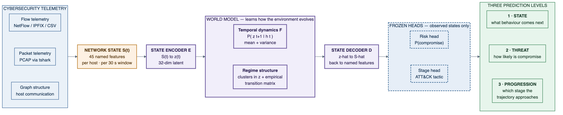












TECHNICAL APPROACH
One pipeline: telemetry → named state → latent dynamics → simulated futures → three prediction levels
WORLD MODEL PIPELINE
PARAMETERS
Window Δ = 30 s · latent z = 32-d
Context L = 30 windows (15 min history)
Horizon K = 6 → 3 min forecast reach
Dynamics 2-layer GRU, 128 hidden
Ensemble 5 seeds · ~1000 trajectories
Risk threshold 0.75 · lead rule m = 2
NETWORK STATE = per host, per 30 s window, 45 named features. Flow-level (syn/ack ratios, bytes, duration, IAT statistics) + packet-level (TTL variance, TCP window entropy, fragmentation, retransmissions, payload distribution) + graph scalars (fan-out, port entropy, new-peer count).
Both levels are required: flow features catch a SYN flood; packet features expose the slow scan built to stay under flow thresholds.
TWO-STAGE TRAINING & PROOF
TECH STACK
Stage A self-supervised pretraining on all traffic — no attack labels used.
Stage B risk + stage heads train on observed states, then freeze.
Inference encode history, roll the latent forward K=6 — no real data after t.
Falsification persistence + time-shuffle must collapse; Infiltration held out.
SHAP
ML DATA
PyTorch
scikit-learn
NumPy
tshark
pandas
SERVE WEB
FastAPI
Redis
PostgreSQL
Docker
Next.js
TypeScript
visx
DISCOVERED BEHAVIOURAL REGIMES k-means over the learned latent + empirical transition counts — the model is never told what an attack stage is. Values illustrative.

Slide 4
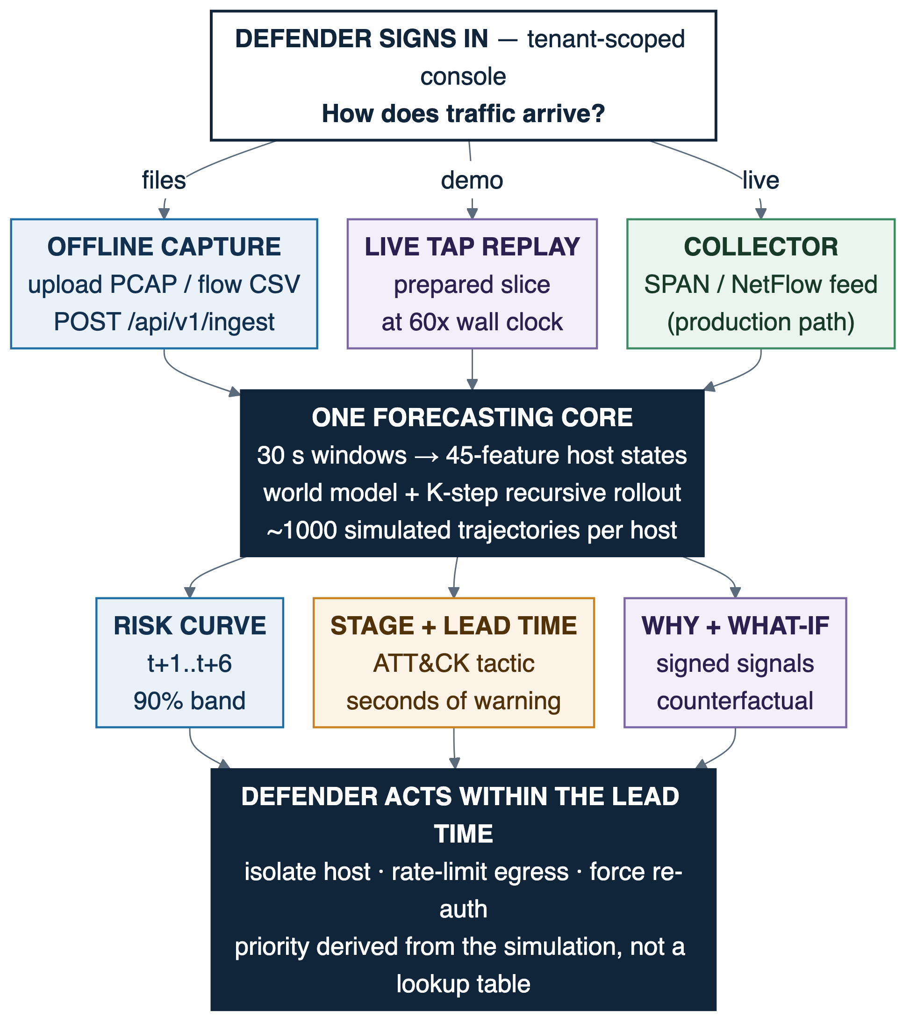
FEASIBILITY AND VIABILITY
Why it can be built, why it stays defensible, and how we would know if we were wrong
FEASIBILITY
VIABILITY — THE MOAT
Technical public data — CIC-IDS2017 has labelled attack timelines (PCAP + flow CSVs). Small model: 32-d GRU dynamics trains on CPU — no GPU cluster.
Already built FastAPI, Redis Streams, PostgreSQL, Docker Compose run today; remaining work is the ML pipeline and console.
Operational passive tap or NetFlow collector — no inline failure mode. Fully offline, verified air-gapped.
Economic open-source end to end — no licensing, no cloud egress, no per-seat cost.
The moat labelled attack data is the scarcest asset in security ML. NIDRA needs it only for two small frozen heads.
It improves by ingesting traffic, not by ingesting labels.
Deployment a new site adapts by watching its own normal — nobody labels anything. Supervised vendors structurally cannot.
Market fit complements the existing IDS / SIEM — adds a forecast horizon for air-gapped CII operations.
TOTAL SYSTEM FLOW
TECHNICAL CHALLENGES
RESEARCH / VALIDATION
Risk: rollout error accumulates — forecasts degrade with horizon.
Mitigation: multi-step unrolled loss + scheduled sampling + ensembling; we report where calibration fails — “reliable to 3 min” is credible.
Risk: the model may memorise signatures — or add nothing over a history-aware classifier.
Mitigation: we test for both and report either way. Temporal + episode splits; random splits are disqualifying.
THE PROOF — evaluation designed to falsify our own claim. Representation: reconstruction · Dynamics: multi-step nRMSE, persistence + time-shuffle ablations · Utility: lead time, unseen-attack holdout · Baselines: LR on identical features + LR on flattened history.
A flat horizon curve is a leakage red flag — smooth degradation is what honest dynamics look like.
REALITY OVERLAY — the next windows arrive and land on the forecast; every prediction is scored against what actually happened. CIC-IDS2017 · ATT&CK mapping · air-gapped.

Slide 5
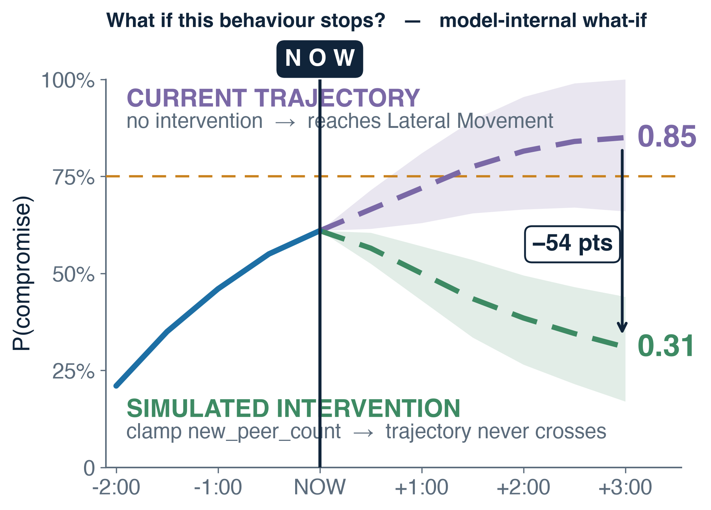
IMPACT AND BENEFITS
From alert to decision — forecast, explanation, and the action that changes the trajectory
IMPACT
▸ Alert → decision. An alert says something is wrong. A NIDRA forecast says what is likely next, how confident, and how long you have — investigation becomes a containment window.
▸ Decision support, not autonomy. What is likely? (forecast) → Why? (signed signals) → What changes it? (counterfactual). The priority is derived from the simulation; a human decides.
▸ National / CII relevance. Air-gapped, passive, interpretable — aligned with NCIIPC guidance for protected systems.
▸ Scientific contribution. Applies the world-model paradigm to network defence, evaluated to falsify rather than support the claim.
94 s
12×
0.9
The defender asks what happens if outbound fan-out stops growing. The model re-simulates: projected risk 0.85 → 0.31, so restricting east-west traffic is the highest-leverage action. Model-internal what-if, not a causal claim. Values illustrative.
median forecast lead time
lead time vs persistence
alerts / hour / host
Capability | Signature IDS | ML / Anomaly NDR | NIDRA
Detects novel behaviour | ✗ | ✓ | ✓
Models temporal sequence | ✗ | partial | ✓
Generates unobserved future states | ✗ | ✗ | ✓
Forecast with horizon + confidence band | ✗ | ✗ | ✓
Counterfactual “what if” simulation | ✗ | ✗ | ✓
Learns without labelled attacks | ✗ | partial | ✓
RESULTS · CIC-IDS2017, temporal split
Metric | LR (S_t) | LR (history) | Persistence | NIDRA
F1 | 0.61 | 0.74 | 0.58 | 0.86
AUC-PR | 0.55 | 0.71 | 0.49 | 0.84
FPR (alerts/hr/host) | 2.4 | 1.7 | 3.1 | 0.9
Median lead time | — | — | 8 s | 94 s
Stage accuracy @ t+3 | — | — | — | 0.72
Bold rows: what nothing else in the table can do.

Slide 6
RESEARCH AND REFERENCES
What we build on, what already exists, and what we are careful not to claim
FOUNDATIONAL RESEARCH
DATA & KNOWLEDGE BASES
World Models — Ha & Schmidhuber (2018). arXiv:1803.10122
Latent dynamics & imagined rollouts — Hafner et al., Dream to Control (arXiv:1912.01603); Discrete World Models (arXiv:2010.02193)
Recurrent state-space models — Hafner et al., PlaNet (arXiv:1811.04551)
Sequence-model alternatives — S4 / Mamba structured state-space models, carried as ablation axes
CIC-IDS2017 / CSE-CIC-IDS2018 — labelled attack timelines with raw PCAP + flow CSVs
UNSW-NB15 · CTU-13 · CICIoT2023 — cross-dataset generalisation evaluation
MITRE ATT&CK — tactic taxonomy for stage presentation
NIST SP 800-94 · NCIIPC — IDS/IPS guidance · protected-systems guidelines
HOW NIDRA DIFFERS FROM WHAT EXISTS
Snort / Suricata / Zeek signature and rule matching → no forecast; blind to novel behaviour
Darktrace / Vectra / ExtraHop behavioural anomaly scoring → scores the present; no simulated futures, no what-if
Academic LSTM-IDS sequence → label classification → a classifier, not a dynamics model — cannot produce a state it never observed
SCIENTIFIC POSITION
PROJECT RESOURCES
NIDRA is a learned temporal world model, not a causal model of attacker intent. We have correlation, temporal prediction and learned dynamics — all legitimate and non-trivial. We do not have causal inference: our data is observational. Counterfactual rollouts are model-internal what-ifs, labelled as such.
Forecast reliability degrades past roughly three minutes; we report the horizon at which calibration fails. The persistence ablation can fail — if it does, we report and diagnose.
Prototype console : nidra.muaazshaikh.com
Demo video / drive : drive.google.com/drive/folders/1lRbftwqcnWhxeIpuILC_y1-YxUtEdBvk
Repository : github.com/clustercoder/nidra
CORE RESEARCH QUESTION Can a world model trained on known attack trajectories forecast the progression of an unseen attack class from its behavioural dynamics rather than memorised signatures?

