Slide 1


SMART INDIA HACKATHON 2026
TITLE PAGE
• Problem Statement ID : 26153
• Problem Statement Title : AI based Network Attack Forecasting from Network Traffic Data
• Theme : Blockchain & Cybersecurity
• PS Category : Software
• Team ID : <Team ID>
• Team Name : <Registered Team Name>
N I D R A
Network Intrusion Dynamics & Risk Anticipation — a network world model that forecasts attack trajectories before compromise completes.
OBSERVE → REPRESENT → LEARN DYNAMICS → IMAGINE → FORECAST

Slide 2
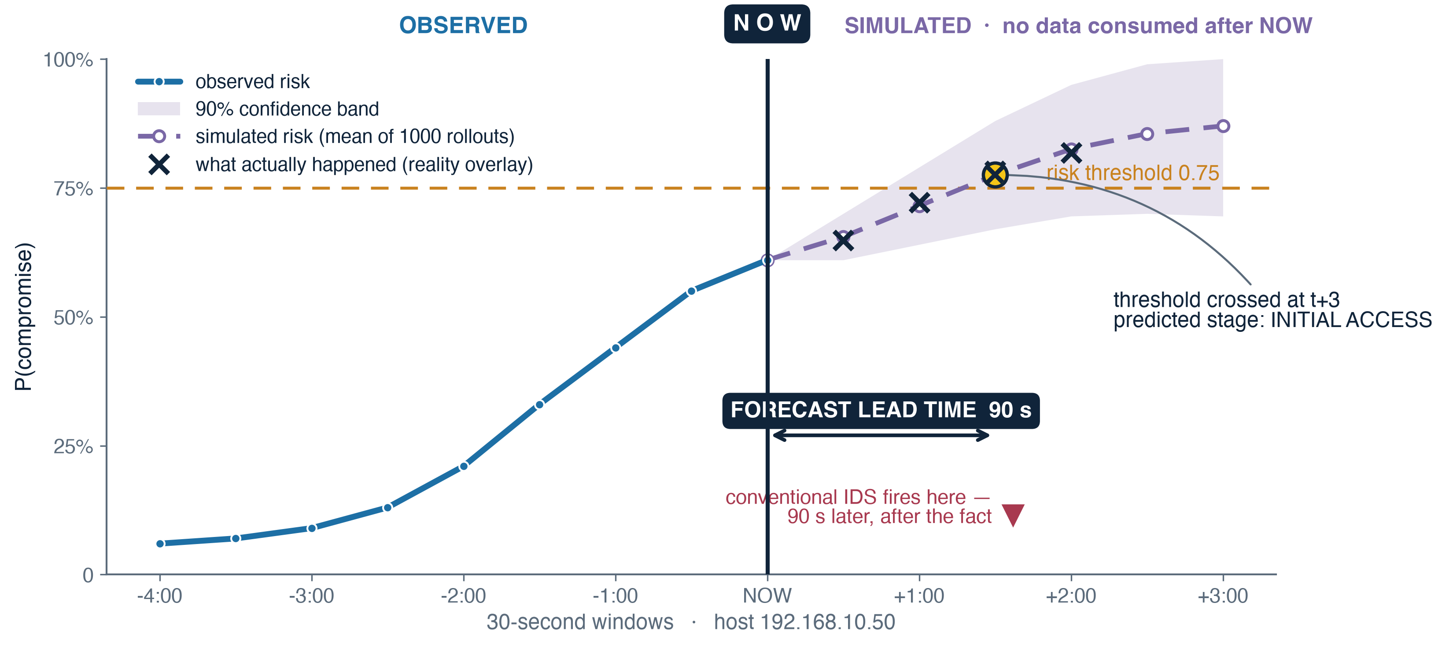
NIDRA — PROPOSED SOLUTION
Network Intrusion Dynamics & Risk Anticipation · a world model that forecasts attack trajectories — not an intrusion detector
★ = innovation
THE PROBLEM WITH DETECTION
▸ Detection is always late. An IDS computes f(traffic) → benign / malicious. It fires once the evidence exists — the behaviour already happened.
▸ Attacks are processes, not packets. Recon → scan → access → lateral → C2 → exfil unfolds over minutes. Per-flow classifiers discard that structure entirely.
▸ Labels are the bottleneck. Supervised IDS needs labelled attacks: expensive, stale, and they do not transfer between networks.
WHAT NIDRA PREDICTS — THREE LEVELS
1 · STATE what will behaviour look like? Ŝ t+1 … Ŝ t+6
2 · THREAT how likely is compromise? P(compromise at t+k) + 90% band
3 · PROGRESSION which stage is it approaching? P(stage | Ŝ), ATT&CK tactic
Every level derives from the same simulated trajectory — “312 of 1000 futures reach Lateral Movement” is a fraction across sampled rollouts, not a point estimate.
Observed risk (solid) meets NOW; everything right of the rule is simulated — states the model generated, scored by a frozen classifier that never saw them. Threshold crossed at t+3: 90 seconds of warning. The ✕ marks are what actually happened. Values illustrative of the demo scenario.
PROPOSED SOLUTION
UVP — UNIQUE VALUE PROPOSITION
▸ Learn dynamics, not a boundary. NIDRA models P(S t+1 | h t) — how a host's behaviour evolves window to window.
★ Simulates futures it never observed. Recursive K-step rollout generates the next 6 windows, consuming no real data after NOW.
★ Frozen heads. Risk & stage classifiers train on observed states only, then freeze — all early warning must come from the learned dynamics.
★ Forecast, not alert. Output has a time axis, a confidence band and a lead time in seconds — enough to act, not just investigate.
★ Counterfactual simulation. “What if fan-out stops?” — needs a reusable transition operator; no detection product has one. Labelled model-internal what-if.
▸ Learns without labels. Pretrains self-supervised on ordinary traffic; adapts to a new network by watching it.

Slide 3
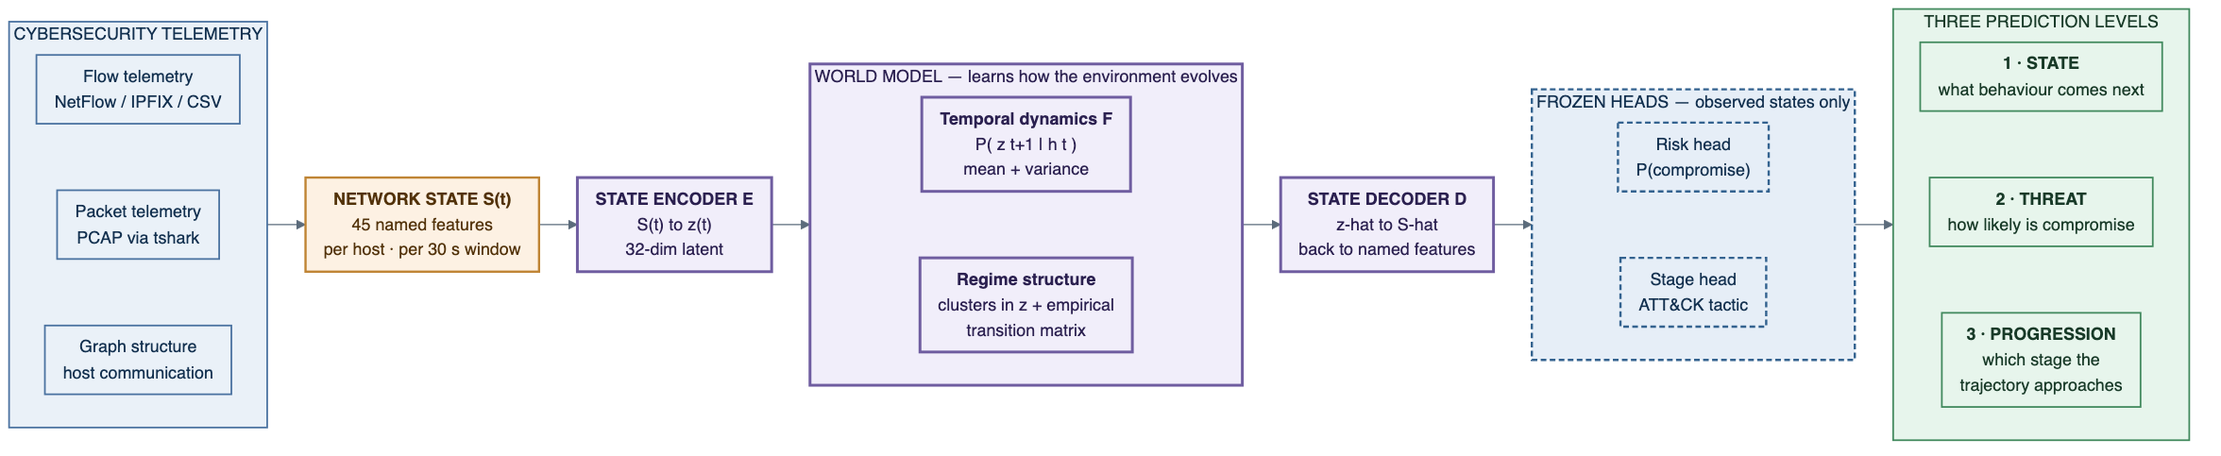












TECHNICAL APPROACH
One pipeline: telemetry → named state → latent dynamics → simulated futures → three prediction levels
WORLD MODEL PIPELINE
PARAMETERS
Window Δ = 30 s · latent z = 32-d
Context L = 30 windows (15 min history)
Horizon K = 6 → 3 min forecast reach
Dynamics 2-layer GRU, 128 hidden
Ensemble 5 seeds · ~1000 trajectories
Risk threshold 0.75 · lead rule m = 2
Splits temporal + episode-level
NETWORK STATE = per host, per 30 s window, 45 named features. Flow-level (syn/ack ratios, bytes, duration, IAT statistics) + packet-level (TTL variance, TCP window entropy, fragmentation, retransmissions, payload distribution) + graph scalars (fan-out, port entropy, new-peer count).
Both levels are required: flow features catch a SYN flood; packet features expose the slow scan built to stay under flow thresholds.
TWO-STAGE TRAINING & PROOF
TECH STACK
Stage A self-supervised world-model pretraining on all traffic, benign included — no attack labels used at any point.
Stage B risk + stage heads trained on observed states with labelled timelines, then frozen. Nothing trains after this.
Inference encode the observed sequence, roll the latent forward K=6, decode — no real data consumed after t.
Falsification persistence + time-shuffle ablations must collapse; Infiltration held out of training entirely.
ML DATA
SHAP
PyTorch
scikit-learn
NumPy
tshark
pandas
SERVE WEB
FastAPI
Redis
PostgreSQL
Docker
Next.js
TypeScript
visx
DISCOVERED BEHAVIOURAL REGIMES k-means over the learned latent + empirical transition counts — the model is never told what an attack stage is. Values illustrative.

Slide 4
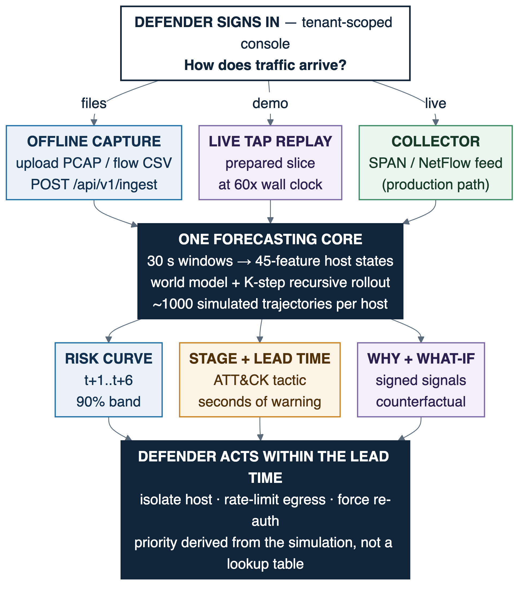
FEASIBILITY AND VIABILITY
Why it can be built, why it stays defensible, and how we would know if we were wrong
FEASIBILITY
VIABILITY — WHERE THE MOAT IS
Technical public data — CIC-IDS2017 has labelled attack timelines with raw PCAP + flow CSVs. Small model: 32-d GRU latent dynamics, trains on CPU — no GPU cluster, no foundation-model dependency.
Already built FastAPI services, Redis Streams pipeline, PostgreSQL, Docker Compose — running today. Remaining work is the ML pipeline and console.
Operational passive tap or NetFlow collector — no inline failure mode. Fully offline: docker compose up, verified air-gapped.
Economic open-source stack end to end. No licensing, no cloud egress, no per-seat cost.
The moat labelled attack data is the scarcest, least transferable asset in security ML. NIDRA needs it only for two small frozen heads.
The system improves by ingesting traffic, not by ingesting labels.
Deployment at a new site it adapts by watching that network's normal — nobody labels anything. Signature and supervised vendors structurally cannot do this.
Market fit complements the existing IDS / SIEM — adds a forecast horizon to the alert stream. CII operators need air-gapped, explainable, non-inline tooling.
TOTAL SYSTEM FLOW — SIGN-IN TO ACTION
TECHNICAL CHALLENGES
RESEARCH / VALIDATION CHALLENGES
Risk: rollout error accumulates — forecasts degrade with horizon.
Mitigation: multi-step unrolled loss + scheduled sampling + ensembling. We report the horizon at which calibration fails — “reliable to 3 minutes” is credible; a 20-step forecast is not. Clamped log-variance and states keep the rollout stable.
Risk: the model may memorise signatures rather than learn dynamics — or add nothing over a history-aware classifier.
Mitigation: we test for both directly and report either way. Temporal + episode-level splits; random splits treated as disqualifying. If persistence matches the model, we say so and diagnose — a reported negative result survives scrutiny.
THE PROOF — evaluation designed to falsify our own claim. Representation: reconstruction quality · Dynamics: multi-step nRMSE, persistence + time-shuffle ablations · Utility: lead time, early-warning precision, unseen-attack holdout. Baselines: mandated LR on identical features + LR on flattened history — history without dynamics, the hard one.
A flat horizon curve is a leakage red flag, not a good result — smooth degradation is what honest dynamics look like.
REALITY OVERLAY — the next windows arrive and land on the forecast; every prediction is scored against what actually happened. CIC-IDS2017 · ATT&CK mapping · air-gapped.

Slide 5
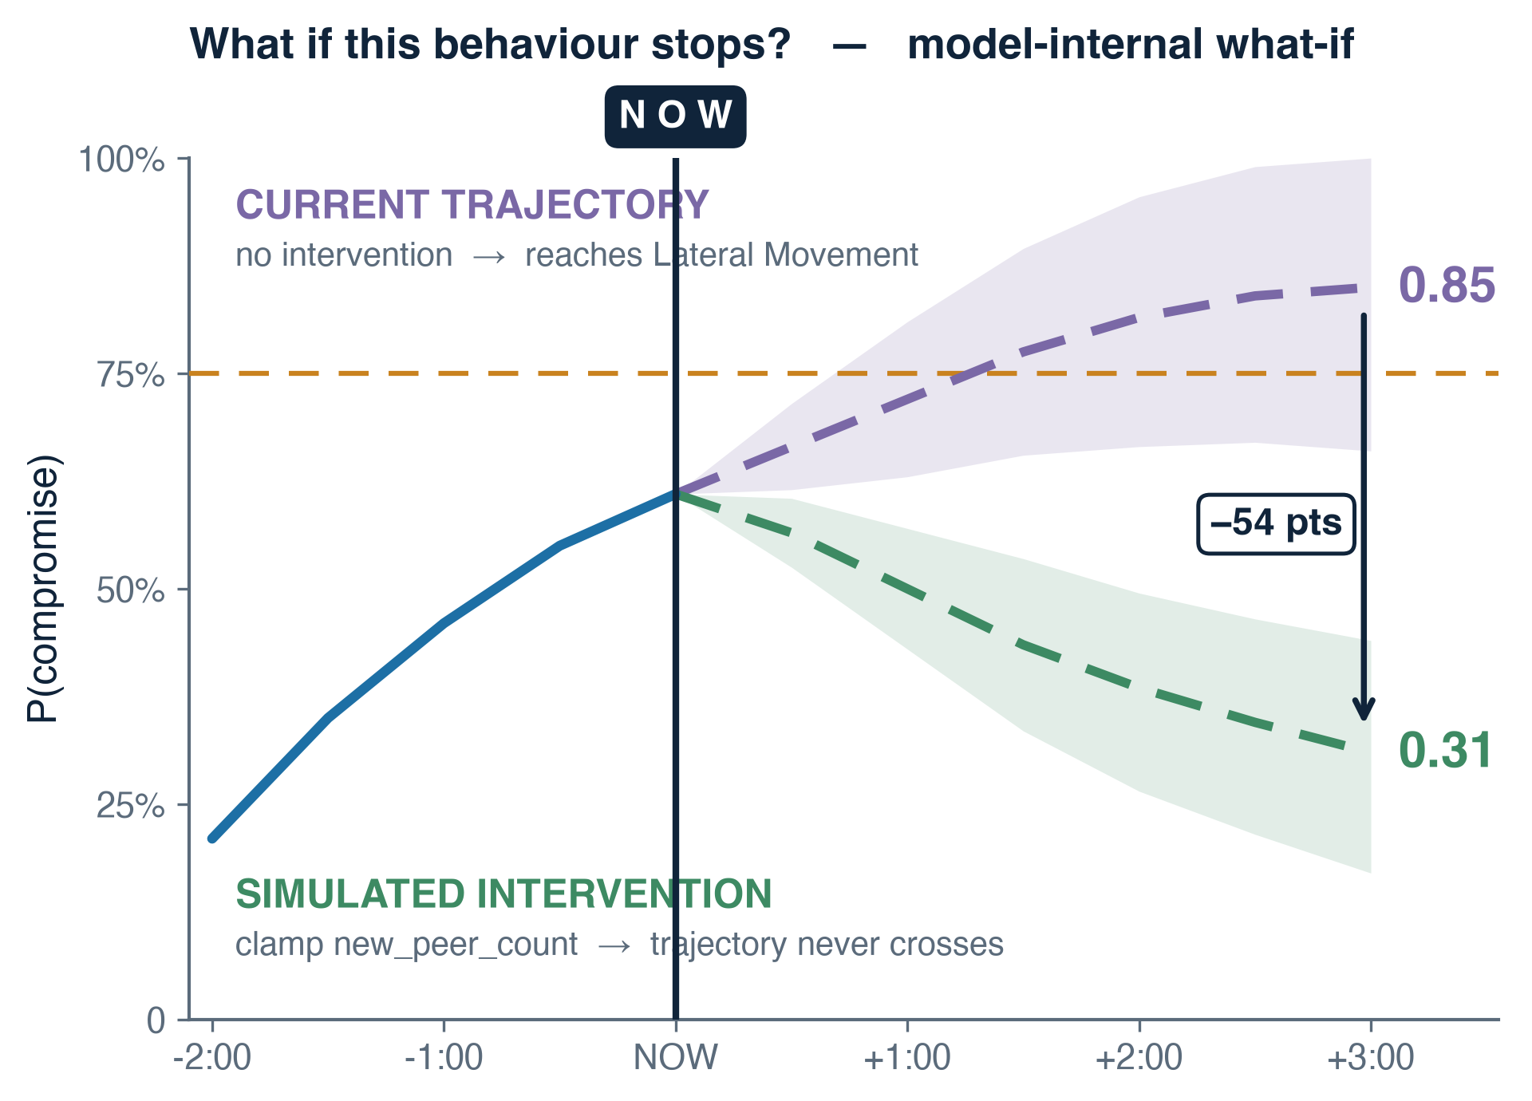
IMPACT AND BENEFITS
From alert to decision — forecast, explanation, and the action that changes the trajectory
IMPACT
▸ Alert → decision. A conventional alert says something is wrong. A NIDRA forecast says what is likely next, how confident, and how long you have — investigation becomes a containment window.
▸ Decision support, not autonomy. What is likely? (forecast) → Why? (signed signals + driving window) → What changes it? (counterfactual). The priority is derived from the simulation, not a stage→action lookup table. A human decides.
▸ National / CII relevance. Air-gapped, passive, interpretable — aligned with NCIIPC guidance for protected systems.
▸ Scientific contribution. Applies the world-model paradigm — learned dynamics with imagined rollouts — to network defence, evaluated to falsify rather than support the claim.
▸ Operational fit. Passive SPAN / NetFlow deployment, no inline failure mode; scales by adding stateless inference workers.
TARGET OUTCOMES — design goals, to be validated on CIC-IDS2017
· median forecast lead time > 60 s before labelled stage onset
· persistence ablation → measurable collapse in lead time and AUC
· unseen-attack holdout → risk rises before Infiltration onset
· calibration → Brier score + reliability diagram per horizon
· state forecast nRMSE per horizon — the metric no classifier can report
The defender asks what happens if outbound fan-out stops growing. The model re-simulates: projected risk 0.85 → 0.31, so restricting east-west traffic is the highest-leverage action. Model-internal what-if, not a causal claim. Values illustrative.
Capability | Signature IDS | ML / Anomaly NDR | NIDRA
Detects novel behaviour | ✗ | ✓ | ✓
Models temporal sequence | ✗ | partial | ✓
Generates unobserved future states | ✗ | ✗ | ✓
Forecast with horizon + confidence band | ✗ | ✗ | ✓
Counterfactual “what if” simulation | ✗ | ✗ | ✓
Learns without labelled attacks | ✗ | partial | ✓
DECISION SUPPORT IN ONE LINE
What is likely? forecast → Why? SHAP + driving window → What changes it? counterfactual
Predicted stage: Lateral Movement · lead time ~80 s → suggested priority: restrict east-west communication
Bold rows: what nothing else in the table can do.

Slide 6
RESEARCH AND REFERENCES
What we build on, what already exists, and what we are careful not to claim
FOUNDATIONAL RESEARCH
DATA & KNOWLEDGE BASES
World Models — Ha & Schmidhuber (2018). arXiv:1803.10122
Latent dynamics & imagined rollouts — Hafner et al., Dream to Control (arXiv:1912.01603); Mastering Atari with Discrete World Models (arXiv:2010.02193)
Recurrent state-space models — Hafner et al., PlaNet (arXiv:1811.04551)
Sequence-model alternatives — S4 / Mamba structured state-space models, carried as reported ablation axes
CIC-IDS2017 / CSE-CIC-IDS2018 — Canadian Institute for Cybersecurity; labelled attack timelines with raw PCAP + flow CSVs
UNSW-NB15 · CTU-13 · CICIoT2023 — cross-dataset generalisation evaluation
MITRE ATT&CK — tactic taxonomy used for stage presentation over dataset labels
NIST SP 800-94 · NCIIPC — IDS/IPS guidance · guidelines for protected systems
HOW NIDRA DIFFERS FROM WHAT EXISTS
Snort / Suricata / Zeek signature and rule matching → no forecast; blind to novel behaviour
Darktrace / Vectra / ExtraHop behavioural anomaly scoring → scores the present; does not simulate futures or support what-if
Academic LSTM-IDS sequence → label classification → a sequence classifier, not a dynamics model — cannot produce a state it never observed
SCIENTIFIC POSITION
PROJECT RESOURCES
NIDRA is a learned temporal world model, not a causal model of attacker intent. We have correlation, temporal prediction and learned dynamics — all legitimate and non-trivial. We do not have causal inference: that requires intervention under an explicit causal graph, and our data is observational. Counterfactual rollouts are model-internal what-ifs, labelled as such in the interface.
Forecast reliability degrades past roughly three minutes; we report the horizon at which calibration fails rather than hiding it. The persistence ablation can fail — if it does, we report and diagnose.
Repository : github.com/clustercoder/nidra
PRD / architecture : docs/ in repository
Decision log : DECISIONS.md — dated design decisions
Demo video : <link>
Prototype console : <link>
CORE RESEARCH QUESTION Can a world model trained on known attack trajectories forecast the progression of an unseen attack class from its behavioural dynamics rather than memorised signatures?

