Slide 1
EDA & Feature Engineering Summary
TTC Streetcar Delay Classification Project

Slide 2
Key EDA Findings
Significant rush‑hour delay patterns (7–9 AM, 4–7 PM)
Mechanical & investigation incidents dominate
Routes 501, 504, 505 show highest incident counts
Weekends have fewer incidents but longer delays

Slide 3
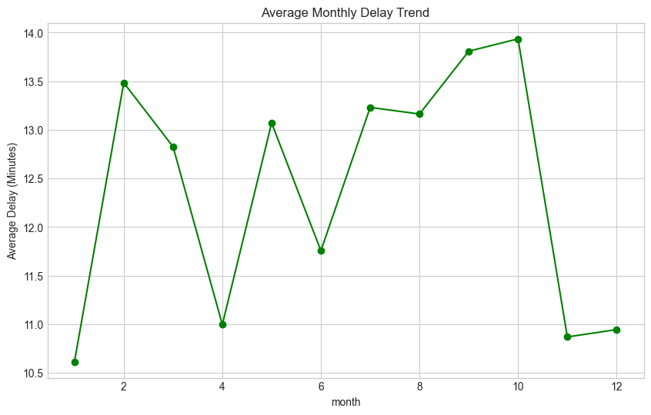
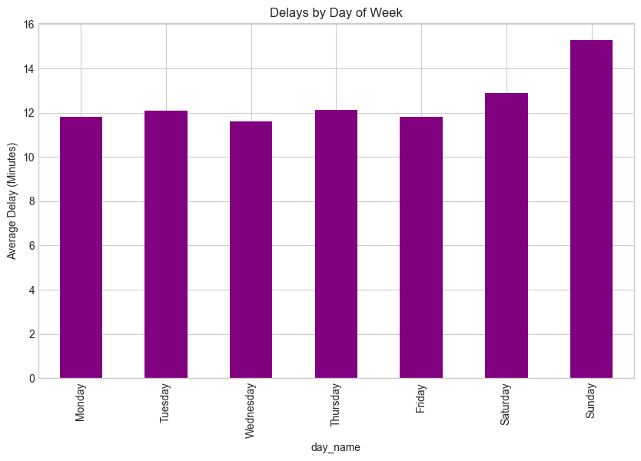
Time‑Based Delay Patterns

Slide 4
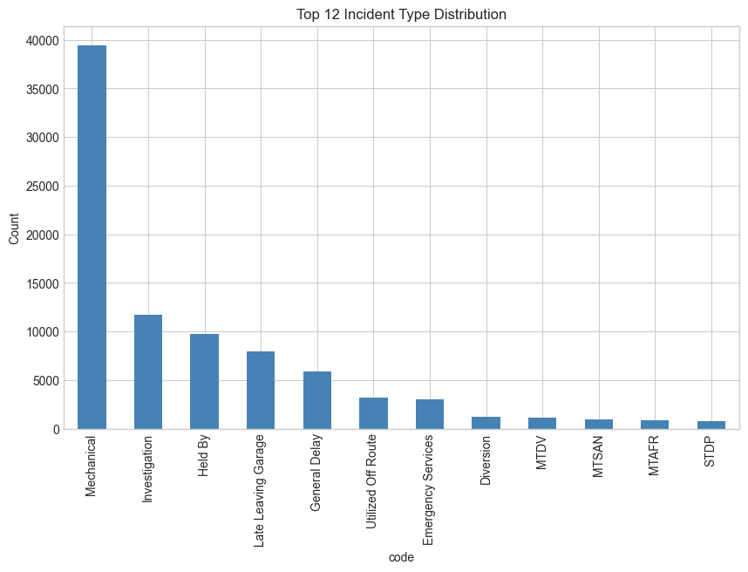
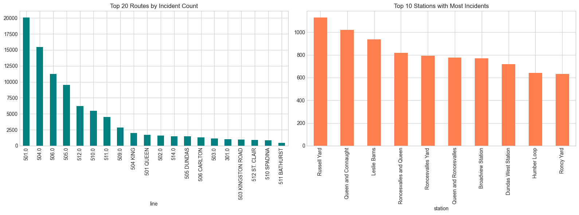
Route & Incident Distribution

Slide 5
Feature Engineering Summary
Added year, month, day, hour, is_weekend
Created delay_category (Low/Med/High)
Encoded incident, route & station
Cleaned missing values (0/Unknown)
Output ready for model training

