Slide 1
tidyverse tidyverse.org
Colette Ward
24 January 2018
Materials available here: https://github.com/clward/tidyverseIntro

Slide 2
There are many ways to do any given task in R.

Slide 3
What is the tidyverse?
Notes:
The tidyverse is a collection of R packages for data science. All packages share an underlying design philosophy, grammar, and data structures.

Slide 4
Core tidyverse
library(tidyverse)
readr (data import)
tidyr (for cleaning data)
dplyr (for data manipulation)
stringr (for working with strings)
forcats (for working with factors)
tibble (for working with tibbles – tidyverse’s version of dataframes)
purrr (for functional programming)
ggplot2

Slide 5
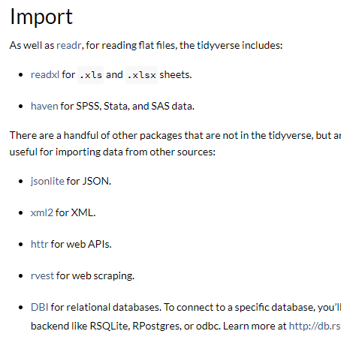
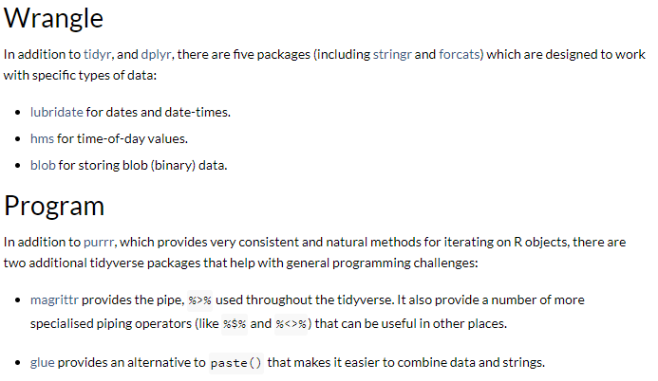
More tidyverse
tidyverse.org

Slide 6
Why use tidyr, dplyr?

Slide 7
A library of functions for cleaning and processing data
The pipe: %>%

Slide 8

The pipe
thatData <- thisData
thatData1 <- do some stuff
thatData2 <- do more stuff
thatData3 <- stuff stuff stuff
thatData3[] <- more stuff
thatData3[] <- the end

Slide 9
The pipe
thatData <- thisData
thatData1 <- do some stuff
thatData2 <- do more stuff
thatData3 <- stuff stuff stuff
thatData3[] <- more stuff
thatData3[] <- the end
thatData <- thisData %>% do some stuff %>%
do more stuff %>%
stuff stuff stuff %>%
more stuff %>%
the end

Slide 10
The tibble
vignette("tibble")
IS a data frame but with minor changes to avoid unexpected behaviours Tibbles never: - change an input type (ie no longer need stringsAsFactors = FALSE) - adjust variable names - create row names from the first variable - and a bunch of other nice things: r4ds.had.co.nz/tibbles.html

Slide 11
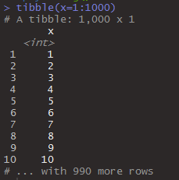
The tibble
vignette("tibble")
IS a data frame but with minor changes to avoid unexpected behaviours Tibbles never: - change an input type (ie no longer need stringsAsFactors = FALSE) - adjust variable names - create row names from the first variable - and a bunch of other nice things
Printing:

Slide 12
The tibble
vignette("tibble")
IS a data frame but with minor changes to avoid unexpected behaviours Tibbles never: - change an input type (ie no longer need stringsAsFactors = FALSE) - adjust variable names - create row names from the first variable - and a bunch of other nice things
Printing:
Subsetting: tibble: [] returns another tibble dataframe: [] returns a data frame or a vector

Slide 13
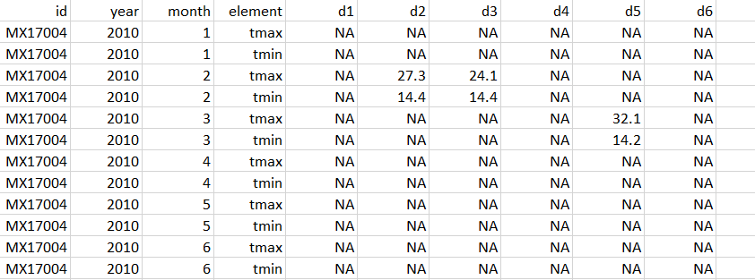
What is tidy data?
Each variable is in a column.
Each observation is a row.
Each value is a cell.
Not tidy!
Notes:
Variables are in rows and columns!

Slide 14
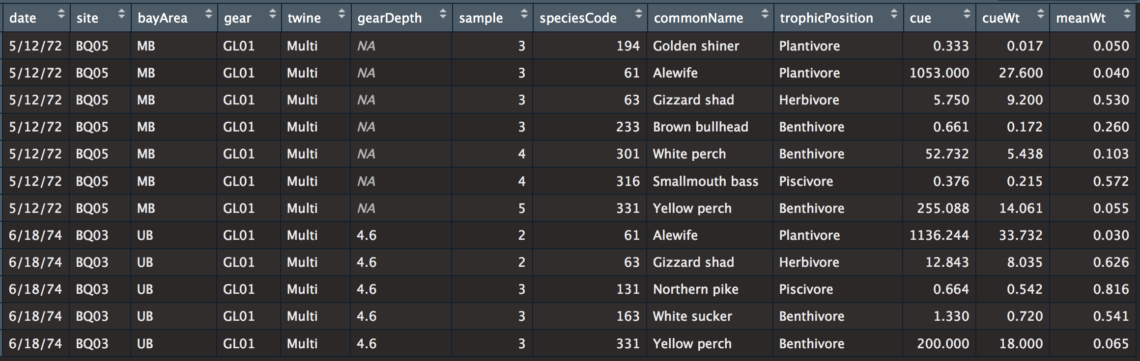
What is tidy data?
Each variable is in a column.
Each observation is a row.
Each value is a cell.
Tidy ☺

Slide 15
Typical tidyverse grammar
result <- functionName(dataframe, vector, vector, specifications) OR result <- dataframe %>% functionName(vector, vector, specs) %>% anotherfunctionName(vector, specs)

Slide 16
tidyr: for data cleaning
1. Reshape data: gather(), spread()
2. Handle missing values: drop_na(), fill(), replace_na()
3. Expand tables: complete(), expand() e.g. the missing zero problem
4. Split / Combine cells: separate(), unite()
Notes:
tidyr goal: to make data cleaning as painless and effective as possible
https://github.com/rstudio/cheatsheets/blob/master/data-import.pdf

Slide 17
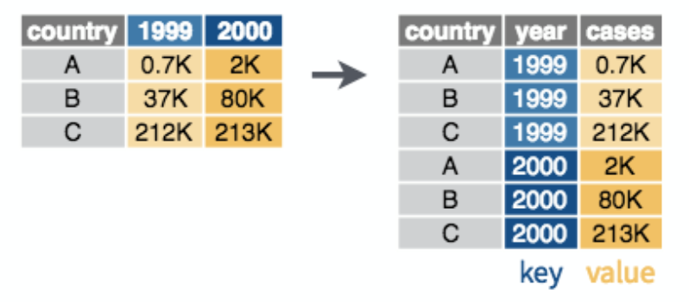
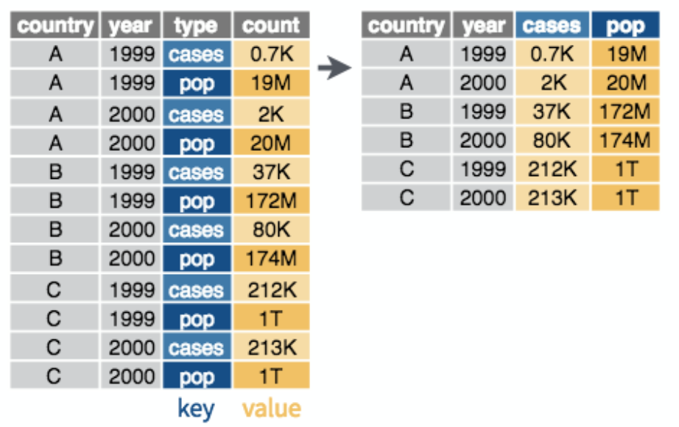
tidyr: for data cleaning
1. Reshape data: gather(), spread()
2. Handle missing values: drop_na(), fill(), replace_na()
gather()
spread()
value
value
github.com/rstudio/cheatsheets/raw/master/data-transformation.pdf

Slide 18
tidyr: for data cleaning
1. Reshape data: gather(), spread()
2. Handle missing values: drop_na(), fill(), replace_na()
3. Expand tables: complete(), expand()
4. Split / Combine cells: separate(), unite()
The missing zero problem

Slide 19
dplyr: for data wrangling A) Working with single tables
Select cases (rows): filter(), distinct()
Re-order cases: arrange()
Select variables: select(), rename()
Create new variables from existing variables: mutate(), transmute()
Collapse multiple values into a single value: group_by() %>% summarize() %>% ungroup()
Take random samples of rows: sample_n(), sample_frac()

Slide 20
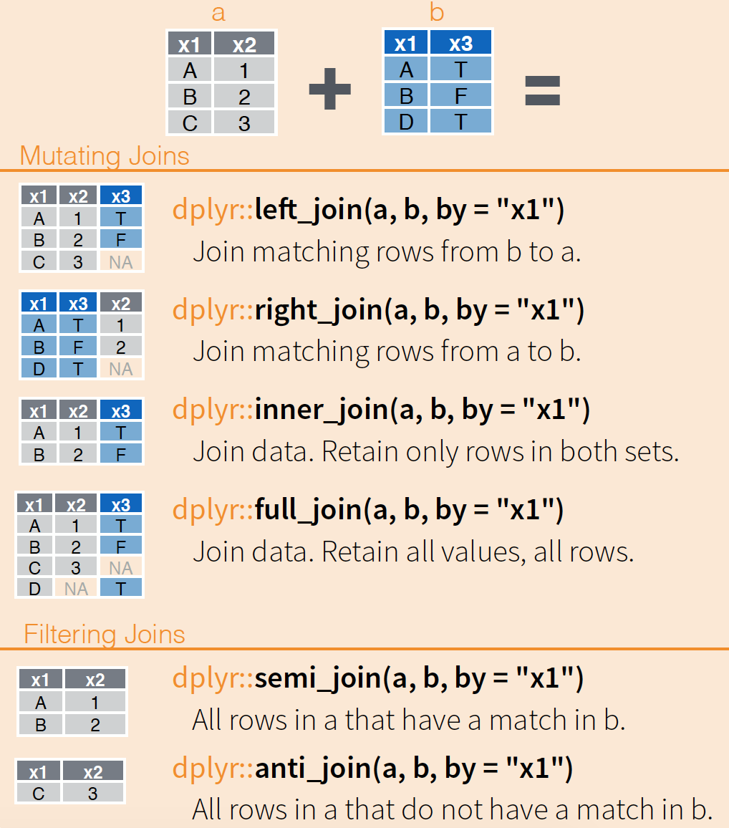
dplyr: for data wrangling B) Combining tables
1. Mutating joins
2. Filtering joins
www.rstudio.com/wp-content/uploads/2015/02/data-wrangling-cheatsheet.pdf

Slide 21
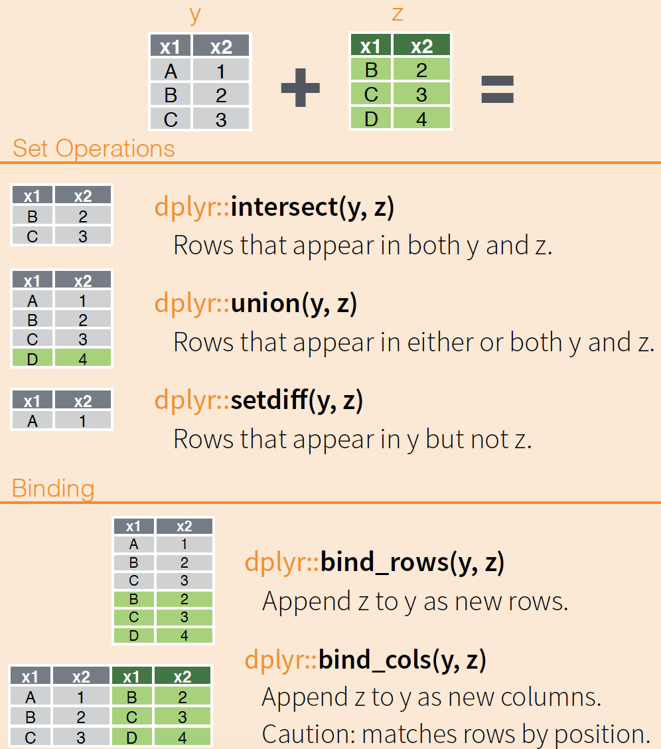
dplyr: for data wrangling B) Combining tables
1. Mutating joins
2. Filtering joins
3. Set operations
4. Bind rows / columns
www.rstudio.com/wp-content/uploads/2015/02/data-wrangling-cheatsheet.pdf

Slide 22
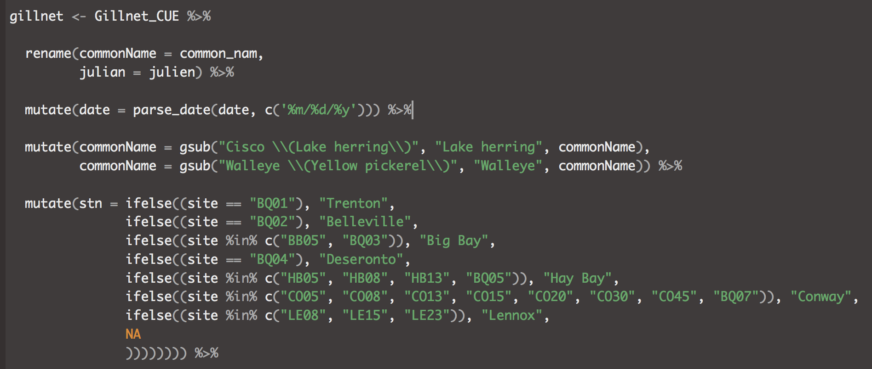
Combining non-tidyverse and tidyverse code

Slide 23
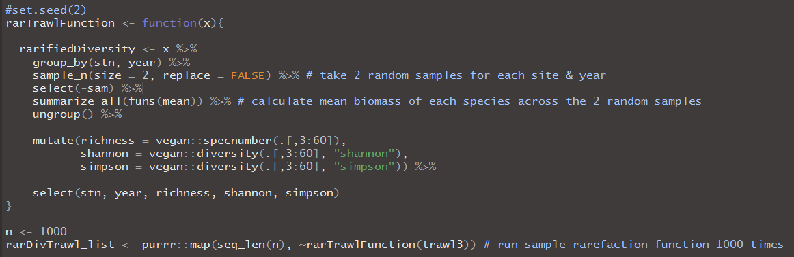
non-tidyverse package
non-standard evaluation
purrr

Slide 24
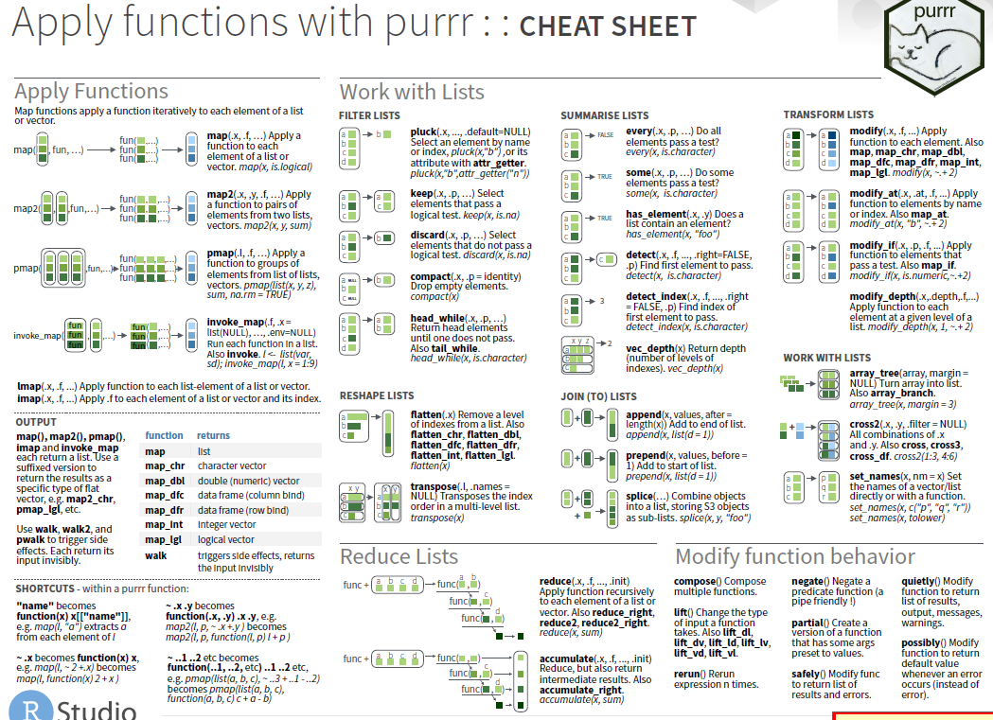
purrr: for functional programming
https://github.com/rstudio/cheatsheets/raw/master/purrr.pdf

Slide 25
Resources
Data Wrangling Cheat Sheet (tidyr, dplyr) https://github.com/rstudio/cheatsheets/raw/master/data-transformation.pdf
I also like this one: https://www.rstudio.com/wp-content/uploads/2015/02/data-wrangling-cheatsheet.pdf
Other tidyverse packages: www.rstudio.com/resources/cheatsheets/
R for Data Science https://r4ds.had.co.nz/ base R / tidyverse equivalencies www.significantdigits.org/2017/10/switching-from-base-r-to-tidyverse/
Help https://stackoverflow.com/ Source code https://github.com/tidyverse/tidyverse

