Slide 1
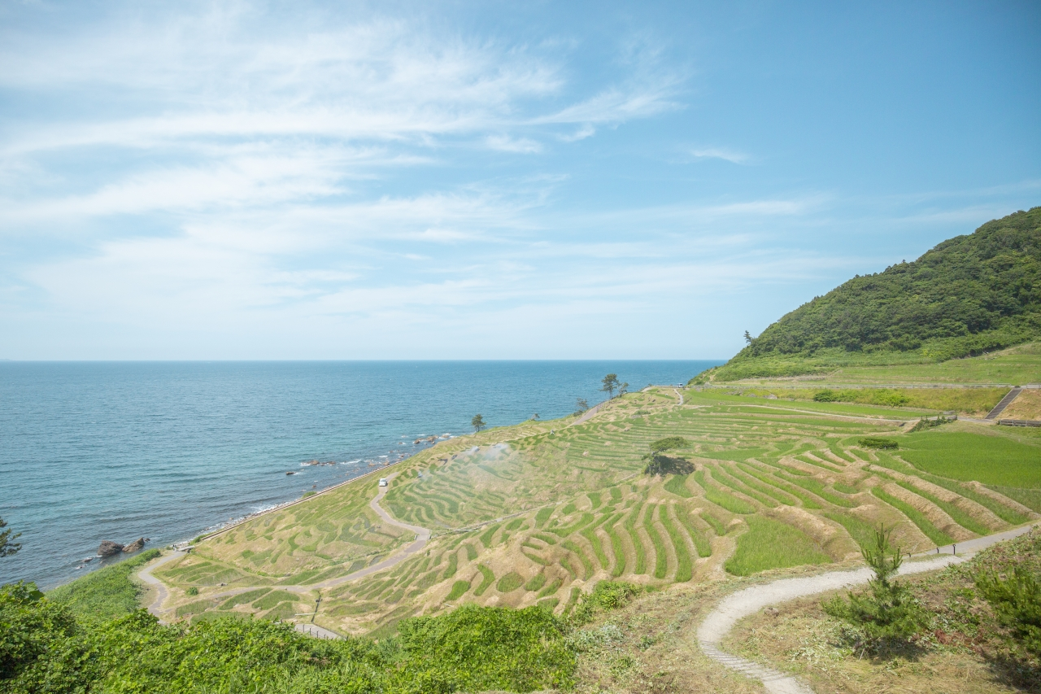

COMP 5411
Assignment
Project Progress
Noto Peninsula: An Interactive 3D Landscape
Group 12
LEE Hyunjin, TAN Jiming
2026-10-20
Cover image: Wajima Coast, Noto Peninsula
Notes:
0:00–0:12 (12 seconds planned)
NARRATION
Hello, we are Group Twelve. Our project is Noto Peninsula, an interactive three-dimensional landscape built with Three.js. This is our current progress.
RECORDING ACTION
Show the cover for twelve seconds. Keep the project title, group number and both names visible. Narrate with face camera enabled.
SOURCES
Course requirements: https://course.cse.ust.hk/comp5411/#assignment-A3 and #assignment-A1 (checked October 20, 2026).
Implementation: https://github.com/clydelhj/COMP5411, commit bbf8abba921deaa13621c54afb3d4e1c72b31cb3, CODE_GUIDE.md and the relevant src modules.
Current viewer captures: October 20, 2026. These stills show appearance; record the running viewer to demonstrate animation.
Template, university logo, cover photography and retained source illustrations: original Project proposal.pptx, supplied by the project team. Original template attribution is retained.
Data/model interpretation: the DEM source spacing is not geological or single-tree survey accuracy. Effects are visual approximations.

Slide 2
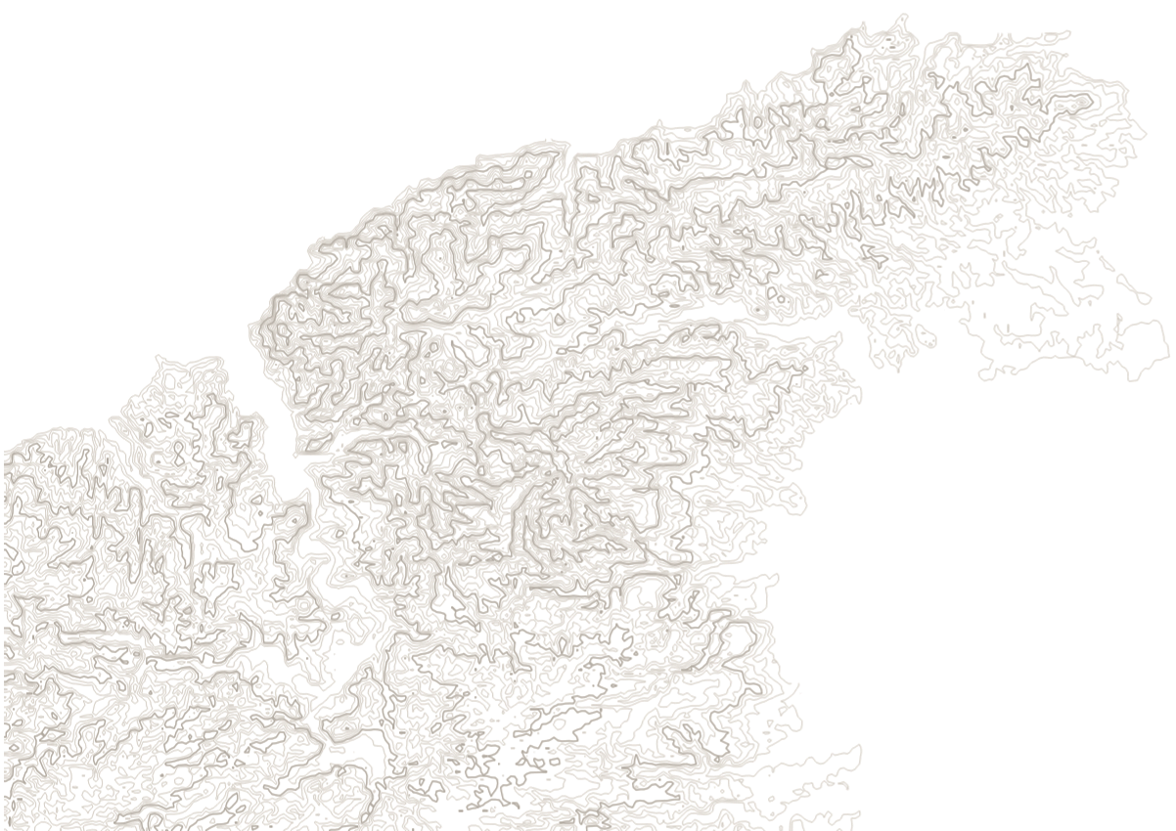
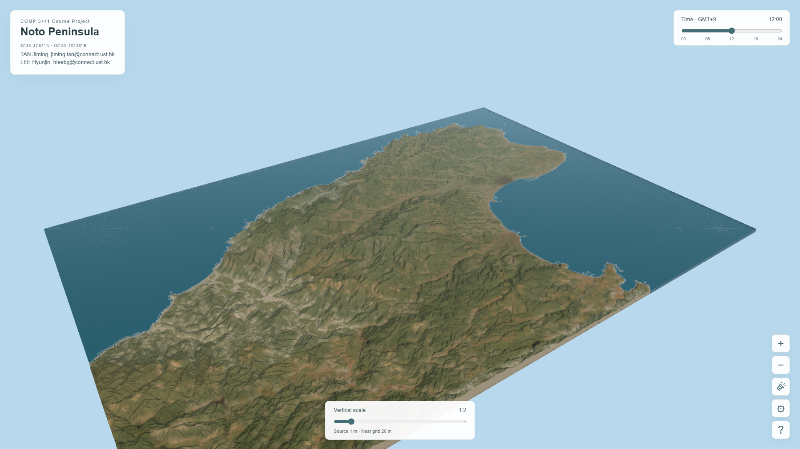
Project Scope and Data
Goal: Explore a real landscape in a web browser.
Inputs: 1 m DEM, geological categories and 2024 vegetation classes.
Platform: Three.js, WebGL and project-specific GLSL shaders.
1 m source DEM contours
Current viewer: approximately 33.23 × 23.14 km
Notes:
0:12–0:42 (30 seconds planned)
NARRATION
We aim to make a real landscape explorable in a web browser, while showing how geometry, materials, and lighting work together. The scene covers roughly thirty-three by twenty-three kilometres. It combines a one-metre elevation dataset, regional geological categories, and a twenty-twenty-four vegetation map. The geological field and individual plants are visualization approximations, rather than detailed subsurface or tree surveys.
RECORDING ACTION
Explain the goal and source scales. Point to the contour map and current viewer image. Do not describe the geological field as one-metre survey data.
SOURCES
Course requirements: https://course.cse.ust.hk/comp5411/#assignment-A3 and #assignment-A1 (checked October 20, 2026).
Implementation: https://github.com/clydelhj/COMP5411, commit bbf8abba921deaa13621c54afb3d4e1c72b31cb3, CODE_GUIDE.md and the relevant src modules.
Current viewer captures: October 20, 2026. These stills show appearance; record the running viewer to demonstrate animation.
Template, university logo, cover photography and retained source illustrations: original Project proposal.pptx, supplied by the project team. Original template attribution is retained.
Data/model interpretation: the DEM source spacing is not geological or single-tree survey accuracy. Effects are visual approximations.

Slide 3
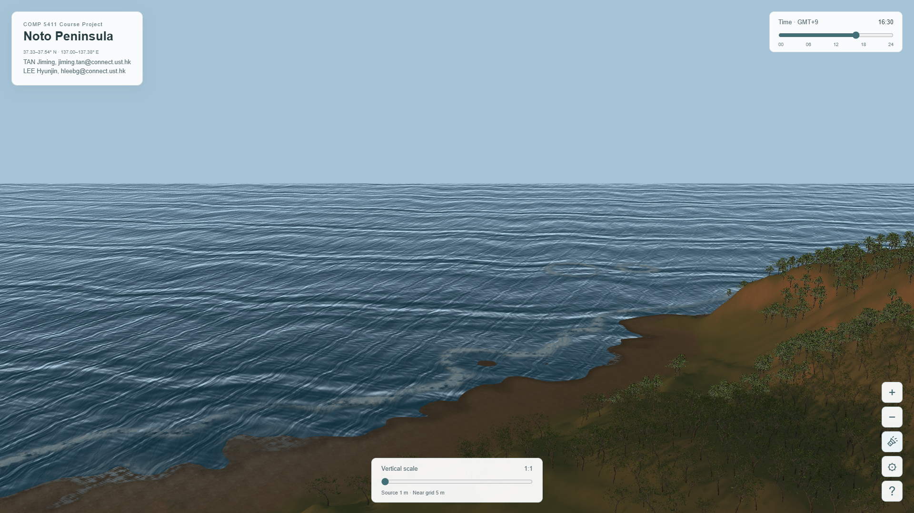
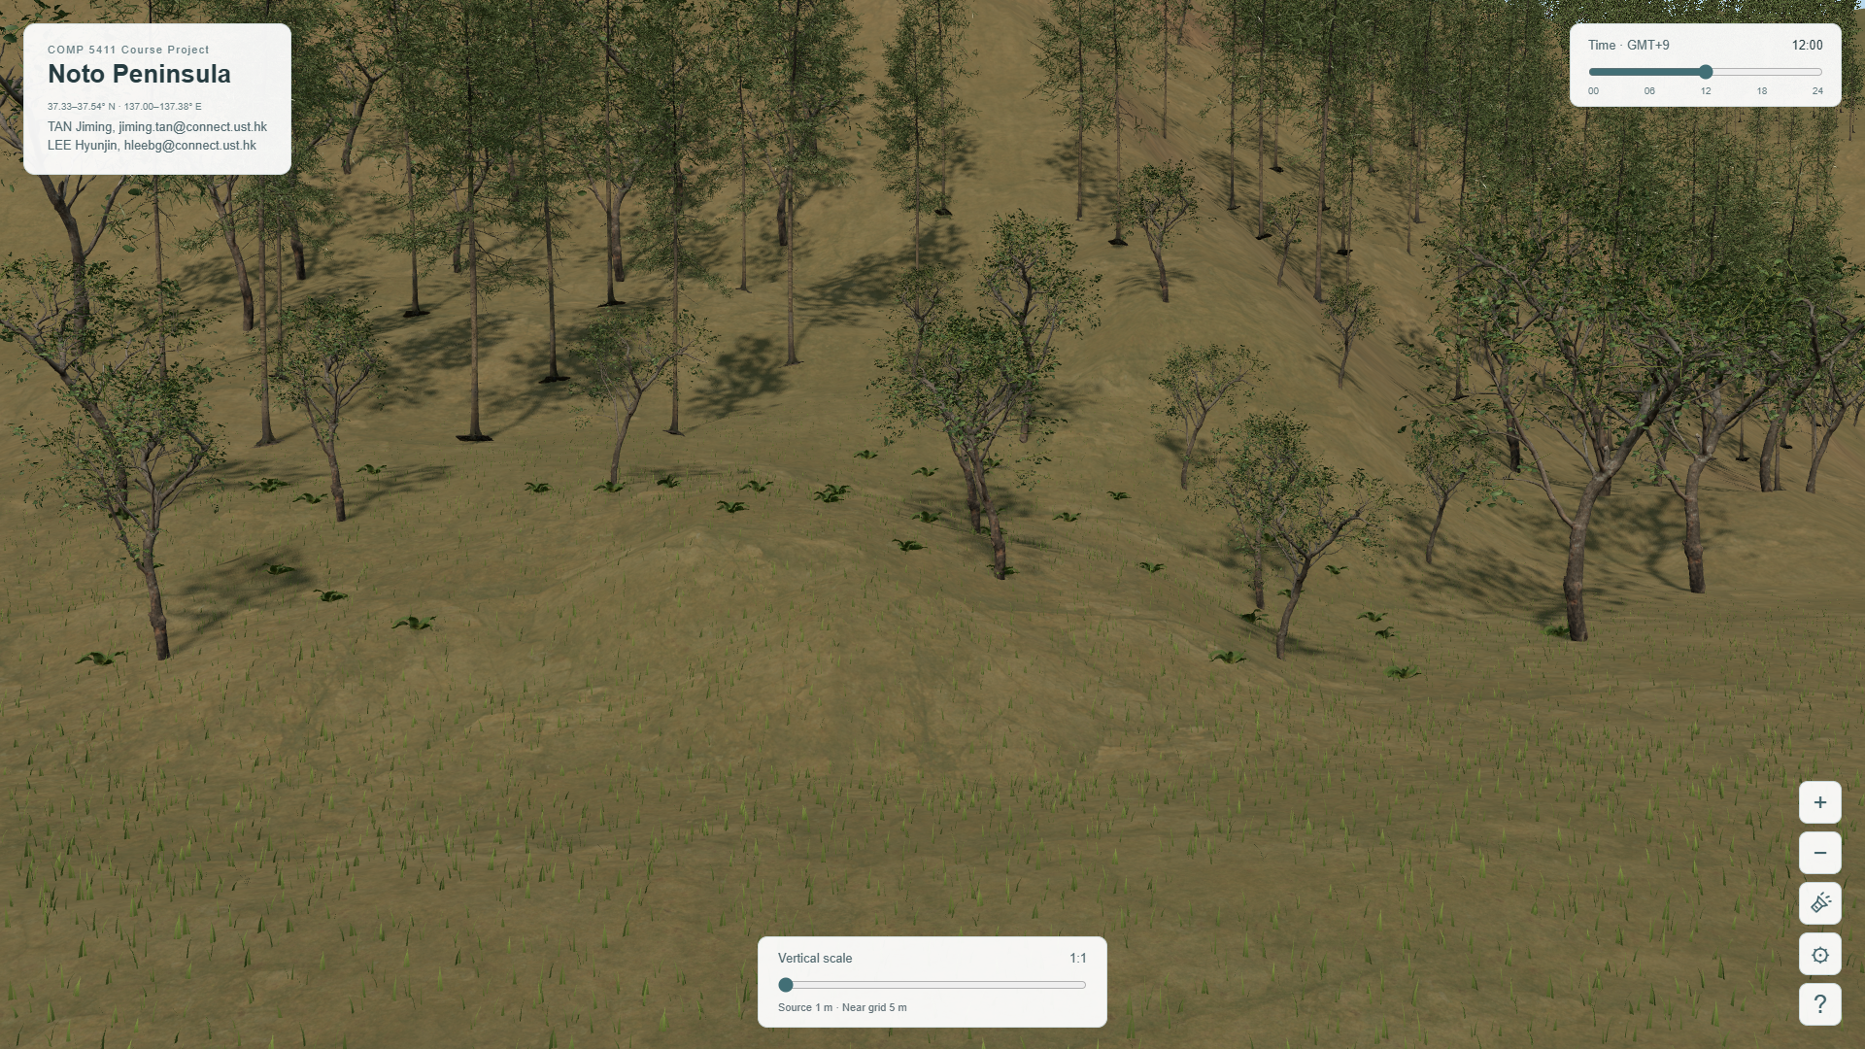
Current Graphics Pipeline
Geometry processing
Tiled triangle meshes with local detail selection.
Compatible patch edges and a continuous display coastline.
Material rendering
Geological PBR categories with triplanar sampling.
Continuous appearance blending and texture filtering.
Animation and illumination
Gerstner water, foam, spray, rain and foliage wind.
Time-dependent sunlight, local shadows and a flashlight.
Instances and scheduling
Shared plant geometry with fixed seeded positions.
Adaptive budgets and one scheduler with idle sleep.
Notes:
0:42–1:10 (28 seconds planned)
NARRATION
Our current pipeline converts elevation samples into tiled triangle meshes, then combines them with geological shaders and vegetation instances. Three.js provides the rendering infrastructure. Project-specific modules handle local terrain detail, material blending, coastal animation, and interaction. The main features from our proposal are now integrated: textured terrain, moving water, sunlight, shadows, and adaptive detail. Next, I will demonstrate their current behavior.
RECORDING ACTION
Finish the opening recap at 1:10, then switch from slides to the running viewer. Slides 4 through 6 contain real stills for orientation and backup, not a substitute for the live demo.
SOURCES
Course requirements: https://course.cse.ust.hk/comp5411/#assignment-A3 and #assignment-A1 (checked October 20, 2026).
Implementation: https://github.com/clydelhj/COMP5411, commit bbf8abba921deaa13621c54afb3d4e1c72b31cb3, CODE_GUIDE.md and the relevant src modules.
Current viewer captures: October 20, 2026. These stills show appearance; record the running viewer to demonstrate animation.
Template, university logo, cover photography and retained source illustrations: original Project proposal.pptx, supplied by the project team. Original template attribution is retained.
Data/model interpretation: the DEM source spacing is not geological or single-tree survey accuracy. Effects are visual approximations.

Slide 4
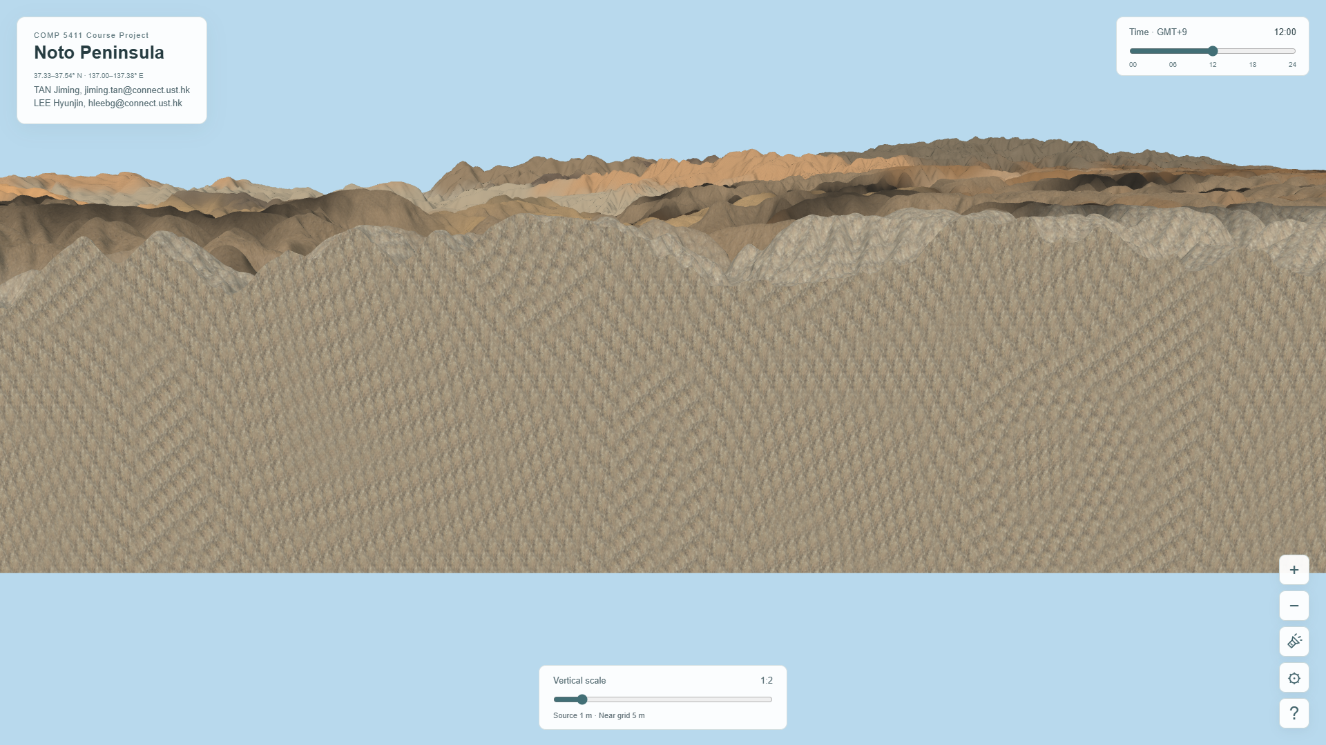
Terrain Geometry and Materials
Geometry
Near patches refine first.
Shared edges keep coverage continuous.
Materials
Triplanar PBR and
blended categories.
Sampling
Randomized textures,
mipmaps and filtering.
Current model crop boundary, 2x display height
Notes:
1:10–1:50 (40 seconds planned)
NARRATION
Here is the current viewer. I can orbit, pan, and move from the regional view toward the surface. Nearby patches receive finer geometry, while distant patches remain coarser. Adjacent levels share compatible boundaries, and the previous coverage stays visible while new patches load. The surface uses category-based PBR materials with triplanar mapping and blended transitions. Randomized texture sampling, mipmaps, and anisotropic filtering reduce repetition and moire at shallow viewing angles. The five-metre setting is a display limit, not the source resolution.
RECORDING ACTION
Record 40 seconds of the actual viewer: regional orbit, approach a textured slope, then a small low-angle turn. Show Near grid changing with distance. Keep the finest permitted spacing at 5 m; avoid waiting for 1 m tiles during the recording.
SOURCES
Course requirements: https://course.cse.ust.hk/comp5411/#assignment-A3 and #assignment-A1 (checked October 20, 2026).
Implementation: https://github.com/clydelhj/COMP5411, commit bbf8abba921deaa13621c54afb3d4e1c72b31cb3, CODE_GUIDE.md and the relevant src modules.
Current viewer captures: October 20, 2026. These stills show appearance; record the running viewer to demonstrate animation.
Template, university logo, cover photography and retained source illustrations: original Project proposal.pptx, supplied by the project team. Original template attribution is retained.
Data/model interpretation: the DEM source spacing is not geological or single-tree survey accuracy. Effects are visual approximations.

Slide 5
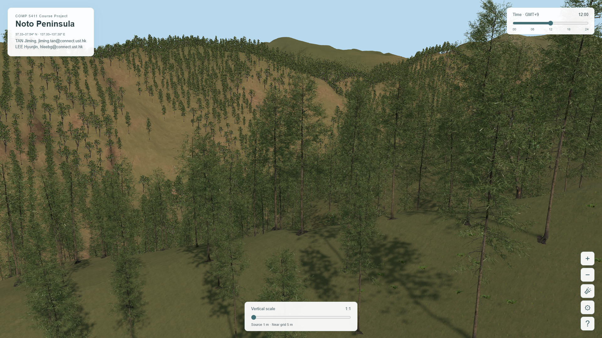
Vegetation and Ground Contact
Instancing
Shared geometry,
fixed seeded locations.
Ground contact
Aligned trunk origins.
Heights from visible triangles.
Visibility
Grass and trees can
be shown independently.
Current forest view, 1x display height
Notes:
1:50–2:20 (30 seconds planned)
NARRATION
Vegetation follows the real land-cover classes, using fixed, seeded locations. Instancing shares geometry across many plants, and distance changes their representation without randomly thinning the forest. Tree variants differ in crown shape and size. Their trunk origins are aligned before placement, so roots follow the displayed terrain. I can also control grass and trees independently, while preserving their positions when they are shown again.
RECORDING ACTION
Record a prepared forest/grass view. Move close enough to show ground contact and blades. Briefly toggle Show trees off/on, then Show grass off/on. Close settings between demonstrations so animation can resume.
SOURCES
Course requirements: https://course.cse.ust.hk/comp5411/#assignment-A3 and #assignment-A1 (checked October 20, 2026).
Implementation: https://github.com/clydelhj/COMP5411, commit bbf8abba921deaa13621c54afb3d4e1c72b31cb3, CODE_GUIDE.md and the relevant src modules.
Current viewer captures: October 20, 2026. These stills show appearance; record the running viewer to demonstrate animation.
Template, university logo, cover photography and retained source illustrations: original Project proposal.pptx, supplied by the project team. Original template attribution is retained.
Data/model interpretation: the DEM source spacing is not geological or single-tree survey accuracy. Effects are visual approximations.

Slide 6
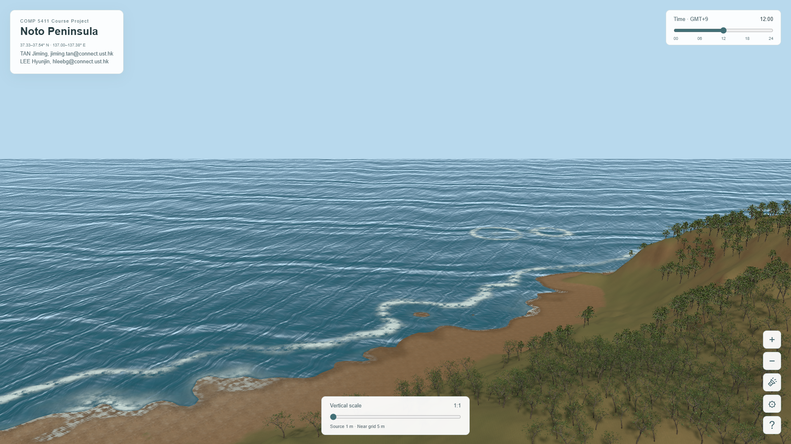
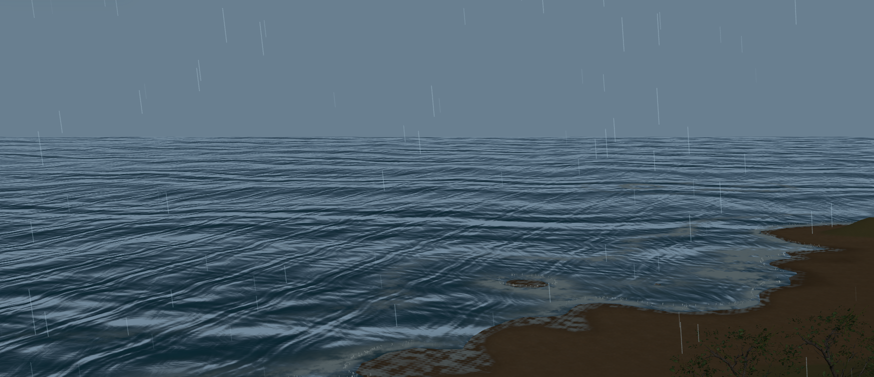
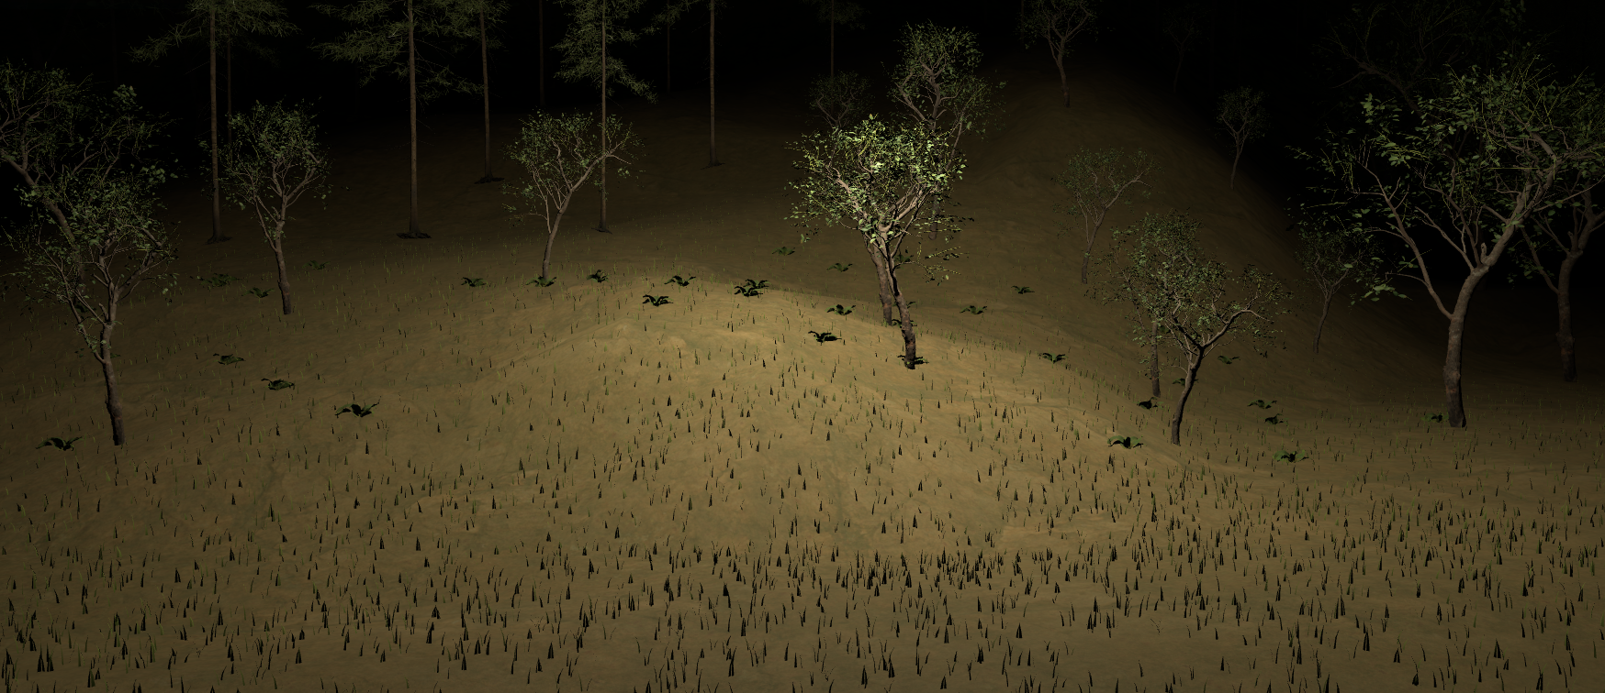
Coastal Water and Lighting
Water geometry
Gerstner displacement
and matching normals.
Shore interaction
Shared distance field,
crests, foam and wetness.
Environment
Sun, rain, shadows
and a pointer flashlight.
Rain
Night flashlight
Notes:
2:20–3:05 (45 seconds planned)
NARRATION
At the coast, Gerstner waves displace the water geometry, with normals that match the animated surface. A shared shoreline-distance field controls wave attenuation, breaking crests, foam, and wetness. Land and water use the same display contour to maintain contact across terrain detail levels. I can change the time to alter sunlight and shadows, switch to rainy weather, and use the pointer flashlight at night. Water, rain, spray, and foliage share one animation clock. These are controllable visual effects, not a fluid or weather simulation.
RECORDING ACTION
Record 18 seconds of moving coast water, about 8 seconds changing time toward sunset, about 8 seconds of rain, then 11 seconds of the prepared night/flashlight view. Cuts between prepared views are acceptable; do not speed up narration. Keep face camera visible.
SOURCES
Course requirements: https://course.cse.ust.hk/comp5411/#assignment-A3 and #assignment-A1 (checked October 20, 2026).
Implementation: https://github.com/clydelhj/COMP5411, commit bbf8abba921deaa13621c54afb3d4e1c72b31cb3, CODE_GUIDE.md and the relevant src modules.
Current viewer captures: October 20, 2026. These stills show appearance; record the running viewer to demonstrate animation.
Template, university logo, cover photography and retained source illustrations: original Project proposal.pptx, supplied by the project team. Original template attribution is retained.
Data/model interpretation: the DEM source spacing is not geological or single-tree survey accuracy. Effects are visual approximations.

Slide 7
Implementation and Checks
Geometry processing
Local LOD, triangle interpolation and compatible land/water edges
Rendering and animation
Triplanar PBR, instancing, Gerstner waves and shadow mapping
Skip unchanged placement
if (!dirty && !changed) return false;
src/vegetation.js: update(now, verticalScale)
Targeted seam, plant-contact and idle checks completed. Wider testing remains.
Notes:
3:05–3:25 (20 seconds planned)
NARRATION
The code separates geometry, material shaders, plants, and environment modules. Targeted checks cover mixed-detail seams, plant attachment, and idle rendering. One scheduler prevents repeated placement during animation-only frames. Wider device and long-session testing still remains.
RECORDING ACTION
Return to slide 7. Use the short source excerpt to explain that unchanged vegetation does not rerun placement. Distinguish completed targeted checks from remaining broad performance acceptance.
SOURCES
Course requirements: https://course.cse.ust.hk/comp5411/#assignment-A3 and #assignment-A1 (checked October 20, 2026).
Implementation: https://github.com/clydelhj/COMP5411, commit bbf8abba921deaa13621c54afb3d4e1c72b31cb3, CODE_GUIDE.md and the relevant src modules.
Current viewer captures: October 20, 2026. These stills show appearance; record the running viewer to demonstrate animation.
Template, university logo, cover photography and retained source illustrations: original Project proposal.pptx, supplied by the project team. Original template attribution is retained.
Data/model interpretation: the DEM source spacing is not geological or single-tree survey accuracy. Effects are visual approximations.

Slide 8
Remaining Work
Area | Remaining programming work | Acceptance focus | Timing
Geometry | Long routes and missing-input fallback | Coverage and mixed-detail seams | Before final
Materials / plants | Refine distant transitions and shore appearance | Shallow angles and difficult light | Before final
Animation | Refine foam, weather and effect transitions | Coast and day/night combinations | Before final
Performance | Sustained runs across devices and browsers | Frame time, caches and memory | Before final
Final slides | Demonstration and presentation | Explain completed graphics work | 22 Nov
Report and code | Implementation and code provenance | AI assistance and external libraries | 27 Nov
Notes:
3:25–3:50 (25 seconds planned)
NARRATION
Next, we will test longer navigation routes, missing-input fallback, and memory behavior across devices. We will refine vegetation transitions, shorelines, and difficult lighting conditions. We will also prepare the final demonstration and document implementation, AI assistance, and external libraries. Our next focus is validation and visual refinement. Thank you.
RECORDING ACTION
Show the remaining-work table and finish around 3:50. Check the exported video duration rather than relying on this planned timing.
SOURCES
Course requirements: https://course.cse.ust.hk/comp5411/#assignment-A3 and #assignment-A1 (checked October 20, 2026).
Implementation: https://github.com/clydelhj/COMP5411, commit bbf8abba921deaa13621c54afb3d4e1c72b31cb3, CODE_GUIDE.md and the relevant src modules.
Current viewer captures: October 20, 2026. These stills show appearance; record the running viewer to demonstrate animation.
Template, university logo, cover photography and retained source illustrations: original Project proposal.pptx, supplied by the project team. Original template attribution is retained.
Data/model interpretation: the DEM source spacing is not geological or single-tree survey accuracy. Effects are visual approximations.
Final deadlines: official course page, assignment-A4 and assignment-A5.

