Slide 1
NCMS
News Management System
Product Versions Overview
Version 1
Version 2
Version 3

Slide 2






NCMS OVERVIEW
Centralized News Management Platform
Designed for digital, broadcast, and newsroom operations with scalable, phased AI integration.
Multi-Platform
Phased Rollout
AI-Powered
Digital, broadcast,
and newsroom ready
3 versions building
on each other
Intelligent tools
integrated gradually
NCMS • News Management System • MBC News Media

Slide 3









VERSION 1 – CORE NCMS
Foundation of the News Management System
User & Role
Management
News Article
Creation & Editing
Category & Tag
Management
Manage access levels
and permissions
Full editorial
content workflow
Organize content with
flexible taxonomy
Media Upload
(Images & Videos)
Basic Approval
Workflow
Publish &
Schedule News
Rich media handling
built in
Editorial review
before publishing
Time-based content
release
NCMS • News Management System • MBC News Media

Slide 4


VERSION 1 – KEY BENEFITS
Stable & Easy-to-Use
A reliable newsroom system designed for daily editorial operations with an intuitive interface that minimizes the learning curve.
Improved Editorial Workflow
Streamlined content creation, review, and publishing processes that save time and reduce errors across the newsroom.
Foundation for AI
Built with forward-looking architecture that supports the phased integration of AI capabilities in future versions.
NCMS • News Management System • MBC News Media

Slide 5
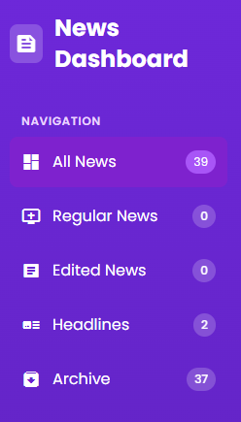
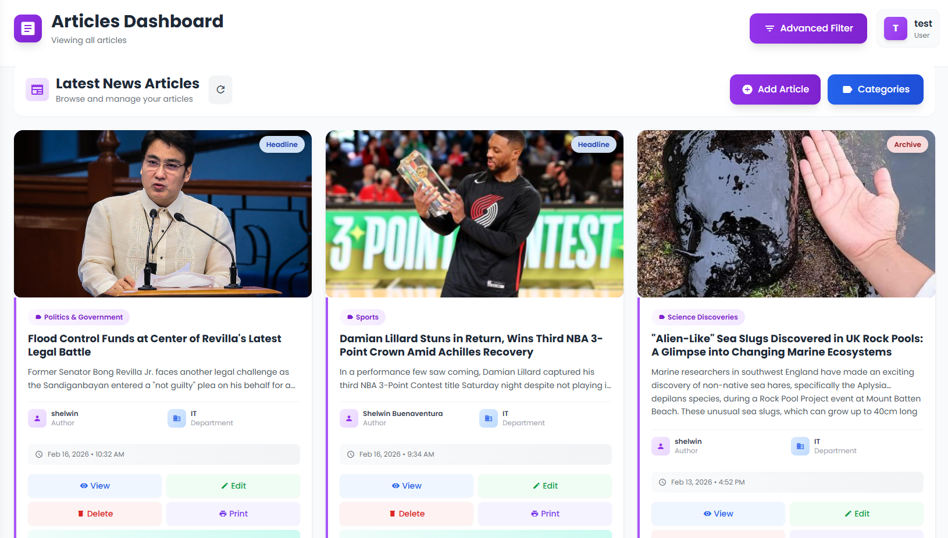
VERSION 1
NCMS • News Management System • MBC News Media

Slide 6



VERSION 2 – AI WORKFLOW & NEWS GATHERING
AI-Powered News
Aggregation
Smart Content
Categorization
AI Headline &
Summary Suggestions
Trend & Topic
Detection
Automatically scan and collect news from multiple sources in real time.
AI classifies articles by topic, region, and relevance automatically.
Generate optimized headlines and concise summaries instantly.
Identify trending stories and emerging topics before competitors.
NCMS • News Management System • MBC News Media

Slide 7




VERSION 2 – INTELLIGENT AI WORKFLOW
Enhanced editorial quality with AI-driven tools
AI-Assisted Content Review
Grammar & Tone Enhancement
Intelligent review flags issues in drafts before they reach editors, saving time and catching errors early.
AI polishes writing style, grammar, and consistency to maintain professional editorial standards.
Duplicate Content Detection
Breaking News Alerts
Automatically identifies and flags duplicate or highly similar content across the entire news database.
Real-time notifications for emerging stories, ensuring the newsroom never misses critical breaking events.
NCMS • News Management System • MBC News Media

Slide 8
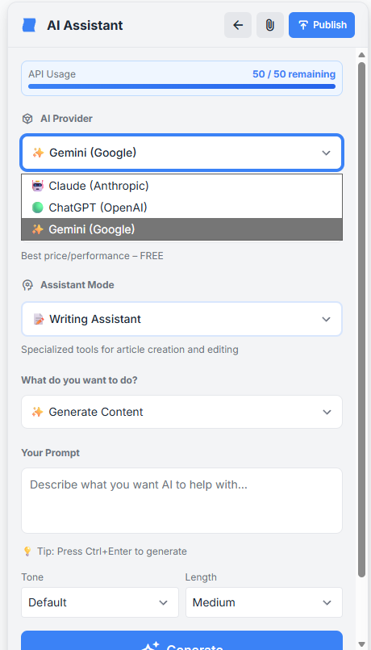
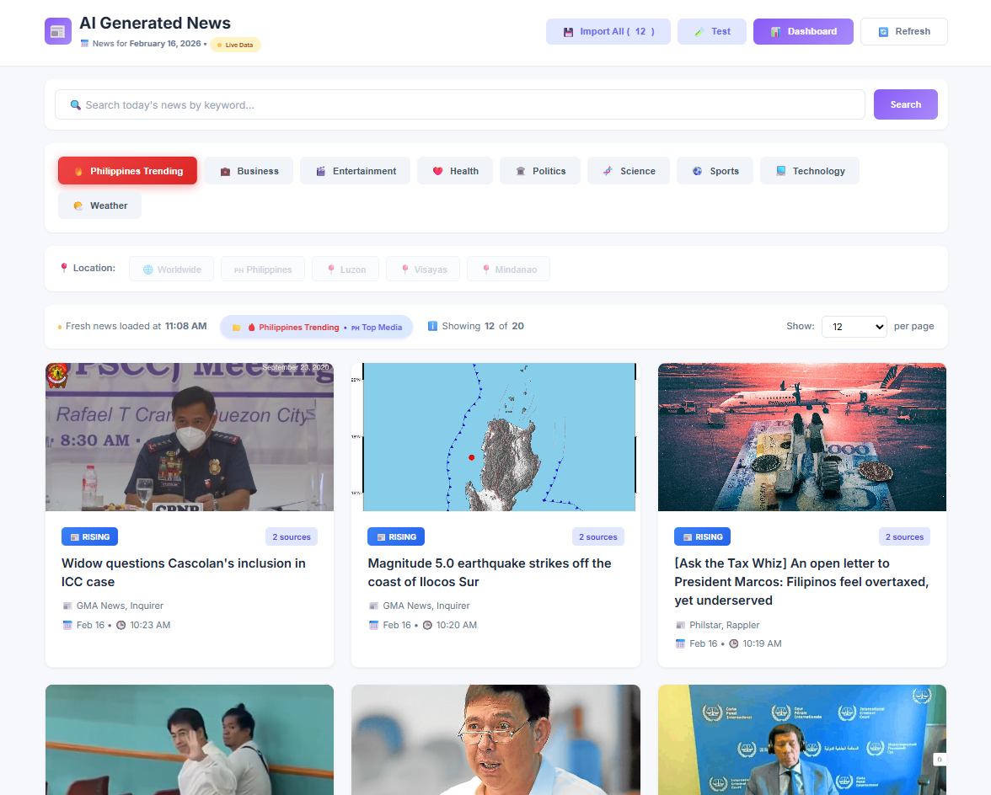
VERSION 2 – INTELLIGENT AI WORKFLOW
Enhanced editorial quality with AI-driven tools
NCMS • News Management System • MBC News Media

Slide 9


VERSION 3
ADVANCED AI & MBC CHAT
Fully AI-Driven
Newsroom Ecosystem
Integrated MBC
Chat System
Real-Time
Collaboration
NCMS Version 3 • The Smart Newsroom

Slide 10



VERSION 3 – MBC CHAT SYSTEM
Built-in communication for the modern newsroom
Internal Newsroom Communication
Dedicated work messaging platform separate from personal apps — all conversations organized and accessible.
Editorial & Field Reporting Channels
Dedicated channels for editorial teams, field reporters, and breaking news coordination in real time.
File & Media Sharing
Share clips, images, documents, and media assets directly within conversations — no external tools needed.
Searchable Chat History
Full-text search across all conversations and shared files — find any message, clip, or decision instantly.
NCMS • News Management System • MBC News Media

Slide 11




VERSION 3 – ADVANCED AI WRITING TOOLS
Supercharge content creation with intelligent assistance
01
02
03
04
AI-Assisted
Article Writing
Auto Article
Generation
Voice-to-Text
Reporting
Fact-Check
Assistance
Co-write articles with
AI that understands
news style
Generate full drafts
from data feeds
and press releases
Field reporters dictate
stories converted to
text instantly
AI cross-references
claims against
trusted sources
NCMS • News Management System • MBC News Media

Slide 12
NCMS ROADMAP SUMMARY
Core News CMS
AI Workflow &
Automation
Smart, Collaborative
Newsroom
User management, article creation, media uploads, approval workflow, publishing & scheduling.
AI aggregation, smart categorization, headline suggestions, content review, duplicate detection, alerts.
MBC Chat, AI writing tools, auto-generation, translation, voice-to-text, fact-checking.
V1
▶
V2
▶
V3
From foundational CMS to a fully AI-powered, collaborative newsroom ecosystem.
NCMS • News Management System • MBC News Media

Slide 13
NCMS
News Management System
Core CMS • AI Workflow • Smart Collaboration • MBC Chat
MBC News Media
Built for us. Controlled by us.

