Slide 1
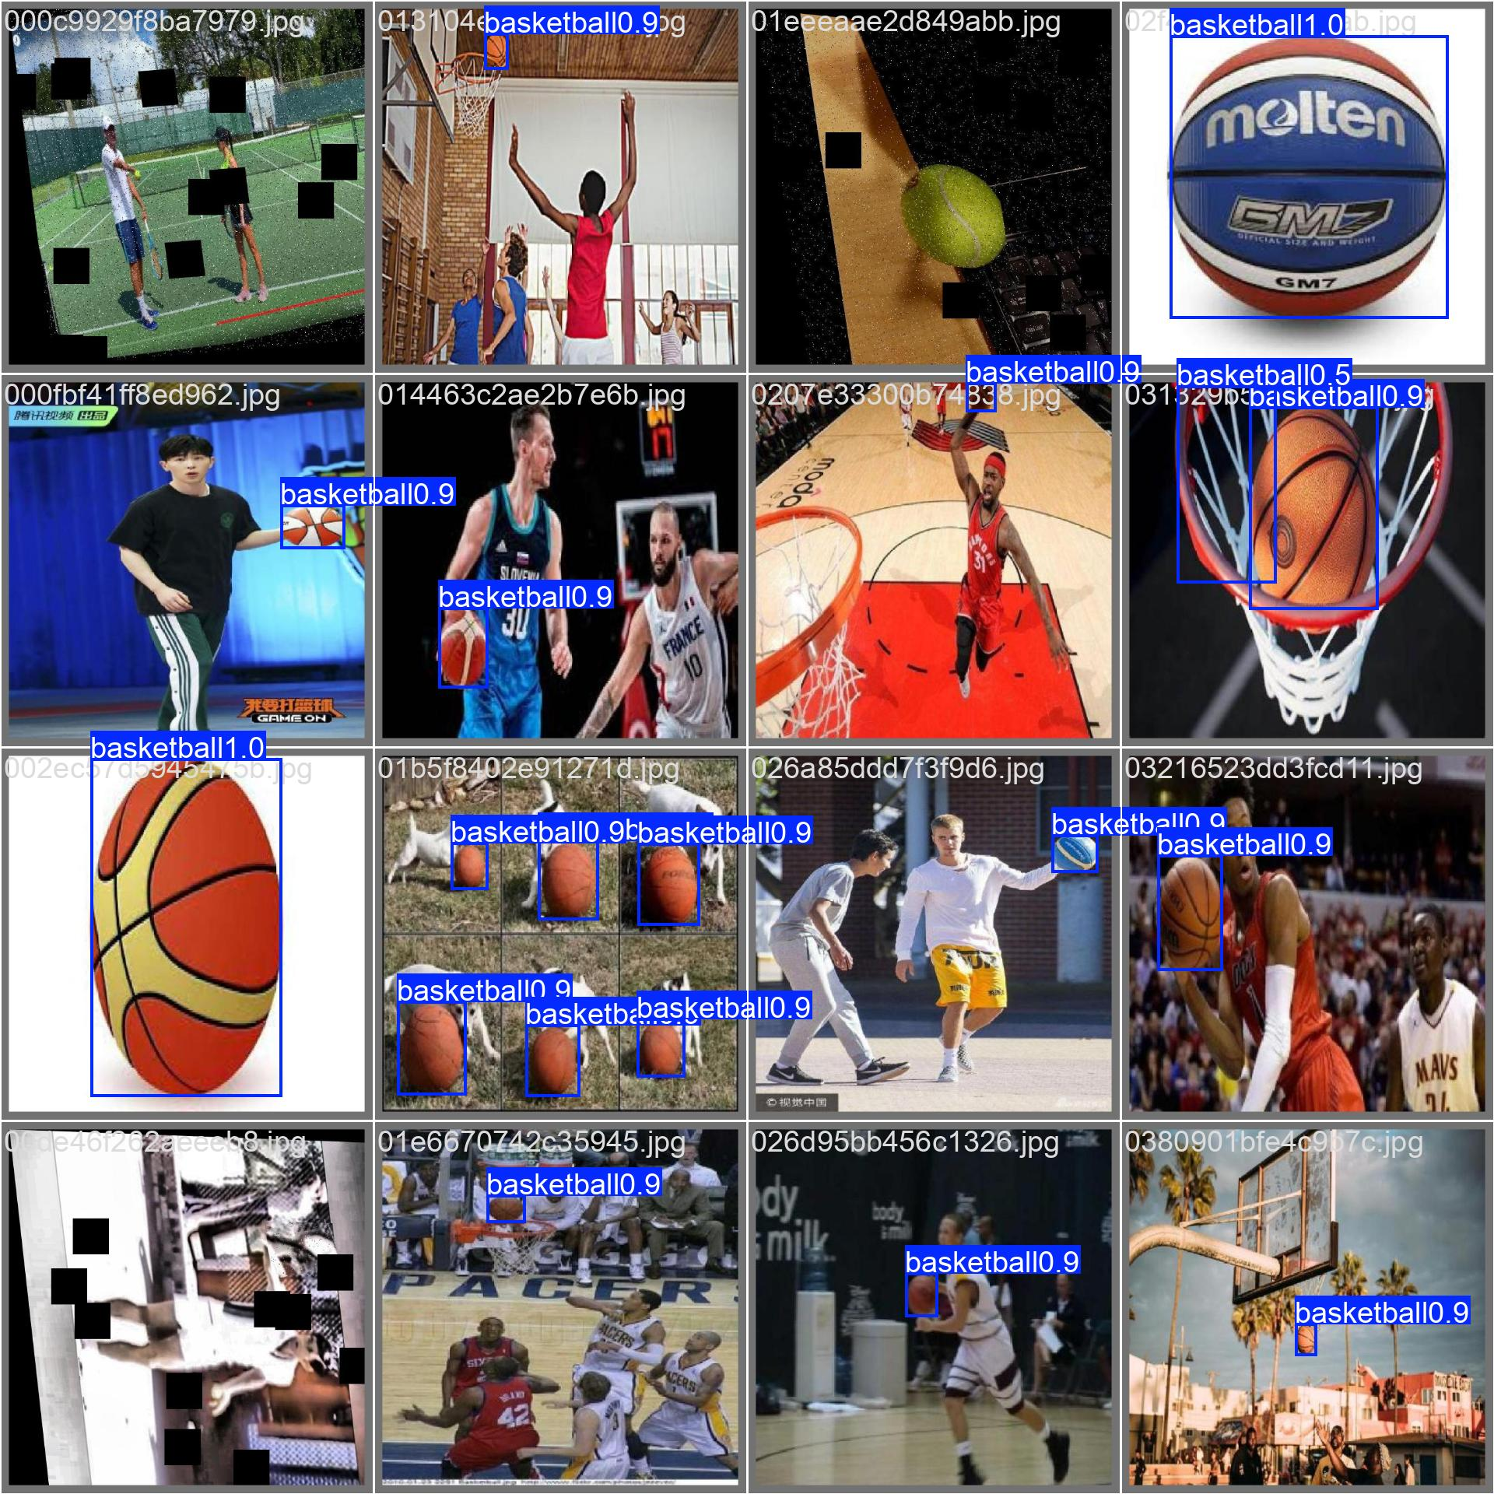
ENABLE PROJECT
Object Detection
Progress Review
Dataset pipeline · YOLO baselines · RF-DETR candidate
Clymber Loong· Progress since June 2026 · 8 September 2026

Slide 2
Current position
The benchmark pipeline is working; RF-DETR Small provisionally leads reported accuracy, while export and latency remain the next gap.
Datasets built
19,084 images prepared
Basketball: 14,052 images
Football: 5,032 images
Normalized and exported in COCO and YOLO formats
Models trained
3 architectures benchmarked
YOLO11n
YOLOX-Tiny
RF-DETR Small
Five representative basketball training runs completed
Best test mAP50–95
Basketball-large held-out test
YOLO11n: 0.7986
YOLOX-Tiny: 0.7469
RF-DETR Small: 0.8265
Main technical finding so far
Held-out test mAP50-95: small vs large dataset
Dataset effect: Dataset scale and split quality changed the results more than the initial model choice. The larger basketball dataset moved both YOLO11n and YOLOX-Tiny from weak results to strong held-out test performance.
Licensing: YOLOX and the RF-DETR core models use the permissive Apache 2.0 licence.
Project activity: RF-DETR has a much stronger current development and release cadence. YOLOX remains usable, but upstream maintenance appears limited, increasing its long-term support risk.
MoveAhead object detection progress review · 8 September 2026
02
Notes:
[0:30–1:40] YOLOX is maintained under Megvii, which is subject to U.S. government restrictions. This introduces an additional organisational and supply-chain consideration, although it does not alter the repository’s Apache 2.0 licence.

Slide 3
Concrete work completed since June
Completed assets and engineering outputs available from the notebooks.
Area
Completed work
Current status
Dataset builds
Small basketball, large basketball, football dataset build
Reusable COCO/YOLO pipeline
Data quality
Class normalization, background images, duplicate checks, source grouping
Traceable manifests
YOLO11n
Fine-tuned/evaluated on small + large basketball
Benchmark only due to licence
YOLOX-Tiny
Fine-tuned/evaluated on small + large basketball
Permissive fallback
RF-DETR Small
Fine-tuned and evaluated on large basketball dataset
best epoch 27; Todo: evaluation of inference
Compute setup
MacBook dev + Google Colab + Renku CUDA GPU Cluster
GPU run reproducible
MoveAhead object detection progress review · 8 September 2026
03
Notes:
[1:40–2:50] This is the concrete-work slide. The outputs are reusable dataset builders, traceable manifests, three model pipelines, saved checkpoints/metrics, and reproducible MacBook-development plus Renku-CUDA environments. The model work is currently Python/PyTorch-first because the chosen detectors are PyTorch-native; ONNX Runtime, TensorFlow/Keras, and TFLite have not yet been exercised as deployment paths.

Slide 4
Dataset assets built
Priority-1 basketball and football use public pre-labelled sources; no new auto- or manual labelling yet.
Dataset
Source handling
Train
Val
Test
Total
Notes
Basketball-small
Public Roboflow + negatives
105
22
23
150
Pipeline validation only
Basketball-large
3 basketball sources + tennis negatives
11,501
1,156
1,395
14,052
30% background in each split
Football
12 Roboflow sources, grouped by source dataset
3,529
718
785
5,032
COCO + YOLO export validated
Dataset build logic
1
Normalize labels to one target class
2
Retain explicit background / hard-negative images
3
Avoid cross-split leakage; football split is grouped by source dataset
4
Export both COCO and Ultralytics YOLO layouts
5
Record provenance manifest for traceability
MoveAhead object detection progress review · 8 September 2026
04
Notes:
[2:50–4:15] I used existing public, pre-annotated Roboflow Universe datasets; I have not added manual or auto-labelling yet. The engineering work normalized inconsistent class names, preserved hard negatives, prevented cross-split leakage, removed exact duplicates for football, and exported COCO plus YOLO formats with provenance. Public availability is not the same as production clearance, so each source licence and attribution requirement still needs a recorded audit.

Slide 5
Model choices and licence position
YOLO11n is useful for reference; deployment candidates should be permissively licensed.
Model
Why included
Licence position
Current recommendation
YOLO11n
Strong baseline; familiar tooling; fast training
AGPL-3.0 / commercial licence route
Benchmark only, not preferred for closed-source app
YOLOX-Tiny
Lightweight YOLO-style model; permissive alternative
Apache 2.0
Keep as fallback/reference
RF-DETR Small
Modern detector; promising accuracy; direct Roboflow support
Apache 2.0 for package + Small weights
Primary candidate for export / latency test
MoveAhead object detection progress review · 8 September 2026
05
Notes:
[4:15–5:35] YOLO11n is a useful benchmark, but Ultralytics’ default route is AGPL-3.0 or a paid enterprise licence, so I do not recommend it for the proprietary app by default. YOLOX-Tiny and RF-DETR Small are the permissive candidates under Apache-2.0. The model variant matters: this assessment is specifically RF-DETR Small, not the differently licensed XL/2XL models. This is a technical assessment, not legal advice.

Slide 6
How training was run
MacBook for development; completed training ran on Renku/DCU CUDA, not Colab, using 640×640 input.
Item
YOLO11n
YOLOX-Tiny
RF-DETR Small
Dataset
Basketball-large / YOLO
Basketball-large / COCO
Basketball-large / COCO-derived RF-DETR layout
Classes
1: basketball
1: basketball
1: basketball
Image size
640×640
640×640
640×640
Epoch budget
100
100
100
Batch size
16
8
4
Hardware
Renku CUDA: RTX PRO 6000 Blackwell MIG 2g.48gb
Renku CUDA: RTX PRO 6000 Blackwell MIG 2g.48gb
Renku CUDA: RTX PRO 6000 Blackwell MIG 2g.48gb
Checkpoint
Best validation mAP50-95
Best validation mAP50-95
Selected epoch 27, regular weights
Important comparison limitation
This is a practical engineering benchmark, not a strictly controlled architecture study. Different frameworks, losses, augmentations and postprocessing mean speed numbers are not yet directly comparable.
MoveAhead object detection progress review · 8 September 2026
06
Notes:
[5:35–6:50] Development and data checks ran locally on the MacBook; the reported training ran headlessly on Renku/DCU CUDA, not Colab. YOLO11n and YOLOX used 100 epochs on the large dataset; RF-DETR had a 100-epoch ceiling and early-stopped after 31 epochs. All used 640-pixel input, but frameworks, batch sizes, augmentation, loss, and post-processing differ, so this is an engineering comparison rather than a controlled architecture paper.

Slide 7
Results table: completed runs
Reported held-out test metrics for one representative completed run per dataset/model configuration.
Dataset
# classes
# images
Model
Parameters
Hardware
Training time
mAP50
mAP50-95
Inference speed
Basketball-small
1
150
YOLO11n
2.59 M
CUDA: RTX PRO 6000 Blackwell
~0.9 min (?)
0.565
0.331
2.86 ms
Basketball-small
1
150
YOLOX-Tiny
5.03 M
CUDA: RTX PRO 6000 Blackwell
~5.0 min
0.660
0.362
1.84 ms
Basketball-large
1
14,052
YOLO11n
2.59 M
CUDA: RTX PRO 6000 Blackwell
2.06 h
0.969
0.799
0.81 ms (?)
Basketball-large
1
14,052
YOLOX-Tiny
5.03 M
CUDA: RTX PRO 6000 Blackwell
5.87 h
0.958
0.747
1.40 ms
Basketball-large
1
14,052
RF-DETR Small
32.0 M
CUDA: RTX PRO 6000 Blackwell
~3.6 h total*
0.977
0.827
Not yet measured (Supposed to be faster)
What is included
Representative completed configurations only; repeated/smoke runs are omitted. Metrics are framework-native; a common evaluator is pending.
MoveAhead object detection progress review · 8 September 2026
07
Notes:
[6:50–8:50] These are the five representative completed configurations requested in the email. I excluded repeated executions and smoke/debug runs rather than presenting them as independent experiments. These are framework-native metrics; the common exported-prediction comparison is still pending. The large dataset changes the result dramatically. RF-DETR Small is best on test AP50:95 at 0.8265, versus 0.7986 for YOLO11n and 0.7469 for YOLOX-Tiny. The parameter counts are 2.59 million for YOLO11n, 5.03 million for YOLOX-Tiny and 32.0 million for RF-DETR Small. RF-DETR's accuracy lead therefore comes with a substantially larger model, making export size and measured mobile latency important decision gates. RF-DETR time is approximately 3.6 hours across the interrupted attempt and resume. Its latency is deliberately blank because it was not measured.

Slide 8
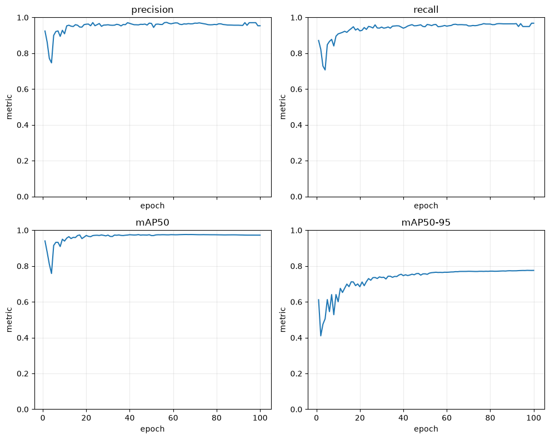
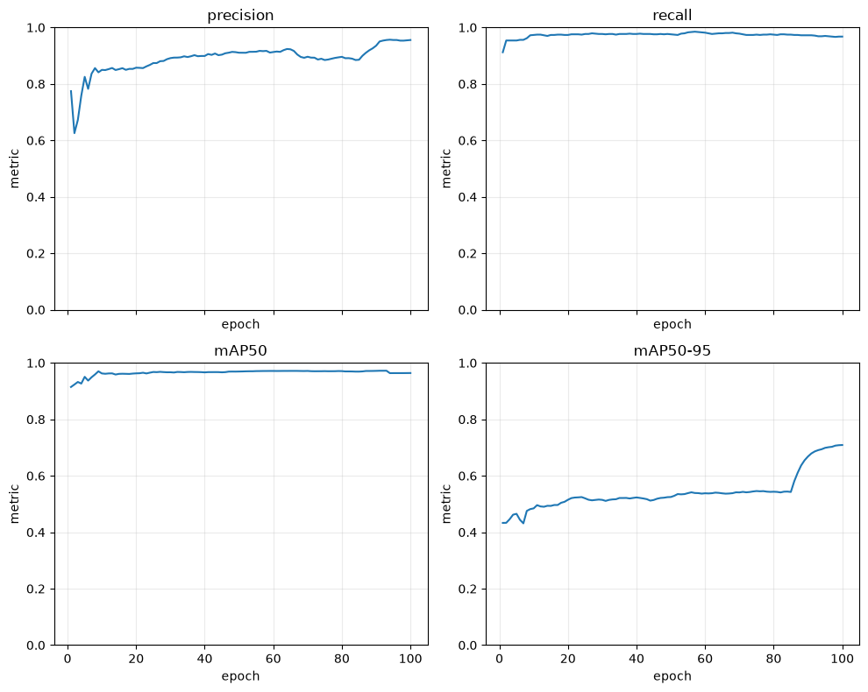
What the completed basketball baselines show
YOLO11n and YOLOX-Tiny both improved sharply when moving from the small test dataset to the large source-separated dataset.
Held-out test mAP50-95: small vs large dataset
YOLO11n validation metrics
Interpretation
The large dataset made the benchmark credible. Next model changes should be evaluated against this scale, not against the 150-image pipeline-validation set.
YOLOX-Tiny validation metrics
MoveAhead object detection progress review · 8 September 2026
08
Notes:
[8:50–10:00] The main learning is about data, not a tiny leaderboard difference. Both YOLO baselines improved sharply from the 150-image pipeline check to the 14,052-image source-separated benchmark. That means future decisions should be made on the large benchmark and on real failure cases. The plots simply show stable training; I would not narrate every curve.

Slide 9
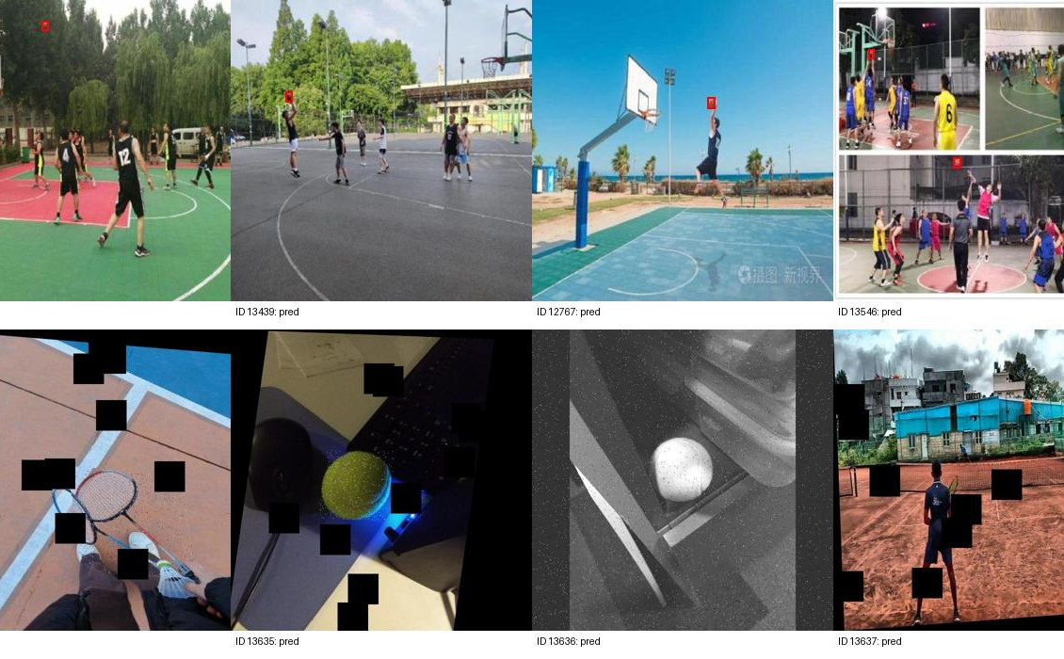
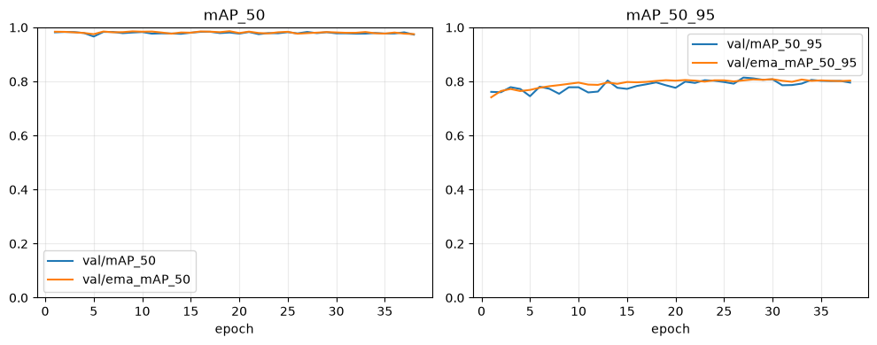
RF-DETR Small: completed benchmark
Large-basketball run completed on Renku CUDA; selected epoch 27 by validation AP50:95.
0.9772
Held-out test AP50
0.8265
Held-out test AP50:95
0.9529 / 0.9745
Precision / Recall
Epoch 27
Selected checkpoint
regular weights
~3.6 h
Observed training time
interrupted + resumed
Qualitative test predictions
Split
AP50
AP50:95
Precision
Recall
F1
Validation
0.9812
0.8149
0.9659
0.9815
0.9736
Test
0.9772
0.8265
0.9529
0.9745
0.9636
Training behaviour
Inference speed was not measured in the RF-DETR notebook. Next step: export/verify ONNX and benchmark ONNX Runtime latency with the same preprocessing and thresholding.
MoveAhead object detection progress review · 8 September 2026
09
Notes:
[10:00–11:15] RF-DETR Small is the strongest current accuracy candidate. The checkpoint was selected on validation AP50:95, not on the test set, then evaluated on the held-out test split. Its 0.8265 AP50:95 and the fixed prediction grid are encouraging. The limitation is equally important: inference was not timed, export was not tried, and the observed training duration combines an interrupted attempt with a resume.

Slide 10
Recommended next technical steps
Focus September on one deployment-capable path rather than widening the model search too much.
Benchmark RF-DETR latency + errors
Recommendation
1
Measure batch-one FP32/FP16 latency; review misses and false positives on the held-out test split.
RF-DETR Small provisionally leads. Run a common evaluator plus ONNX and latency checks before selection; keep YOLOX-Tiny as fallback.
Validate ONNX export
2
Not yet attempted: export RF-DETR Small, then compare PyTorch and ONNX Runtime on fixed images.
Train football and other sport detectors
3
Use the prepared 5,032-image football dataset; report same metrics table.
Package inference contract
4
Document preprocessing, class names, score thresholds, NMS/postprocess and expected tensors.
MoveAhead object detection progress review · 8 September 2026
10
Notes:
[11:15–12:45] I recommend narrowing rather than adding models. First, measure RF-DETR batch-one latency and review failure cases. Second, make an ONNX export and require prediction parity in ONNX Runtime. Third, train the already-prepared football dataset. Finally, document the complete inference contract needed by an app. ONNX is the first target; TFLite is deferred unless the chosen mobile/Unity runtime requires it.

Slide 11
Realistic 3–4 week delivery estimate
RF-DETR-first forecast for end of September, assuming continued part-time availability and GPU access.
Question
Estimate
Confidence / caveat
Time to train one model on one large dataset
RF-DETR Small: ~3.6 h observed per large-dataset run
Allow ~half a day per run with validation; observed total includes interruption + resume
Object classes working by end September
2 RF-DETR-evaluated classes: basketball + football
Separate detectors first; a third class remains a stretch goal
ONNX export for Unity integration
RF-DETR ONNX not yet attempted; allow 1 week for export + parity
If blocked, switch export work to YOLOX; full Unity integration remains separate
Most valuable September outcome
RF-DETR Small ONNX proof + basketball and football evaluation
YOLOX is the technical fallback; YOLO11n remains benchmark-only
Recommendation for this funding window
Commit to RF-DETR Small: evaluate basketball and football, then deliver an ONNX Runtime proof-of-concept. Keep YOLOX as the technical fallback and YOLO11n as a benchmark only.
MoveAhead object detection progress review · 8 September 2026
11
Notes:
[12:45–14:30] My primary 3–4 week path is RF-DETR Small. I will first evaluate it on basketball and football, then test ONNX export and runtime parity. The observed large-basketball run took about 3.6 hours including interruption and resume, so training itself is hours; data quality, export compatibility and integration are the schedule risks. I would allow one week for RF-DETR export and parity testing. If RF-DETR latency or export is unsuitable, YOLOX is the technical fallback. YOLO11n remains a benchmark only because its default licensing route does not fit the proprietary app. Full Unity integration and a third class remain follow-on work, not funding promises. Pause here for discussion.

Slide 12
Appendix: current notebook/source basis
Use this only if asked; it documents where the current claims came from.
Claim area
Basis in current work
Basketball-small dataset
nb01.01: COCO/YOLO basketball_105_22_23, 150 total images
Basketball-large dataset
nb01.02: COCO/YOLO basketball_11501_1156_1395, 14,052 total images
Football dataset
nb01.03: COCO/YOLO football_3529_718_785, 5,032 retained images
YOLO11n results
nb02.01 and nb02.02: validation/test metrics and speed outputs
YOLOX-Tiny results
nb03.01 and nb03.02: validation/test metrics and speed outputs
RF-DETR + export status
nb04.02: completed RF-DETR Small benchmark; no ONNX/TFLite model artifact or Unity integration yet
Licence notes
Ultralytics licence page; YOLOX GitHub Apache-2.0; RF-DETR GitHub/PyPI licence split
Raw source URLs are intentionally not over-emphasised in the main slides; dataset provenance and licensing checks should live in the project manifest/report.
MoveAhead object detection progress review · 8 September 2026
12
Notes:
[Appendix—only if asked] This maps the claims back to the executed Renku notebooks and the licensing review. The key deployment-status evidence is negative but useful: there is no ONNX or TFLite model artifact and no Unity integration in the repository yet. Licence sources were checked against the official Ultralytics, YOLOX, and RF-DETR materials.

