Slide 1
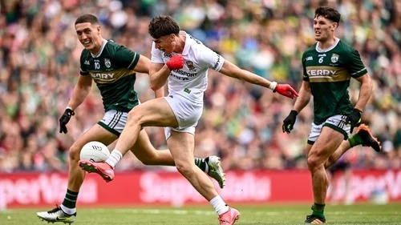
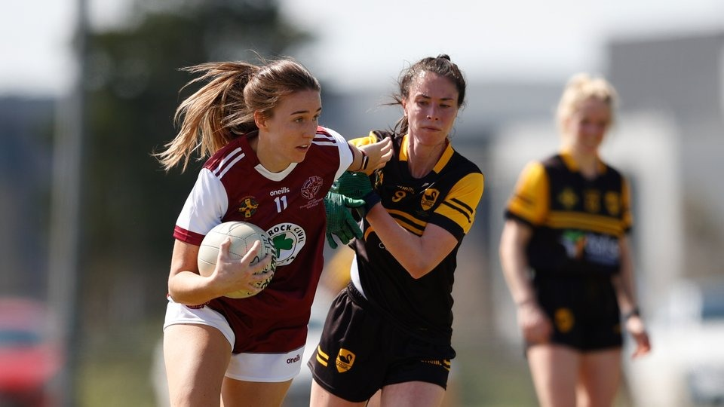
ENABLE
Object Detection
Progress &
Future Plan
A clearer engineering workflow.
A shared evaluation layer.
A labeled Gaelic football seed dataset.
Next: semi-automatic labeling → specialised detector
Clymber Chunyu Loong · 22 October 2026
Reporting period: 7 September–22 October 2026
Human-reviewed Gaelic football training examples
Notes:
since the previous report, the emphasis has moved from individual experiments to an organised engineering workflow, comparable evaluation, and a manually reviewed Gaelic football seed dataset.
The semi-automatic labeling routes in slides 6–8 are proposed work. Photos and bounding boxes are actual COCO training examples, not predictions.

Slide 2
One workspace, clear engineering roles
Separate responsibilities make the work easier to develop, test, and hand over.
Dataset
object-detection (Workspace)
Data engineer
Clean, annotate, split, and export data.
› Workspace
› Dataset
Ultralytics · YOLOX · RF-DETR
› Ultralytics
ML engineer
Train, recover runs, and export models.
› YOLOX
› RF-DETR
Evaluation
› Evaluation
QA / validation
Compare accuracy, errors, and inference speed.
› Detection Common
› Notebook Tools
› Docker / renku / Dockerfile
Docker
› Documents
Platform / MLOps engineer
Reproduce development environments and runtime, such as compute platform: DCU Renku cluster.
Each Python project has its own environment and tests; shared helpers and notebook tools support the
workflow.
COMPLETED WORK
ENABLE Project · Object detection · 7 Sep–22 Oct 2026
02
Notes:
Explain the reorganisation through engineering roles. These roles describe a work focus, not separate people or staffing. Six source packages are independently packaged: detection_common, dataset, evaluation, rfdetr, ultralytics, and yolox. Notebook tooling has a separate environment. Docker owns the Renku image and startup scripts. Mac development uses MPS/CPU profiles; Renku uses Linux/CUDA profiles.

Slide 3
Evaluation now provides a shared quality check
Model projects produce prediction artifacts; evaluation compares them independently.
Model pipelines
Shared artifacts
Evaluation
YOLO11n · YOLOX
RF-DETR
Predictions · checkpoint hash
Dataset identity · run record
COCO metrics · error analysis
Training cost · inference latency
Comparable results
Traceable experiments
Same canonical dataset, validation/test splits, and metric
definitions.
Record training attempts, hardware, timing, and checkpoint
identity.
Independent ONNX inference
Reusable QA outputs
Preprocess and decode all four detectors without their training
frameworks.
Publish validated bundles, tables, and visual detection
comparisons.
COMPLETED WORK
nb05.01: model comparison · nb05.02: runtime checks · nb05.03: ONNX inference
ENABLE Project · Object detection · 7 Sep–22 Oct 2026
03
Notes:
The evaluation project is framework neutral: it does not import model training pipelines. Producers in model projects write versioned artifacts. Run protocol records dataset identity, settings, smoke status, attempts, and training hardware. Bundle readers validate hashes and schemas. The independent ONNX implementation handles model-specific preprocessing, decoding, NMS where needed, matching, and batch-one benchmarking. Recovery and atomic publication help avoid comparing partial outputs.

Slide 4
Evaluation evidence: accuracy and runtime
Basketball benchmark results and an Apple Silicon ONNX proof of execution.
Held-out basketball test results
ONNX: CPU → CoreML-first
Model
AP50:95
GPU ms/image
Model
CPU ms
CoreML ms
YOLO11n
78.26%
3.19
YOLO11n
41.93
11.90
YOLOX-Tiny
74.79%
6.72
YOLOX-Tiny
80.88
13.84
YOLOX-Nano
72.90%
6.17
YOLOX-Nano
35.02
9.79
RF-DETR Small
82.59%
8.26
RF-DETR Small
387.60
94.57
RF-DETR leads on accuracy; YOLO11n is fastest in this
saved GPU comparison.
All four exports ran successfully with CPU and
CoreML-first providers.
22–23 Sep runs · H200 MIG · FP32 batch 1 · 32 timing images
Apple Silicon · 1 image × 30 timed runs · CPU fallback may apply
COMPLETED WORK
ENABLE Project · Object detection · 7 Sep–22 Oct 2026
04
Notes:
Left: saved outputs/comparisons/basketball_large_dataset/comparison_test.md selects runs from 22–23 September, with 1,395 test images for AP. Median GPU latency uses 32 images, five warm-ups, FP32 batch one on NVIDIA H200, including preprocessing and postprocessing. Training budgets and model preprocessing differ. The comparison report has not yet been refreshed to the later October run set.
Right: saved nb05.03 outputs use newer ONNX exports on macOS arm64. This is one selected held-out image, five warm-ups and 30 timed repeats per case. It is not full-test ONNX accuracy or a multi-image throughput study. CoreML-first can partition work to CPU. Session creation, compilation, drawing, and file I/O are excluded.

Slide 5
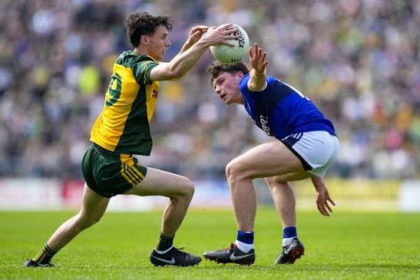
Gaelic football: the seed dataset is labeled
nb01.05 cleans the images; nb01.06 supports annotation, review, and COCO export.
124
114
29
1
reviewed images
bounding boxes
negative/background images
target class
Split
Images
Labeled
Boxes
Train
86
66
80
Val
20
15
18
Test
18
14
16
Human-reviewed training examples.
95 labeled images + 29 reviewed negatives.
Seeded ~70/15/15 split; class IDs agree across all COCO
exports.
Current files: 147 source → 127 cleaned → 124 reviewed.
COMPLETED WORK
Seed data and annotation workflow are complete; Gaelic detector training is the next step.
ENABLE Project · Object detection · 7 Sep–22 Oct 2026
05
Notes:
Train: 86 images, 66 with boxes, 20 backgrounds, 80 boxes. Validation: 20 images, 15 with boxes, 5 backgrounds, 18 boxes. Test: 18 images, 14 with boxes, 4 backgrounds, 16 boxes. Totals: 124 images, 95 with boxes, 29 backgrounds, 114 boxes. nb01.05 computes exact/near duplicates and supports manual deletion. Current directory image counts are 147 source, 127 cleaned, 124 reviewed; these are file snapshots, not an immutable image-removal audit. nb01.06 persists FiftyOne annotations, explicitly includes reviewed negatives, excludes unreviewed samples, fixes seed 42 and filepath order, and uses consistent category IDs. Current splitting is random separately within positives and negatives, not grouped by video/source. Audit source and sequence overlap before freezing the next training/evaluation release. A test set of 18 images is an initial diagnostic only; expand independent evaluation coverage before making deployment claims.

Slide 6
Route A: iterative self-training / pseudo-labeling
Use the manually labeled seed to build a detector, then expand its training data in rounds.
01
02
03
04
Train a seed
detector
Predict on a larger
unlabeled pool
Review and accept
proposed boxes
Retrain on the
expanded data
86 training images + validation
New training images only
Correct misses + false positives
Human labels + approved additions
Repeat only when validation improves
Start with a reviewed pilot
Preserve a trusted evaluation set
Review every proposal in round 1. Measure acceptance,
correction time, missed balls, and false positives.
Keep validation/test out of the pseudo-label pool. Audit
source/sequence overlap and retain reviewed negatives.
PROPOSED PLAN
Research context: Unbiased Teacher (2021); proposed pilot keeps explicit human review.
ENABLE Project · Object detection · 7 Sep–22 Oct 2026
06
Notes:
100–200 manually labeled images, train an initial Gaelic-football detector, infer over a larger unlabeled pool, accept/review annotations, retrain, and repeat. The existing 124 reviewed images fit that seed scale, but only 86 are training images because validation and test stay separate. Start with a manual-only baseline. Round 1 retains human review of all proposed annotations and checks for missed objects. A no-detection image is not automatically a negative. Later experiments may admit audited, high-confidence pseudo-labels with explicit provenance and appropriate weighting, after establishing quality on held-out development data. Pseudo-label bias is a known issue in the Unbiased Teacher paper; this deck proposes an offline human-reviewed loop, not an implementation of that paper’s joint EMA teacher/student algorithm.

Slide 7
Route B: large teacher → small specialised detector
Use an open-vocabulary foundation model to propose labels before training a compact target model.
Foundation teacher
Reviewed training data
Small target detector
Grounding DINO candidate
Prompt: “Gaelic football”
Map proposals to one target class
Filter and correct boxes
Merge with trusted human labels
Export a versioned COCO dataset
YOLOX-Nano candidate
Train for the Gaelic-football task
Export ONNX and measure latency
Autodistill-style transfer
Verify the teacher on our domain
The teacher runs offline to create annotations. The small
detector handles deployment; the large model stays out of the
app.
Benchmark prompts and missed small balls on validation data.
Grounded SAM is optional if masks provide useful extra
information.
PROPOSED PLAN
Autodistill docs: Base Model → labeled Dataset → Target Model. COCO handoff to existing YOLOX.
ENABLE Project · Object detection · 7 Sep–22 Oct 2026
07
Notes:
a large general-purpose/foundation Base Model such as Grounding DINO or Grounded SAM labels unlabeled images, and the generated dataset trains a smaller Target Model for deployment.
The teacher is not the seed detector from Route A. Grounding DINO uses text-conditioned open-set detection, but prompting it with Gaelic football does not establish reliable performance on this domain. Compare candidate prompts on validation data and manually check precision, recall, ball size, occlusion, and negatives.
Proposed first trial: Grounding DINO for boxes. Add Grounded SAM only if masks are needed or improve the annotation workflow. Use a COCO export to the existing YOLOX-Nano training pipeline; the deck does not claim that Autodistill has a built-in YOLOX-Nano adapter. Transfer here is through annotations.
Feature/logit distillation would be a separate later experiment. Teacher inference runs in a separately managed model environment, outside the framework-neutral evaluation environment. Start with human review, rather than assuming automatic labels are ground truth.

Slide 8
Next delivery plan: a measured labeling pilot
Proposed 4–6 week sequence; timing depends on source data, review capacity, and GPU availability.
Freeze the baseline
WEEK 1
Audit seed/source overlap; train manual-only Gaelic detector; record QA baseline.
Pilot both labeling routes
WEEKS 2–3
Use the same new image pool; compare seed-detector and foundation-teacher proposals.
Train the specialised student
WEEK 4
Review additions, version datasets, and compare student models on validation data.
Evaluate and decide
WEEKS 5–6
Run a second round if useful; select the candidate, run final test, and benchmark ONNX.
Deliverable: a reproducible semi-auto labeling workflow, a versioned expanded dataset, and an evaluated small
Gaelic-football detector.
PROPOSED PLAN
Pilot success: less review time, acceptable annotation quality, and no validation regression.
ENABLE Project · Object detection · 7 Sep–22 Oct 2026
08
Notes:
Week 1: confirm source availability and rights to use data; audit the seed, establish evaluation groups, and record a manual-only baseline.
Weeks 2–3: use the same deduplicated unlabeled training pool for route A and route B. Review all annotations in the first pilot and time a sample of manual-from-scratch annotation for comparison.
Week 4: train comparable student candidates using the same training budget where practical, and select thresholds/candidates using validation only.
Weeks 5–6: run one additional labeling/training round only if the first round shows value. Final deliverables include data/model provenance, error breakdown, review-time comparison, test metrics, and ONNX runtime measurements on the intended target hardware. Define acceptance targets before the pilot using baseline variability and the intended application; no numerical quality gain, label volume, or deployment FPS is claimed in advance. With only 18 current seed test images, broader independent evaluation remains part of the pilot.

