Slide 1

Beyond
Skia
GPU scheduling and profiling with Impeller on Android 10+
Collins Munene
DevOps and Software Engineer, Shipht
Notes:
Hi, I'm Collins. Let me show you a chart.
>>> DEMO, phone: Kiln → Canvas Thrash → tap 8×. Let it run red. No phone: play 01-broken-chart-8x.mp4 from local/clips-stage/.

Slide 2
Impeller tamed one kind of jank.
Tamed
Still yours to fix
Compilation jank
Drawing cost
Notes:
This is a live market chart in Flutter, on Impeller, on Vulkan, on a 120 hertz phone. Every red bar there was a frame that missed its deadline. It ran at about a third of the frame rate the screen can show.
Impeller was supposed to fix jank. It tamed one kind: compilation jank, about 13 times shorter on my test phone. It didn't touch the other kind: drawing cost. That's today's map. To understand either one, we first need to see how Flutter gets a picture onto the screen, so let's start at the top.

Slide 3
Dart and the engine are different things.
Framework
Widgets, layout, your paint()
Dart
dart:ui
Engine
Runs your Dart. Renders your frames.
C++
Embedder
Android surface, input, threads
Java, C++
Notes:
Three layers. The framework is Dart: widgets, layout, your paint methods. Everything you write lives here. The engine is C++ that ships inside your app. It runs your Dart, renders frames and lays out text, and dart:ui is the door between the two. The embedder hosts all of it on Android: it provides the surface, the input and the threads.
So when I say Dart, I mean your code. When I say engine, I mean the C++ underneath it. And notice one thing: Flutter doesn't ask Android to draw a button. It asks the GPU to draw triangles. The renderer inside the engine is the part this talk replaces. Now let's follow one frame through these layers.

Slide 4
One frame, from vsync to pixels.
vsync
main thread
1.raster
GPU
Records
Prepares
Executes
paint() draws nothing. It writes a DisplayList.
Pipelines, triangles, commands. This is CPU time.
Later, on its own schedule. Not a Flutter thread.
Notes:
Vsync fires. CLICK: on the main thread, Flutter animates, builds, lays out and paints. Here's the first thing people get wrong: paint draws nothing. Your paint method records a list of commands called a DisplayList, and hands it over.
CLICK: the raster thread takes that list. It replays it, gets the GPU programs it needs, breaks paths into triangles, and records commands for the GPU. Raster time is CPU time. The GPU hasn't done this work yet.
CLICK: the GPU runs those commands later, on its own schedule, then Android puts the result on the display. So there are three names and only two CPU threads. Remember this picture: everything we measure today lands in one of those three. Now, how long do they have?

Slide 5
Every frame gets 8.3 ms.
0 ms
8.3
16.7
25
33.3
Target
UI
4 + 4 ms
120 fps
Raster
Limit
UI
8.3 ms each
120 fps
Raster
Measured
UI
28 ms raster
36 fps
Raster
Top rows drawn to scale. Bottom row: real frames from a system trace on the phone.
Notes:
At 120 hertz each frame gets 8.3 milliseconds. Those lines are the deadlines.
CLICK: budget about 4 milliseconds for UI and 4 for raster, and the whole frame lands in one refresh.
CLICK: strictly, the threads overlap. While raster draws this frame, Dart can already build the next. So each thread can stretch to 8.3 and you still hit 120, but every frame arrives later and you have no headroom. Four and four is the target. 8.3 per thread is the limit.
CLICK: this is the chart you just saw, real frames from a trace. Raster is 28 milliseconds. A thousand divided by 28 is 36 frames a second, and that is what we measured. The slowest thread sets your frame rate.
Hold on to that. Now let's go back to where a frame could suddenly take almost two seconds.
>>> AFTER THIS SLIDE: play 02-skia-to-impeller-concept.mp4 from local/clips-stage/, then come back and press Next.

Slide 6
Android before: Skia on OpenGL ES.
When Flutter is built
When the app runs
platform
Android views, input, lifecycle
Nothing.
1.ui
Animate
Build
Layout
Paint
No shader for your screen exists yet.
1.raster
Replay
Write the shader
Driver compiles it
Draw
OpenGL ES
The driver hides the work
GPU
Fills the pixels
Android, simplified. iOS used Metal under Skia. Dart ran on 1.ui until Flutter 3.29.
Notes:
Here's the engine as it was on Android. Skia is the 2D library behind Chrome and Android's own UI, excellent and general purpose, and Flutter shipped on it from the start. On iOS, Skia ended up on Metal, but today we're on Android.
Read it top to bottom. The platform thread is Android. Back then, Dart had its own thread, 1.ui, and handed over what it recorded. Skia replays it on the raster thread, on top of OpenGL ES, and the driver underneath hides the work.
Now look at the left. When Flutter is built, no shader for your screen exists. CLICK: so they are written and compiled here, on the raster thread, while the user is watching. That's the design decision that caused everything on the next slide.

Slide 7
Compilation jank.
A shader is a small GPU program. On Android, the driver compiles it for that exact chip.
new paint + blend + clip → SkSL → GLSL → driver compile → missed frame
1.8 s
118 shaders, compiled inside
one frame. About 14.5 ms each.
8.3 ms: one frame’s budget, same scale
Real Skia trace on the Infinix, to scale: 1,714 ms of programs in a 1,820 ms frame. 144 new effects.
Notes:
So what is compilation jank? A shader is a small program for the GPU, and the driver has to compile it for that exact chip. Skia is general, so it generates a shader for each new combination of paint, blend and clip.
CLICK: a new combination appears on screen. Skia writes SkSL, that's translated to GLSL, the driver compiles it on the raster thread, inside your frame, and the frame misses its deadline.
CLICK: how bad? That tiny mark is one frame's budget. Each block is one program from a real Skia trace, to scale: 118 of them, about 14.5 milliseconds each, in one frame. 1.8 seconds.
It happens once per shader, per install, and a Flutter upgrade resets the cache. You rarely see it, because your own phone is already warm. And no amount of optimising Dart touches it. The UI bar stays green while the app is frozen.
For years people worked around this with warm-up code and bundled shaders, and had to capture again after each engine upgrade. The Flutter team's own issue, opened in May 2019, asked for something that "requires 0 extra effort from developers". It closed in August 2023, with the team pointing to Impeller. So what changed?

Slide 8
Android now: Impeller on Vulkan.
When Flutter is built
When the app runs
main
Android and Dart, one thread since 3.29
impellerc
main
Animate
Build
Layout
Paint
A small, fixed set of shaders, compiled for:
1.raster
Replay
Bind or build a pipeline
Tessellate
Record commands
Vulkan: SPIR-V
Metal: iOS, macOS
OpenGL ES: GLSL
Vulkan
Explicit commands, on phones that pass the checks
Inside the engine binary
GPU
Runs the commands, fills the pixels
Android on Vulkan, simplified. iOS and macOS run Impeller on Metal.
Notes:
Same picture, same positions, now, still on Android. Three things moved.
At the top, Dart moved. Since 3.29 it runs on the platform main thread, with Android. That's separate from Impeller, but you'll see it in your traces, so know it. DevTools still calls it UI.
CLICK: on the left, the side that was empty. A small fixed set of shaders, written by the Flutter team, goes through impellerc when the engine is built: SPIR-V for Vulkan, Metal for iOS and macOS, and GLSL ES for OpenGL ES. They ship inside the engine. Look at the raster thread: write a shader, compile a shader, both gone.
And underneath, Vulkan replaces OpenGL ES, on phones that can use it, and we'll come back to that. On iOS, the same Impeller runs on Metal. Vulkan hides much less. The engine says exactly what runs and when.
CLICK: one new step appears: tessellate. Impeller turns paths into triangles itself. Keep your eye on that step, because it's the bill for this design. First, let's see exactly when each engine does its work.

Slide 9
Skia compiles late. Impeller compiles early.
Engine build
App build
App start
First use
Every frame
Skia
Nothing yet
Your .frag stays as SkSL text
Warm-up, if you wrote one
Write and compile, in the frame
14.5 ms each
Bind the cached program
JIT
Impeller
impellerc: engine shaders
impellerc: your .frag
Most pipelines are built
A missing pipeline: 2.2 ms each, in the frame
Bind a built pipeline
AOT
A pipeline is shader code plus fixed GPU state. On Vulkan, the driver finishes the compile when it is built. Infinix traces.
Notes:
Here's the same app as a timeline, left to right, from when the code is built to every frame on the phone.
CLICK: Skia. Nothing happens ahead of time unless you wrote a warm-up. All the expensive work lands in the first use of an effect: about 14.5 milliseconds per program, inside the frame.
CLICK: Impeller. Shaders are compiled at engine build, and your own frag files when you build your app. A pipeline is a compiled shader plus fixed GPU state. Most are built at startup.
But be careful: not all of them. The design goal in Impeller's README is to build pipeline state up front, and my traces show a few still built in the frame, about 2.2 milliseconds each, when a draw needs a combination it doesn't have yet. So the honest claim is: no shader is written in the frame, and the source was compiled ahead of time. But SPIR-V isn't what the GPU runs. When a pipeline is built, the Vulkan driver still turns it into code for this chip, and Vulkan's own docs call that shader compilation. That's those 2.2 milliseconds, and Impeller saves the result to disk, which is why a relaunch is faster. So "no runtime compilation" is shorthand. It's a fraction of what it was, not zero.

Slide 10
Impeller arrived one platform at a time.
iOS
Default in 3.10
May 2023
On Metal. Skia removed in 3.29
Android
Default in 3.27
December 2024
Android 10+ (API 29+), on Vulkan where it can
Desktop
Default in 3.47
2026
macOS, Windows and Linux
Flutter docs and release notes. Web still renders with Skia.
Notes:
Impeller didn't arrive everywhere at once. CLICK: iOS first, on Metal, default in 3.10 in May 2023, and Skia gone from iOS in 3.29.
CLICK: Android took longer, because of the range of hardware. Default in 3.27, December 2024.
CLICK: desktop, this year, in 3.47: macOS, Windows and Linux.
If asked: web still renders with Skia. The Skia build's own log warns that opting out is deprecated, so this comparison won't be possible forever.

Slide 11
On Android, Vulkan isn’t guaranteed.
Android 9 or older
Skia on OpenGL ES
Android 10+, a device check fails
Impeller on OpenGL ES
Android 10+, every check passes
Impeller on Vulkan
The checks, in this engine
Emulator. Huawei. MediaTek with a vendor API below 32. Adreno 650 or older.
Some Exynos chips. No working Vulkan 1.1 with the extensions Impeller needs.
adb logcat | grep "Impeller rendering backend"
Flutter 3.47.8: flutter_main.cc, android_context_dynamic_impeller.cc, driver_info_vk.cc. My Impeller numbers: Vulkan, per the log.
Notes:
The talk's title says Android 10 and up. That's the minimum, not a promise of Vulkan. Android 9 or older gets Skia on OpenGL ES, unconditionally.
CLICK: from Android 10, the engine checks the device. It avoids Vulkan on emulators, on Huawei, on MediaTek chips whose vendor API is below 32, on Adreno 650 and older, and on some Exynos chips and known-bad drivers. Then it tries to start Vulkan 1.1 with the extensions it needs. Any failure means Impeller on OpenGL ES, not Skia. Note it's the vendor API, the Android version the chip's drivers were built for. So a phone updated to Android 13 can still land on OpenGL ES, and so can a recent Android version on an older Snapdragon. [Only if you've confirmed the cause: that happened on my Android 13 phone.] Flutter 3.29's notes say why: black screens and crashes with Vulkan on some MediaTek and PowerVR chips.
CLICK: so don't guess. Read the log. Every Impeller number today comes from a phone whose log says Vulkan. If yours says OpenGLES, the pipeline and command-buffer details on the next slides don't apply in the same way, though the tessellation and the drawing costs still do.

Slide 12
A trade, not a free upgrade.
On Android | Before | Now
Shaders | Written and compiled in the frame | Pre-compiled with the engine
Cache | Automatic raster cache | No raster cache
Paths | GPU and mask techniques | Tessellated on the CPU
GPU API | OpenGL ES, the driver decides | Vulkan where possible, explicit
Dart | Its own 1.ui thread | Main thread, since 3.29
Notes:
Impeller isn't free. It's a trade, and this table, for Android, is the rest of the talk. Row one is the win, and we'll measure it next. Rows two and three are the bill: no raster cache, so some old fast code is now honestly slow, and paths become CPU work. Row four: Vulkan doesn't hide costs, so what you pay for is how much you record. The last row isn't Impeller at all: my Skia build runs Dart on the main thread too. It landed around the same time, so it's in every trace you'll read. So is the win real? Let's measure it.

Slide 13
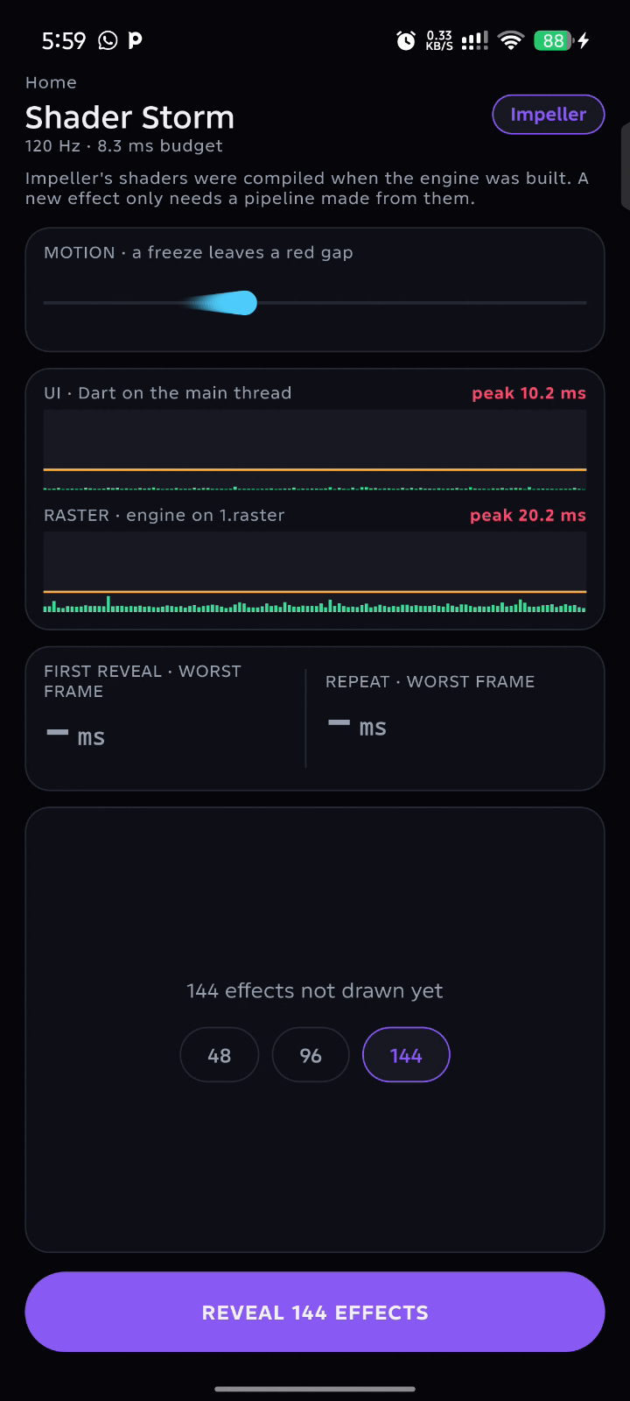
Same app. Same phone. Two renderers.
First reveal
Second time
1,863 ms
23 ms
Skia
145 ms
48 ms
Impeller
Worst frame, median of 3 rounds. Infinix X6873, Mali-G615, 120 Hz. Skia on OpenGL ES, Impeller on Vulkan.
Notes:
Don't trust a badge. Read what the engine writes at startup. One build says "The application opted out of Impeller". The other says "Using the Impeller rendering backend (Vulkan)". Same Flutter SDK, same Dart code, same phone, one setting different. Shader Storm reveals 144 tiles at once, and no two share the same mix of paint settings. The scoreboard shows medians of three clean runs on my test phone, an Infinix, so what you see live will differ.
>>> DEMO, phone: Kiln Skia → Shader Storm → 144 → Reveal (cold: clear the app's data before the talk). Watch the motion lane, and say nothing for two seconds. No phone: play 03-skia-first-reveal.mp4.
CLICK: Frozen. Nearly two seconds, the whole motion lane red. And the UI lane stayed green: Dart was fine, the engine stopped to compile.
VOTE: same effects, second time. Hands up: will it freeze again? Wait for hands.
>>> DEMO, phone: reveal the same 144 again. No phone: play 04-skia-repeat.mp4.
CLICK: 23 milliseconds. No freeze. The programs are already built.
Now Impeller, same phone, same 144 effects, first time.
>>> DEMO, phone: Kiln Impeller → Shader Storm → 144 → Reveal. No phone: play 05-impeller-first-reveal.mp4.
CLICK: 145 milliseconds. Short, but not zero. And its second time is 48.

Slide 14
Skia’s freeze grows. Impeller’s barely does.
Skia 1,863 ms
13×
shorter, at 144 new effects on screen
Impeller 145 ms
Worst frame after a cold reveal, median of 3 rounds. New effects on the axis.
Notes:
CLICK: the lines draw. As we tripled the new effects, from 48 to 144, Skia went from 0.7 to 1.9 seconds. Impeller went from 127 to 145 milliseconds. That's 13 times shorter at 144. After a relaunch, disk caches help both: 102 against 73. But Skia's cache is keyed to the engine version, so a Flutter upgrade sends your users back to the top line.

Slide 15
The cost shrank and moved. It didn’t vanish.
Skia: 118 shaders
1,714 ms
Impeller: 40 pipelines
87 ms
Same session, second time
Skia 23 ms. Impeller 48 ms.
Predictable. Not always faster.
System traces of one cold reveal, tracing on, drawn to scale. Second time: median of 3 rounds, tracing off.
Notes:
Here's why it barely grows. CLICK: Skia builds a program per effect, 118 in the reveal frame. Impeller only builds pipelines from shaders that are already compiled: 40 of them, about two milliseconds each. Both on the raster thread, both in the frame. The cost moved and shrank. It did not vanish.
CLICK: and to be fair, in the same session Skia is actually faster: 23 against 48. So this is not 'Impeller is always faster'. It's predictable, and it took the most expensive work out of the frame. So what is Impeller doing in those frames instead? Let's look inside one.

Slide 16
Tessellation: how a path becomes triangles.
Path
Points
Vertices
Triangles
What paint() asks for
Curves flatten
Two per point
v − 2 of them
The demo at 8×: 16 lines × 8,000 points × 2 = 256,000+ vertices.
Illustration. On the CPU, every frame. Vertex count worked out from stroke_path_geometry.cc, not measured.
Notes:
Now the step I told you to watch. Your GPU fills triangles. It can't fill a Bezier curve. So someone has to cut every path into triangles, and on Impeller that someone is the CPU.
CLICK: paint asks for a path: lines and curves.
CLICK: curves flatten into points. The tolerance depends on scale, so drawing it larger gives more points.
CLICK: for a stroke, each point gets two vertices, half the stroke width each side. A corner adds two more, unless the turn moves the edge by less than a quarter of a device pixel.
CLICK: those become one long triangle strip. v vertices make v minus 2 triangles.
CLICK: this all happens on the CPU, on the raster thread. The vertices are copied into per-frame memory, and it becomes one draw. Next frame, it all happens again. There's no cache between frames.
So words matter. A path is what you ask for. Tessellation is the work Impeller does with it. The chart you saw is my demo at its 8× setting: 16 lines of 8,000 points. By the engine's own rule that's at least a quarter of a million vertices every frame, built by the CPU. Then what happens to them?

Slide 17
The CPU records. The GPU executes.
That handoff is GPU scheduling.
begin render pass
bind pipeline
bind vertex buffer
bind uniforms
draw
...
end render pass
submit to queue, fence
1.raster
queue
GPU
fence
Illustration of the order of work, not a measured trace.
Notes:
Those triangles don't go straight to the GPU. The raster thread writes a list: begin a render pass, bind a pipeline, bind buffers, draw, and so on. That's a command buffer. On Vulkan this is explicit, so Impeller writes each command itself.
CLICK: watch one frame go through. Raster records. It submits to the queue and moves on. The GPU executes while the raster thread is already on the next frame. A fence tells the CPU when the GPU has finished.
That is GPU scheduling. The CPU records, the GPU executes, fences keep them in step. No single command is slow. Volume is the cost. And one kind of command costs far more than the others.

Slide 18
Why a layer costs more than a draw.
One render pass
Clear
All draws, in fast tile memory
Resolve
Store once
With one saveLayer
Draws so far
Store
Offscreen pass: draw and blur
Store
Load
Composite
Store
Measured: 64 saveLayer a frame. Removing them cut raster from 13.7 to 6.6 ms.
The GPU side is the model. This phone’s driver doesn’t expose it.
Illustration, not to scale. The accent marks a trip to main memory.
Notes:
Most mobile GPUs are tile-based. They split the screen into tiles and draw each one in fast on-chip memory. Writing out to main memory is slow and costs battery, so the ideal frame is one render pass: clear, all your draws on the chip, resolve the anti-aliasing on the chip, store once.
CLICK: now add one saveLayer with a blur. The GPU has to store what it has drawn, switch to an offscreen target, draw and blur there, then load everything back to composite it. The Flutter docs compare it to making a firehose change direction. The docs list ShaderMask and ColorFilter as widgets that might trigger a saveLayer, and some Chip and Text cases.
I need to be honest about one thing. What I measured is the CPU side: 64 saveLayer and two queue submits per frame, and taking them out cut raster from 13.7 to 6.6 milliseconds. What the Mali GPU did with those passes, this phone's driver doesn't expose. So the GPU side here is the model, not my trace.
That's the full picture of a frame. Now we can break one.

Slide 19
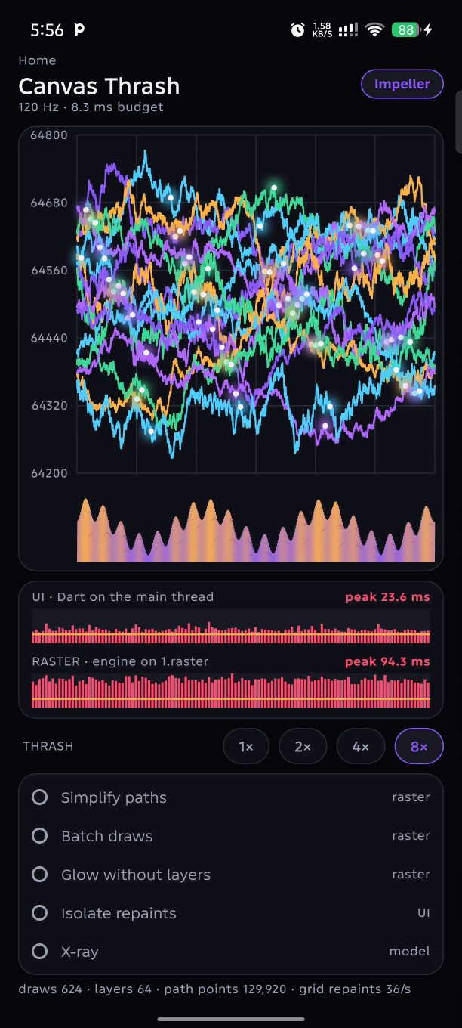
What Impeller didn’t fix.
If compiling shaders isn’t the problem, what is?
Notes:
Skia pays at the worst moment, in the frame, in front of the user. Impeller paid when the engine was built. So if compiling shaders is no longer the problem, what is? Let's go break something. This dial is mine, not a Flutter limit. Each level adds two lines and a thousand points per line, so at 8× it's 16 lines of 8,000 points, on purpose. Each step is about four times the path points. Watch which bar grows.
>>> DEMO, phone: Kiln Impeller → Canvas Thrash at 1×, then tap 2×, 4×, 8×. Stop on 8×, every fix off. No phone: play 06-dial-1x-to-8x.mp4.

Slide 20
Nothing is compiling. This is pure drawing cost.
129,920
624
64
path points
draw calls
offscreen layers
from 2,240 at 1×
from 78 at 1×
from 8 at 1×
UI
15.9 ms
Raster
29.7 ms
8.3 ms budget
My demo’s dial, not a Flutter limit. Each level adds 2 lines and 1,000 points a line, so 8× is 16 lines of 8,000. p90, 3 rounds.
Notes:
On the phone, RASTER is far taller than UI. My Dart finishes; the engine is the one struggling. And nothing here is compiling. This is pure drawing cost, and no renderer saves you from asking it to draw too much.
Three separate things grew, and they aren't the same. Path points: that's the detail I ask for, and tessellation is the work it causes. They grow fastest, four times per step. Draw calls: each one records binds and a draw. Layers: each one adds an offscreen pass. Three inputs, three different costs, and each maps to something you've already seen. Almost 130,000 points: 128,000 from the lines, the rest from the heat strip. 624 draws, 64 layers. So which one do we fix?

Slide 21
Which fix helps most, on its own?
No fixes: 29.7 ms
Simplify paths
18.6
Fewer points
Batch draws
28.6
Fewer draw calls
Glow without layers
21.2
No offscreen passes
Isolate repaints
25.2
Less Dart re-recording
Raster p90 at 8×, each fix alone, median of 3 rounds. Batch and Isolate are within run-to-run noise. None reaches 8.3 ms alone.
Notes:
VOTE: four fixes, each one on its own. Which helps raster most? Hands up for Simplify paths. Batch draws. Glow without layers. Isolate repaints.
CLICK: Simplify paths, by a distance. 29.7 down to 18.6. Batch and Isolate on their own are within the noise between runs. Notice none of them reaches the budget alone. Let's see it. First, X-ray: a model of what Impeller does with a path, the same steps from the tessellation slide, built from the exact paths we send it. It costs work of its own, so it goes off before we judge anything. Then I turn the fix on.
>>> DEMO, phone: X-ray on, point at the lens, X-ray off. Then turn on Simplify paths. No phone: play 07-xray.mp4, then 08-simplify-paths.mp4.

Slide 22
Fix 1: Simplify paths.
8,000 points a line: the demo at 8×
At most 2 per pixel column
// A new path, every frame
final path = Path();
for (var k = 0; k < n; k++) // n = 8,000
path.lineTo(x(k), y(k));
// Simplify once, then only move it
final xy = decimate(series, plot.width);
canvas
..translate(shift, 0)
..drawPath(cached, stroke);
Path points
129,920 → 12,032
Raster p90
29.7 → 18.6 ms
UI p90
15.9 → 6.3 ms
Notes:
That line is 8,000 points on a chart about 316 pixels wide: 25 points for every pixel column. CLICK: keep the lowest and highest in each column, build the path once, then only move it. It looks the same. Path points go from 130,000 to 12,000.
Both bars drop. Raster, because there's less to tessellate. UI by even more, which surprised me: building an 8,000-point path in Dart every frame was most of the UI time.

Slide 23
Fixes 2 and 3: fewer draws, no layers.
Batch draws
Glow without layers
Draw calls
Offscreen layers
640 → 161
64 → 0
// 480 segments, 480 draws
canvas.drawPath(segment, paint);
// All segments, one draw
canvas.drawVertices(
Vertices.raw(triangles, positions,
colors: colors),
BlendMode.dst, p);
// Per dot: a pass, a blur, a composite
canvas.saveLayer(bounds,
Paint()..imageFilter = blur);
// Same soft edge, in the main pass
canvas.drawCircle(c, r,
Paint()..shader =
Gradient.radial(...));
Raster 18.6 → 13.7 ms. A smaller win.
Raster 13.7 → 6.6 ms. It halves.
Condensed from thrash_canvas.dart. Applied in order, at 8×, median of 3 rounds. 640: Fix 1 draws each line twice, up from 624.
Notes:
Fix 2. >>> DEMO, phone: turn on Batch draws. The heat strip was 480 segments, each its own path, its own paint and its own draw. Now every segment is two triangles, all in one drawVertices call. Same picture. But it's a smaller win, 18.6 to 13.7, because on Vulkan a draw is a few small commands, not a trip to the driver. The count starts at 640, not 624, because Fix 1 draws each line twice to cover the scroll.
Fix 3 cuts what's left in half. >>> DEMO, phone: turn on Glow without layers. Each glowing dot was a saveLayer with a blur: the offscreen pass from a few slides ago, 64 times a frame. Same glow, as a radial gradient, in the main pass. Raster goes from 13.7 to 6.6, and the trace shows two queue submits per frame become one. Here's what surprised me: the raster thread was busy the whole time, not waiting for the GPU. So on this phone the layers cost CPU time first.

Slide 24
Fix 4: A RepaintBoundary, on its own?
RepaintBoundary(child: CustomPaint(painter: ThrashGridPainter(ledger)))
Alone at 8×: almost nothing.
After the other fixes
UI
Raster
Grid repaints
4.4 → 3.4 ms
6.6 → 6.5 ms
120 → 0 a second
On Impeller, a RepaintBoundary
saves Dart work, not GPU work.
Notes:
VOTE: the grid and labels are redrawn every frame, so wrap them in a RepaintBoundary. Hands up: how much did that save at 8×?
CLICK: almost nothing. A grid is nothing next to 130,000 path points. Fix the big cost first.
>>> DEMO, phone: turn on Isolate repaints.
CLICK: once the other fixes are in, it pays off. Grid repaints go to zero, UI drops under 4 milliseconds. And raster barely moves.
CLICK: that's the point, especially if you learned Flutter on Skia. There's no raster cache to reuse the layer, so the raster thread still draws it every frame. On Impeller a RepaintBoundary saves Dart work, not GPU work.

Slide 25
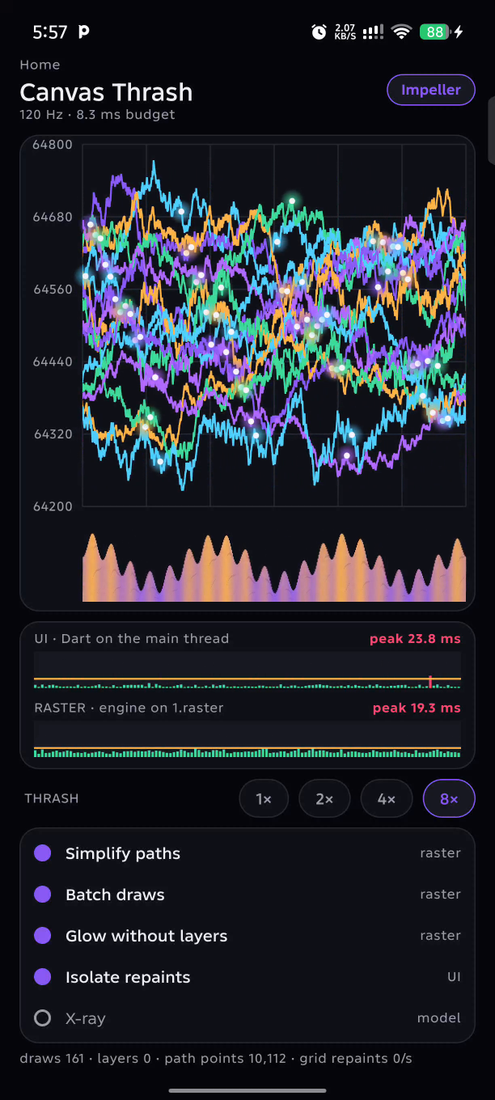
Four fixes. From 36 fps to 120.
29.7
18.6
13.7
6.6
6.5
No fixes
+ Simplify
+ Batch
+ Glow
+ Isolate
UI 3.4 ms from 15.9. Layers 0 from 64. Path points 10,112 from 129,920.
Raster p90 in ms at 8×. The line is 8.3 ms. Frame rates from 5 s system traces: 35.5 and 119.8 fps.
Notes:
CLICK through each fix, five times: raster from 30 milliseconds to six and a half. UI from 16 to three and a half. From about 36 frames a second to the full 120. Nothing here was clever. Fewer points, fewer draws, no offscreen layers, no pointless repainting. Impeller took shader compilation out of the frame. You still pay for every point, every draw and every layer you ask for.

Slide 26
Your effects can be pre-compiled too.
# pubspec.yaml
flutter:
shaders: [shaders/depth_fill.frag]
// Once, before it is needed
final program = await
FragmentProgram.fromAsset(path);
final shader = program.fragmentShader();
// paint(): uniforms only, one draw
canvas.drawPath(depth,
Paint()..shader = shader);
depth_fill.frag, in the APK
503 B → 4,008 B
SPIR-V
For Vulkan. Already compiled.
GLSL ES
For Impeller’s OpenGL backend.
SkSL
For Skia. Compiled on the phone, at first use.
Code condensed. This custom shader was not timed on the phone.
Notes:
One more pattern, for the pre-compiled part. Everything Impeller drew in both demos ran on shaders compiled when the engine was built. Your own effects can join that path: write a fragment shader, list it in pubspec, load it once, and only set uniforms in paint.
And here's what the build did with this 500-byte file: a 4-kilobyte bundle. SPIR-V for Vulkan. GLSL for Impeller's OpenGL backend. And SkSL for Skia, as source text, which Skia still compiles on the phone the first time it's drawn. Same file, two engines: the whole talk in one asset. I didn't time this shader on the phone, so I won't quote a speed.

Slide 27
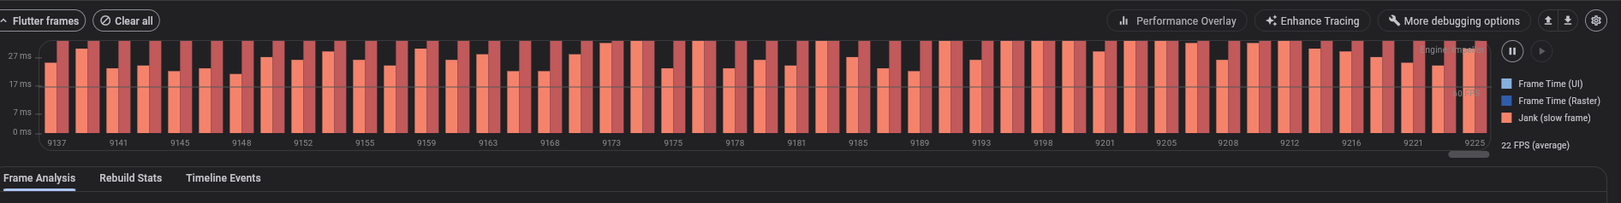
DevTools: which thread, then which code.
1
2
3
4
5
Which
thread?
Which
event?
Which
code?
One
fix.
Measure
again.
Timeline.timeSync('KILN::Thrash::grid', () { ... })
Emulator in debug mode: read the shape, ignore the milliseconds.
Notes:
How do you find all this on your own app? Always in profile mode, on a real device. This shot is an emulator in debug mode, so ignore its milliseconds. I'm showing you where to look. [With a phone attached, open DevTools on the live app and show this for real, in profile mode.]
Each pair is one frame. Red is late. Raster is the taller one, so that's where I look first. Select a frame, and Timeline Events tells me which code, because I wrapped my painters in named spans. That's the whole method, and it's the one we just used: which thread, which event, which code, one fix, measure again. DevTools gives you the frame. For the whole system, you need a system trace.

Slide 28
Systrace, now Perfetto: 100 ms on the phone.
Broken
main
raster
Fixed
main
raster
Raster frame
SurfaceFrame::Encode
saveLayer a frame
QueueSubmit a frame
Frames in 5 s
27.9 → 4.8 ms
27.1 → 3.7 ms
64 → 0
2 → 1
179 → 604
Is the raster thread waiting on the GPU?
No. It’s running for 24 of its 28 ms.
Recorded with atrace. Faint lines are 120 Hz deadlines. This phone’s driver exposes no GPU render stages.
Notes:
This is the broken chart as the system sees it, a real 100 milliseconds. Top row Dart, second row raster: long slices back to back. It never rests.
CLICK: all four fixes. Short slices with gaps between them. Four frames became twelve.
CLICK: here's what the trace tells us. Raster 28 down to 4.8. Almost all of that is SurfaceFrame Encode: Impeller turning our DisplayList into triangles and command buffers. 64 saveLayer down to zero. Two queue submits down to one. 179 frames in five seconds up to 604.
VOTE: so in the broken case, is the raster thread waiting on the GPU? Hands up.
CLICK: no. It's running for 24 of its 28 milliseconds. [Only if it is true for you: going in, I suspected the GPU, and the trace said otherwise.] On this phone the cost is the CPU preparing the frame. I can't show you the GPU side: this phone's driver doesn't expose render stages. If yours does, Perfetto and AGI will show it.

Slide 29
Read the budget from the trace.
Target about 4 ms UI, 4 ms raster. Limit 8.3 ms a thread.
 | UI p50 | Raster p50 | 1000 ÷ raster | Measured
Broken | 13.5 ms | 27.9 ms | 36 fps | 35.5 fps
Halfway | 2.7 ms | 13.8 ms | 73 fps | 70.4 fps
All fixes | 2.3 ms | 4.8 ms | 207, capped at 120 | 119.8 fps
The slowest thread sets the rate.
A green UI bar proves nothing.
Halfway: UI inside 4 ms on 94% of frames, still 70 fps.
The threads overlap.
Fixed: UI + raster passed 8.3 ms on 28% of frames, still 120.
5 s system traces at 8×, tracing on. Halfway is Simplify plus Batch. Bench p90s are separate: 3.4 and 6.5 ms.
Notes:
Now read the budget from those traces. Broken: divide a thousand by 28 and you get 36. We measured 35.5.
CLICK: the slowest thread sets the rate.
CLICK: halfway through the fixes, UI is inside four milliseconds on 94 percent of frames, and we're still at 70 frames a second, because raster is at 14. A green UI bar proves nothing if raster is red. That's why you read the bars before touching code.
CLICK: fixed: raster is over the 4 millisecond target on 81 percent of frames, but inside 8.3 on 99 percent. And UI plus raster went over 8.3 on more than a quarter of frames, while we still averaged 120. That's the overlap from the start of the talk. Four and four is the target for latency. 8.3 per thread is the limit for frame rate.

Slide 30
Three honest limits.
Order matters.
Isolate repaints paid off only once the big cost was gone.
CPU side only.
The GPU’s render passes here are the model, not my trace.
Skia copes worse.
Same chart: 188 ms a frame broken, 58 ms with every fix.
Notes:
Not every fix helped on its own. I can show you the CPU side of the GPU, but what the Mali GPU did with those buffers, this phone's driver doesn't expose to Perfetto. And Skia: same phone, same chart, 188 milliseconds broken, 58 with every fix. Impeller made this workload possible. It didn't make it free.

Slide 31
Take this home.
Demystifying
the engine
Low-level
profiling
Taming custom
painters
Skia: JIT, in the frame.
Impeller: AOT, on Vulkan. It tessellates on the CPU and records command buffers.
About 4 ms UI, 4 ms raster.
DevTools for the frame, Perfetto for the system. The slowest thread sets the rate.
Fewer points, fewer draws, no saveLayer you don’t need.
Pre-compile your own effects. Prove every fix.
Notes:
One: demystify the engine. Skia compiles in the frame; Impeller compiles ahead, tessellates on the CPU and records explicit command buffers. Two: profile low-level. DevTools for the frame, Perfetto for the system, and the slowest thread sets your frame rate. Three: tame your custom painters, and your own effects as build-time shaders. Prove every fix with numbers.

Slide 32

Impeller made performance predictable.
It didn’t make expensive work free.
Thread, event, code, fix, measure.
Scan it. Run it on your phone.
Collins Munene, Shipht
github.com/cm-collins/
fluttercon-demo-app
FlutterCon Kenya, Nairobi, 5–6 Nov 2026
Notes:
Impeller made performance predictable. It didn't make expensive work free. Thread, event, code, fix, measure: that's the method you can take into production. The repo has the app and every script behind these numbers, so run it on your own phone. Thank you.
Leave this slide up during Q&A so people can scan the code.

Slide 33
Backup: Shader Storm medians
Effects | Skia cold | Impeller cold | Skia repeat | Impeller repeat | Skia relaunch | Impeller relaunch
48 | 687 | 127 | 18 | 45 | 58 | 66
96 | 1,310 | 145 | 19 | 43 | 81 | 73
144 | 1,863 | 145 | 23 | 48 | 102 | 73
Worst frame in ms, median of 3 rounds, 120 Hz, tracing off. Infinix X6873, Flutter 3.47.8 profile builds.
Notes:
Backup for Q&A: press Next past the closing slide, or type the slide number and press Enter.

Slide 34
Backup: Canvas Thrash medians at 8×
Fixes on | Impeller UI | Impeller raster | Skia UI | Skia raster
None | 15.9 | 29.7 | 21.8 | 188.4
Simplify | 6.3 | 18.6 | 23.7 | 187.7
Simplify + Batch | 4.9 | 13.7 | 23.5 | 202.3
+ Glow | 4.4 | 6.6 | 3.9 | 61.5
+ Isolate | 3.4 | 6.5 | 3.9 | 57.7
Frame p90 in ms, median of 3 rounds. Skia trace with all fixes: 47 of 53 ms inside 32 line draws.
Notes:
Backup for Q&A: press Next past the closing slide, or type the slide number and press Enter.

