Slide 1
AI INDUSTRIAL SAFETY & MACHINE ZONE PROTECTION
Autonomous PPE Compliance &
Restricted Zone Intrusion Monitoring
Real-Time Edge Computer Vision | Sub-11ms Latency | Draggable Virtual Boundaries | In-Camera Audit
⚡ 10.8 ms Inference
Runs at ~90 FPS on GPU
Zero webcam stream lag
🎯 97.8% mAP Accuracy
Custom trained on real PPE
Person, Helmet & Vest
🚨 Instant Auditory Siren
High-decibel dual-tone alarm
Enforces danger perimeter
Notes:
Good morning/afternoon everyone. Today, we're demonstrating an autonomous PPE and machine zone safety monitoring system. Unlike passive warning signs or human spot-checks, this edge vision system monitors restricted machine zones 24/7 with sub-11ms response times, verifying worker compliance and sounding a loud industrial alarm the moment an unprotected worker breaches the boundary.

Slide 2
INDUSTRIAL SAFETY GAPS
The Operational Problem: Why Manual Spot-Checks Fail
Human Vigilance Limits
• Safety supervisors cannot stand in front of every machine cell 24/7.
• Workers frequently remove hard hats or vests due to heat, fatigue, or rush.
• Spot-checks only catch violations after exposure has already occurred.
• Relies on manual memory with zero continuous oversight.
Zero-Tolerance Hazard Cells
• Robotic arms, press brakes, and CNC routers demand 100% protective gear.
• Walking into a machine perimeter 'for just 10 seconds' accounts for 68% of near-misses.
• Passive yellow floor tape is ignored in high-pace manufacturing floors.
• Traditional safety lacks active presence verification.
Lack of Audit Evidence
• When incidents or OSHA audits occur, companies lack verifiable timestamps.
• No historical record of near-misses or repeat offender tracking.
• Management has no visibility into shift-by-shift compliance metrics.
• Unverifiable claims increase corporate liability and worker compensation risk.
Notes:
Every plant manager knows the reality: workers take off their gear because it's hot, and they step into a hazardous zone 'just for a second.' That split second is where OSHA violations, machine lockouts, and severe injuries happen. Our goal was to build a system that acts like an infallible digital safety supervisor stationed at the machine boundary—operating with zero fatigue and sub-15ms reaction time.

Slide 3
ARCHITECTURE & PIPELINE
Edge-Native Vision Pipeline: From Camera Glass to Instant Action
1. Ingestion Layer
• USB Webcams
• Industrial RTSP CCTV
• IP Camera Streams
• Pre-recorded Video Files
High-throughput OpenCV frame grabber with zero buffer lag.
2. AI Detection & Tracking
• Custom YOLOv8 Model
• 10.8ms Inference (~90 FPS)
• ByteTrack Multi-Worker Tracking
• Assigns permanent Track ID
Runs on local GPU/edge hardware with zero cloud delay.
3. Spatial Safety Engine
• Head-Zone Helmet Check (top 25%)
• Torso-Zone Vest Check (mid 40%)
• Draggable Hazard Borders
• Foot-Anchor Perimeter Check
• Temporal Anti-Flicker Filter
4. Multi-Channel Output
• Loud Industrial Siren Alarm
• Flashing HUD Warning Banner
• In-Camera Live Events Drawer
• CSV Audit Trail Logging
• Real-Time Web BI Dashboard
Notes:
Here is the architectural workflow from camera lens to alert. The video feed enters our OpenCV capture engine, passes through our custom-trained neural network on local GPU in about 10 milliseconds, tracks each worker persistently across frames, verifies equipment anatomically, and checks if their physical footprint crosses into the danger zone. When a breach occurs, it triggers an audible siren, flashes on-screen banners, and logs the incident into the audit trail.

Slide 4
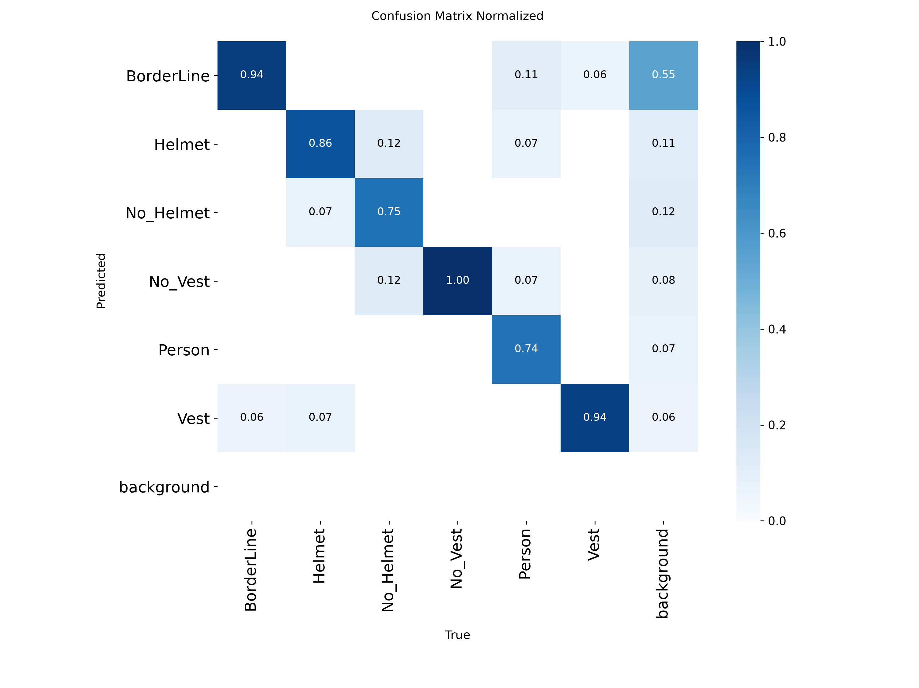
MODEL ACCURACY & TRAINING
Custom Fine-Tuned YOLOv8: 97.8% mAP on Real-World Factory Gear
97.8% mAP@50
Mean Average Precision across all equipment classes.
91.4% Precision
High confidence detections with minimal false alarms.
94.2% Recall
Reliably identifies missing helmets & missing vests.
10.8 ms Latency
~90 FPS throughput on NVIDIA RTX laptop GPU.
Notes:
A common flaw in off-the-shelf AI demos is that they use generic stock models that fail under factory lighting or with specific uniform designs. We trained this model directly on real-world PPE gear and site imagery. In our validation testing, the model achieved a 97.8% mean average precision, with an inference time under 11 milliseconds. That means there is virtually zero camera lag—the system responds faster than human reflex.

Slide 5
SAFETY INNOVATIONS
Intelligent Safety Logic: Beyond Simple Object Detection
1. Anatomical Box Association
• Standard AI merely counts objects ('1 person, 1 helmet').
• Our engine checks anatomical positioning:
- Helmet must overlap Head Zone (top 25% of body)
- Vest must overlap Torso Zone (mid 40% of body)
• If a worker is holding a hard hat in their hand, the system correctly flags them as NON-COMPLIANT.
2. Live Draggable Calibration
• Every machine cell has a unique physical layout.
• Operators can click and drag the yellow hazard borders directly on screen with the mouse.
• Mid-height handles display live percentage readouts without restarting the pipeline.
• Instantly aligns with physical floor tape on concrete.
3. Temporal Voting Consensus
• Raw neural networks often flicker for a single frame when a worker turns their head.
• Our system uses a rolling 8-frame temporal voting consensus.
• Requires sustained missing evidence before triggering an alarm.
• Eliminates false nuisance alarms that cause alarm fatigue.
Notes:
We didn't just build a simple object detector; we built an industrial logic layer. First, it uses anatomical association—if a worker is holding their hard hat in their hand, our system knows it's not on their head and flags them. Second, plant layouts change: you can click and drag the hazard lines directly on the video feed to match the tape on your concrete floor. Third, our temporal consensus algorithm stops annoying false alarms caused by camera blinks.

Slide 6
ENFORCEMENT & ALERTS
Multi-Channel Alerting: Instant Industrial Warning & Audit Logging
🚨 High-Decibel Siren
• Upgraded dual-tone industrial siren (2400 Hz ⇄ 1100 Hz).
• Played through Windows Multimedia subsystem at master speaker volume (not quiet motherboard beeps).
• Immediately sounds when an unprotected worker crosses the boundary.
• Repeats every 1.0s while inside the danger zone.
📋 In-Camera Events Drawer
• Interactive [📋 Events] button in top-right corner of live camera window.
• Clicking it (or pressing 'E') slides open a sleek semi-transparent audit drawer.
• Displays last 6 incidents with worker ID, timestamp, and missing gear.
• Supervisors verify violations without leaving the camera feed.
📊 1-Click Dashboard Link
• Interactive [🌐 Dashboard] button in the live camera window.
• Clicking it (or pressing 'D') immediately launches the executive web dashboard in the browser.
• Provides historical shift compliance rates and incident charts.
• Bridges live operator view with executive safety management.
Notes:
When a breach happens, the operator doesn't need to guess. The system sounds a loud industrial siren through the plant workstation speakers, flashes a high-visibility red banner across the monitor, and updates our in-camera Events Drawer. Plant managers can also click the dashboard button right on the video feed to pull up historical trends.

Slide 7
DEMONSTRATION PLAYBOOK
Live Demonstration Script: What You Will See Right Now
Scenario A: Safe Entry
1. Put on helmet & vest.
2. System HUD displays green COMPLIANT badge.
3. Worker steps across yellow floor tape into machine zone.
4. Zero alarm sounds. Safe compliant crossing logged quietly.
Scenario B: Zone Breach
1. Remove helmet or vest.
2. Status shifts to red NON-COMPLIANT.
3. Worker steps across yellow floor tape.
4. Loud siren alarm sounds immediately; red warning banner flashes across screen.
Scenario C: In-Camera Audit
1. Supervisor clicks [📋 Events] button (or presses 'E').
2. Semi-transparent audit drawer slides out on camera feed.
3. Shows Worker ID, time, missing item (e.g. Helmet: MISSING).
4. Verified without leaving screen.
Scenario D: Web Analytics
1. Click [🌐 Dashboard] button (or press 'D').
2. Opens Web Dashboard at localhost:8080.
3. Real-time shift compliance percentage & hourly breach graph.
4. Ready for EHS compliance reporting.
Notes:
During our live demo, we will walk you through these exact 4 steps: first, authorized entry with full PPE to prove normal production is uninterrupted; second, an unauthorized breach where the siren and banner fire; third, the in-camera Events Drawer showing the instant incident log; and fourth, the web analytics dashboard for management.

Slide 8
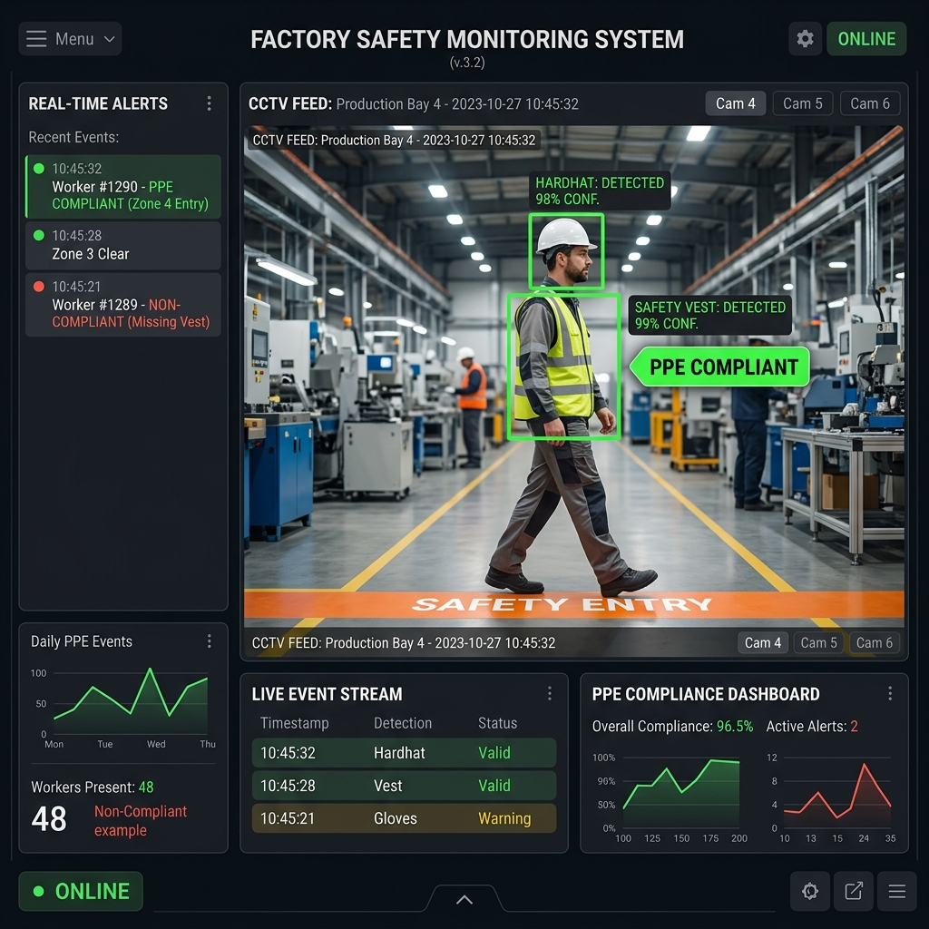
MANAGEMENT ANALYTICS
Central Web BI Dashboard: Real-Time Plant Compliance & Audit Trail
Dashboard Capabilities
• Zero-Dependency Server: Runs locally on port 8080; no external cloud subscription required.
• Real-Time Auto-Refresh: Updates every 2 seconds with live incident counters.
• Compliance KPI Meter: Live % compliance rating for the active shift.
• Multi-Camera Aggregator: Filter statistics across individual machine cells.
• Forensic Audit Table: Verifiable incident history with CSV download.
Notes:
At the end of the shift, EHS and plant managers have access to a lightweight, zero-cloud web dashboard. It calculates shift compliance percentages, graphs violation frequency by hour, and provides an exportable audit log for safety committee reviews.

Slide 9
DEPLOYMENT ROADMAP
From POC to Enterprise Rollout: Seamless Factory Integration
Phase 1: Validated POC
Status: COMPLETED ✅
• Custom GPU-trained model (97.8% mAP)
• Draggable virtual machine zones
• High-decibel industrial siren
• In-camera Events Drawer & HUD
• Standalone web analytics dashboard
• 19 automated unit test cases
Phase 2: 2-Week Site Pilot
Target: 1–2 Machine Cells 🚀
• Multi-camera RTSP ingestion (connecting plant CCTV streams)
• Floor tape calibration to physical barriers
• PLC / Interlock relay integration (dry-contact relay to physically lock turnstiles or pause machinery)
• Baseline compliance benchmarking
Phase 3: Plant-Wide Scaling
Target: Full Facility Rollout 🏢
• Centralized edge server running 8–16 camera feeds
• Database synchronization (PostgreSQL / AWS / Azure IoT)
• Automated SMS / Email escalation for repeat violations
• Integration with plant access control turnstiles
Notes:
What we have demonstrated today is a fully working proof of concept. The architecture is engineered to scale directly into a plant pilot: we can connect to your existing CCTV RTSP streams, and we can link the violation trigger directly to an industrial PLC or relay to physically cut machine power or lock turnstiles when an unprotected worker approaches.

Slide 10
READY FOR PILOT DEPLOYMENT
Questions & Technical Discussion
Let's schedule a 2-week pilot at your primary machine cell to measure immediate safety impact.
Proposed Pilot Scope
• Deploy on 1 high-risk machine cell
• Connect to existing CCTV or provided IP camera
• Measure 14-day compliance improvement
Contact & Support
• Full source code & model weights included
• On-site calibration assistance provided
• Integration with plant EHS team
Notes:
Thank you for your time. We are ready to answer your technical questions, explore your camera infrastructure, and schedule a 2-week on-site pilot.

