Slide 1

Leveraging LLMs to Evaluate Public Comments on Japan's Environmental Plans
https://github.com/cm3/iaia2025data
Insert presenter headshot here.
CLICK & DELETE THIS TEXT BOX.
Kohei ISHII
PhD Student/Chiba University
Japan
Linked In: https://www.linkedin.com/in/kohei-ishii-a83bb2281/
E-mail: koukou1011.15@gmail.com

Slide 2
Introduction
Research objects
Data and Preprocessing
Methods
Results
Conclusion
Limitations and Future Works

Slide 3
1. Introduction
Public comments are essential for participatory policymaking.
Japan's public comment system often criticized as superficial.
Strategic Environmental Assessment (SEA) emphasizes consensus building.
“Meaningful Reply” proposed to enhance genuine participation (Harashina, 2005).
This study explores public comment influence in environmental policy.
Focus: Sixth Basic Environmental Plan
Approach: Introduce AI-assisted evaluation

Slide 4
2. Research Objects
Analyze contribution of public comments to policy documents drafting
Score administrative responses using “Meaningful Reply” scale
Compare responsiveness across different comments categories

Slide 5
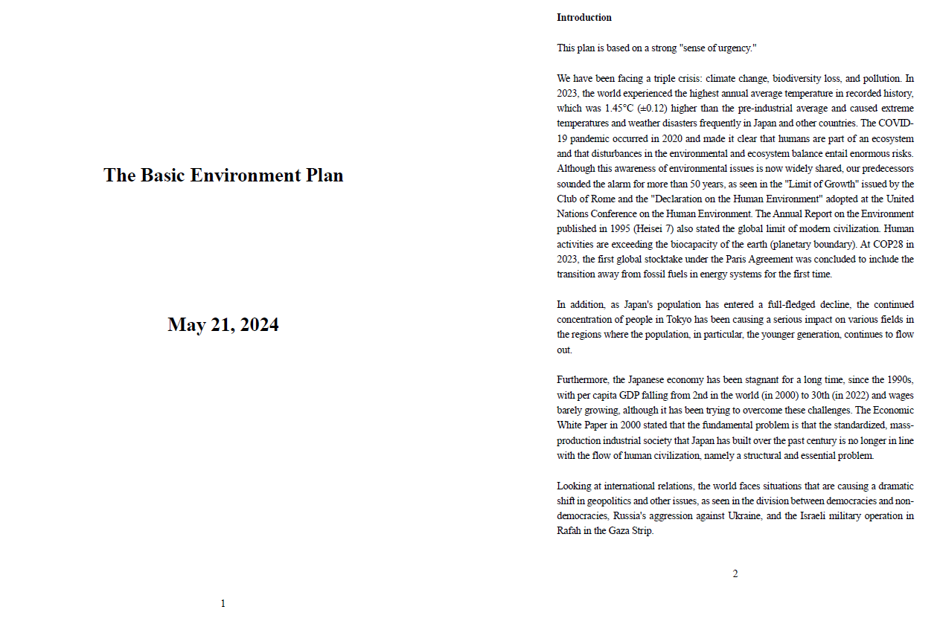
3. Data and Preprocessing
https://www.env.go.jp/council/content/i_01/000281036.pdf

Slide 6
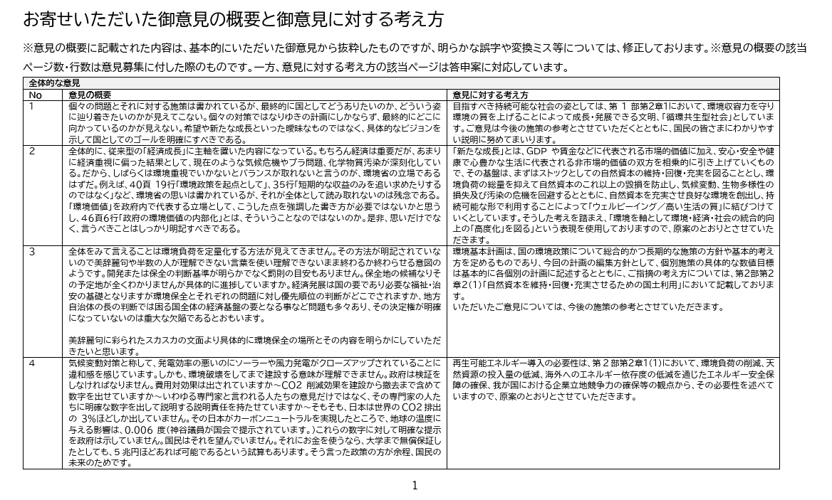
3. Data and Preprocessing
Public Comment File (CSV):
Public comments and corresponding administrative replies
https://www.env.go.jp/council/content/i_01/000222792.pdf

Slide 7
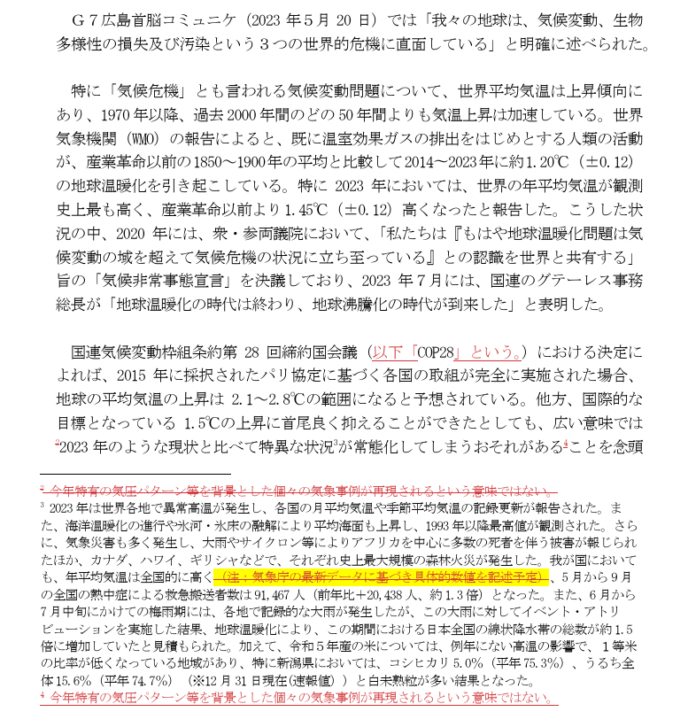
3. Data and Preprocessing
Change Log File (CSV):
Revisions between draft and revised plan
Include in “Add” and “Delete”
https://www.env.go.jp/council/content/i_01/000221700.pdf

Slide 8
3. Data and Preprocessing
Source documents:
Official PDFs from Ministry of the Environment (https://www.env.go.jp/council/02policy/yoshi02.html)
Converted via Adobe Acrobat and MS Office tools
Organized for automated analysis using ChatGPT 4o

Slide 9
4. Methods
(1) Matching Changes
Each pair was rated on a 4-point fulfillment scale:
4 = Fully fulfilled— the requested revision or addition was made as asked.
3 = Partially fulfilled— the response addressed the comment in part or via alternative means.
2 = No change made, but the response claims the request is already fulfilled.
1 = Rejected— the request was not accepted or implemented.

Slide 10
4. Methods
(1) Matching Changes
To identify whether and how public comments influenced actual revisions in the plan draft.
Matched each comment–reply pair with draft revisions
Used ChatGPT 4o API for matching process
Focused on added and deleted text segments
ChatGPT judged whether each comment–reply pair contributed to a specific change.

Slide 11
4. Methods
(1) Matching Changes
Returned relevant Change IDs and brief justifications.
Comment: (Original Japanese) P9 L19～26 クマ類について取り上げられているが、これより深刻化している鳥獣被害はシカであり、この種に関し、取り上げるべきと考える。つまり、国土強靭化基本計画で取り上げられているよう、森林生態系における二ホンジカ等による下層植生の衰退や裸地化に伴う土砂災害の発生の危険性について政府において認識されているところであり、ｐ5 の 18 行で記載するところの基盤としての自然資本は重要であり、自然資本を維持・回復・充実は不可欠である。このため、クマ類よりも深刻化している二ホンジカ等による下層植生の衰退や裸地化に伴う土砂災害の発生の危険性を取り上げて記載すべきである。
(English translation) While the draft mentions bears, a more pressing issue is the damage caused by deer. The Basic Plan for National Resilience already recognizes the risks of landslides due to the decline of understory vegetation and bare land caused by the overpopulation of Japanese deer. Since such ecosystem degradation undermines the natural capital mentioned on p.5, line 18, it is vital that the draft include reference to this more serious issue, rather than focusing solely on bears.
Reply: (Original Japanese) ご指摘を踏まえ、P6 L21 以降に、以下の文章を追記いたします。「また、ニホンジカの生息域の拡大や生息数の増加により、下層植生の衰退や裸地化等の森林生態系等への被害が深刻化しており、防災・減災等、森林の多面的機能が十分発揮されないことも懸念されている。」
(English translation) Based on your feedback, we will add the following sentence after P6, L21: “Moreover, the expansion of the Japanese deer’s habitat and increase in population are causing serious damage to forest ecosystems, such as the decline of understory vegetation and land degradation. This is raising concerns about the diminished capacity of forests to serve their multifaceted functions, including disaster prevention and mitigation.”
Request Fulfillment: 4, Reason: The administration has fully addressed the comment by adding a section that acknowledges the concerns raised about the impact of the expanding range and increasing population of deer on forest ecosystems, thus fulfilling the request to highlight this issue.
Relevant changes: - Change ID: 11, Reason: Addition addresses deer impact on ecosystems

Slide 12
4. Methods
(2) Scoring “Meaningful Reply”
Evaluated each administrative reply on a 5-point scale
Criteria: relevance, completeness, clarity
Meaningful Reply Scores:
5 = fully addresses comment
4 = mainly addresses
3 = partially addresses
2 = scarcely addresses
1 = does not address

Slide 13
4. Methods
(3) Comparative Analysis
Divided comment–reply pairs:
Contribution to draft revision (Yes)
No contribution (No)
Compared Meaningful Reply scores between groups
Score distributions visualized (bar plots, boxplots)
Mann–Whitney U test conducted

Slide 14
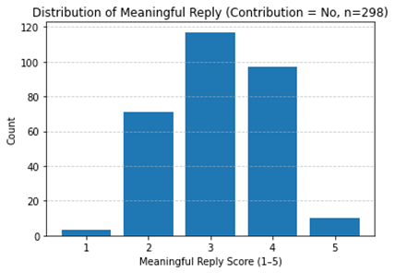
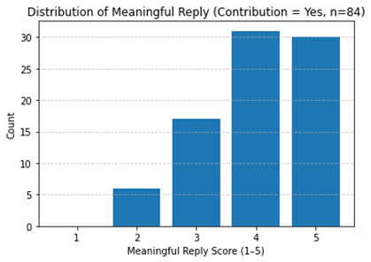
5. Results
Figure 1: Distribution of Meaningful Reply (Contribution = No, n=298)
Figure 2: Distribution of Meaningful Reply (Contribution = Yes, n=84)

Slide 15
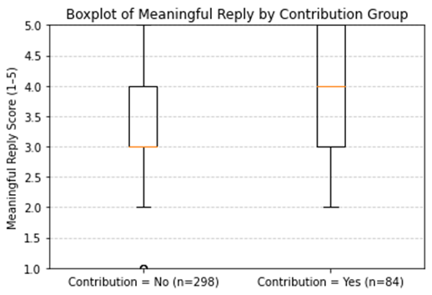
5. Results
Figure 3: Boxplot of Meaningful Reply by Contribution Group

Slide 16
5. Results
Table 1: Mann-Whitney U Test (Meaningful Reply)
Indicator | Output
U statistics: | 6334.0
P-value: | p < 0.001
Contribution = No (n=298), Mean: | 3.13
Contribution = Yes (n=84), Mean: | 4.01

Slide 17
6. Conclusion
84/382 (22%) of public comments led to revisions.
LLM-based evaluation reveals hidden stakeholder influence.
Meaningful Reply can be operationalized quantitatively.
Public input not merely recorded, but often substantively reflected.
To some extent, LLMs enhance transparency and reproducibility in evaluation.

Slide 18
7. Limitations and Future Works
Study limited to a single policy cycle
Difficulties aligning AI and nuanced human judgments
Need for cross-sectoral validation
Future directions:
Comparative Analysis of Public and Expert Influence on Policy Changes
Examine differential adoption patterns between expert input and citizen input
Calibration against human evaluation
Expansion to other environmental and policy fields

Slide 19
Kohei ISHII 1, Akihiro KAMEDA 2
1: PhD Student/Chiba University; 2: Researcher/National Institutes for the Humanities
Japan
Linked In: https://www.linkedin.com/in/kohei-ishii-a83bb2281/
E-mail: koukou1011.15@gmail.com

