Slide 1





Thermal-Aware Scheduling for Real-time Applications in Embedded Systems
Adam Lewis, Soumik Ghosh, and N.-F. Tzenz
Center for Advanced Computer Studie,
University of Louisiana
Lafayette, Louisiana
High Performance Embedded Computing (HPEC) Workshop
23−25 September 2009
(A) Approved for public release; distribution is unlimited.

Slide 2
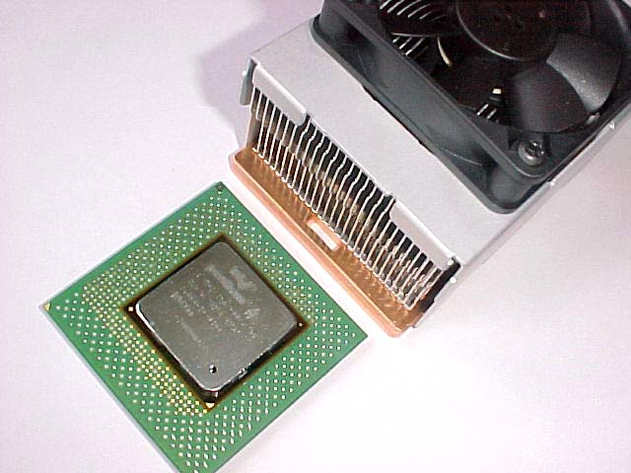
Thermal management techniques used on the desktop inappropriate for embedded systems
  DTM techniques problematic
    Use of DVFS in response to DTM event has negative impact on deadlines
    Real-time requirements eliminates available slack in schedules
  Need quantitative understanding of relationship between power consumption and thermal load at the system level to avoid rather than react to thermal events
Creating model that relates system energy input to subsystem energy consumption based on tightly correlated parameters
Develop scheduler-based mechanisms that dispatch jobs to confine power consumption to a given power budget and thermal envelope
Introduction

Slide 3
Related work
  Hardware techniques
    Mobile and desktop processor
    Storage devices and main memory
  Power models
    Correlate power consumption to application execution using system metrics
    Linear regression techniques
  Thermal models
    Impact of multi- and many-core
  Power aware scheduling
    Avoid DTM events
Technical challenges
  How to create a full system power model?
  Do we have the correct set of sensors?
  Are sensors correctly placed on the server?
  Topology aware scheduling & better linkage between operating system dispatcher and power management
  Power treated same as all other resource in scheduling decisions
Related Work

Slide 4
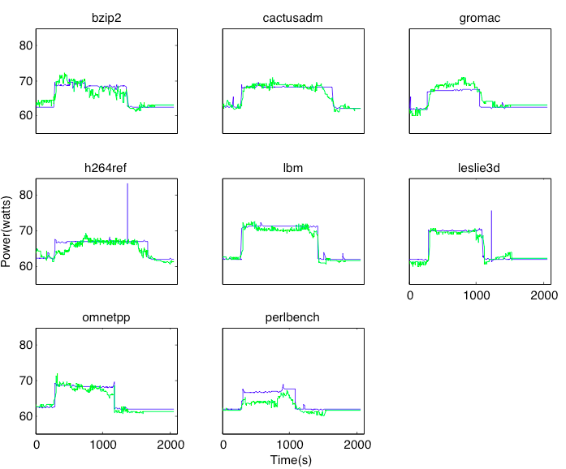
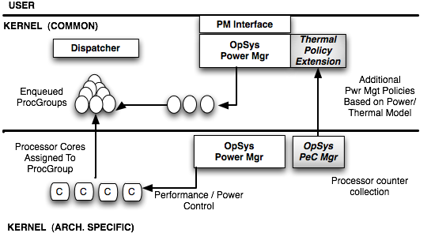
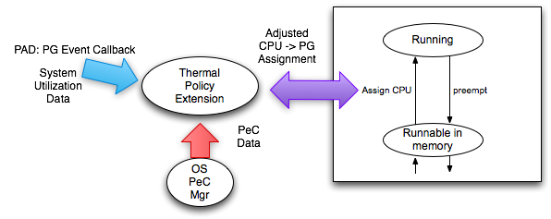
System-wide energy model
Based on H/W performance counters
Map system power consumption to overall thermal envelope
Thermal Policy Manager
Extends existing power mgt
Uses model to predict what threads are leading to a DTM event
OS Dispatcher
Adjusts load balance to move work to cooler processing cores
Introduction
Proposed Scheme

Slide 5
Contributions
System Scheduler Prototype
  Regulation of application thermal load
    Using model that measures
      Bus traffic
      Transactional load
    Avoids thermal emergency by transfer of workload away from overheated cores
Introduction
Proposed Scheme
Conclusion

