Slide 1
Chaotic Attractor Prediction for Server Run-time Energy
Consumption
Adam Lewis, Nian-Feng Tzeng, Soumik Ghosh
The Center for Advanced Computer Studies
The University of Louisiana at Lafayette

Slide 2
Agenda
Introduction and problem statement
CAP: prediction with chaotic time series
Results
Future work and next steps
Summary

Slide 3

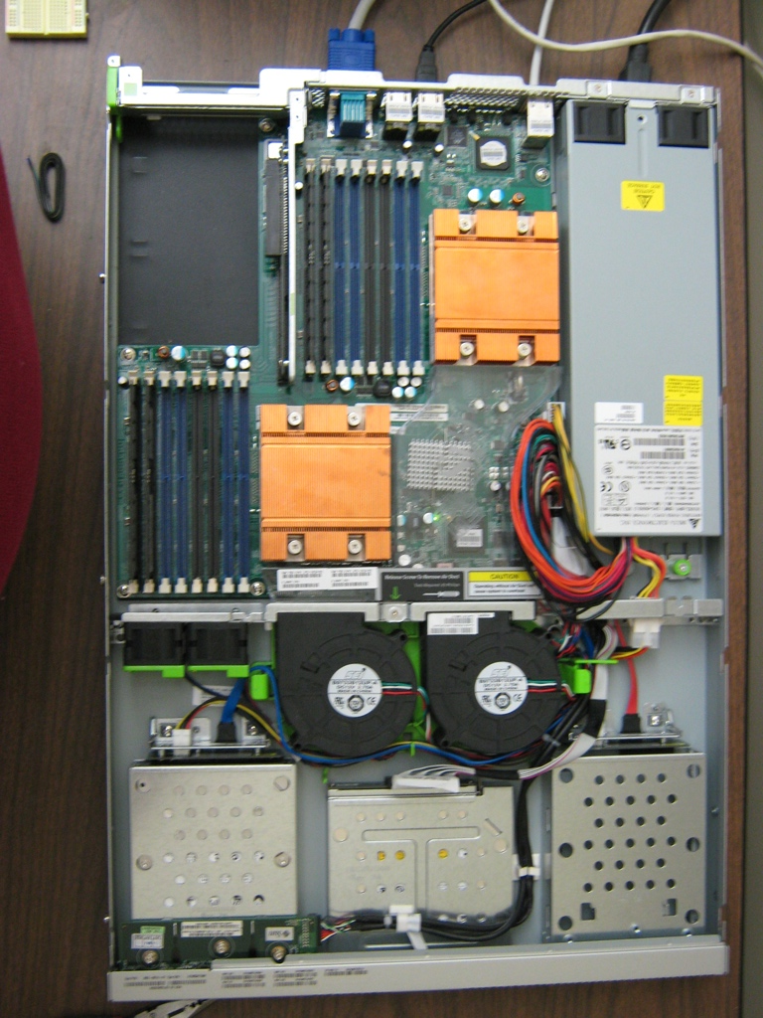
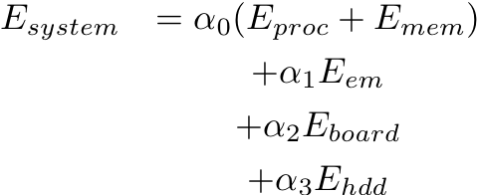

Full-system Power Models
[Lewis 2008]
Continuous model time series approximation
Linear regression
dd
Notes:
Eproc: Energy consumed in the processor due to all computationsEmemory: Energy consumed in the DRAM chips andEem: Energy consumed by all electrical and electromechanical components in the server blade. Thisincludes fans, and other components on the server which consume AC power.Eboard: Energy consumed by peripherals that support the operation of the board. These include alldevices in the multiple voltage domains across the board, including chipset chips, voltage regulation,bus control chips, connectors, interface devices etc.Ehdd: Energy consumed by the hard disk drive during the server’s operation.

Slide 4
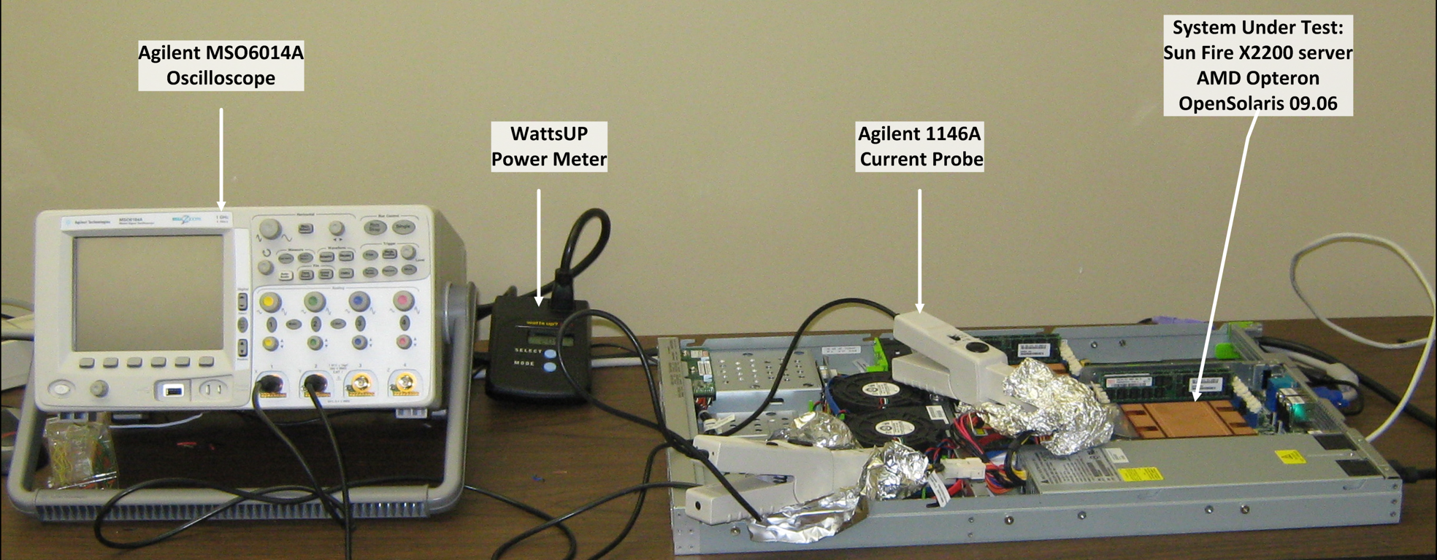
System Under Test
SPEC CPU2006 Benchmarks
 | Sun Fire 2200
CPU | 2 AMD Opteron
CPU L2 cache | 2x2MB
Memory | 8GB
disk | 2060GB
Network | 2x1000Mbps
Video | On-board
Height | 1 rack unit
Benchmark |  | Type | Use
perlbench | C | Integer | PERL Programming Language
bzip2 | C | Integer | Compression
mcf | C | Integer | Combinatorial Optimization
omnetpp | C++ | Integer | Discrete Event Simulation
gromacs | C/Fortran | Float | Biochemistry/Molecular Dynamics
cacstusADM | C/Fortran | Float | Physics/General Relativity
leslie3d | Fortran | Float | Fluid Dynamics
lbm | C | Float | Fluid Dynamics
zeusmp | C | Float | Fluid Dynamics

Slide 5


Linear methods - A good idea?
Linear Regression
  Easy, simple
  Odd mis-predictions
  Corrective methods required
Linear AR Model: AMD Opteron
Linear AR Model: Intel Nehalem

Slide 6
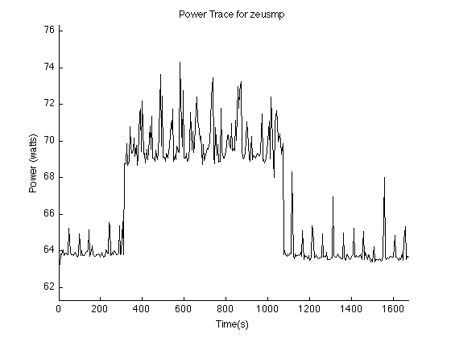
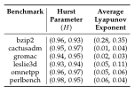
Linear, non-linear, and chaotic
Chaotic behavior
Non-linear?
Noise?
Error?

Slide 7
Chaotic Time Series
Time-delay reconstructed state space
  Uses Takens Embedding Theorem:
    Time-delayed partition of observations to build function that preserves the topological and dynamical properties of our original chaotic system
Find nearest neighbors on attractor to our observations
Perform least-square curve fit to find a polynomial that approximates the attractor

Slide 8
Creating and using a CAP
One time process for new hardware
  Create a training set for the process
  Use training set to reconstruct state space
    Embed using Taken’s Theorem
    Nearest Neighbors
  Solve resulting linear least squares problem

Slide 9

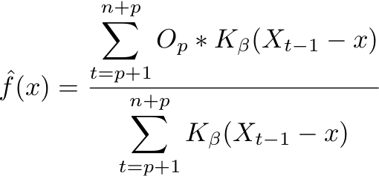


Kernel weighting
1.
a
3.
a
2.
a

Slide 10
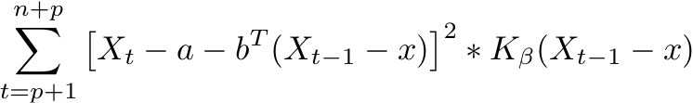
Forward prediction
Start with a Taylor series expansion
Find the coefficients of the polynomial by solving the linear least squares problem for a and b:

Slide 11
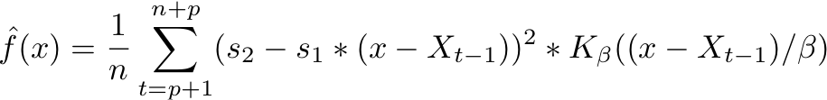
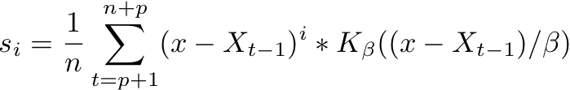
Forward prediction
Explicit solution for our linear least squares problem:

Slide 12
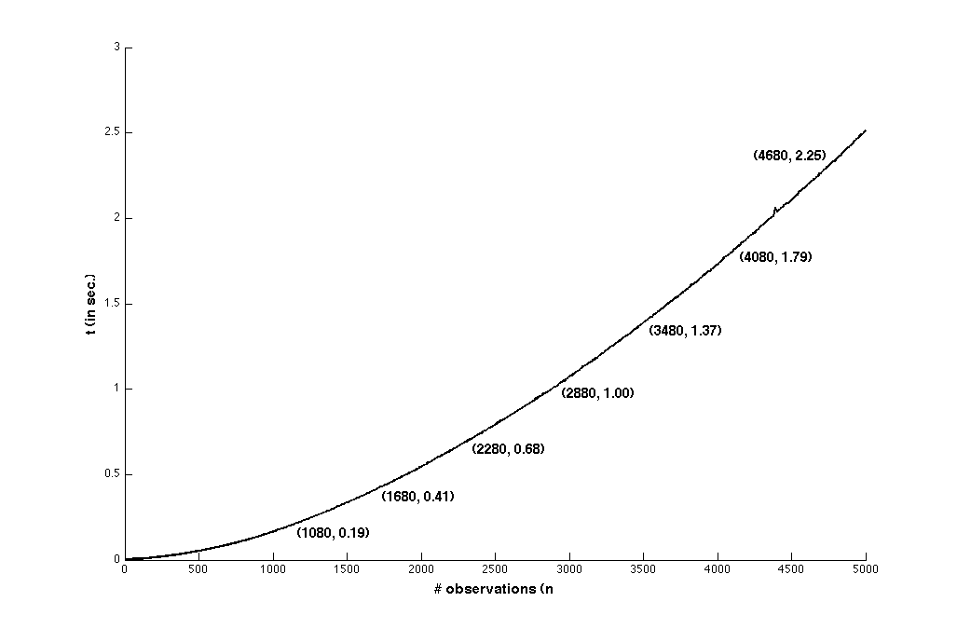
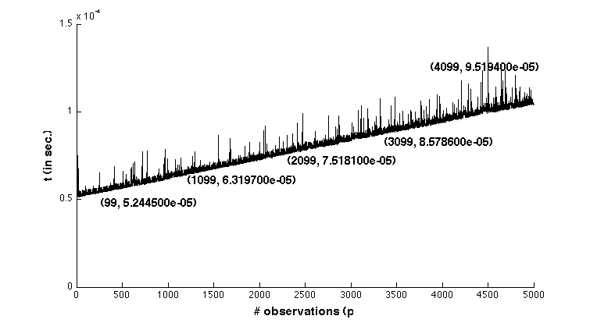


Time Complexity
n future observations
p past observations
Creating a CAP:
Predicting with a CAP:

Slide 13

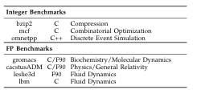

Evaluation
Training Benchmarks
Evaluation Benchmarks

Slide 14
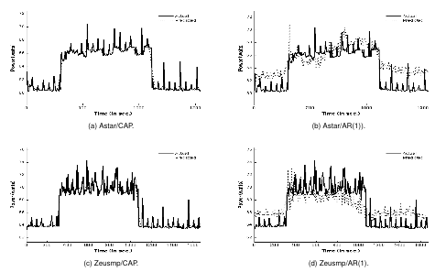
Results: AMD Opteron f10h

Slide 15
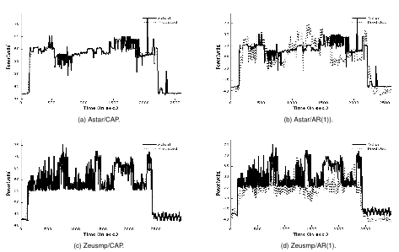
Results: Intel Nehalem

Slide 16
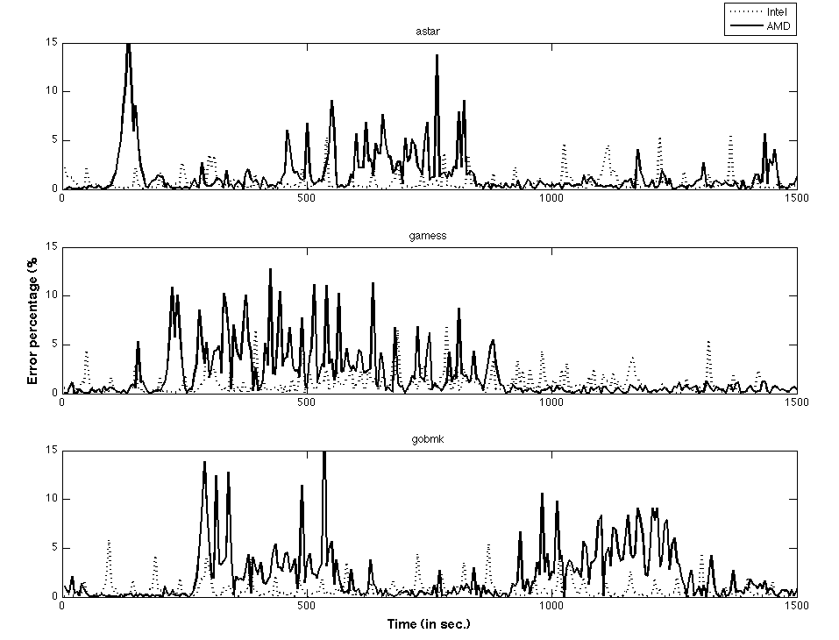
Results: Error - Other Benchmarks

Slide 17
Observations and Analysis
Where does maximum error occur?
Choice of performance counters
  Difference in behavior between processors?
  The right set of performance counters
Benchmark selection

Slide 18
Conclusions
Fast and accurate model
  Addresses non-linearity
  Addresses chaotic dynamics
Future work
  Other workloads
  Other architectures

Slide 19


This work was supported in part by the U.S. Department of Energy and by the Louisiana Board of Regents

Slide 20
Questions?

