Slide 1
Thermal-Aware Scheduling in Multicore Systems Using Chaotic
Attractor Predictors
Adam Wade Lewis and Nian-Feng Tzeng
The Center for Advanced Computer Studies
The University of Louisiana at Lafayette

Slide 2
OS Thread Scheduling
Scheduling...
  in time: who runs next
  in space: who runs where
Optimization problem
  Who runs next: least use of energy with best performance quality of service
  Who runs where: best utilization of resources with least increase in processor and/or ambient temperature

Slide 3
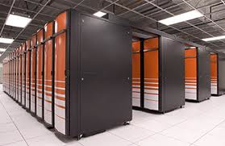




Thread Scheduling & Power Management
DVFS:
SpeedStep
Performance issues [LLBL 2007]
  Lack of slack
  High load = No gain
Reliability issues [Bircher 2008]
  Under-clocking & MTBF
Reactive rather than proactive
Multi-core/Many-core
Cache affinity
Load balancing
Opportunity to turn off the lights?
Notes:
Processor capable of tweaking either V, f, or both
Recent advances support core and component level DVFS
Cache affinity:
run incoming work on previous resource
temporal nature of data in cache
Concentrate workload to be able to turn off resources
Doesn’t help for HPC workloads
Decrease in MTBF

Slide 4
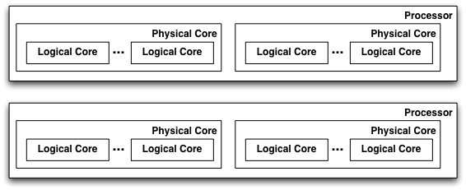

Current Practice: Multicore Servers
Find the set of processors that maximizes performance on the smallest possible number of logical cores
Notes:
The trick is to try pack the workload as tightly as possible to provide the opportunity to turn off unused resources. This assumes that we can trade time for space; in other words, sacrifice time for space. This becomes a problem when we have have workloads that result in high utilization of the processor.

Slide 5
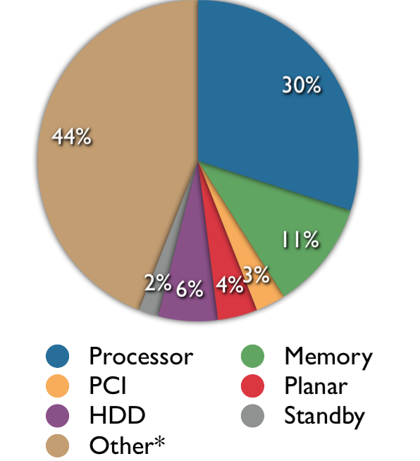




A Full System Energy Model
Source: Intel Corp
[Lewis2008]

Slide 6
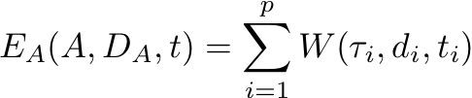
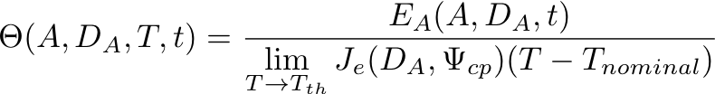

Extensions to System Thermal Modeling
1.
2.
An application A is
composed of p threads
with data set DA with di data
per processor
The energy consumed
by an application for a given workload W
3.
4.
Which is used to compute the
Thermal Efficiency of Application
That is used to compute
Cost of Performance per Unit Power

Slide 7
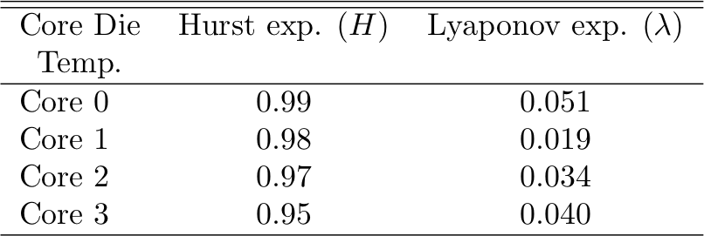
Prediction w/ Chaotic Time Series
Chaotic behavior
Chaotic Time Series
Time-delay reconstructed state space
  Uses Takens Embedding Theorem:
    Time-delayed partition of observations to build function that preserves the topological and dynamical properties of our original chaotic system
Find nearest neighbors on attractor to our observations
Perform least-square curve fit to find a polynomial that approximates the attractor
[Lewis 2008] [Lewis 2010] [Lewis 2012]
Complex dynamics
Non-linear behavior
Notes:
Let’s reconsider our system model
complex dynamics
non-linear behavior
Perhaps the PDEs in our system model are chaotic in nature
Hurst Parameter -> measure of randomness in Brownian motion
Lyapunov Exponent -> topological dimension of the underlying observation
Examine power traces from workloads built from running the SPEC CPU2006 benchmark on two different commodity servers using AMD and Intel processors
Clear indication of chaotic behavior in observations
Use approximation technique whose behavior mirrors that the dynamics of our system model
Find the attractors in our observations
Curve fit to the attractors

Slide 8
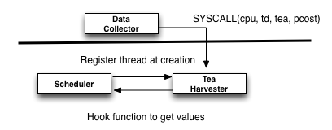
A Thermal Aware Scheduler for FreeBSD
Separate the infrastructure for data collection and computing tCAP predictions

Slide 9
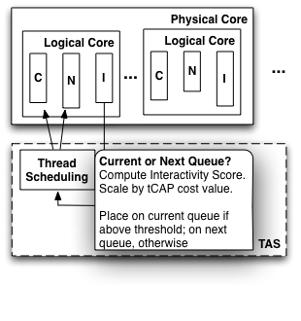
Thread Scheduling
  Start with existing decisions about “interactivity”
  Penalize threads with higher “thermal cost”

Slide 10
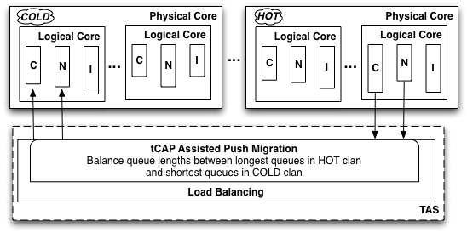
Load Balancing
Accept less performance to provide time for overtaxed resources to recover

Slide 11

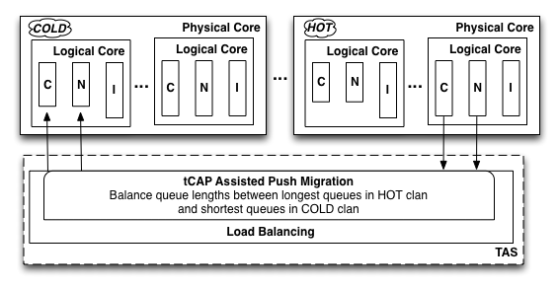
Load Balancing
BEGIN Determine if the logical core is in the Hot, Warm, or Cold clan. For each thread in the run queue BEGIN Use tCAP to estimate resulting temperature change if the thread is executed. END Determine least loaded core in the Cold clan. Migrate the thread with worst impact on temperature to logical core in the Cold clan most suitable from the speed standpoint. END
Most suitable from a speed standpoint?
  Shared last level
  Same processor
  Other processor

Slide 12
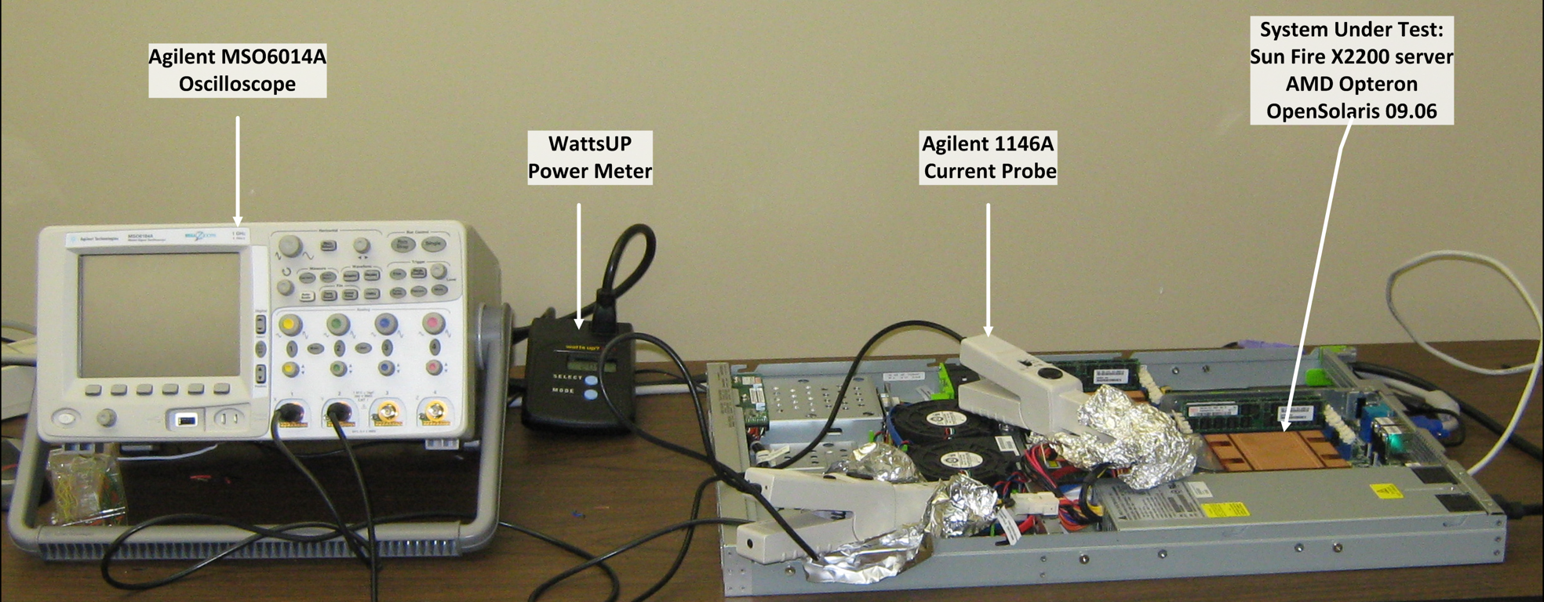
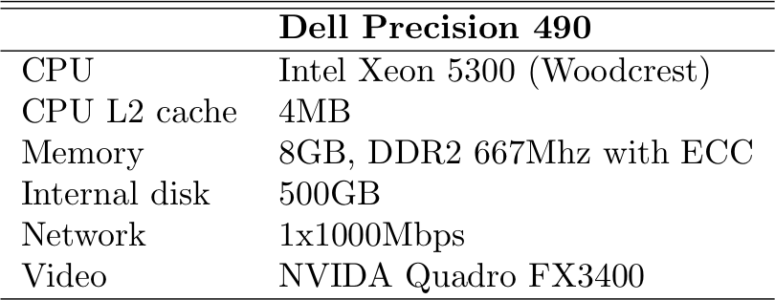



Evaluation Environment
Training Benchmarks
Evaluation Benchmarks
Two extremes
Idle
Stressed
CPU2006
Notes:
The predictive ability of CAP was tested against two commodity servers using server-oriented benchmarks from the SPEC CPU2006 benchmark suite as inputs to training set for CAP and inputs to the evaluation process.

Slide 13
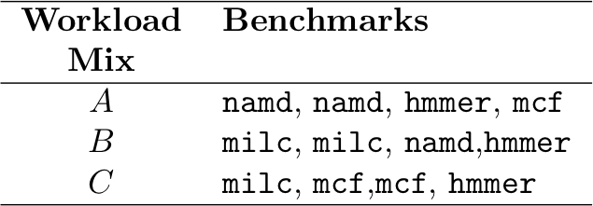
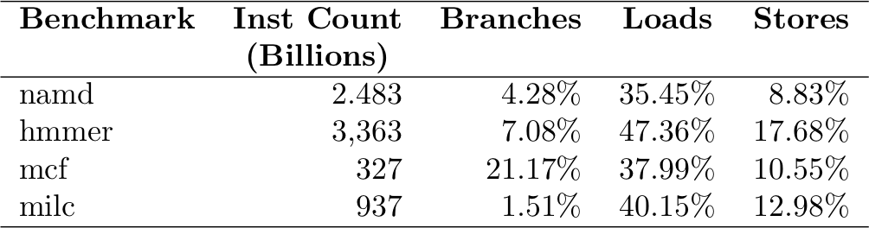
CPU-bound Benchmarks
SPEC CPU2006 benchmarks
Each benchmark is single-threaded
Combine into synthetic workloads
Multiple selection criteria

Slide 14
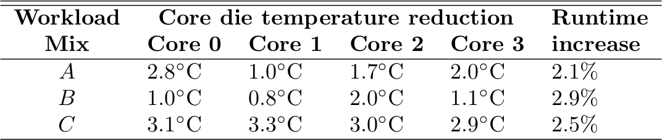
CPU-bound Benchmarks
Threads tend to pin themselves to particular cores
In-line with prior work but
  More aware of cache affinity
  Other methods simulation based

Slide 15
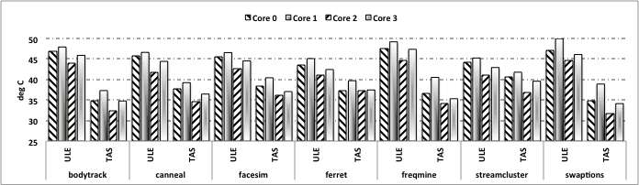
Parallel Benchmarks: Temperature
Better results for benchmarks with smaller working sets
  Lower cache requirements
  Up to 12.8˚C improvement
Benchmarks with streaming functions have much large working sets
  Smaller temperature benefit
  Average 3 to 6˚C improvement vs. ULE

Slide 16
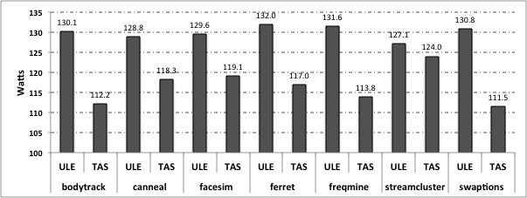
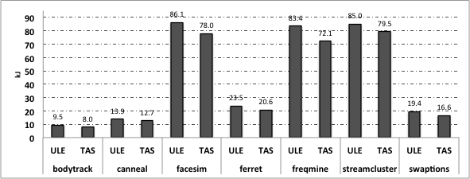
Parallel Benchmarks: Power and Energy
Average power dissipation difference of ~3W to ~21W over all benchmarks
Energy savings from 1.5kJ to 8.1kJ over all benchmarks

Slide 17
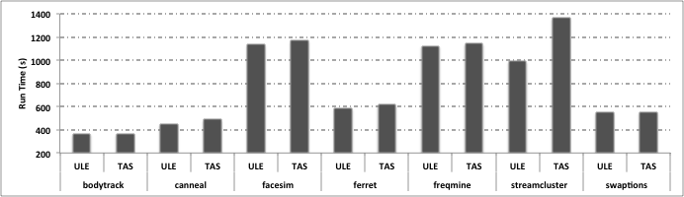
Parallel Benchmarks: Performance
Negligible performance degradation compared to ULE (no more than 3.3%)
Behavior of streamcluster benchmark
  Load balancing and cache affinity

