Slide 1
Architecture Diagram
3 tier Design
TOMCAT
Browser
Mobile Device
Rest Client
jQuery
Jersey 2/JAX-RS 2.0
Java
JPA 2.0/
Hibernate 5[ORM]
Rest Layer
Business Layer
Data/Persistence Layer
MySQL5
Client
Application/Web Server
DataBase Server

Slide 2
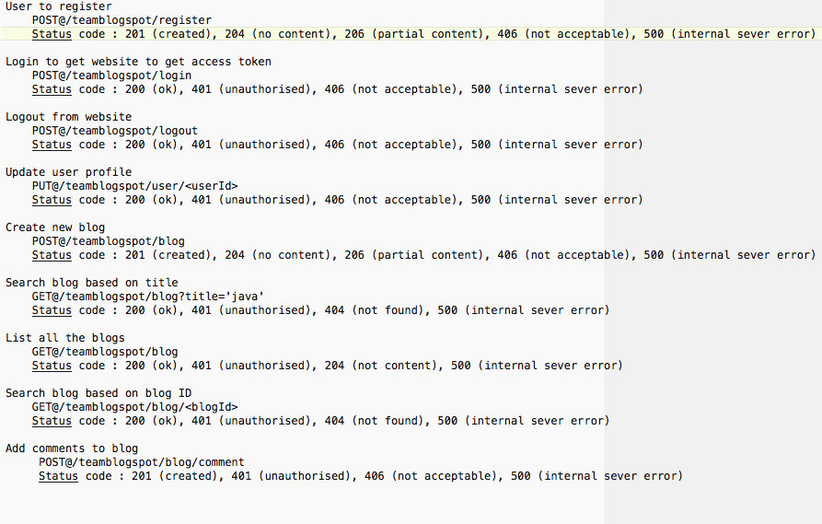
Rest API with HTTP verbs, Status Codes

Slide 3
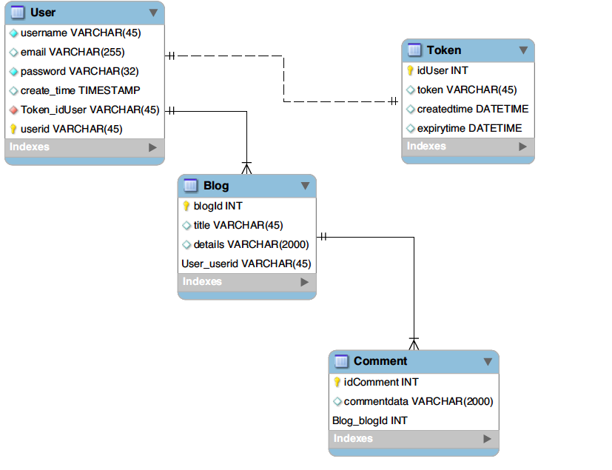
DataBase Schema

Slide 4
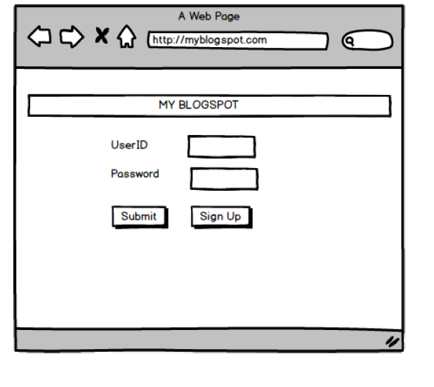
User Interface

Slide 5
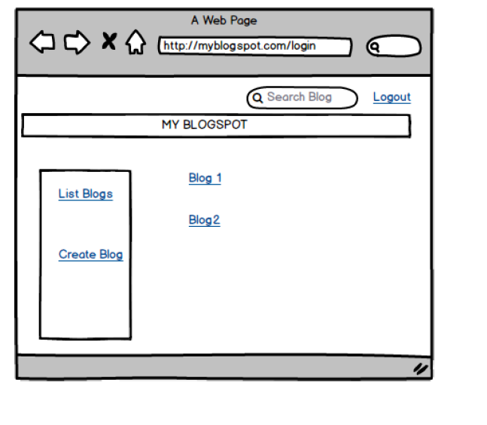
User Interface

Slide 6
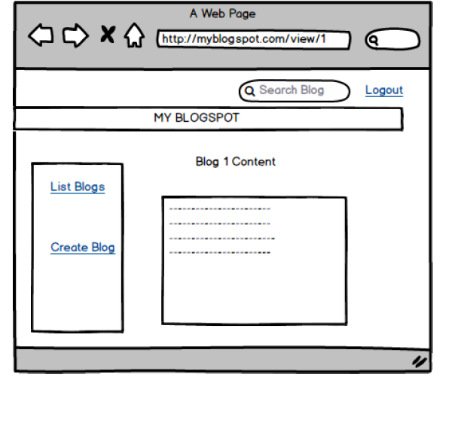
User Interface

Slide 7
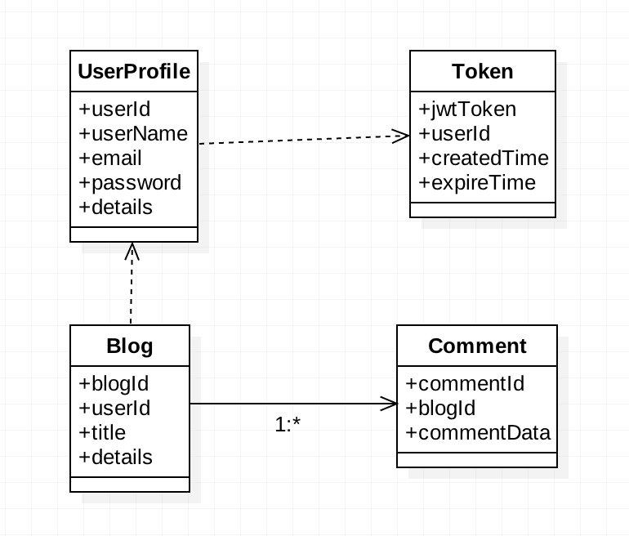
Domain Classes

Slide 8
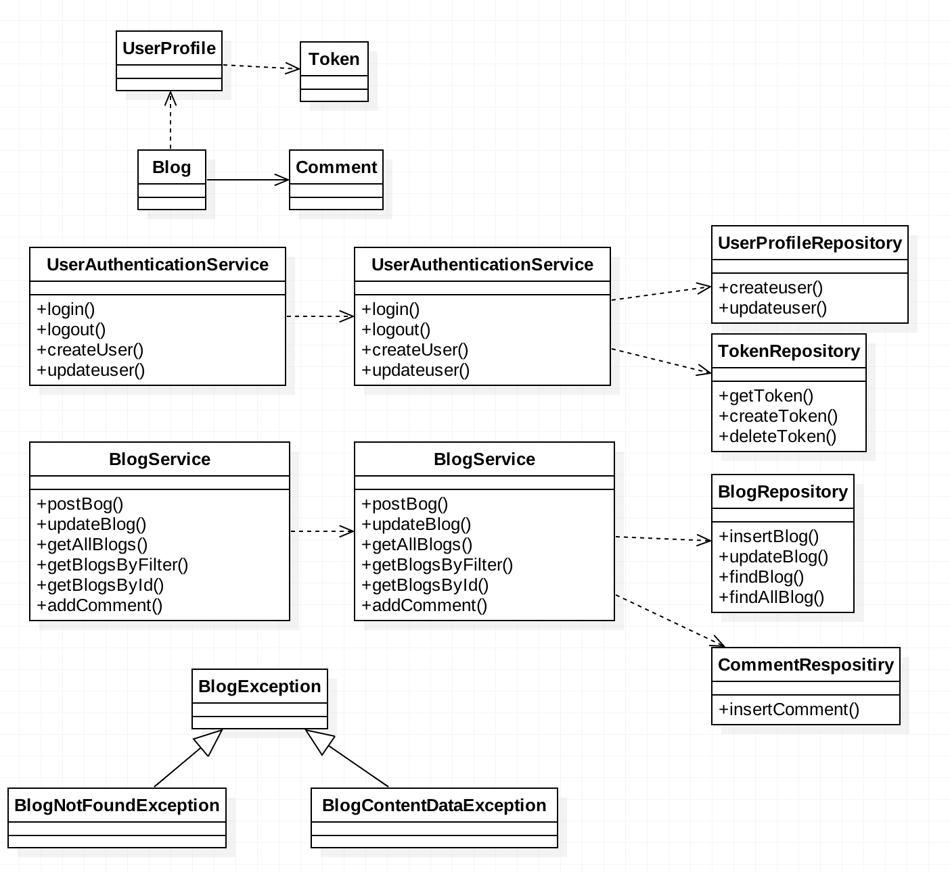
Design Diagram

