Slide 1
T9Blogger
Bino Varghese

Slide 2
Architecture
React
jQuery
Bootstrap
Jersey 2
JAX-RS 2.0
Business logic
Java 1.8
MongoDB
Apache Tomcat webserver 8.5

Slide 3
REST APIs
Sl.No | Rest Url | HTTP Verb | Business Operation
1 | /users | POST | Register New User
2 | /users | PUT | Update User Profile
3 | /users/{userId} | GET | Get User Profile
4 | /users/login | POST | Authenticate User
5 | /blogs | POST | Create Blog
6 | /blogs | GET | Get all blogs
7 | /blogs/{blogId} | GET | View a blog
8 | /blogs/{blogId} | DELETE | Delete a blog
9 | /blogs/{blogId}/comments | GET | Get all comments
10 | /blogs/{blogId}/comments | POST | Post a comment

Slide 4
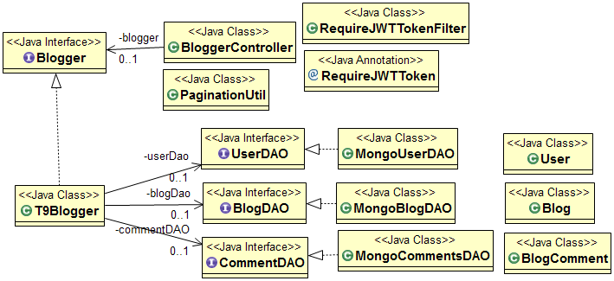
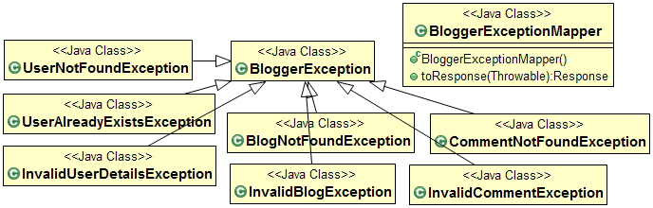
Backend Design

Slide 5
UI Design (React Components)
Blogger
NavBar
BloggerHome
BlogDisplay
BlogAndCommentsScreen
BlogDisplay
CommentDisplay
LoginScreen
NewUser
NewBlog
UserProfile

Slide 6
CI/CD
GitHub
https://github.com/cmad-team9/cmad-t9bloggerV4.git
Jenkins Pipeline (On Google Cloud)
http://146.148.44.101:8080/
Deployment on Google Cloud
http://35.188.12.144/cmad/

Slide 7
Thank you

