Slide 1
Discussion of
Amazon Case Study | DELTTAA
Chad Madding

Slide 2
DELTTAA Data
Data:
Guest ID: credit card bucket of history of what they have bought at Target
The desire to collect information on customers is not new for target or any other large retailer, of course. For decades, Target has collected vast amounts of data on every person who regularly walks into one of its stores. Whenever possible, Target assigns each shopper a unique code—known internally as the Guest ID number—that keeps tabs on everything they buy. “If you use a credit card or a coupon, or fill out a survey, or mail in a refund, or call the customer help line, or open an e-mail we’ve sent you or visit our Web site, we’ll record it and link it to your Guest ID,” Pole said. “We want to know everything we can.”

Slide 3
DELTTAA Data
Data:
Amazon has a bunch of data on you, but you’ve provided it all over the years.
It has a record of everything you’ve purchased, hundreds of items it thinks you’ll like, everything you’ve asked Amazon Alexa and more.
This according to cnbc.com “Here’s how to find what Amazon knows about you”

Slide 4
DELTTAA Enterprise
“Seattle-based e-commerce giant Amazon, is leveraging big data on its 200 million customer accounts by hosting their 1,000,000,000 GB of data on more than 1,400,000 servers to increase sales through predictive analytics. Data is the lifeblood of Amazon, which it uses to ensure that it is doing something special for its customers through personalized recommendations, price optimization, targeted marketing and more. Big data analytics is the magic wand for Amazon that helps form loyal customer relationships in a fierce competitive world by leveraging personal data. The ability to use data and the right to innovate is the building block for Amazon’s debut into Fortune 500 global retail empire.”
https://dzone.com/articles/big-data-analytics-delivering-business-value-at-am

Slide 5
DELTTAA Leadership
“Jeff Bezos and his team at Amazon have revolutionized online shopping for consumers over the last 17 years, with a revenue of $2 billion per year (including its supreme e-commerce and cloud computing services) to show for it. Below is a case study of how Amazon leverages Big Data analysis for its business.”
https://dzone.com/articles/big-data-analytics-delivering-business-value-at-am

Slide 6
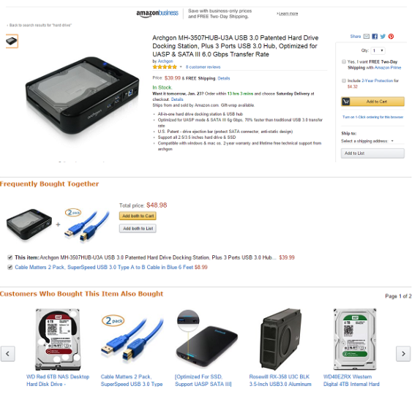
DELTTAA Targets
Below we see that if you select to buy a hard drive in Amazon.com you will also be shown products that are frequently bought with the hard drive and the other choices besides the hard drive that you would like to purchase.

Slide 7
DELTTAA Technologies
Use of Hadoop Technology at Amazon
Amazon has expanded its usage of big data through various tools in the cloud for data storage, data collection, data processing, data sharing and data collaboration. Amazon’s Elastic MapReduce helps the retailer effectively manage and use the analytics platform, built on top of Hadoop framework. The product catalogue data of about 1.5 billion products in the retail store, spread across 200 fulfilment centres across the globe and stored in Amazon S3 interface, receives close to 50 million updates every week. The product catalog of data in S3 is crunched every 30 minutes and sent back to various data warehouses.
https://dzone.com/articles/big-data-analytics-delivering-business-value-at-am

Slide 8
DELTTAA Analytical Techniques
Personalized Recommendations at Amazon
Amazon is winning the heart of its customers by analyzing big data to find what customers actually buy, what they are searching for and what actually they need.
Amazon generates an additional 10%-30% revenue in response to the recommended suggestions it offers to its customers. Amazon is the pioneer in mining the big data to provide personalization to entice customers with a curated shopping experience. With more than 2 million sellers across 10 countries serving close to 200 million customers - Amazon provides personalized recommendations to its customers through its super innovative data-driven technology.
Amazon thinks of its customers in two ways-
Amazon-buying customers
Sellers on the Amazon Marketplace
Amazon recommendation algorithms incorporate various factors like- purchase history, browsing history, impact of friends, trends for a particular product, social media mentions on the popularity of a product, purchases made by customers with similar purchase history, etc. before they recommend a product to a customer. Amazon is always on the verge of refining its recommendation algorithms with a quest to better serve its customers.
https://dzone.com/articles/big-data-analytics-delivering-business-value-at-am

Slide 9
DELTTAA Analytical Techniques
Dynamic Price Optimization at Amazon
Price optimization is an important factor in the retail market as retailers struggle to offer best price on each product. Price management is monitored closely at Amazon to attract buyers, win the battle against other competitors and grow the business on profit margins.
Dynamic pricing helped Amazon boost profits by 25% on an average and they stay competitive by monitoring the price 24x7, 365 days. Amazon increased its sales by 27.2% from 2012 to 2013 and made an entry into the list of top 10 retailers in US for the first time. Product pricing strategy at Amazon supports real-time pricing by considering data from various sources like customer activity on the website, available inventory of a product, competitor pricing for a product, order history, preferences set for a product, expected margin on the product, and more. Amazon changes the price of its products every 10 minutes.
https://dzone.com/articles/big-data-analytics-delivering-business-value-at-am

Slide 10
DELTTAA Analysts
Andrew Pole had just started working as a statistician for Target in 2002, when two colleagues from the marketing department stopped by his desk to ask an odd question: “If we wanted to figure out if a customer is pregnant, even if she didn’t want us to know, can you do that?”

Slide 11


DELTTAA Analysts

Slide 12
DELTTAA Analysts
About
Energetic data executive with a demonstrated history of building high-performing data science teams and delivering strategic analytic projects.
Proven track record of influencing and disrupting business models of large international organizations with strategic insights and implementation of data-driven solutions.

Slide 13
Discussion of
Amazon Case Study | FACE
Chad Madding

Slide 14
FACE
Framing the problem
Problem recognition
Review of previous findings
Modeling approach
Solving the problem
Data collection
Modeling
Data analysis
Communicating and acting on results
Results presentation and action, i.e., “telling a story”
Creating impactful visualization
Embedding final models and methods in enterprise business processes and systems

Slide 15
FACE
Framing the problem
Problem recognition
Seattle-based e-commerce giant Amazon, is leveraging big data on its 200 million customer accounts by hosting their 1,000,000,000 GB of data on more than 1,400,000 servers to increase sales through predictive analytics. Data is the lifeblood of Amazon, which it uses to ensure that it is doing something special for its customers through personalized recommendations, price optimization, targeted marketing and more. Big data analytics is the magic wand for Amazon that helps form loyal customer relationships in a fierce competitive world by leveraging personal data. The ability to use data and the right to innovate is the building block for Amazon’s debut into Fortune 500 global retail empire.

Slide 16
FACE
Framing the problem
Problem recognition:
Review of previous findings
“Data is Power” is the success mantra at Amazon. Just look at your Amazon homepage, it is never the same. Amazon tracks everything you do at the e-commerce website and app - to collect as much data as it can. A look at the “Account” section on Amazon will give an idea about the robust account management they have, to collect data from its customers. With various sections on the homepage like – “Inspired by Your Wish List,” “Recommendations for You,” “Inspired by Your Browsing History,” “Related to Items You Have Viewed,” “Customers Who Bought This Item Also Bought,” Amazon is continuously tracking what their customers do - to provide them a personalized preeminent shopping experience.

Slide 17
FACE
Solving the problem
Data collection
Seattle-based e-commerce giant Amazon, is leveraging big data on its 200 million customer accounts by hosting their 1,000,000,000 GB of data on more than 1,400,000 servers to increase sales through predictive analytics. Data is the lifeblood of Amazon, which it uses to ensure that it is doing something special for its customers through personalized recommendations, price optimization, targeted marketing and more. Big data analytics is the magic wand for Amazon that helps form loyal customer relationships in a fierce competitive world by leveraging personal data. The ability to use data and the right to innovate is the building block for Amazon’s debut into Fortune 500 global retail empire.

Slide 18
FACE
Solving the problem
Data collection
Modeling
Amazon has expanded its usage of big data through various tools in the cloud for data storage, data collection, data processing, data sharing and data collaboration. Amazon’s Elastic MapReduce helps the retailer effectively manage and use the analytics platform, built on top of Hadoop framework. The product catalogue data of about 1.5 billion products in the retail store, spread across 200 fulfilment centers across the globe and stored in Amazon S3 interface, receives close to 50 million updates every week. The product catalog of data in S3 is crunched every 30 minutes and sent back to various data warehouses.
https://dzone.com/articles/big-data-analytics-delivering-business-value-at-am

Slide 19
FACE
Solving the problem
Data collection
Modeling
Data analysis
Amazon is winning the heart of its customers by analyzing big data to find what customers actually buy, what they are searching for and what actually they need.
Amazon generates an additional 10%-30% revenue in response to the recommended suggestions it offers to its customers. Amazon is the pioneer in mining the big data to provide personalization to entice customers with a curated shopping experience. With more than 2 million sellers across 10 countries serving close to 200 million customers - Amazon provides personalized recommendations to its customers through its super innovative data-driven technology.
https://dzone.com/articles/big-data-analytics-delivering-business-value-at-am

Slide 20
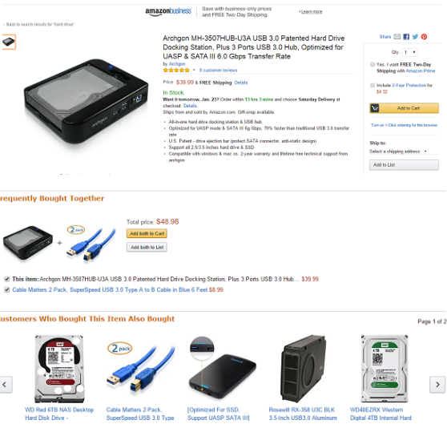
FACE
Communicating and acting on results
Results presentation and action, i.e., “telling a story”
Creating impactful visualization
See that if you select to buy a hard drive in Amazon.com you will also be shown products that are frequently bought with the hard drive and the other choices besides the hard drive that you would like to purchase.
https://dzone.com/articles/big-data-analytics-delivering-business-value-at-am

Slide 21
FACE
Embedding final models and methods in enterprise business processes and systems
Amazon has obtained a big take-over among its competitors by acquiring a patent for Anticipatory Shipping to make quicker deliveries. It has patented the process of shipping a product to a customer with an expectancy that the customer will order that product based on the power of predictive analytics. The patent signifies that Amazon believes, that the predictive analytics systems will become so accurate that they will be able to predict what a customer will buy and when.
https://dzone.com/articles/big-data-analytics-delivering-business-value-at-am

Slide 22

FACE: The Pachinko Machine!

Slide 23
Frame and Solve:
Analytics Solution Approach
Decision
What will you buy next? This is an ongoing decision.
One time or ongoing?
Predictive
Amazon can show you what it predicts you will buy next ?
Prescriptive
What does Amazon prescribe to show you what you will buy?
Stochastic
At the end of the day Amazon is forecasting/predicting what you will buy next.
Probabilistic statistical
Clustering, logistic regression, LDA, RF are all possible stochastic/statistical models to employ to estimate the probability of what you will buy next.
Clustering, logistic regression, LDA, RF are all possible stochastic/statistical models to employ to estimate the probability of what you will buy next.
R, SAS,
SPSS,Python

