Slide 1
Introduction
Doug Gray

Slide 2
Methodologies
Four pillars
Five stages
DELTTA
FACE

Slide 4
Introduction to Target Case Study
Doug Gray

Slide 5
Target Stores:
The Case of the Pregnant Teenager
http://www.forbes.com/sites/kashmirhill/20 12/02/16/how-target-figured-out-a-teen- girl-was-pregnant-before-her-father-did/
https://www.nytimes.com/2012/02/19/mag azine/shopping- habits.html?pagewanted=1&_r=1&hp

Slide 7
Discussion of
Target Case Study | DELTTAA
Doug Gray

Slide 8
DELTTAA Data
Data:
Guest ID: credit card bucket of history of what they have bought at Target
The desire to collect information on customers is not new for target or any other large retailer, of course. For decades, Target has collected vast amounts of data on every person who regularly walks into one of its stores. Whenever possible, Target assigns each shopper a unique code—known internally as the Guest ID number—that keeps tabs on everything they buy. “If you use a credit card or a coupon, or fill out a survey, or mail in a refund, or call the customer help line, or open an e-mail we’ve sent you or visit our Web site, we’ll record it and link it to your Guest ID,” Pole said. “We want to know everything we can.”

Slide 9
DELTTAA Data
Data:
Buying purchasing and demographic information from other sources
Also linked to your Guest ID is demographic information like your age, whether you are married and have kids, which part of town you live in, how long it takes you to drive to the store, your estimated salary, whether you’ve moved recently, what credit cards you carry in your wallet and what Web sites you visit. Target can buy data about your ethnicity, job history, the magazines you read, if you’ve ever declared bankruptcy or got divorced, the year you bought (or lost) your house, where you went to college, what kinds of topics you talk about online, whether you prefer certain brands of coffee, paper towels, cereal, or applesauce, your political leanings, reading habits, charitable giving, and the number of cars you own. (In a statement, Target declined to identify what demographic information it collects or purchases.)

Slide 10
DELTTAA Data
Data:
Baby registry data
The only problem is that identifying pregnant customers is harder than it sounds. Target has a baby-shower registry, and Pole started there, observing how shopping habits changed as a woman approached her due date, which women on the registry had willingly disclosed. He ran test after test, analysing the data, and before long some useful patterns emerged.

Slide 11
DELTTAA Enterprise
Almost every major retailer, from grocery chains to investment banks to the U.S. Postal Service, has a “predictive analytics” department devoted to understanding not just consumers’ shopping habits but also their personal habits, so as to more efficiently market to them. “But Target has always been one of the smartest at this,” says Eric Siegel, a consultant and the chairman of a conference called Predictive Analytics World. “We’re living through a golden age of behavioral research. It’s amazing how much we can figure out about how people think now.”

Slide 12
DELTTAA Leadership
Soon after the new ad campaign began, Target’s Mom and Baby sales exploded. The company doesn’t break out figures for specific divisions, but between 2002—when Pole was hired—and 2010, Target’s revenues grew from $44 billion to $67 billion. In 2005, the company’s president, Gregg Steinhafel, boasted to a room of investors about the company’s “heightened focus on items and categories that appeal to specific guest segments such as mom and baby.”

Slide 13
DELTTAA Leadership
Pole applied his program to every regular female shopper in Target’s national database and soon had a list of tens of thousands of women who were most likely pregnant. If they could entice those women or their husbands to visit Target and buy baby-related products, the company’s cue-routine- reward calculators could kick in and start pushing them to buy groceries, bathing suits, toys and clothing, as well.
When Pole shared his list with the marketers, he said, they were ecstatic. Soon, Pole was getting invited to meetings above his paygrade. Eventually his paygrade went up.
Eventually, he became more of the leadership!

Slide 14
DELTTAA Targets
There are, however, some brief periods in a person’s life when old routines fall apart and buying habits are suddenly in flux. One of those moments—the moment, really—is right around the birth of a child, when parents are exhausted and overwhelmed and their shopping patterns and brand loyalties are up for grabs. But as Target’s marketers explained to Pole, timing is everything. Because birth records are usually public, the moment a couple have a new baby, they are almost instantaneously barraged with offers and incentives and advertisements from all sorts of companies. Which means that the key is to reach them earlier, before any other retailers know a baby is on the way. Specifically, the marketers said they wanted to send specially designed ads to women in their second trimester, which is when most expectant mothers begin buying all sorts of new things, like prenatal vitamins and maternity clothing. “Can you give us a list?” the marketers asked.
In other words:
Can you identify women that are pregnant before they deliver?
Can you identify women in the second trimester?

Slide 15


DELTTAA Technologies
Proficiency in data
analytics languages such as SQL, R, Python.
Card scanning infrastructure for “Guest ID” tracking.
Proficiency in
big data technologies such as Hadoop, Hive, Spark
Search “target data scientist” in glassdoor: https://www.glassdoor.com/index.htm

Slide 16
DELTTAA Analytical Techniques
3+ years of experience
in large scale A/B and multivariate testing, or other relevant work in design of experiments.
Conceivable techniques: Clustering for customer segmentation
Expertise in either
statistical modeling or machine learning (deep learning).
Search “target data scientist” in glassdoor: https://www.glassdoor.com/index.htm

Slide 17
DELTTAA Analysts
Andrew Pole had just started working as a statistician for Target in 2002, when two colleagues from the marketing department stopped by his desk to ask an odd question: “If we wanted to figure out if a customer is pregnant, even if she didn’t want us to know, can you do that?”

Slide 18
DELTTAA Analysts
Pole has a master’s degree in statistics and another in economics, and has been obsessed with the intersection of data and human behaviour most of his life. His parents were teachers in North Dakota, and while other kids were going to 4-H, Pole was doing algebra and writing computer programs. “The stereotype of a math nerd is true,” he told me when I spoke with him last year. “I kind of like going out and evangelizing analytics.”

Slide 19
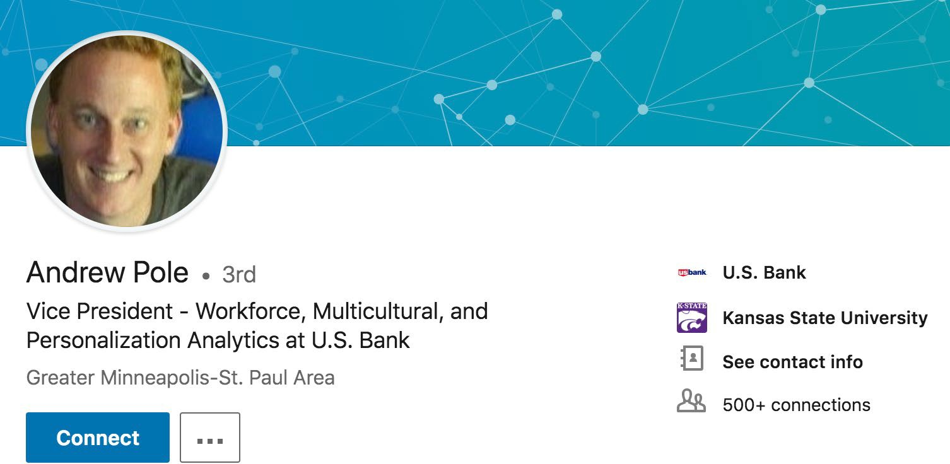

DELTTAA Analysts

Slide 20
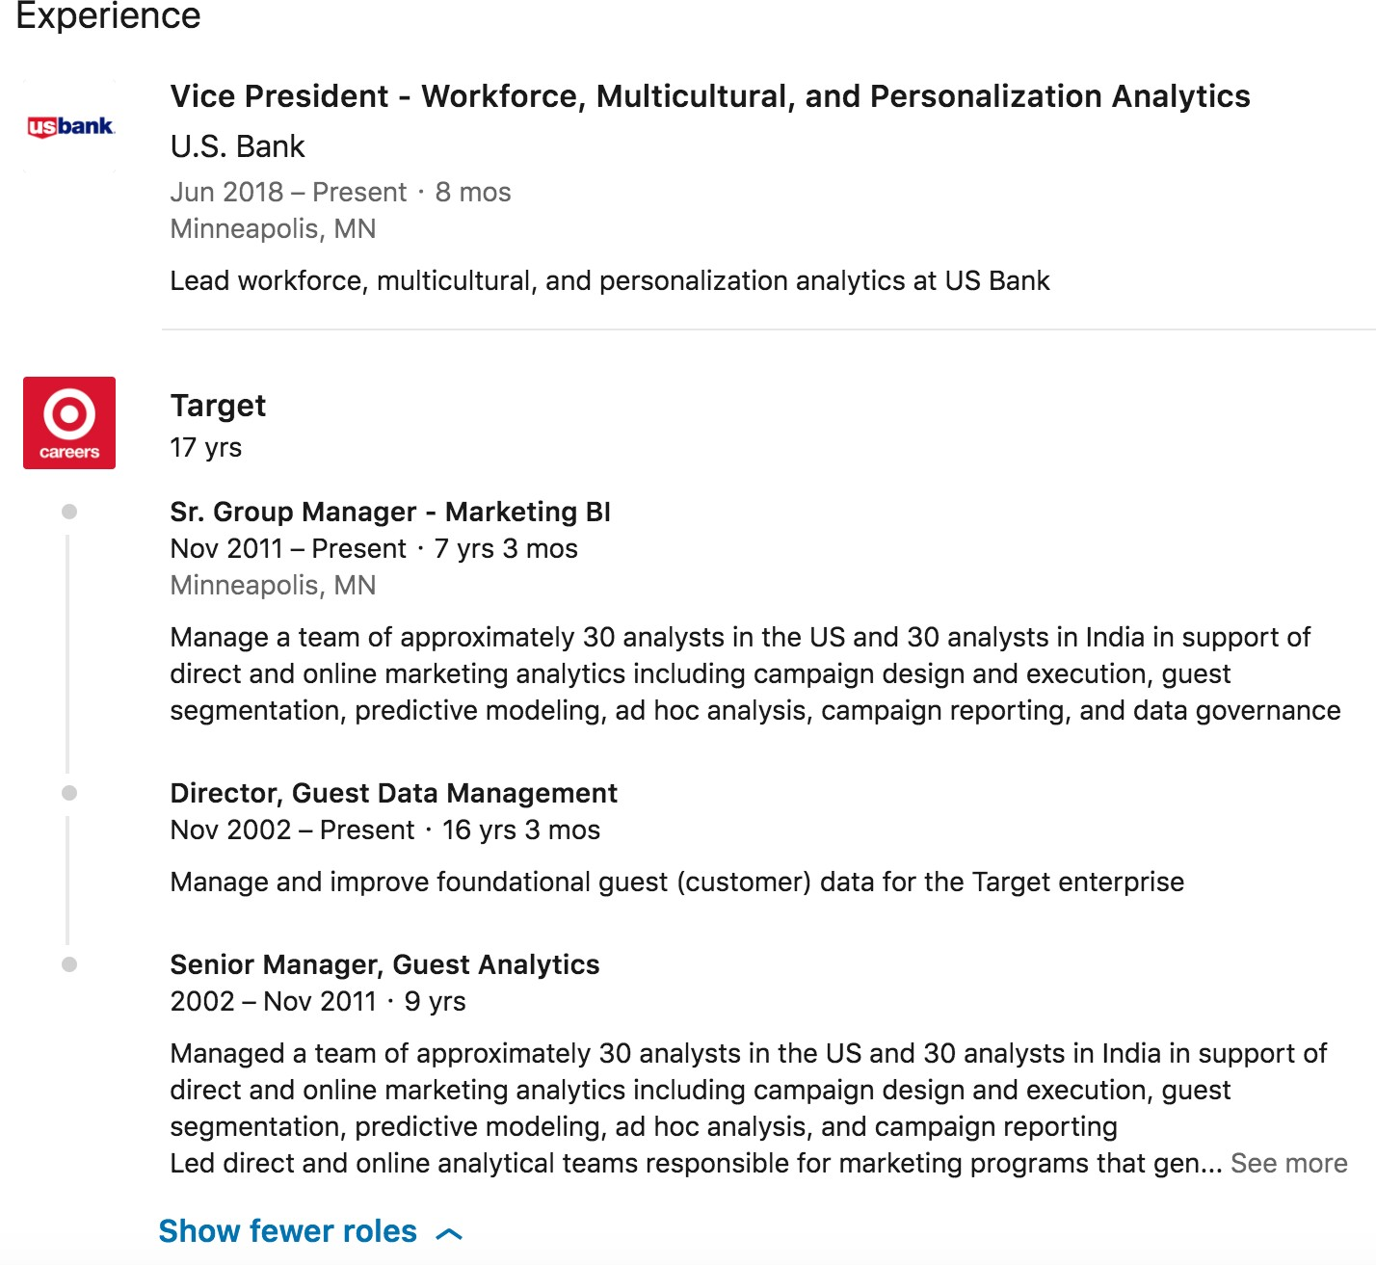
DELTTAA Analysts

Slide 22
Discussion of
Target Case Study | FACE
Doug Gray

Slide 23
FACE
Framing the problem
Problem recognition
Review of previous findings
Modeling approach
Solving the problem
Data collection
Modeling
Data analysis
Communicating and acting on results
Results presentation and action, i.e., “telling a story”
Creating impactful visualization
Embedding final models and methods in enterprise business processes and systems

Slide 24
FACE
Framing the problem
Problem recognition
Andrew Pole had just started working as a statistician for Target in 2002, when two colleagues from the marketing department stopped by his desk to ask an odd question: “If we wanted to figure out if a customer is pregnant, even if she didn’t want us to know, can you do that?”

Slide 25
FACE
Framing the problem
Problem recognition:
Andrew Pole was hired by Target to use the same kinds of insights into consumers’ habits to expand Target’s sales. His assignment was to analyse all the cue-routine-reward loops among shoppers and help the company figure out how to exploit them. Much of his department’s work was straightforward: find the customers who have children and send them catalogs that feature toys before Christmas. Look for shoppers who habitually purchase swimsuits in April and send them coupons for sunscreen in July and diet books in December. But Pole’s most important assignment was to identify those unique moments in consumers’ lives when their shopping habits become particularly flexible and the right advertisement or coupon would cause them to begin spending in new ways. And among life events, none are more important than the arrival of a baby. At that moment, new parents’ habits are more flexible than at almost any other time in their adult lives. If companies can identify pregnant shoppers, they can earn millions.

Slide 26
FACE
Framing the problem
Problem recognition:
Review of previous findings
The reason Target can snoop on our shopping habits is that, over the past two decades, the science of habit formation has become a major field of research in neurology and psychology departments at hundreds of major medical centers and universities, as well as inside extremely well financed corporate labs. "It's like an arms race to hire statisticians nowadays," said Andreas Weigend, the former chief scientist at Amazon.com.
…
exist. One study from Duke University estimated that habits, rather than conscious decision-making, shape 45 percent of the choices we make every day, and recent discoveries have begun to change everything from the way we think about dieting to how doctors conceive treatments for anxiety, depression, and addictions.

Slide 27
FACE
Framing the problem
Problem recognition:
Review of previous findings
Modeling approach

Slide 28
FACE
Solving the problem
Data collection
The only problem is that identifying pregnant customers is harder than it sounds. Target has a baby-shower registry, and Pole started there, observing how shopping habits changed as a woman approached her due date, which women on the registry had willingly disclosed. He ran test after test, analysing the data, and before long some useful patterns emerged.

Slide 29
FACE
Solving the problem
Data collection
The desire to collect information on customers is not new for Target or any other large retailer, of course. For decades, Target has collected vast amounts of data on every person who regularly walks into one of its stores. Whenever possible, Target assigns each shopper a unique code—known internally as the Guest ID number—that keeps tabs on everything they buy. “If you use a credit card or a coupon, or fill out a survey, or mail in a refund, or call the customer help line, or open an e-mail we’ve sent you or visit our Web site, we’ll record it and link it to your Guest ID,” Pole said. “We want to know everything we can.”

Slide 30
FACE
Solving the problem
Data collection
Also linked to your Guest ID is demographic information like your age, whether you are married and have kids, which part of town you live in, how long it takes you to drive to the store, your estimated salary, whether you’ve moved recently, what credit cards you carry in your wallet and what web sites you visit. Target can buy data about your ethnicity, job history, the magazines you read, if you’ve ever declared bankruptcy or got divorced, the year you bought (or lost) your house, where you went to college, what kinds of topics you talk about online, whether you prefer certain brands of coffee, paper towels, cereal or applesauce, your political leanings, reading habits, charitable giving and the number of cars you own. (In a statement, Target declined to identify what demographic information it collects or purchases.)

Slide 31
FACE
Solving the problem
Data collection
Modeling
Andrew Pole had just started working as a statistician for Target in 2002, when two colleagues from the marketing department stopped by his desk to ask an odd question: “If we wanted to figure out if a customer is pregnant, even if she didn’t want us to know, can you do that?”
Predicting Pregnant / Not Pregnant: Logistic Regression, SVM, LDA, Latent Class Modeling, Random Forest, CHAID, KNN

Slide 32
FACE
Solving the problem
Data collection
Modeling
As Pole’s computers crawled through the data, he was able to identify about 25 products that, when analysed together, allowed him to assign each shopper a “pregnancy prediction” score. More important, he could also estimate her due date to within a small window, so Target could send coupons timed to very specific stages of her pregnancy.
Predicting Due Date: Multiple Linear Regression, Random Forest, Neural Networks

Slide 33
FACE
Solving the problem
Data collection
Modeling
Data analysis
date, which women on the registry had willingly disclosed. He ran test after test, analysing the data, and before long some useful patterns emerged. Lotions, for example. Lots of people buy lotion, but one of Pole’s colleagues noticed that women on the baby registry were buying larger quantities of unscented lotion around the beginning of their second trimester. Another analyst noted that sometime in the first 20 weeks, pregnant women loaded up on supplements like calcium, magnesium and zinc. Many shoppers purchase soap and cotton balls, but when someone suddenly starts buying lots of scent-free soap and extra-big bags of cotton balls, in addition to hand sanitizers and washcloths, it signals they could be getting close to their delivery date.

Slide 34
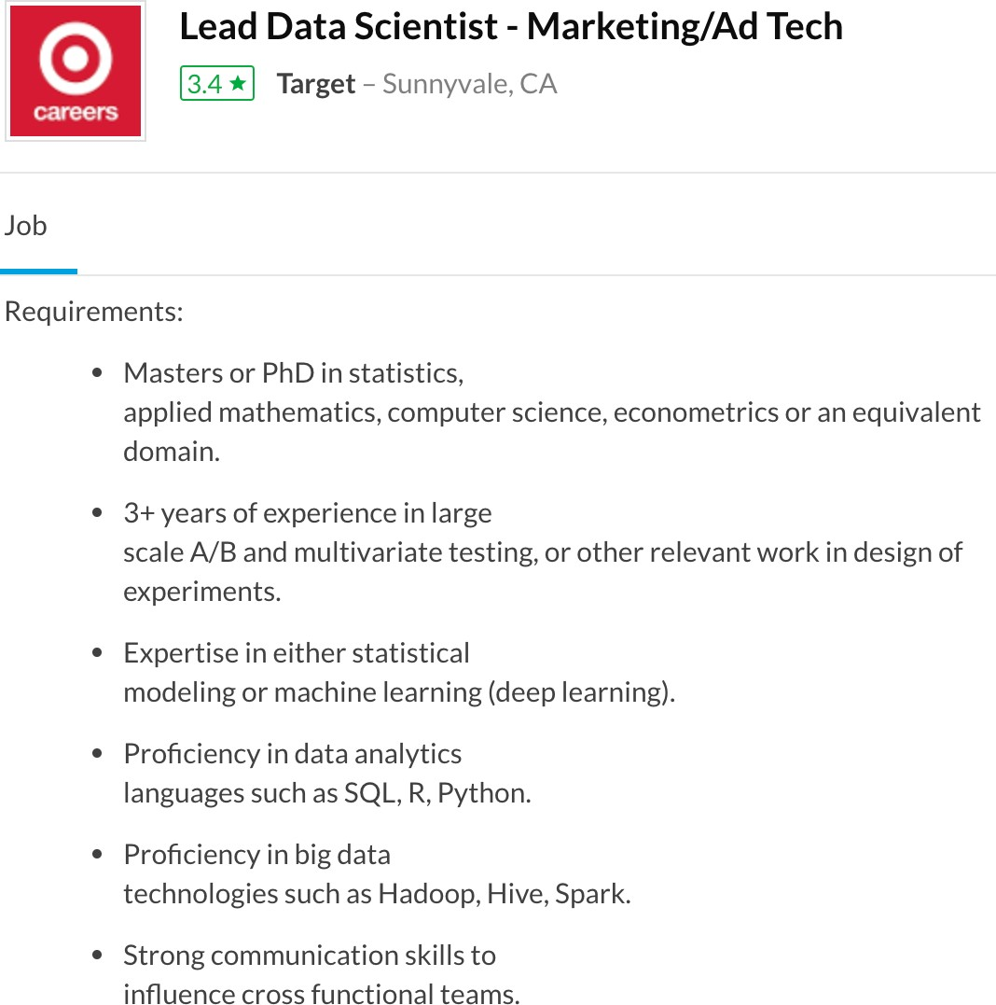

FACE
Communicating and acting on results
Results presentation and action, i.e., “telling a story”
Creating impactful visualization

Slide 35
FACE
Embedding final models and methods in enterprise business processes and systems
know a baby is on the way. Specifically, the marketers said they wanted to send specially designed ads to women in their second trimester, which is when most expectant mothers begin buying all sorts of new things, like prenatal vitamins and maternity clothing. “Can you give us a list?” the marketers asked.
Pole applied his program to every regular female shopper in Target’s national database and soon had a list of tens of thousands of women who were most likely pregnant. If they could entice those women or their husbands to visit Target and buy baby-related products, the company’s cue- routine-reward calculators could kick in and start pushing them to buy groceries, bathing suits, toys and clothing, as well. When Pole shared his list with the marketers, he said, they were ecstatic. Soon, Pole was getting invited to meetings above his paygrade. Eventually his paygrade went up.

Slide 36
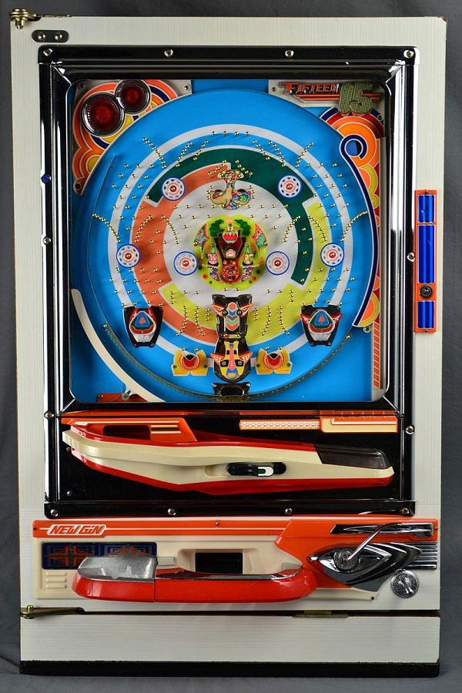
FACE: The Pachinko Machine!

Slide 37
Frame and Solve:
Analytics Solution Approach
Decision
Problem
Opportunity
One time or ongoing?
Descriptive
Diagnostic
Predictive
Prescriptive
BI/Reporting Tableau Microstrategy
SAP Business Objects Pentaho
Stochastic
Hybrid
Deterministic
Analytics modeling methods
Evaluative simulation
Probabilistic statistical
Normative optimization
Analytics modeling technologies
Arena, Simio, Simul8
R, SAS,
SPSS,Python
CPLEX, Xpress, Gurobi

Slide 38
Frame and Solve:
Analytics Solution Approach
Whom should we market to? Who is likely pregnant?
Decision
One time or ongoing?
Predictive
Who do we predict is pregnant?
Prescriptive
Who do we prescribe marketing to send coupon too? (And what type of coupons?)
At the end of the day we are forecasting/predicting who is pregnant.
Stochastic
Probabilistic statistical
Clustering, logistic regression, LDA, RF are all possible stochastic/statistical models to employ to estimate the probability of being pregnant.
Clustering, logistic regression, LDA, RF are all possible stochastic/statistical models to employ to estimate the probability of being pregnant.
R, SAS,
SPSS,Python

Slide 40
Introduction to Additional Case Studies
Doug Gray

Slide 42
Additional Case Studies
Doug Gray

Slide 43
Uber / Lyft / Didi Chuxing
How do they know what to charge?
https://www.fastcompany.com/company/uber
https://www.investopedia.com/articles/personal- finance/111015/story-uber.asp
https://www.forbes.com/sites/bizcarson/2018/09/19/where- uber-is-winning-the-world-and-where-it-has- lost/#62e92f0b4d6e
https://www.forbes.com/sites/jinshanhong/2017/08/03/how- chinas-ride-hailing-king-didi-is-taking-over-the-world-before- uber-can/#2eab47cd3fd8
https://www.forbes.com/sites/bernardmarr/2018/11/26/ai-in- china-how-uber-rival-didi-chuxing-uses-machine-learning-to- revolutionize-transportation/#3b7a64326732

Slide 44
Walmart
Home of the 13 petabyte data warehouse
Descriptive analytics on steroids

Slide 45
UPS ORION
Road integrated optimization and navigation
120 deliveries per day each by 55,000 drivers
120 uniquely different routes to deliver them https://www.ups.com/us/en/services/knowledge- center/article.page?name=orion-the-algorithm-
proving-that-left-isn-t-right&kid=aa3710c2
https://www.pressroom.ups.com/pressroom/Conte ntDetailsViewer.page?ConceptType=Factsheets&i d=1426321616277-282

Slide 46
Netflix
How many copies of Top Gun to buy and where to store them?
http://www.cnet.com/news/netflix-awards-1- million-for-outdoing-cinematch/

Slide 48
Introduction to Amazon Case Study
Doug Gray

Slide 49
Amazon
How did they know you like Tom Clancy
novels, and how do they get them to you?
http://www.wired.com/2015/10/get-used-to- amazon-being-a-profitable-company/

Slide 51
Discussion of Amazon Case Study | DELTTAA
Doug Gray

Slide 52
Amazon Retail DELTTAA
“We never throw any data away, regardless of whether or not we know what we are going to do with it.”
— Jeff Bezos
310M+ customers
400M SKUs
Thousands of suppliers
Demand patterns
Shipment times
Storage locations
Supplier data
Shortage costs
Holding costs

Slide 53
Amazon Retail DELTTAA
“Supply Chain Optimization Technologies (SCOT) is the core of Amazon Retail and has streamlined, automated, and optimized 100% of every aspect of our retail supply chain processes, decision-making enterprise-wide using predictive and prescriptive analytics”
310M+ customers
400M SKUs
Thousands of suppliers
How much to buy?
Shipment times
Storage locations
Where to store it?
Shortage costs
Holding costs

Slide 54


Amazon Retail DELTTAA
“Supply chain optimization technologies (SCOT) is the core of Amazon Retail and has streamlined, automated, and optimized 100% of every aspect of our retail supply chain processes, decision-making enterprise-wide using predictive and prescriptive analytics.”
Dr. Gang Yu
Wharton School, University of Pennsylvania
PhD, Operations Research VP World Wide Supply Chain Operations
“We never throw any data away, regardless of whether or not we know what we are going to do with it.”
— Jeff Bezos
Jeff Bezos Princeton University
B.S. Electrical Engineering and Computer Science Chairman and CEO
http://www.se.cuhk.edu.hk/yu-gang

Slide 55


Amazon Retail DELTTAA
Inventory turns
Delivery time performance
Lead times
YOY sales growth
Shortage costs
Holding costs
Gross margin
Targets
Delivery costs

Slide 56





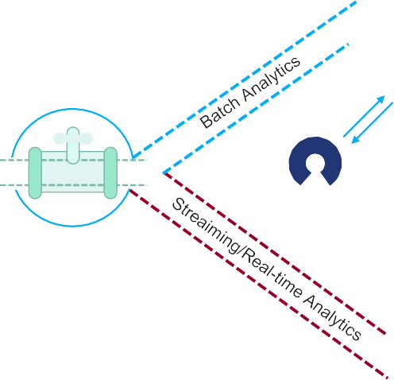













Amazon Retail
DELTTAA (Amazon Web Services AWS)
Serving Tier
M
Data Science Sandbox
Transactional Data
Amazon ElastiCache
Redis
Amazon Aurora Relational Database
Amazon Aurora Clusterless SQL Query
Amazon DynamoDB NoSQL Database
Amazon Redshift Data Warehouse
Amazon S3 Data Lake
AWS Glue Clusterless ETL
Visualization/ Reporting
Data Sources
Any Open Source Tool Of Choice on EC2
Amazon EMR Hadoop /Spark
Amazon Kinesis Streams and Firehose
Amazon Machine Learning Predictive Analytics
Data Lake and Real-time Analytics
Streaming Analytics Tools
Amazon Elasticsearch Service
Amazon Kinesis Analytics
SQL
Spark Streaming on EMR
Apache Flink on EMR
AWS Lambda
Apache Storm on EMR

Slide 57
Amazon Retail DELTTAA
Predictive
Prescriptive
310M+ customers
400M SKUs
Thousands of suppliers
Demand patterns
Shipment times
Storage locations
Supplier data
How much to buy?
Shortage costs
Holding costs
Where to store it?

Slide 58
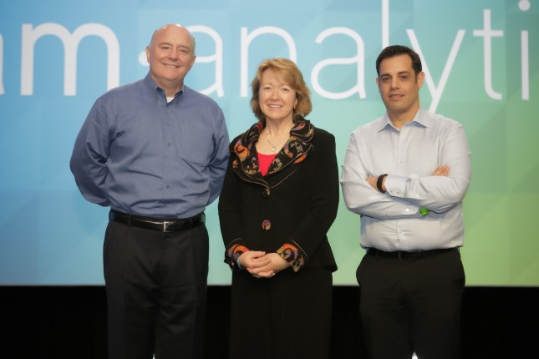

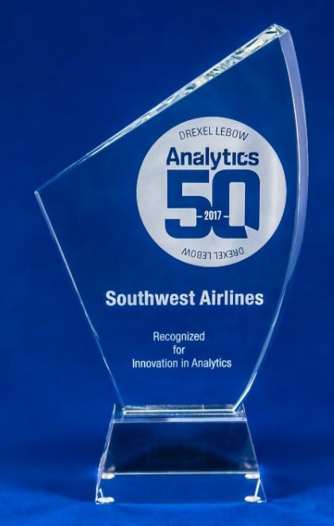
Amazon Retail DELTTAA
SCOT = 1,200 Omids
Dr. Alirezai “Omid” Madadi Clemson University
PhD, Industrial Engineering
Thesis: Retail Supply Chain Optimization Amazon SCOT Research Scientist II

Slide 60
Discussion of
Amazon Case Study | FACE
Doug Gray

Slide 61
Amazon Retail FACE
Decision
Problem
Predictive
Prescriptive
Stochastic
Hybrid
Deterministic
310M+ customers
400M SKUs
Thousands of suppliers
Demand patterns
Shipment times
Storage locations
Supplier data
How much to buy?
Shortage costs
Holding costs
Where to store it?

Slide 62
Amazon Retail FACE
Decision
Problem
Predictive
Prescriptive
Stochastic
Hybrid
Deterministic
Collaborative Filtering Customer Segmentation K-means, KNN
400M SKUs
Transportation, Transshipment Network Flow Models
Outcome, Action Odds Log Regression, RF, GB
Inventory models Economic Order Quantity (EOQ)
Demand Forecasting Time Series, Regression Machine Learning
Facility Location Models
Demand patterns
Shipment times
Storage locations
Supplier data
How much to buy?
Shortage costs
Holding costs
Where to store it?

Slide 63
Amazon Retail FACE
Six-page brief
MS PPT

Slide 64




















Amazon Retail FACE
Acquire
Data Source
Organize
Analyze
Deliver
Streaming/In Motion
Processing and Data Preparation
LOB APPS
Feature Engineering
Includes Feature Extraction and Feature Transformation
Policy
Orchestration
IT Log
Messaging IoT Feeds Protocols
Stream Ingestion Real Time
Transformation Normalization ^{Cleaning and}
API
Encoding
Streaming
Video
R/T
Execution and Operationalizing
Experiment
Test
Tune
Traditional Reporting
Interact
Image Audio Staging/At Rest
IoT Platform
Pub/Sub
Device
Preprocessing Data
Sample Selection
Training/ Testing Set
Self-Service Data Preparation/ Data Access Layer
Columnar Storage/ In-Memory Temporary Storage
Analytics Capabilities
Analyze
Optimize
Forecast
Report
Plan
Discover
Collaborate
Predict
Model
Operational Systems
Smart Data Discovery
Distributed
Other NoSQL NoSQL NoSQL
Other IMDB Centralized/Monolithic
SQL RDBMS
Data Modeling
Model Engineering
Includes Model Fitting and Model Evaluation
Visual Exploration
𝑓𝑓 (𝑥𝑥)
Clustering Algorithm
𝑓𝑓 (𝑥𝑥)
Learning Algorithm
Embed
API
Analytics Dashboards
Data Services – Marketplace or Datasets
API
App
ERP
Data Integration Transform Aggregate
Logical Data Warehouse
Storytelling/ Narrative
Virtualization
Traditional Data Management
SQL
Distributed Process
_{NoSQL} Other/
Hadoop
Automate
Doc
Image Feeds
Advanced Analytics
Enrich
Data Store
Video
Text IT Log
API
External
Administration
Manage and Govern
Information Governance (including Metadata Management, Data Quality, Data Modeling and Master Data Management), Data Management (Data Administration, Security, Privacy and Identity) and Organization (People)
= Optional
= Cloud, On-Premises or Hybrid
© 2017 Gartner, Inc

Slide 65





Amazon Retail FACE
Analytics project (delivery execution) management
1–3 months
1–3–6 months
Governance approval and funding processes
Customer business problem I
Sandbox
Model 1
Portfolio priority
Inception
Decision
Model 2
Model
process
identified
AWS
Cloud
3
Departmental analytics or self-service analytics or technology AA/OS
Model peer review | Model viability, verification, and
validation established by The Data Science Center
Domain expert | End-user | Model development cohort
3–6 months per release (MVP, R1, R2, R3, …)
Production system environment
Customer business problem solved I Decision enabled
IDF
Data in
motion
Micro-service
Business logic layer
GUI
logic layer
final
Model
Data at rest
Application layer
Domain expert | End-user | Model development cohort
Data Center–Network Complex

