Slide 1
Introduction
Doug Gray

Slide 2
Unit 9
How to successfully apply analytics to your business to deliver economic impact and achieve strategic competitive advantage
Disclaimer: The information contained herein is confidential and is the
intellectual property of Optima Analytics. Do not copy, reproduce, or distribute without expressed written consent of Douglas A. Gray, President, Optima Analytics. 2015

Slide 3
Unit 9 Outline
Minimizing readmittance: minimizing discomfort and saving money
Substance abuse rehabilitation readmission predictor
Evidence-based medicine: spinal surgery predictor
DR probe and predicting orthopedic surgery readmission

Slide 5
Overview of Healthcare Industry
Doug Gray

Slide 6
Healthcare Industry
$3 trillion U.S. industry (2015); about 20% GDP; $7 trillion globally; $8.7 trillion (2020)
25–30% of every dollar spent goes to administration
Three primary goals for healthcare entities:
Patient outcome and quality of life
Patient quality of care
Economic efficiency and financial performance (hospitals, insurance, pharma, etc.)
Trend towards “evidence-based” medicine, e.g., stomach ulcer case
Based on data and data science, including AI, machine learning

Slide 7
Hospital Readmissions
Readmissions are a particularly chronic problem today, top causes being:
Infection (sepsis), blood poisoning (septicemia)
Pneumonia
Congestive heart failure
Complications of surgical or medical care
https://www.verywellhealth.com/sepsis-and-septicemia-2615130

Slide 8
Hospital Readmissions
The cost of all readmissions must now be borne by the hospital provider
In 2011, 3.3 million adult all-cause readmissions associated with $41.3 billion in hospital costs
Medicare patients’ top three readmission conditions resulted in $4.3 billion in hospital costs
Medicaid patients’ top three readmission conditions resulted in $839 million in hospital costs
Privately insured patients’ top three readmission conditions resulted in $785 million in hospital costs
https://www.verywellhealth.com/sepsis-and-septicemia-2615130

Slide 10
CIGNA Paper Discussion
Doug Gray

Slide 11
Cigna Collaborative Accountable Care
Patient-centered medical home
Accountable care organizations: quality, affordability, experience of care
Achieved the
Focus on the right care Built on the principles of the IOM
right way Guided by patient- centered medical home principles
Accountable for outcomes
Enabled by CIGNA
resources
Safe
Timely
Efficient
Effective
Equitable
Patient-centric
Reward for improving the triple aim:
Quality
Cost efficiency
Patient experience
Personal physician
Physician-directed practice
Whole-person orientation
Coordinated care
Quality and safety
Enhanced access
Health advocacy integration
Patient-specific actionable information
Performance management reports
Improve delivery of evidence-based care
Improve patient engagement in care
Improve care outcomes and overall health
Reduce unnecessary care and costs

Slide 12
Cigna Solutions
CIGNA Solution
Clinical programs
Disease management
Case management
24-hour health information line
Health assessment
Online coaching
Patient-specific information
Readmission predictor
General predictor
Gaps in care
Performance management reports
Population-based
Episode-based
Focused trends
Client resources
Cigna field project management
Network engagement consultants
Clinical insights

Slide 14
Substance Abuse Readmittance
Doug Gray

Slide 15
Case Analysis
Substance abuse rehabilitation

Slide 16
Readmissions Are a Huge Source
of Costs for Hospitals and Insurers
According to the Agency for Healthcare Research and Quality (AHRQ):
Hospitals spent $41.3 billion between January and November 2011 to treat patients readmitted within 30 days of discharge.
1.8 million readmissions cost the Medicare program
$24 billion.
600,000 privately insured patient readmittance totaled
$8.1 billion.
700,000 medicaid patient readmissions cost hospitals
$7.6 billion.
The 200,000 uninsured patients who were readmitted cost hospitals a relatively paltry $1.5 billion.

Slide 17
Causes of Readmissions
Complications from surgery or treatment
Infection
Relapse of a physical malady or other condition
Related (direct or indirect) health episode

Slide 18
Setting
For a project with a $2 billion U.S. Midwest healthcare insurer who wanted to look more closely at substance abuse patients who were readmitted versus those who were not

Slide 19
Goal
Identify and intercept those with a high propensity for readmissions and advise, treat, and counsel them accordingly.

Slide 20
Classifying and Predicting
Patient Post-Discharge Behavior
Classification, segmentation, propensity to re-admit
Latent class modeling
K-means clustering, CART/CHAID
Logistic regression (odds of readmitting)
Bayesian Inference (Multivariate)

Slide 21
Data
Medical history data including pre-existing and current conditions
Demographic and psychographic data from Acxiom
Prior readmission history

Slide 22
Frame and Solve:
Analytics Solution Approach
Healthcare industry
Healthcare insurer
“Substance abuse readmissions have increased 33% YOY”
“Limited patient care staff cannot amply support all recently released patients”

Slide 23
Frame and Solve:
Analytics Solution Approach
“How can we focus patient care staff on the patients at highest risk of readmission?”
Identify (predict) patients who may be prone to substance abuse rehabilitation
Predictive
readmission and care for them to reduce their likelihood of readmission
There are a dozen or more variables that can influence whether or not a patient will readmit after rehabilitation
Predicting readmission with certainty is not possible; predict the “probability” of a patient readmitting after rehabilitation
Stochastic
Probability: Bayesian Inference
Odds or [p/(1-p)]: Logistic Regression

Slide 24
Bayesian Inference Model
The “Swiss Army Knife” of modern
statistical predictive modeling
Breast Cancer Screening Indicator (BCSI) Test
BCSI test result | True cancer state | Patient has cancer | Patient has no cancer | Total number patients tested
POS + |  | 88 | 36 | 124
NEG - |  | 16 | 37 | 55
Total |  | 106 | 73 | 179
P(Patient has cancer/POS + test result) = 88 / 124 = 71%
P(POS + test result/patient has no cancer) = 36 /73 = 49%
P(E|M)
P(M|E) = P(M) ·
P(E)
Modeling propensity of an outcome given prior information and empirical information
Disease state given a test result
Heart attack or stroke
Hospital readmission
Consumer behavior, e.g., product purchase, churn

Slide 26
Spinal Injury
Pachinko, Logistic Regression, and Architecture
Doug Gray

Slide 27
Case Analysis
Spinal surgery predictor

Slide 28
Spinal Surgery Can Often Be
Avoided or Postponed Indefinitely With
Weight loss
Exercise
Physical therapy or occupational therapy
Improved mechanics
Medications

Slide 29
Goal
Goal: identify and intercept with a high propensity for spinal surgery and advise and counsel them with alternative non-invasive, non-surgical treatments

Slide 30
Methods: Classifying and Predicting
Patient Propensity for Spinal Surgery
Classification, segmentation, propensity to require spine surgery
Latent class modeling
K-means clustering, CART/CHAID
Logistic regression (odds of requiring spinal surgery)

Slide 31
Data
Medical history data including preexisting and current conditions
Demographic and psychographic data from Acxiom
Prior readmission history
Work history

Slide 32
Frame and Solve:
Analytics Solution Approach
Healthcare industry
Healthcare insurer
“Spinal surgery patients have increased 25% YOY”
“Spinal surgery typically results in additional surgeries, creating risk”

Slide 33
Frame and Solve:
Analytics Solution Approach
“How can we prevent spinal surgeries from occurring?”
Identify (predict) patients who may be prone to spinal surgery and intercept and treat them before they undertake surgery
Predictive
There are a dozen or more variables that can influence whether or not a patient will require spinal surgery
Predicting spinal surgery with certainty is not possible; predict the “odds” or “probability” of a patient spinal surgery event
Stochastic
Odds or [p/(1-p)]: Logistic Regression
Probability: Bayesian Inference

Slide 34
Logistic Regression Model
The “Swiss Army Knife” of classical
statistical predictive modeling
_{𝑒𝑒}≈
1
𝑓𝑓(𝑧𝑧) = _{𝑒𝑒≈ + 1} = _{1 + 𝑒𝑒−≈}
1
Modeling propensity of an outcome
Nonlinear: No closed form equations for model parameters; must be solved using maximum likelihood estimation (MLE)
Heart attack or stroke
Hospital readmission
Consumer behavior, e.g., product purchase, churn
0.5
Solve using MS excel solver (GRG) for nonlinear programming or MATLAB
0
0
-6
-4
-2
2
4
6
𝑧𝑧 = 𝛽𝛽₀ + 𝛽𝛽₁𝑥𝑥₁ + 𝛽𝛽₂𝑥𝑥₂ + 𝛽𝛽₃𝑥𝑥₃ + … + 𝛽𝛽_{𝑘𝑘}𝑥𝑥_{𝑘𝑘}

Slide 35














Analytics Architecture Flow
Enterprise systems
IBM DB2 UDB
Enterprise data warehouse
ETL
Analytics data warehouse
IBM SPSS
44 Source systems
Business problems or questions
Cloud hosting
_{𝑒𝑒}≈
1
𝑓𝑓(𝑧𝑧) = _{𝑒𝑒≈ + 1} = _{1 + 𝑒𝑒−≈}
Patient risk profiles
𝑧𝑧 = 𝛽𝛽₀ + 𝛽𝛽₁𝑥𝑥₁ + 𝛽𝛽₂𝑥𝑥₂ + 𝛽𝛽₃𝑥𝑥₃ + … + 𝛽𝛽_{𝑘𝑘}𝑥𝑥_{𝑘𝑘}
Decision makers
Patient outcome predictions
 |  | 1
 |  | 0.5
P(M|E) = P(M) ·
P(E|M)
$
Patient outcome likelihoods
P(E)
0
Analytical models
-6 -4 -2 0
2
4
6

Slide 37
Orthopedic Surgery (Hip, Knee) Re-admission Predictor

Slide 38
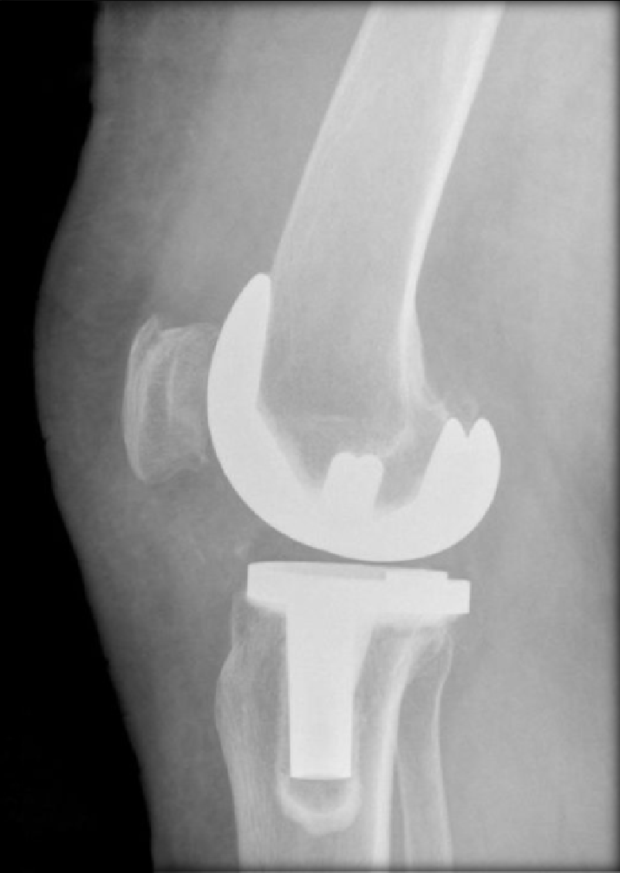
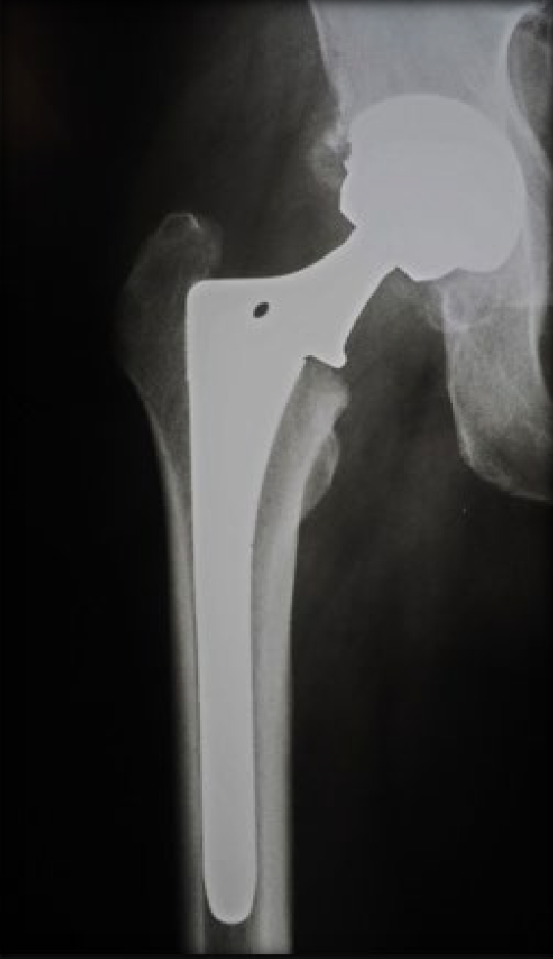
Predicting Hospital
Final Project
→ Readmissions ←
Following Joint Replacement Surgery

Slide 39
Meet... Jim & John
Jim
Total Hip Replacement Surgery
John
Total Hip Replacement Surgery
Not Readmitted
Readmitted

Slide 40
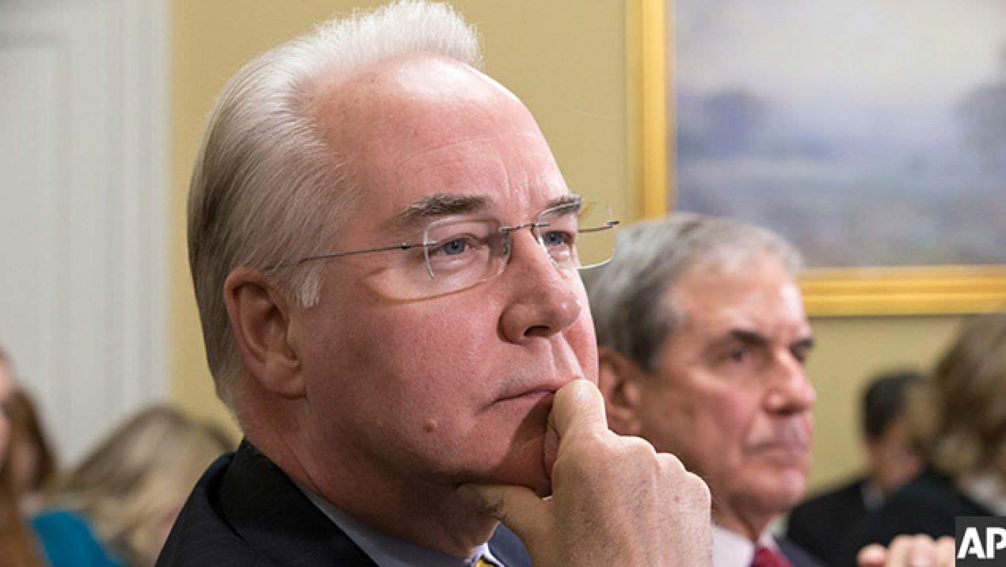
WHY... focus on Joint Replacement ???
40
By 80 years of age
6% will have an → artificial hip
10% will have an → artificial knee
Growth rate
Hips
Knees
7.4% CAGR
15.7% CAGR
total knee customer
Average cost:
$28,184 US
$6,687 Spain

Slide 41
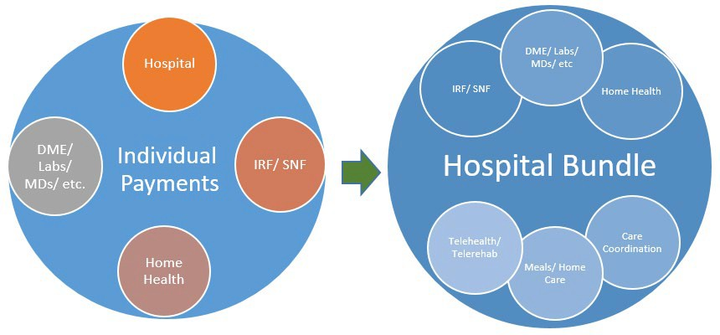
Evolution of Medicare Payments
Medicare created.........................1965
Inpatient prospective payment............1984
DRG (diagnosis related groups)
MS-DRGs
APR-DRGs
Optional Bundled Payment....................2013
Pilot Mandatory Bundled Payment.....................2016

Slide 42
Bundles: Reimbursement Future?
42
Bundled Payment for Care Improvement (BPCI)
Volunteer Program Started in October 2013
48 Episode Types Made Up Of DRG “Families”
Account for 70% of Total Medicare Spend
Most Volunteered for by Participants - Major Joint Replacement, Congestive Heart Failure, Simple Pneumonia, COPD & Sepsis
Joints (CJR) First BPCI to be Mandated
Hospitals held responsible for Costs and Quality for lower extremity joint replacement (LEJR) procedures – DRGs 469 & 470 – includes fractures
Costs: All Part A and B costs of care during stay plus Medicare costs for surgery plus 90 days post hospital discharge w/very few exclusions
Quality: RSCR, HCAHPS & Patient Reported Outcomes (PRO)
Average Cost of Each Readmission:
→ $19,000 ABOVE... (Original $28,184 Care)

Slide 43
Back to... Jim & John
Jim
Total Hip Replacement Surgery
John
SAME: Procedure
Total Hip Replacement Surgery
SAME: Age
65 years old
65 years old
SAME: Length of Stay
3 Days in Hospital post- op
3 Days in Hospital post- op
SAME: Discharge Type
Home Health
Home Health
readmit and Jim ?
SO THEN...
WHYdoes John
doesn’t
DIFFERENT OUTCOME
Not Readmitted
Readmitted

Slide 44
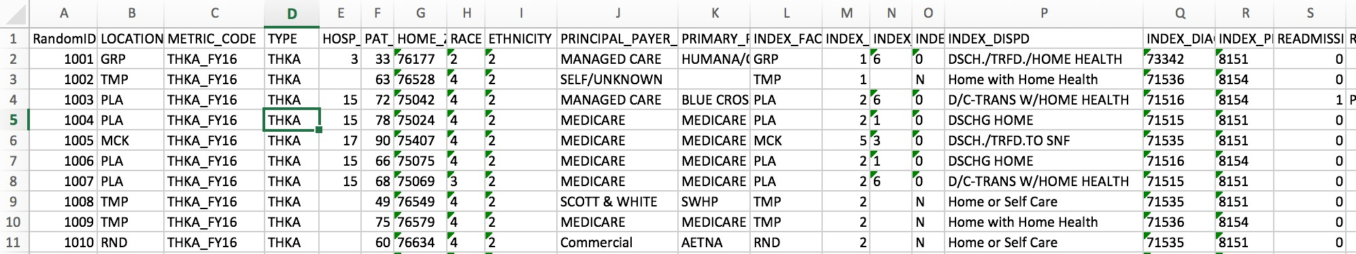
The Data
July 2014 – June 2016 (2 years)
7192 hip and knee replacements
341 Readmissions
Variable
Age, Race, Ethnicity, Payment Type, Discharge Date, Length of Stay, Discharge Instructions, Hospital System, and MORE.

Slide 45
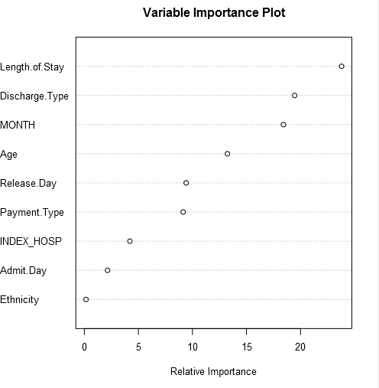
Expand the dataset
Boosted model ran to determine key variables in dataset
Expected importance:
Length of Stay
Discharge Type
Age
Unexpected
Release Month
Release Day of Week
Payment Type

Slide 46
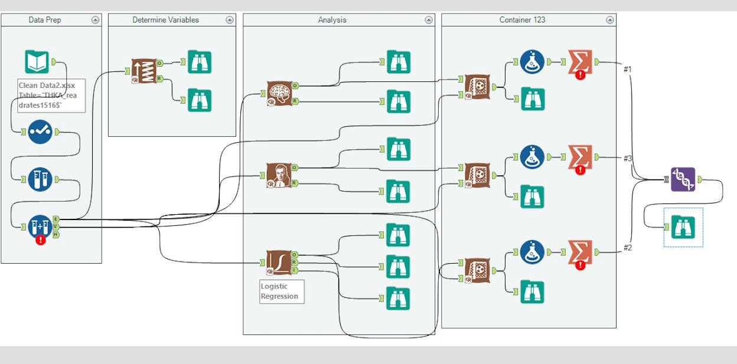
Alteryx Model

Slide 47
Test Batch Results
Logistic Regression → (Most False Positives X )
 | Suc-Obs | Fail-Obs
Suc-Pred | 171 | 299 | 470
Fail-Pred | 101 | 565 | 666
 | 272 | 864 | 1136
Accuracy | 62.87% | 65.39% | 64.79%
Naïve Bayes
 | Suc-Obs | Fail-Obs
Suc-Pred | 33 | 50 | 83
Fail-Pred | 239 | 814 | 1053
 | 272 | 864 | 1136
Accuracy | 12.13% | 94.21% | 74.56%
Neural Network→ (Most Accurate!!!)
 | Suc-Obs | Fail-Obs
Suc-Pred | 86 | 43 | 129
Fail-Pred | 186 | 821 | 1007
 | 272 | 864 | 1136
Accuracy | 31.62% | 95.02% | 79.84%

Slide 48
Sensitivity, Specificity and Predictive Value
 | Logistic Regression | Naïve Bayes |  |  | Neural Network
True Positive | 171 | 33 |  |  | 86
False Negative | 101 | 239 |  |  | 186
False Positive | 299 | 50 |  |  | 43
True Negative | 565 | 814 |  |  | 821
Sensitivity | 62.87% | 12.13% |  |  | 31.62%
Specificity | 65.39%
 |  |  | 94.21% |  |  | 95.02%
Positive Predictive Value | 36.38% | 39.76% |  |  | 66.67%
Sensitivity – The ability to determine the MAXIMUM number of POSITIVES Specificity – The ability to determine the MAXIMUM number of NEGATIVES Predictive Value - How accurate is the POSITIVE prediction

Slide 49
Back to..... Jim & John
Score
.
Score
.7104
Jim (Not Readmitted)
John (readmitted)
3572
May Surgery
August Surgery
Neural Network Predicts NEGATIVE
Readmission
Released on Sunday
Released on Thursday
Neural Network Predicts POSITIVE
Readmission
Medicare
Medicare
Hospital = TMP
Hospital = WAX
Not Hispanic
Not Hispanic

Slide 50
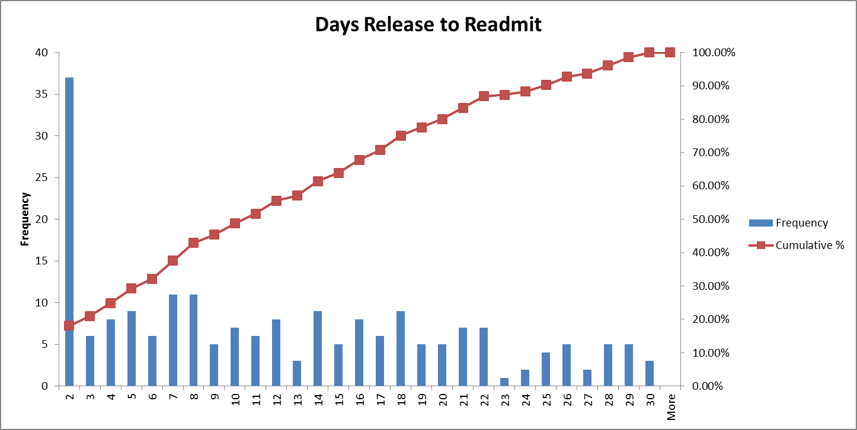
Histogram of Data Set
→ 18.05% of dataset readmitted within 2 days of release from hospital ←
Estimated cost of each readmission: $19,000

Slide 51


2 Prong Medical Intervention:
Day 1
“WEARABLE”VITALS
* Temperature
* SPO2
* Respiratory Rate
Posture
Steps
DAILY RECORDINGS
DIGITALLY DELIVERED
* HR
Day 3-4
Internal Medicine Doctor Visit

Slide 52
ECONOMICS
Preventative Cost Measures /Patient
$100 Monitoring System [+]
$250 Dr. Visit
x81 Patients with high risk
→$28,350 / annual cost←
To Prevent 54 Readmissions saving
$ 19,000 / Patient
TOTAL SAVINGS →$513 K
NET SAVINGS $484,650 / Year
→ Assuming a 50% success rate for preventative measures ←

