Slide 1
Unit 10: Health Care Part 2
For Live Session Assignment

Slide 2
Medicare Fraud and ML
Assume you are consulting for Blue Cross Blue Shield and your boss found this paper and has asked you to prepare an explanation / report of its finding. He has been in the company for 30 years and is the VP of Fraud detection but is relying in you to interpret the statistics / evidence / meaningful conclusion presented in this paper. Prepare at least one slide for each topic (number) below. Expected time: 3-5 hours.
Director Gray makes mention of the costs of Medicare fraud. In order to see the relevance and importance of this problem, what evidence / information does this paper provide to underline the potential impact that ML methods could have?
Describe the final data set used in this study (size, source, etc.) and any challenges / decisions made in obtaining this final data set from the original source.
Describe to your boss what an ROC curve is, how to interpret the AUC and how the plot is formed.
Define Oversampling and Undersampling. Why is Undersampling preferred here? What are its disadvantages?
What method of cross validation was employed? How many AUC / FPR and FNR statistics were generated?
What software was used to fit the models and generate the fit statistics? What information can you find about it from a quick web search?
What software do you / have you used in your company? Do they prefer a particular software / language or are they “agnostic” and leave it up to the researcher/data scientist/analyst?
Write a conclusion statement(s) for the ANOVA? What does this test tell us in the context of this study?
Remember the Tukey HSD from STAT 1 (6371?) Write a conclusion statement(s) for the Tukey HSD?
To finish up, breifly describe the results of the study! Is there hope for Medicare Fraud detection using ML?

Slide 3
Medicare Fraud and ML
Director Gray makes mention of the costs of Medicare fraud. In order to see the relevance and importance of this problem, what evidence / information does this paper provide to underline the potential impact that ML methods could have?
2015, spending on healthcare-related activities reached $3.2 trillion, which is about 17% of the total U.S. budget
Medicare alone accounts for about 15% in spending (net of $588 billion), per year of the total healthcare budget and
expected to increase to 18% within the next
The impact of healthcare fraud is estimated to be between 3% to 10% of the nation’s total healthcare spending
“Moreover, in 2015, spending on healthcare-related activities reached $3.2 trillion, which is about 17% of the total U.S. budget (Backman 2017). Medicare is one such U.S. healthcare program created to assist the elderly and other individuals with certain medical conditions (Medicare 2017). Medicare alone accounts for about 15% in spending (net of $588 billion), per year of the total healthcare budget and is expected to increase to 18% within the next decade (Backman 2017). Given the increase in the elderly population, with their need for increased healthcare and financial assistance, programs like Medicare are critical and, as such, must reduce program expenses and costs to allow for accessible healthcare. One way to accomplish this is to lessen the impact of fraud. The impact of healthcare fraud is estimated to be between 3% to 10% of the nation’s total healthcare spending continuing to adversely impact the Medicare program and its beneficiaries (NHCAA 2017).”

Slide 4
Medicare Fraud and ML
2. Describe the final data set used in this study (size, source, etc.) and any challenges / decisions made in obtaining this final data set from the original source.
Medicare Provider Utilization and Payment Data: Physician and Other Supplier, available from the Centers for Medicaid and Medicare Services (CMS)
CMS has over 37 million rows
The Medicare data does not contain labels indicating fraudulent providers or procedures.
List of Excluded Individualsand Entities (LEIE) database contains the labels (fraud / not fraud)
There is a process for merging the Medicare data and the LEIE labels that accounts for differing lengths of exclusions, matching providers by unique identification numbers.
The final dataset has significantly more non-fraud versus fraud labels.
Random undersampling was employed to obtain a more balanced data set.

Slide 5
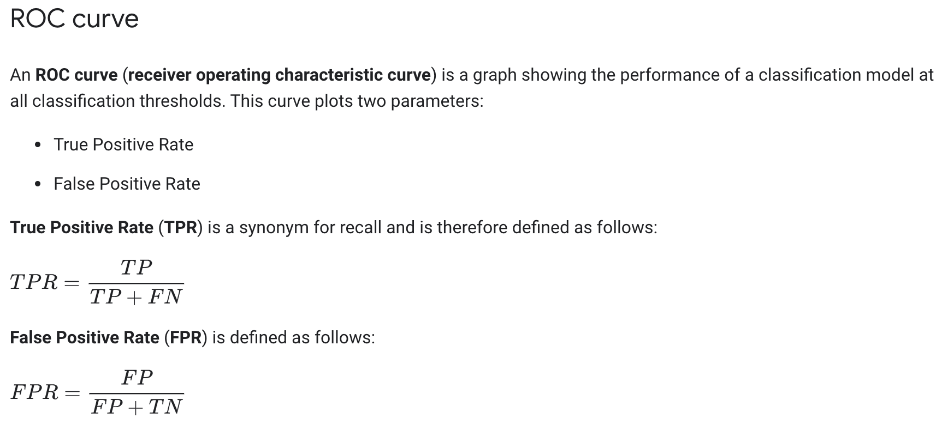
Medicare Fraud and ML
3. Describe to your boss what an ROC curve is, how to interpret the AUC and how the plot is formed.
“The ROC curve is used to characterize the trade-off between true positive rate and false positive rate and depicts a learner’s performance across all decision thresholds, i.e. a value between 0 and 1 that theoretically separate the classes. AUC is a single value that ranges from 0 to 1, where a perfect classifier provides an AUC value of 1.”
https://developers.google.com/machine-learning/crash-course/classification/roc-and-auc

Slide 6
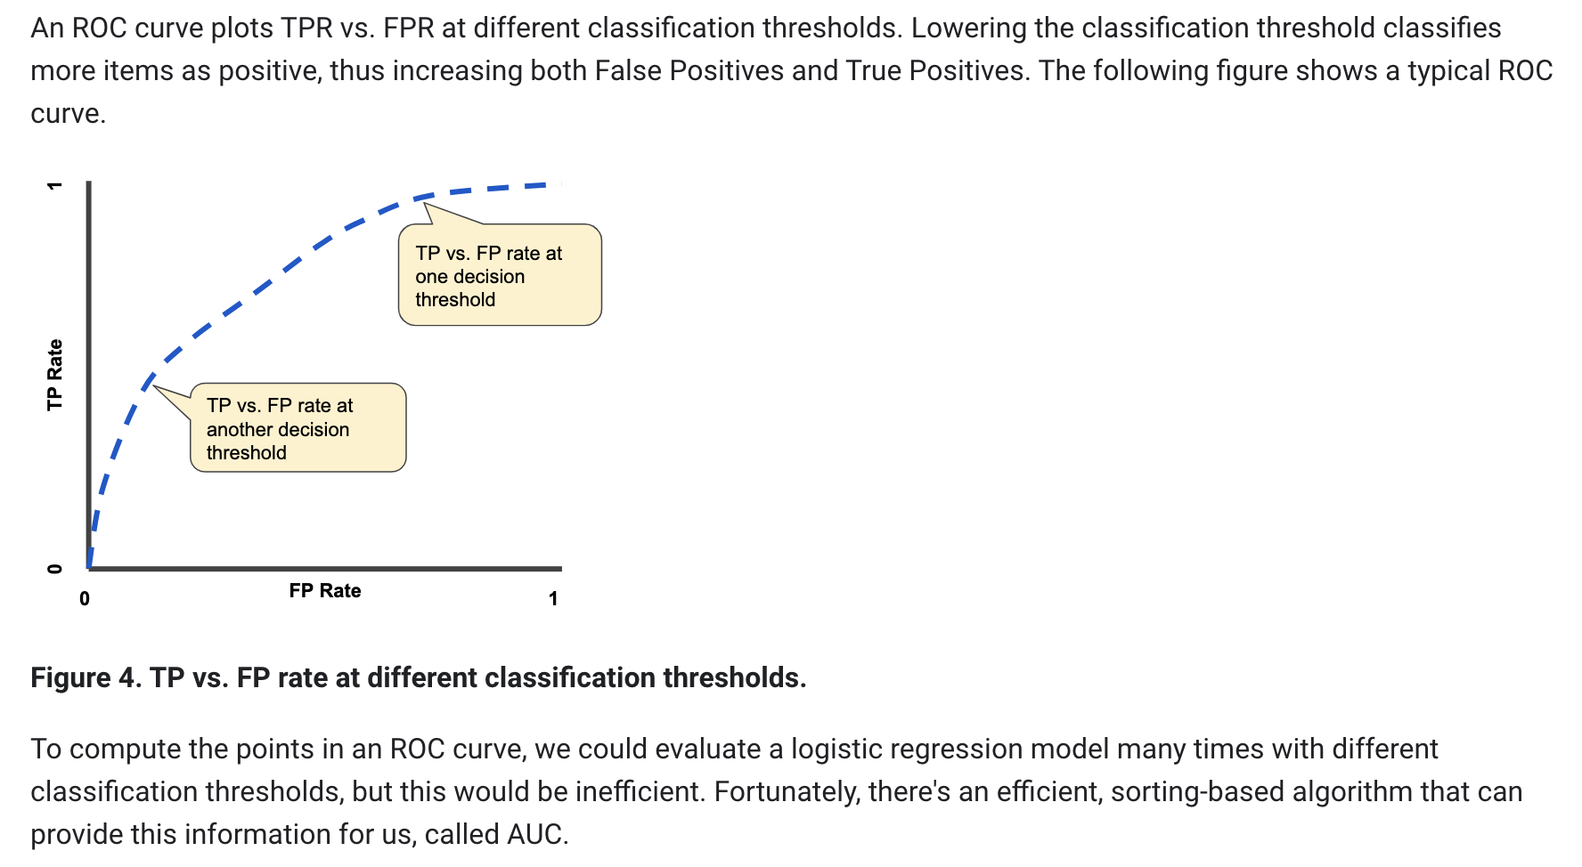
Medicare Fraud and ML
3. Describe to your boss what an ROC curve is, how to interpret the AUC and how the plot is formed.
https://developers.google.com/machine-learning/crash-course/classification/roc-and-auc

Slide 7
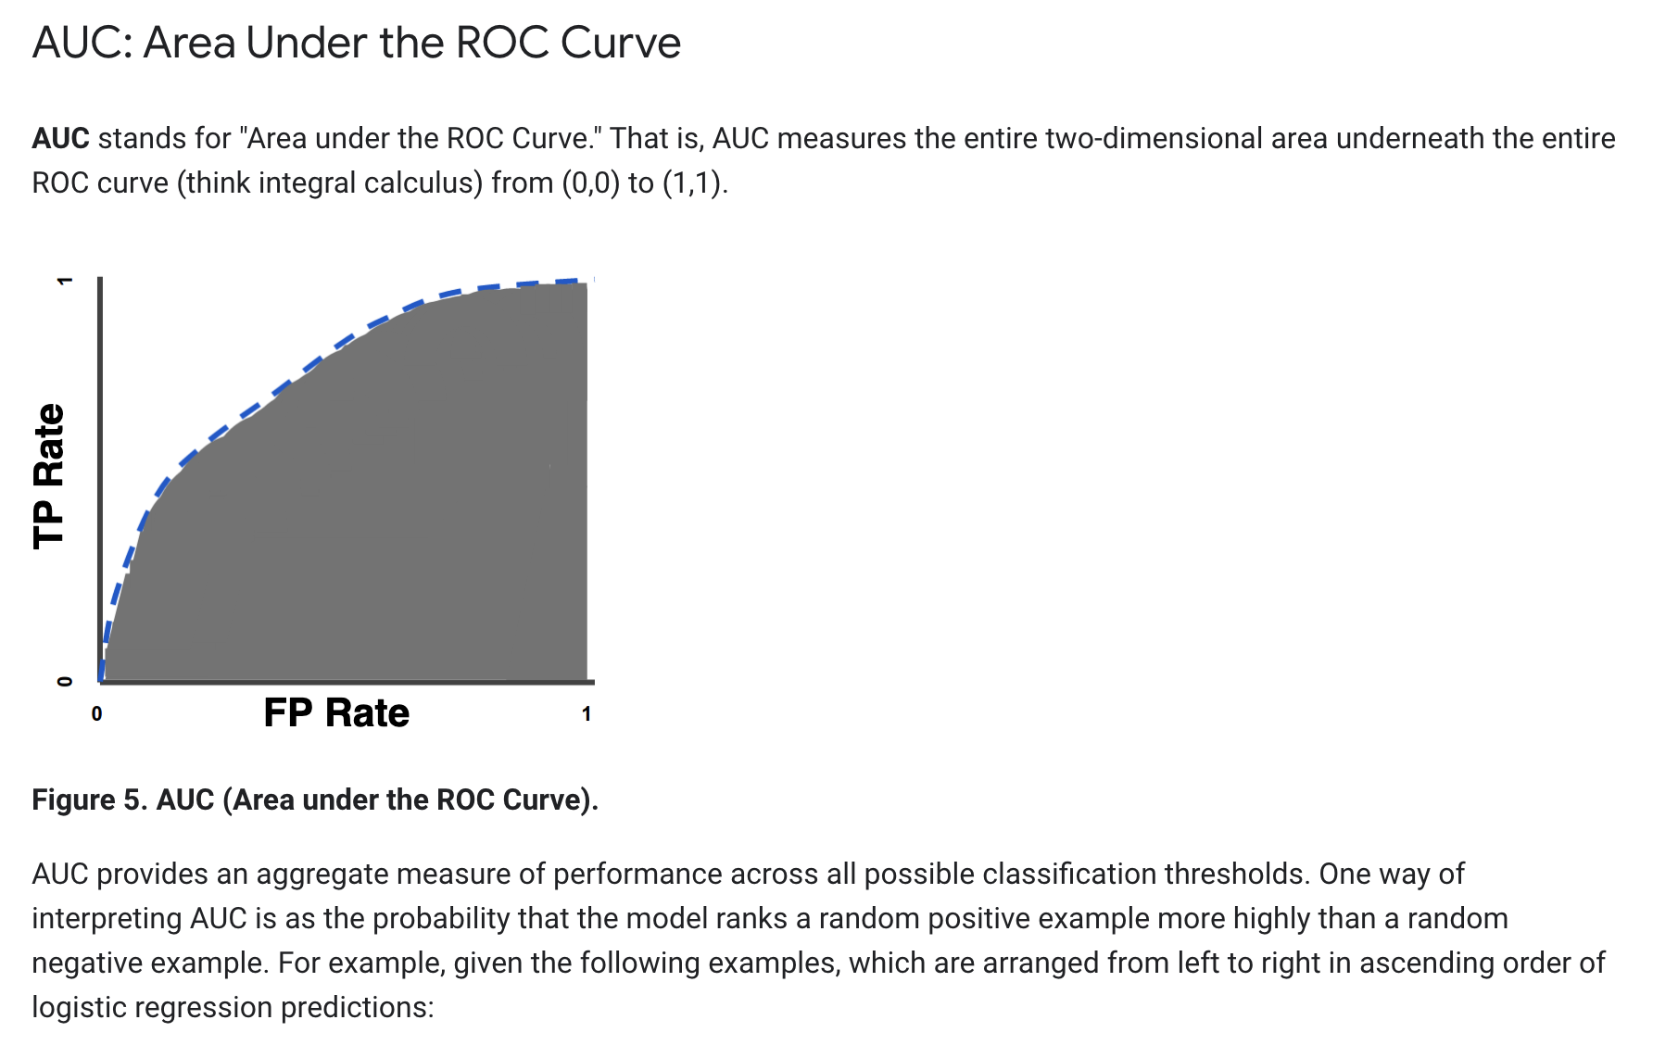
Medicare Fraud and ML
3. Describe to your boss what an ROC curve is, how to interpret the AUC and how the plot is formed.
https://developers.google.com/machine-learning/crash-course/classification/roc-and-auc

Slide 8
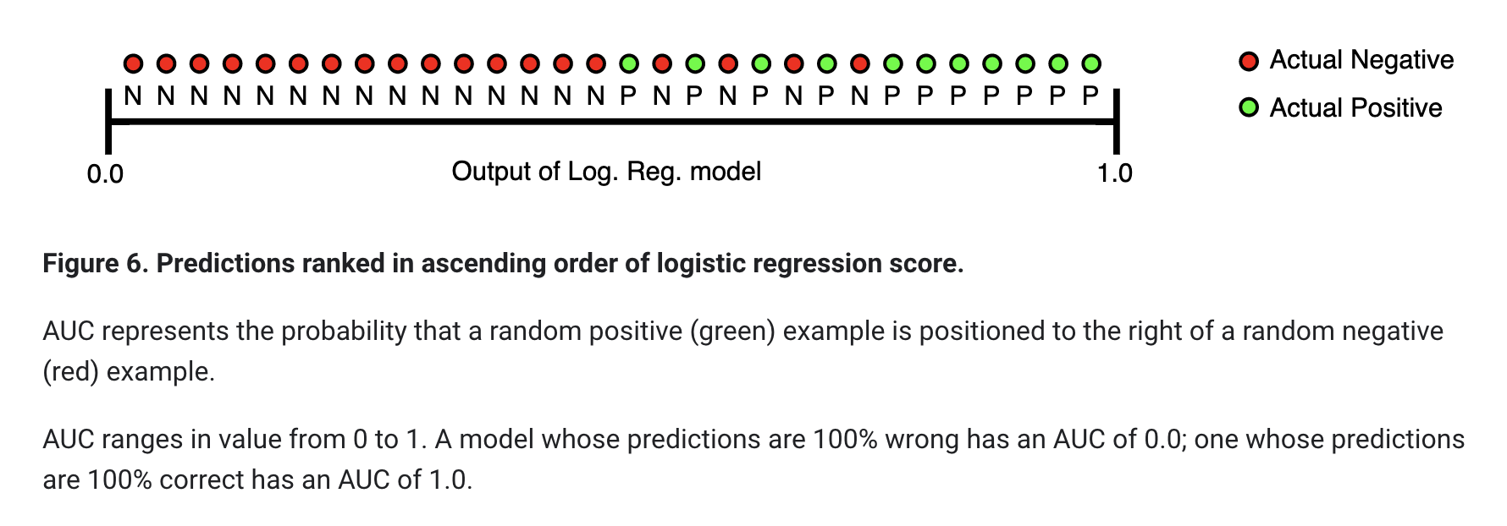
Medicare Fraud and ML
3. Describe to your boss what an ROC curve is, how to interpret the AUC and how the plot is formed.
https://developers.google.com/machine-learning/crash-course/classification/roc-and-auc

Slide 9
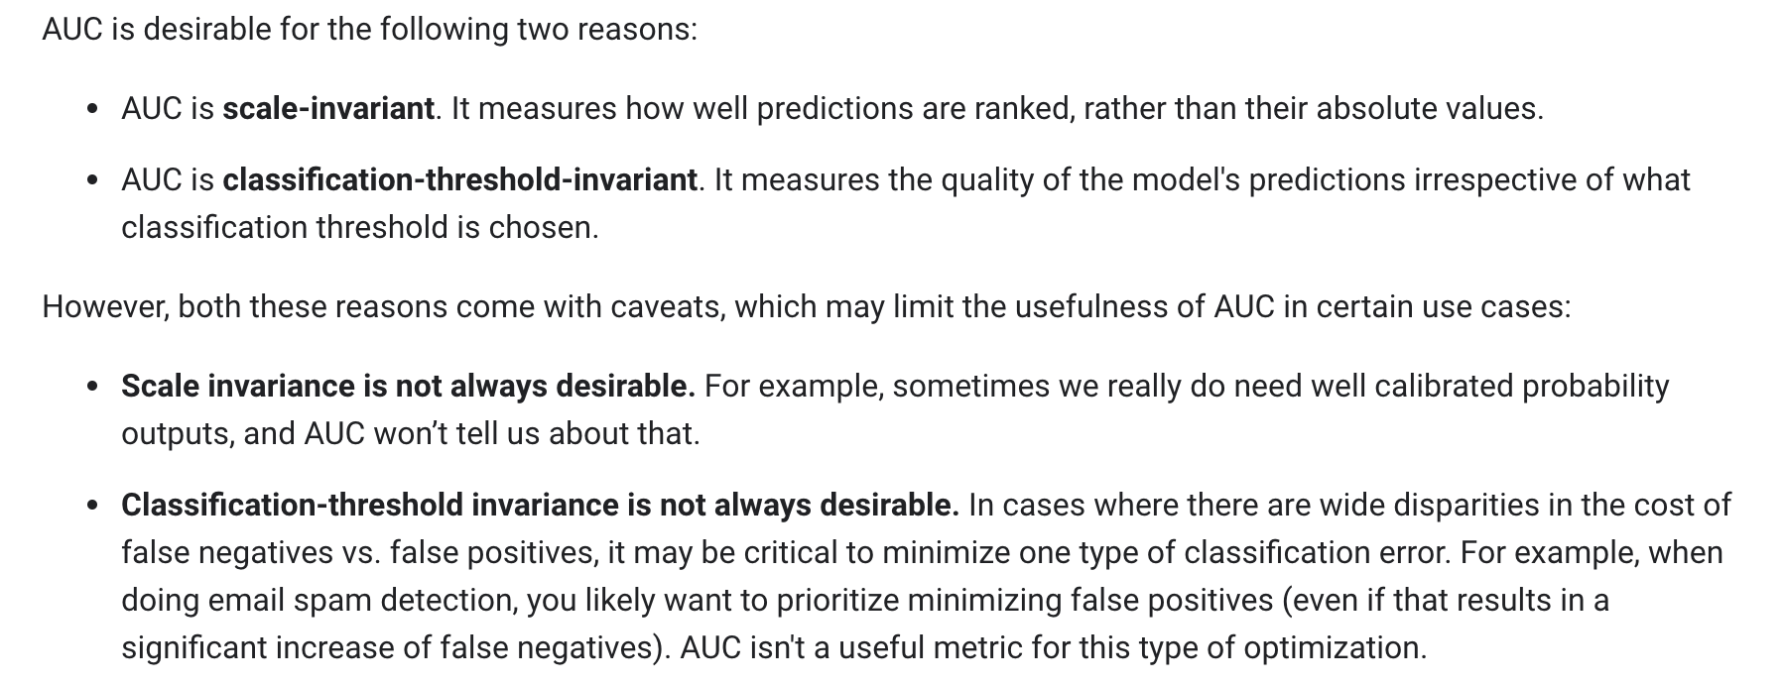
Medicare Fraud and ML
3. Describe to your boss what an ROC curve is, how to interpret the AUC and how the plot is formed.
https://developers.google.com/machine-learning/crash-course/classification/roc-and-auc

Slide 10

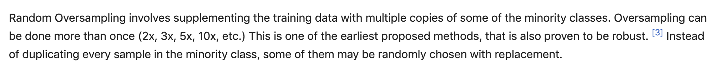

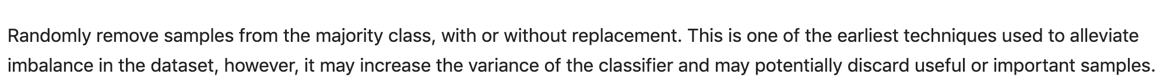
Medicare Fraud and ML
4. Define Oversampling and Undersampling. Why is Undersampling preferred here? What are its disadvantages?
“with undersampling, we retain all of the original fraud labeled instances and randomly sample without replacement from the remaining majority class instances.”
“In our study, we use random undersampling (RUS) with the following class distributions (majority:minority): 50:50, 65:35, 75:25, and 80:20.”
https://en.m.wikipedia.org/wiki/Oversampling_and_undersampling_in_data_analysis
https://www.kaggle.com/rafjaa/resampling-strategies-for-imbalanced-datasets

Slide 11
Medicare Fraud and ML
5. What method of cross validation was employed? How many AUC / FPR and FNR statistics were generated?
In our experiment, we repeat the RUS process 10 times for each of the class distributions.
We employ stratified 5-fold cross-validation to assess the performance of each of the learners
The reason we use 5-fold cross-validation is because of the extremely low percentage of fraud labels throughout the entire Medicare dataset.
This reduces the likelihood that a fold has too few positive class instances and retains more equitable labeled data for fair evaluation.
To further reduce bias due to bad random draws and to better represent the claims data, we repeat the 5-fold cross-validation process 10 times and average the scores to get the final performance results.

Slide 12

Medicare Fraud and ML
6. What software was used to fit the models and generate the fit statistics? What information can you find about it from a quick web search?
Each of these learners was built and tested using the Weka machine learning software.
https://www.cs.waikato.ac.nz/ml/weka/

Slide 13
Medicare Fraud and ML
7. What software do you / have you used in your company? Do they prefer a particular software / language or are they “agnostic” and leave it up to the researcher/data scientist/analyst?

Slide 14
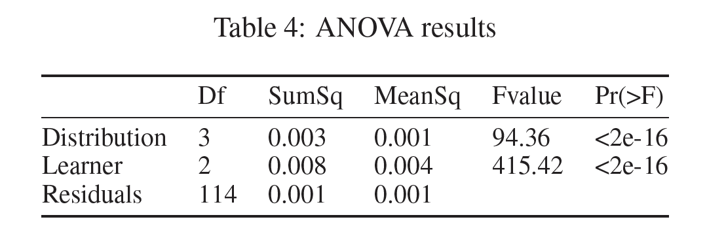
Medicare Fraud and ML
8. Write a conclusion statement(s) for the ANOVA? What does this test tell us in the context of this study?
In this study the RUS undersampling technique was used to sample 10 datasets from the original dataset that had severely unbalanced data (Many more non fraud than fraud cases.). This was done to create data sets that were had the non-fraud / fraud breakdown to be 80:20, 75:25, 60:40 and 50:50. 10 data sets for each breakdown were sampled and the analysis was run on each. Therefore there were 10 AUCs for each of 3 models for each of 4 breakdowns (120 total).
Distribution:
The ANOVA table above provides overwhelming evidence that at least one pair of ”Distributions” (”Breakdowns”) have difference mean AUCs (pvalue < .00001). This means that there is overwhelming evidence that the choice of distribution of the data set has an effect on the performance of the models.

Slide 15
Medicare Fraud and ML
8. Write a conclusion statement(s) for the ANOVA? What does this test tell us in the context of this study?
In this study the RUS undersampling technique was used to sample 10 datasets from the original dataset that had severely unbalanced data (Many more non fraud than fraud cases.). This was done to create data sets that were had the non-fraud / fraud breakdown to be 80:20, 75:25, 60:40 and 50:50. 10 data sets for each breakdown were sampled and the analysis was run on each. Therefore there were 10 AUCs for each of 3 models for each of 4 breakdowns (120 total).
This is interesting … but wouldn’t we like to know which pairs of distributions and which pairs of models … and my how much?
Coming Up!
Learner:
The ANOVA table above provides overwhelming evidence that at least one pair of ”Learners” (”Models”) have difference mean AUCs (pvalue < .00001). This means that there is overwhelming evidence that the choice of model has an effect on the performance of the models.

Slide 16
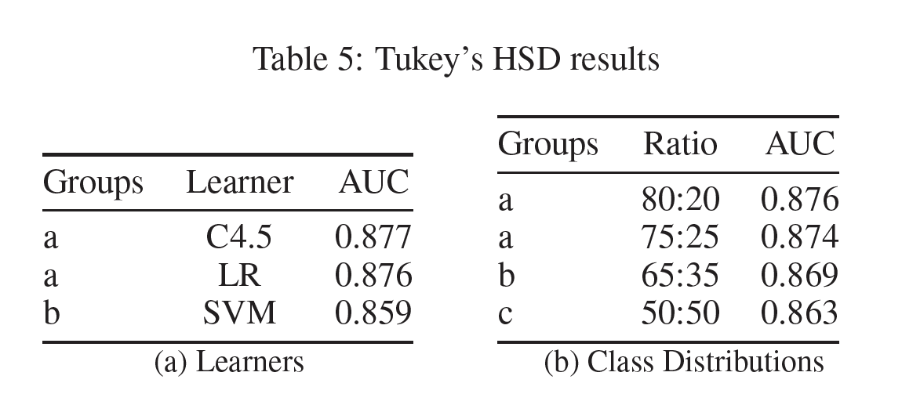
Medicare Fraud and ML
9. Remember the Tukey HSD from STAT 1 (6371?) Write a conclusion statement(s) for the Tukey HSD?
Tukeys’ Honest Significant Difference (HSD) is a method of multiple comparison to account for conducting multiple tests each at an identical significance level (alpha).
Learners:
The results in Table 5a indicate that there was evidence of a significant difference in mean AUC between C4.5 and SVM and LR and SVM but not between C4.5 and LR. The corresponding AUC estimates are given in the table.
Distributions:
The results in Table 5b indicate that there was evidence of a significant difference in mean AUC between the 80:20 and both 65:35 and 50:50. In addition there was evidence that the mean AUC was different between 75:25 and both 65:35 and 50:50. To continue, there was evidence that there was a significant difference in mean AUC between 65:35 and 50:50. Finally, there was not enough evidence to suggest that there was a difference in mean AUC between the 80:20 and 75:25 distributions. The corresponding mean AUCs are visible in Table 5b and suggest that the 80:20 and 75:25 distributions yield the greatest mean AUCs.

Slide 17
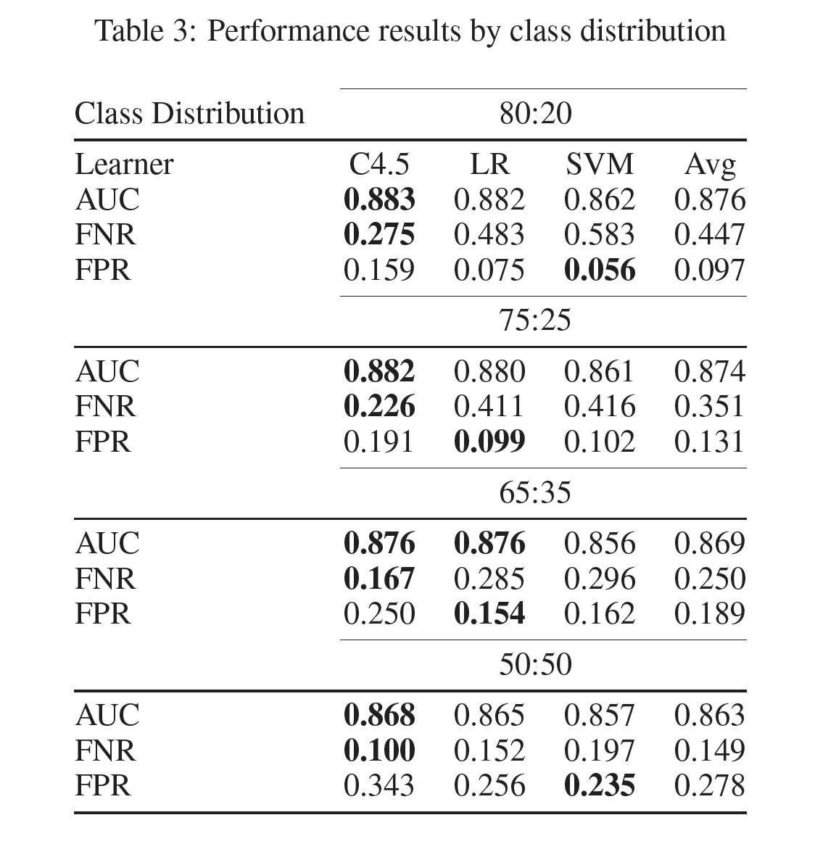
Medicare Fraud and ML
10. To finish up, breifly describe the results o the study! Is there hope for Medicare Fraud detection using ML?
detection of real fraud cases is more important than detecting non-fraud ones.
C4.5 has the highest AUC for each class distribution
LR being very close to C4.5 in average AUC.
Fraud the positive class.
FNR = Classifying a fraud case as a non fraud! (Important to keep this low.)
FPR = Classifying a non-fraud case as fraud. (We can tolerate a larger FPR)
The C4.5 decision tree learner has the lowest FNR for every class distribution, but also the highest FPR.
The lowest FPR scores alternate between LR and SVM.
Even though LR and C4.5 have similar AUC scores, LR has higher false negative rates.
C4.5 learner is the best choice with the highest AUC and the lowest rate of false negatives. (since it is important to not misclassify fraudulent cases (minimize FNR.)

Slide 18
ANN vs LRM in Classifying Malignant and Biopsy
You read the ANN v LRM paper in the asynch. Prepare at least one slide to discuss each of the 7 topics below with respect to that paper. Expected time: 2-3 hours.
Were the data balanced 50% malignant / 50% benign? If not what was the breakdown?
What was the train / test split percentages?
What software was used to implement the neural network and logistic regression models?
What was the structure of the neural network model? They also call it a “training paradigm” in the Discussion.
There was a full and reduced logistic regression model (LRM). Specify each model (a screen shot is fine). What do you notice that is odd about how the reduced model was formed?
Table 3 has the parameter estimates from the LRM model. Select a significant feature (at the .05 level of significance) and interpret that parameter. Information on each parameter can be found in Table 2. As usual, please provide confidence intervals with your interpretation. Hint: You may need to go back to your Stat 2 slides for this question (Unit 12 of 6372.)
Discuss at least one limitation of the study.

Slide 19
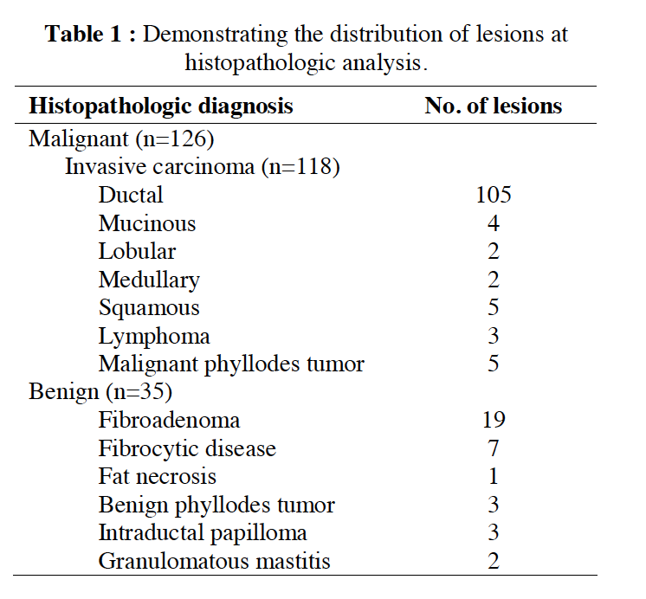
ANN vs LRM in Classifying Malignant and Biopsy
You read the ANN v LRM paper in the asynch. Prepare at least one slide to discuss each of the 7 topics below with respect to that paper. Expected time: 2-3 hours.
Were the data balanced 50% malignant / 50% benign? If not what was the breakdown?
Malignant: 126/161 = 77.6%
Benign: 35/161 = 22.4%

Slide 20
ANN vs LRM in Classifying Malignant and Biopsy
You read the ANN v LRM paper in the asynch. Prepare at least one slide to discuss each of the 7 topics below with respect to that paper. Expected time: 2-3 hours.
2. What was the train / test (validation) split percentages?
the training samples comprising 100 patient records (20 benign, 80 malignant)
the validation samples comprising 61 patient records (15 benign, 46 malignant)

Slide 21
ANN vs LRM in Classifying Malignant and Biopsy
You read the ANN v LRM paper in the asynch. Prepare at least one slide to discuss each of the 7 topics below with respect to that paper. Expected time: 2-3 hours.
3. What software was used to implement the neural network and logistic regression models?
“We used the stepwise procedure of PROC LOGISTIC in SAS statistical package (SAS Institute, Inc., Cary, North Carolina) to establish the logistic regression models.”
“The software used to construct the neural network was written locally in MATLAB programming language.”

Slide 22
ANN vs LRM in Classifying Malignant and Biopsy
You read the ANN v LRM paper in the asynch. Prepare at least one slide to discuss each of the 7 topics below with respect to that paper. Expected time: 2-3 hours.
4. What was the structure of the neural network model? They also call it a “training paradigm” in the Discussion.
“The neural network, which was employed in this study, had three layers. The first layer consisted of 6 input elements, each of which corresponded to the subjective data extracted from MR images as well as time-intensity curves type; the second layer, the hidden one, had 5 nodes and finally the output layer with 1 elements, which represented 1 for malignant and 0 for benign lesions.”

Slide 23
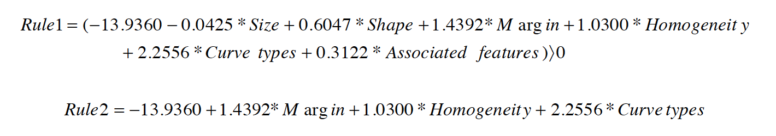
ANN vs LRM in Classifying Malignant and Biopsy
You read the ANN v LRM paper in the asynch. Prepare at least one slide to discuss each of the 7 topics below with respect to that paper. Expected time: 2-3 hours.
There was a full and reduced logistic regression model (LRM). Specify each model (a screen shot is fine). What do you notice that is odd about how the reduced model was formed?
The second model does not appear to be refit. The reduced model is simply comprised of the first model with the unwanted variables deleted. The parameter estimates are estimated assuming the other variables are in the model. Using model 2 assumes that the value of these missing variables is 0.

Slide 24
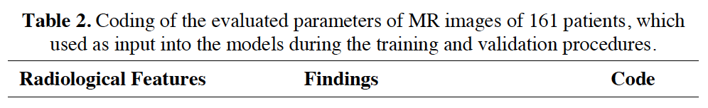
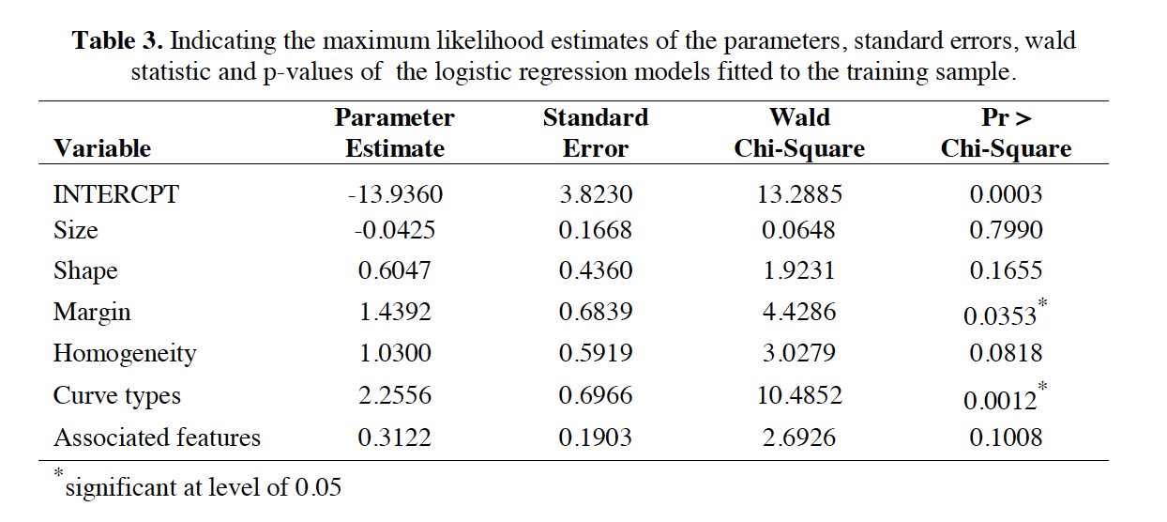
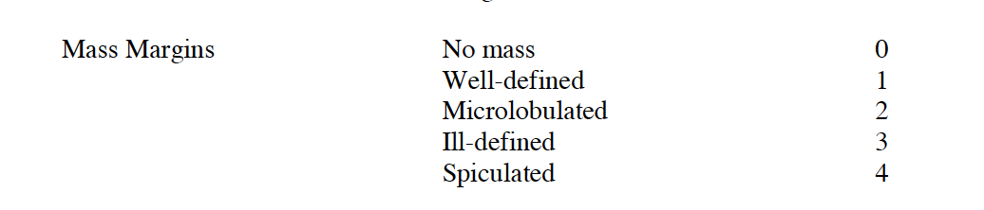
ANN vs LRM in Classifying Malignant and Biopsy
You read the ANN v LRM paper in the asynch. Prepare at least one slide to discuss each of the 7 topics below with respect to that paper. Expected time: 2-3 hours.
Table 3 has the parameter estimates from the LRM model. Select a significant feature (at the .05 level of significance) and interpret that parameter. Information on each parameter can be found in Table 2. As usual, please provide confidence intervals with your interpretation. Hint: You may need to go back to your Stat 2 slides for this question (Unit 12 of 6372.)
Interpretation of Margin Slope Estimate:
It appears that the model was fit treating the code as a continuous variable thus the odds of malignancy are estimated to be 4.27 (e^{1.4392}) times that of no mass at all. A 95% confidence interval for this estimate is (1.104, 16. 113). (e^{1.4392-1.96*.6839}, e^{1.4392-1.96*.6839})

Slide 25
ANN vs LRM in Classifying Malignant and Biopsy
You read the ANN v LRM paper in the asynch. Prepare at least one slide to discuss each of the 7 topics below with respect to that paper. Expected time: 2-3 hours.
Discuss at least one limitation of the study.
One limitation of the study would be if the coding of the variables are being treated as continuous variables when they are really nominal (or possibly ordinal) describing levels of a categorical variable. The difference between no mass and well defined mass is being measured as 1 currently. By treating the variable as continuous we are saying that Microlobulated masses twice as ”far” from no mass than well definted masses. What does that distance mean? One may need to be a domain expert to know, but it seems like these are not constant differences between the levels.

